Slide 1

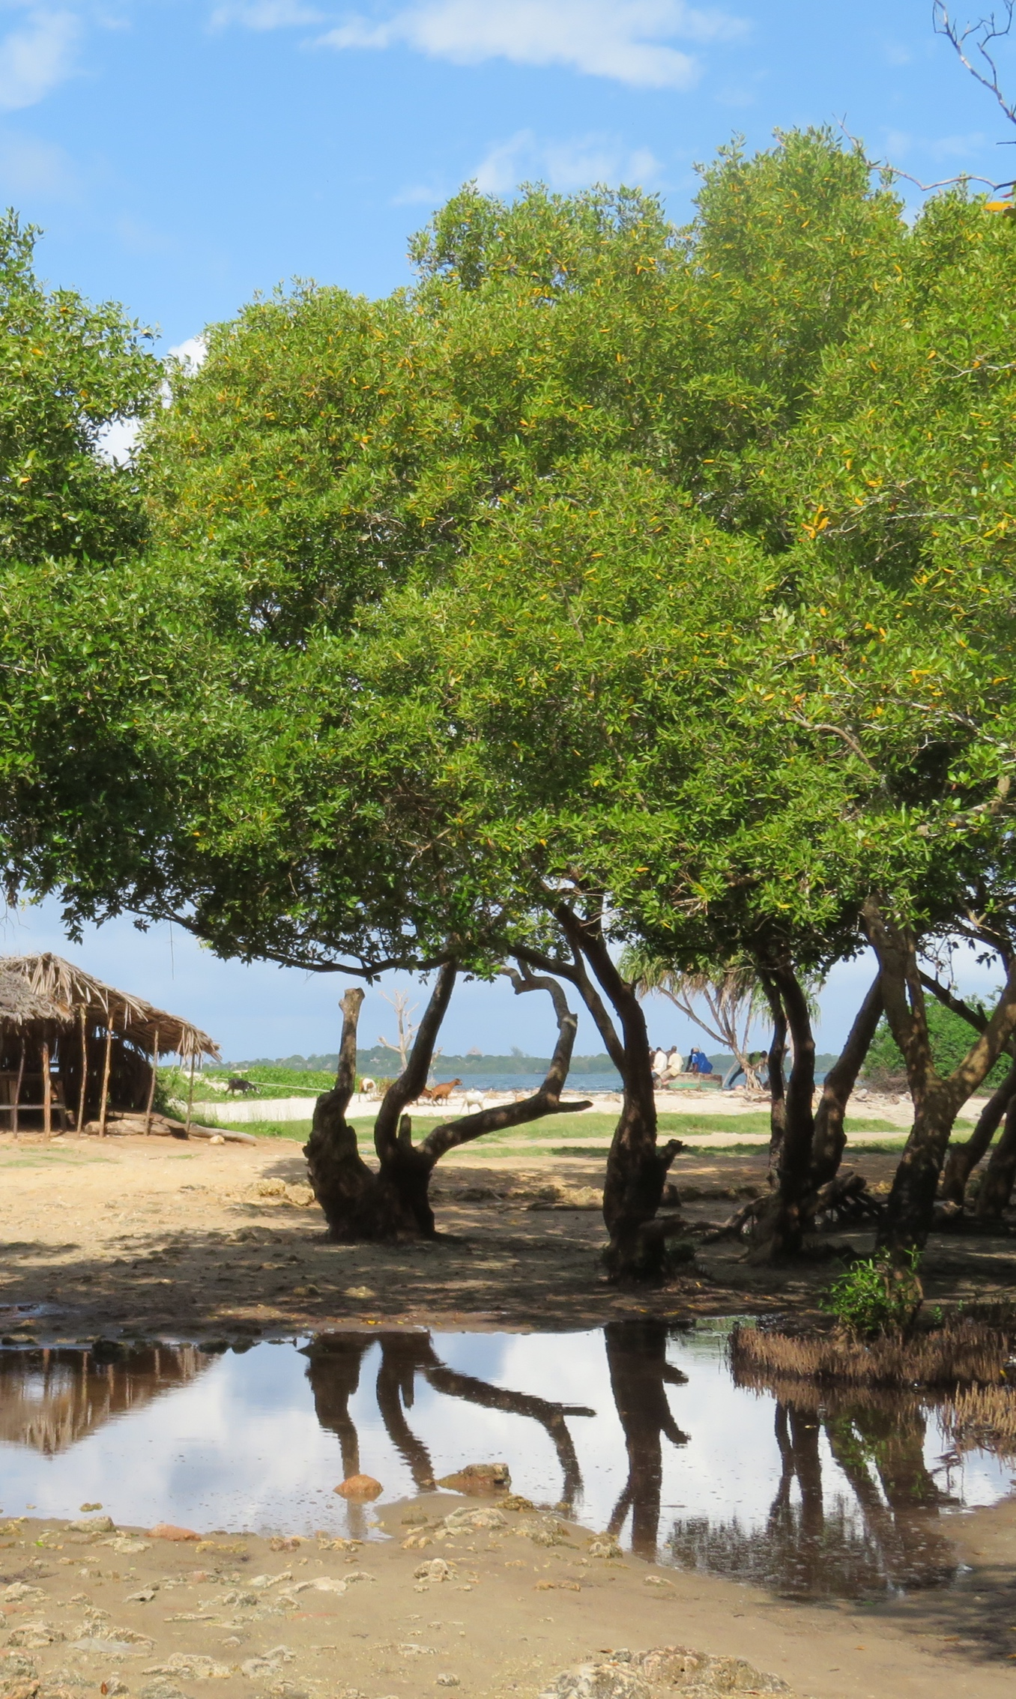

Mikoko Pamoja:
A demonstrable mangrove carbon offset project in Kenya
JAMES KAIRO, PhD, MBS
Project Developer/Chief Scientist
KMFRI/MIKOKO PAMOJA

Slide 2
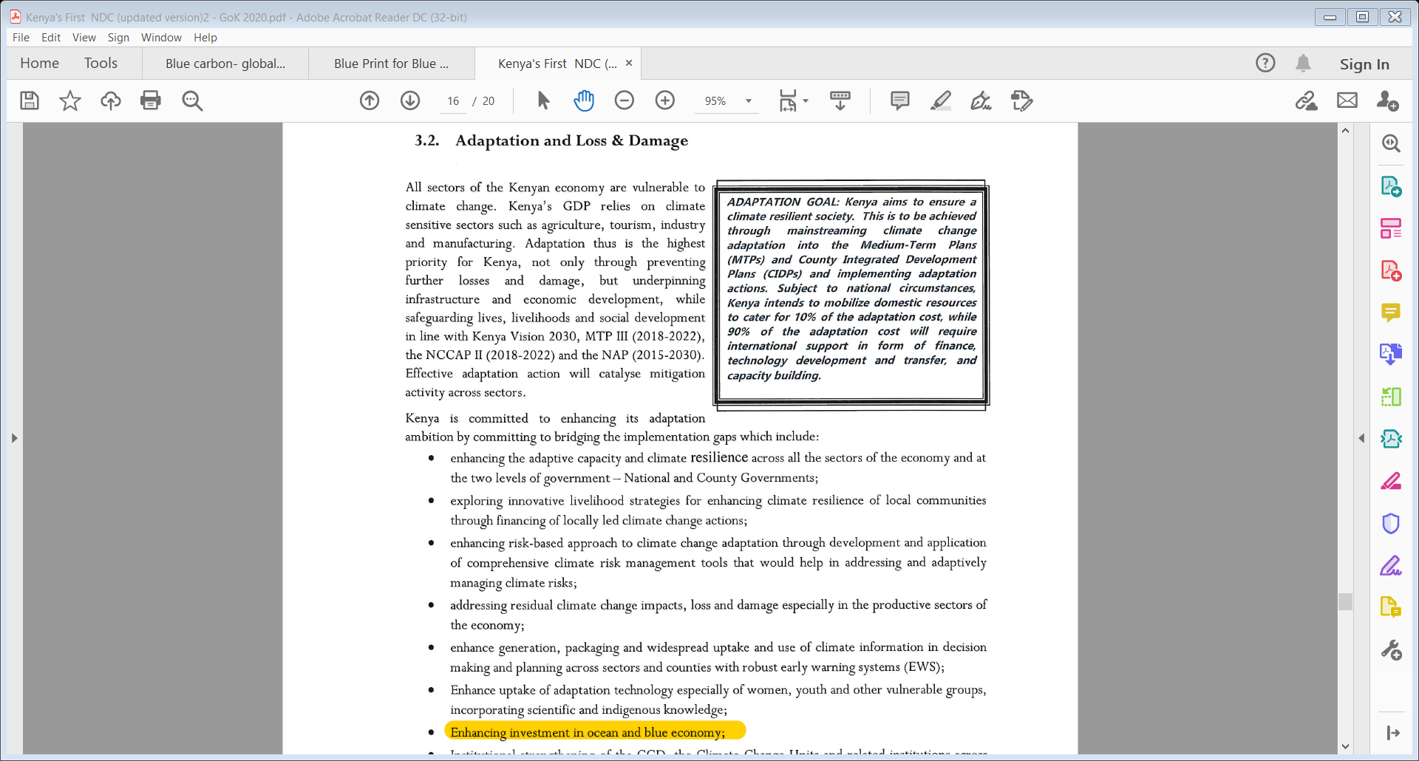
Kenya committed to abate GHGs emissions by 32% by 2030 relative to the BAU scenario of 143 MtCO₂eq/yr (GoK, 2020- NDC).

Slide 3
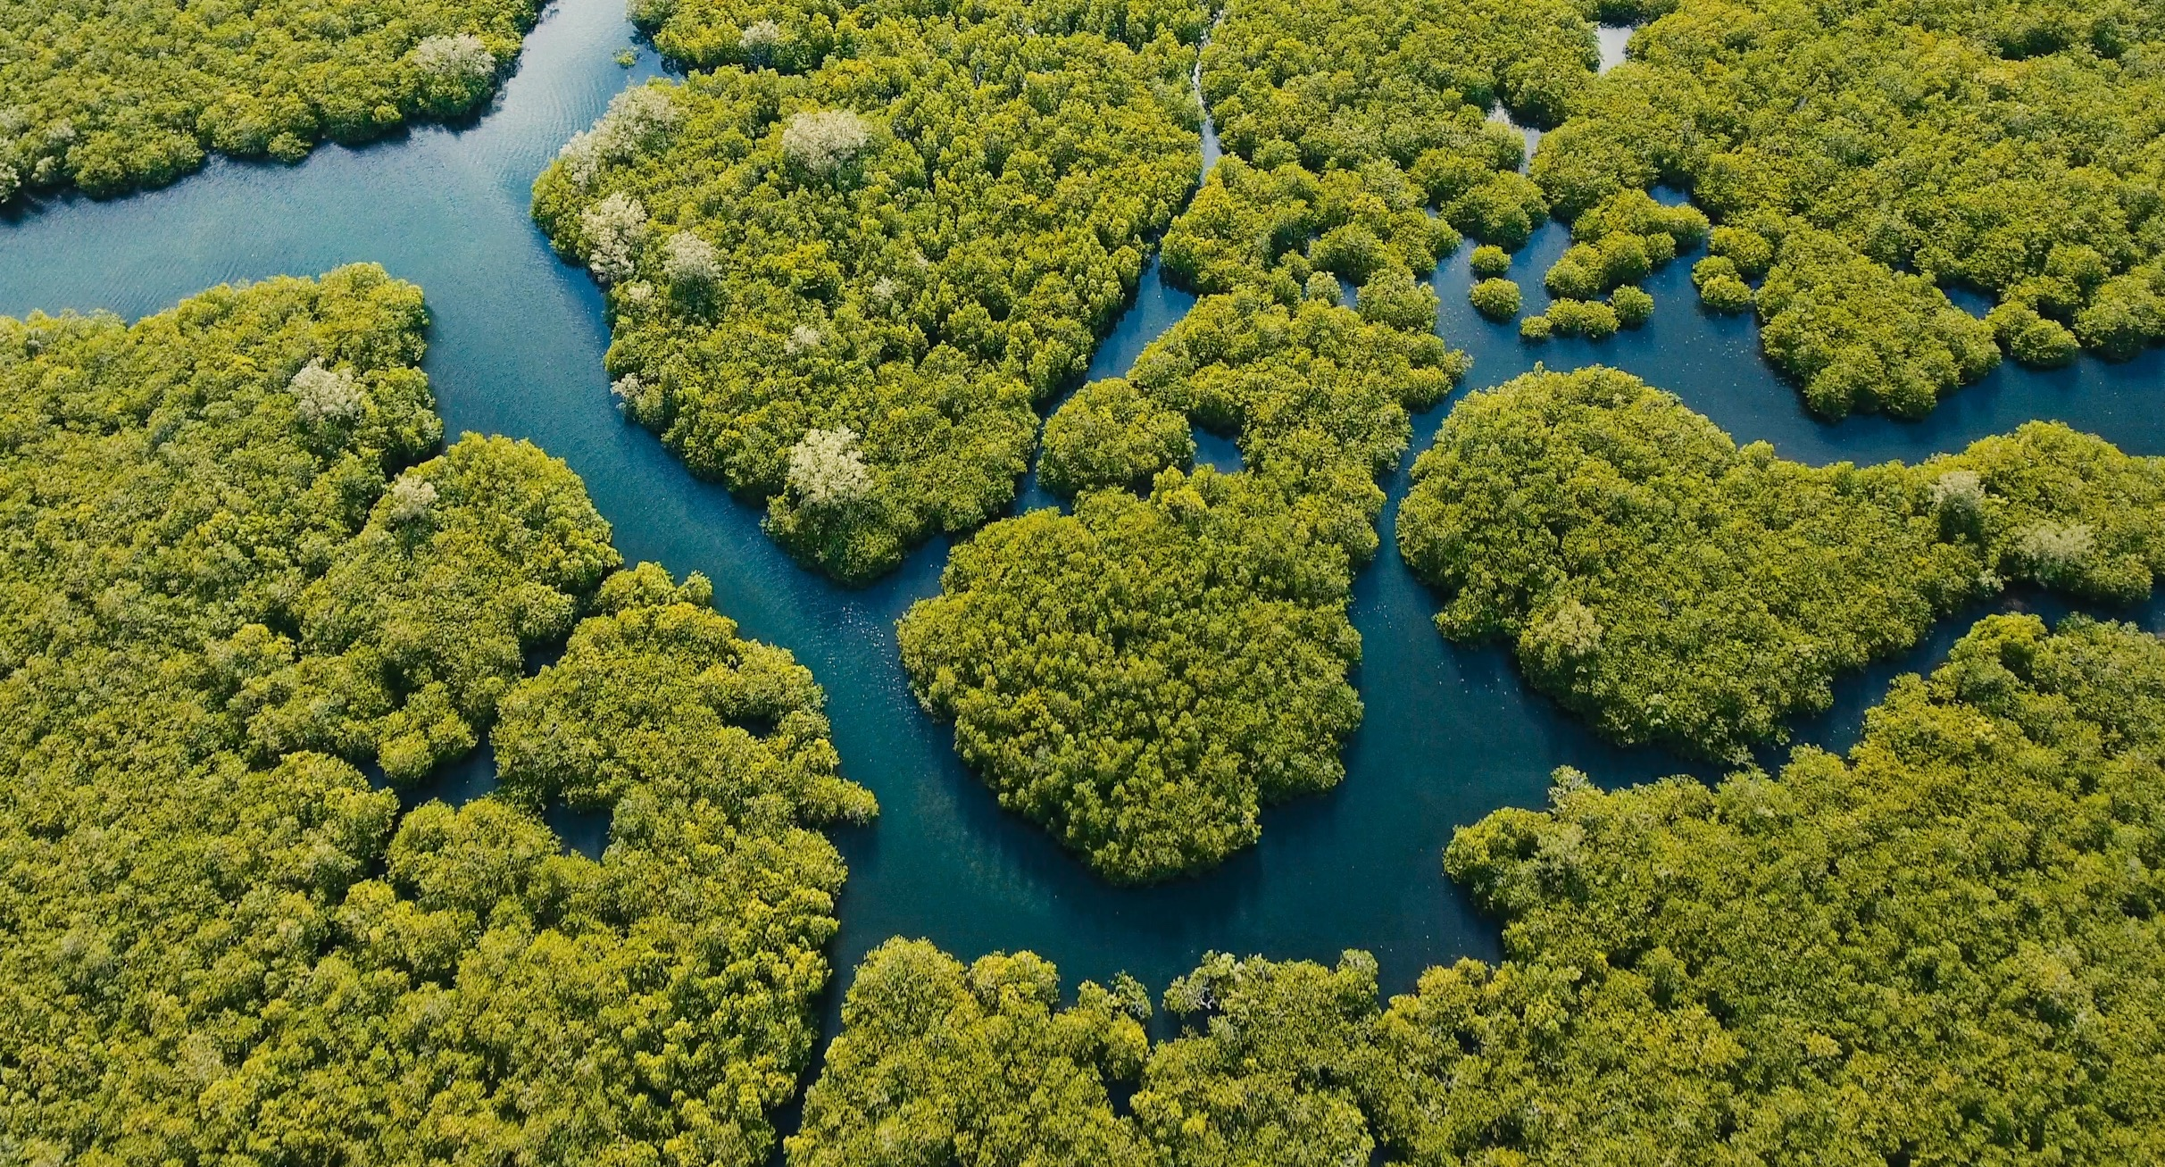
FORESTS GROWING IN THE SEA!
© Shutterstock
Notes:
© Shutterstock

Slide 4
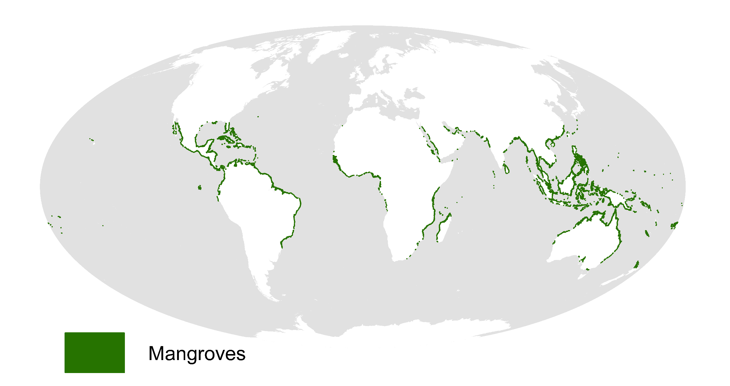
130 000 km² of the coast
Less than 0.01% of the total forested area
Source: USGS 2011

Slide 5
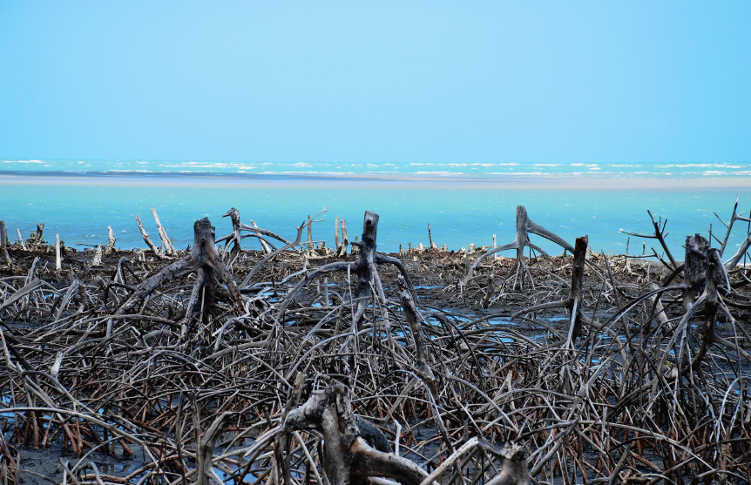
Why mangroves ecosystems are important!
Why coastal blue carbon conservation?
Healthy mangrove ecosystems store and sequester carbon
They also support coastal communities around the world
Degraded coastal ecosystems release carbon
Mangroves can be part of climate mitigation and adaptation strategies

Slide 6
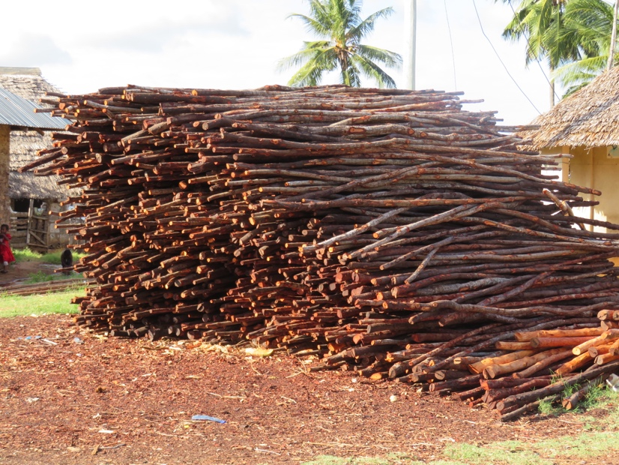
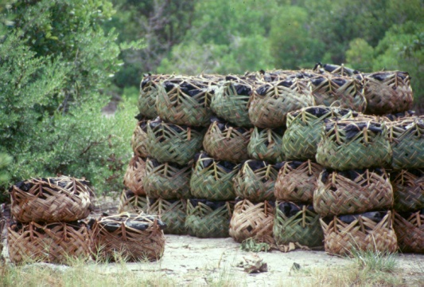
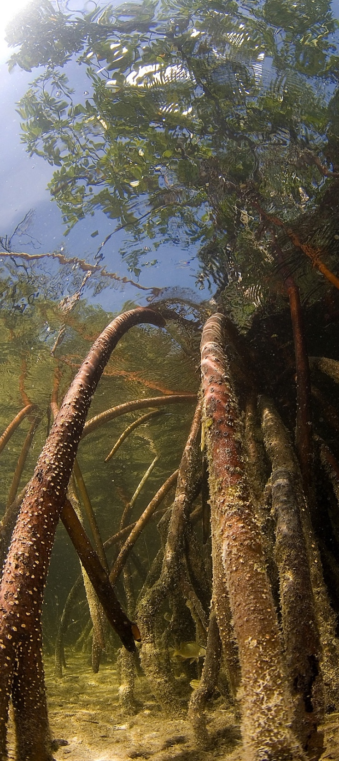
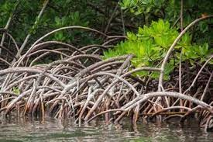
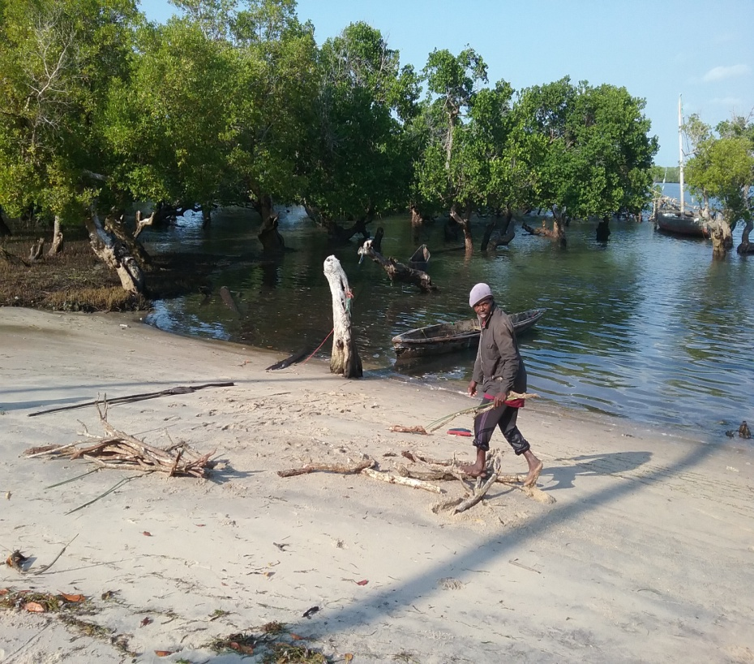
Mangrove Goods and Services
Total Economic Value - US$ 33,000-57,000/ha/yr (IUCN, 2020)

Slide 7
Mangrove as carbon sinks
  Blue carbon = 5-10 times higher terrestrial forests
(Pan et al. 2011; Fourqurean et al. 2012; Pendleton et al. 2012)
Notes:
Mangroves sequester 5x more carbon than any terrestrial forest
Large carbon storage = large carbon emission risk

Slide 8
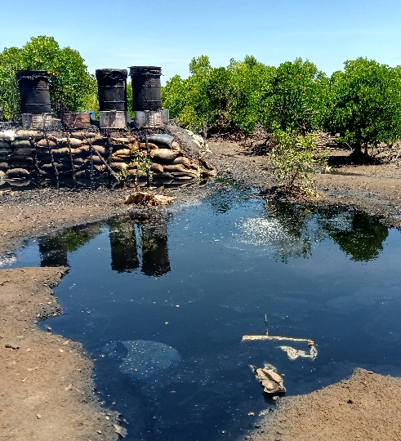
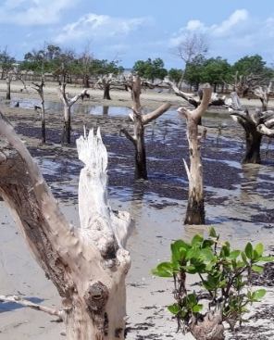
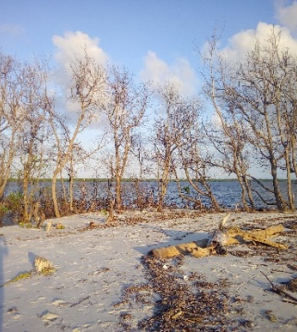
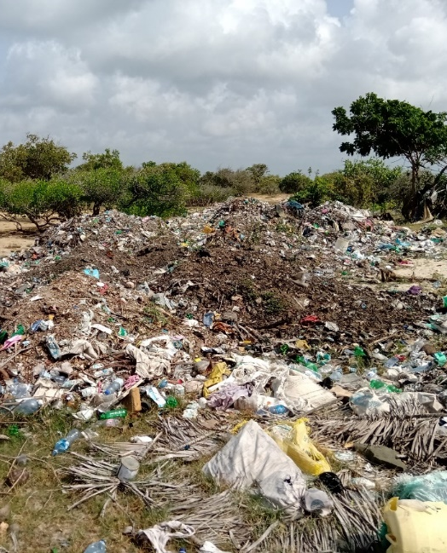
Threats facing mangrove forests
  Loosing 1-2%/year due to:
Over-exploitation
Land use change
Aquaculture
Pollution
Climate change

Slide 9
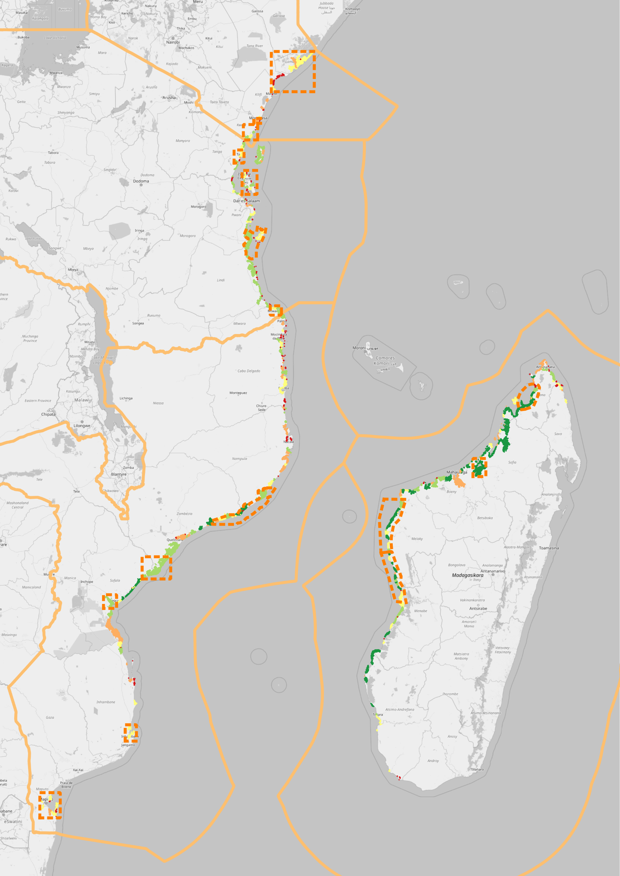
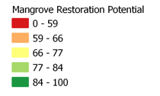
WIO REGION
MANGROVE
RESTORATION POTENTIAL
Geographic scope | Restoration potential (Ha)
WIO region | 40,900
Kenya | 3,351
Tanzania | 3,611
Mozambique | 25,899
Madagascar | 8,039
Mangrove restoration can generate tradable carbon credits

Slide 10
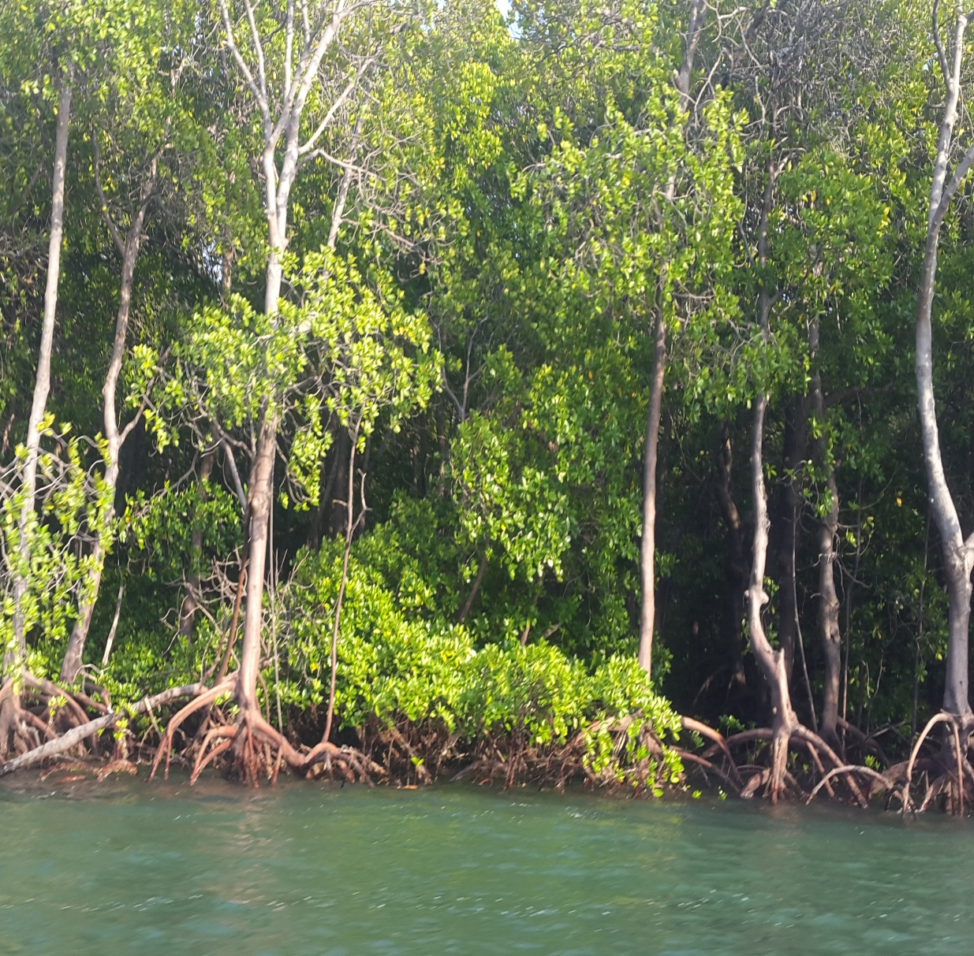
How can we sustain supply of mangroves goods and services?
What is the role of communities?
How can we incentivize mangrove conservation activities?

Slide 11
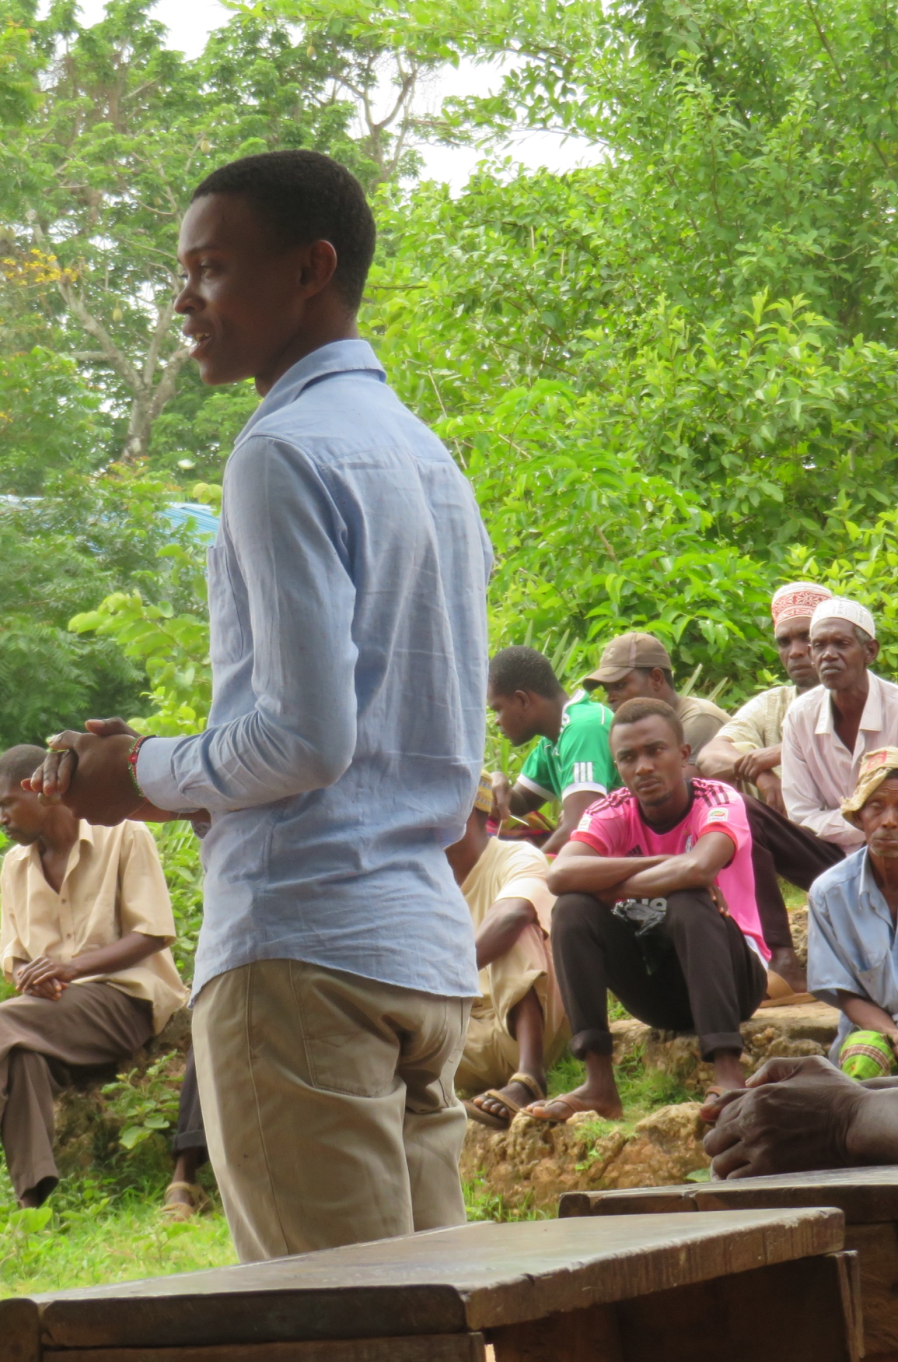
MIKOKO PAMOJA – Our Carbon Offset Facility
“Mangroves Together”
The first mangrove PES project in the world
A community-led mangrove conservation project in Kenya
  Objective: Restoration and protection of mangroves through sale of carbon credits
Verified 20yrs by Plan Vivo standards
Carbon sold into voluntary market = 3,000 tCO₂ /annum

Slide 12
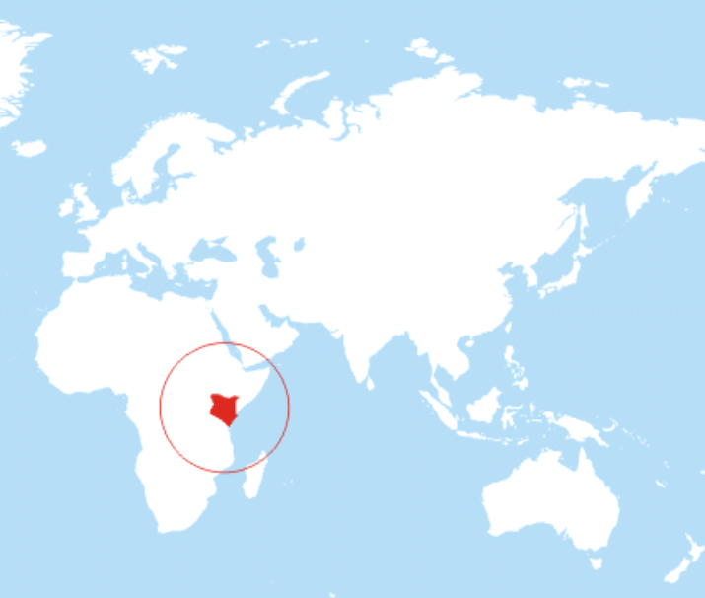
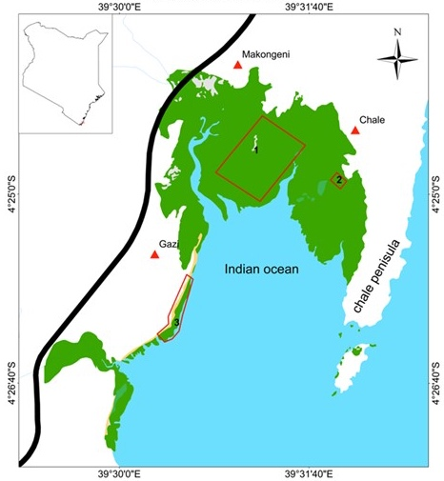
Project site
  Gazi Bay, Kenya
  715 ha of mangrove forest
  117 ha is protected
    Avoided deforestation (107 ha)
    Plantation (10 ha)
    Planting 0.4 ha per year
@mikoko_pamoja

Slide 13
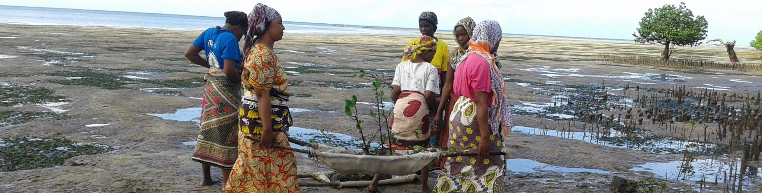

Project activities
Reforestation of degraded mangrove areas
Avoided deforestation
  Surveillance of the forest against illegal activities
Education and awareness
Forest monitoring
@mikoko_pamoja

Slide 14
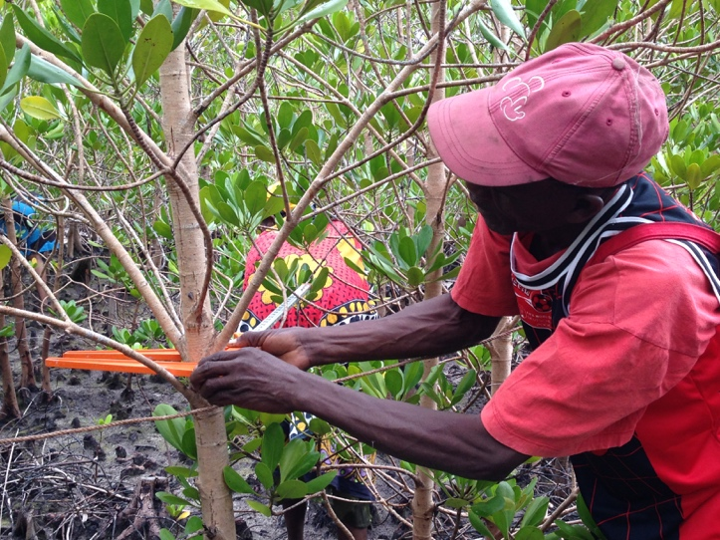
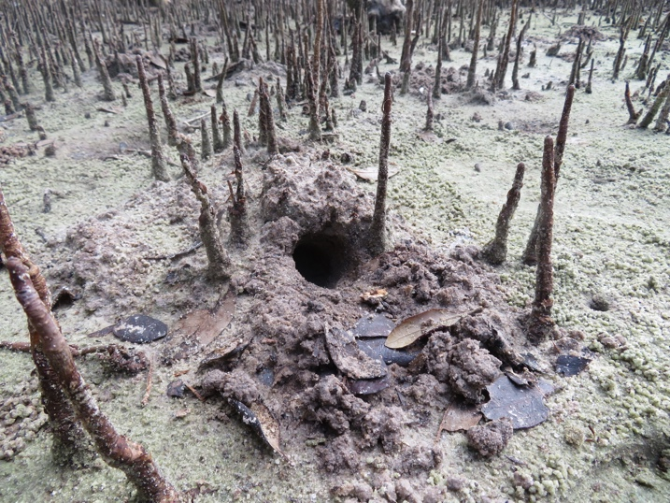
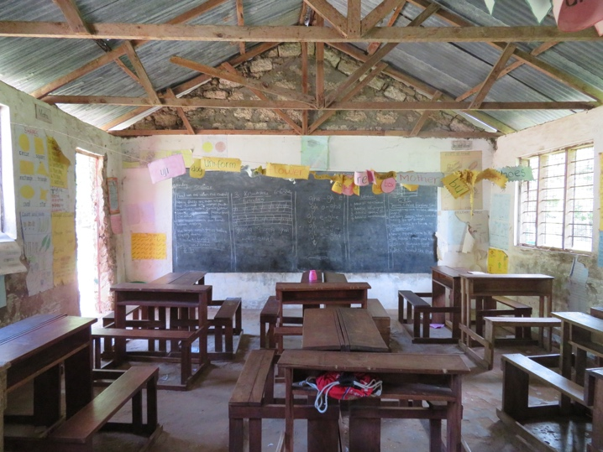
Methods
Vegetation monitoring
Biodiversity baselines
Impact assessment

Slide 15
MIKOKO PAMOJA: BENEFIT SHARING
Association For Coastal Ecosystem Services (Scottish Charity Account)
External buyers of carbon credits
Money paid to ACES account
6%
income transfered upon meeting target
Money held to meet cost 5 year independent verification
Mikoko Pamoja community organization
21%
32%
36%
5%
Community benefit
Expenditure to be determined through an annual community benefit consultation process
Mikoko Pamoja Work teams and individuals: Nursery teams
Community reporters
Woodlot maintenance
Monitoring and evaluation tasks
Group expenses (stationery etc)
Project co-ordinator annual salary

Slide 16
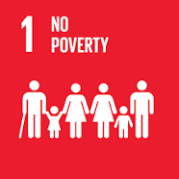
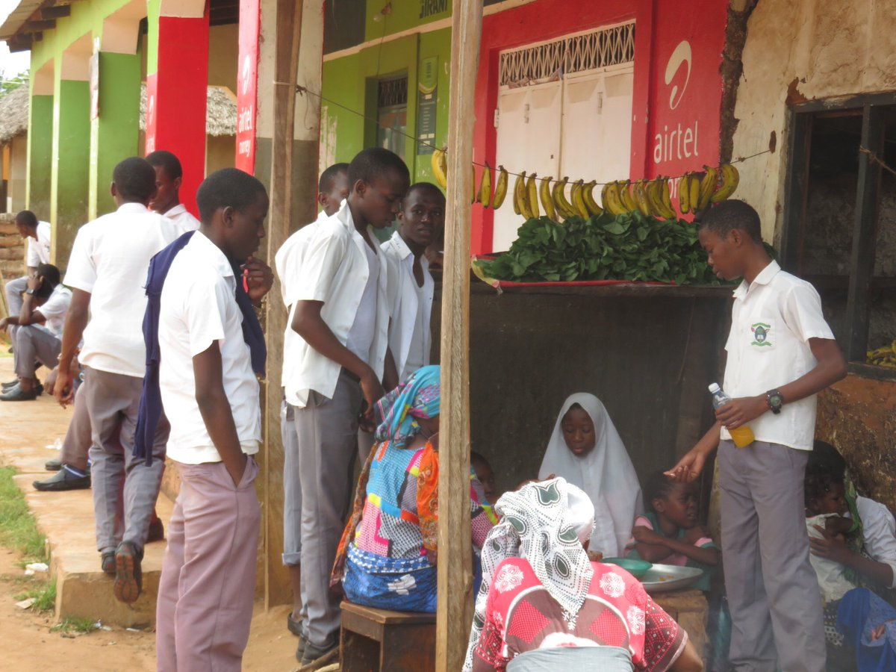
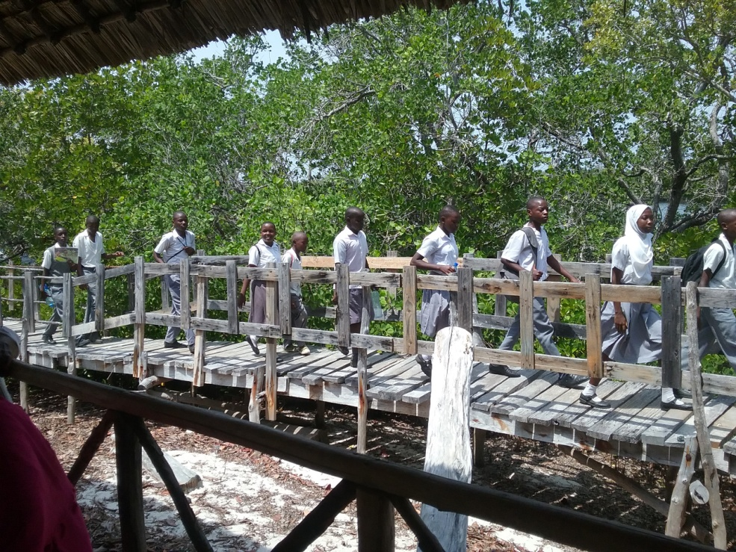
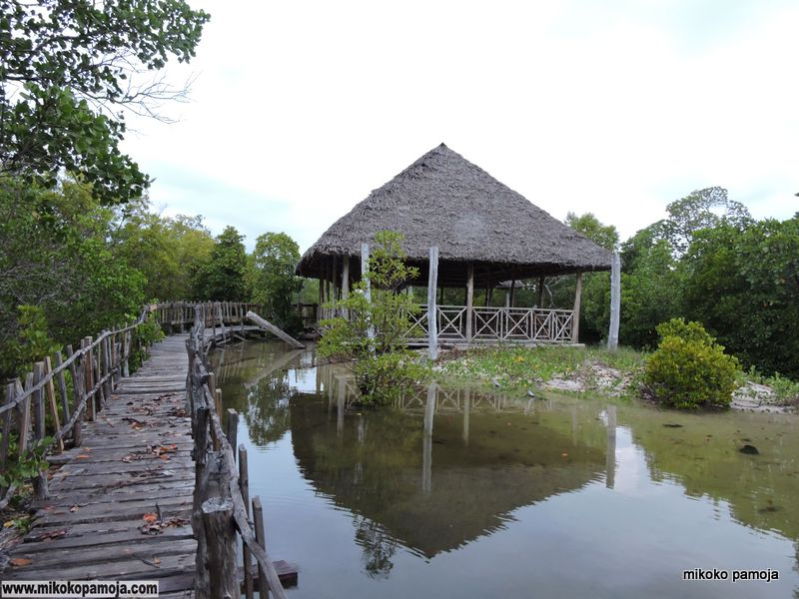
Livelihood support
4 directly employed
Co-ordinator, Assistant co-ordinator and 2 community scouts
1business supporting
20 youths
32 indirectly
employed in since 2016
Notes:
As a result of installing water in the community, 20 youths have come together and started up a car wash.
When students and other visitors visit our project, we encourage them to visit Gazi women boardwalk where they promote the group by paying an entrance fee. They also promote other livelihoods in the village such as shops and other food businesses

Slide 17

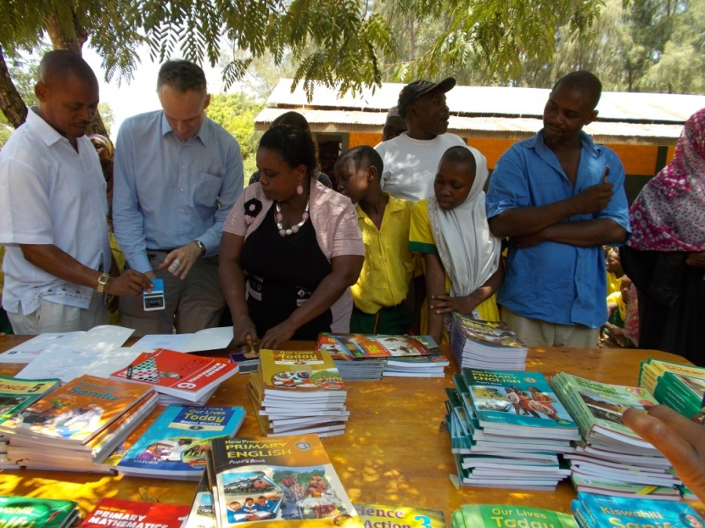
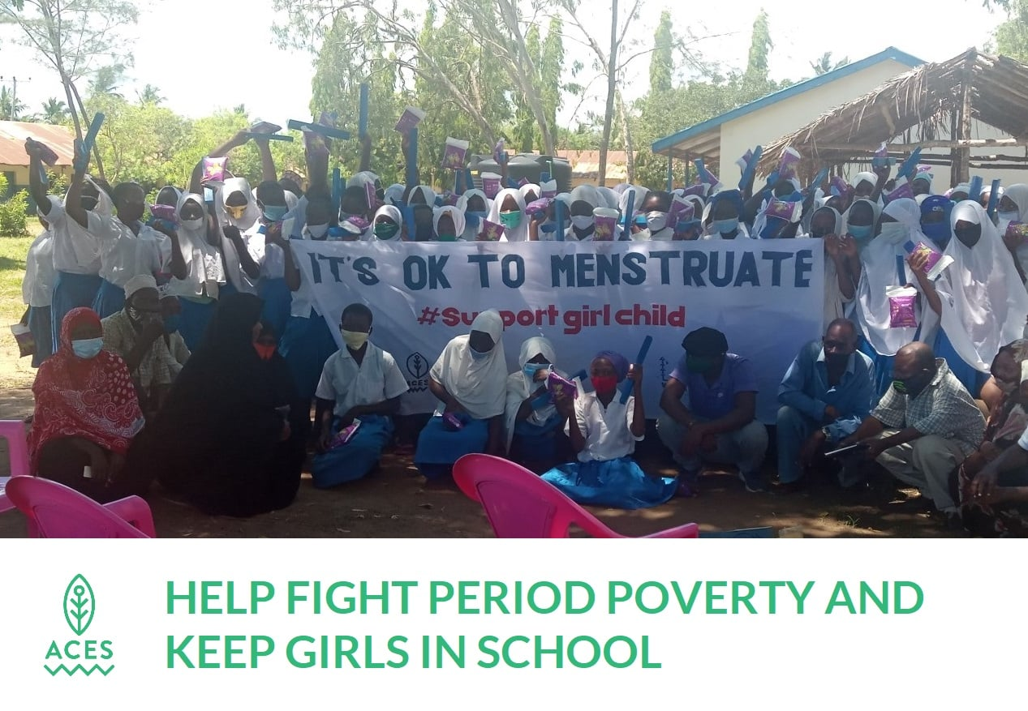
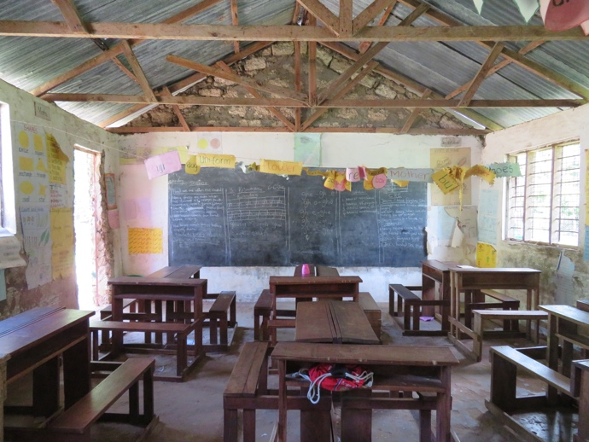
Education
Provided >600 text books- in 2 Primary schools
Renovated classrooms
Donated Desks
Fighting period poverty by provision of sanitary towels to girls in schools

Slide 18

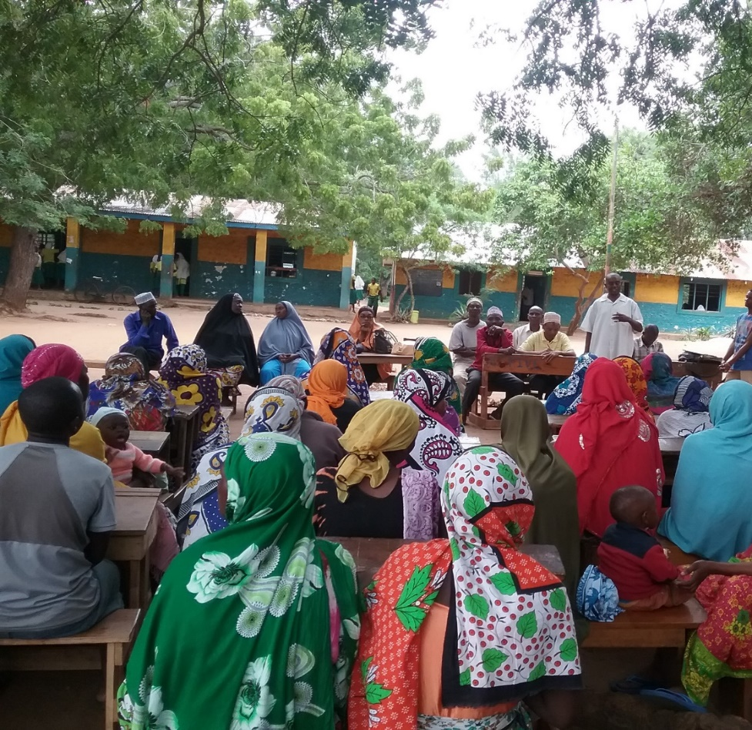
Decision making
Women are involved in prioritizing community projects
40% of committee members are women.
Notes:
Mikoko Pamoja has provided a ‘voice for women’ in project management.

Slide 19

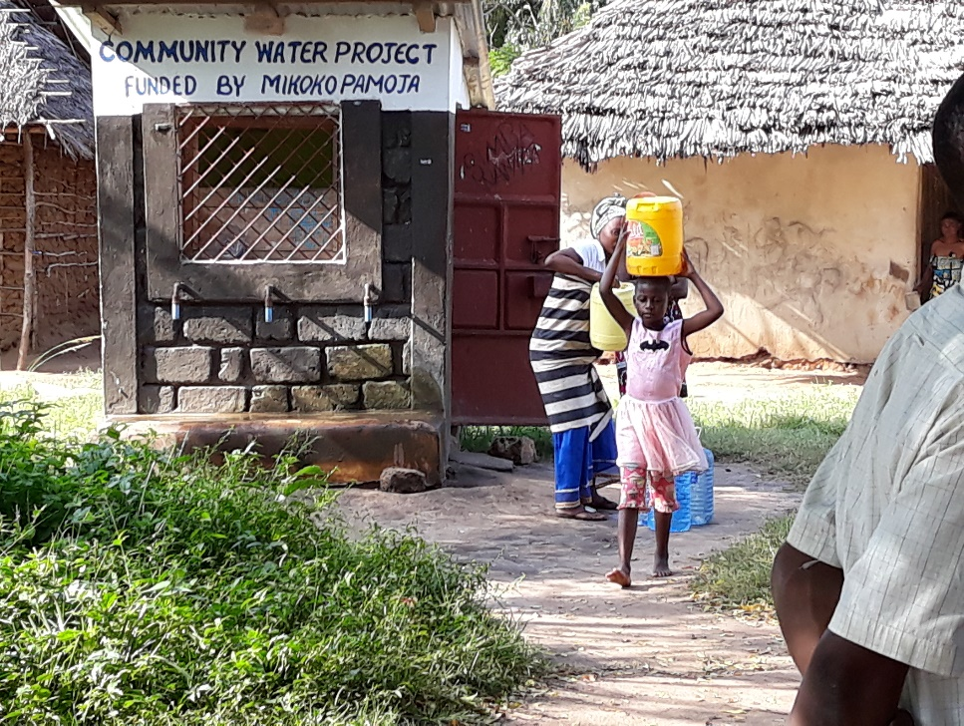
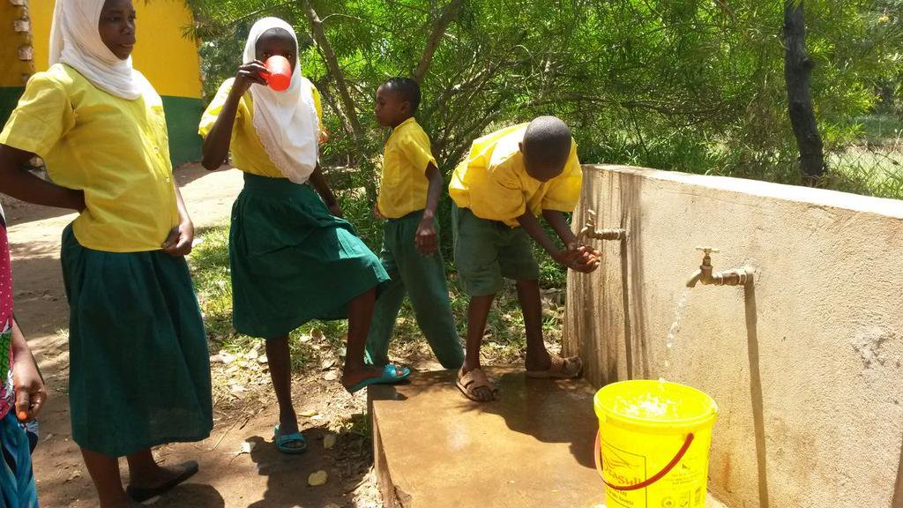
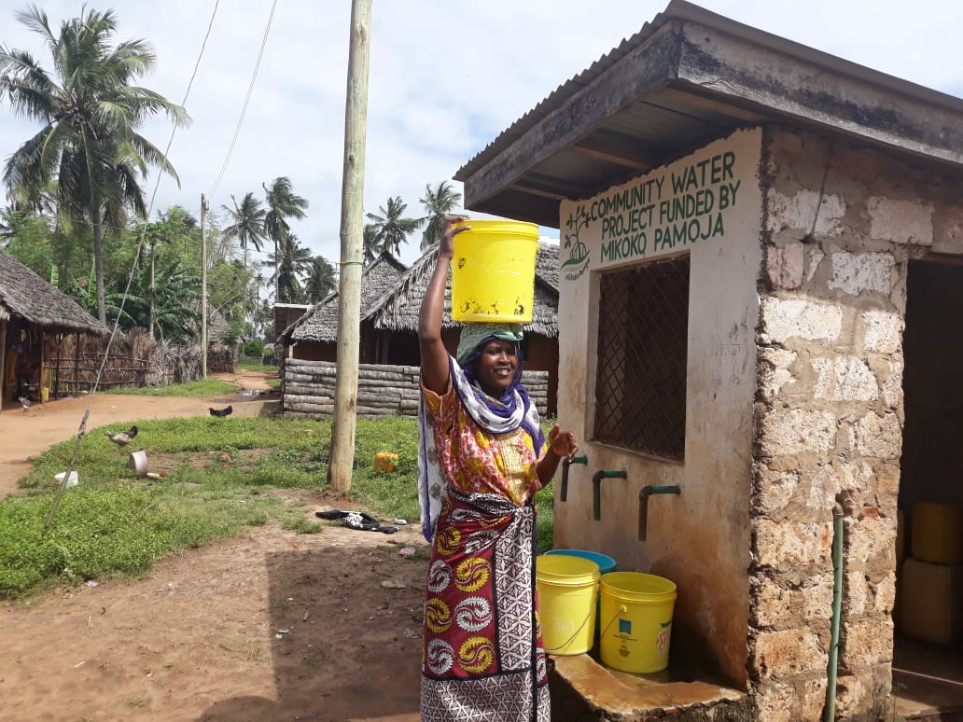
Water & sanitation
Mikoko Pamoja has provided water in 2 villages: 3 tanks; 4 water points; 1 tower; free water for 3 schools ~1000 students and built Public toilets

Slide 20
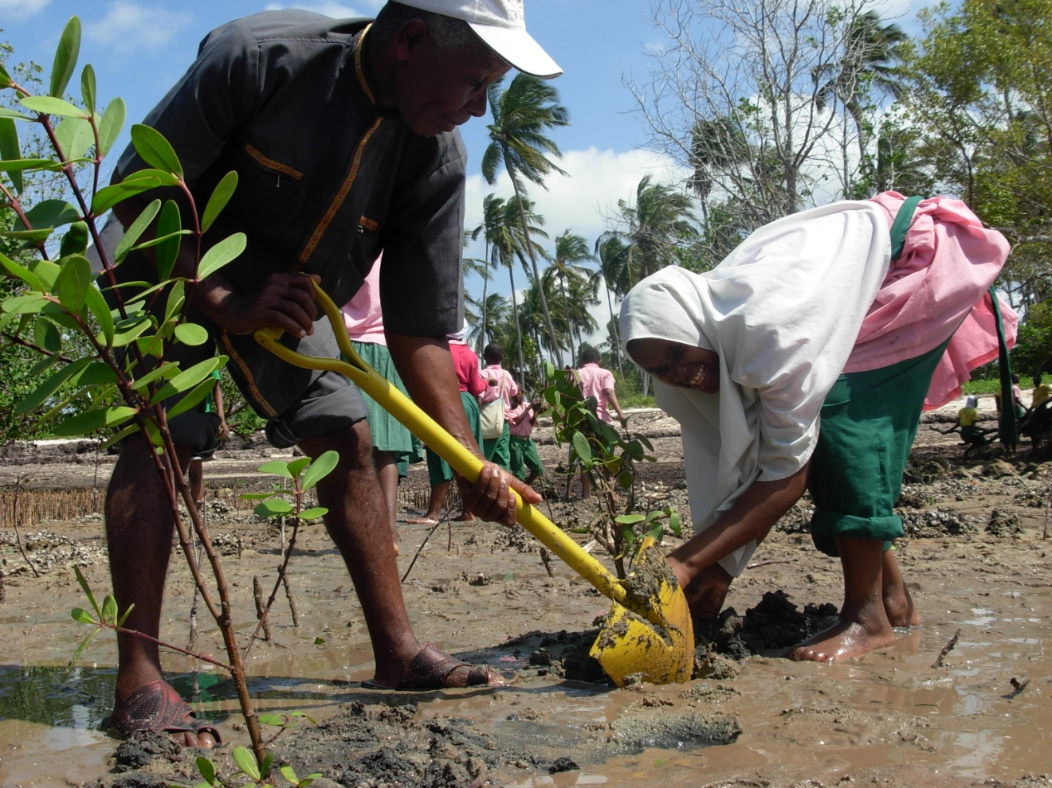
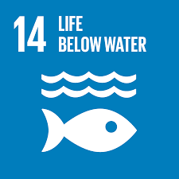
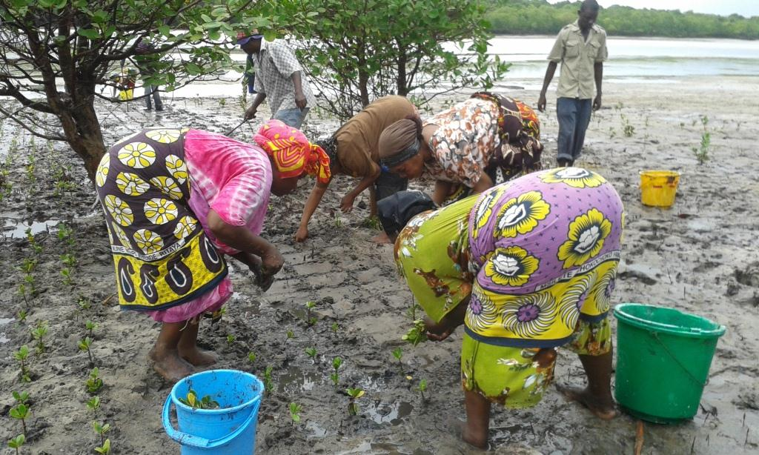
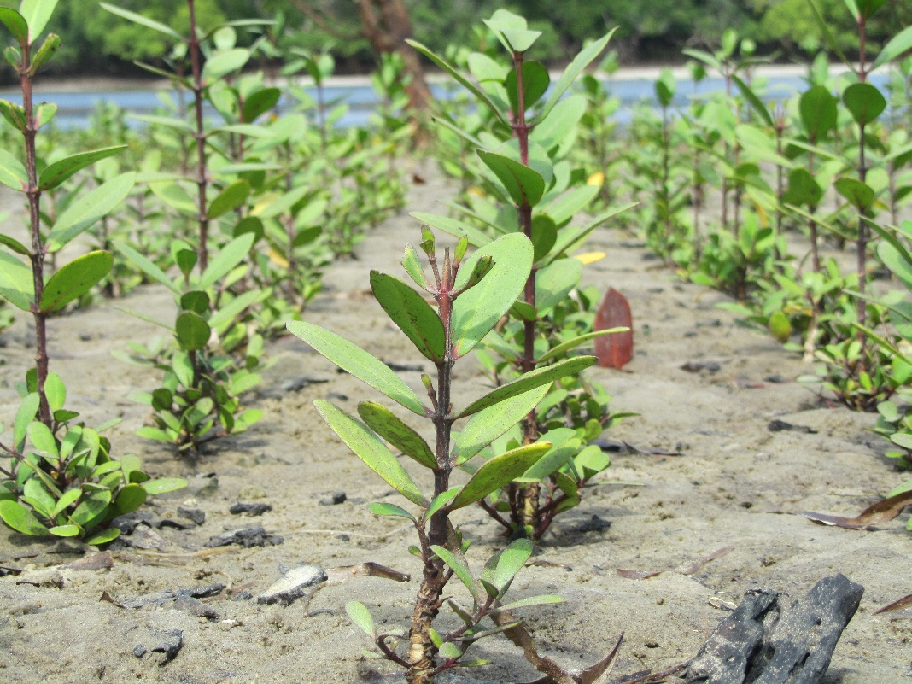
Mangrove restoration
Mikoko Pamoja project conserves 117 ha of mangroves and has been restoring 0.4ha annually
The project has saved 24,000t CO2 emissions during the 8 years of operation

Slide 21
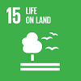
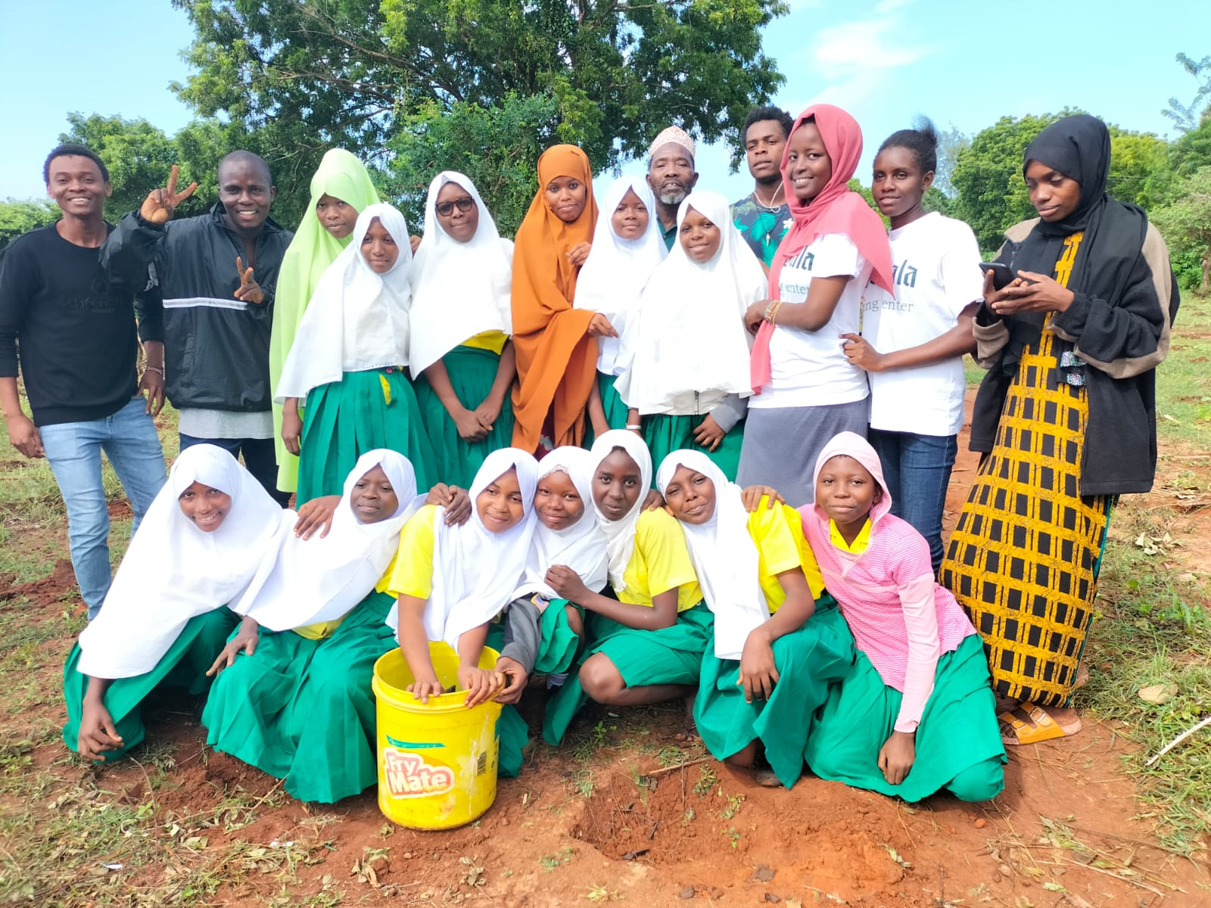
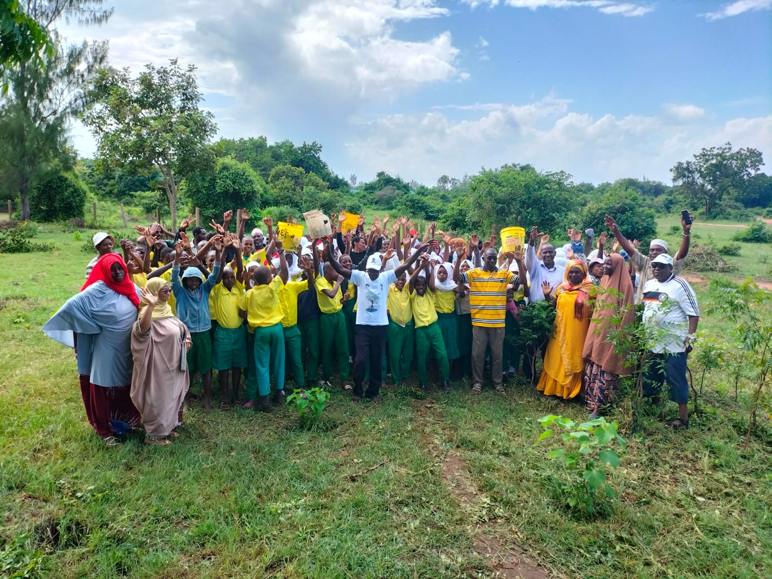
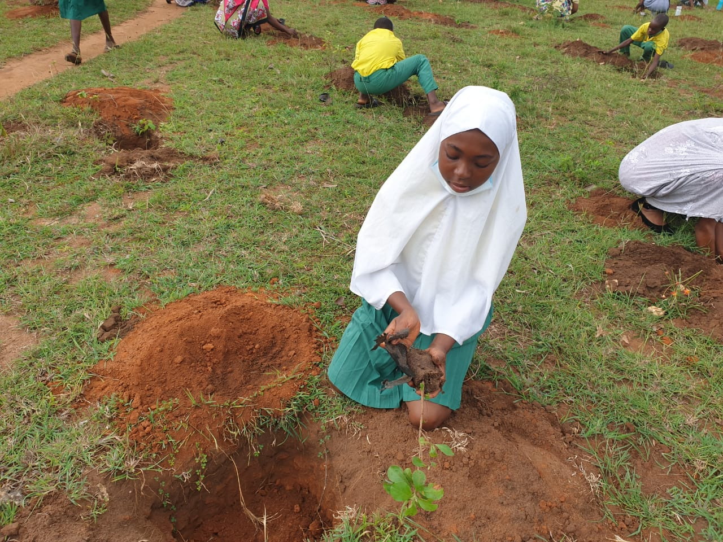
Community Woodlot
woodlots of first growing trees in schools and community lands to serve as alternative sources of wood products products for the local community

Slide 22
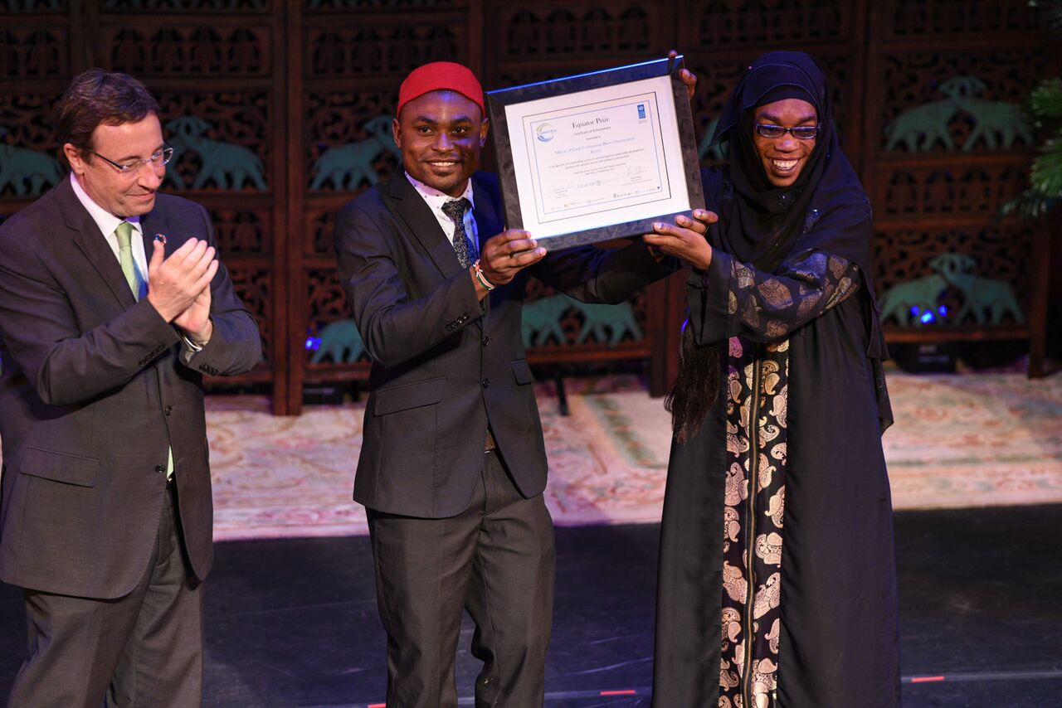
Equator Prize 2017

Slide 23
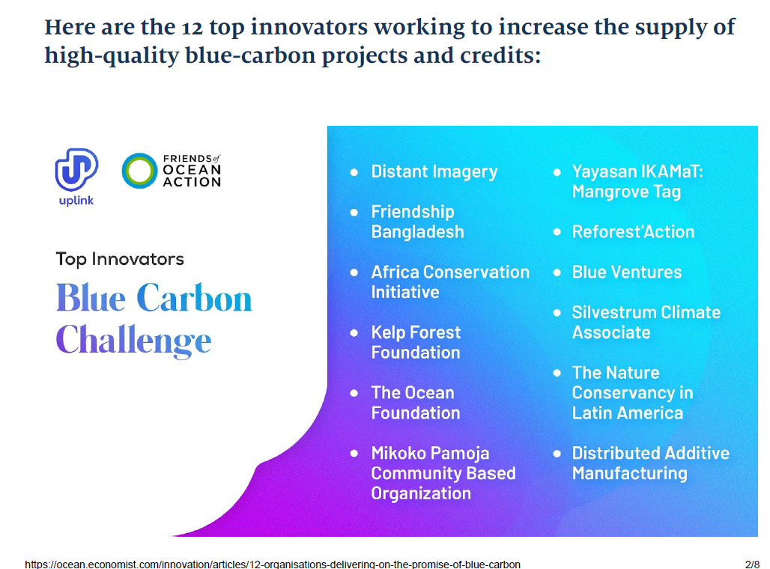

UpLink Blue Carbon Challenge (2022)

Slide 24
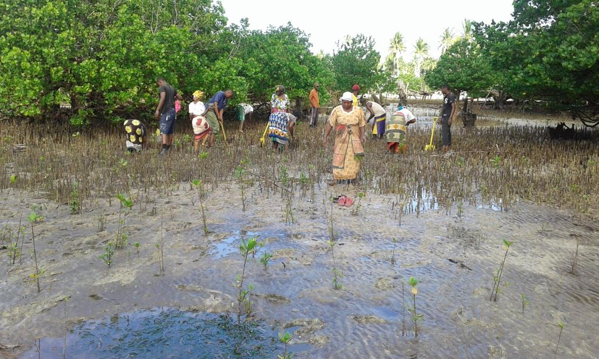
Why Mikoko Pamoja is successful…
Community commitment
Strong science
Government support
International network

Slide 25
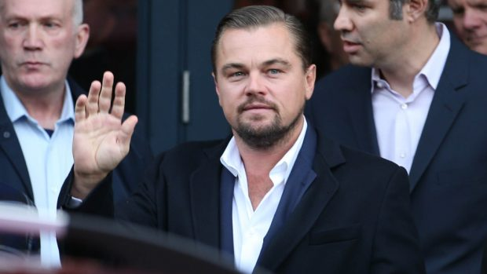
Hollywood actor Leonardo DiCaprio supported expansion of Mikoko Pamoja to Vanga
By Press Association 25/09/2017

Slide 26
Take home messages…
Mikoko Pamoja is transforming lives in Kenya
All carbon credits are owned by the community
Mikoko Pamoja is a triple win to climate, community and biodiversity conservation
Success of Mikoko Pamoja is being replicated elsewhere in Kenya and Africa at large
You too can support mangrove conservation by offsetting with Mikoko Pamoja
Notes:
Community Education and Participation and awareness

Slide 27

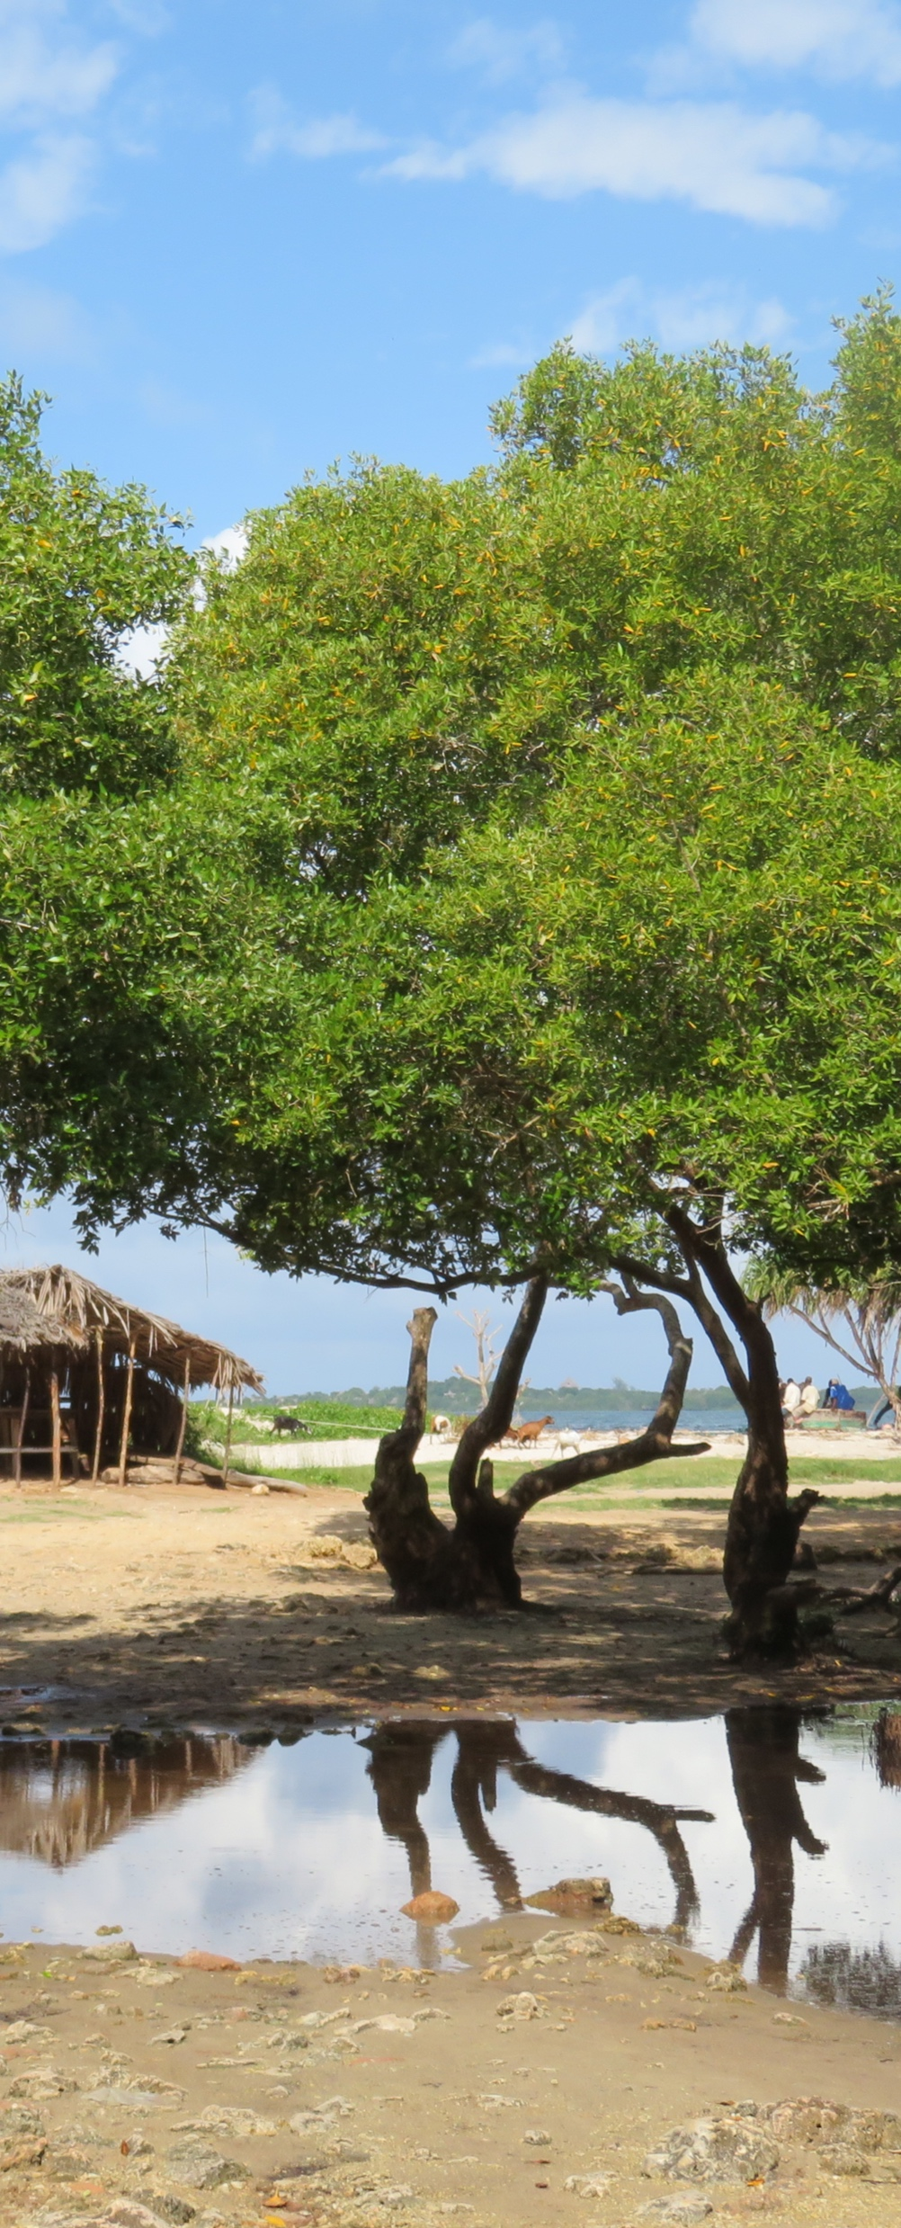
For more information on
Mikoko Pamoja, please visit:
www.mikokopamoja.com
Plan Vivo Website
http://www.planvivo.org/projects/registeredprojects/mikoko-pamoja-kenya/
Association of Coastal Ecosystem Services (ACES)
http://www.aces-org.co.uk
Or contact us directly:
Project Team Email: mikokopamojaKE@gmail.com
@mikoko_pamoja

Slide 28
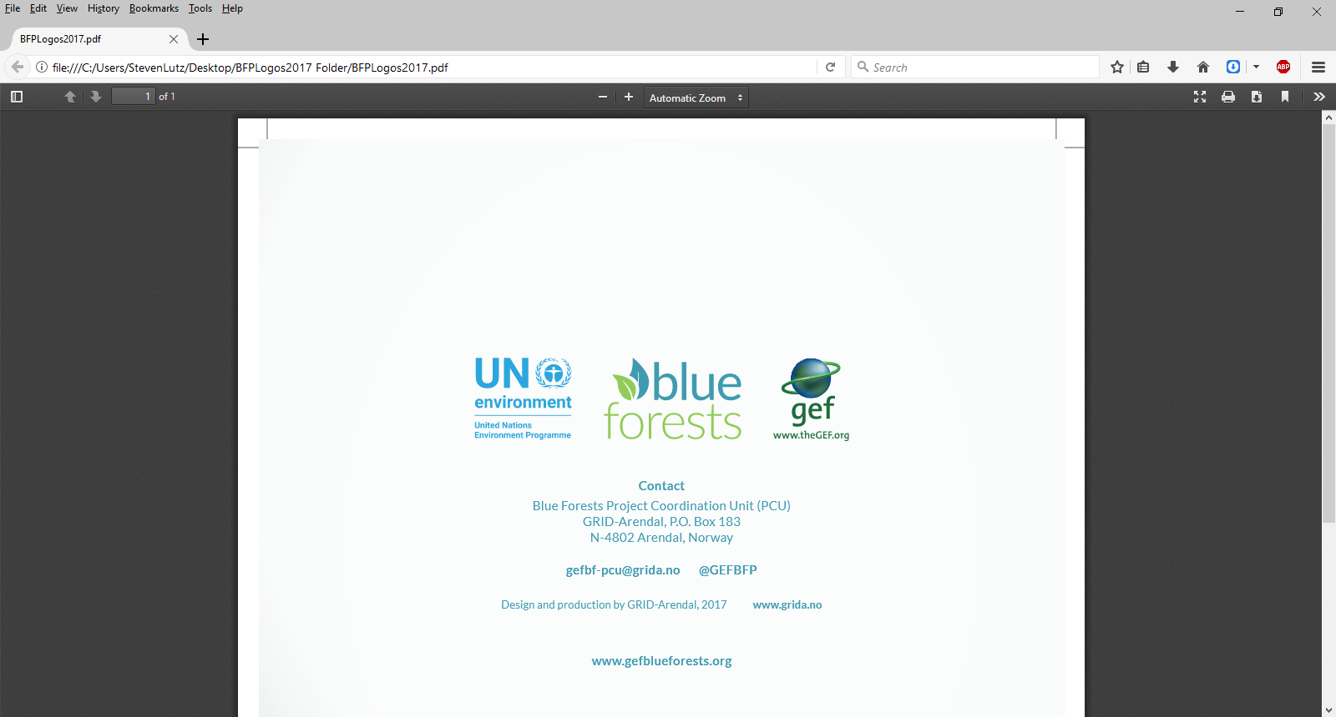






ACKNOWLEDGEMENT

