Slide 1
Subregional Policy Dialogues on CoM23 –
Fostering recovery and transformation in Africa
to reduce inequalities and vulnerabilities
Zuzana Schwidrowski Director, Subregional Office for North Africa 16 March 2023

Slide 2
Outline
I. Objectives and participants
II. Some observations on inequality and vulnerability in Africa
III. Policy messages

Slide 3
I. Objectives and participants

Slide 4
I. Objectives
To engage with multi-stakeholder incl. public & private sectors, academia, civil society organizations, women & youth groups, media & UNCTs
To introduce the COM 2023 theme and discuss the constraints and opportunities for reaching its goals
To identify measures that help stakeholders to approach the CoM 2023 with fresh views on key drivers of reducing inequality & vulnerability

Slide 5
Dates, participants and nature of sessions
Subregion | Southern Africa | East Africa | Central Africa | West Africa | North Africa
Dates | 23 February | 7 March | 6 March | 9 March | 6 and 7 March
Stakeholders | Participants from 11 MS, Ministries for social welfare, finance, trade investments; central banks; experts | Participants from MS, RECs, private sector, academia, think-tanks, women & youth organizations | Participants from MS, RECs, women business associations | Participants from RECs, UN, government, private sector, civil society, academia, youth & the Network of the Economic Journalists for West Africa | Participants for MS, academia, think tanks, policy makers, female business association
Form | virtual | virtual | virtual | virtual | virtual

Slide 6
II. Some observations on inequality and sources of vulnerability

Slide 7
Inequality
In 2022, Africa accounted for over half of global poverty, but for only about 17% of population.
1. Inequality
Income inequality: Africa is the 2nd most unequal continent (in terms of Gini Coefficient) and most unequal in terms of average income accruing to the richest 20% of population
At the continental level, large differences among countries prevail. COVID disproportionally affected the bottom 40% in Africa due to its adverse health and economic impacts and within-country inequality rose.
Other dimensions of inequality:
Wealth: Oxfam (2019) pointed out that at that time Africa’s 3 richest billionaires had more wealth than the bottom 50% of the population, about 650 million people;
Levels of gender inequality are among the highest in the world;
Inequality in access to health products, vaccines, key medicine (across &within countries)
Digital divide – regional and demographic inequality in access to ICT

Slide 8
Inequality and vulnerability
Selected megatrends as source of inequality & vulnerability
Climate change
Africa is highly vulnerable to climate change given its strong economic dependency on climate-related activities & low adaptive capacity.
Presents special challenges to the poorest and is likely to exacerbate inequality within and between countries;
2. Technological progress, 4th Industrial revolution
Africa’s challenge is related to skill gaps and potential replacement of humans by machines, in the context of growing population. Goal is both enhancing productivity and job opportunities.
Required technological changes must also address challenges of climate change

Slide 9
III. Policy messages

Slide 10
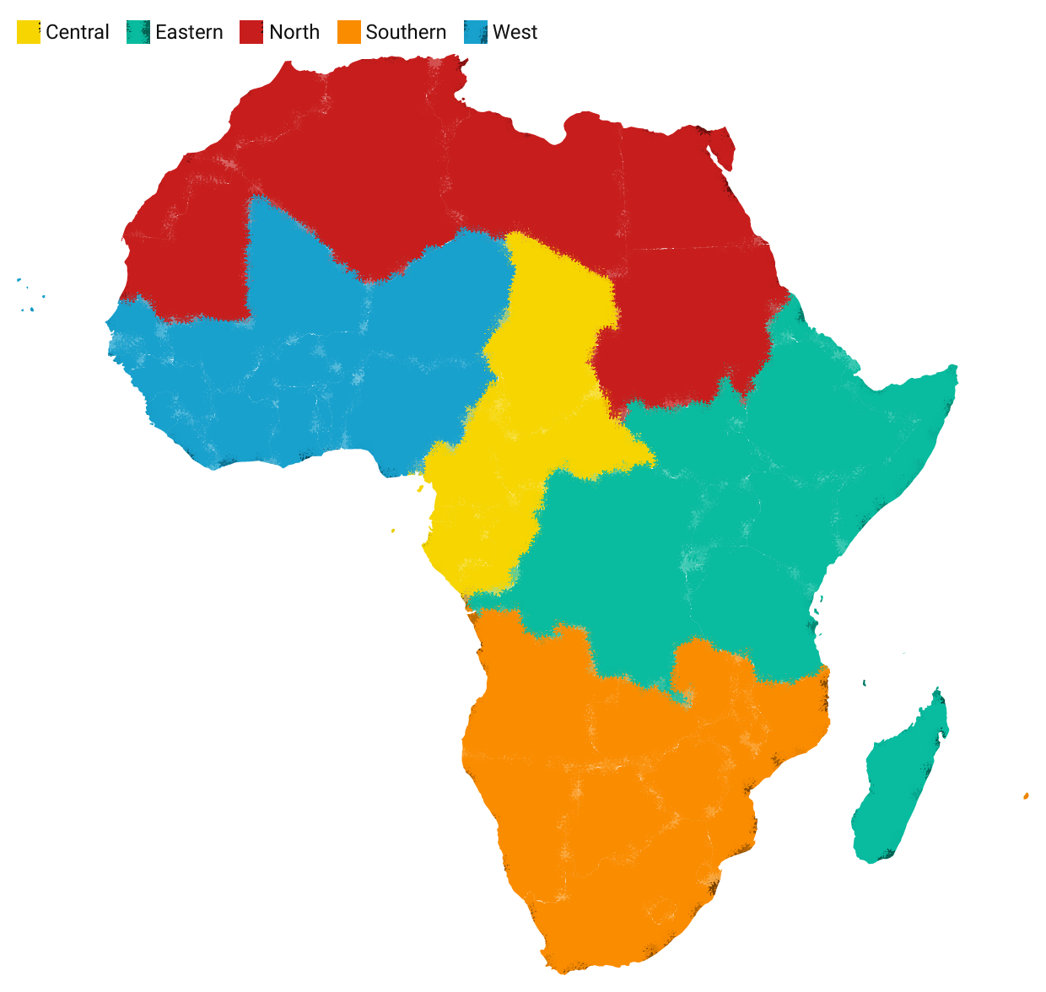
Key messages from the policy dialogues in 5 sub-regions
NORTH AFRICA
Algeria • Egypt • Libya • Mauritania • Morocco • Sudan • Tunisia
Title
Support female entrepreneurs to gain digital skills. Leverage the private sector for green transition, promote green skills
EASTERN AFRICA
Burundi • Comoros • Democratic Republic of Congo Djibouti • Eritrea • Ethiopia • Kenya • Madagascar Rwanda • Seychelles • Somalia • South Sudan
Tanzania • Uganda
WEST AFRICA
Benin • Burkina Faso • Cabo Verde
Côte d'Ivoire • Gambia • Ghana Guinea • Guinea-Bissau • Liberia Mali • Niger Nigeria • Senegal
Sierra Leone • Togo
Expand fiscal space via restoring debt sustainability & domestic resource mobilization. Progressive taxation is needed to raise revenues and promote social justice.
Harness demographic dividend by Harness dem. dividend by investing in youth & women’s education & skills, health & decent jobs
and women’s education and skills
SOUTHERN AFRICA
Angola • Botswana • Eswatini • Lesotho • Malawi Mauritius • Mozambique • Namibia • South Africa Zambia • Zimbabwe
CENTRAL AFRICA
Cameroon • Central African Republic • Chad • Congo Equatorial Guinea • Gabon • Sao Tomé and Principe
Utilize AfCFTA to diversify economies away from primary products and exports of raw commodities to value addition.
Integrate women & youth in high- potential value chains so they benefit from AfCFTA

Slide 11
What are the country experiences with maximizing the pro-poor and inclusive outcomes of macroeconomic policies?
Incorporation of poverty and inequality issues in national legal frameworks and development plans, examples: (Malawi’s Vision 2063, Niger - inequality, vulnerability and poverty as enshrined in the country’s National Socioeconomic Development Plan).
Boosting productivity in job-intensive sectors can raise income and reduce inequality. Supporting SMEs & enhancing their financial inclusion & resilience key to structural development that promotes long-term resilience & measurably reduces poverty & inequality;
Regarding fiscal policy, governments should institute fair taxing systems that support the poor and the vulnerable. They should be progressive and accompanied by efficient fiscal spendings

Slide 12
How can the African Continental Free Trade Area (AfCTA) be harnessed to increase economic resilience and inclusion and to reduce vulnerability?
Implementing AfCFTA gives more attention to regional infrastructure development to boost MS’ capacity to trade and supply goods and services across border
The AfCFTA presents an opportunity for risk management. Creating competitive regional value chains will help countries to diversify markets as a hedge against global shocks.
The AfCFTA can be leveraged for development of regional green value chains
The AfCFTA Guided Trade Initiative will allow to test the readiness of the private sector to participate in trade under the AfCFTA regime and identify possible future interventions
Promote gender mainstreaming by MSs, to ensure that all segments of society benefit from the commercial opportunities of the AfCFTA and that gender inequalities are not perpetuated

Slide 13
How to accelerate the creation of a structural development that reduces gender inequality?
Supporting women's participation in all sectors, including those with traditionally low participation to reduce gender wage gap. Support productive female entrepreneurship
In some regions, supporting female participation in family-owned business can help bring them to labour market
Support female entrepreneurs with accessible financing, networks and digital skills
Knowledge of AfCFTA and ability to be part of e-commerce
Digital literacy & improved access to internet-based technologies will help ensure that women are not being left out of the opportunities presented by a digital economy
Address gender inequality in land ownership which would improve women’s access to finance and have multiple positive impact on women’s socioeconomic empowerment.

Slide 14
IV. APPENDIX

Slide 15
Appendix
Income inequality: Africa is the 2nd most unequal continent (in terms of Gini Coefficient) and most unequal in terms of average income accruing to the richest 20% of population
Source: World Bank.

Slide 16
Thank you.

Slide 17
THANK YOU!
Follow the conversation: #COM2023
More: www.uneca.org/cfm2023

