Slide 1

Findings of the 1st GLOBAL STOCKTAKE and how to incorporate them into Liberia’s NDC 3.0 2.0
Workshop on the Development and Finalization of Nationally Determined Contribution 3.0 of Liberia
2 – 3 December 2024,
K-Plaza Hotel, Buchanan, Liberia
Y. B. Osafo
GST Lead Coordinator for AGN

Slide 2
CONTENT
Output of the 1st GST
Africa’s objectives
Background and NDC Guidance
Context and Cross-cutting considerations
Mitigation: Energy, Forestry & Economy-wide
Adaptation
Loss & Damage and Response Measures
Means of Implementation and International Cooperation

Slide 3


Background to GST-1
1st GST conducted under the Paris Agreement
Pressure on negotiations from findings of most recent and Best Available Science (IPCC 6AR)
  That we are not on track especially to limit warming to 1.5C:
  Global emissions need to peak by 2025 for 1.5C
  Deep, rapid and sustained reductions of global GHG emissions by 43 pct by 2030 and 60 pct by 2019 levels by 2035
Article 14.3: Outcome of GST shall inform Parties:
In updating and enhancing their action and support
Enhance international cooperation for climate action
What outcome should do?
Identify opportunities and challenges for enhancing action and support to bridge the gap towards achieving goals of PA;
Provide guidance for next NDCs and climate action to be undertaken post-cop28 till 2035;
Signal to wider audience with better specifics about what we want to achieve over the decade

Slide 4
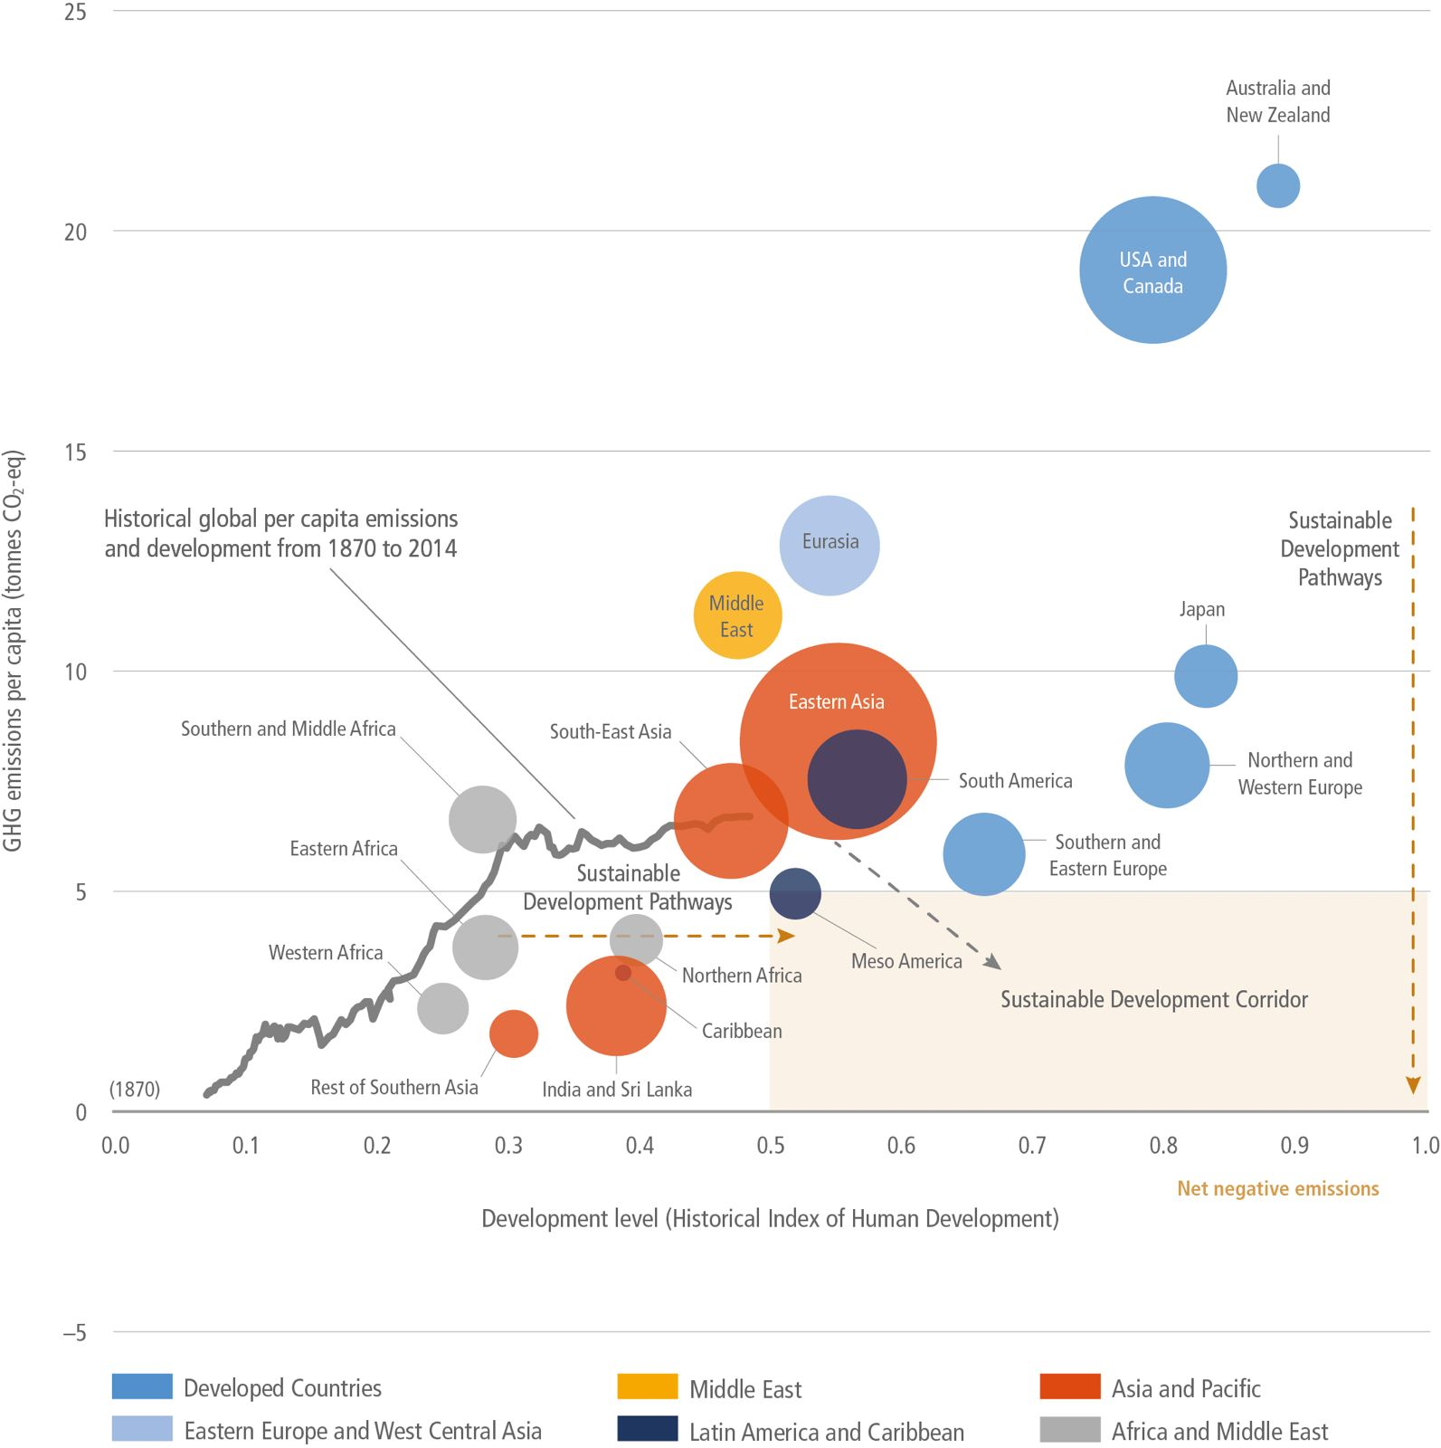
Africa’s Overriding Objectives
1. Recognition of the context in which African countries will be undertaking their climate obligations – climate change is a development issue for Africa:
Negligible historical and current contribution to climate change,
Lowest regional progress towards SDGs and most underdeveloped region in the world
limited capacity, and
disproportionate impact of climate change
2. Promote understanding about synergies between the PA goals, climate action and pursuit of our developmental priorities;
3. Recognition of multiple pathways to achieving goals of PA, that will differ in timing, and be based on different contexts and starting points, with developed countries taking the lead
4. Secure the support and the policy space for the exploitation of our natural endowments and resources to meet national and continental development priorities (SDGs and Agenda 2063) and just transition

Slide 5
UAE Consensus and NDC Guidance
“UAE Consensus” Decision 1/CMA.5 - Set of global goals that Parties are expected to contribute to but in a nationally determined manner and guided by the principles of the PA.
NDC Guidance
§164 – 171 recalls relevant agreed directions on NDC from the Paris Agreement and CMA decisions §166 - Submission of next NDCs by at least 9-12 months before COP 30 (Nov 2025) (§25 of Dec 1/CP.21)
§168 – Information necessary for clarity, transparency and understanding [4/CMA.1 §7 and 8]
§169 – Provide information on how NDC preparation has been informed by GST outcome [4/CMA.1, §4(c) Annex I]
§177 – Parties encouraged to take into account good practices and opportunities identified from GST-1
§170 – Encouraged to communicate NDCs with 10-year timeframe (2025-2035)
§171 – Parties to put in place new or intensify existing domestic arrangements for preparing and implementing successive NDCs

Slide 6
Preamble, Context and Cross-Cutting
Considerations
GST Outcome affirms the notion that pursuing SDGs is consistent with goals of the Paris Agreement – to be achieved in a low carbon manner
Importance of recalling Article 2.1 of PA - Reaffirming collective understanding that climate action is pursued in context of sustainable development and poverty eradication…and equity
Good sprinkling of references to right to development, action that is climate action that is aligned with sustainable development and poverty eradication objectives
  right to development, right to clean, healthy and sustainable environment, safeguarding food security and ending hunger, preservation of water ecosystems, integrity of all ecosystems including forests and biodiversity; and the urgent need to address cc and biodiversity loss in broader context of achieving SDGs by using nature and ecosystems sustainably for effective and sustainable climate action
  Numerous other paragraphs scattered through the Decision - §6 & §7 Commitment to accelerated action on basis of CBDR-RC, different national circumstances, Sustainable Development & EP, and equity, §16, 26, 32, 34, 43, 65, - §154 …etc with references to action in the context of SDs

Slide 7
Context and Cross-Cutting Considerations
GST outcome acknowledges Differentiation and Multiple Pathways
Notion of different national circumstances and contexts and consequently different starting points and pathways to achieve goals of PA including peaking of emission; and reaching net zero emissions;
§15 - Recalling of findings from the IPCC 6AR about incremental and fragmented adaptation response unequally distributed across sectors and regions
  significant and growing implementation gap […in adaptation response];
Sustainable Development Pathways
§16 - positives to embedding mitigation in wider development context along with policies that shift development pathways to sustainability “…enable pursuit of synergies with development priorities”
Role of Governments, investors, central banks and regulators in redirecting finance flows
§16(b) - Sufficient global capital to close investment gap – role for governments, investors, central banks and regulators in redirecting finance flows

Slide 8
Mitigation
UAE Consensus contains mitigation global goals/targets and measures that Parties must contribute to and adopt:
Global Emission Reduction Target
Energy Transition Goals and Measures
Forest Mitigation Goals; and
Low Emissions Development Strategies and Economy-Wide Emission Reduction Targets
1. Global Emission Reduction Target: §21 – 25 summarizes the implementation gap, what remains of the carbon budget and the rapidly narrowing window to address is the emission reduction gap
§27 and 28: Recognizes the need for deep, rapid and sustained reductions in greenhouse gas emissions in line with 1.5 °C pathways
  Global target of 43 pct of 2019 levels by 2030; and 60 pct by 2035
  Each country’s contribution must be nationally-determined - take into account the PA and national circumstances, pathways and approaches [the idea of differentiation and multiple pathways]

Slide 9
Mitigation: Energy Transition
2. Energy Transition Goals and Measures - There are 10 measures in the energy and transport sector listed in §28 – 30 that Parties must contribute to:
Tripling of Global Renewable Energy Capacity by 2030 and doubling of global average annual rate of energy efficiency improvements by 2030 [§28(a)]
Accelerating phase-down of unabated [high intensity] coal power [§28(b)]
Accelerating efforts towards net zero emissions energy systems and technologies, use of zero and low-carbon fuels well before 2050 [§28(c and e)]
§28(d) and §29 accelerating “transitioning away from fossil fuels…in a just, orderly and equitable manner” by 2030, with natural gas as a transitional fuel for facilitating energy transition and security
  §28(g) emission reductions from road transport through range of measures e.g. zero to low emission vehicles, development of infrastructure
Accelerating reduction in emission of non-co2 gases especially methane by 2030 [§28(f)]
Phase-out of inefficient subsidies except where it addresses energy poverty or just transitions [§28(h)]
Recognition of the need to increase affordability and accessibility of mitigation technologies [§30]

Slide 10
Mitigation: Forestry and Low Emissions Development Plans
3. Forest Mitigation Goals
Role of forest, marine and other terrestrial ecosystems mitigation and restoration in achieving goals of the PA, and the goal of halting and reversing deforestation and forest degradation by 2030 [§34].
Notes need for enhanced support and investment through provision of finance notably results-based finance, and also technology transfer, and capacity-building [§34].
4. Low Emissions Development Strategies and Economy-Wide Emission Reductions
Measures whose adoption is encouraged will be in context of national circumstances:
“Request” parties to strengthen and align 2030 targets with PA’s temperature goal by 2024 [§37];
“Encouragement” to developing countries to move towards economy-wide emission reductions targets that cover all GHG, sectors and categories [§38-39].
“Invites” ALL Parties to develop and align long-term ghg emissions development strategies (Art 4.19) with just transition to net zero emissions by 2050 [§38-39]
“Align” NDC 2.0 to the LDS and “communicate” by cop29

Slide 11
Adaptation
Recognition of the intrinsic link between adaptation and sustainable development - §43 Emphasizes importance of GGA to climate change, goals of PA, and contributing to sustainable development
Early Warning Systems (EWS) [§49-50]: 1/3rd of world does not have access to EWS and climate information systems - 60 percent of Africa;
  UN Secretary-General has a target of universal coverage by 2027;
  Invitation to development partners, International Financial Institutions (IFIs) and operating entities to provide support to achieve this goal
Emirates Framework for Global Climate Resilience to guide achievement of GGA (Article 7)
  7 thematic targets [2030] - reduce adverse effects and build resilience
  i. Water, ii. agriculture and food security, iii. health, iv. nature, ecosystems and biodiversity, v. infrastructure and human settlements, vi. poverty eradication and livelihoods, and vii. cultural heritage and practices
  Targets for the [4] dimensions of the iterative adaptation cycle: Impact, vulnerability and risk assessment
  Planning
  Implementation; and
  Monitoring, evaluation and learning
2-year UAE-Belem Work Programme to compile indicators for measuring progress achieved towards targets

Slide 12
Loss & Damage and Response Measures
Loss & Damage – Improved response and management to L&D and Reporting
§131 – Parties to improve coherence and synergies between climate caused disasters and humanitarian crisis management activities in order to to avert, minimize and address L&D
§132 - Recalls that Parties can provide information to enhance understanding, action and support to avert, minimize and address L&D
Response Measures
§137 recalled Article 4.15 which calls on Parties to take into consideration concerns of Parties most affected by their implementation of PA
§143 - 146 encourages [Parties] development of methodologies and tools for analysing and assessing impacts of response measures including national case studies; as well as efforts to diversify economies

Slide 13
Means of Implementation - Finance
Finance
Certainty/Agreement that the CMA’s consideration of the new collective quantified goal will consider the level of support to meet the full implementation of GST-1 outcomes, NDCs by 2035 and NAPs by 2030;
§94 - NCQG deliberations could take into account need to support implementation of current NDCs and NAPs implementation of current NDCs and NAPs
Technology Development & Transfer
§110 - Technology Implementation Programme (TIP) to strengthen support for implementation of developing country technology priorities and address challenges from first periodic assessment of TEM by provision of support from operating entities of Financial Mechanism
Capacity Building
§119 - PCCB to consider new activities related to Adaptation, Article 6 and ETF as part of new annual focus areas
§120 - Financial Mechanism and Adaptation Fund to enhance support for CB in developing countries and report
International Cooperation
§157 - Also recognizes that international cooperation is critical for addressing climate change, in the context of sustainable development and poverty eradication, particularly for those who have significant capacity constraints, and enhancing climate action across all actors of society, sectors and regions;

Slide 14

THANK YOU

