Slide 1
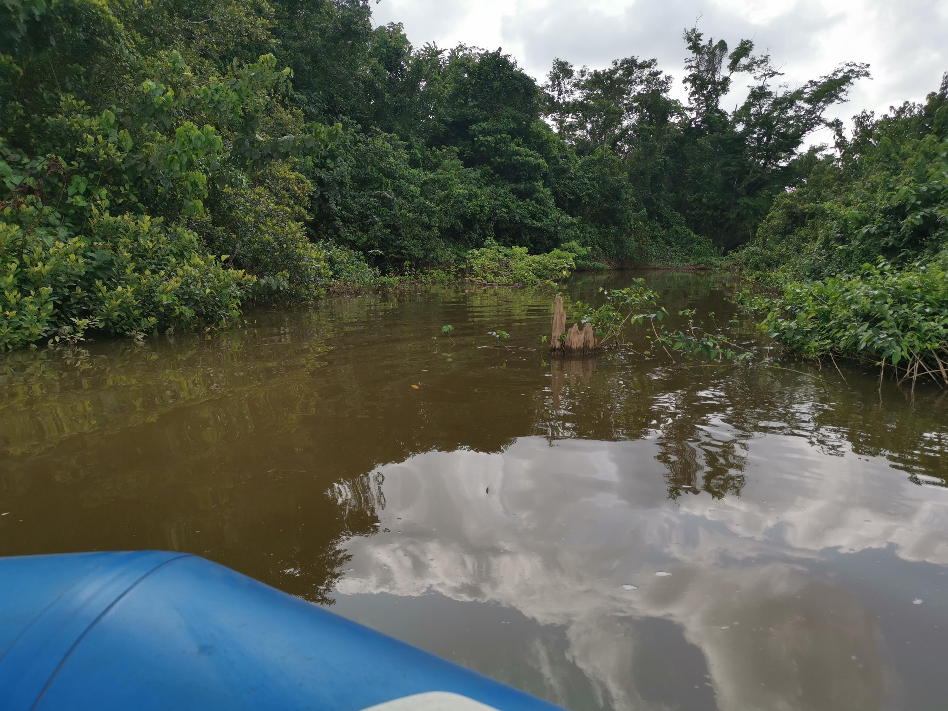
Overview of Liberia’s Freshwater Ecosystems: A need for Safeguarding
Nick Benitos Goll, II
Environmental Specialist, LEC
12.01. 2024

Slide 2
Table of Contents
Overview of Liberia’s Freshwater
The country's freshwater resources
Challenges/ threats to Liberia’s water resources
Key Takeaways

Slide 3
Overview of Liberia’s Freshwater
Liberia has a total land area of 111,370 square kilometers, including 96,320 square kilometers of land (9.63 million hectares) of which 15,050 km2 is covered in water
Surface water and wetlands account for roughly 14% of Liberia's total surface area
Unlike many other countries around the world, Liberia has abundant water resources throughout the country
Liberia's freshwater resources include rivers, lakes, lagoons, creeks, and streams that mostly drain into the Atlantic Ocean.

Slide 4
Overview of Liberia’s Freshwater
Liberia has 23 small coastal drainage areas and 15 principal basins that drain from the northeast to the southwest towards the Atlantic Ocean (Liberian Hydrological Service. Liberia River Basins 2016)
The six major rivers: The Cavalla, Cestos, Lofa, St. John, Mano, and the Saint Paul River
The headwaters of the six main rivers are in the Fouta Djallon Mountains in Guinea.
Most are navigable up to 20 miles from the coast, except for the Cavalla, which is navigable up to 50 miles.

Slide 5
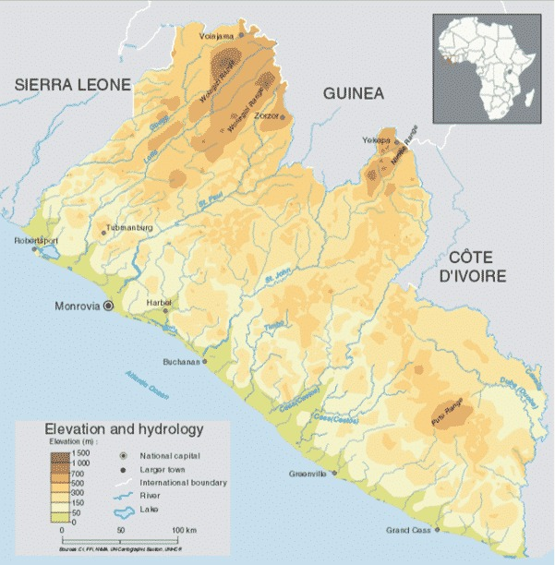
Hydrology of Liberia showing major Rivers

Slide 6
Overview of Liberia’s Freshwater
There is a total of 1800 kilometers of river, most of which is shallow, rocky and with cataracts and fallen logs (DAI 2008; FAO 2006)
Water availability per capita is the third highest in Sub-Saharan Africa at 49,028 m3 and is significantly higher than the Falkenmarki threshold for water stress.
It has been estimated that Liberia’s total annual renewable freshwater supply is approximately 300 km3 (Macdonald et al. 2012).
Aquifer productivity is variable in both groundwater systems, but there is limited understanding of aquifer characteristics.
Most wells are shallow (5 to 25 meters deep) but have relatively low yields.

Slide 7

The country's freshwater resources
Total renewable water resources: 232 cubic kilometers per year, with 200 cubic kilometers produced internally and 32 cubic kilometers coming from neighboring countries
Internal groundwater: 60 cubic kilometers per year
The St. Paul River’s average flow rate in September exceeds 1,400 m3/ s and declines to 50 m3/s in February

Slide 8
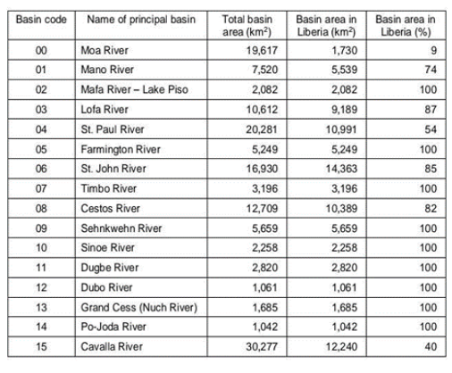
Liberia’s River Basins and Annual Flow
Basin | Annual Flow (m/s)
Cavalla | 380
Cestos | 60.3
Lofa | N/A
Mano | 251
St. John | N/A
St. Paul | 512.3
Source: LHS

Slide 9
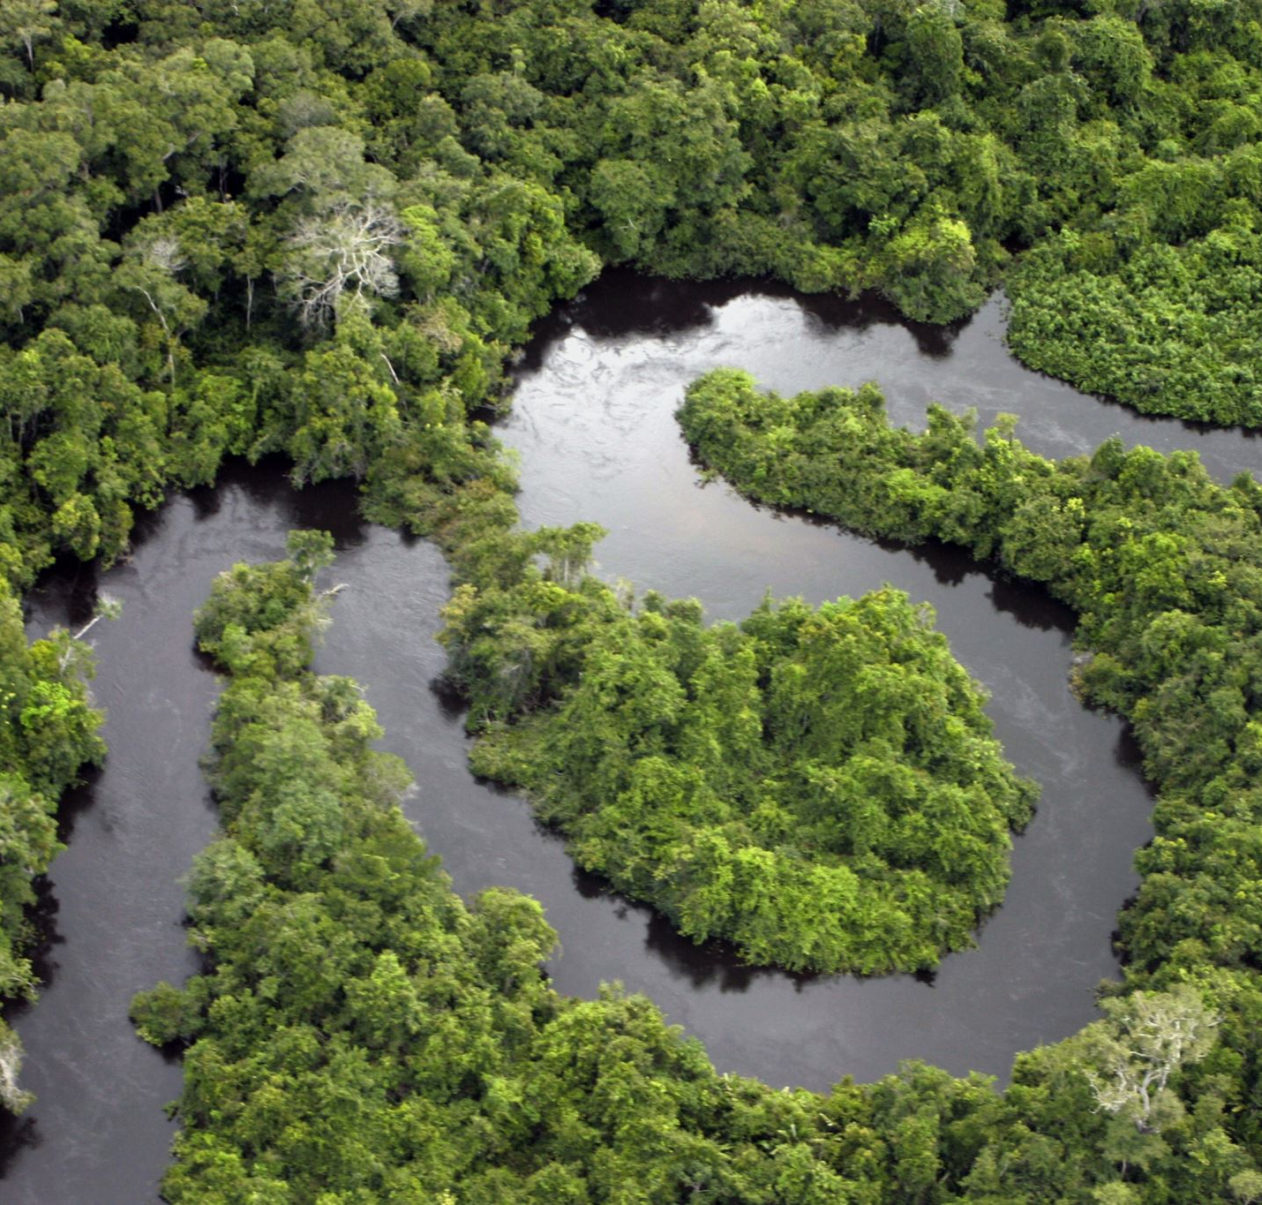
Wetlands of RAMSAR Importance
Liberia’s coastal plains have over 600,000 hectares of freshwater wetlands, 55,000 hectares of coastal mangroves, and three of Liberia’s five Ramsar sites (Gatter, 1988; USAID, 2014)
Gbedin Wetlands (25 hectares, 07°16'N 008°48'W) is situated in Nimba county in the north of Liberia - the area is largely a swamp but also includes a man-made wetland with an irrigation system that includes channels, ditches, dams and drainages.
Kpatawee Wetlands (835 hectares, 07°07'N 009°38'W) is in Bong county - the Kpatawee waterfall falls within the rainforest zone of Liberia, as a branch of the St. John River, one of the six major rivers in the country.
Marshall Wetlands (12,168 hectares, 06°08'N 010°22'W), in Margibi county, comprises three small rivers . The wetland is chiefly a mangrove type with mature trees reaching up to 30m.
Mesurado Wetlands (6,760 hectares, 06°18'N 010°45'W) is located in the capital city Monrovia and Montserrado County (the largest administrative region of the country with 1 million people).the site is particularly important for the protection of three mangrove species (Rhizophora harrisonii, R. mangle and Avicennia africana), which are threatened by intense charcoal burning and fuel wood collection.

Slide 10
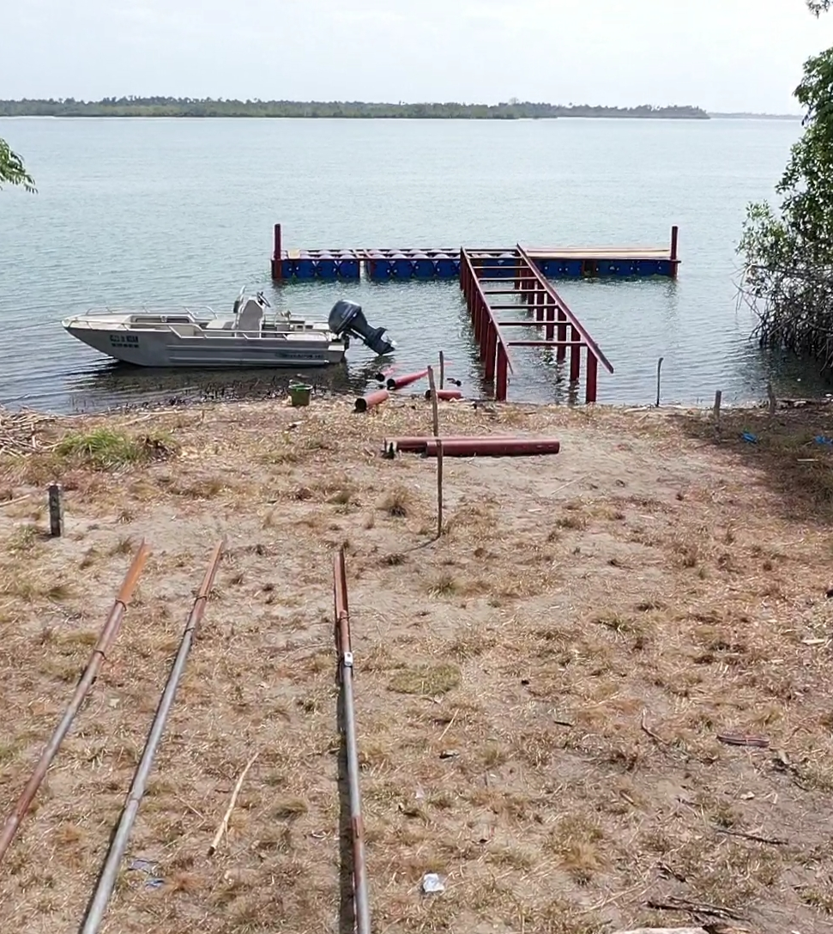
Known Lakes
Lake Piso
It is an oblong tidal lagoon and the largest in Liberia, covering 103 km2 .
largest Ramsar site in Liberia
Lake Shepard
Lake Shepherd is also a long narrow lagoon with similar vegetation to Lake Piso
a shallow coastal waterbody, completely or partly separated from a larger body of water by a barrier island, coral reef or other depositional feature. The estimate terrain elevation above sea level is 4 meters.
* However, Liberia has only 1 lake registered on the ‘World Lake Database’ see (https://wldb.ilec.or.jp/Search/Country/L)

Slide 11
Man-made Lakes
Lake Tilleh: Man-made lake located in Sanniquellie , Nimba County
Current size unknown,
Estimated at 3.54 acres in 2021 (EPA)
Blue Lake: characterized as a 300 ft deep manmade pond with the waters originating from iron ore mining activities.

Slide 12
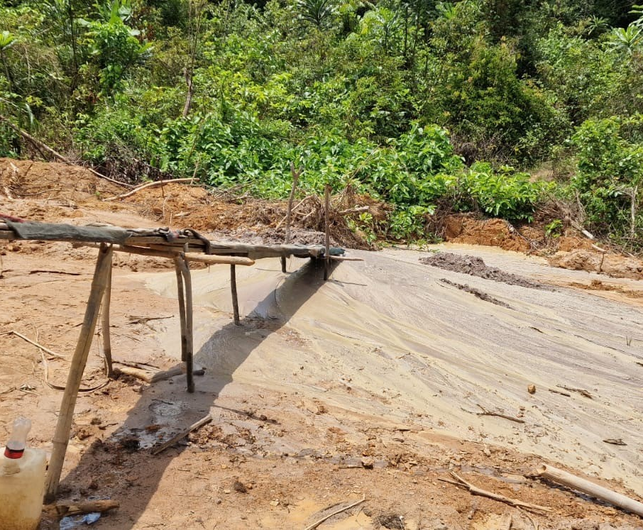
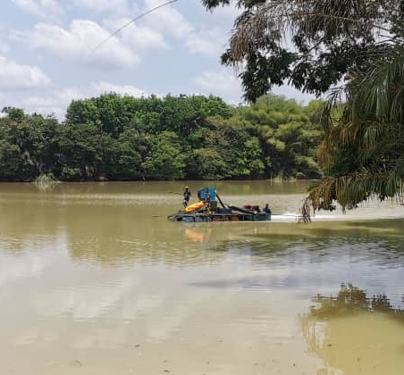
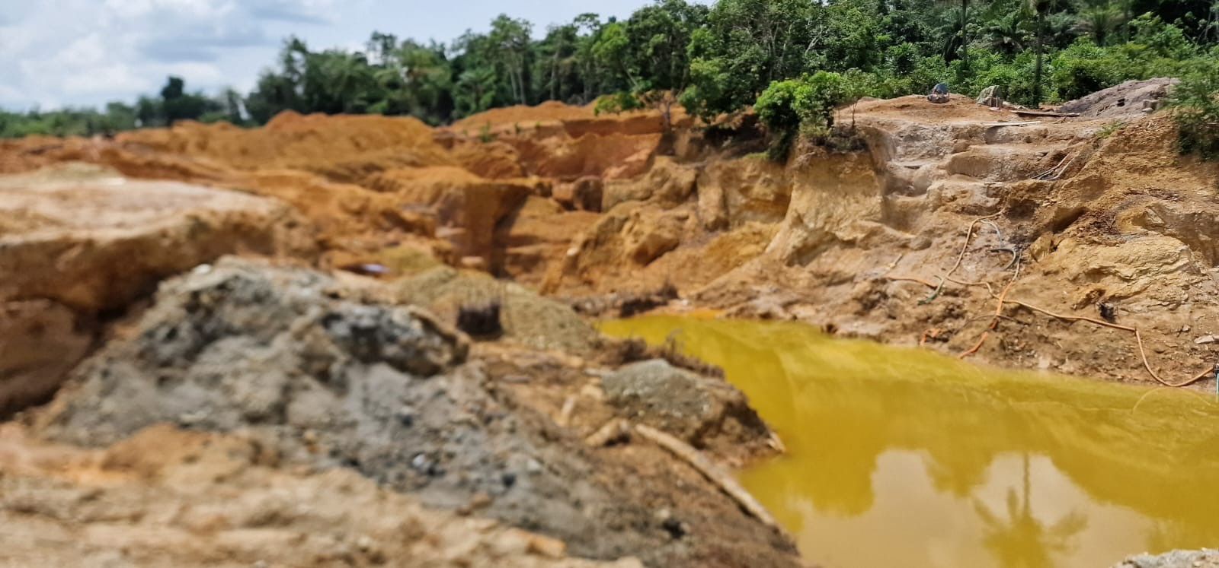
Threats/Challenges to Liberia’s Water Resources
Artisanal mining (unregulated)

Slide 13
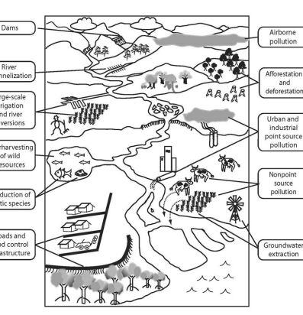
Threats/Challenges to Liberia’s Water Resources
Sea level rise: Liberia's extensive coastal plains and large coastal population make it vulnerable to sea level rise, which can accelerate coastal erosion and increase the risk of storm surges
Poor water management: Low funding and technical capacity, along with a lack of institutional capacity, hinder water resources management
Poor sanitation and drainage systems: Monrovia and other cities have poorly developed sanitation systems, which can lead to the spread of sewage and solid waste during the wet season. Toilets on the river bodies; Waste disposal; Open defecation etc.

Slide 14
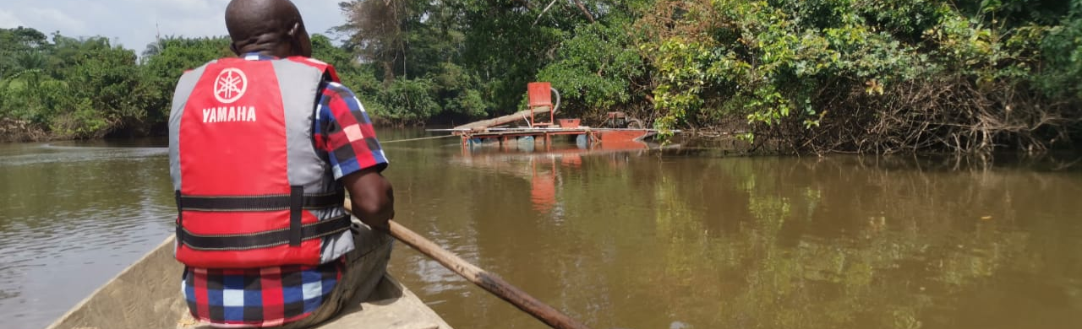
Threats/Challenges to Liberia’s Water Resources
Climate change: Flash flooding; Drought; threaten to inundate coastal wetlands and mangroves; Total rainfall has decreased since the 1960s
Low seasonal flow (dry season): Despite having abundant surface water, dry season flows can be low. The MCHPP is Liberia’s only notable reservoir, storing 239 Million Cubic Meters (MCM) from the St. Paul River.
Low flows on the St. Paul River significantly reduces hydropower generation at the Mount Coffee Dam, which is the largest source of municipal power and a major source of electricity for Monrovia.

Slide 15
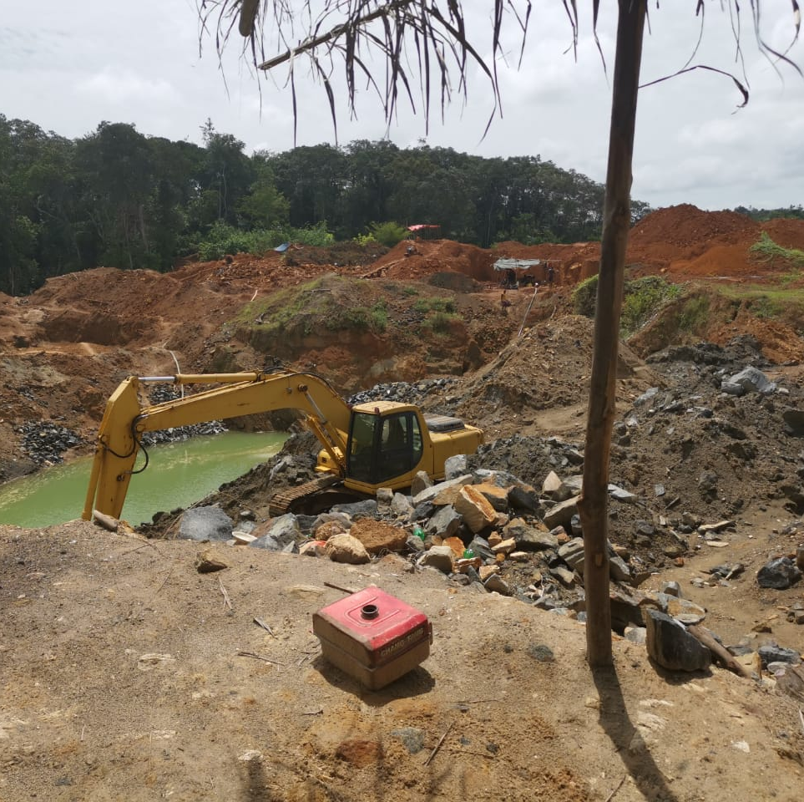
Threats/Challenges to Liberia’s Water Resources
Sedimentation
- freshwater is often affected by saline intrusion.
Rubber processing and plantations : key sources of surface water pollution and watershed degradation. Rubber plantations and processing facilities commonly use chemicals such as sulfuric acid, ammonia, formic acid, and lye, which can harm wetland biodiversity and public health if effluent is not treated

Slide 16
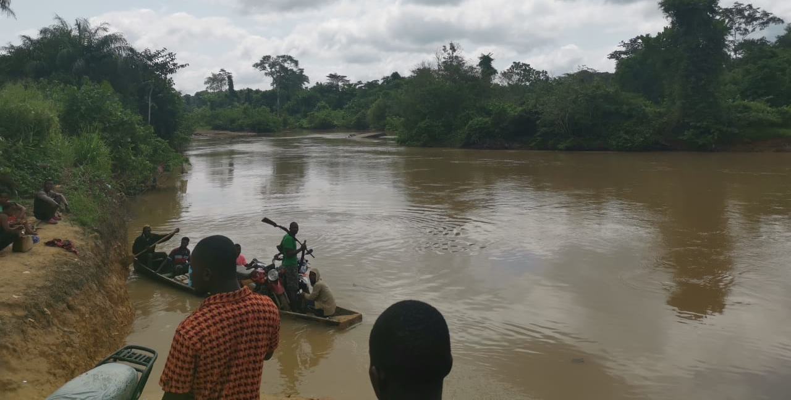
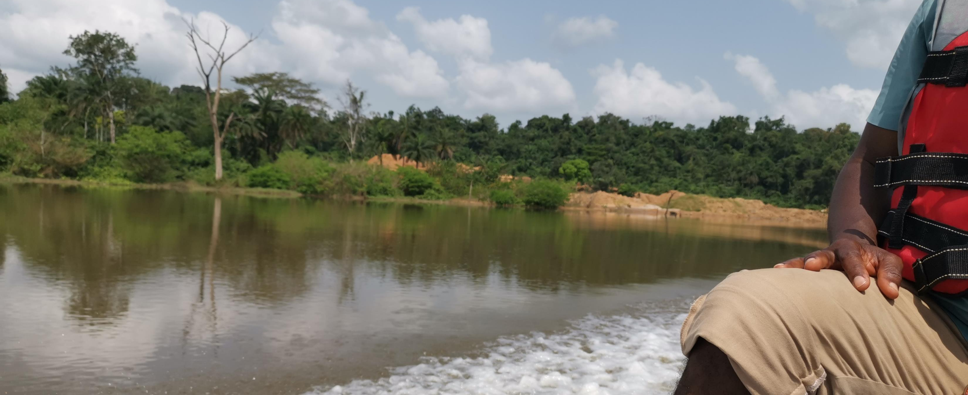
Threats/Challenges to Liberia’s Water Resources
Water Resource data : There is limited data on surface and groundwater availability, quality, water use
Urbanization/Unplanned settlements:
Built-in communities in the Mesurado Wetland
Dumping ground on breeding ground

Slide 17
Key Takeaways
Liberia has abundant of freshwater ecosystems, but they’re not sustainably managed
Municipal water supply and industry are the main sources of demand for freshwater.
Liberia experiences Seasonal fluctuation in river and freshwater flows
Ineffective sectors are compounding the threats on our freshwater
Human pressure adversely impacting our freshwater ecosystem

Slide 18
Thank you for listening.

Slide 19
References
Liberian Hydrological Service. Liberia River Basins 2016: Drainage Divisions and River Basin Boundaries; Monrovia, 2016.
Gökçekuş, H., Kassem, A. P. D. Y., & Dioh, F. S. (2022). A Review of Liberia’s Water Resources: The Quality and Management with Particular Focus on Freshwater Resources.
Liberia Water Resources Profile, USAID/Sustainable Water Partnership, August 2021
https://dicf.unepgrid.ch/liberia/water
https://www.sdg6data.org/en/country-or-area/liberia
https://www.land-links.org/country-profile/liberia/
https://www.mindat.org/feature-2273963.html
https://lr.geoview.info/shepard_lake,2273963
https://link.springer.com/article/10.1007/s44218-024-00039-9

