Slide 1


Emission Potential of Agriculture, Forestry and Other Land Use Practices
Frank Rutabingwa
Senior Regional Advisor
Climate Change and Natural Resources Management
United Nations Economic Commission for Africa(UNECA)
2 December 2024

Slide 2
Outline
  General information on GHG emissions
  AFOLU
  Key summary of Liberia NDC
  AFOLU initiatives in Liberia’s NDC
  Additional initiatives for consideration

Slide 3
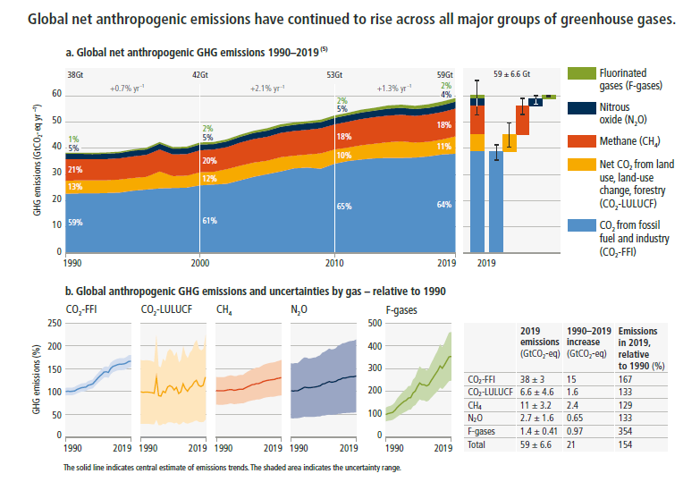

Slide 4
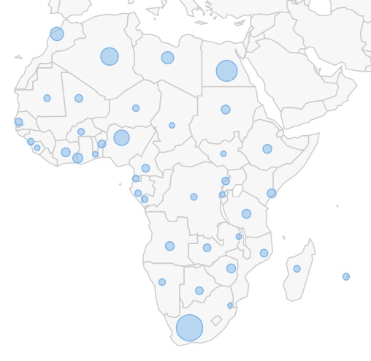
Carbon Dioxide Emissions- Fossil Fuels (2022)
Data Source: EIA, 2024

Slide 5
Liberia’s CO2 emission from Fossil Fuels
Data Source: EIA, 2024

Slide 6
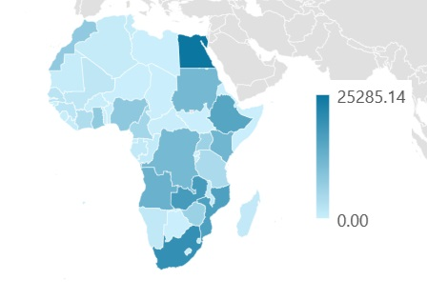
Total energy production from renewables (hydroelectric, and non-hydroelectric renewable)
Renewable Energy (GWH)
Rank | Country | Renewable Energy (GWH)
31 | Liberia | 534.00
13 | Zimbabwe | 6166.58
12 | Morocco | 7585.85
11 | Ghana | 7686.05
10 | Nigeria | 8047.60
9 | DRC | 11082.62
8 | Sudan | 11312.63
7 | Kenya | 11820.37
6 | Angola | 12798.01
5 | Ethiopia | 15456.42
4 | Mozambique | 16535.55
3 | Zambia | 17424.84
2 | South Africa | 19989.70
1 | Egypt | 25285.14
Data Source: EIA, 2024

Slide 7
Why do we need to enhance NDCs
Keeping global warming to 1.5°C requires reductions in global GHG emissions of 43% by 2030 and 60% by 2035, relative to 2019 to reach net-zero CO2 emissions by 2050
Full implementation of current NDCs (2023) would reduce global GHG emissions by just 2% by 2030, compared with 2019 levels
Rationale to enhance the next round of NDCs is made clear in the GST decision given persisting gaps in progress towards the long-term temperature goal of the Paris Agreement
Good practices for designing, preparing, implementing and reporting on more ambitious NDCs discussed in the first GST technical dialogues include for example,
  strengthened mitigation targets,
  elaboration of sectoral implementation plans,
  provision of information on domestic mitigation measures,
  inclusive processes of stakeholder engagement in developing NDCs, etc.

Slide 8
Why do we need to enhance NDCs
Parties should be encouraged to consider separating emission reduction and removal targets in their NDCs. Separating reduction and removal targets could also enhance transparency, help to incentivize the scale-up of removal technologies, and enhance certainty for project developers.
Preparations for the next round of NDCs need to move forward in parallel to efforts to implement current NDCs to deliver enhanced efforts and alongside on-going discussions on scaling up finance and investment

Slide 9
1. General information about AFOLU
AFOLU sector
Agriculture, Forestry, and Other Land Uses (AFOLU) defines as the human use of and influence on land areas
is responsible for about 22% (20-24%) of global GHGs emission, making it the second largest contributor after electricity and heat production
emissions come from a variety of sources, including deforestation, livestock production, rice cultivation, and the use of fertilizers
measures can offer substantial co-benefits, addressing broader challenges in land management, including ecosystem health, food security, and carbon sequestration

Slide 10
2. Liberia’s NDC (2021)
Liberia’s Revised NDC commits to reducing GHG emissions by 64% below business-as-usual (BAU) levels by 2030
  unconditional reduction is 10% (resulting in 11,187 Gg CO2e by 2030)
  conditional reduction is 54% reduction but contingent upon international support as (resulting in 4,537 Gg CO2e by 2030)
  targets reductions in nine sectors: Agriculture, Forests,, Health, Transport, Energy, and Waste. (Coastal Zones, Fisheries, Industry added in revised)
  Cross-cutting targets include urban green corridors

Slide 11
3. Liberia’s AFOLU
Liberia’s national projects and initiatives in the Agriculture (40% below BAU levels by 2030)
  low-carbon agricultural practices, low-emissions livestock system, and linking agricultural development with the National REDD+ Strategy
    e.g., conservation agriculture, no/low tillage, agro-silvopastoral systems, improved lowland rice cultivation, multi-cropping, organic fertilizers, fertigation, composting, crop rotation, and sustainable agricultural waste management

Slide 12
3. Liberia’s AFOLU
Liberia’s national projects and initiatives in the Forestry (50% below BAU levels by 2030)
  REDD+, improving sustainable fuelwood and charcoal production, increasing Protected Areas, increasing the urban canopy covers, enhancing forest carbon stocks by incentivizing and increasing agroforestry, reforestation, afforestation, and forest restoration, including through reforestation agreements with logging companies; Conserving High Conservation Value-High Carbon Stock (HCV-HCS) forests within agricultural, tree crop, and commercial forestry, and site new concessions on open/degraded land; Increasing the designation of Community Forest Area.

Slide 13
3. Liberia’s AFOLU
Liberia’s national projects and initiatives in the Coastal zone (not given below BAU levels by 2030)
  increasing mangrove and coastal conservation and restoration, based on a survey analysis of coastal zone ecosystems to identify threats and priority action areas, Expanding marine and coastal ecosystem protection, Promoting mangroves within the National REDD+ Strategy, and developing mechanisms for sustainable community management of mangrove areas

Slide 14
4. Proposed AFOLU project
Additional national projects and initiatives in the NDC3.0
  Agroforestry Initiatives (contributes to sequesters carbon, improves soil health, and enhances biodiversity. Promotes sustainable farming practices that reduce emissions from agricultural activities.)
  Sustainable Land Management (SLM) Programs (to enhance soil carbon sequestration, reduces emissions from land degradation, and prevents further loss of ecosystems)
  Climate-Smart Agriculture (CSA) Initiatives (to reduces emissions from agriculture (e.g., methane from livestock and nitrous oxide from fertilizer), while increasing carbon sequestration in soils)

Slide 15
4. Proposed AFOLU project
  Carbon Sequestration Programs (Increases soil organic carbon and reduces atmospheric CO2 levels)
  Integrated Water and Land Management Projects (manage water resources more effectively, reduces emissions from water-intensive farming, and supports sustainable land use practices)
  Urban green corridors aim to:
    Enhance urban resilience by reducing heat island effects.
    Improve air quality and overall urban living conditions.
    Provide carbon sequestration through the planting of trees and the restoration of degraded urban landscapes.
    Contribute to the development of green spaces that are beneficial for biodiversity conservation and climate adaptation in cities.

Slide 16
5. Methodological framework
  Define the national context
  Determine the reference point (include base year)
  Time frame and/or implementation period
  Scope and coverage
  Defining the adaptation and mitigation measures
  Describe the review process
  Consider important assumptions and conditions
  Select appropriate methodological approach
  Include important annexes

Slide 17
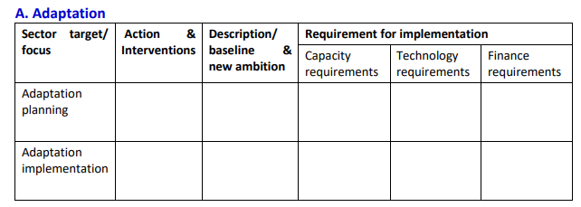
5. Methodological framework

Slide 18
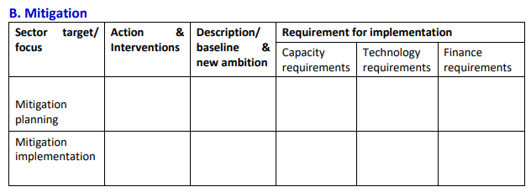
5. Methodological framework

Slide 19
Thank You!

