Slide 1
Existing National Projects and Initiatives Which Can Reduce Emissions including
Renewable Energy, Energy Efficiency initiatives, Waste Management improvements, and Transportation initiatives
Presented by:
Dr. Charles Asumana, Sr. (Anthony Saah Tengbeh)
Date: December 2, 2024

Slide 2
Table of Contents
Objective and Key Areas
Renewable Energy Projects in Liberia
Solar Energy Initiatives
Energy Efficiency Initiatives
Industrial Energy Efficiency
Waste Management Improvements
Transportation Initiatives
Challenges Facing These Initiatives
Opportunities for Progress
Conclusion

Slide 3
Objective: To highlight the national projects and initiatives in Liberia aimed at reducing emissions and promoting sustainability.
Key Areas:
Renewable Energy Projects
Energy Efficiency Initiatives
Waste Management Improvements
Transportation Initiatives

Slide 4
Renewable Energy Projects in Liberia
Liberia's Renewable Energy Potential
Liberia has significant renewable energy resources, including hydro, solar, and biomass.
Goal: Achieving a 30% renewable energy share in electricity generation by 2030.
Key Projects:
The Mount Coffee Hydroelectric Project
  Capacity: 88 MW (megawatts)
  Impact: Provides cleaner energy to the national grid and helps to reduce reliance on diesel-based electricity generation.

Slide 5
Solar Energy Initiatives
Examples: Small-scale projects in rural areas, as well as larger solar farms (Harrisburg, Montserrado County 20MW facility)
Goal: Improve access to cleaner energy and reduce carbon emissions
Biomass and Wind Energy
Exploration of biomass from agricultural waste and potential wind energy projects. (There is a 1000KW Biomass Energy Plant in Kwendin, Nimba County, that uses wood chips, coconut, and palm kernel shells to produce affordable energy for over 200 households)

Slide 6
Energy Efficiency Initiatives
.
Liberia Energy Efficiency Program
Focus: Reducing energy consumption and improving the efficiency of electrical systems and appliances
Key Areas:
Upgrading electrical grids
Introducing energy-efficient lighting and appliances
Public education campaigns on energy conservation

Slide 7
Industrial Energy Efficiency
Support for industries to adopt energy-saving technologies, reduce waste, and improve production processes.
Sustainable Building and Construction Standards
There is a need for the promotion of energy-efficient buildings, the use of alternative construction materials, and better insulation techniques.

Slide 8
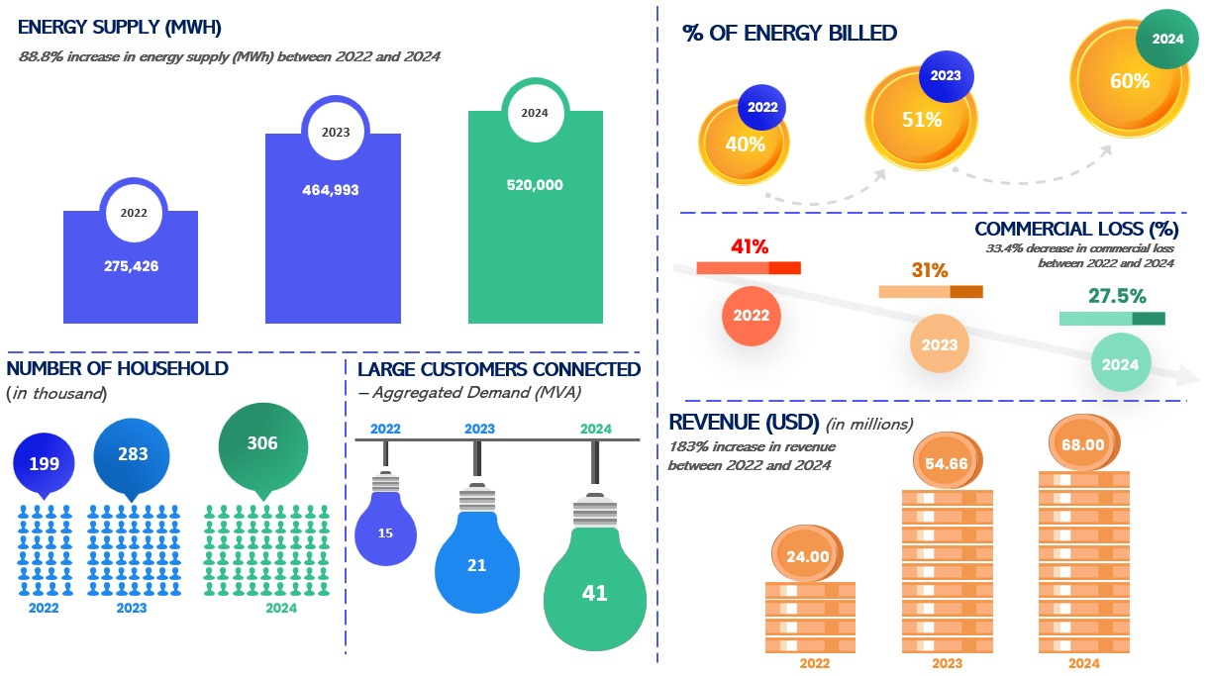
EVIDENCE OF ENERGY DEMAND AND SUPPLY
DATA SOURCE: LEC

Slide 9
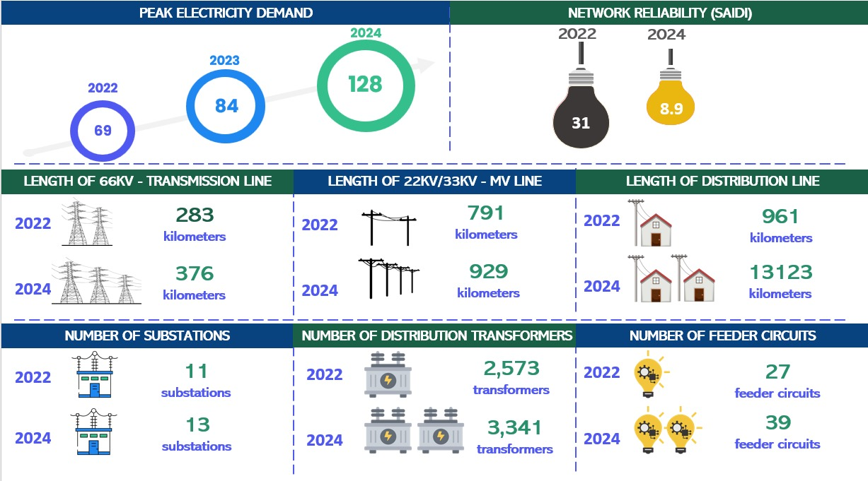
ELECTRICITY DEMAND AND NETWORK RELIABILITY
DATA SOURCE: LEC

Slide 10
ENERGY SUPPLY/GENERATION
Table 1DATA CREDIT: LEC
𝗘𝗡𝗘𝗥𝗚𝗬 𝗦𝗨𝗣𝗣𝗟𝗬/𝗚𝗘𝗡𝗘𝗥𝗔𝗧𝗜𝗢𝗡 BY YEAR SINCE
2022 | 275,426 MWH
2023 | 464,993 MWH
2024(OCTOBER) | 520,000 MWH

Slide 11
Waste Management Improvements
Liberia National Waste Management Strategy (aligns with SDGs)
Aim: Reduce emissions from landfills and improve waste disposal methods.
Key components:
  Recycling initiatives: Promoting the use of recyclable materials.
  Landfill management improvements: Introducing better waste segregation and recycling programs.
Composting and Waste-to-Energy Projects
Composting organic waste to reduce landfill emissions.
Exploring waste-to-energy technologies to generate electricity from waste products.
Public Awareness Campaigns
Focus on reducing plastic waste, encouraging recycling, and educating the public about sustainable waste management practices.

Slide 12
Solid waste generated in Monrovia
Data source: JOURNAL OF SOLID WASTE TECHNOLOGY AND MANAGEMENT VOLUME 45, NO. 1 FEBRUARY 2019
Composition of solid waste generated in Monrovia
Composition | Percentage
Paper | 12.2
Plastic | 14.2
Glass/ Ceramics | 10.5
Metal | 3.0
Rubber | 10.0
Batteries | 9.9
Total | 100

Slide 13
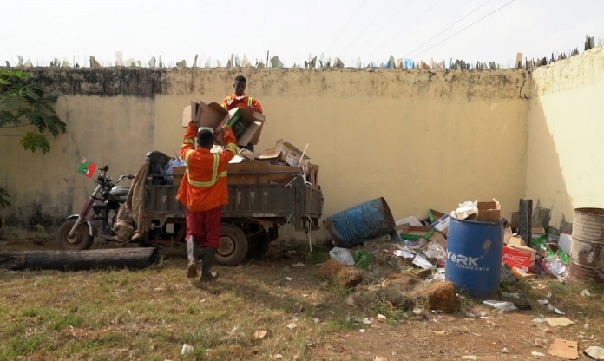
Waste collection for waste-to-energy project photo source: Cities Alliance/UNOPS

Slide 14
Transportation Initiatives
Sustainable Transport Development
Goal: Transition to low-emission and efficient transport systems.
Key Actions needed:
  Promotion of electric vehicles (EVs): Incentives for electric vehicles and related infrastructure, including EV charging stations.
  Improvement of public transportation systems: Expanding and improving the public transport network to reduce reliance on private cars.

Slide 15
Transportation Initiatives Con’t
Fuel Efficiency and Cleaner Fuels
Efforts are needed to improve fuel standards and promote the use of cleaner fuels in the transportation sector.
We need to encourage the use of biofuels or LPG (Liquefied Petroleum Gas) to reduce air pollution and carbon emissions.
Traffic Management Systems
There is a need to implement smart traffic management systems to reduce congestion and improve fuel efficiency.

Slide 16
Challenges Facing These Initiatives
.
Limited funding: Many of these projects require sufficient investment
Infrastructure gap: Limited infrastructure for renewable energy, Evs, and waste management
Capacity and Awareness: Lack of technical expertise and public awareness about the importance of emission-reducing practices
Policy and Regulatory Challenge: Need for stronger governmental policies and regulations to support green initiative

Slide 17
Opportunities for Progress
International Support and Partnerships: Leveraging support from international donors and private investors for clean energy and green projects.
Public-Private Partnerships (PPPs): Encouraging collaboration between the government, local businesses, and international companies
Green Jobs Creation: Opportunities to create sustainable jobs in the renewable energy, energy efficiency, waste management, and transportation sectors.
Technological Innovations: Harnessing new technologies to accelerate the transition to a low-carbon economy

Slide 18
Conclusion
Liberia has made progress in reducing emissions through renewable energy, energy efficiency, waste management, and transportation initiatives.
While challenges remain, there is significant potential for these sectors to contribute to Liberia's long-term sustainability and emission reduction goals
Continued government commitment, investment, and collaboration with international stakeholders will be key to achieving Liberia's climate goals.

Slide 19
THANK YOU

