Slide 1





Lease agreements for productive land use and self reliance of refugees in their host communities
Irumba Henry Harrison
Ministry of Lands, Housing and Urban Development

Slide 2
General refugee hosting context, West Nile, Uganda
Uganda hosts over 1,927,593 refugees (UNHCR June 2025)
78 % are women and children (UNHCR June 2025)
West Nile alone has an estimated 850,000+ Refugees
Terego, a refugee hosting district established on July 1, 2020, hosts 85297, refugees making 25% of its total population of 323,253 (UBOS 2024),
Refugees settled on customary land provided by the landlord and most of the Refugees allocated 30*30m land by OPM.
Reduction in general food rations
Funding cuts from big donors
Acquisition of additional land self reliance from the host community is an immediate need for refugees.

Slide 3
Context (Cont’d)
Secured land rights and land lease set incentives for efficient land use: Refugee settlements are often located in underutilized, difficult to farm, former pastoral land, requiring investment into the soils and sustainable, adjusted farming practices.
Gender dimension: Female refugees are particularly vulnerable to misuse of landlord-tenant relationship. Many women-headed households have fled alone with their children and are therefore under immense pressure
Low level of familiarity of refugees with the Ugandan land regulations: Continuous sensitization is vital in the land sector in general. It is pivotal to include refugees into the sensitization with representation

Slide 4
Context (Cont’d)
Intragenerational conflicts spill over in the refugee context: Youth was often observed to be the perpetrators of land related conflicts between host communities and refugee.
Conflict dimension: Land conflicts are multi-layered in the refugee-host context. Particularly the open question of compensation for permanently settled land
Lease agreements to address volatility in the host-refugee relations: Despite the ambition to have refugees return to their places of origin, as soon as they are safe, the duration of refugees staying after they migrated exceeds often several years.
Effective land use and productivity dimension: Refugees mostly engage in perennial crop cultivation, having to negotiate their lease on an annual basis. With more reliable lease agreements, the period of cultivation can gradually be extended.

Slide 5
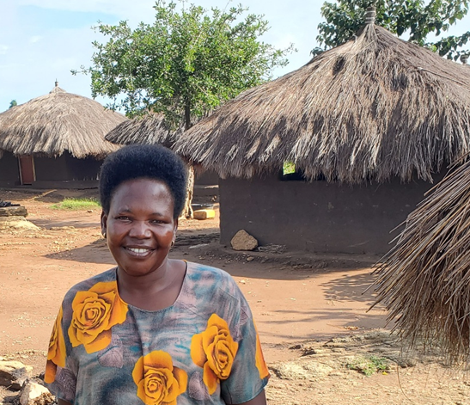
Jane Awate, 45, is a South Sudanese refugee and widow living in Ofua II, Rhino Camp Settlement. Married at just 14, she is a mother of eight— though four died in South Sudan due to illness. Today, she is the sole provider for her four surviving children (two boys and two girls), following the death of her husband, Khemis, in 2019.
Life in the settlement became even harder after Khemis passed away. “Just after his death, I hired land in Wanguru on a verbal agreement for two years. But after my first cassava harvest, the landlord told me to leave. I lost everything,” Jane shares.
“I was also supported with seeds, but I had nowhere to plant them. I feared hiring land again after my first experience,” Jane explains.

Slide 6
Refugee access to agricultural land context
The provision of land for refugees assumed that this would enable refugees to become self-sufficient through agriculture. However, the individual plots of land granted by the Government of Uganda are not sufficient for refugees to become self-reliant.
Refugee households often enter informal land use arrangements outside settlement zones with Ugandan landowners in the nearby villages.
General Food Assistance is often used or sold by refugee households to pay for the leasing of additional land for subsistence farming.
Landlords prefer advance cash payments instead of yield sharing schemes, given the risk of crop failure.
Verbal rental/ land use arrangements seem to be increasingly used to access farmland as food rations are decreasing and land inside the settlement area is scarce

Slide 7
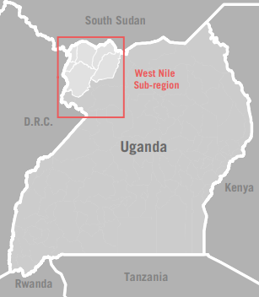
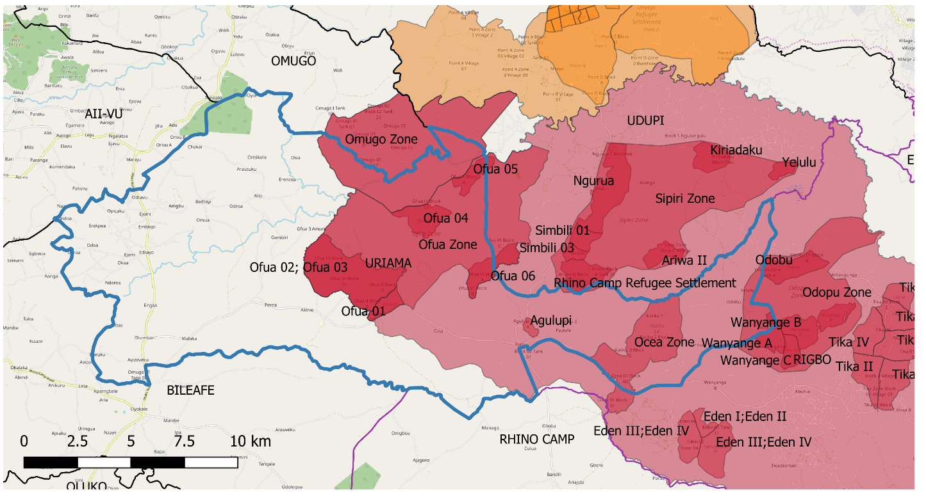
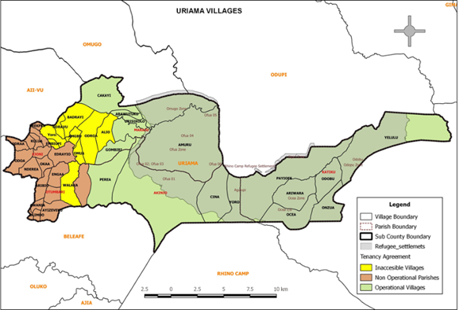
Uriama Sub County, Terego District, Uganda

Slide 8
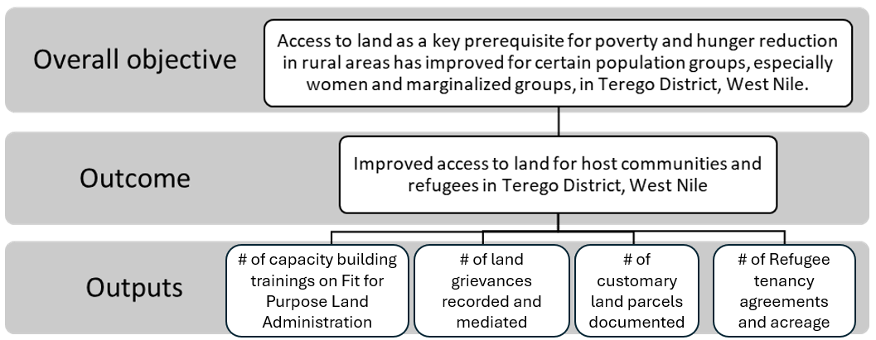
Overview of the project
Improvement of Land Governance for Refugee Host Communities Phase I &II
Area: Uriama and Biliefe sub-counties Terego district.
Duration: November 2020 to March 2024

Slide 9
Objective of the policy paper: Land –Refugee nexus
Draws learnings and recommendations from pilot experience in West Nile, working with host communities and refugees to secure access and ownership of land.
The pilot highlighted that land documentation can contribute to social cohesion between host communities and refugees, provide a source of income for hosts and at the same time enhance food autonomy of refugees.
The policy brief seeks to inform based on evidence,
Policy formulation in the relevant sectoral Ministries (e.g. the National Refugee Policy currently being developed, the Transition Management Process and the revision of the National Land Policy)
Formulation of District Annual Action Plans in concerned locations
Facilitating strategic discussions between Office of the Prime Minister and the international donor community on the need to prioritise self reliance initiatives

Slide 10
Why the refugee tenancy agreement document
Less conflict, identification of true and honest landlord (willing to give lease agreement to refugees),
A trust-building measure for stronger, mutually bebeficial refugee-host community relations
longer-term lease periods for more sustainable production, higher productivity, self-reliance
future potential to mobilize lending based on long-term lease for agricultural investment

Slide 11
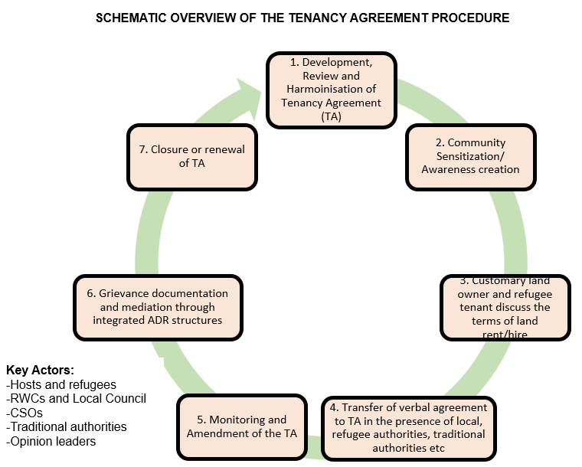
RWC- Refugee Welfare Council
CSOs- Civil Society Organisation
TA- Tenancy agreement
ADR- Alternative Dispute Resolution

Slide 12
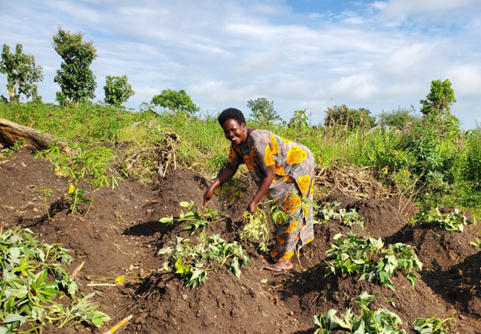
Encouraged by the awareness sessions, Jane approached a landlord, Mr. Anjo. “He gave me half an acre for free from 2021 to 2023, and we signed a tenancy agreement. I felt safe because the agreement protected me.”
In 2024, she renewed the agreement under improved terms. “This year, I agreed to pay 45,000 shillings annually for two years. My landlord is very good and even encourages me to cultivate more land from him,” Jane says with hope.
Secure land access has transformed Jane’s life. “Last year, I harvested seven sacks of cassava flour. That helped me restart my tea business in Ofua II. I also bought chickens and goats, and from the sales, I was able to pay school fees for my four children,” she proudly shares.

Slide 13
Results
Increased land tenure security for host communities and refugees through the Certificates of Customary Ownership and land tenancy agreement
901 (419 Females and 475 Males) signed tenancy agreements with host community landlords
570.03 Acres total land size hired between the host and the refugees.
10,216 participants were reached through awareness raising events: (5,804 National Male, 2,714 National Female; 1,015 Refugee Male & 683 Refugee Female).
1,514 total Certificates of Customary Ownership were issued (853 Male individuals, 95 owned by Female individuals and 566 jointly owned).
Improved capacities of land administration structures to deliver land services in Terego District
91 local land management actors trained
2 sub-county Area Land Committee offices equipped and functional with storage and digital land mapping equipment
Reduction in land conflicts
140 (83%) out of 169 conflicts were resolved through Alternative Dispute Resolution structures

Slide 14
Key success messages:
1. "Ever since I got my tenancy agreement, I've felt more in control. I know exactly what I can do with my land, and there's no fear of unexpected disputes. It's a game-changer for us." Male refugee, Uriama
2. "Having the tenancy document made a huge difference. Before, I was always worried about being asked to leave the land. Now, I have peace of mind and can focus on growing crops for my family and selling the excess." Female Tenant, Uriama
3. "Knowing that I have rights to this land for a set period has allowed me to invest more in it. I’ve expanded my farm, and it’s thriving. It’s not just about feeling secure; it’s about being able to plan for the future." Male Tenant (Host community)
4. "The tenancy agreement gave me a sense of belonging. For the first time since fleeing my home, I feel like I can settle and grow roots, even if it’s just for a while. It’s a significant step towards rebuilding our lives." Female Tenant (Refugee)

Slide 15
Key lessons & challenges
Challenges
Resistance by some landlords to enter in a formal agreement.
Lack of enough awareness especially on the host community side.
Key learnings
Popularizing tenancy agreement documents increases demand for land hire hence greater self-reliance.
Involvement of landlords in spearheading community sensitizations leads to more ownership and trust.

Slide 16
Policy Recommendations
Review of the National Land Policy: Integrate modes of management of land in line with other relevant policies concerning management of refugee questions to account for the sectoral responsibility of MLHUD in the context of host-refugee land nexus;
Recognition and documentation of host community customary land rights: 1. Fast-track the registration of customary land rights for host communities to create pre-condition for productive land use, 2. Develop sustainable business models; working with incentives: access to credit, waving of land tax for Landlords leasing out land etc.
Verify the status of public infrastructure under given land claims: Government to survey sensitive borders and critical infrastructure.
Lease arrangements should be aligned to context Lease orientation should take into account 1) potential land use and quality, 2) value attributed to the land (formal valorisation), 3) availability versus demand for lease, 4) access to infrastructure

Slide 17



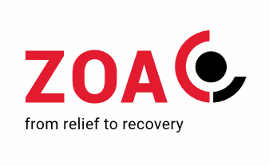
Thank you!
irumba2001@yahoo.co.uk

