Slide 1


MODELLING CLIMATE CHANGE IMPACT ON FOOD SECURITY IN WEST AFRICA: TOWARDS ACHIEVING SUSTAINABLE DEVELOPMENT GOAL
AUTHORS:
Okunade, S. O., Alimi, A. S., Adeyemi, O. J. & Saibu, M. O.
Chrisland University, Abeokuta, Nigeria.

Slide 2
Background
Food security, a fundamental aspect of human well-being, is intricately linked to agricultural productivity, which in turn is profoundly affected by climate change and variability .
Globally, food security is significantly threatened by climate change, particularly in regions such as West Africa where agriculture is essential for sustenance and subsistence.
West African countries are linked through shared ecosystems, trade networks, and socio-political relations, which collectively impact food availability, access, and stability.
This interdependence in food security among West African nations means that food insecurity in one country can have spillover effects on its neighbors, potentially exacerbating regional instability and conflicts.

Slide 3
Statement of the Problem
West Africa region is already grappling with a multitude of socioeconomic challenges, climate change poses a substantial hazard to food security.
Heavy dependence of West Africa on rain-fed agriculture renders it particularly vulnerable to climate variability.
Rapid population growth and extreme weather events exacerbate challenges

Slide 4
Objectives of the Study
Assess the impact of climate change on food security in West Africa;
Examine the food security spillovers within West African countries; and
Critical to achieve SDG-2: End hunger, achieve food security, promote sustainable agriculture

Slide 5
Methodology
Research Design: Ex-Post Facto
Population of the Study: 16 West African Countries (2002-2022).
Sampling Size: 15 West African Countries (excluding Liberia based on Data Availability)
Method of Data Collection: Secondary Data from United Nations’ Food and Agriculture Organization (FAO) Suite of Food Security Indicators (FAOSTAT) and World Development Indicators (WDI) 2023.
Method of analysis: Descriptive and Inferential statistics
PCA to generate Food Security Index (FSI) and Climate change index (CCI).
The Prais-Winsten Regression Model with Panel Corrected Standard Error (PCSE), Feasible Generalized Least Squares (FGLS) techniques and Dumitrescu-Hurlin panel non-granger causality test.

Slide 6
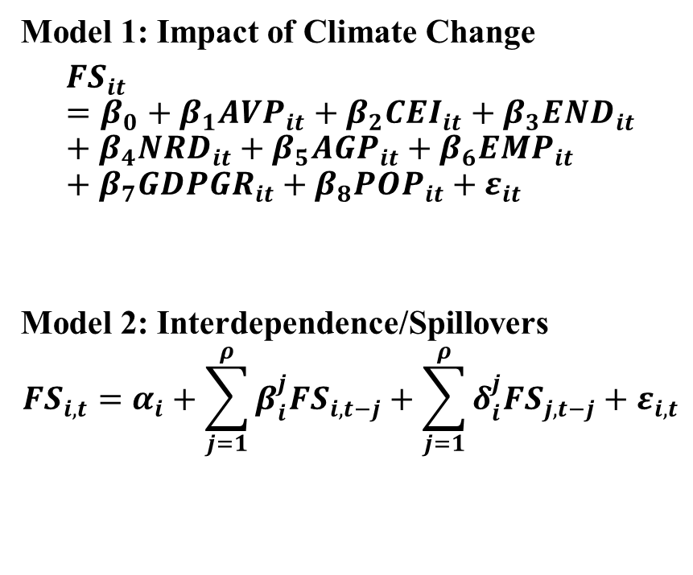
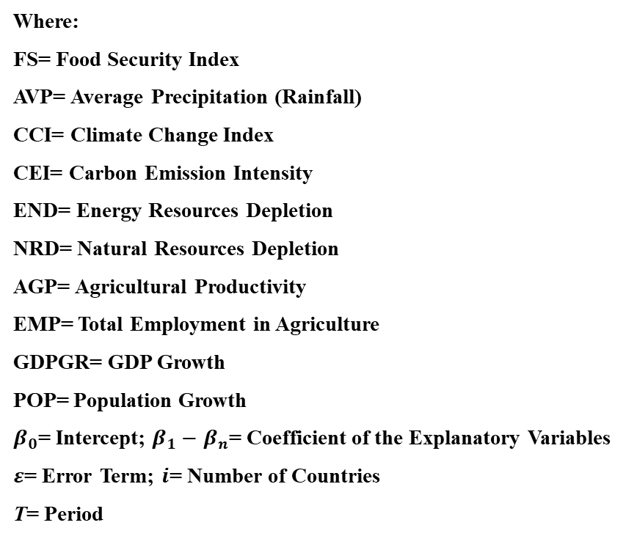
Methodology
Model 1: Impact of Climate Change
$${FS}_{it}=β_{0}+β_{1}{AVP}_{it}+β_{2}{CEI}_{it}+β_{3}{END}_{it}+β_{4}{NRD}_{it}+β_{5}{AGP}_{it}+β_{6}{EMP}_{it}+β_{7}{GDPGR}_{it}+β_{8}{POP}_{it}+ε_{it}$$
Model 2: Interdependence/Spillovers
$${FS}_{i,t}=α_{i}+\sum_{j=1}^{ρ}{β_{i}^{j}{FS}_{i,t−j}}+\sum_{j=1}^{ρ}{δ_{i}^{j}{FS}_{j,t−j}}+ε_{i,t}$$
Where:
FS= Food Security Index
AVP= Average Precipitation (Rainfall)
CCI= Climate Change Index
CEI= Carbon Emission Intensity
END= Energy Resources Depletion
NRD= Natural Resources Depletion
AGP= Agricultural Productivity
EMP= Total Employment in Agriculture
GDPGR= GDP Growth
POP= Population Growth
$β_{0}$= Intercept; $β_{1}−$ $β_{n}$= Coefficient of the Explanatory Variables
$ε$= Error Term; $i$= Number of Countries
T= Period

Slide 7
Trend of Food Security and Nutrition

Slide 8
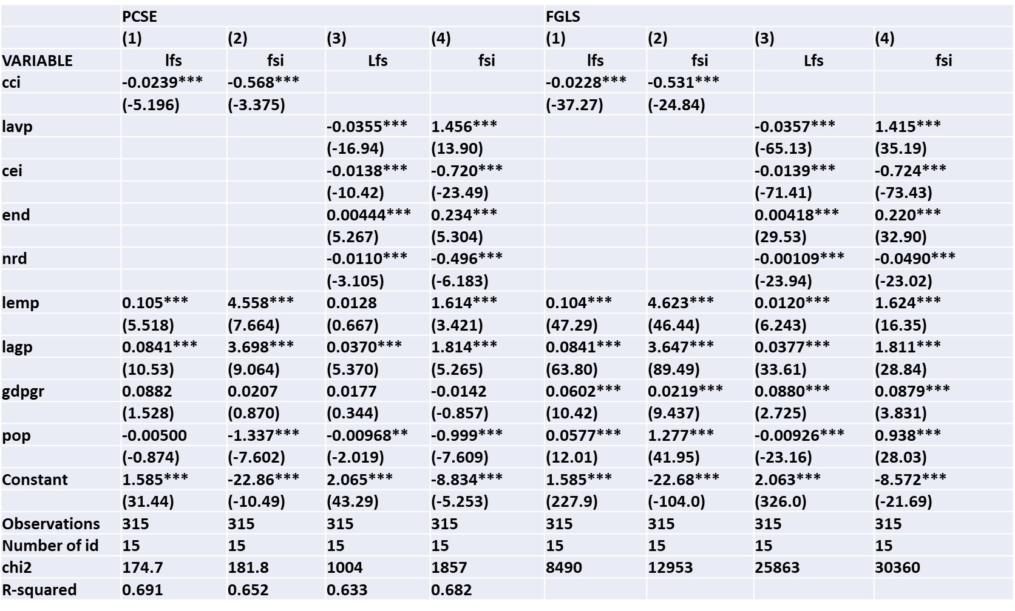
Results

Slide 9
Key Findings
The findings from PCSE reveal that climate change index has a negative effect on food security (FS) proxied by average dietary energy supply adequacy in West Africa.
The findings show that changes in precipitation patterns, including both droughts and floods, negatively impact food security.
High carbon emissions contribute to global warming and climate change, negatively impacting food security.
Also, the study reports that depletion of natural resources undermines agricultural productivity and sustainability, thus reduces food security.
The findings reveal that rapid population growth strains food systems and resources, negatively impacting food security.

Slide 10
Key Findings
However, the finding reveals that climate change measured by energy depletion (END) has positive effect on food security (FS) in West Africa. This indicates a shift towards more sustainable energy practices, reducing reliance on non-renewable resources.
The findings buttress the conclusion from the literature that higher employment in agriculture supports food production and availability, thereby increases food security.
Lastly, GDP growth and agricultural productivity (AGP) have positive effects on food security (FS) proxied by average dietary energy supply adequacy in West Africa

Slide 11
Key Findings
However, the finding reveals that climate change measured by energy depletion (END) has positive effect on food security (FS) in West Africa. This indicates a shift towards more sustainable energy practices, reducing reliance on non-renewable resources.
The findings buttress the conclusion from the literature that higher employment in agriculture supports food production and availability, thereby increases food security.
Lastly, GDP growth and agricultural productivity (AGP) have positive effects on food security (FS) proxied by average dietary energy supply adequacy in West Africa

Slide 12
Results of Dumitrescu-Hurlin Non-Granger Causality
Table 5: Results of Dumitrescu-Hurlin Non-Granger Causality
*** p<0.01, ** p<0.05, * p<0.1
Variable | Nigeria | Benin | Burkina Faso | Cabo Verde | Gambia | Ghana | Guinea | Guinea-Bisau | Cote d’Ivoire | Mali | Mauritania | Niger | Senegal | Sierra Leone | Togo
Nigeria | ------- | 0.724 | 0.530 | 0.080 | 3.752** | 0.456 | 1.774 | 2.323 | 1.614** | 10.63** | 1.926 | 0.792 | 1.858 | 2.309 | 0.041
Benin | 4.977** | ------- | 0.977 | 11.009** | 0.145 | 3.925** | 0.056 | 3.718* | 1.059 | 1.167 | 4.073** | 0.470 | 1.718 | 4.381** | 2.169
Burkina Faso | 5.248** | 1.555 | ------- | 15.58*** | 0.0134 | 3.905** | 2.693 | 4.733** | 0.964 | 1.676 | 5.456** | 3.529* | 0.048 | 10.379** | 1.384
Cabo Verde | 3.323* | 1.749 | 0.662 | ------- | 3.140* | 1.055 | 2.170 | 1.822 | 1.682 | 12.91** | 1.025 | 0.311 | 0.942 | 1.180 | 0.004
Gambia | 0.337 | 2.567 | 1.132 | 4.277** | ------- | 2.117 | 1.911 | 6.946** | 0.759 | 1.653 | 0.538 | 0.450 | 6.058** | 2.729* | 0.724
Ghana | 3.201* | 0.891 | 1.081 | 7.539** | 0.079 | ------- | 0.064 | 3.769** | 0.472 | 0.252 | 2.529 | 0.145 | 1.352 | 2.667 | 10.17**
Guinea | 0.114 | 3.787** | 0.300 | 3.814** | 0.440 | 4.539** | ------- | 1.622 | 2.943* | 0.269 | 0.395 | 0.185 | 2.009 | 1.900 | 4.356**
Guinea-Bisau | 4.271** | 0.272 | 0.333 | 3.340* | 1.369 | 8.437** | 2.401 | ------- | 1.053 | 4.560* | 1.221 | 0.456 | 4.816** | 0.762 | 0.349
Cote d’Ivoire | 1.369 | 4.708** | 0.155 | 1.232 | 0.409 | 2.996* | 5.506** | 0.282 | ------- | 2.657 | 0.026 | 2.905 | 3.751** | 1.256 | 0.226
Mali | 4.485*** | 3.848** | 3.332* | 10.92** | 8.185** | 0.738 | 1.274 | 6.895*** | 2.484 | ------- | 14.48** | 1.053 | 0.727 | 10.84*** | 0.473
Mauritania | 5.809** | 0.019 | 10.001*** | 14.13*** | 1.223 | 0.228 | 0.139 | 7.508** | 5.190** | 0.538 | ------- | 1.212 | 0.673 | 2.852* | 1.285
Niger | 12.32*** | 1.321 | 0.291 | 5.311** | 0.091 | 3.874** | 1.139 | 2.352 | 4.403** | 0.512 | 3.652* | ------- | 3.056* | 0.794 | 3.131*
Senegal | 8.992*** | 2.713 | 0.170 | 5.526** | 0.814 | 10.93** | 1.876 | 7.18*** | 1.640 | 0.363 | 4.401** | 0.054 | ------- | 1.318 | 10.55**
Sierra Leone | 1.898 | 0.391 | 1.360 | 7.061** | 1.939 | 0.848 | 0.468 | 5.556** | 0.631 | 2.937* | 9.256** | 0.744 | 0.938 | ------- | 0.341
Togo | 0.199** | 1.001 | 0.901 | 9.555** | 0.214 | 2.001 | 0.351 | 3.955** | 1.347 | 0.892 | 5.985** | 2.859* | 1.964 | 0.928 | -------

Slide 13
Conclusion
Table 5: Results of Dumitrescu-Hurlin Non-Granger Causality
*** p<0.01, ** p<0.05, * p<0.1
The findings indicate that climate change adversely affects food security across the region.
Conversely, agricultural employment, productivity, and GDP growth positively influence food security, while population growth presents additional challenges.
The study also highlights the interdependence of food security among West African nations, with significant spillover effects observed. Countries like Niger, Guinea, Burkina Faso, and Mali show self-sufficiency in food production, whereas Nigeria, Cabo Verde, and Guinea-Bissau are heavily reliant on food imports.

Slide 14
Recommendations
Table 5: Results of Dumitrescu-Hurlin Non-Granger Causality
*** p<0.01, ** p<0.05, * p<0.1
Policymakers should establish robust early warning systems and emergency response mechanisms to address climate change and food crises promptly.
Second, strengthening regional trade agreements and cooperation through bodies like ECOWAS to ensure smooth cross-border food supply chains and reduce dependency on external markets is necessary.
Governments and stakeholders in import-dependent West African countries Such as Nigeria should provide targeted support to smallholder farmers through access to finance, markets, and agricultural inputs by developing microfinance programs, establishing cooperative societies, and offer training programs

Slide 15
Thank you!
ahmedshina8@gmail.com

