Slide 1


Framework for Leveraging Land Information Systems for Climate Change Prediction: Spatial Analysis of Land Tenure and Land Use Patterns in Africa Authors: Alani Jimmy (Uganda) Mivule Joseph(Uganda) Oput Richard (Uganda) Toko Godfrey (Uganda)

Slide 2

Presentation Outline
Introduction
Background: Land, Climate, and Information Systems
Case Study: Uganda’s National Land Information System (UgNLIS)
Proposed Framework for Leveraging LIS in Climate Prediction
Lessons Learned
Scalability Across Africa
Key Takeaways & Closing

Slide 3
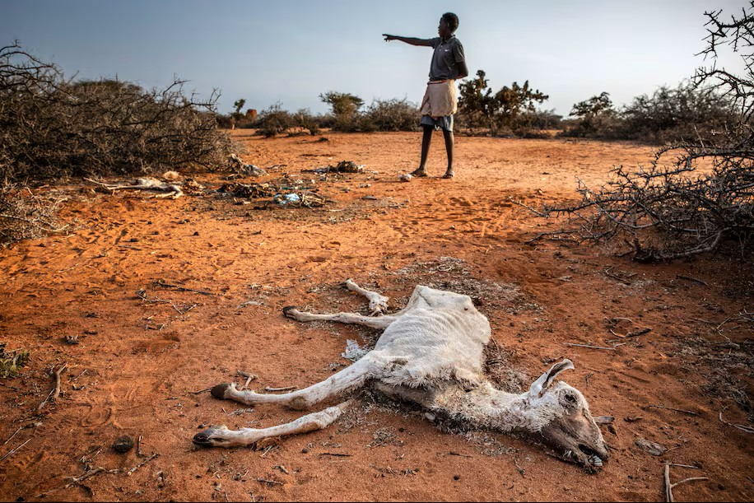
Introduction
Africa faces rising temperatures, erratic rainfall, and extreme weather threatening key ecosystems.
Insecure land tenure and poor land use intensify climate vulnerability.
Land Information Systems (LIS) integrate spatial, tenure, and environmental data.
Linking LIS with climate data strengthens prediction, mitigation, and resilience.
Uganda’s National Land Information System (UgNLIS) serves as a case study for this framework
man stands near the carcass of a dead goat in an area heavily affected by drought near Doolow, Somalia, in June 2022. (Luis Tato for The Washington Post)
Notes:
Africa faces severe climate impacts — rising temperatures, erratic rainfall, and extreme weather threaten agriculture, water, and forests.
Communities dependent on natural resources are increasingly vulnerable
Land tenure and use play a critical role: insecure tenure limits sustainable practices, while poor planning drives deforestation and degradation.
Land Information Systems (LIS) offer a transformative opportunity to integrate spatial data into climate prediction and adaptation.
LIS combine digital cadastres, geospatial land databases, and analytics on tenure, ownership, and land use.
When linked to environmental data, LIS enhance climate modeling, support mitigation, and build resilience.
This paper presents a framework for leveraging LIS in climate change prediction, with Uganda’s National Land Information System (UgNLIS) as a case study.

Slide 4
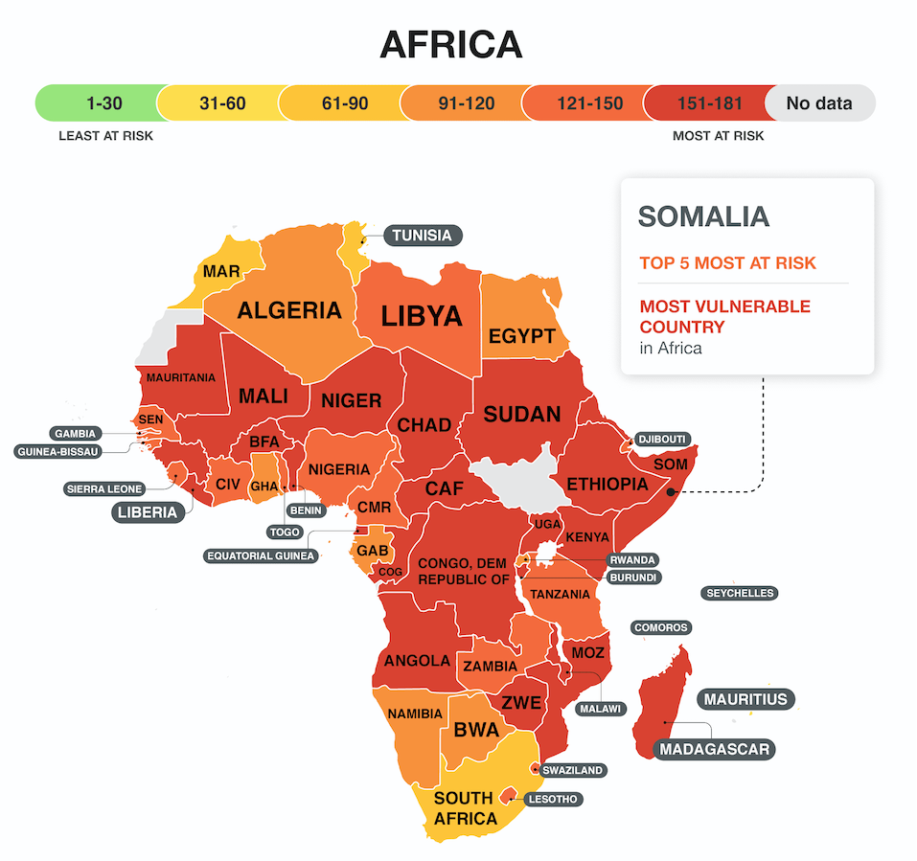
Background: Land, Climate. and Information Systems
Climate Change and Land Use in Africa
Agriculture supports 60–80% of livelihoods in Sub-Saharan Africa but is highly climate-sensitive.
Unsustainable practices (shifting cultivation, overgrazing, wetland loss) worsen degradation and reduce carbon storage
Secure land tenure and evidence-based governance are key to adaptation and mitigation
Countries most likely to survive climate change map

Slide 5
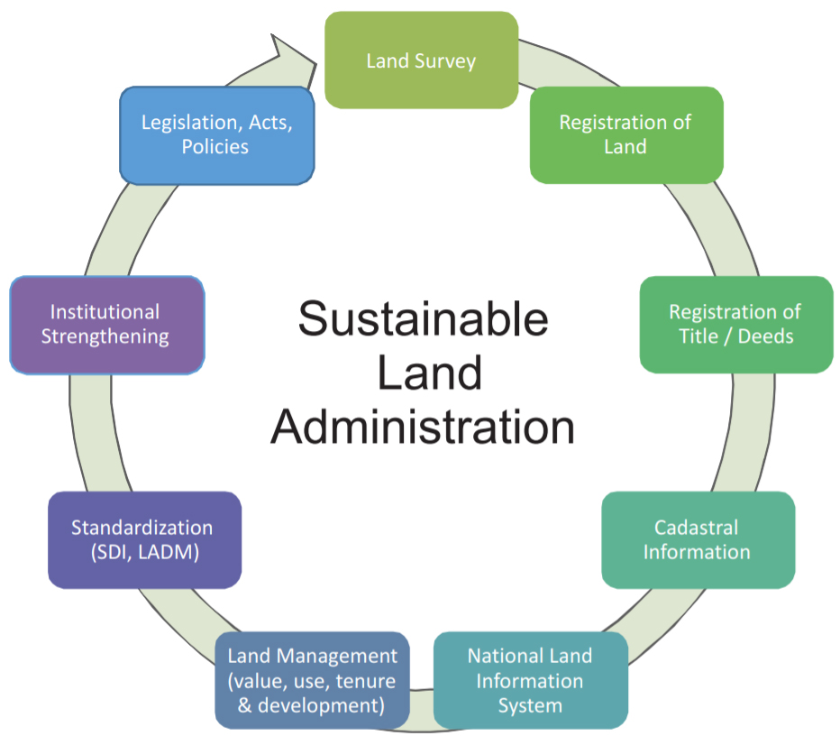
Background: Land, Climate. and Information Systems
Land Information Systems (LIS) in Context
LIS integrate data on land tenure, rights, and use for transparent, data-driven management.
In Africa, LIS enhance transparency, reduce fraud, and modernize land administration.
When aligned with climate goals, LIS can:
Monitor land cover changes
Identify vulnerable ecosystems.
Support land use modeling.
Integrate hydrological and climate data for prediction.

Slide 6
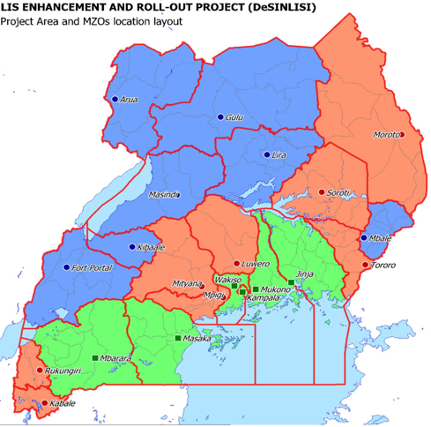
CASE STUDY: UGANDA’S NATIONAL LAND INFORMATION SYSTEM
Development and Evolution:
Originated from DeSILISoR pilot (2010–2013); scaled nationally (2015–2020)
Provides a digital platform for land tenure, registration, and cadastral.
Integrates service centers, digitized titles, and geospatial layers on land use and cover.

Slide 7

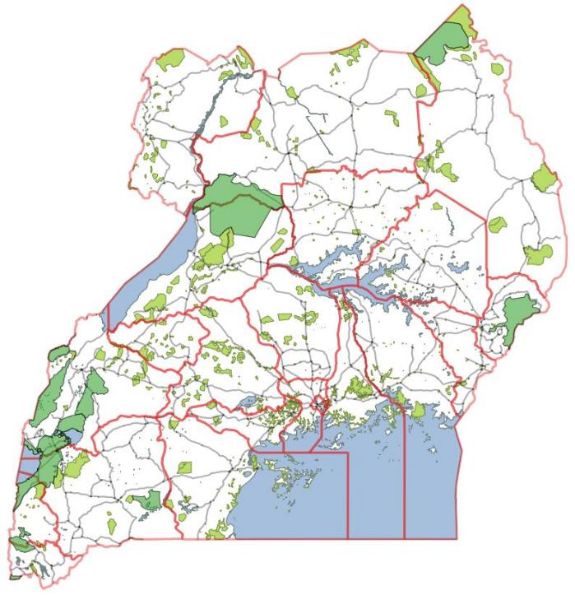
LIS Phase 1 (2010-2013)
Kampala
Wakiso
Mukono
Jinja
Masaka
Mbarara
LIS Phase 2 (2015-2020)
Lira
Kabarole
Kibaale
Arua
Gulu
Masindi
Mbale
Mpigi
Rukungiri
Kabale
Mityana
Luwero
Soroti
Tororo
Moroto
Wakiso 2
Development and Evolution:

Slide 8



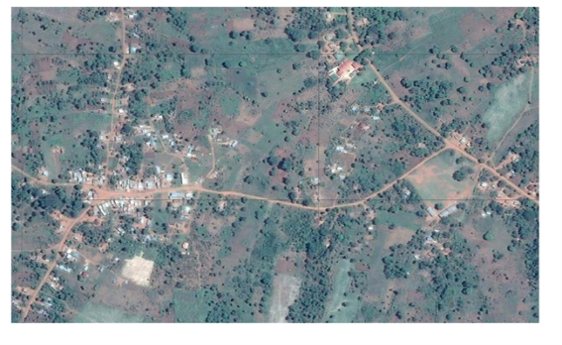
CASE STUDY: UGANDA’S NATIONAL LAND INFORMATION SYSTEM
Climate Change Relevance of UgNLIS:
Land cover change monitoring: Orthophotos + cadastral data track deforestation and agricultural expansion.
Carbon sequestration mapping: Tenure-linked maps estimate carbon storage potential
Scenario modeling: Land data support predictive models on land use and climate variability
Governance: Secure tenure promotes sustainable land management practices

Slide 9
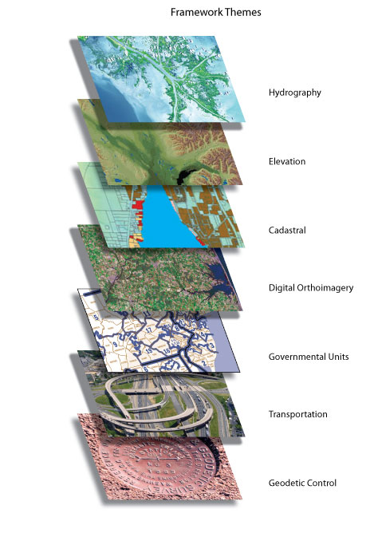

CASE STUDY: UGANDA’S NATIONAL LAND INFORMATION SYSTEM (UGNLIS)
Challenges and Opportunities:
Challenges
Data gaps and limited interoperability
with environmental systems.
Insufficient technical capacity.
Weak policy and institutional integration.
Opportunities
Integrate hydrological and
meteorological datasets.
Foster community participation
and local data validation.
Scale UgNLIS lessons to other
African countries

Slide 10
Conceptual diagram of UgNLIS structure and climate change linkage
Uganda National Land Information system (UgNLIS)
Cadastre & Titles, Tenure/Restrictions,
Meteorology & Hydrology (Rainfall, Temperature, Discharge)
Orthophotos,Remote sensing (Landsat/Sentinel, LULC, NDVI)
Decision Services & Portals
Dashboards, Planning Tools, Reports, Community Feedback, APIs
Analytics & Modeling.
LULU Change, Carbon/Emisions. Erosion/flood Risk
Suitability, Early Warning
Socioeconomic & Field Data (Census, Surveys, Soil, Yield)

Slide 11
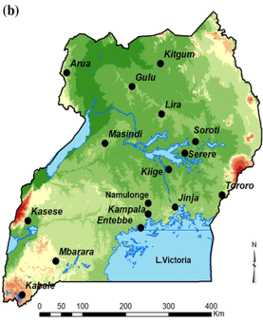
Proposed Framework for Leveraging LIS in Climate Prediction
Land Information Systems (LIS) in Context
Builds on Uganda’s UgNLIS experience, adaptable across Africa.
Framework rests on four key pillars:
Data Infrastructure
Stakeholder Engagement
Policy & Institutional Alignment
Capacity Building

Slide 12
LIS Integration with climate data Sources

Slide 13
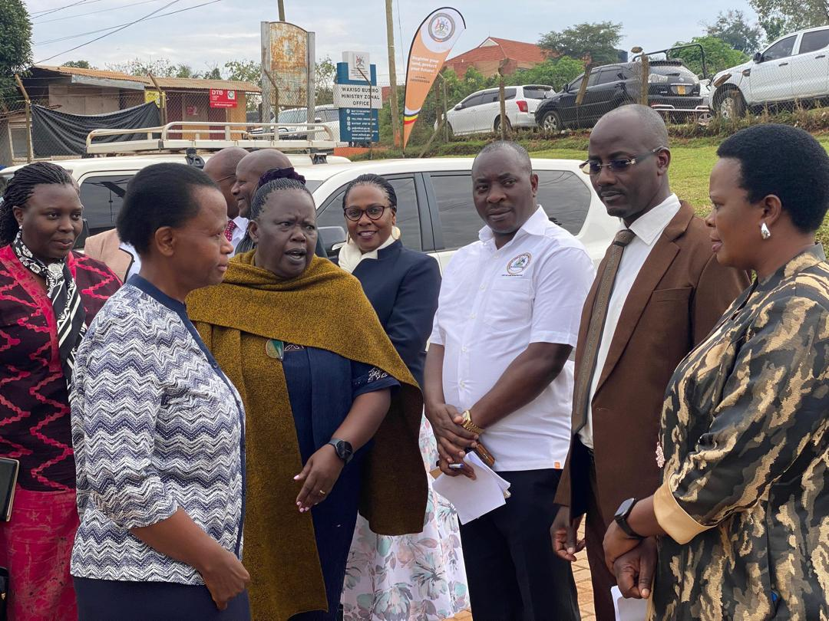
Pillar 1- Data Infrastructure
Develop interoperable LIS platforms integrating:
Orthophotos, cadastral, meteorological, hydrological, and remote sensing data
Adopt open standards and APIs to enable cross-sectoral data sharing
Pillar 2 - Stakeholder Engagement
Involve government, academia, civil society, and communities.
Create multi-stakeholder data governance boards for legitimacy and inclusivity
Pillar 1 and Pillar 2

Slide 14
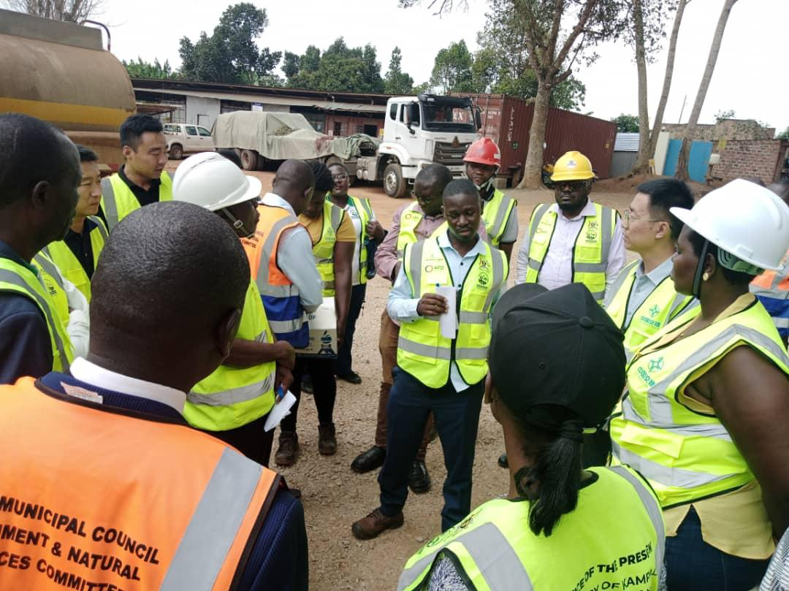
Pillar 3- Policy & Institutional Alignment
Embed LIS within national climate adaptation plans and land policies.
Align with AU Climate Change Strategy and Agenda 2063 objectives.
Pillar 4 - Capacity Building
Train land administrators, climate scientists, and local authorities in geospatial tools
Establish regional centers of excellence for LIS–climate integration.
Pillar 3 and Pillar 4

Slide 15
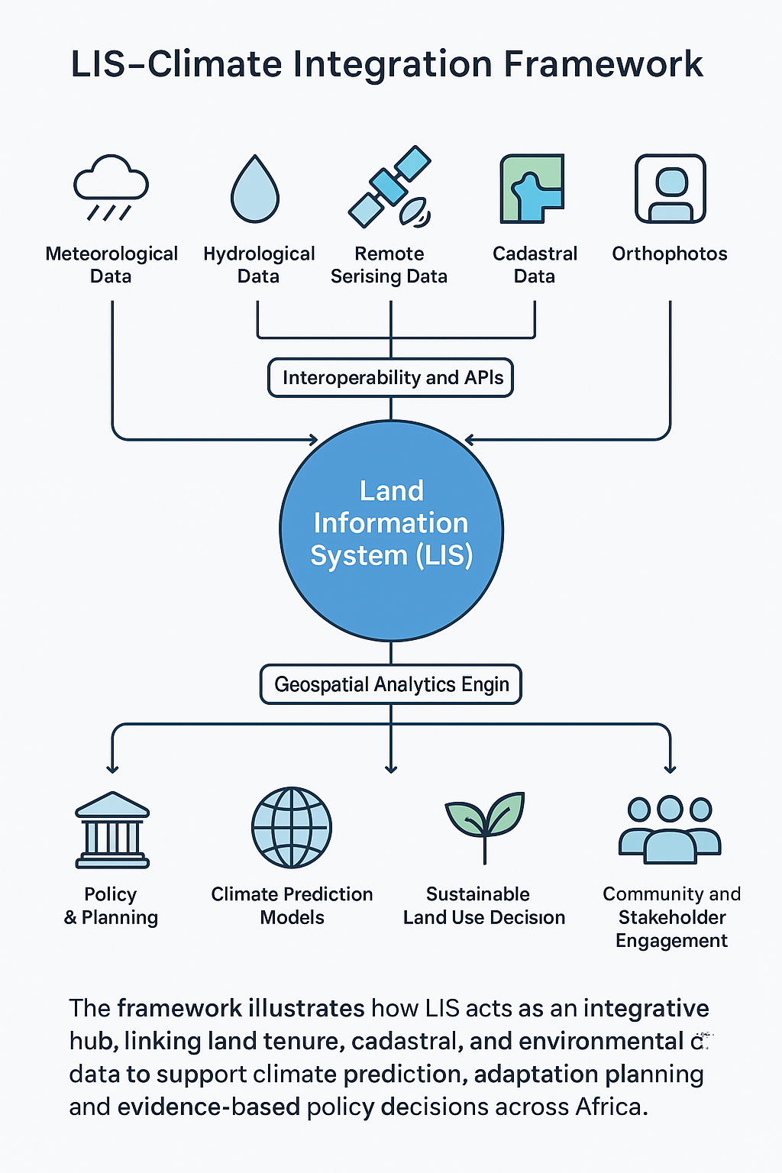
LIS as Climate Infrastructure
LIS should be viewed not just as land governance tools, but as climate infrastructure
They provide reliable, spatially disaggregated data essential for:
Climate modeling
Resilience planning
Evidence-based decision-making
Lessons Learnt

Slide 16

Artificial Intelligence (AI): Enables predictive modeling of land use and climate impacts.
Cloud GIS: Facilitates scalable, real-time data management and analysis
Together, these technologies can enhance the precision, accessibility, and responsiveness of LIS for climate action
Integration with Emerging Technologies

Slide 17
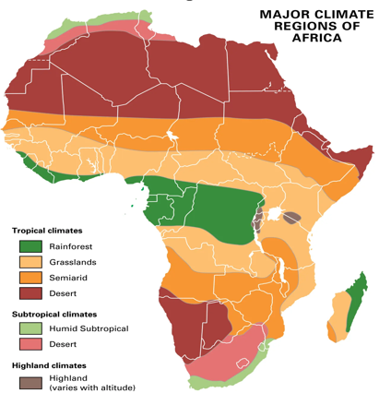
Conclusion
Leveraging LIS for climate prediction and resilience is feasible and essential.
Uganda’s UgNLIS shows how spatially enabled land governance supports adaptation, mitigation, and informed decisions
The proposed framework guides African nations in integrating LIS through:
Interoperable data systems
Stakeholder engagement
Policy alignment and Capacity building
LIS investment, collaboration, and knowledge-sharing are key to a climate-resilient Africa

Slide 18
Asanteni sana!

