Slide 1




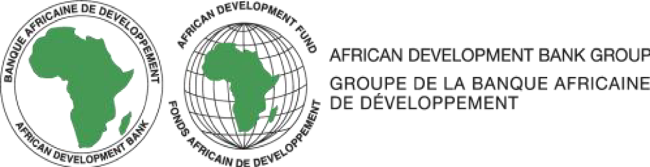

DISPLACEMENT AND LAND GRABBING IN PLATEAU STATE, NIGERIA: The Impact of Crises on Internally Displaced Persons and the Urgency of Land Justice
OLU-SILAS Rahila Amosha
Plateau State Internal Revenue Service,
Jos, Plateau State, Nigeria
SILAS Olugbenga Akindele
University of Jos,
Jos, Plateau State, Nigeria

Slide 2
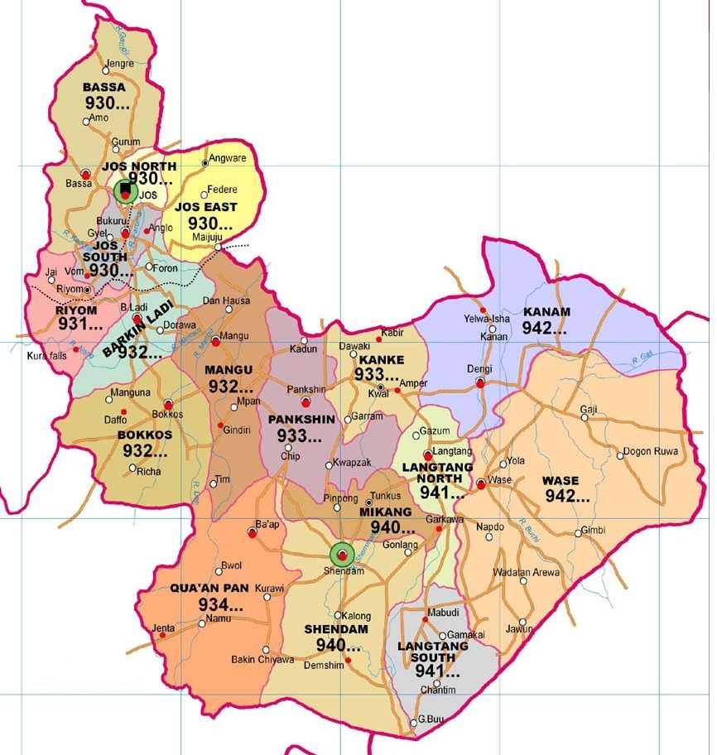
PLATEAU STATE, NIGERIA
Geopolitical Zone
North Central
Capital City
Jos
Land Mass
30,193 km²
Estimated Population
Over 4 million as at 2022
Local Government Areas
17 – Jos North, Jos South, Jos East, Bassa, Bokkos, Mangu, Barkin Ladi, Riyom, Pankshin, Kanke, Kanam, Wase, Shendam, Mikang, Langtang North, Langtang South, Qua’an Pan.
Slogan
Home of Peace and Tourism
Notes:
Plateau State also has over 40 ethno-linguistic groups including Berom, Tarok, Afizere, Anaguta, Bogghom, Jarawa, Mwaghavul, Ngas, Bijim, Buji, Irigwe, Jukun, among others.

Slide 3
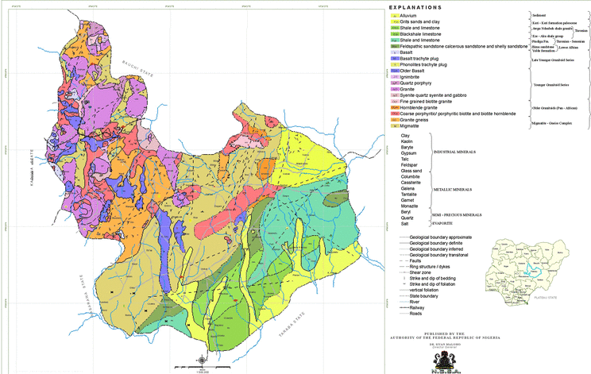
STUDY AREA: EPICENTRES OF VIOLENCE AND DISPLACEMENTS
The crises in Plateau State have been particularly devastating in Bokkos, Mangu, Barkin Ladi, and Riyom Local Government Areas (LGAs).
The Geological Map of Plateau State highlights the richness of these LGAs in fertile soil and mineral resources such as Tin, Columbite, Lead, Zinc, Marble, Granite, Iron Ore, Kaolin, Barite, Bauxite, Bismuth, Cassiterite, among others.
These LGAs have thus become epicentres of reoccurring violent attacks, mass displacement and systematic violent land grabbing.
Notes:
From Home of Peace to Crisis: Plateau State has become an epicentre of reoccurring violent attacks, mass displacement, and systematic violent land grabbing over the past two decades. These are not random clashes but deliberate strategies of territorial conquest that have killed thousands, displaced nearly 30,000 people and destroyed properties worth billions of Naira.

Slide 4
METHODOLOGY
This study employed a qualitative, multi-method research design.
Data were collected through 57 in-depth interviews with IDPs, community leaders, traditional rulers, government officials, security operatives, elder statesmen, advisory groups, and civil society representatives.
Fieldwork was concentrated in Bokkos, Mangu, Barkin Ladi and Riyom LGAs, reflecting the disproportionate impact of displacement and land grabbing in these areas.

Slide 5
RESULTS
Primary Actors
77.19% of respondents identified armed Fulani militias as the main perpetrators of violent attacks that led to land seizures.
Forceful Takeover
Current Occupants
63.16% indicated that Fulani herders remain the current occupants of seized lands.
57.89% confirmed that ancestral land and properties were forcefully taken over.
Notes:
Respondents reported prolonged displacement, often spanning several years, with families unable to return due to the continued occupation of ancestral lands. These findings are consistent with national-level critiques of Nigeria’s dual tenure system under the Land Use Act (1978), which has created contradictions between statutory and customary land management.

Slide 6

CULTURAL ERASURE: THE RENAMING OF COMMUNITIES
A striking pattern is the renaming of occupied communities by invading groups—a deliberate act to reinforce territorial claims and erase indigenous identity. Approximately 25 communities were renamed.
Bokkos LGA
Mangu LGA
Barkin Ladi LGA
Hokk and Kadim Kassa renamed Sabon Bauchi;
Changal renamed Changal Fulani;
Dogo Nahawa, Dyen, Kazok, Sharun, Gashet, Rantis, Kubon, Gashish District, Ruku and Njor were either renamed or fully taken over.
Riyom LGA
Rankum in Jol Ward renamed Mahanga I.
Kadim Bisa renamed Sabon Nawola;
Others affected include Doho, Metzet, Yilbur, Sangar, Vokurde, Dungram and Dulu.
Kumbili renamed Kumbili Fulani;
Rankum renamed Mahanga II;
Washna renamed Washna Fulani.
Notes:
This phenomenon mirrors global patterns of conflict-driven toponymy documented in Bosnia, Palestine, and South Sudan, where renaming is deployed as a strategy of cultural displacement and identity erasure.

Slide 7
THE MULTI-DIMENSIONAL IMPACT ON IDPs
The consequences of land grabbing are devastating, extending beyond immediate humanitarian needs to systemic economic and psychological trauma.
Health and Security
Increased exposure to violence, sexual abuse (especially women/girls) and waterborne diseases due to poor camp conditions.
Education Disruption
Children’s access to schooling is severely limited, jeopardising future prospects.
Economic Disempowerment
Loss of primary income (farming and mining) forces IDPs into low-wage, insecure urban jobs, leading to massive drop in household income
Perpetual Poverty
Loss of farmland and mining sites – the core assets – prevents wealth accumulation and perpetuates the cycle of poverty.
A durable solution requires a shift to a comprehensive framework of land justice and reparations, not just temporary aid.

Slide 8
LEGAL FRAMEWORKS: CONFLICT AND INADEQUACY
Nigeria’s land governance is complicated by the Land Use Act (LUA) of 1978, which conflicts with customary tenure systems.
The Land Use Act (1978)
Vested all land in the State Governor, held in trust for the people.
Abolished perpetual ownership, replacing it with a limited 99-year leasehold (Certificate of Occupancy).
Plateau State Anti-Land Grabbing Law (2020)
Mandates the return of seized lands and holds complicit officials/traditional rulers accountable.
Despite its strength, enforcement is weak: over 64 communities remain illegally occupied and renamed.
Created legal pluralism: customary ownership (informal) is vulnerable to statutory challenge.
The bureaucratic process for Certificate of Occupancy hinders the rural poor and encourages corruption.
Landmark law criminalising land grabbing with stringent penalties (up to 21 years or death).
Lack of prosecutions suggests that the law remains largely symbolic rather than transformative.

Slide 9
COMPARATIVE LESSONS FOR LAND JUSTICE
International examples show that dedicated institutions and recognition of customary rights are vital for effective restitution.
Plateau State Anti-Land Grabbing Law (2020)
Criminalises land grabbing with severe penalties (21 years, death if armed).
Mandates return of seized lands; demolition of illegal structures.
Gujarat Land Grabbing (Prohibition) Act (2020, India)
Criminalises land grabbing and provides special tribunals to adjudicate cases.
Mandates return of land and allows fast-track enforcement through tribunals.
Uganda – Customary Tenure Recognition (Land Act 1998 & Reforms)
Recognises customary tenure as legally valid; integrates local land councils into statutory systems.
Shows the importance of empowering local institutions by recognising customary tenure.
Establishes a Joint Task Force but poorly resourced.
Progressive in criminalisation but largely symbolic without restitution or enforcement.
Establishes special tribunals and special courts for land grabbing disputes.
Shows the importance of dedicated specialised tribunals/courts for institutional autonomy and fast-tracking cases.
Provides communities with Certificates of Customary Ownership (CCOs); formal recognition of customary rights.
Establishes Local Land Committees to validate and enforce customary tenure at community level.

Slide 10
LAND REFORMS IN OTHER JURISDICTIONS
Rwanda
- Adopted a radical land reform agenda centred on systematic Land Tenure Regularization (LTR) following the 1994 genocide.
Liberia
- Gradual land reform approach after civil wars.
South Africa
Mozambique
- Land Law of 1997 guarantees community land rights under the principle of “Direito de Uso e Aproveitamento da Terra” (DUAT).
- Significantly reduced land disputes between 2010 and 2013 by registering over 10.3 million parcels.
- Experimented with land sharing and villagisation to resettle returnees and divide contested lands.
- Focused on policy, law reform and rebuilding government capacity.
- Land Rights Act of 2018 formally recognised customary land rights and established a five-step process for communities to secure land tenure.
- Restitution of Land Rights Acts (1994) created the Commission on Restitution of Land Rights and the Land Claims Court.
- Individuals and communities dispossessed under apartheid lodged land claims resulting in restitution of the land itself or compensation.
- Slow implementation due to resource constraint; but reframed restitution as a matter of justice rather than charity.
- Rights are not extinguished by absence during displacement, enabling returnees to reclaim land post-conflict.
- Ensured that returnees could reclaim their lands without losing rights due to prolonged absence.

Slide 11
GLOBAL IMPERATIVE FOR LAND JUSTICE
International and African Union frameworks stress that displacement without restitution entrenches injustice and destabilises communities.
African Union (AU)
Framework and Guidelines on Land Policy in Africa urges member states to protect vulnerable rights and recognise customary tenure.
United Nations (UN)
Voluntary Guidelines on the Responsible Governance of Tenure (VGGT) specifically calls for remedies and restitution in cases of dispossession.
Key Actionable Insights
Prioritise land-for-land restitution over cash-only compensation.
Ensure displacement does not extinguish ancestral rights.
Grant statutory legitimacy to communal land rights.
Frame restitution as a legal right, not a relief measure.
Strengthen enforcement through institutional restitution mechanisms – land restitution tribunal or commission.

Slide 12
CONCLUSION
The crisis in Plateau State is a profound question of justice.
In Bokkos, Mangu, Riyom, and Barkin Ladi, violent invasions have led to the seizure and renaming of ancestral communities, displacing tens of thousands and erasing cultural identities.
The persistence of this crisis underscores the failure of Nigeria’s existing frameworks—most notably the Land Use Act (1978) and the 1999 Constitution—to protect vulnerable populations from dispossession.
The Plateau State Anti-Land Grabbing Law (2020) represents an important recognition of the problem, yet its weak enforcement highlights the gap between law and lived realities.
A durable solution requires a fundamental shift from reactive security to a proactive, system-oriented strategy focused on land justice and reparations.
Without confronting the land question, displacement will persist, development will falter, and peace will remain elusive.

Slide 13
RECOMMENDATIONS
Reforming the Foundational Legal Framework
Amend or Remove the Land Use Act (1978) from the Constitution.
Strengthen the Plateau State Anti-Land Grabbing Law (2020).
Institutional Innovations
Automated Land Registry to reduce disputes and corruption.
Implementing a Reparation Framework for Dispossessed Communities
Government-led land restitution and titling.
Economic rehabilitation to restore livelihoods.
Improve rural infrastructure – accessible roads, GSM networks, technology adoption.
Explicitly prohibit renaming of seized communities to preserve cultural identity.
Independent Commission to oversee land restitution.
Integrate Customary Authorities to ensure legitimacy and accessibility.
Protecting IDP Rights
Guarantee land rights despite absence.
Equal restitution rights for women and youths.
Establish explicit legal guarantees preventing the permanent loss of IDP land rights.

Slide 14
SPONSORSHIP AND FUTURE PROSPECTS
FUNDING AND SPONSORSHIP
PREJUDICE
FUTURE PROSPECTS
This research has been privately funded, reflecting the authors’ personal commitment to advancing knowledge and advocacy on displacement and land justice in Plateau State. This however, constrained the scope of the study to select communities in the LGAs of interest. With funding and sponsorship, the authors aim to conduct similar studies to cover land grabbing issues in the entire 17 LGAs of Plateau State.
The study’s independent nature ensured that findings were free from political or institutional bias.
Looking forward, the authors aim to expand the impact of this research to cover land grabbing issues in the entire 17 LGAs of Plateau State through a documentary film project that will visually capture the experiences of displaced persons, the realities of land grabbing, and the urgent need for land justice in Plateau State. Such a documentary will serve as both an academic and advocacy tool, raising awareness at local, national, and international levels, and mobilising support for restitution and reform.

Slide 15
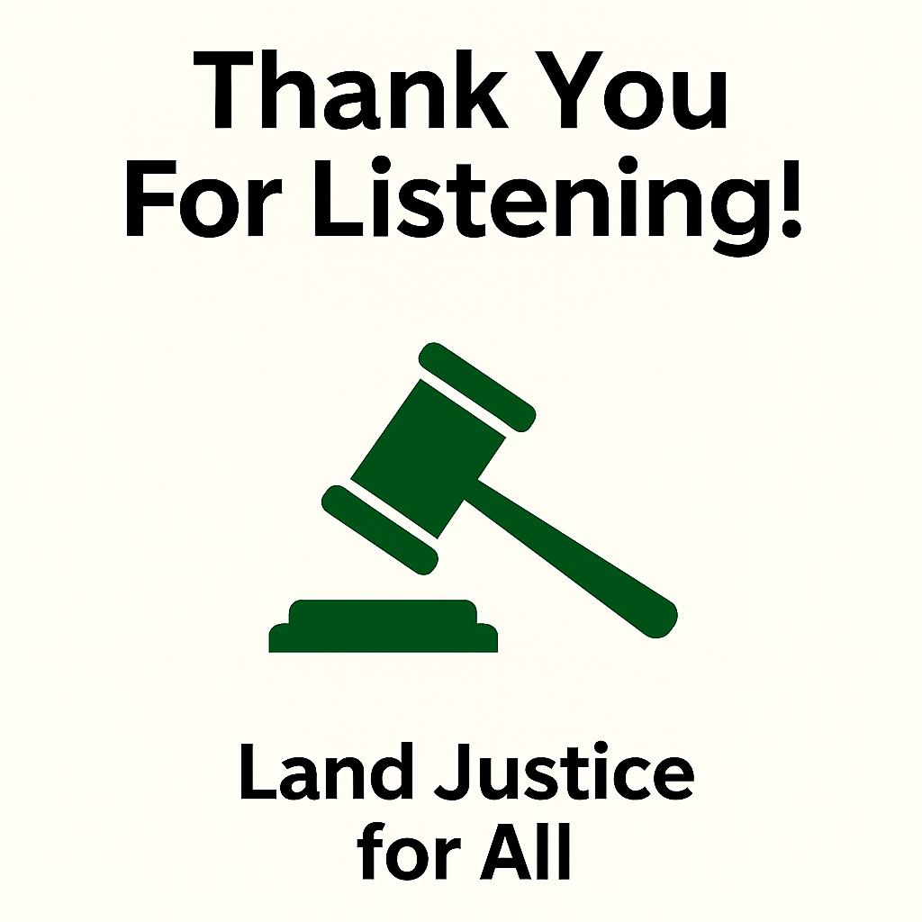
CONTACT US
OLU-SILAS Rahila Amosha
Plateau State Internal Revenue Service,
Jos, Plateau State, Nigeria
rahilaolusilas@gmail.com
SILAS Olugbenga Akindele
University of Jos,
Jos, Plateau State, Nigeria
drgbenga@yahoo.com

