Slide 1


The State of Spatial Justice in Namibia: An Assessment of Walvis Bay Aune Shikongo Namibia University of Science and Technology(NUST)

Slide 2
Content
Introduction
Objectives of the study
Conceptual Framework
Methodology
Findings
Recommendations
Conclusion

Slide 3
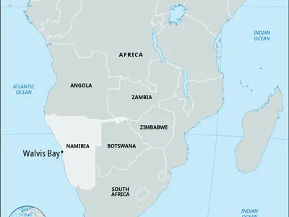
Introduction
Spatial justice refers to the fair distribution of spatial resources, opportunities, and rights across urban and rural landscapes (Kohima, et al., 2023).
Colonial and apartheid urban planning deliberately segregated African cities.
Post-independence policies across Africa have often failed to dismantle these inherited spatial inequalities.
Namibia’s urban geography was one of the most racially segregated under apartheid.
The spatial divide is still evident today , especially in Walvis Bay, Namibia’s principal port town.
Source: Google, retrieved October 20205

Slide 4
Namibian context
After independence in 1990 and Walvis Bay’s reintegration in 1994, Namibia sought to redress these inequalities.
Key policies included:
National Land Policy (1998) – equitable access to land as a basic right.
Flexible Land Tenure Act (2012) – to provide affordable, incremental ownership for low-income households.
Tutaleni Housing Project (2000s) – serviced plots with basic infrastructure to reduce informality.
Yet, these efforts have not fully transformed the urban divide.

Slide 5
Objectives of the Study
The study has three main objectives:
Analyse the persistence of apartheid-era spatial divisions in Walvis Bay’s current urban form.
Evaluate the role of Namibia’s land policies and governance structures in promoting or constraining spatial justice.
Propose policy recommendations that integrate a reparative justice lens into urban land governance.

Slide 6
Conceptual Framework
The study’s conceptual framework is built on the theory of spatial justice as advanced by Henri Lefebvre (1991) and Edward Soja (2010).
It connects the production of space, policy frameworks, and lived urban realities.
The framework situates Namibia’s urban development within broader debates on reparative and distributive justice.
It integrates three key dimensions:
Historical – apartheid spatial legacies that continue to shape settlement patterns.
Institutional – current land and housing policies (National Land Policy 1998, FLTA 2012, Draft Urban Land Policy 2025).
Socio-economic – access to land, services, and housing opportunities.

Slide 7
Methodology
The study adopted a qualitative research design to capture the depth and complexity of spatial injustice.
Case Study Approach: Walvis Bay was selected as a representative urban area reflecting Namibia’s colonial and post-independence dynamics.
Data Collection Methods:
Semi-structured interviews with municipal officials, community leaders, and residents.
Document review of national and local land policies.
Field observations in Kuisebmund, Tutaleni, and Meersig.

Slide 8
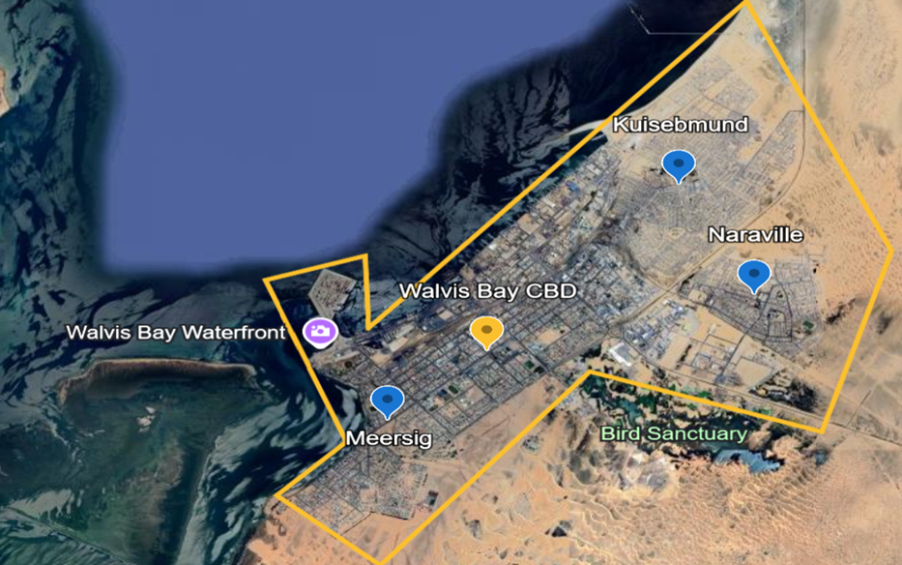
Findings – Historical Legacies and Urban Inequality
Apartheid spatial divisions persist almost three decades after independence.
Walvis Bay remains physically and socially segregated, with distinct neighbourhoods reflecting racialized planning:
Kuisebmund – densely populated, limited infrastructure, dominated by low-income and informal housing.
Narraville – middle-income, modest services.
Meersig & Lagoon Area – affluent, spacious plots, full municipal services.
Reintegration in 1994 did not dismantle inherited patterns of inequality; instead, new developments reinforced separation through market-driven planning.
Urban expansion has often occurred without addressing underlying spatial injustice.

Slide 9
Findings – Land, Tenure, and Infrastructure Challenges
Land Accessibility: Prime land near the coast remains prohibitively expensive.
Low-income residents are confined to peripheral areas with limited opportunity
Tenure and Housing: Backyard rentals have proliferated in Kuisebmund and Tutaleni — offering affordability but lacking tenure security and adequate services.
The Flexible Land Tenure Act (2012) has not been fully implemented, limiting secure land rights for informal residents.
Infrastructure Inequality:
Service delivery (water, sanitation, waste, roads) is heavily unequal.
Poor coordination between municipal departments delays infrastructure upgrades.
Result: Persistent inequality in access to housing and services reproduces spatial injustice.

Slide 10
Policy Recommendations – Advancing Spatial Justice in Namibia
The study highlights the need for a justice-oriented approach to urban land governance, moving beyond technical land delivery to redistributive transformation.
Key recommendations:
Develop a Spatial Reparations Framework – integrate justice and redress into urban policy to address historical spatial inequalities.
Formalize Backyard Rentals – introduce minimum service standards, tenure protection, and inclusion in municipal plans.
Inclusionary Housing Policy – require mixed-income developments to promote social integration.
Integrate Justice Indicators – embed equity measures within land information and monitoring systems.
Strengthen Governance Coordination – align land, housing, and infrastructure planning at municipal level.

Slide 11
Conclusion
Apartheid spatial patterns still shape Walvis Bay’s urban form.
Namibia’s policies show strong intent but weak implementation.
Achieving spatial justice means addressing historic exclusion and promoting equitable access to land and services.
Walvis Bay can lead by example, demonstrating how reparative planning can build inclusive and sustainable cities.

Slide 12
REFERENCES
Kohima, J. M., Chigbu, U. E., Mazambani, M. L., & Mabakeng, M. R. (2023). (Neo-) segregation,(neo-) racism, and one-city two-system planning in Windhoek, Namibia: What can a new national urban policy do?. Land Use Policy, 125, 106480.
Lefebvre, H. (1991). The production of space. Blackwell.
Soja, E. W. (2010). Seeking spatial justice. University of Minnesota Press.

Slide 13
Thank you!
Email: aushikongo@nust.na

