Slide 1


Revitalizing Zimbabwe’s Agricultural Economy after Fast Track land Reform: The Urgency of Enhanced Livelihoods
Charles Chavunduka, Magreth Mahuni and Patience Mazanhi
University of Zimbabwe

Slide 2
Introduction
Strong connection between land, livelihoods and economic progress
History of dispossession and marginalization of blacks into Native Reserves
Very successful white settler agriculture propped up (as in South Africa) by the government
A problematic duality: Zimbabwe had great economic success and wealth alongside extreme dispossession and poverty

Slide 3
Problem Statement
Since implementation of the FTLRP in 2000, significant decline in agricultural output
A large amount of white owned land returned to black families, but much of the land has remained underutilized
For good reasons the FTLRP dismantled white commercial agriculture but there seems to have been no effective strategy to replace what had been dismantled
Returning forcibly taken land to the dispossessed is necessary but not sufficient

Slide 4
Research Methodology
Case study design
Research question: How can Zimbabwe’s agricultural economy be revitalized following fast track land reform?
Data sources
  Empirical literature
  ZimStat
  UNFAO and World Bank publications

Slide 5
Findings
ESAP led to the abandonment of government support programmes at a time that land reform beneficiaries were left to swim or sink on the land they acquired
After 2000 Zimbabwe remained a net importer of cereals and other staple foods

Slide 6
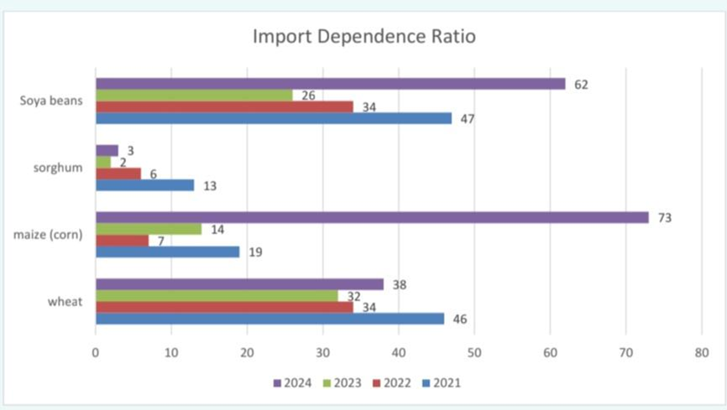
Import Dependence Ratio of top 4 available food items

Slide 7
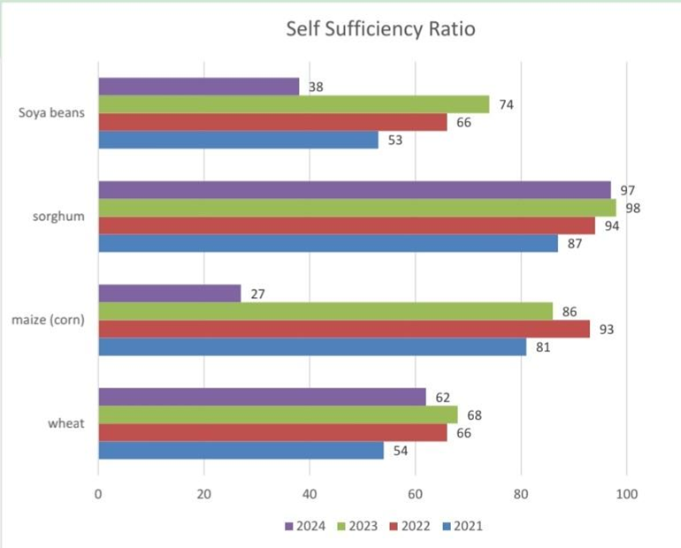
Self-sufficiency ratio of top 4 available food items

Slide 8
Necessary Corrective Action
Address incoherences in the agricultural policy environment e.g. unconditional titles, under designed agricultural programmes, price controls
Proactive state support for climate resilient systems because:
  Zimbabwe’s agriculture is highly vulnerable to climate shocks such as droughts and cyclones
  More than 55% of the country receives unreliable rainfall more regularly than ever before

Slide 9
Necessary corrective action
Partnership between the government and new farmers requires strengthening
  The government to provide institutional support so as to reduce production costs
  This can be achieved through investment in enablers of production such as affordable electricity, water supply, and fertilizers, and
  Organizing farmers into clusters

Slide 10
Necessary corrective action
Government has introduced title deeds in resettlement areas as a way of improving tenure security and access to credit
  This is an opportunity for the government to underwrite (collateralize) production credit
  However, it is advised that title deeds be not granted to newly settled farmers until after a set of pre-conditions have been met
  But this commitment must be matched by a similar commitment from the government for access to affordable capitalization and operational costs of the new farmers

Slide 11
Conclusion
Although the FTLRP disrupted established farming systems, it created opportunities for broader land ownership and rural empowerment
The way forward requires the government to capacitate beneficiaries into productive farmers
The government can designate some of the most productive agricultural lands as clusters for enhanced livelihoods
The outcome for Zimbabwe would be reduced import dependency for food

Slide 12
Thank you!
cchavunduka@eng.uz.ac.zw

