Slide 1




Urban Land Injustices and the Logic of Disposability: Land, Evictions, and Informality in Zimbabwe’s Cities Dr. Johannes I. Bhanye African Climate and Development Initiative (ACDI), University of Cape Town, South Africa Email: joebhanye@gmail.com

Slide 2
Why This Study Matters (Context)
Zimbabwe rapid urban growth + Scarce affordable serviced land
Informal housing & street economies = primary safety nets
Operation Murambatsvina (2005) displaced 700k+; set a template for future clearances
Since 2005: rolling micro-demolitions in Harare, Chitungwiza, Epworth, Mbare…Evictions framed as “sanitization”, “legality”, “risk mitigation” → colonial logics revived

Slide 3
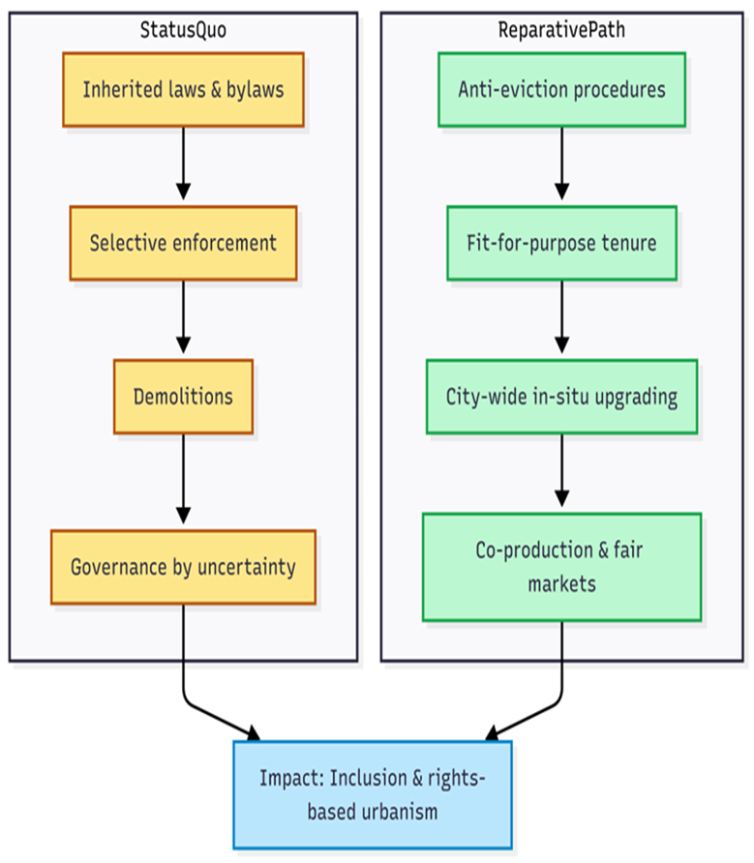
Research Aim & Questions
Aim: Reframe urban evictions as structural violence and spatial disposability, and chart a reparative policy path.
Objectives
Diagnose evictions as structural violence and necropolitics
Trace colonial → postcolonial continuities in planning law and practice
Propose a reparative urban-land framework: tenure, in-situ upgrading, participation, due process

Slide 4
Methodology
Approach: Critical socio-legal & urban political-economy
Sources: Peer-reviewed studies; UN/government reports; court judgments; municipal by-laws & notices; civil-society/media; public testimonies
Event catalogue (2005–2025): Date, legal basis, scale, due-process safeguards, alternatives offered (or not)
Analysis:
Concept-led coding (structural violence, necropolitics, disposability, right to the city)
Close reading of statutes/by-laws/judgments → enforcement pathways
Process tracing across cases to identify scripts (tolerate → purge; “clean-up” rhetoric; post-hoc promises)

Slide 5
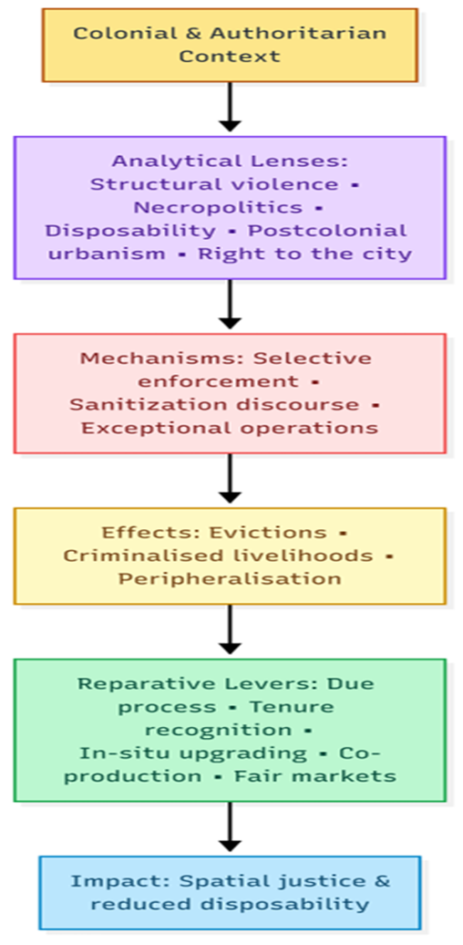
Theoretical Approach
Five Lenses (interlocking):
Structural violence (Galtung): bureaucratic harm via law/by-law/standards
Necropolitics (Mbembe): sovereign decision over who dwells/works; spectacle of demolitions
Logic of disposability (Bauman/Giroux): poor rendered surplus; erasure appears “reasonable”
Postcolonial urbanism (Simone/Myers): colonial orders endure; people improvise infrastructure
Right to the city (Lefebvre/Harvey): from control → co-production & redress

Slide 6
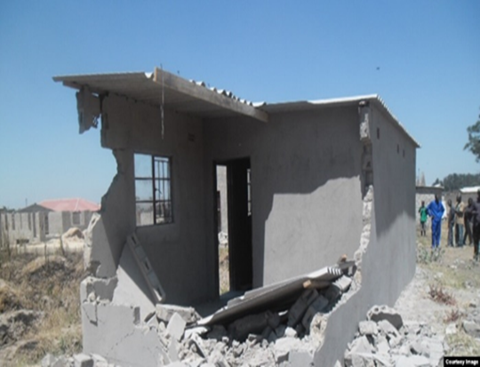
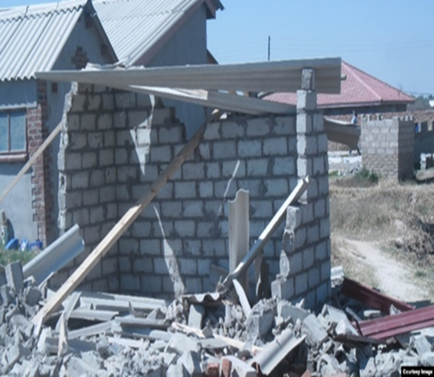
Finding 1: From Exception to Routine
Demolition normalized as a city-management tool since 2005
Selective enforcement of inherited planning laws/by-laws
Governed precarity: tacit toleration → sudden criminalization
Residents live “waiting to be removed”; minimal notice; poor relocation options
“Illegality” masks image-making and elite land consolidation
Case tags: Budiriro (2015; 2020–21), Mbare markets (2021–23), Chitungwiza (2014 raids; 2020 notices), Epworth (2012; 2025 threats).

Slide 7
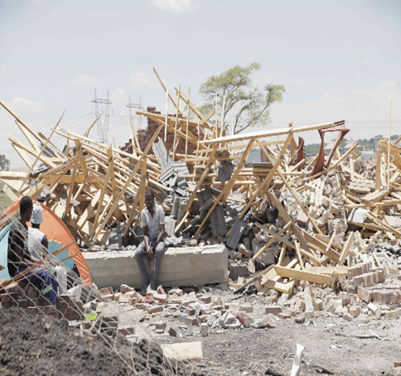
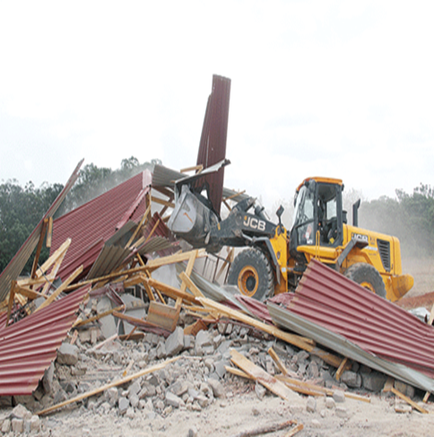
Finding 2: Politics, Patronage & Lawfare
Patronage urbanism: land access via party networks & “land barons”
Authorities collect fees/recognize settlements/markets, then later erase them
Lawfare: legality deployed strategically; extra-legal actions still occur
Jurisprudence turning point: High Court (2024) & Constitutional Court (Feb 2025) push for court orders & due process
Net effect: administrative ambiguity produces dependency & disposability

Slide 8
Finding 3: Human & Spatial Impacts
Housing loss → exposure, homelessness, family fragmentation
Livelihood destruction: vending/stalls cleared; asset confiscations
Gendered vulnerabilities; children’s schooling and health disrupted
Peripheralisation: relocation far from jobs/services; new unlivable zones
Lived testimonies: “We have nowhere else to go… this is our home.”

Slide 9
Reparative Urban-Land Framework (What To Do)
Legal & Institutional
Anti-eviction/due-process statutes: notice, meaningful engagement, court oversight, duty to provide feasible alternatives
Amend RTCPA: curb summary powers; recognize graduated tenure & reblocking
Tenure & Administration
Fit-for-purpose tenure continuum: occupancy certificates → leasehold/freehold
Participatory enumeration & STDM to rapidly record legitimate claims
Planning & Delivery
City-wide, multi-year in-situ upgrading pipelines; flexible service/plot standards
Livelihood-supportive markets: serviced trading bays, fair fees, protection from arbitrary confiscation
Co-production & Redress
Institutionalize neighbourhood forums, social audits, savings schemes
Targeted reparations: fast-track tenure near original sites, modest compensation for verified losses

Slide 10
Conclusion: From Bulldozers to Rights-Based Urbanism
Evictions in Zimbabwe = structural violence + necropolitical governance
Disposability is the value regime to dismantle
Reparative urbanism = tenure security, due process, co-produced upgrading, livelihood corridors
Call to action:
National government: legislate due-process & fund upgrading
Municipalities: end demolition-first; adopt city-wide in-situ programs
Judiciary: uphold timely remedies
Civic/academia/partners: enumerations, social audits, context-fit standards, long-horizon financing
Urban land justice means inclusion, security, and dignity. The benchmark is simple: no progress if people live waiting to be removed.

Slide 11
Thank you!
Your Email address

