Slide 1


ANALYSIS OF POST-GENOCIDE LAND-SHARING POLICIES AND THEIR IMPLEMENTATION IN RWANDA Jossam POTEL University of Rwanda

Slide 3
Background and Problem Statement
Brief background of Rwanda’s land governance and history
After the 1994 Genocide against the Tutsi, Rwanda faced challenges of reintegration, land disputes, and rebuilding cohesion.
Post genocide government view land reforms like land sharing and villagization as a main solution to address land grievances and restore social cohesion
Land was central to reconciliation efforts. It’s been over 2 decades since land reform started and implemented
Key responses: Land Sharing and Villagization (Imidugudu).
Gap in literature: Social implications of these reforms remain underexplored.
As many available literatures focus on institutional structures and legal framework but perception and its impacts on social cohesion remains unexplored

Slide 4
Research goal and Objectives
Critically examine how post-genocide land-sharing policies were designed, implemented, and experienced in Rwanda, focusing on their influence on social cohesion and perceptions of fairness.
Key objectives:
Analyze implementation of land-sharing and villagization in Kayonza and Gatsibo.
Explore perceptions of fairness among returnees, residents, and genocide survivors.

Slide 5
Theoretical Framework
Robert Putnam’s Social Capital Theory:
- Bonding capital (intra-group trust)
- Bridging capital (inter-group cooperation)
Used to assess how land policies influenced trust and cohesion.

Slide 6
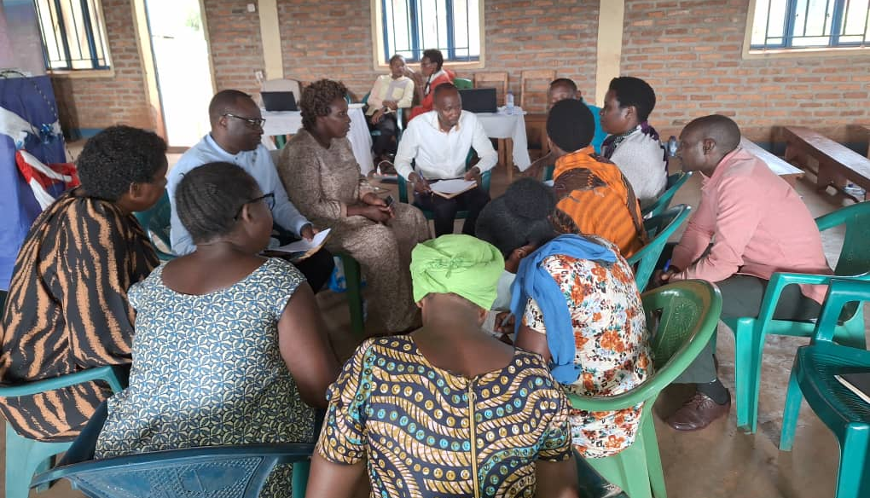
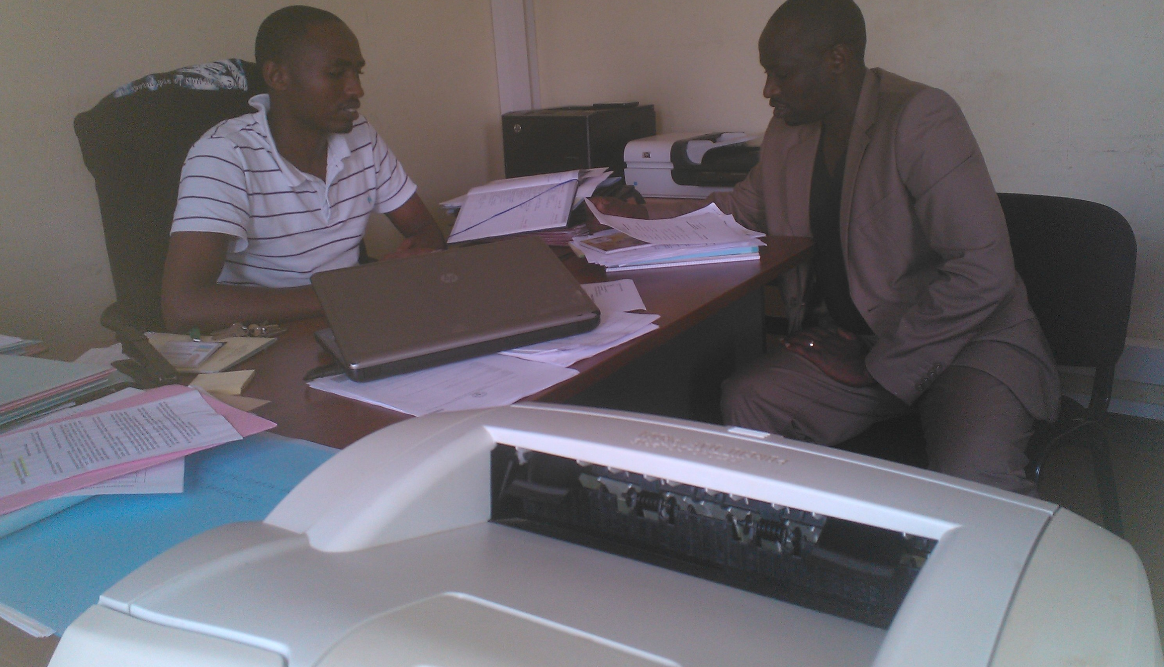
Research Approach
Qualitative case study (2023–2025)
- 18 Key Informant Interviews
- 32 In-Depth Interviews
- 8 Focus Group Discussions
Sites: Kayonza & Gatsibo
Design: Constructivist and Interpretivist

Slide 7
Discussion of Findings
State-led Land Reform Implementation

Slide 8
Findings On Implementation
Land sharing enabled peaceful resettlement but was perceived as abrupt and sometimes coercive.
Villagization improved services but disrupted livelihoods.
Local leaders played key roles in land mediation.

Slide 9
Perceptions of Fairness
Returnees saw land as restoration of identity.
Residents felt excluded or coerced.
Survivors viewed policies as unjust yet accepted them for peace.
Gendered exclusion noted.

Slide 10
Challenges Identified
Inequities in parcel size distribution.
Lingering mistrust and emotional trauma influenced local perceptions.
Some cases of favoritism/nepotism reduced trust.
Lack of consultation
Top-down implementation

Slide 11
Positive Outcomes
Facilitated reintegration
Enabled cross-group dialogue
Fostered local dispute resolution
Built limited bridging capital

Slide 12

Recommendations
Support
Support inclusive and participatory reforms
Integrate
Integrate traditional mechanisms
Ensure
Ensure gender-sensitive land governance
Monitor
Monitor fairness of implementation

Slide 13
Thank you!
j.Potel@ur.ac.rw

