Slide 1


Securing Land Tenure Beyond Formalization: A Look into Post-Titling Transactions.
Khadija Mrisho
Landesa Tanzania

Slide 2
Layout
Context
Goal and Objectives
Methodology
Result and discussion
recommendation

Slide 3
Context
land formalization is a solution to tenure insecurity.
Proponents adduce that land formalization and issuing land titles fosters formal land transactions, reduces land conflicts and ensures proper management of land and natural resources.
It is on this basis land tenure projects have been implemented in Tanzania since 2015 to ensure growth of a formal land transactions, among other things
For years For years land governance reforms have emphasized
However, this is only the initial step in the process of securing tenure rights of rural communities. The post-formalization phase—when titled land is sold, inherited, mortgaged, leased, or subdivided—is often where tenure security is tested and either strengthened or weakened. The paper is based on a study carried out in Iringa Rural District between 2022 and 2024. the place where the Land Tenure Assistance project was implemented from 2015 to 2021

Slide 4
Context
Across Africa, land tenure formalization, especially through land titling and certification has been widely promoted to security of tenure, legal protection of property rights, reduce land-related conflicts, and enhance rural development. Tanzania, like many African countries, has implemented formalization programs such as the Land Tenure Support Program, Land Tenure Improvement Program (LTIP) and the Land Tenure Assistance (LTA) Project which undertook land use planning and issuance of Certificates of Customary Right of Occupancy (CCROs aiming to strengthen land tenure security in both rural and peri-urban areas (Odgaard, 2006; Fairley, 2012). These initiatives were grounded in the confidence that legally documented land rights led to enhanced legal protection, proper land use, improved livelihoods and increased investments (Deininger et al., 2008
However, growing evidence suggests that formalization alone does not ensure long-term tenure security. In Tanzania, post-titling land transactions including informal sales, rentals, inheritance, and land subdivision often take place outside the formal legal processes and frameworks, particularly in rural areas where government oversight is minimal (Kombe & Kreibich, 2000; Kironde, 2009 These practices lead uncertainty into land rights, weaken security of tenure, and limit enforceability of formal documents like CCROs. In some cases, titled land reverts to informal arrangements due to institutional inefficiencies, the high cost of formal transactions, and, or a lack of awareness about legal procedures (Askew et al., 2013). Consequently, land rights and security of tenure can remain susceptible to contestation, even after formalization.

Slide 5
Goal objectives
To examine the effectiveness and challenges of post-titling land transactions in rural Tanzania, with a specific focus growth and governance of formal land sale transactions following land formalization efforts, to propose strategies that enhance land tenure security beyond titling.
Specific objectives include assessing the Processes used in formal land transactions, Strategies used to promote formal land transactions after land formalization, and Challenges affecting growth of formal land transactions in rural areas, particularly In Iringa Rural District of Tanzania.

Slide 6
Methodology
The study was carried out in Iringa Rural District, Tanzania. Three villages were involved namely Kipera, Nyamihuu, and Magubike villages – LTA project areas.
The study employs a descriptive case study research design, where both quantitative and qualitative data were gathered.
The study employed household survey where 143 heads of household were engaged,
16 key-informant interviews, and documents review as data collection methods.
Descriptive analysis was used to analyze quantitative data and output of the analysis were presented into tables and figures showing the frequency and percent distribution.
Content analysis was used to process and analyses data gathered through interviews and document review and presented through summaries of narratives.

Slide 7
Research Questions
How is the process of formal land transactions undertaken in Iringa Rural District?
How are formal land transactions promoted in Iringa Rural District?
What challenges affect growth of formal land transactions in Iringa Rural District?

Slide 8
1. Process for Undertaking formal land transactions in Iringa Rural district
1. Official search Findings show that 78.3% of respondents from household surveys confirmed to have not undertaken official search on land parcel status before buying while 21.7% agreed they undertook official search. Instead, neighbors and villagers are relied to confirm proof of ownership by sellers. | ii. Execution of Sale Agreements. Household survey findings revealed that 95.8% of the respondents commented that the sale agreement is important when buying parcels of land while 4.2% responded that a sale agreement is not important. Lack of knowledge on parties to the contract was also observed such as | iii. Payment of Fees The household survey conducted in Iringa Rural District shows that while most land buyers and sellers (74.8%) reported being aware of fees associated with land purchases, their knowledge was limited primarily to the land purchase price and, to a lesser extent, the capital gain fee paid to village councils | iv. Transfer of rights after land sale only 16.1% of respondents were aware of the assignment process involving Land Forms 24 and 25, while a significant 83.9% lacked this knowledge

Slide 9
Figure 3: Common parties that are involved in sale agreements
Source: Survey Data (2023)

Slide 10

2. Strategies used to promote formal land transactions in Iringa Rural District.
1. Land Tenure Assistance (project) strategies - Hamlet meetings 16% - Village council meeting to raise awareness 25.5.% - Mapping and demarcation 30% - Registration of mapped parcels 28.5%

Slide 11
ii. Village council strategies - The village employed the following strategies ;- - Land purchase contracts 65.5% - Overseeing purchase agreements 57% - As witness to transaction - Less capacity was noted

Slide 12
iii. Strategies used by District Council Encouraging CCRO application 70% Preparing land use plans 84% Participating in land dispute resolution 32%

Slide 13
3. Challenges Affecting Growth of Formal Land Transactions in Iringa Rural District.
Low Knowledge about formal land transactions processes.
Absence of Formal Land Transactions Training Clinics
Fees prescribed by the village council
Costs of transferring ownership
Absence of village land registry in the post titling phase

Slide 14
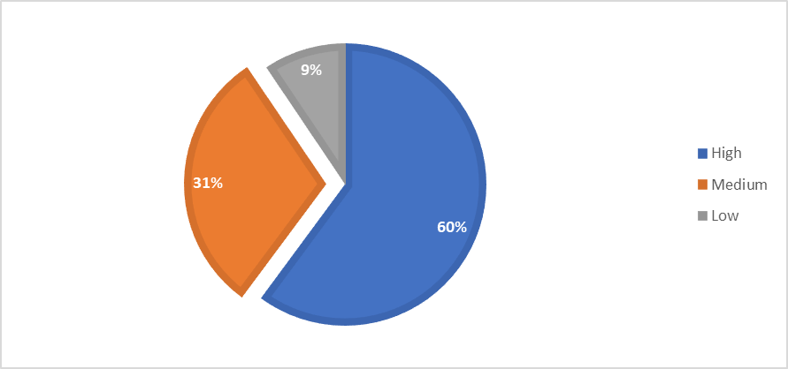
3. Challenges Affecting Growth of Formal Land Transactions in Iringa Rural District.
Costs of transferring ownership
Legal certification fee,
Transport costs

Slide 15
Conclusion
The study reveals that in Iringa Rural District, the processes for undertaking land transactions remain deeply rooted in informal and traditional practices despite the implementation of the Land Tenure Assistance (LTA) project, which aimed to formalize land ownership. Post-titling, land buyers and sellers continue to rely on customary procedures such as involving hamlet or village leaders, relatives, and neighboring landowners over formal institutional processes. These informal and traditional mechanisms, while socially recognized, fall short in ensuring legally secure and enforceable land right.
The strategies used by village council, including the use of village-level agreement templates and witness involvement, were insufficient to transition the community toward fully formalized land transactions. Lack of capacity-building by the Village and District Councils, contributing to limited awareness and weak enforcement of formal procedures.
Key challenges stalling the growth of formal land transactions in the district include inadequate knowledge among land buyers, high transaction and transfer costs, lack of professional village-level land registry officers, and the complete absence of training clinics on formal land transactions. Notably, a strong community belief in the adequacy of traditional land transaction methods further hinders the shift to formalized land transactions.

Slide 16
Recommendations
Establish land training clinics
Hire Village land registry professionals
Enhance capacity building for local government leaders
Strengthen post titling support mechanisms
Conduct public awareness campaigns
Enactment of post-titling guidelines

Slide 17
Thank you!
khadijam@landesa.org

