Slide 1






Urban Displacement and Reparative Land Justice in Nairobi: Confronting Colonial Legacies through Afrocentric Urbanism
Linus K. Korir
Technical University of Kenya (TU-K)
Addis Ababa, Ethiopia November 10th – 14th, 2025

Slide 2
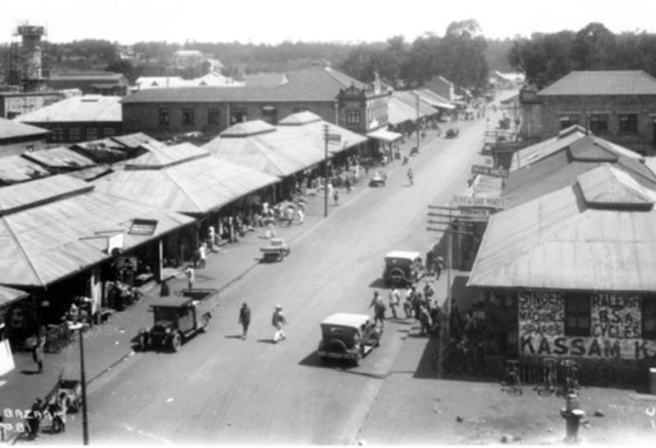
A City Built on Exclusion
From its founding, Nairobi was never meant to be inclusive.
That legacy still shapes who stays and who is pushed out.
How can we heal a city built to segregate?

Slide 3
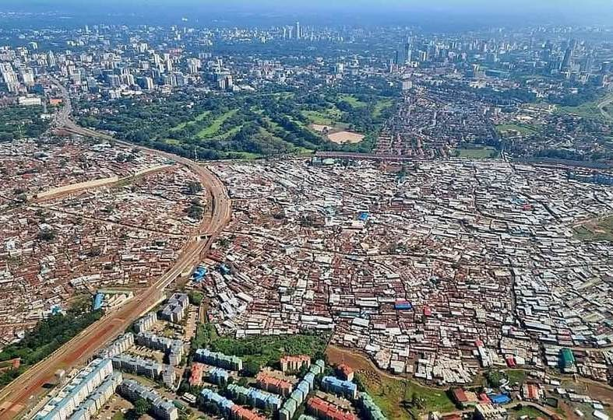
A City Built on Exclusion…
Over 60% of Nairobi’s inhabitants live on only 6% of the city’s land (Un-Habitat, 2022).
Urban inequality mirrors its colonial DNA.
Displacement is not incidental
— it’s systemic.

Slide 4
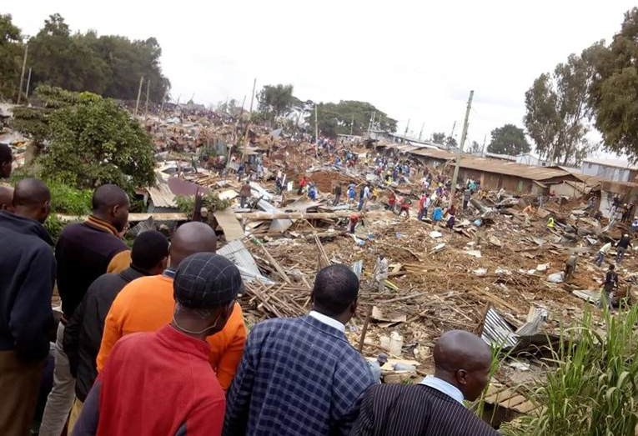
Displacement in Today’s Nairobi
Evictions: Mukuru, Mathare, Kibera, Kariobangi, Ruai.
Driven by infrastructure projects, speculative redevelopment, and elite capture.
Loss of homes, livelihoods, and dignity.

Slide 5
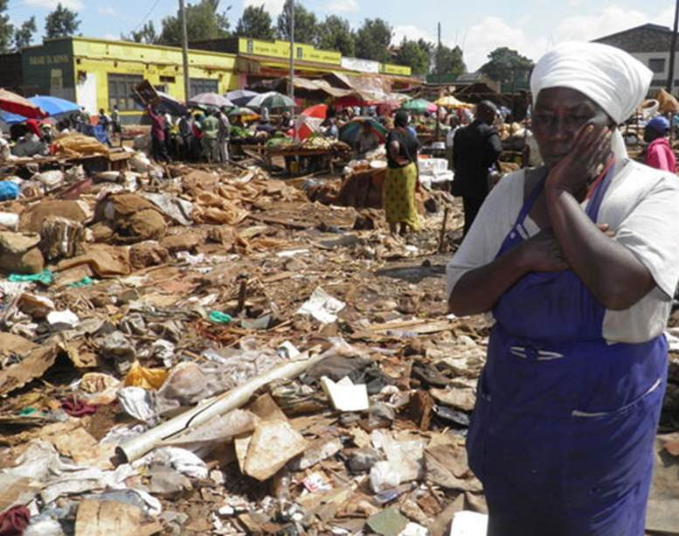
Displacement in Today’s Nairobi…
Displacement today wears modern clothes — highways, ‘smart cities,’ and ‘beautification’ — but the story is the same.

Slide 6
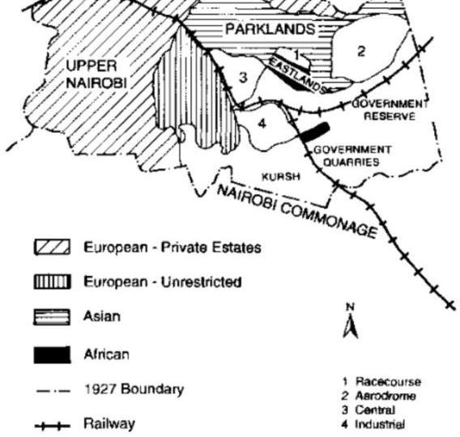
Colonial Urbanism: The Blueprint of Exclusion
1899-1963: Segregated city by design.
Zoning by race institutionalized inequality.
Planning used to control mobility and ownership.

Slide 7
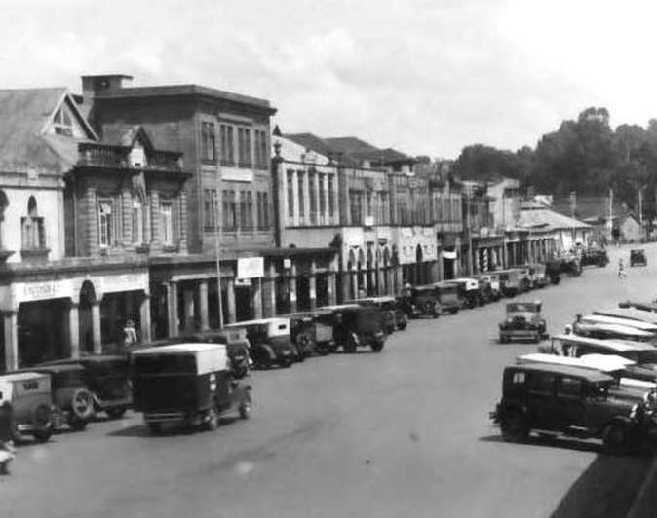
Colonial Urbanism: The Blueprint of Exclusion…
“Natives should be housed outside the town.” –Colonial Urban Officer (1931)
Urban planning was never neutral — it was a political technology of exclusion.

Slide 8
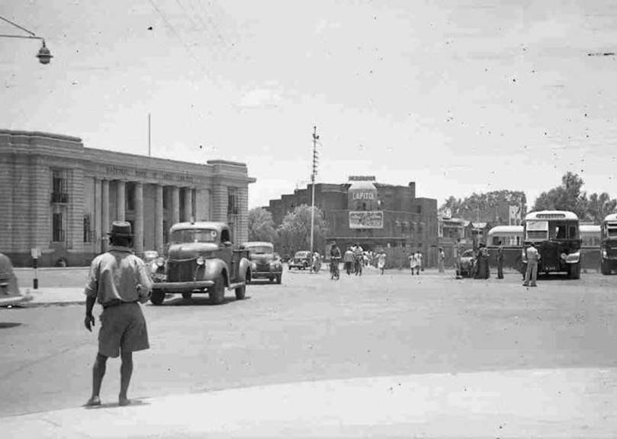
Postcolonial Continuities
Post-1963: Colonial laws and planning models retained.
‘Modernization’ often displaces the poor.
We inherited systems without transforming their logic.

Slide 9
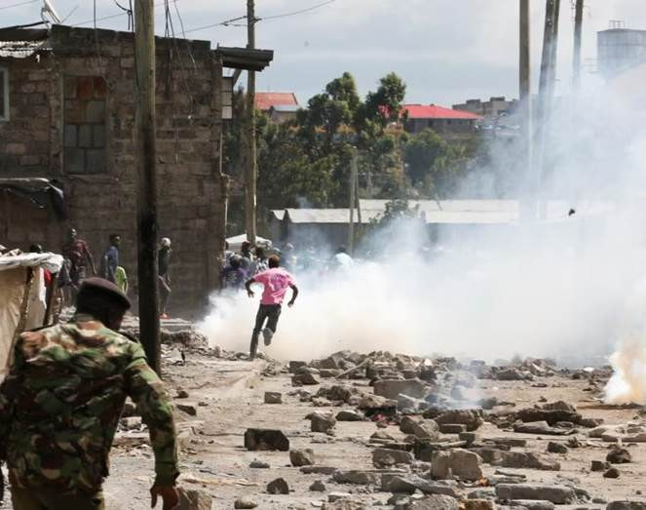
Postcolonial Continuities…
Continuity > Exclusion > Control.
Independence gave us political power — but not epistemic freedom in how we shape our cities.

Slide 10
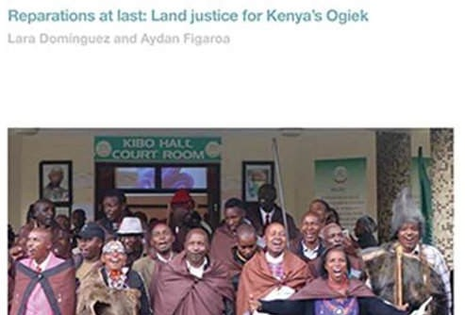
What Is Reparative Land Justice?
Repair: confronting historical harms.
Reform: transforming institutions and laws.
Regeneration: restoring dignity and ecological balance.
Reparative justice means more than redistribution — it’s about repairing the moral and spatial fabric of the city.

Slide 11
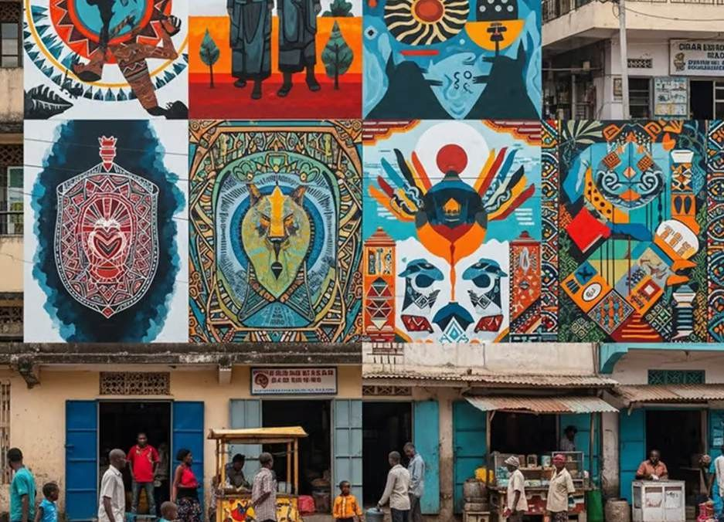
Afrocentric Urbanism: Reimagining the City
Rooted in African worldviews of community, land, and spirituality.
Emphasizes participation, relationality, and collective memory.

Slide 12
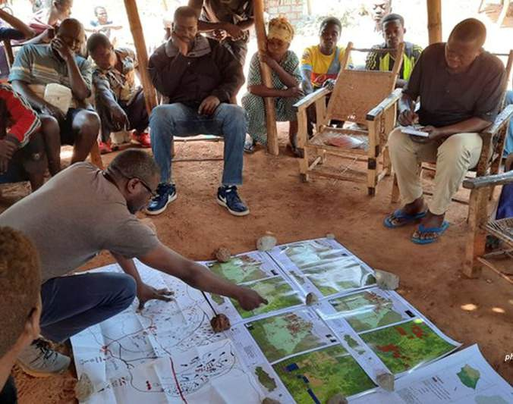
Afrocentric Urbanism: Reimagining the City…
Moves from imported templates
→ homegrown city-making.
Afrocentric urbanism asks: “what would Nairobi look like if it was planned through our own cultural logic of belonging?”

Slide 13

From Colonial Modernity to Decolonial Futures
Colonial modernity equated order with exclusion.
Reparative urbanism centres care, memory, and justice.
The bridge: From domination → to dignity.
To move forward, we must first remember and repair.

Slide 14
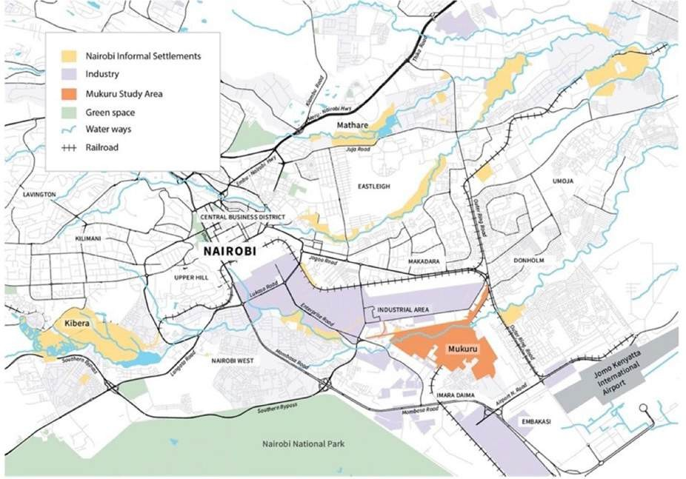
Case Study: Mukuru Special Planning Area (SPA)
650,000 residents co-created their own planning framework.
Participatory mapping, tenure regularization, and service upgrading.

Slide 15
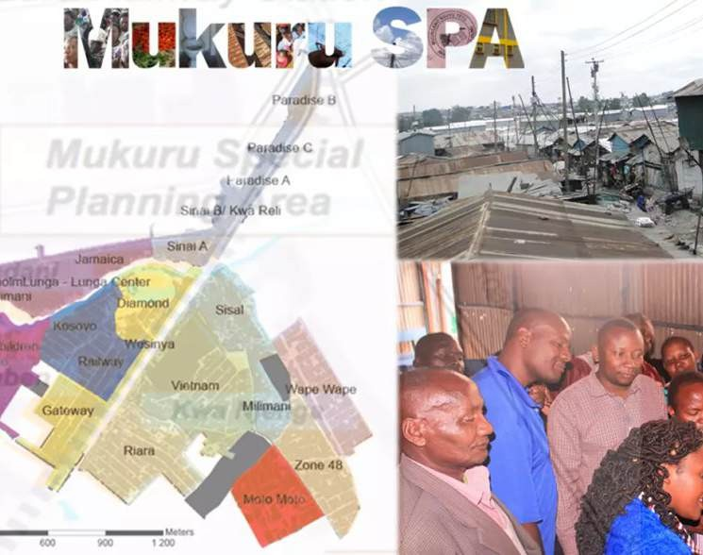
Case Study: Mukuru Special Planning Area (SPA)…
Example of participation as restitution.
Mukuru shows that communities are not beneficiaries — they are co-authors of reparative change.

Slide 16
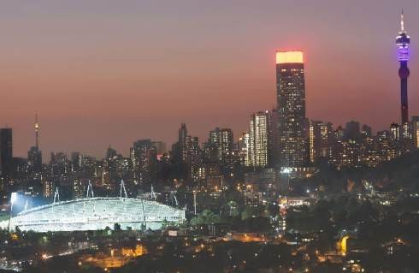
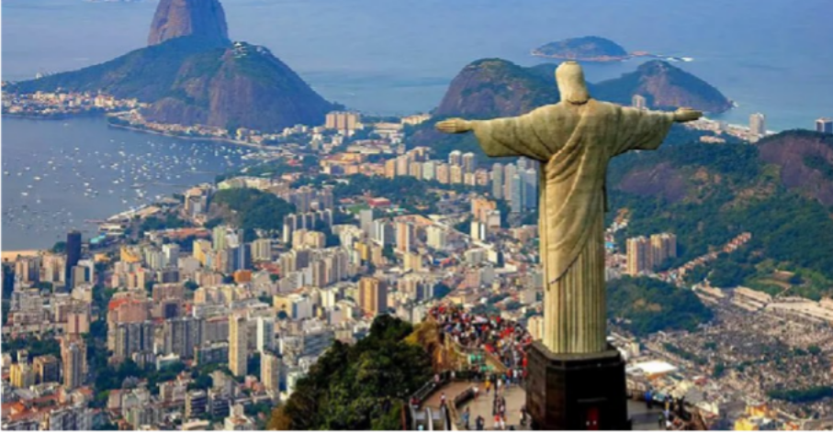
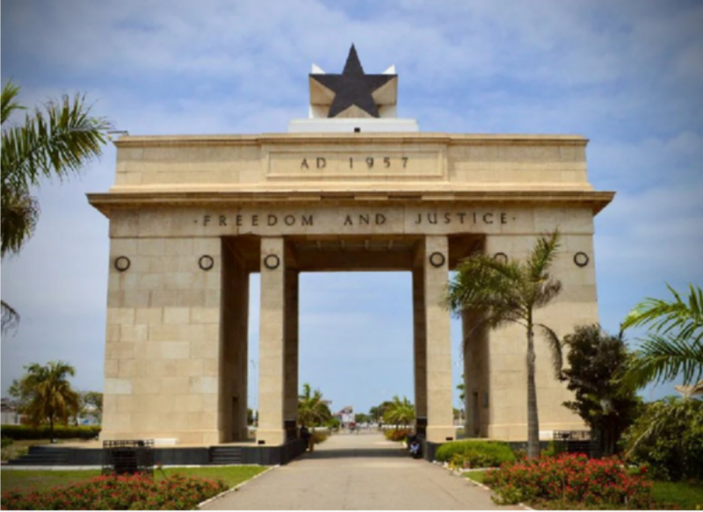
Comparative Inspirations
South Africa: Land restitution and spatial justice jurisprudence.
Brazil: Favela upgrading through citizen rights.
Ghana: Customary land boards integrating tradition with reform.
Across the Global South, reparative urbanism is not theory — it’s emerging practice.

Slide 17



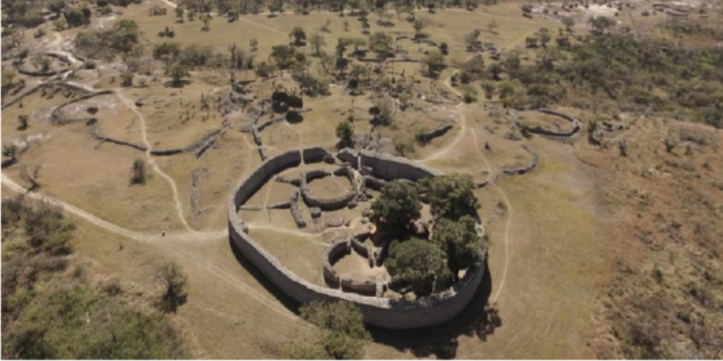
Policy Pathways for Reparative Urban Futures
Historical land audits before any redevelopment.
Community land boards with reparative authority.
Afrocentric planning curricula in universities.
Reparative clauses in infrastructure and housing policies.
Heritage-led regeneration instead of eviction.

Slide 18
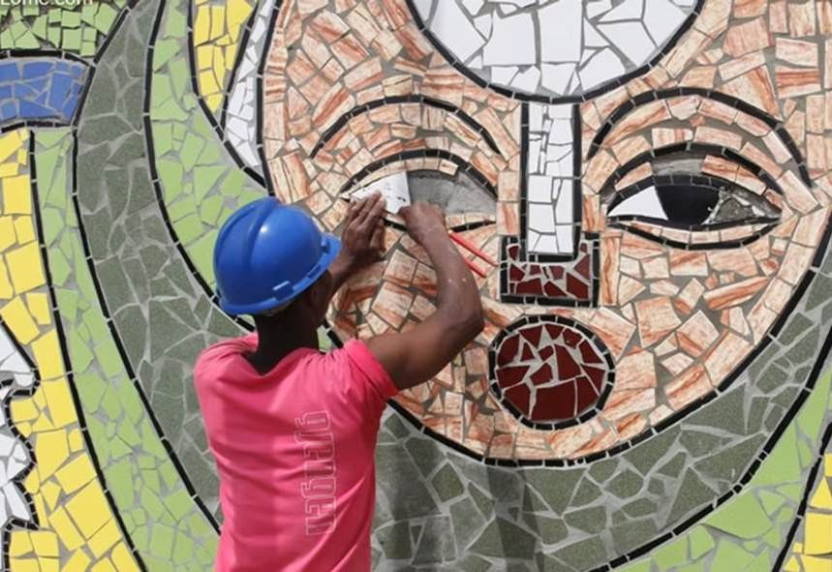
Call to Action: Reclaiming the Right to the City
Reparative justice is not charity
— it is restitution.
Urban Africa must stop imitating and start remembering.
The right to the city begins with the right to memory — to build, to belong, to become.

Slide 19
Thank you! linus.korir@tukenya.ac.ke

