Slide 1

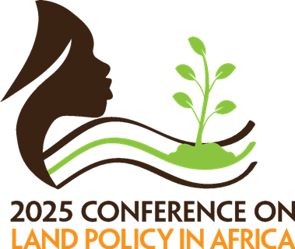
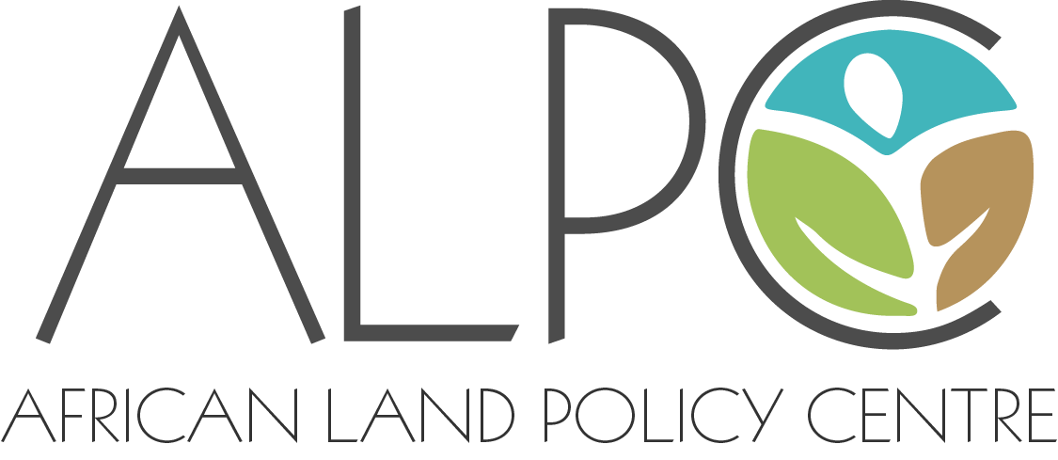

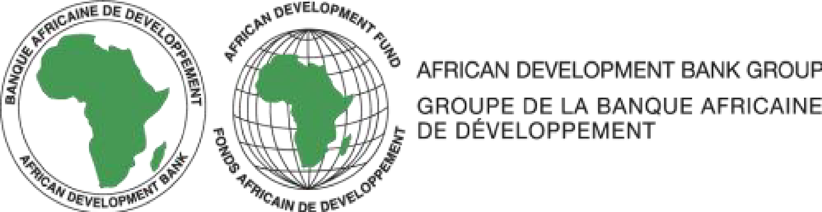

Colonial Legacies, Legal Orders and Land Relations: Understanding the Power of Boundary Demarcations in Transforming the Commons
¹Benjamin Avurinyinbiik Ajabuin
²Prof. Joseph Kwaku Kidido (Presenter)
³Abdul-Hamid Sawang
¹University of Victoria, Victoria, Canada.
²Kwame University of Science and Technology, Kumasi, Ghana
³Memorial University of Newfoundland, St. Johns, Canada
2025 Conference on Land Policy in Africa, Addis Ababa, Ethiopia, 10-14 November 2025

Slide 2
Introduction
Research Context
Colonialism and colonial contact brought various transformations to the political, socio-cultural, and economic systems of most African societies.
Maps, codification of custom, and political reorientation of African systems were used to perpetuate colonial rule.
These subsequently transformed precolonial models of land ownership and governance structures (Lentz, 2000; Lund, 2008).
In this study, we aim to expose the concealed systems of colonialism and unearth its roots of spatialization (Goeman, 2008), tracing the historical processes that led to erasures or distortions in tenure arrangements.
Specifically, the study examines the British colonial rule in the Gold Coast and the history of the Bulsa geopolitical structure and land relations as:
“an analytical category of how historical legacies of colonial rule, power struggles, legislative changes after independence, and the like impinge on local dynamics of property and politics” (Lund, 2008, p. 3).
We looked at the development of the institution of chieftaincy in the context of colonial boundary demarcations to highlight:
Its inventions and limits of the same on land tenure transformation and the development of ‘customary law’, and how it was used to enhance and entrench powers of native authorities.

Slide 3
Introduction
Research Questions
To address the issues mentioned earlier, the following research questions are raised:
How does colonialism impact the structure of land governance among the Bulsa people?
How does the defense of colonial boundary demarcations by native authorities become part of land tenure claims?
And what are the implications of these transformations in landownership and the lives of the commons?
The paper is presented to cover:
The history and development of the chieftaincy institution among the Bulsas between 1898 and 1912, as well as the structure of land governance following the British occupation of the Northern Protectorate of the Gold Coast (now Ghana).
the tensions and struggles of native authorities and their defense of colonial boundary demarcations and the implications on land ownership.
The last part discusses the implications of the colonial development on land tenure transformation in the region, as well as
the social, economic, and political costs of these transformations and the influence of the policy of the modern Ghanaian state on land marginalization.

Slide 4
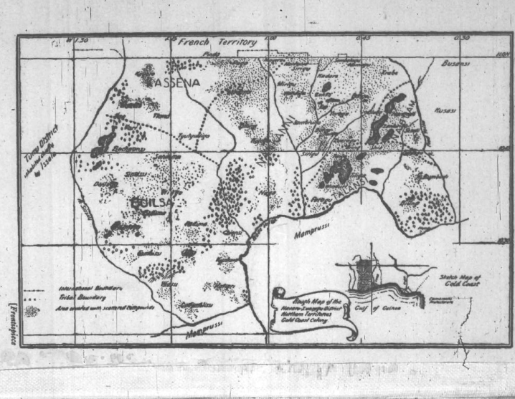
Methodology
The research is purely qualitative and grounded in historical accounts.
The archives, colonial records, statutes, case law, and deed records are used to explain the evolution of colonial map-making and how the integration of native authorities in the colonial administration impacted the social, cultural, and political structure for land governance in Ghana.
We engaged “archives-as-subject” instead of the “archive-as-source” of research by treating the texts as sites of “knowledge production” rather than “knowledge retrieval” (Stoler, 2002, p. 87).
Archival resources were from the Tamale office of the Public Records and Archives Administration Department and supplemented by records from the British Online Library project by the Endangered Archives Programme (https://eap.bl.uk/).
We analyzed these historical textual documents and put them into a discourse to answer the research questions.

Slide 5
The Bulsas at The Eve of Colonialism
After the 1898 Anglo-French Convention, the British gained protection of the Northern Territories of the Gold Coast.
Because of the vast nature of the area, limited resources and personnel, the colonial policy was to rely on the locals.
The governor, Lt. Col. H. P. Northcott, noted: "The agency employed will be that of the native chiefs, and their power will, during good behaviour, be uniformly supported, except in matters of their relationship with neighbouring chiefs and of offences of a capital nature, which will be reserved for decision by a member of the administration” (p. 9).
Yet there was a challenge of “big chiefs” as “…each head of the family is a law unto himself”(Northcott,p. 27), although they acknowledge the presence of some.
Therefore, geopolitical arrangements were strategically executed to ensure social consolidation and promote geographic polity and social cohesion for governance
First, the colonial administration created social and mental maps about the orientation of ethnic groups in the region.
They categorized ethnic groups based on centralized and “acephalous societies” and, while believing that acephalous societies were part of the centralized ones, they sought to reconstitute them.
As such, Northcott finalized treaties with claimed independent “chiefs” who ruled over considerable territory (Bening, 1975).
Subsequently, Watherston reorganized the Northern Territories into three main provinces: Southern, Northwestern, and Northeastern, with little or no attention given to ethnic considerations in defining these boundaries (Bening, 2001)

Slide 6
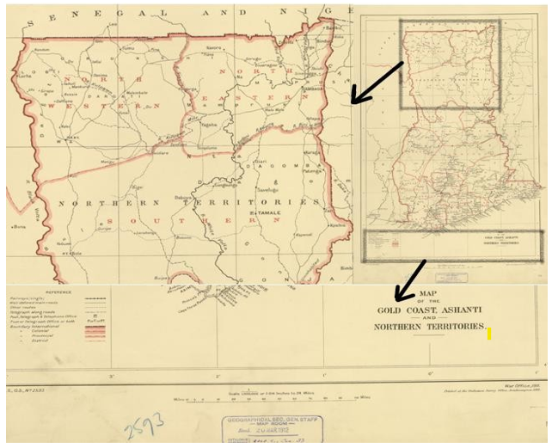
The Bulsas at the Eve of Colonialism
The Bulsas were put in the Northeastern province and subjected to the control of the Mamprusis under the authority of the Na-yiri(King of the Mamprusis).
A power network of head chiefs and hierarchy of power were therefore designed to ensure geographic polity and administrative convenience (Lentz, 2006).
The Annual Report of the Northern Territories (ARNT) of 1911 noted: In the Navarro District, chiefs have also been appointed over the Kanjarga (Bulsa) and Grunshi Tribes. The Na of Mamprusi has been taken by a Commissioner for an extended tour in the North-Eastern Province, and has been everywhere acclaimed as overlord of the chiefs of all the towns he visited. It is interesting to note that this has been the first occasion on which a Na of Mamprusi has ever left the neighbourhood of Gambaga and Nalerigu. This chief has now been appointed the paramount chief of the North-Eastern Province (p. 21).
Also, through an election process, each of the independent settlements, including the Bulsa communities, was consolidated under the authority of a head chief.
Bulsa communities were subjected to Sandema, one of the 13 Bulsa communities.
Capt. E. O. Warden reported in the same year that the Bulsa head chiefship was won by the Sandema nab after it had been contested by the Sandema and Kanjarga nabs (chiefs) (Iliasu, 1975).

Slide 7
The Bulsas at the Eve of Colonialism
In these processes, the local people rejected the appointment of chiefs while the appointed chiefs also rejected the authority of the Na-yiri as their head chief.
The commissioner of the Northeastern Province, Major Festing, in 1911, expressed worry about the authority of the Na-yiri in the Bulsa area when he noted:
“My experience in the workings among these pagan communities, such as we have to deal with in this Province is that one has to be guided to a considerable extent by the feelings of the people and that it is very difficult to force them…Also, in Kanjargah (Bulsa) I gather the Mamprusi influence is small. We would have to think seriously as to whether we can force them to acknowledge Mamprusi (Na-yiri) or, failing this whether there is any one among them who can take the lead” (as cited in Brukum, 1999, p. 106).
Watherston earlier also noted :
Each compound was more or less a law unto itself. The people obey no man really, though they have nominal chiefs, selected as a rule for their incapacity to make anyone obey them. Partial blindness, paralysis, and often idiocy appear to have been the qualification in many parts of the country, the only sine qua non being that the chief should have cattle, as on him falls the privilege of paying any fines that the Commissioner might impose on them (ARNT, 1907, p. 8).
E. A. Irvine, the provincial commissioner, added:
[The] majority of the natives have been passive resisters as far as obeying the chiefs was concerned. Heads of families, if sufficiently powerful, were, formerly, a law unto themselves. . . . Considering the difficulties which have had to be dealt with, very Favourable progress has been made in getting the people to realize that their chiefs are no longer to be considered figure heads, and that in consequence all their lawful orders must be obeyed (ARNT, 1911, pp. 20–21).

Slide 8
The Earth priest and Chiefs at the Eve of Colonialism
The colonial policy also created vested interests and created new power layers in the Bulsa land governance arrangements – the position of the teng-nyam and chiefs
The idea of linking the native “political structure” with native “land rights” was problematic for the colonial administration, and they had difficulty reconciling the role of the chiefs as a colonial instrument on one hand and the role of the earth priests in land matters on the other hand (Lund, 2008).
Also, after years of contact with the Ashanti nations and Fanti groups of the coastal towns of the Gold Coast (now Ghana), the idea of earth priests was strange to the colonial administration.
Further, the idea of land as property to be ‘owned’ was confused with land as a territory to be governed.
Though chiefs did not have significant powers until the 1930s, the Bulsa chiefs were projected above the teng-nyam in matters of land as a territory and property.
The teng-nyam's role, especially concerning land as property, remained private and invisible to the colonial administration.
C. H. Armitage wrote:
“Every encouragement has been given to the Chiefs to exercise their authority; to hear and determine cases relating to native property, marriage, and other Civil actions, and to uphold native laws and customs so long as they are not opposed to our ideas of justice and equity. Few appeals from decisions of the Chiefs are made to the Commissioners’ Courts, and, as a rule, local authority is exercised with the greatest moderation” (ARNT, 1916, p. 10).

Slide 9
The Bulsas in Colonial Development and Expansion
In the 1920s, Governor F. G. Guggisberg’s plan to construct a railway connecting the Northern Territories with the British colony generated two opposing debates on land tenure in the protectorate (Bening, 1995):
The governor and secretary of state argued it was inappropriate for the commissioners to obtain deeds of land from the chiefs as gifts. This gives the chiefs the de facto ownership of land in the region, which should never be encouraged.
Arthur J. Philbrick, the secretary for native affairs, who later assumed the title of chief commissioner of the protectorate, was of the view that the Northern Territories were a protectorate and not a colony, and hence, it was inappropriate for the colonial governor to acquire land for public purposes without paying compensation.
Therefore legislations were enacted and old ones revised to give authority to the colonial administration in land matters through vesting and restrictive land uses by the indigenes.
At the same time, major research projects were also commissioned to document the histories and customs of the various ethnic groups in the Northern Territories.
The Bulsas and Kasenas were granted an independent native authority but not an administrative unit until 1949.
The governor dismissed the pleas of the Bulsas and Kasenas and noted:
As a district is merely an administrative area, the refusal of the Builsa, Kasena, and Nankani tribes to acknowledge their subordination to the Na of Mamprusi is not affected by the inclusion of their territories in the same district as that within which the Mamprusi State lies. Whether these small tribes can at a later date be attracted or guided to enter the Mamprusi State must be left to the future: it will be all to the good if they do and the process of absorption will be facilitated by all parties being in the same administrative area (as cited in Bening, 1975, p. 130).

Slide 10
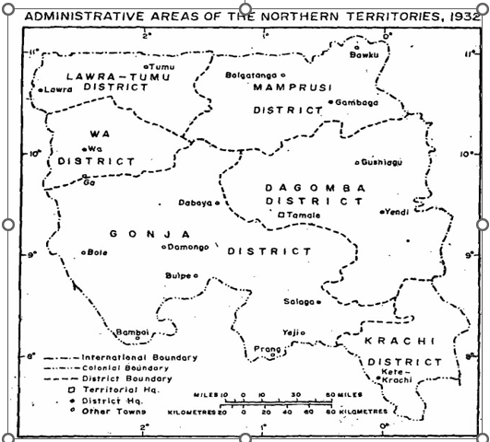
The Bulsas in Colonial Development and Expansion
The Political Boundaries were then re-demarcated, yet three communities which are belief to be of Bulsa origin, remain answerable to the Na-yiri despite the Bulsas ‘independence’ to have their own unit at Navrongo.
Azantilow, the head chief of the Bulsas wrote and complained: “Since some years ago, three villages of the Builsas; Kunkuaga (Kunkua), Kategara (Katigira) and Jaadema are being serving under the Mamprusi N.A. but really they are Builsa, as regards their customs and language is the same way done as the Builsas, and moreover, they are settling on the Builsa Land” (Bazukwe Vrs. Naga and Sandema Claim, 1932–1951, p. 59).
Azantilow’s letter was addressed to the Na-yiri, yet the district commissioner replied, noting that the boundaries had been settled and he had no intention of reopening them.
Azantilow persisted and petitioned the Governor to address the boundary concerns.

Slide 11
The Bulsas in Colonial Development and Expansion
The chief commissioner, in transmitting Azantilow’s letter to the colonial secretary for the opinion of the Governor’s legal advisers, noted: “I may perhaps add that the Sandema Nab is one of the most able and progressive of the Chiefs in the Northern Territories and it may be that prestige he has enjoyed on this account has encouraged him to persist in his present action (Bazukwe Vrs. Naga and Sandema Claim, 1932–1951, p. 72).
When finally granted an interview with the Governor in 1950, Azantilow conveyed:
The men from there (the disputed areas) marry from here (the Bulsa region); the language and custom is Builsa language and custom. Many of them try to say they are Builsas, but they are punished if they visit Sandema. Before the Whiteman came the river was the boundary. There is no dispute between the Sissala and ourselves on our other (S.W) boundary (Bazukwe Vrs. Naga and Sandema Claim, 1932–1951, p. 130).
He went on to say: “During Babatu’s raid the chiefs fought for the land; the land belongs to the Bulsas; the Mumprusis did not fight for the land nor did they defend it. . . . In Babatu’s raid, we fought for all the land up to the river” (Bazukwe Vrs. Naga and Sandema Claim, 1932–1951, p. 129).
It was clear that Azantilow’s claim was both of land ownership and political belonging. He also claimed in his petition that it was the wish of the people that they follow the Bulsas.
However, a commission of inquiry rendered both of his claims futile. The first claim was flawed as Eyre-Smith, the Assistant Secretary of Native Affairs, had said, “In no instance did the land belong to the chiefs in the Northern Territories” (Bazukwe Vrs. Naga and Sandema Claim, 1932–1951, p. 163).
Also, though all evidence shows through language, ritual, and culture that the people of those communities are Bulsas, yet the people wished to follow Na-yiri through Kpassankpe.

Slide 12
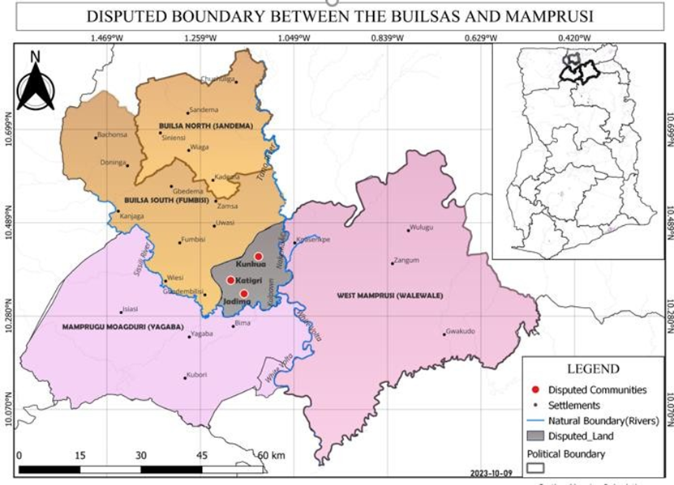
Azantilow vs Nayiri & Others in Colonial Expansion
Azantilow proceeded and instituted a legal action against the Na-yiri of the Mamprusis, with the chiefs of Jaadema, Katigiri, and Kunkua as co-defendants, in the chief commissioner’s court of the Northern Territories.
However, the case was dismissed on the grounds of insufficient evidence to support his claims. He appealed the case in the West African Court of Appeal, but it was dismissed in an unreported judgment delivered on April 9, 1953.
Indeed, Azantilow lost the case for his claim of landownership by asserting himself as the allodial title holder without any support from the Bulsa teng-nyam. As Kotey (1993, p. 115) puts it more succinctly: “The present Sandemanab (who has been on the skin for a very long time and was the plaintiff) in Azantilow v. Nayeri has judiciously asserted his authority over the whole of the Builsa. His claim to allodial ownership as opposed to sovereignty (in a jurisdictional nonproprietary sense) of all Builsa land, however has no basis in the indigenous law”.
Again, the facts of Azantilow v. Nayiri and others were on the locus standi and capacity of the parties to sue. As noted by Woodman (1996, p. 56): “the court there [in Azantilow v. Na-yiri] spoke of chiefs having title to sue, but the evidence merely showed that the Tindanena claimed no title themselves. Otherwise, the chiefs’ right to sue was simply taken for granted”.

Slide 13
Azantilow vs Nayiri & Others in Colonial Expansion
After independence in 1957, no action was taken to divest lands in the Northern Territory until the 1970s. The Government held the Lands in trust for the benefit of the people.
The Roland Issifu Alhassan committee was commissioned in 1978 to investigate and report on the nature of land ownership in the Northern and Upper Regions. Among the Bulsas, he noted:
“The Committee was satisfied from the evidence adduced on the above subject that the paramount title of Builsa Land is vested absolutely in the Paramount chief, the Sandema-Nab, and is held in the trust for the benefit of the Builsas. The day-to-day administration of the land is taken care of by the Divisional chiefs, the Subchiefs, and the Tindanas/Tinyam for and behalf of the Paramount Skin” (Government of Ghana, 1978, p. 38).
However, Alhassan’s committee report has been criticized on various occasions and by different scholars for its anomalies and inconsistencies regarding the history and practices of the people concerned.
First, Alhassan, who is a Dagomba (a brotherly tribe with the Mamprusis) and a legal practitioner, may have been aware of and influenced by the Azantilow case to have made such instinctive suggestions in his report.
Second, the wording of the report itself is akin to or consequential to it being the true reflection of the Bulsa land tenure arrangement. For example, in one part, it states: “Only the Sandema-Nab can authorize a grant of a piece of land to a stranger” (Government of Ghana, 1978, pp. 38–40).

Slide 14
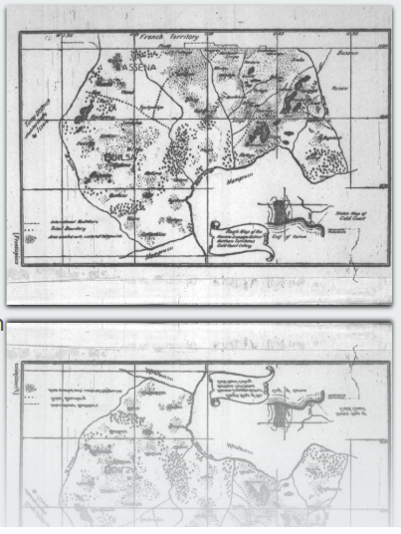
Azantilow vs Nayiri & Others in Colonial Expansion
And another part says: “The tindana/tinyono has only a priestly role in the grant of land.He . . . performs sacrifices when new grants are made before the grantee is put into possession” (pp. 38–40).\
The separate roles, as the report sought to differentiate, were problematic on two grounds: first, the report did not specify whether the findings were in accordance with custom or modern land governance among the Bulsas; and
second, all forms of historical evidence of the Bulsa land relations and how they were established were disregarded, as the report merely states: “The Builsas migrated from elsewhere and came to occupy the present area as first settlers” (p. 38).
Therefore, even if the Bulsa communities had chiefs before the advent of colonialism, the hierarchy of these chiefs, of which the Sandema nab is a beneficiary, has no roots in custom or traditional law of the Bulsas.

Slide 15
Bulsa Land Relations in Postcolonial Ghana
Yet Ghana’s post-independence constitutions, including the 1992 constitution, left a lacuna regarding which persons or institutions were responsible for making legal decisions concerning the disposal of land in the regions.
Though the 1992 constitution and other statutes have made provisions for the skins and district assemblies to benefit from revenue accruing from lands in their area of jurisdiction, the legal question as to who has the right to administer such revenues in the context of the Bulsa communities remains problematic as far as the institutions of the skin or chieftaincy and tengnyam or families are concerned.
Paradoxically, in the current legal framework, the colonial law and English ways of legislation are considered the general applicable law, while custom and indigenous practices require further proof before their legality is accepted (Kunbuor, 2002).
The confines of customary law are defined within the limits of colonial law or the postcolonial state law, neither of which fully acknowledged the Bulsa custom, no matter how contested it has been.
For instance, evidence from deeds and title documents suggests that custodianship of Bulsa land, both in substance and form, lies with the Bulsa chiefs.
Records from the Title and Registry Division of the Lands Commission provide the following format for land titling (the lease document) in the Bulsa communities (at least for Sandema, Fumbisi, and Wiaga):
THIS LEASE is made the [Date of Transaction] BETWEEN Nab [Name of the chief], Chief of name of [Community of which the land is located] in the Builsa District the Upper East Region of the Republic of Ghana (hereinafter called the “LESSOR” which expression shall where the context so admits or requires include his successors in office and assigns) with the consent and concurrence of the Principal Elders of [Community Name ] Skin are evidenced by the signing of these presents at least two of the aforementioned Principal Elders of the one part and [Name and address of the Lessee] of the Republic of Ghana (hereinafter called the “LESSEE” which expression shall where the context so admits or requires include heirs and assigns) of the other part.
The above description is found in Form A of the lease document, which problematic because the Bulsa land tenure system is reduced to properties in this titling process, while the institutions of land governance are redefined to project a legal marginality in the substance and form of land ownership .
Second, legal and institutional complexity is created by the Lands Commission to marginalize the teng-nyam and Bulsa families in the substance of these deeds.
The evidence suggests that the chiefs’ endorsement of these transactions not only gives validity or serves as a testament to the transactions but also accords with the Bulsa chiefs' legal ownership and custodianship of the land.

Slide 16
Bulsa Land Relations in Postcolonial Ghana
Yet Ghana’s post-independence constitutions, including the 1992 constitution, left a lacuna regarding which persons or institutions were responsible for making legal decisions concerning the disposal of land in the regions.
Though the 1992 constitution and other statutes have made provisions for the skins and district assemblies to benefit from revenue accruing from lands in their area of jurisdiction, the legal question as to who has the right to administer such revenues in the context of the Bulsa communities remains problematic as far as the institutions of the skin or chieftaincy and tengnyam or families are concerned.
Paradoxically, in the current legal framework, the colonial law and English ways of legislation are considered the general applicable law, while custom and indigenous practices require further proof before their legality is accepted (Kunbuor, 2002).
The confines of customary law are defined within the limits of colonial law or the postcolonial state law, neither of which fully acknowledged the Bulsa custom, no matter how contested it has been.
For instance, evidence from deeds and title documents suggests that custodianship of Bulsa land, both in substance and form, lies with the Bulsa chiefs.

Slide 17
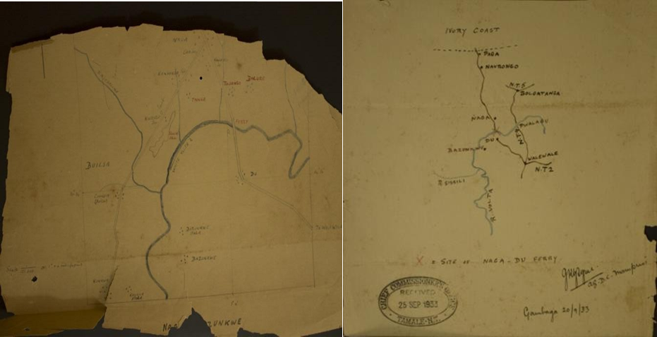
Conclusion
We cautioned that care must be taken not to appropriate the historical case of Azantilow vs Na-yiri and others that sought to protect the dignity of the Bulsa family into hastening fears of exclusion and dispossession. \
We also argued that such instances have the potential of awakening a new form of tenurial changes that have intergenerational consequences.
Unless clarity is achieved on title deeds (lease) of land transactions in Buluk, the consequential land tenure outcomes between the chieftaincy institutions, the office of the teng-nyam, and the Bulsa families are bound when those leases eventually expire.
This is because in the form and substance of these deeds, constitutional orders and rules of the state are rooted in colonial law, are projected above the Bulsa normative behavioral codes—cultural values that define land relations.
Thus, the normative behavioral codes on communal ownership, which are vested in the Bulsa families and clan sections, are transformed into property regimes with proprietary rights of ownership vested in the chiefs, at least in the form of deeds.
We have shown that the deeds appraise history and recognize chiefs as the de facto custodians, though de jure custodianship rests with the teng-nyam and family heads according to custom.

Slide 18
Thank you!
jkkidido.cap@knust.edu.gh

