Slide 1


Reach, Benefit, Empower, Transform (RBET):
A guide to helping rural women secure their land tenure rights
Anne M Larson, Ruth Meinzen-Dick
& Sabrina Trautman
CIFOR-ICRAF

Slide 2

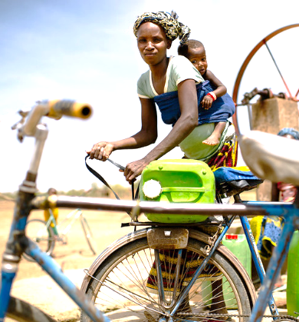
Objectives
To enhance the recognition and protection of women’s resource rights
in targeted countries.
To contribute to the creation of conditions that would enable women's enjoyment
of resource rights over time.
WLRR Initiative
Specific Objectives
To design and embed innovative GTAs in ongoing IFAD projects, to strengthen women’s land and resource rights (WLRR) in targeted countries.
To build capacities of key stakeholders at local and national levels and ensure that evidence and experiences from country-level pilots inform relevant policy and implementation processes.
To generate evidence-based recommendations and share good practices for integrating GTAs into IFAD’s global portfolio and advocacy strategy.
Notes:
More specifically, the project will
Design and deploy innovative and participatory GTAs
Engage stakeholders in building our collective capacities at local, national, consortia levels
Bring evidence into the implementation process – grounded in gender analysis
Develop a set of recommendations to tailor and scale this approach beyond the project

Slide 3
Country pilots

Slide 4
Why women’s land rights?

Slide 5
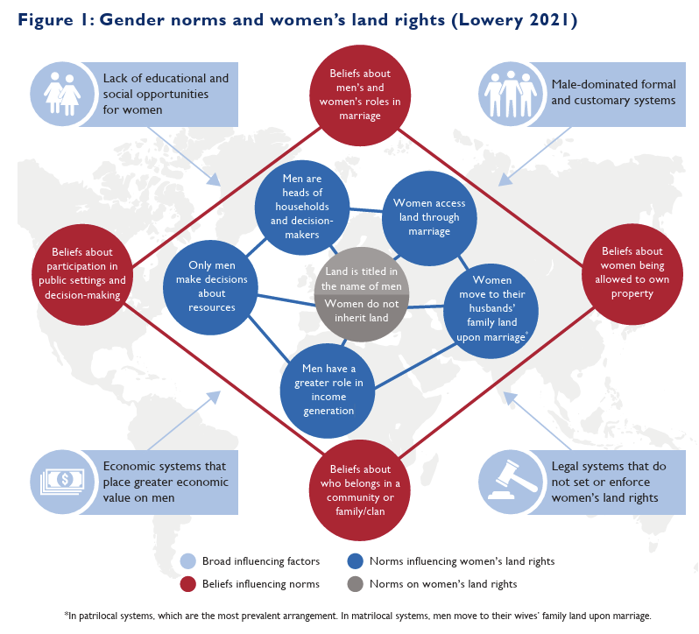
Gender and intersectional inequalities in land rights
Lowery S. 2021. Gender Norms and Women’s Land Rights: How to Identify and Shift Harmful Gender Norms in the Context of Land and Natural Resources. Washington, D.C.: USAID.

Slide 6
What is the RBET framework?

Slide 7




The REACH, BENEFIT, EMPOWER, TRANSFORM (RBET) framework
Reach
Benefit
Empower
Transform
Include women in program activities
Reaching women means ensuring that women have the same opportunity to access the program activities as men
Improve women’s well-being
Requires more than reach:
Intervention itself needs to be designed in a way that ensures that women value it and that it is beneficial to them
This requires women’s needs, preferences and constraints to be considered in the intervention design
Strengthen ability of women to make strategic life choices and act on them
Beyond reach and benefit:
Involves increasing women’s agency
Some projects focus directly on shifting gender norms and attitudes
Change gender norms and attitudes on a larger scale: Changing systems, not women
Beyond empowering individual women or the household level:
Involves men
Changes gender norms at the community and societal levels
Addresses structural and institutional barriers
Mobilizes the power of the collective
Courtesy of Ruth Meinzen-Dick

Slide 8

Being transformative = Going ‘under the surface’
What is visible
What is underlying: structures, cultures,
norms, belief systems

Slide 9
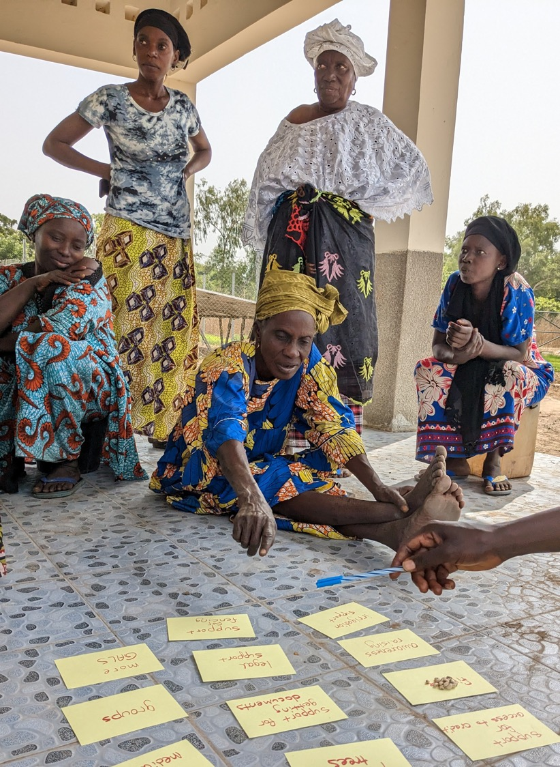

Gender Transformative Approaches (GTAs)
To understand and address the multiple and overlapping systemic underlying drivers of gender inequality.
Increase the ambition from empowering individual women to catalyzing wider, deeper, and more lasting changes to women’s rights (‘changing systems’).
Require processes that enable those targeted by initiatives (e.g., grassroots women and their allies) to lead or be meaningfully included in defining the changes sought and accompanying strategies.
Notes:
What are GTAs, what’s different from other approaches.
Those systems include gender norms, structures and institutions: these reflect ideas of accepted behavior, or perceptions of accepted behavior, embedded in institutions and reproduced by people's actions

Slide 10
Applying the framework to women’s land rights

Slide 11
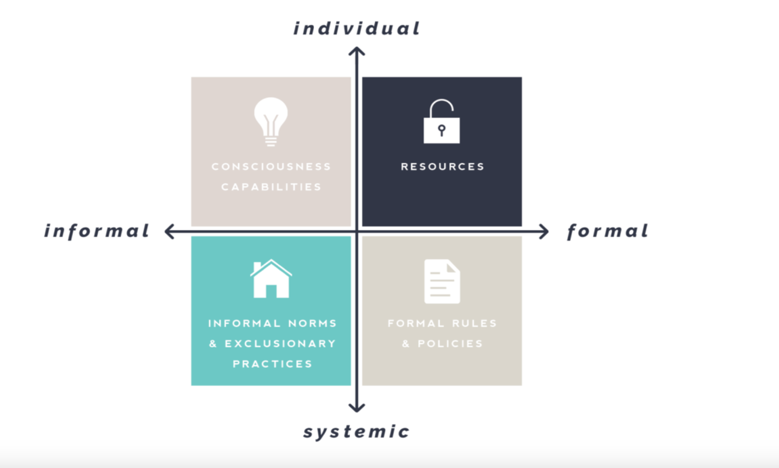
Analytical Framework (1): https://genderatwork.org/
The Gender at Work Framework highlights the interrelationship between gender equality,
institutions or ‘rules of the game’ held in place by power dynamics and what it takes to bring about change
Notes:
Evolving, co-learning process

Slide 12
Adapting the framework: For WLR, what needs to change according to each quadrant?
Individual
Informal | Transform consciousness, attitudes and behaviour / individual consciousness and capabilities Increase women’s and men’s understanding of legal rights to lands/resources Strengthen skills/confidence of women to influence land/resource rights and decision making Transform women’s and men’s consciousness, attitudes and behaviour | Transform access to opportunities and resources for individuals / formal access to land for individuals Support women to access legal services in land disputes Enhance women’s opportunity to participate in decision making Support women to obtain formal land titles | Formal
 | Transform informal rules and decision-making processes, and exclusionary socio-cultural norms Identify and address exclusionary norms and practices preventing women’s land access/ownership Support traditional leaders, duty bearers and male champions to challenge exclusionary customary practices | Transform formal laws, policies and formal decision-making institutions Advocate for legal changes to land/resources Advocate for legal changes to structural barriers (i.e. around violence against women) that prevent women securing land Build capacity of government officials and other duty bearers to implement and uphold women’s land rights
Systemic

Slide 13
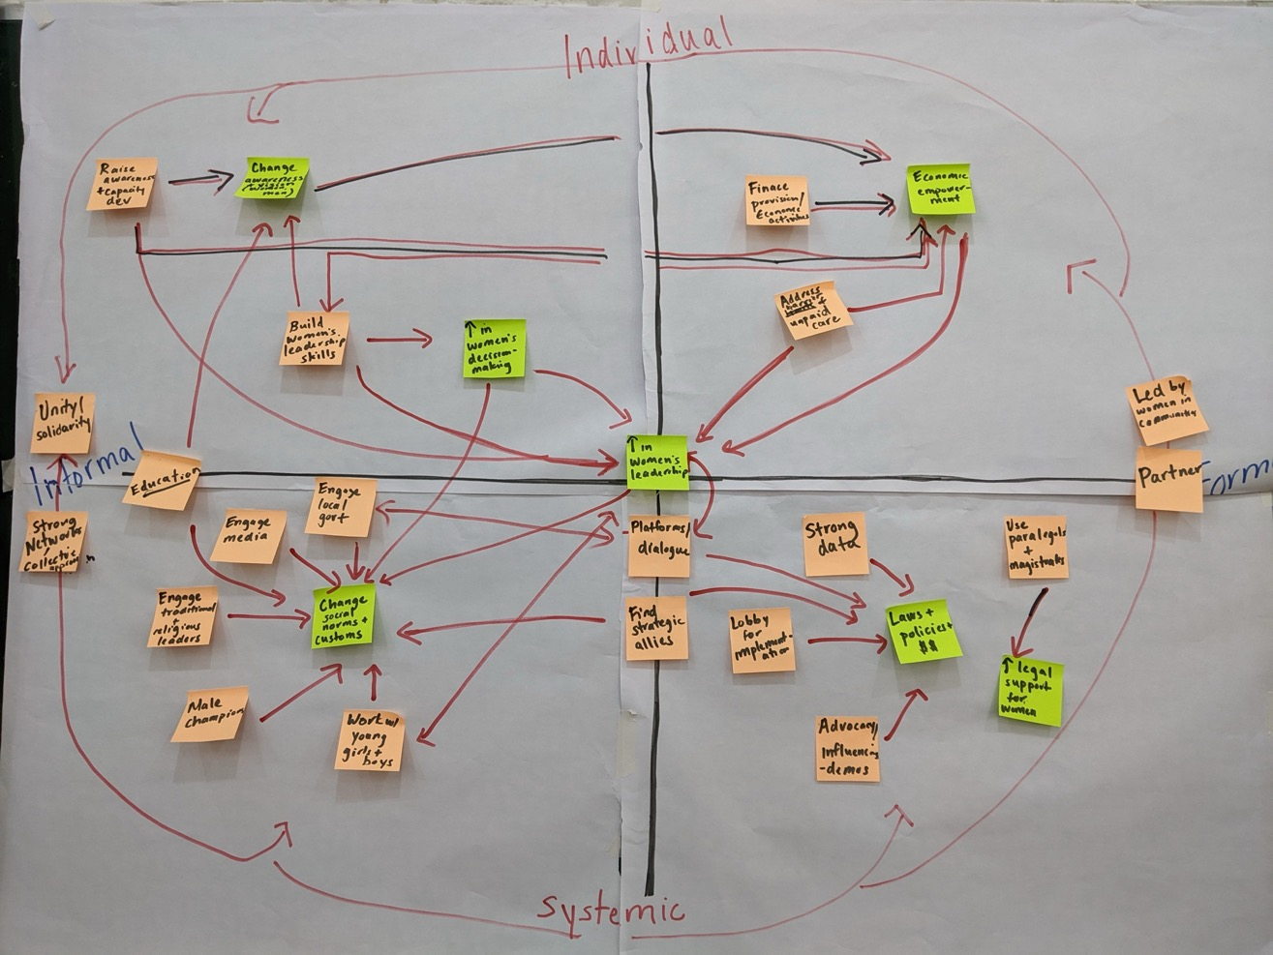
https://alliancebioversityciat.org/stories/how-do-we-know-if-what-were-doing-really-gender-transformative (Miranda Morgan)

Slide 14
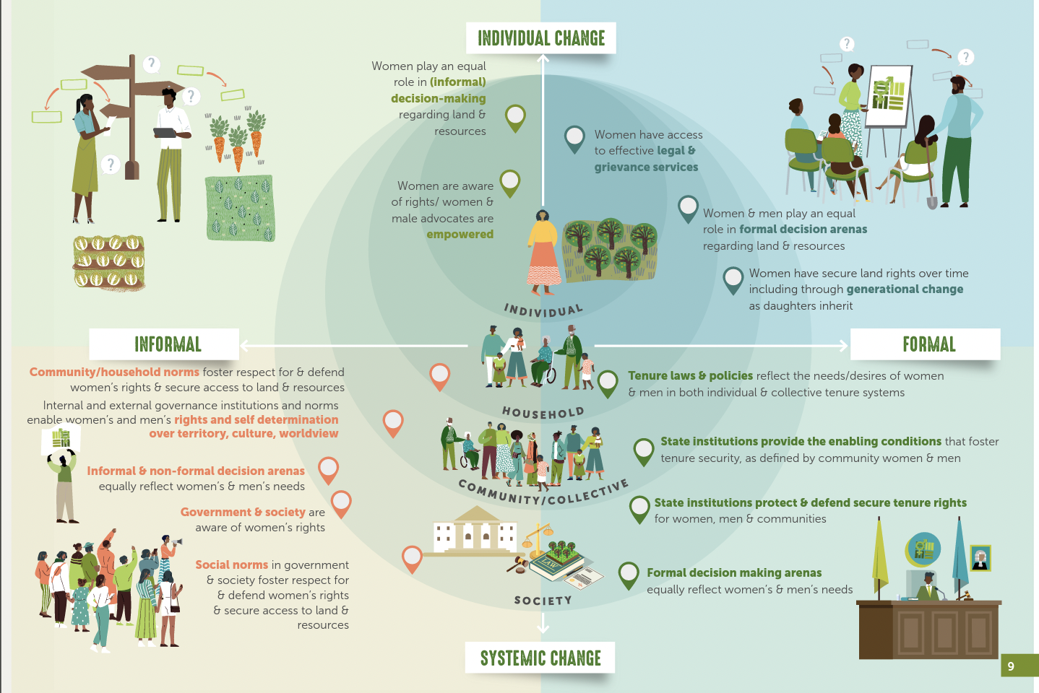
Screen Shot 2024-12-01 at 12.03.17 PM

Slide 15
Using the REACH, BENEFIT, EMPOWER, TRANSFORM framework
Analytical Framework (2)
Reach
Benefit
Empower
Transform
Include women in program activities
Reaching women means ensuring that women have the same opportunity to access the program activities as men
Improve women’s well-being
Requires more than reach:
Intervention itself needs to be designed in a way that ensures that women value it and that it is beneficial to them
This requires women’s needs, preferences and constraints to be considered in the intervention design
Strengthen ability of women to make strategic life choices and act on them
Beyond reach and benefit:
Involves increasing women’s agency
Some projects focus directly on shifting gender norms and attitudes
Change gender norms and attitudes on a larger scale: Changing systems, not women
Beyond empowering individual women or the household level:
Involves men
Changes gender norms at the community and societal levels
Addresses structural and institutional barriers
Mobilizes the power of the collective
Courtesy of Ruth Meinzen-Dick

Slide 16
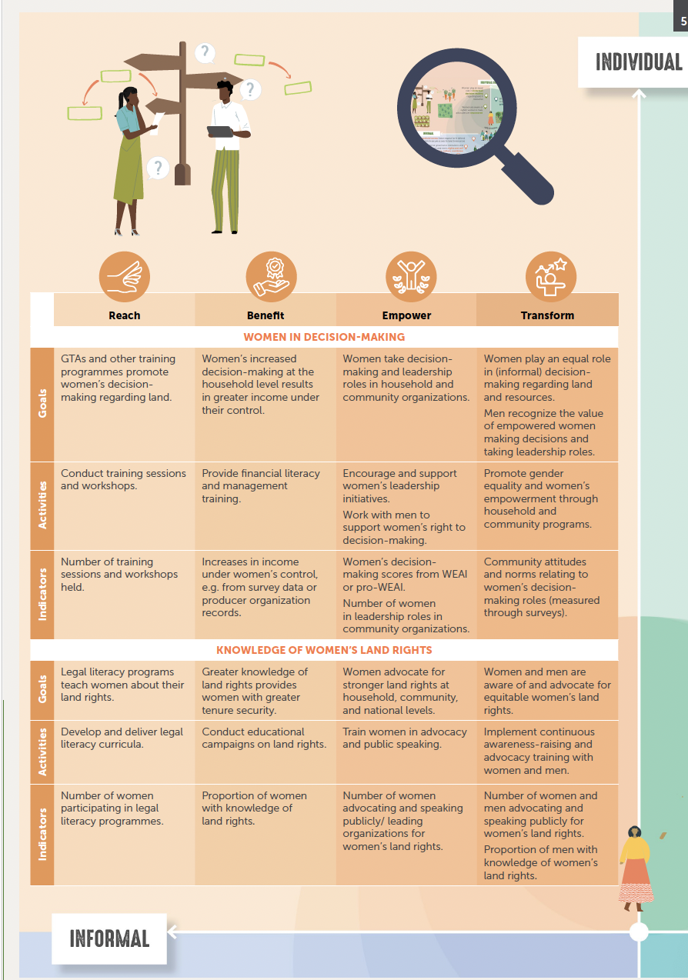
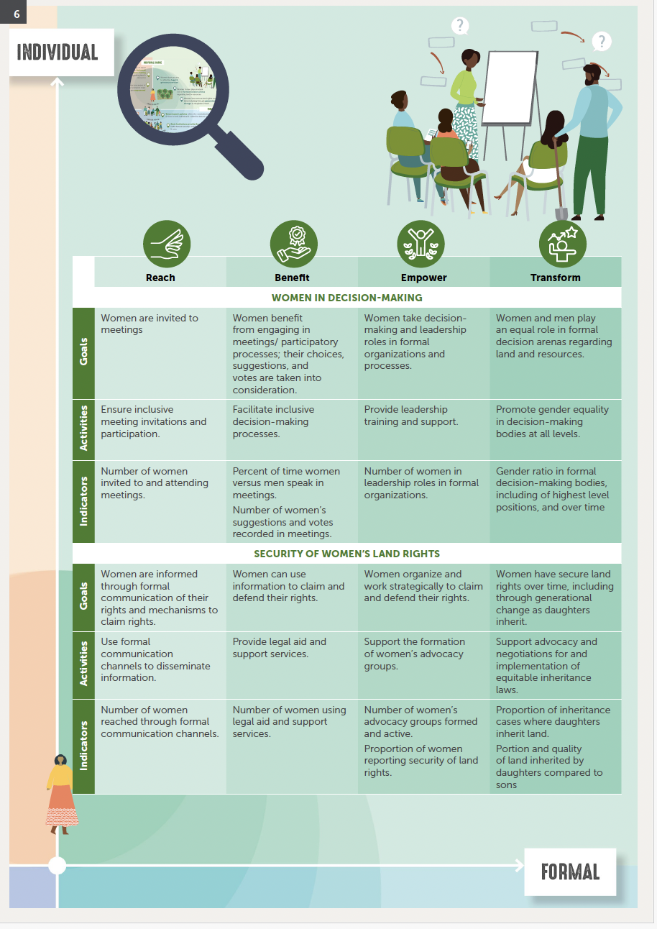

Slide 17
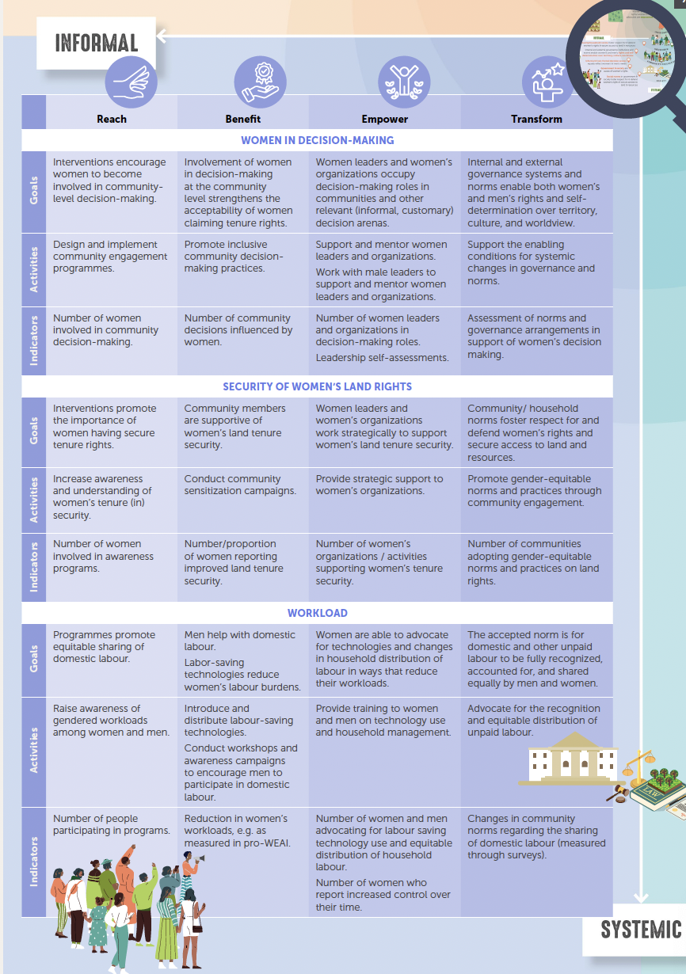
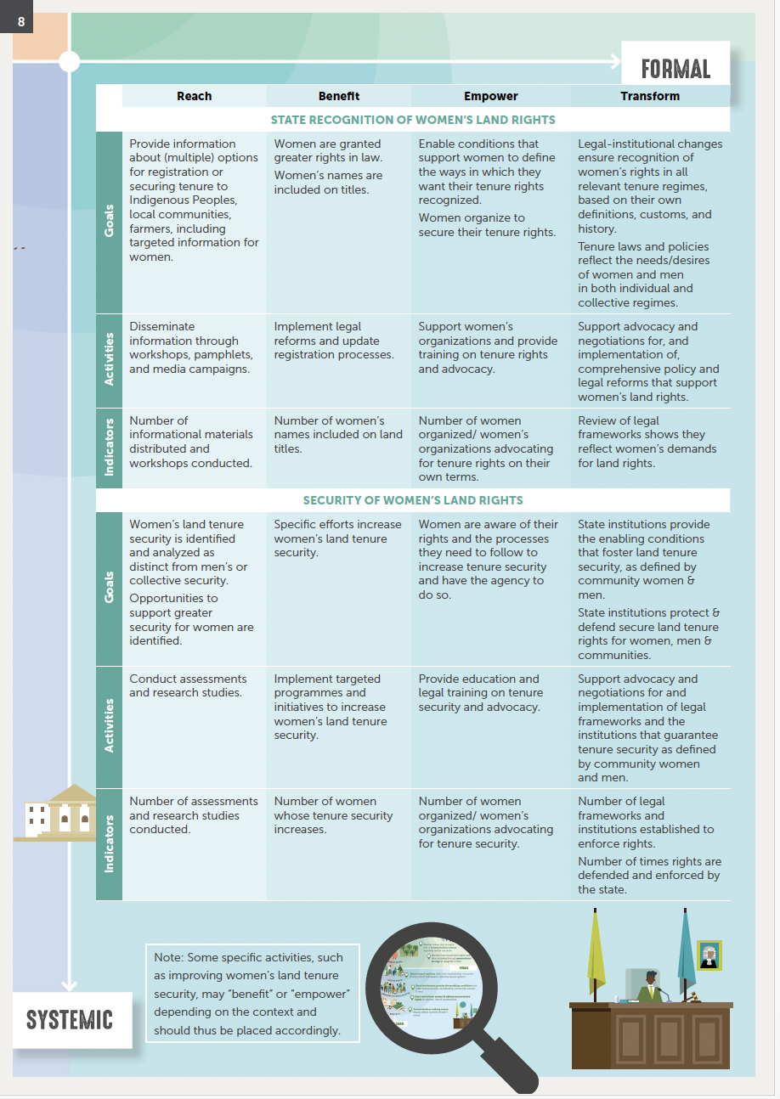

Slide 18
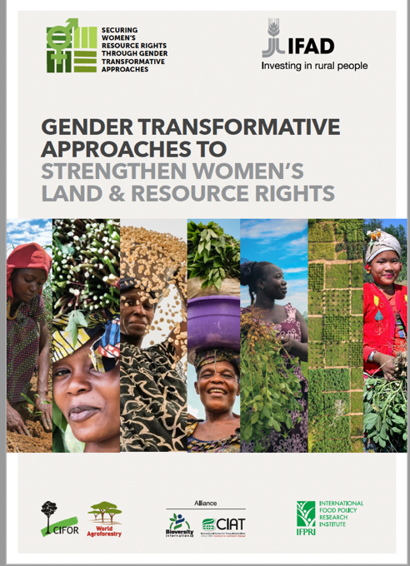
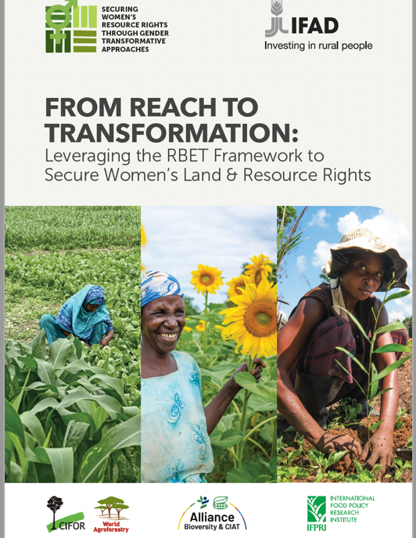
Notes:
These two publications go through what Miranda has shared and what I have shared.

Slide 19


OUTPUTS
28 country publications
14 tools developed in country pilots plus one overview guide to all the tools
7 other global publications, most of which are in 3 languages
https://www.cifor-icraf.org/wlr/

Slide 20
Thank you!
a.larson@cifor-icraf.org

