Slide 1



“Tenancy at Will” in Kenya Coast Region: Historical Roots, Current Challenges, and Pathways to Sustainable Land Tenure
Dr. Mary Wandia, Clementine Wavinya, Nancy Kosgey, Markmoses Kinaiti
National Land Commission, Kenya

Slide 2
Background
Land access and tenure security are essential for socio-economic development.
Land Tenure security, according to (Frank, F.K, 2003 and IFAD, 2015) influences the extent to which communities invest in land through access to credit, shapes social relations, contributes to social stability, improves land management and agricultural productivity.
25% of the global population lacks secure land rights (Landesa, 2022).
In Kenya’s Coast region, “Tenancy at Will” is a legacy of colonial and historical injustices.
The system perpetuates insecurity, disputes, and underdevelopment.
The system exemplifies the call for land justice and reparations.

Slide 3
Introduction
Tenancy at Will: an arrangement formal or otherwise where a tenant is allowed by the land owner and or their agent to build and own a house in exchange for paying rent to the land owner.
In Kenya there exist three main land tenure systems recognized under land laws; freehold, leasehold and customary/community.
Tenants-at-will, commonly understood as “houses without land” as form of tenure began prior to and manifested during colonial occupation at the coast.

Slide 4
In brief;
Rooted in colonial alienation and post-independence policy gaps.
'Houses without land' symbolize past and present land injustices.
Tenancy-at-Will is unrecognized in Kenyan law, perpetuating disputes.
Echoes Africa’s broader struggle for land rights and restitution.

Slide 5
Justification
This system is not covered under the existing land laws hence characterized by tenure insecurity thus (the land owners and the tenants at will cannot realize full potential of their property).
Numerous disputes exist in courts and other Government agencies including the National Assembly and National Land Commission for arbitration, legislation and determination.
There have also been claims of historical land injustices claims.
The National Land Commission commissioned this research study to understand this unique land tenure arrangement.

Slide 6
Objectives
The main objective of the study was to examine the tenancy at will, its sustainability and place in Kenya’s policy and legal framework.
The specific objectives were to;
To establish prevalence and examine nature of tenancy at will in Kilifi, Lamu and Mombasa Counties.
To establish the challenges and successes of the tenancy at will.
To provide recommendations on sustainability of the tenancy at will tenure system and its place in Kenya’s legal frameworks.

Slide 7
Scope
The study focused on Mombasa (Bondeni, Mvita, Tononoka) Lamu (Kashmir, Bombay and Shella) and Kilifi (Mtwapa, Tezo) Counties where the tenure system is prevalent.
The unique tenure system is within Mwambao, a ten-mile strip of coastal land that extended from Tana River in Kenya, to River Ruvuma and spread to a distance of ten miles from the high-water mark into the interior (Kanyiga, 2000) controlled by the Sultan of Zanzibar.
Notes:
River Ruvuma forms the boundary between Tanzania and Mozambique

Slide 8
Methodology
Mixed methods approach;
      Questionnaires:
      Key informant interviews:
      Focus group discussions
      Observations
  Respondents: Landlords, tenants, National and County Government officials, CSOs, Judiciary officials, community members and Law Society of Kenya.
  Sites: Mombasa (Mwembe Kuku), Kilifi (Mtwapa, Mtondia), Lamu (Bombay, Shella)
  Sampling: the study used purposive sampling to identify the sites and respondents to participate in the study.

Slide 9
Historical Evolution of Land Tenure in Kenya
Pre-Colonial: Communal ownership (Okoth-Ogendo, 1991).
Colonial: Crown Lands Ordinances (1902, 1915) made Africans 'tenants of the Crown.'
Post-Independence: Freehold titles preserved; locals became squatters.
→ Persistent tenure injustices requiring reparation and recognition.
Notes:
Pre-independence agreements
The post-colonial government, entered a pre-independence agreement with British Government and the Sultan regarding the control of land in Mwambao.
“The freehold titles to land in the Coast Region that are already registered, will at all times be recognized, steps will be taken to ensure the continuation of the procedure for the registration of new freehold titles and the rights of freeholders will at all times be preserved save in so far as it may be necessary to acquire freehold land for public purposes, in which event full and prompt compensation will be paid.”

Slide 10
Legal Framework Timeline
1897 – East Africa Land Regulations
1902 – Crown Lands Ordinance
1915 – Crown Lands Amendment
1963 – Government Lands Act
2010+ – Constitution & Land Acts (Land as a human right)
→ Reforms must now evolve toward justice and reparations for the dispossessed.
Notes:
Pre-independence agreements
The post-colonial government, entered a pre-independence agreement with British Government and the Sultan regarding the control of land in Mwambao.
“The freehold titles to land in the Coast Region that are already registered, will at all times be recognized, steps will be taken to ensure the continuation of the procedure for the registration of new freehold titles and the rights of freeholders will at all times be preserved save in so far as it may be necessary to acquire freehold land for public purposes, in which event full and prompt compensation will be paid.”

Slide 11
Tenancy at will in other jurisdictions
The existing literature indicates that that the system common in a number of the former British colonies.
Feudal land tenure in England; land belonging to the landed gentry was held by tenants in a lifelong mutual bond of trust, with the Crown being the ultimate source of authority
Crofting in Scotland; a relatively small agricultural land holding is held in tenancy and which may or may not have buildings or a house associated with it.
Zamindari in India; Landlords, under this settlement, were recognized as full proprietors of the land and in return, were given the responsibility of collecting rent from the farmers who were tenants
Mailo system in Uganda; land ownership in Buganda was controlled by Kabaka and individual plots were conferenced to individuals by local chiefs who became landlords and the ‘peasants’ tenants.

Slide 12
Case Study: Coast Region (Mwambao)
Mwambao: 10-mile coastal strip (Kanyinga, 2000)
Sites: Mombasa, Kilifi, Lamu.
Tenants build houses on private land without title.
Reflects unresolved colonial-era dispossession and need for coastal reparations.

Slide 13
Factors driving tenancy at will in Kenya
Affordability; a majority of tenants pay less than Kshs. 2,000 per month as rent in key urban areas and were engaging in subletting of housing units for rental income
Convenience; most of the areas where tenancy at will is prevalent in counties of Kilifi, Mombasa and Lamu are in close proximity to key public utilities or employment sources e.g port, CBD.
Inheritance; this arose from historical occupation of the area by the local indigenous communities (84% of HHs in Mombasa, 22% in Kilifi and 16% in Lamu)

Slide 14
Previous redress attempts
Presidential directive; a presidential directive in 1984 ordered the tenants to pay Kshs. 30,000 per plot for the street front rows and Kshs. 15,000 per plot for those located behind the street front row.
Suspension of ground rent; the Ministry of Lands in 2007 issued a notice to all the owners of the houses to cease to pay ground rent so as to ensure harmonious resolution of the rent disputes.
NLC led negotiation; negotiation over the rental dispute between landlords and tenants within Mombasa Island in 2019 recommended that landlords sell the land at the costs of between Kshs. 400,000 and Kshs. 500,000 per plot.
The recommendations were however not implemented due to the prevailing market value of the land.

Slide 15
Constitutionality of tenancy at will
In the case of Laurenco K. Karisa & 3 others v Salim Ali Jemadar as Administrator of Jemadar Amin & 6 others [2017] the constitutionality of the concept was questioned. The learned judge ruled as follows :
“The Constitution 2010 does not make any reference to the concept of “tenancy at will”. The Constitution has clearly specified the classification of land holding in Kenya. It behoves logic to ask this court to declare as unconstitutional that which the Constitution does not know or recognize…. Therefore, for the reason that the concept is not recognized under `the 2010 Constitution it is my finding that it cannot be said to be unconstitutional.”

Slide 16
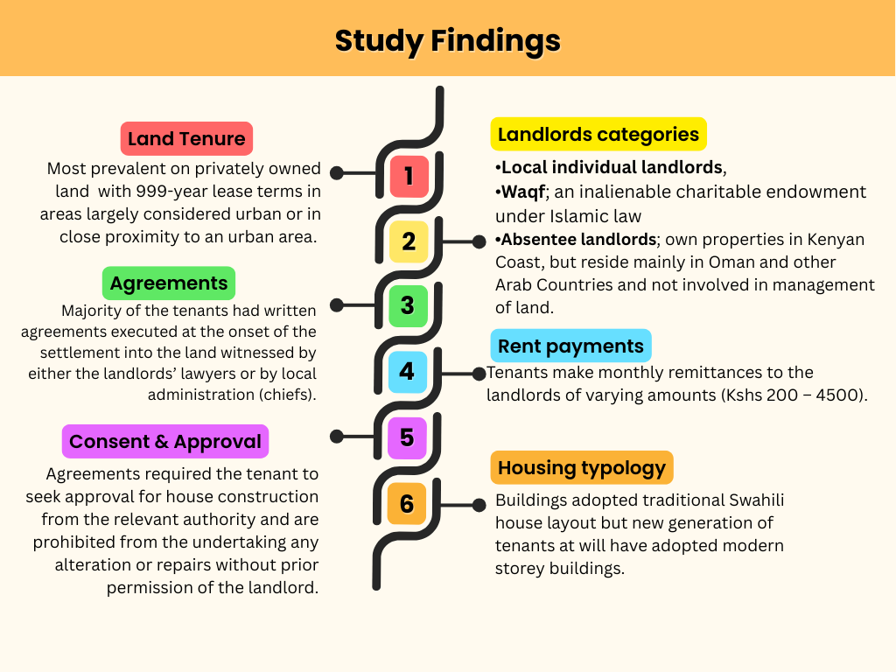
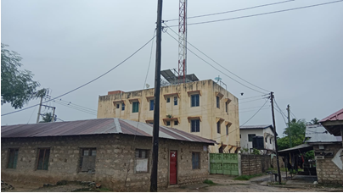

Slide 17
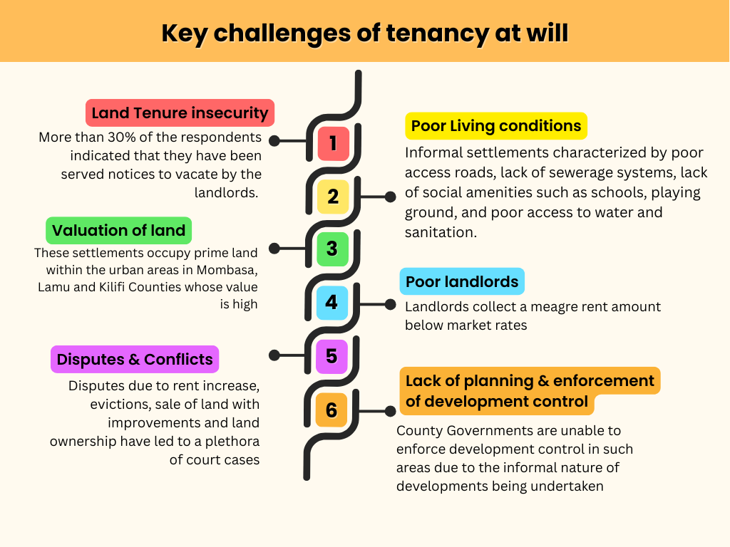
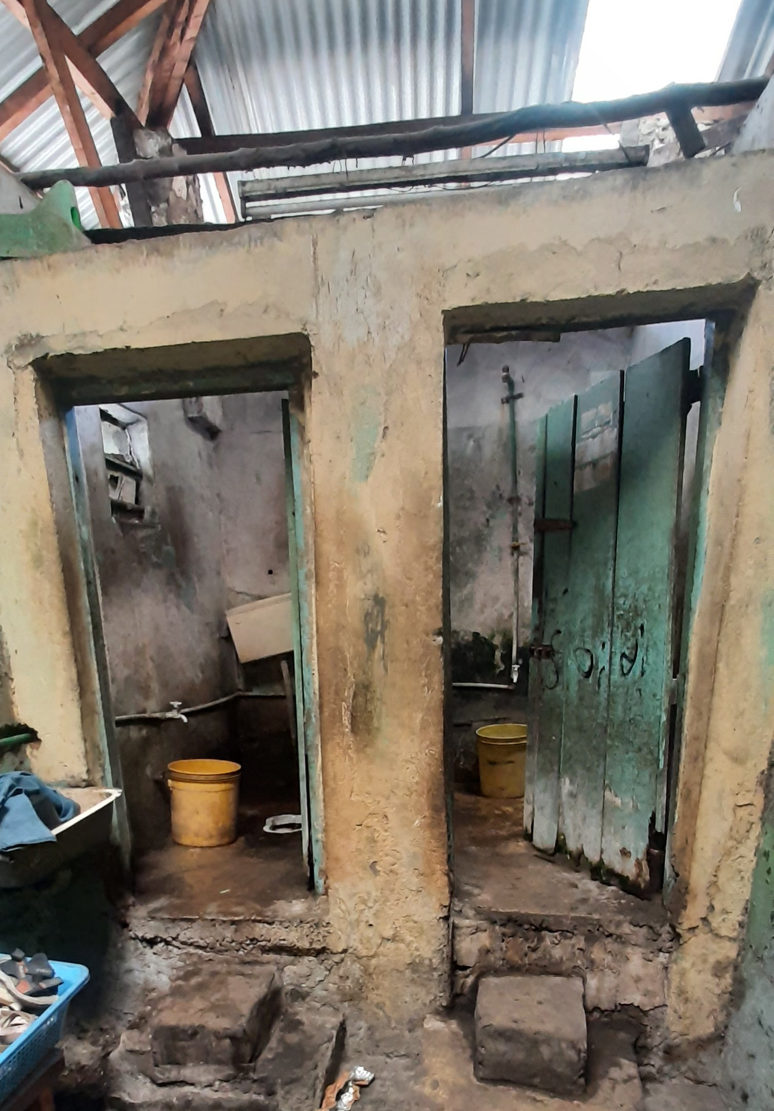
An example of dilapidated building in study area

Slide 18
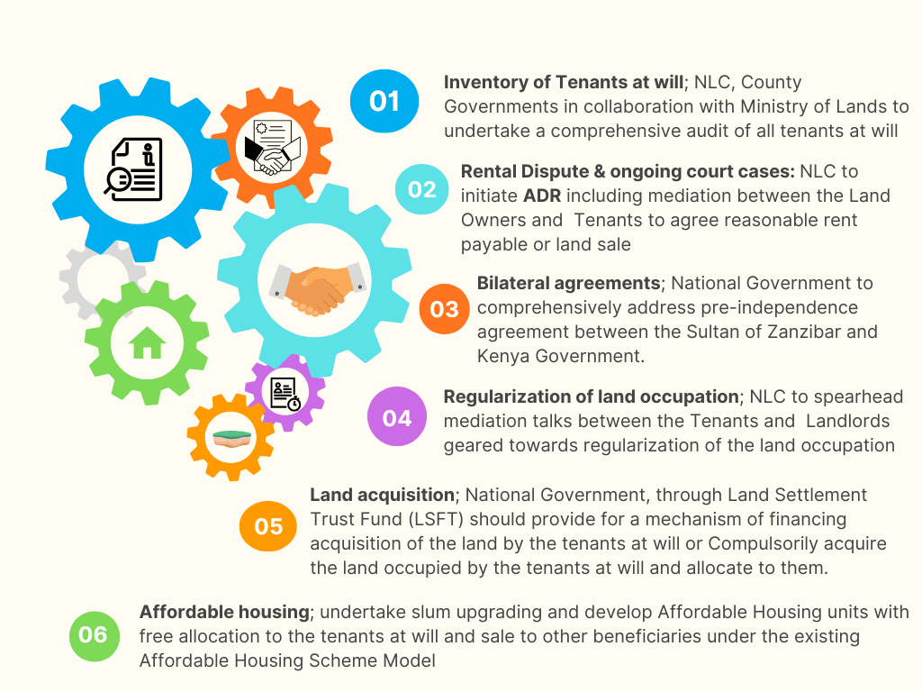
Recommendations

Slide 19
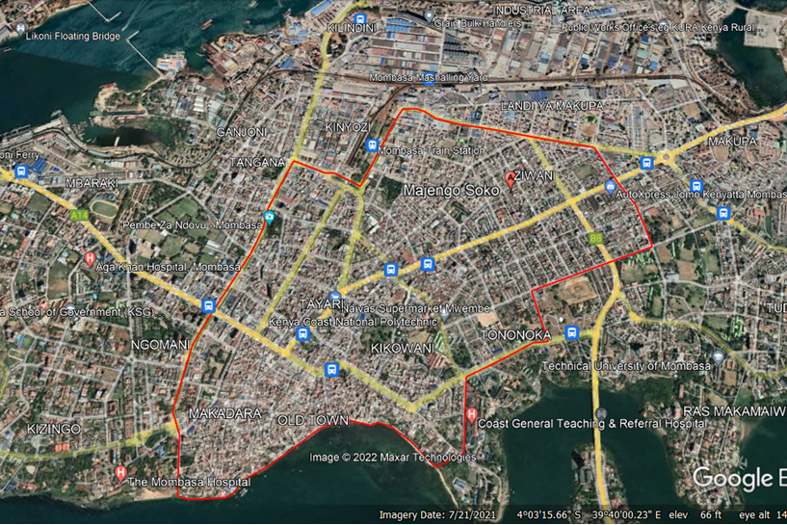
Satellite Image of Mombasa

Slide 20
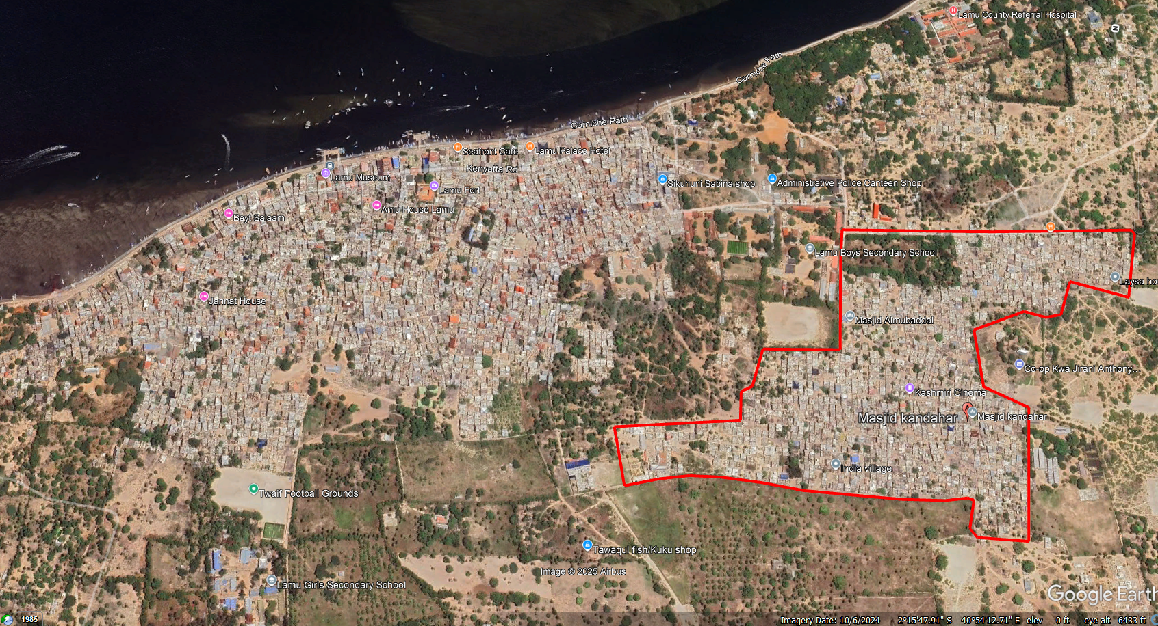
Satellite Image of Lamu

Slide 21
Thank you!
Email: info@landcommission.go.ke
www.landcommission.go.ke

