Slide 1

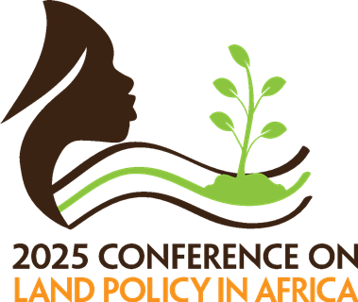


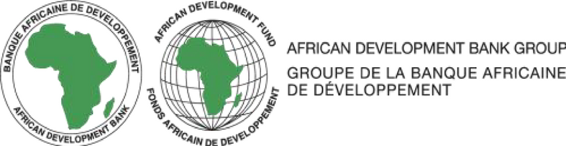

Artificial Intelligence for a climate Just and resilient Africa:
A Review of Colonial Legacies, Climate Injustice, and AI-Driven Reparations in Africa
1,2Ayah Lyacoubi,1Pr BENSIALI Saloua, 2MINKA Marcel Loyd, 2HOUEDJI Innocent Antoine, 3Pr BOULAASAL Hakim, 1Pr EL-AYACHI Moha
1Institut Agronomique et Vétérinaire Hassan II, Morocco
2 Youth Initiative for Land Administration in Africa
3 Abdelmalek Essaâdi University, Faculty of Science and Technology Tangier, Morocco

Slide 2

“There is a deep structural link
between the use and control of resources and the organization and exercise of power. Control over resources is the ultimate source of power.”
Shivji (1998)

Slide 3
The Climate Crisis in Africa Today
Colonial Climate Legacies?
“That the climate is changing is unequivocal. The landscape, the environment, the places we inhabit are changing too”
(Semplici & Campbell, 2023).

Slide 4
Climate legacies in Africa:
key findings from the literature review
There is a lack of studies directly mapping and assessing the impact of colonialism on Africa’s climate and environment.
Main data extracted from the 5 selected review papers
Existing Climate and environmental risks in Africa
Defining climate legacies
Identified Climate Legacies in Africa in literature
Solutions proposed for addressing climate legacies

Slide 5


Key findings : Defining climate legacies
There is no universally agreed-upon terminology for the concept
Climate coloniality (Sultana, 2022)
“Reproduction the hauntings of colonialism and imperialism through climate impacts in the postcolony, revealing uneven and unequal vulnerabilities and marginalizations.”
Toxic coloniality (Peša, 2024)
Where colonial massive extractive practices caused enduring environmental and social issues
Green colonialism (Blanc, 2022)
where forms of ecological control and destruction are carried out under the pretext of environmental policies.
Transactional colonialism (Ramirez & Böhm, 2021),
Describing how ongoing injustices can be traced back to historical colonial transaction.
Any climate, environment related risk caused under the colonial rule and has persistent negative impact on the climate and communities in Africa.

Slide 6
Identified Climate Legacies in Africa in literature
Cultural and political
Colonial and foreign interventions caused deep cultural and socioeconomic disruption by eroding indigenous identities, displacing communities, undermining traditional governance and rights, and institutionalizing inequality through exploitative land and labor systems.
Land, water and Resources
Colonial and post-colonial land expropriation and resource exploitation displaced Indigenous communities, degraded ecosystems, and fueled social, political, and environmental instability.
Food security and livelihoods
Colonialism’s unsustainable exploitation and monoculture practices disrupted ecological balance, destroyed biodiversity, and deepened food insecurity and livelihood loss.
Environmental and social
Colonial exploitation transformed natural environments into polluted industrial zones, causing environmental degradation, loss of biodiversity, and systemic environmental racism.

Slide 7

Solutions proposed by the authors for addressing climate legacies
PROPOSED SOLUTIONS
TRADITIONAL/INDIGENOUS APPROACHES
MODERN/ TRANSFORMATIVE APPROACHES
  Rituals, taboos, clan-based governance, community-led conservation
  Reintegration of customary tenure systems
  Empowerment of local chiefs and community-based governance
  Advocates for restorative justice rooted in indigenous traditions
  Recognition of indigenous energy ethics (Sovacool & Dworkin, 2015)
  Inclusion of Ubuntu and Southern cosmovisions (Muller et al., 2021)
  Coproduction of knowledge, participatory research
  Microfinance for women
  Inclusion of elders in advisory roles
  Culturally sensitive education programs
  Participatory land reform (e.g. Mozambique’s Land Campaign)
  Legal recognition of customary land rights
  Consultative forums for multisector dialogue
  Emphasizes distributive, inclusive , procedural and restorative justice frameworks
  Calls for pluralizing and localizing energy justice to reflect Africa realities
  Relationality and care
  Inclusion of local communities in remediation
  Environmental activism
  Knowledge pluralism
AI was not mentioned

Slide 8

Harnessing AI for reparatory justice in Africa
Defining AI
“AI is the science of making computers perform complex tasks typically associated
with human intelligence”(McCormick et al., 2024).
Machine Learning (ML) refers to a system that uses human-provided, problem- specific training data to automatically build analytical models and perform defined tasks (Janiesch et al., 2021).
Deep Learning is a subset of machine learning, it usually based on the use on “Artificial Neural Networks” (ANNs), it presents more advanced feature extraction ability, compared to ML. (Janiesch et al., 2021).

Slide 9

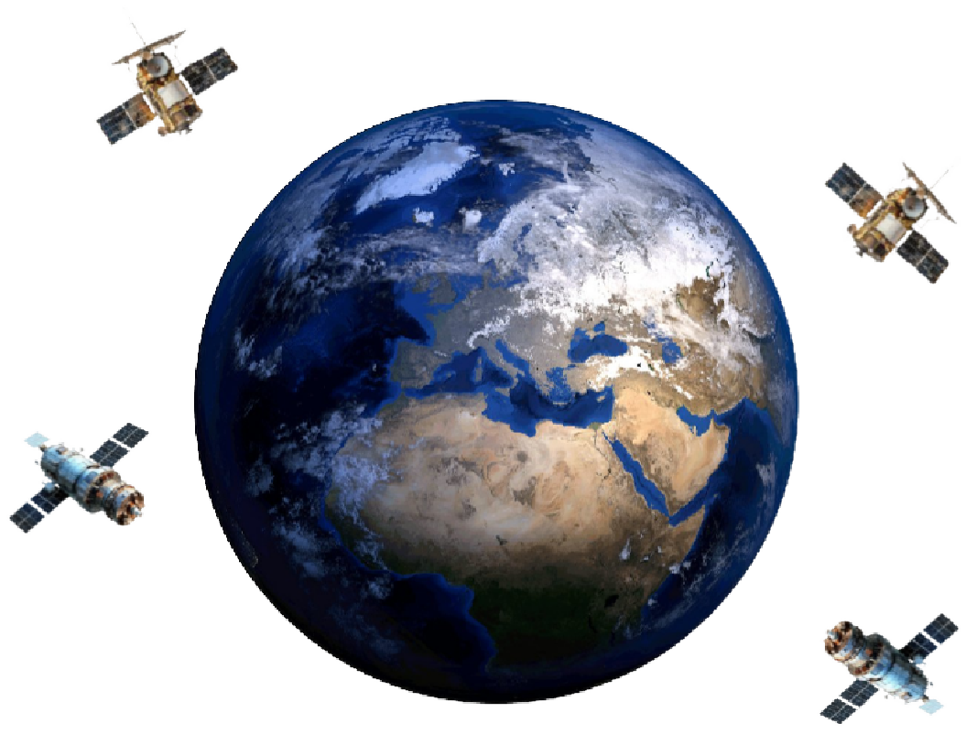
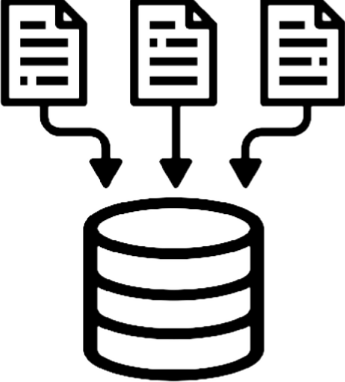


The intersection of AI and climate resilience
How is That Possible ?
322 currently-in-orbit earth observation satellites (WMO, 2024)
Classification, computer vision, deep learling and machine learning methods
Environement, soci- economic, climate,,..etc data
Data since 1972 (Launch of Landsat 1)

Slide 10
AI as a solution to overcome climate legacies: Opportunities
CULTURAL AND POLITICAL
LAND, WATER, AND RESOURCES
Predicting Human-Made Structures
Geolocation of Tweets
Urban Burglary Risk Assessment
Village-Level Poverty Identification
Human Travel Behavior Prediction
Mapping Human Perception
Conflict and Crime Prediction *added
Community Engagement Mapping *added
Building Detection and Mapping
Accurate Footprint Extraction
Advanced Road Marking Detection
Historical Road Mapping
Infrastructure and POI Analysis
Urban Pattern Classification
Building Detection
Coastal Mapping
Wetland Classification
Land Use Expansion
Feature Extraction
Multisource Data Integration
Footprint Mapping
Soil and Drainage Mapping
Aquaculture Mapping
FOOD SECURITY ANDENVIRONMENTAL AND
Climate Downscaling
Ecosystem Service Estimation
Green Space Analysis
Vegetation Dynamics Forecasting
Hazard Risk Assessment
Flood Risk Estimation
Landslide Susceptibility Mapping
Flash Flood Regionalization
SOCIAL
Time-Series Analysis
LIVELIHOODS
Aquaculture Mapping (also relevant here)
Village-Level Poverty Identification (also relevant here)
Soil Mapping (also relevant here
Crop Yield prediction *added
Pest and disease detection *added
Livestock health prediction *added
precision agriculture *added
“Advances in geocomputation and geospatial artificial intelligence (GeoAI) for mapping” by (Song et al., 2023)

Slide 11
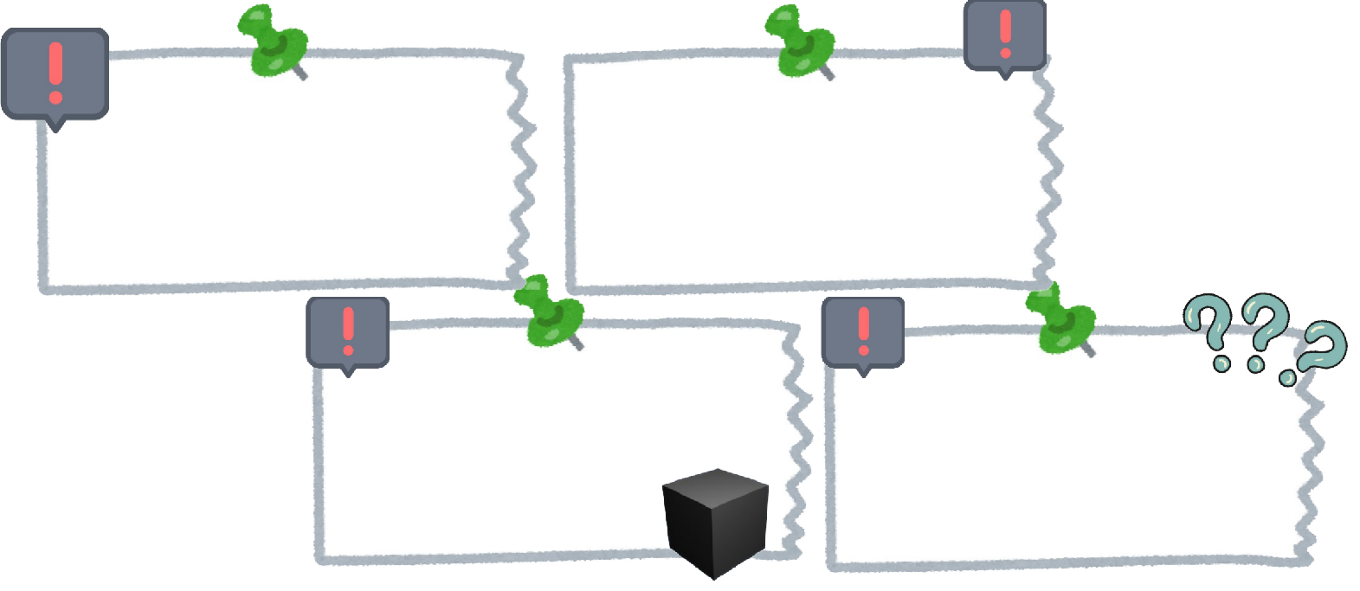

Limits and challenges of the use of AI in this context Is AI the Panacea to climate change?
Digital divide
Limited access to hardware, data infrastructure, and digital literacy in vulnerable communities.
Language and representation bias
Most AI tools use English and exclude local contexts and voices.
Data bias
AI models trained mainly on Global North data fail to reflect African and local climate realities.
Black box problem
Lack of transparency in AI decision- making limits trust, accountability, and ethical oversight.
AI paradox
AI systems meant to support climate action also consume vast energy and resources, contributing to emissions.

Slide 12
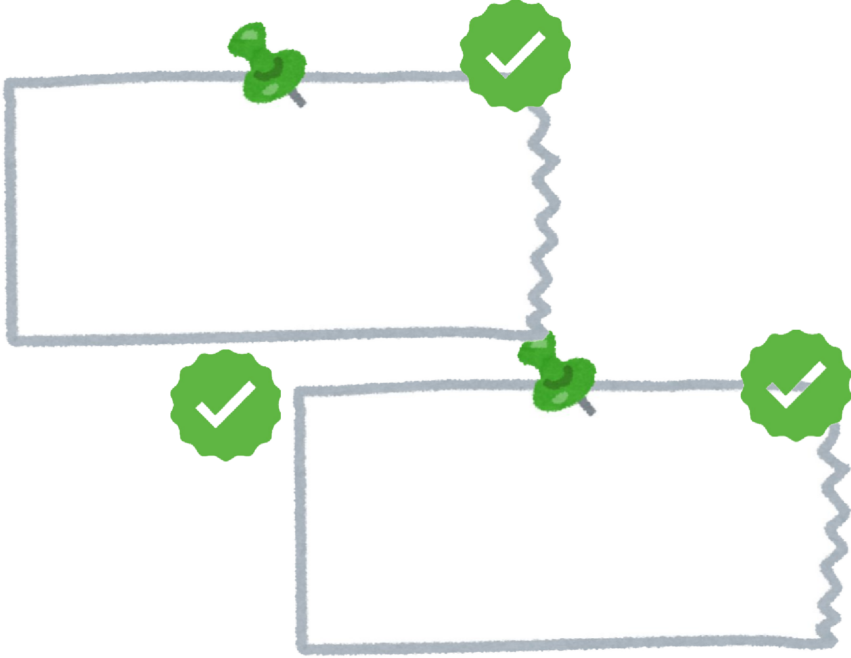
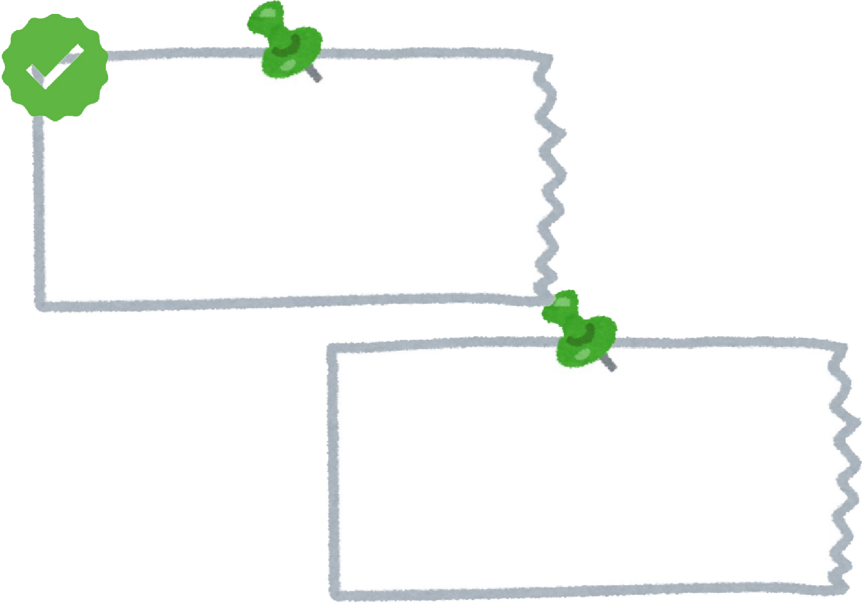

Recommendations
Digital divide
Invest in affordable internet, community tech hubs, and local digital training programs.
Language and representation bias
Develop AI tools in local languages and include indigenous knowledge systems.
Data bias
Build African data repositories and support local climate data collection.
Black box problem
AI paradox
Encourage transparent, explainable AI and local ethical oversight frameworks.
Promote green AI powered by renewable energy and energy-efficient computing.

Slide 13
Concluding remarks
“AI can be a true game-changer for Africa, a powerful panacea for many of our challenges, if used wisely, ethically, and with our realities at the center.”
“To unlock the power of youth, we must invest in their education, an education that meets today’s realities”

Slide 14
Thank you!
ayah.lyacoubi@gmail.com

