Slide 1

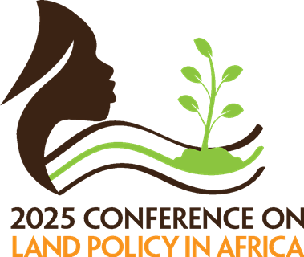




CONTESTED PERI-URBAN COMMONS: WHO OWNS THE LANDS IN THE SURROUNDINGS OF KUMASI, GHANA? Augustine Fosu Institute for Poverty, Land and Agrarian Studies, University of the Western Cape, South Africa & Institute of Social Anthropology, University of Bern, Switzerland

Slide 2
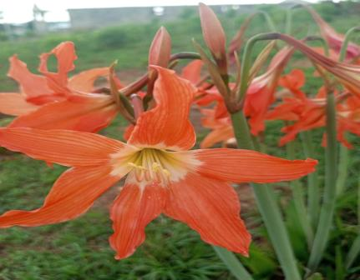
PRESENTATION OUTLINE
Introduction
Research context
Theoretical framework
Research methodology
Results and discussion
Conclusion

Slide 3
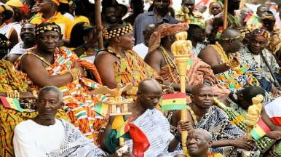
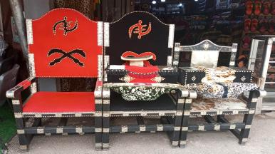
INTRODUCTION
This paper argues that the customary land ownership in Ghana has mutated since the pre-colonial era because of the country’s interactions with the European countries. The British destroyed the indigenous political structure and created a new structure which favoured their exploitative agenda. The British promoted their land tenure systems which regarded the chiefs of the communities as landowners.
In post-colonial era, the statutory recognition of customary land tenure systems and the strengthening of the capacity of customary land administration have sustained the distorted colonial land tenure systems in legal framework. During land commodification, the chiefs use the colonial notions of the customary, which are supported by the state land sector agencies, to evict their indigenes.

Slide 4
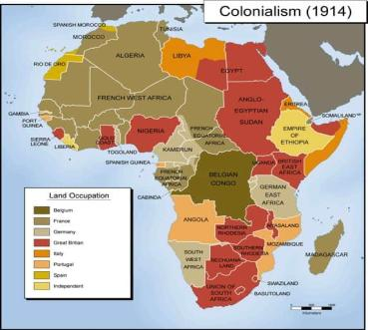
RESEARCH CONTEXT
Debate about the formalisation of customary land rights
In Africa and Ghana, customary land tenure systems/common property institutions are the predominant institutions that regulate the use of the commons. However, studies reveal that the common property institutions have changed over the years
During the colonial era, the changes in political, social, and economic organisations of the Ghanaian communities affected the common property institutions. Also, the formalisation of customary land rights led to changes in common property institutions.
In the post-colonial period, formalisation of customary land rights continues, and customary land administration has been strengthened.
Although formalisation of the common property institutions transforms the tenure systems, a study reveals that the common property institutions change when land values appreciate.
Notes:
Favours of formalisation of common property institutions argue that common property rights do not protect societies against resource destruction due to high costs of internalising externalities and transaction costs, creating a free-rider problem. Therefore, the commons should be privatised. Contemporary, many scholars and international lending organisations argue that customary land tenure systems should be recognised in legal frameworks and customary land administration should be strengthened.
On the other hand, other scholars argue that the commons have property rights. These scholars highlight that the Global South commons have existing institutional arrangements that protect landholders' rights and ensure fair distribution of resources.

Slide 5
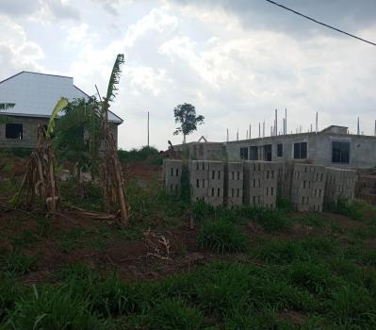
RESEARCH CONTEXT CONT’D
In peri-urban Ghana, urban expansion, internal migration, globalisation, the proliferation of land laws, and technological advancement have increased the demand for customary lands (common property), resulting in land commodification.
During the land commodification, traditional leaders such as chiefs and clan heads redefine the common property institutions regulating the customary lands and evict their subjects from their ancestral lands
The change in common property institutions results in land conflicts, breakdown of social cohesion, intergenerational loss of wealth, and deepen the existing social inequalities.
Notes:
Presently, population increase, urban expansion, local and international policies, globalisation, and technological advancement have exacerbated the demand for customary lands in peri-urban communities in Ghana (Ubink, 2008c; Akaateba, 2018; Fosu, 2020; Sumbo, 2021).
The increase in demand for customary lands in peri-urban areas often leads to land commoditisation, which causes state land actors and traditional leaders to enforce formalised customary land rights in these communities (Akaateba, 2018; Sumbo, 2021; Fosu, 2022).
During the land commodification in peri-urban Ghana, institutional pluralism is created on the commons, where actors employ state laws and traditions to manage peri-urban commons. This situation affords actors with higher bargaining power, such as traditional leaders, clan heads, and community elites, opportunities to change the existing common property institutions. Scholars highlight that the redefinition of customs on peri-urban commons by actors precipitates the eviction of subjects from their ancestral land during land commoditisation (Nyasulu, 2012; Barry and Danso, 2014; Akaateba, 2019; Fosu, 2020; Sumbo, 2021).

Slide 6

RESEARCH CONTEXT CONT’D
Research Gap
The widespread land commodification and the changes in common property institutions in peri-urban customary land governance have been noted in the literature.
When the customary land values appreciate, studies reveal that chiefs redefine customs on land allocation and claim that all the customary lands must be allocated by them (Akaateba, 2018; Fosu, 2020; Sumbo, 2021).
The land use conversion creates contestations and struggles between chiefs and clans and within clans.
At the heart of this land use conversion is the question of who owns the land (land ownership), which is influenced by a complex interplay of customary practices, statutory laws, and the socio-political dynamics in peri-urban Ghana.
Several studies have documented a redefinition and reinterpretation of customs on land ownership by chiefs during land commodification (Nyasulu, 2012; Barry and Danso, 2014; Akaateba, 2019; Fosu, 2020; Sumbo, 2021).
Some studies portrayed the redefinition of land ownership as a shortcoming of the customary land tenure systems and recommend formalization of land rights. Others also illustrate the reinterpretation of the land ownership without showing empirically and theoretically how the changes occurs and the ways actors legitimize the reinterpretation of the land ownership patterns.
Notes:
Despite the changes in common property institutions and power relations in customary land governance emerging during land commodification in peri-urban Ghana and beyond, the World Bank and other international lending organisations have relentlessly endorsed the statutory recognition of customary land tenure systems and the strengthening of the capacity of customary land administration as a nascent strategy to enhance tenure security, improve the livelihood of the rural poor, and boost economic development in developing countries (Deininger, 2003; Knight, 2010; Collins and Mitchell, 2016; Akaateba, 2018).
Furthermore, studies on institutional change and power relations in customary land governance portray the institutional change as swift and often focus on the distributional effects such as land conflicts, land use changes, livelihood struggles, and others emerging from the changes in the common property institutions and power relations (Nyasulu, 2012; Barry and Danso, 2014; Akaateba, 2018; Fosu, 2020; Sumbo, 2021).

Slide 7
RESEARCH CONTEXT CONT’D
Relevance of the Study
Moreover, about 80% of Ghana’s land is under customary administration, and most peri-urban commons are under customary land administration.
Furthermore, peri-urban areas have become an alternative source of land for urban residents who cannot afford the higher housing land prices in urban areas.
Additionally, there is a continuous proliferation of laws and policies, both locally and internationally to formalise common property institutions, and this has incessantly increased the power of customary authorities.
Consequently, this situation has necessitated a study on how land ownership patterns change in customary land governance in peri-urban areas of Ghana during land commodification.
Overarching Research Questions
This study primarily tries to fill this gap and examine the complex contested terrain of land ownership within the customary land governance in peri-urban Kumasi, Ghana. The paper, predominantly, explores the power asymmetries among actors, their motivations, and strategies adopted to shape land ownership patterns during land commodification.
Notes:
Moreover, approximately 80 per cent of Ghana's total land is customary land, and the commodification of peri-urban lands affects the customary land governance in these areas.

Slide 8
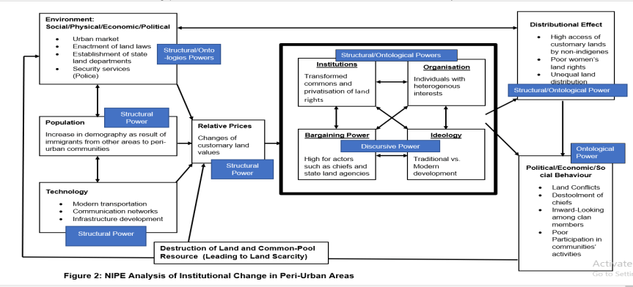
THEORETICAL FRAMEWORK

Slide 9
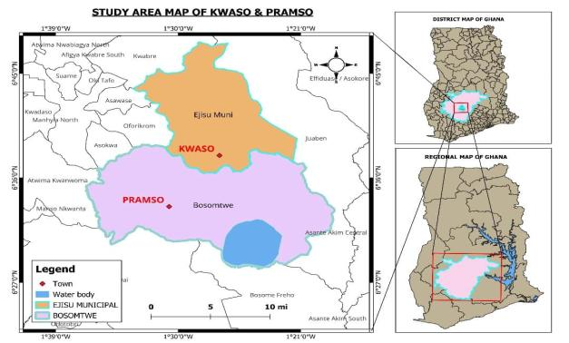
RESEARCH METHODOLOGY
Research Strategy
(Case Studies)

Slide 10
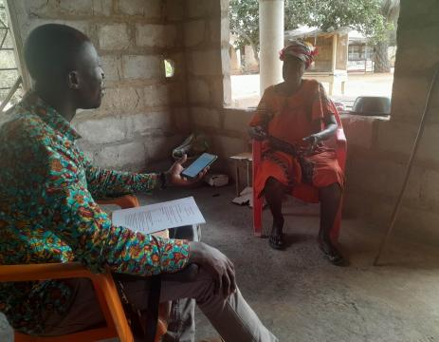
RESEARCH METHODOLOGY CONT’D
Research Methods
Qualitative research method
Sampling Techniques
Purposive sampling for key informants and snowball sampling for households

Slide 11
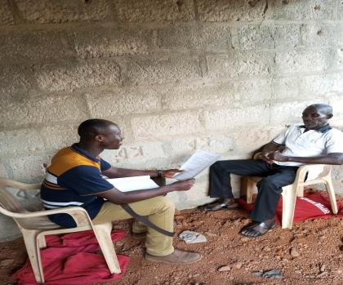
RESEARCH METHODOLOGY CONT’D

Slide 12
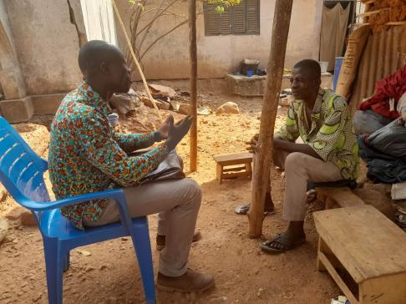
RESEARCH METHODOLOGY CONT’D
Sampling instrument
Key informant interviews for participants such as traditional authorities, land surveyors, Asante historians, and government officials.
Biographies and narrative interviews for household heads.
Data analysis
Thematic analysis

Slide 13
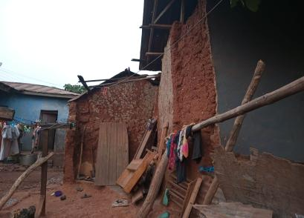
RESULTS AND DISCUSSION
PRE-COLONIAL AND COLONIAL CUSTOMARY LAND OWNERSHIP IN KWASO AND PRAMSO
Believed that the lands and the land property were protected by earth goddess (Asaase Yaa), smaller gods (abosom), spirits (ahonhom), and ancestral spirits (nsamanfoↄ)
The spirits protected the users of the land and helped them to be successful in their economic activities on the land
Initial land acquisition by the first settlers and latter clans who supported the initial establishment of the communities acquired lands through the clearance of the virgin forest
I was told that during the time of our ancestors,….the virgin forests were available. Wherever you cleared became your property. It was not that someone fought and claimed all the lands and shared with the latter clans. Those who were able to clear more land obtained vast land. People did not divide the land and give the plots to others, unlike today, the way plots of land for housing are delivered to prospective land purchasers (Interview with KWIN–5, Kwaso, 10/10/2023).

Slide 14
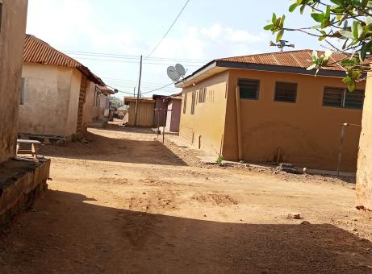
RESULTS AND DISCUSSION CONT’D
PRE-COLONIAL AND COLONIAL CUSTOMARY LAND OWNERSHIP IN KWASO AND PRAMSO CONT’D
Latter clans that joined the communities after their establishment acquired land through gifts, purchase, and sharecropping arrangements.
During the colonial era, the customary land tenure systems in these research did not change significantly because they were villages. Also, the colonial administrators did not dispossess the people in Ashanti region, unlike Southern and Eastern Africa

Slide 15
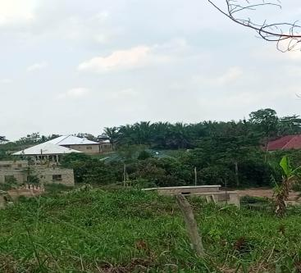
RESULTS AND DISCUSSION CONT’D
LAND COMMODIFICATION IN KWASO AND PRAMSO
Using NIPE, the factors that caused an increase in land values included environment, population, and technology
Environmental factors
Physical (the expansion of the Kumasi metropolis, proximity of peri-urban areas to the urban centres);
Economic (changes in the occupations of the people–agrarian economy to industrial or technology economy, the nature of housing provision in Ghana, and the differences between the land prices in peri-urban and urban centres, and the urban market)
Social factors such as the breakdown of attachment to building houses in hometowns and the greediness of traditional leaders led to the increase in customary land prices in Kwaso and Pramso.
Current legal system (customary land administration) motivated people to purchase customary land in both communities.
“Many non-indigenes migrate to Kwaso to buy plots of land for residential purposes. The reason is that when you go to Kumasi, for instance, Gyinyase, I heard that a plot of land was GHS150,000.00 about 3 years ago. If a person has such an amount of money and comes here, the person can purchase a plot of land and build a mansion.” (Interview with KWIN–6, Kwaso, 28/02/2023).

Slide 16
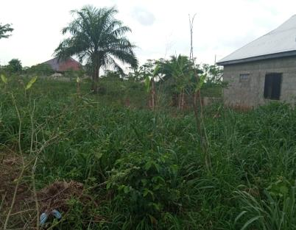
RESULTS AND DISCUSSION CONT’D
LAND COMMODIFICATION IN KWASO AND PRAMSO CONT’D
Using NIPE, the factors that caused an increase in land values included environment, population, and technology
Population Growth
Population contributed to the increase in the land values in Kwaso and Pramso.
Technology
Technological advancement including the development of infrastructures and improvement in transportation and communication networks contributed to the changing relative prices of customary lands in Kwaso and Pramso.

Slide 17

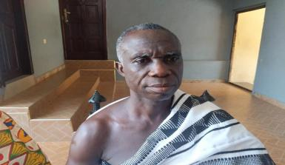
RESULTS AND DISCUSSION CONT’D
ACTORS AND REDEFINITION OF CUSTOMARY LAND OWNERSHIP
Actors in Customary Land Governance
Chiefs, clan heads, clan elites, state land agencies (the Physical Planning Department, Office of the Administrator of Stool Lands, Customary Land Secretariats, and Lands Commission of Ghana), private surveyors, and indigenes.
Redefinition of Customary Land Ownership
Some research participants mentioned that the lands were owned by the stools (chiefs) of the communities but not the individuals or the various clans.
The majority of the research participants from the government land sectors, courts, police service, Ashanti regional house of chiefs, land secretariats, the sub-chiefs, and an indigene mentioned that the Golden Stool (Otumfuo) owned all lands in Ashanti region.
Some research participants stated that the lands in the Ashanti region belonged to clans and families.

Slide 18
RESULTS AND DISCUSSION CONT’D
INSTITUTIONAL SHOPPING, COUNTERCLAIMS, AND POWER RELATIONS: STRUCTURAL AND ONTOLOGICAL POWERS
Use of the discourse of first discovery by chiefs to claim that the communities’ lands belonged to them. The narrative was that the chiefs’ ancestors founded the communities and gave the latter clans lands for cultivating crops.
The general counterargument was that the community was founded by the initial latter clans and the first settlers during the Asante wars.
Asante ako no akyi na nkuro kyekyereɛ (We established communities after the Asante wars) (Interview with PRIN-6, Pramso, 06/12/2024)

Slide 19
RESULTS AND DISCUSSION CONT’D
INSTITUTIONAL SHOPPING, COUNTERCLAIMS, AND POWER RELATIONS: STRUCTURAL AND ONTOLOGICAL POWERS CONT’D
Chiefs claimed ownership of the community lands on the basis that their ancestors went to war and obtained the land.
The counterargument was that the chiefs’ ancestors did not go to the wars alone. Some of the other clans that contributed to the initial establishment of the communities were instrumental in those wars.

Slide 20
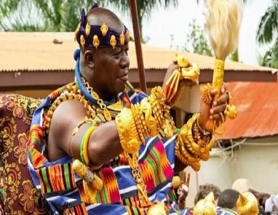
RESULTS AND DISCUSSION CONT’D
INSTITUTIONAL SHOPPING, COUNTERCLAIMS, AND POWER RELATIONS: STRUCTURAL AND ONTOLOGICAL POWERS CONT’D
The chiefs used the traditional discourse that the Asantehene was the landowner of all the lands in the Ashanti region and the chiefs were his representatives to legitimate their claim that they were landowners. The argument was that Asantehene was the overlord of all the chiefs in the Ashanti region.
On the contrary, some research participants highlighted that the perception that the Golden Stool is the owner of all the lands in the Ashanti region diverges from the Asante land tenure systems.
The Asante Confederacy was formed by Okomfo Anokye who united the different Asante states with the Golden Stool. Osei Tutu I was the first king of the Asante Empire. Each state owned its land and when they came together, the Asante King did not directly involve himself in their land affairs. However, he allowed each state to manage its land. (My Field Notes: Interactions with AS–HISTORIAN–1, Asante Historian, 25/10/2023).

Slide 21
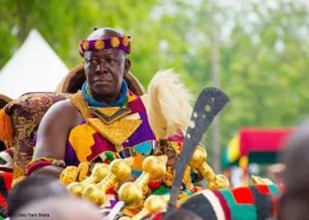
RESULTS AND DISCUSSION CONT’D
INSTITUTIONAL SHOPPING, COUNTERCLAIMS, AND POWER RELATIONS: STRUCTURAL AND ONTOLOGICAL POWERS CONT’D
The chiefs had both structural and ontological powers.
Some indigenes had structural and ontological powers. However, their structural and ontological powers were weaker than the chiefs’. The support the chiefs gained from the state and the sale of lands to obtain money helped the chiefs to have stronger structural powers.
Increasing Structural Power/Bargaining Power
Indigenous people
Some indigenes send the chiefs to court
Alliance with higher chiefs and political affiliation
Chiefs
Chiefs sent some people to court
The chiefs used the police to arrest the people who resisted their land allocations
Use the provisions in the 1992 Constitution [Article 36 (6)] and support from land sector agencies

Slide 22
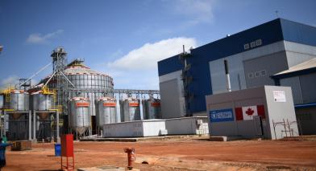
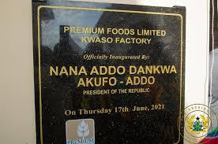
RESULTS AND DISCUSSION CONT’D
Legitimisation of Emerging Institutions, Counterarguments, and Power Relations: Discursive Power
Traditional development institutions (Traditional development discourses and narrative)
Modern development institutions (modern development discourses and narrative is that the indigenes would get jobs)
Allocation of Land for Premium Foods Limited and nursing schools)
Counterargument
The indigenes were not recognised traditionally and in the legal frameworks of the state.
Discursive Power
The chiefs had more discursive power than the indigenes

Slide 23
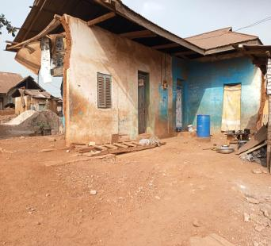
CONCLUSION AND RECOMMENDATION
CONCLUSION
In conclusion, the paper has illustrated how land ownership patterns have transformed in peri-urban Ghana since the pre-colonial era and uses Kwaso and Pramso in peri-urban Ghana.
The paper also argues that contemporary, the commodification of customary lands reveals a new version of indirect rule where foreign and domestic capitals use the state and the chiefs to evict indigenous people from their commons. The state shows an unconcerned attitude, and the indigenes lose their lands and become landless leading to intergenerational loss of wealth.
In fact, the idea that the statutory recognition of customary land tenure systems and the strengthening of customary land administration will support poverty alleviation, promote economic development and tenure security of the vulnerable is a misnomer in peri-urban. However, the recognition of customary land tenure systems in legal frameworks and the strengthening of the capacity of customary land administration continue to sustain the distorted notions of customary tenure systems created during colonialism.
RECOMMENDATION
The paper recommends that a deeper understanding of the historical, cultural, and power dynamics of customary land ownership is vital for developing sustainable land management strategies that balance the interests of diverse stakeholders and promote equitable development in peri-urban Ghana and beyond.

Slide 24
Thank you!
augustfosu84@gmail.com
augustine.fosu@students.unibe.ch
388570@myuwc.ac.za

