Slide 1


From Compounds to Cooperatives: Women’s collective mobilization for state irrigation land in patrilineal Northern Ghana Gertrude Aputiik Department of Sociology University of Ghana, Legon.

Slide 2
Context : Women’s Land Access constraints
Marginalisation
Land sizes
Type of land
Tenure security
Customary norms (Apusigah 2009; Adolwine & Dudima, 2010; Agana, 2012; Cooper, 2012; Wanyeki, 2003) Neoliberal factors (Aputiik, 2020, 2021; Kidido et al., 2017)
Customary Norms
Neoliberal factors
Notes:
When you ask the question : In what ways are women marginalized in the access and control of land? You find this existing literature, now overemphasized.

Slide 3
The reverse question
In what ways do women negotiate their vulnerabilities for land access and control?

Slide 4
Case study : Rice irrigation project in Biu, Upper East region, Ghana.
How women mobilized for state irrigation lands
What is the collective mobilization strategy employed by women for access to state irrigation land?
What are the specific outcomes of the mobilization

Slide 5
Critical Agrarian studies
Feminist Political Ecology
Land tenure
Customary Institutions (Patrilineal structures)
Gender – shapes resource access and control
Gender as relational but also reconfigured through agency
Land Tenure (Amanor and Ubink 2008; Lund 2002; Peters 2013; Yaro et.al 2018, Griffths 1986) Feminist Political Ecology (Bezner Kerr 2014; Elmhirst 2011b; Guruani 2002; Hovorka 2006; Rocheleau et. al. 1996; Nightingale 2011)

Slide 6
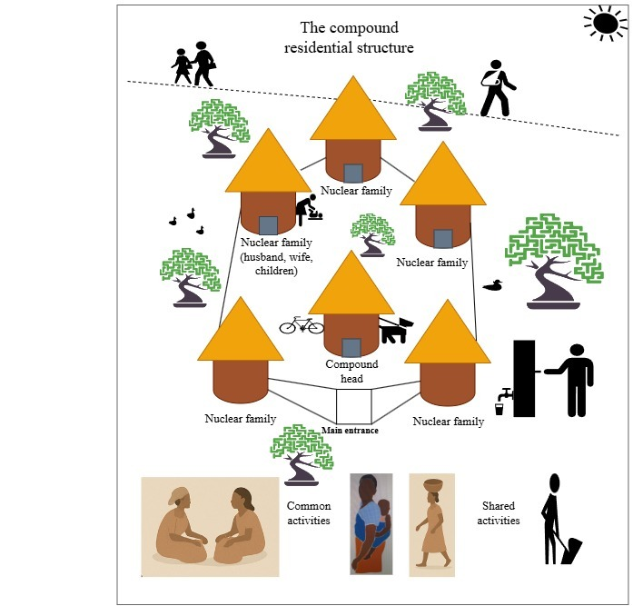
Mobilisation strategy
The compound mobilisation model
The compound as a site of resistance
From compound to cooperative
The collective as collateral

Slide 7
Outcomes and sustainability of the mobilisation
Successful acquisition of irrigation land
Transformed local women into entrepreneurial cooperative members, so neither individual ‘petty commodity producers’ nor wage labourers
Regional expansion of women farmer cooperatives
Intergenerational thinking around resistance to gender discrimination.
Intergenerational land transfers to daughters, in-laws, etc

Slide 8
Conceptual and Policy Reflections
Patrilineal communities may not be sites of equity
Yet, the compound residential structure peculiar to patrilineal communities of Northern Ghana provides space for building collectives and movements
Leveraging women’s traditional place and space for mobilisation
Confronting customary and statutory institutions require multiple strategies
Strengthening women farmer cooperatives

Slide 9
Thank you!
gaputiik@st.ug.edu.gh
gertrudeaputiik@gmail.com

