Slide 1






Land Based Products, Trade And Intellectual Property In Africa Gideon Ngaruiya Graduate Student, University Of Turin

Slide 2
Structural disconnect between land-based production capacity and capturing returns along value chains:
60% of the world's uncultivated arable land in Africa
Food imports projected to surge from $35 billion (current) to $110 billion by 2025
33 million smallholder farms contribute 70% of the continent's food supply
Majority of farms are less than 1 hectare
Smallholder farmers remain trapped in poverty cycles

Slide 3
Beyond Production: Strategic Value Addition through GIs
Traditional GI function: Information asymmetry mitigation (Akerlof market failure remedy)
Redistributive function: Conferring bounded territorial monopoly power on dispersed producers
Mechanism: Non-excludable collective good (designation) creates excludable private benefits (premium pricing via quality signaling)
Rental extraction: GI-protected products command 15-30% price premiums independent of quality differentials
Prerequisite: Producer coordination capacity and compliance with exogenous quality standards (certification requirements)
Collective Ownership
Premium Pricing

Slide 4
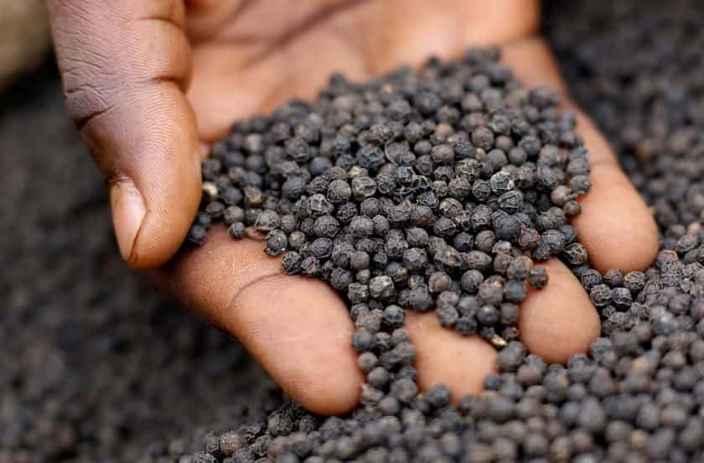
African GI Success stories
Penja Pepper (Cameroon): €50–100/kg premium (gourmet EU markets) with 20% CAGR post-designation
Income redistribution: 3,000 registered smallholders earn 3x baseline pepper grower income
Scale of appropriation: €30–50M annual export revenue captured by smallholder cohort
South Africa: 106 GI registrations (wine, rooibos, honeybush tea) dominating premium segments
Aggregated impact: ~190 African GIs registered (baseline 2010), representing concentrated geographic and sectoral clustering
Caveat: Selection bias;GI success predicated on producers meeting EU compliance; excludes subsistence and intermediate producers;Scalability

Slide 5
The Patent Problem: Incentives of Scale vs Agricultural Biodiversity Loss
Patent protection incentivizes uniform, high-yielding crop varieties
Drives farmers away from traditional varieties
Results in genetic erosion as diverse local cultivars are abandoned
Loss of agricultural biodiversity increases vulnerability to environmental stresses
Reduces genetic resources for future crop improvement
Particularly critical in context of climate change
No ecological cost for patent-holder

Slide 6
Biopiracy: Appropriation, Commodification and Decontextualization of Land-Based products
Biopiracy mechanisms: Patent-granting on traditional practices/derivatives without prior informed consent or benefit-sharing
Teff case study: Ethiopian grain (3,000-year cultivational history); 2003 EPO patents to Dutch inventor Jans Roosjen (processing/storage); invalidated post-litigation
Pharmaceutical biopiracy: Systematic documentation of traditional medicinal knowledge → patenting of synthetic derivatives or extraction processes
Consequence: Traditional healers legally prevented from accessing ancestral pharmacopoeias; knowledge expropriation decoupled from cultural context
Governance gap: Patent examination agency (ISA) capacity in SSA, GRATK requires disclosure but lacks enforcement teeth

Slide 7
Leveraging TRIPS Flexibilities and Regional Integration
Compulsory licensing mechanisms
Exhaustion principles-regional under AfCFTA IP Protocol
Can balance IP protection with public welfare concerns
Genetic Resources and Traditional Knowledge Treaty requires mandatory disclosure, Nagoya Protocol requires PIC and ABS.
Know-how as key element of technology transfer under WIPO DA
Leverage the Africa Continental Free Trade Agreement (AfCFTA) as market and negotiating bloc

Slide 8
Policy Solutions
Local value chain governance and linkage effects
Formalize indigenous innovation systems and promote intra-Africa knowledge-transfer
Supportive and progressive cooperative policies as “vents-for-surplus” demographic and epistemic
Digitalising Certificate of Origin and phytosanitary certificates, SPSS disharmony is an NTB
Facilitating MSME consolidation of costs, encourage tailored FIs products

Slide 9
Thank you!
hello@meetgideon.me

