Slide 1


Bridging the Reparations Gap:
An Analysis of Land Dispossession and Foreign Land Acquisitions in Post-Independence Africa
Michael Ayertey Nanor, PhD
Department of Planning
Kwame Nkrumah University of Science and Technology,
Kumasi, Ghana

Slide 2
Presentation Outline
Introduction
Study objectives
Global land politics and development debates
Land governance in africa: continuity and change
Theoretical perspectives on land justice
Methodological and empirical gaps in land studies
Conceptual framework
Methodology
Results
  Reparations gap index
  Logistic regression model
  Determinants of tenure security in African countries
  Spatial clustering of reparations gap index (RGI
Synthesis and policy sensitivity analysis
Policy recommendations moving forward
Conclusion

Slide 3
INTRODUCTION
Land is more than a productive asset; it is a cornerstone of social identity, political authority, and economic power.
Globally, pressures on land are shaped by overlapping crises of climate change, food insecurity, and financial speculation.
Africa’s post-colonial land paradox reveals a profound contradiction of sovereignty.
The core problem is that land injustice is cumulative. Yet research and policy often treat colonial expropriation and modern LSLAs as separate issues

Slide 4
INTRODUCTION
This leads to three interrelated challenges;
Theoretical Fragmentation
Measurement Deficiency
Policy Inertia
This study seeks to interrogate and empirically measure the cumulative debt of land injustice across Africa.
Specifically, the study constructs RGI for 39 African countries, drawing on archival data on colonial land loss, Land Matrix records on LSLAs, and tenure security surveys from FAO and Prindex

Slide 5
STUDY OBJECTIVES
The study aims to conceptualise, operationalize, and empirically measure the Reparations Gap as a structural justice deficit in African land governance. Specific Objectives Includeds;
To develop a theoretical framework integrating colonial dispossession, contemporary LSLA, and tenure insecurity across Africa
To construct RGI for 39 African countries by combining colonial land alienation estimates, Land Matrix LSLA records, and tenure security data
To analyze the determinants and developmental impacts of the RGI using econometric models
To generate geospatial insights by mapping LSLA hotspots against tenure insecurity and ecological zones
To derive policy recommendations aligned with SDGs, AU Agenda 2063, and UNECA frameworks, turning reparations discourse into evidence-based reform strategies

Slide 6
GLOBAL LAND POLITICS AND DEVELOPMENT DEBATES
The politics of land has always been central to the making and remaking of global order
In Europe, the enclosure movement transformed vast tracts of common land into private property, displacing peasants and consolidating wealth into the hands of a few.
In the Americas, plantation economies established through slavery and colonization converted land and people alike into commodities.
According to the Land Matrix, Africa accounted for more than half of the over 30 million hectares of land acquired between 2000 and 2021, globally.

Slide 7
GLOBAL LAND POLITICS AND DEVELOPMENT DEBATES
Governments in many low-income countries frame such deals as vehicles for achieving the Sustainable Development Goals, particularly SDG 1 and 2
Global governance frameworks have attempted to regulate these dynamics, but with limited effect.
Critics argue that such frameworks legitimize dispossession by cloaking exploitative practices in the language of “responsibility” and “sustainability.”
The paradox is stark: Africa holds nearly 60 percent of the world’s uncultivated arable land but continues to have some of the highest rates of hunger and rural poverty

Slide 8
LAND GOVERNANCE IN AFRICA: CONTINUITY AND CHANGE
The African land question cannot be understood without reference to colonial history
Customary systems were relegated to “native reserves,”
Colonial land policies entrenched structural injustices whose legacies remain deeply embedded in African land governance.
Post-colonial reforms emphasized modernization and national development, but often at the expense of rural tenure security
The African land question is therefore characterized by continuity and change

Slide 9
THEORETICAL PERSPECTIVES ON LAND JUSTICE
The politics of land has been studied from diverse theoretical standpoints
Agrarian political economy approaches stress the structural role of land in capitalist development
Institutional and governance approaches emphasize property rights, tenure security, and rule of law as key determinants of land outcomes
Distributive justice approaches focus on the unequal allocation of land and benefits
Procedural justice perspectives emphasize participation, transparency, and accountability in land governance
Restorative justice frameworks argues that colonial expropriation and contemporary land grabs create a structural debt that requires restitution or reparations

Slide 10
METHODOLOGICAL AND EMPIRICAL GAPS IN LAND STUDIES
The literature on land acquisitions and governance is extensive, but it suffers from significant methodological fragmentation, which includes;
Existing metrics are siloed and incomplete.
Over-reliance on case studies, which, while insightful, often lack generalizability
spatial methods remain underutilized in land studies
Few studies explicitly engage with the reparations dimension of land injustice
By proposing and operationalizing the Reparations Gap Index, this study bridges normative discourse and empirical analysis, enabling reparations debates to be grounded in measurable evidence

Slide 11
CONCEPTUAL FRAMEWORK
Colonial Dispossession
Land alienation
Native reserves
Extractive laws
Contemporary LSLAs
Food & biofuel demand
Climate/Carbon markets
Investor asymmetry
Governance Failures
Weak monitoring
Opaque contracts
Elite capture
Reparations Gap Index (RGI)
Structural Justice Deficit
(Historical + Contemporary + Governance + Impacts)
Tenure Insecurity
Customary fragility
Gendered exclusion
Lack of documentation
Socio-economic Impacts
Displacement
Rural poverty
Resource conflicts
Ecological Consequences
Deforestation
Water rights loss
Land degradation

Slide 12
METHODOLOGY
Research Design: Cross-national design covering 39 African countries
Core metric: Reparations Gap Index (RGI) combining colonial expropriation, modern LSLAs, and tenure insecurity
Sources of Data:
Land Matrix (1,576 land deals)
Prindex (tenure security)
FAO & World Bank (land area, GDP, rural share)
Datasets merged using unique IDs and standardized into km² for comparability

Slide 13
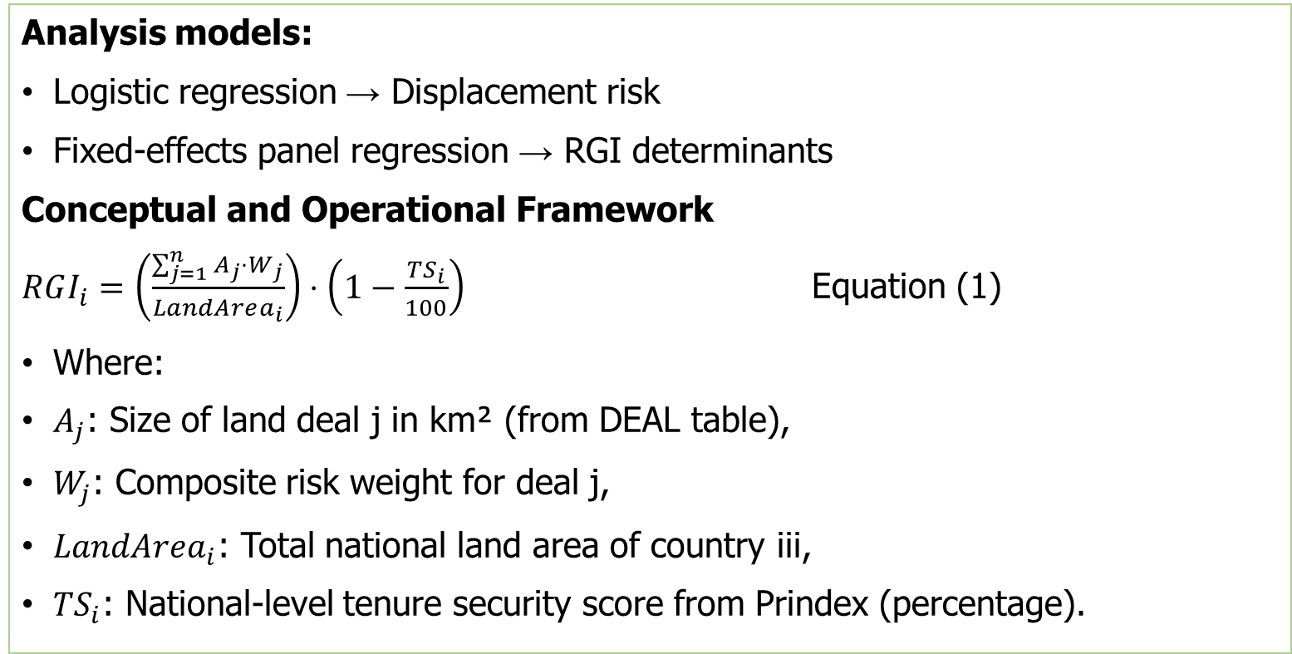
METHODOLOGY
Analysis models:
Logistic regression → Displacement risk
Fixed-effects panel regression → RGI determinants
Conceptual and Operational Framework
$RGI_{i}=\left(\frac{\sum_{j=1}^{n}{A_{j}}⋅W_{j}}{LandArea_{i}}\right)⋅\left(1−\frac{TS_{i}}{100}\right)$ Equation (1)
Where:
$A_{j}$​: Size of land deal j in km² (from DEAL table),
$W_{j}$: Composite risk weight for deal j,
$LandArea_{i}​$: Total national land area of country iii,
$TS_{i}$​: National-level tenure security score from Prindex (percentage).

Slide 14
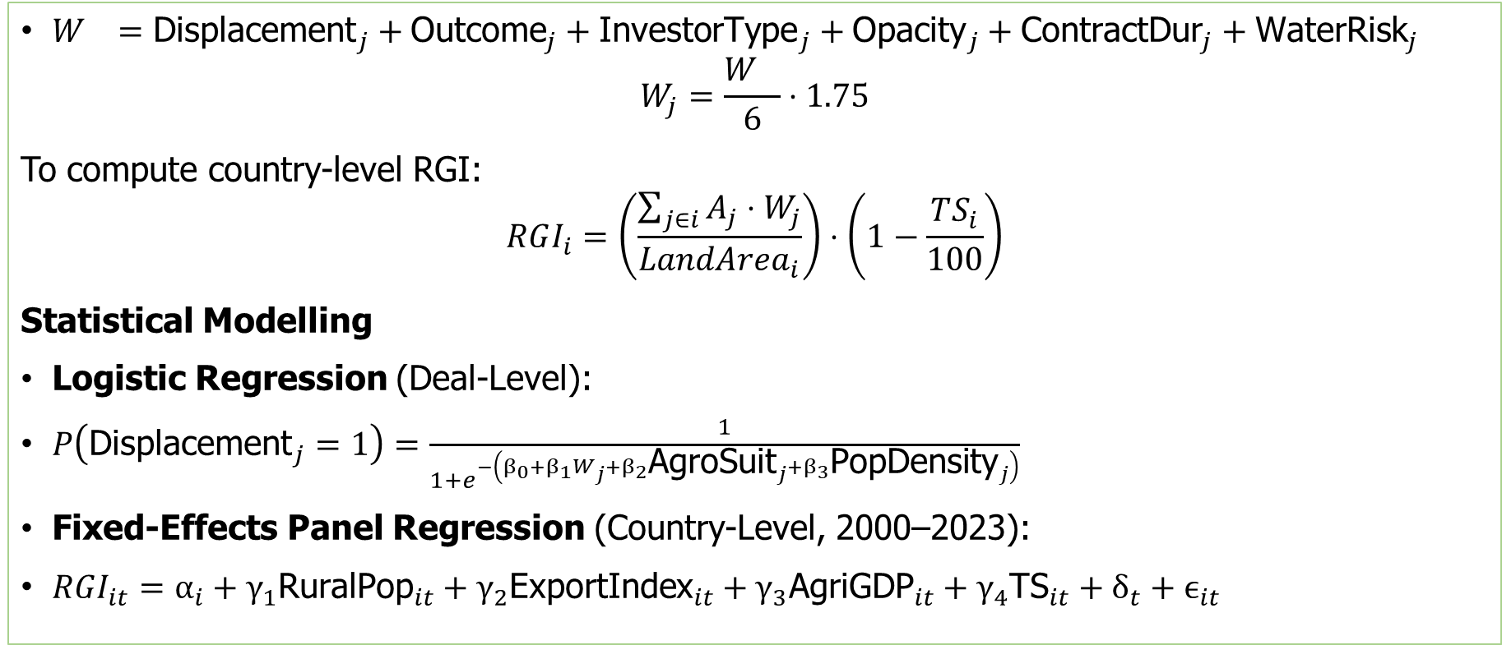
METHODOLOGY
$W_{}={\text{Displacement}}_{j}+{\text{Outcome}}_{j}+{\text{InvestorType}}_{j}+{\text{Opacity}}_{j}+{\text{ContractDur}}_{j}+{\text{WaterRisk}}_{j}$
$$W_{j}=\frac{W_{}}{6}⋅1.75$$
To compute country-level RGI:
$$RGI_{i}=\left(\frac{\sum_{j∈i}{A_{j}}⋅W_{j}}{LandArea_{i}}\right)⋅\left(1−\frac{TS_{i}}{100}\right)$$
Statistical Modelling
Logistic Regression (Deal-Level):
$P\left({\text{Displacement}}_{j}=1\right)=\frac{1}{1+e^{−\left(β_{0}+β_{1}W_{j}+β_{2}{\text{AgroSuit}}_{j}+β_{3}{\text{PopDensity}}_{j}\right)}}$
Fixed-Effects Panel Regression (Country-Level, 2000–2023):
$RGI_{it}=α_{i}+γ_{1}{\text{RuralPop}}_{it}+γ_{2}{\text{ExportIndex}}_{it}+γ_{3}{\text{AgriGDP}}_{it}+γ_{4}{\text{TS}}_{it}+δ_{t}+ϵ_{it}$

Slide 15
RESULTS
Dataset Profile (N = 1,576)
Variable | Mean | SD | Min | Median | Max
Deal size (km²) | 417.12 | 1258.5 | 2.2 | 80.5 | 16,800
Contract duration | 44.04 | 21.31 | 5 | 45 | 100
Tenure security (%) | 65.70 | 13.21 | 39.0 | 66.0 | 89.5
The average deal size was 417.12 km², though deal sizes ranged widely from as low as 2.2 km² to as high as 16,800 km², reflecting a high degree of heterogeneity
Categorical Variable Profiling
Implementation Status of Land Deals Displacement Reported in Land Deals
Status | Frequency | Percent
In production | 617 | 39.1%
Abandoned | 382 | 24.2%
Failed | 200 | 12.7%
Intended | 177 | 11.2%
Stalled | 143 | 9.1%
Unknown | 57 | 3.6%
Displacement Reported | Frequency | Percent
Yes | 432 | 27.4%
No | 864 | 54.8%
Unknown | 280 | 17.8%
These figures highlight the potential social cost of land investments, particularly in tenure-insecure contexts where customary rights may not be fully recognized
A significant number were either "abandoned" (24.2%) or "failed" (12.7%),

Slide 16
RESULTS (CATEGORICAL VARIABLE PROFILING)
Classification of Investors Public Availability of Contracts
Investor Type | Frequency | Percent
Private | 991 | 62.9%
State/Sovereign | 371 | 23.5%
Cooperative | 134 | 8.5%
Unknown | 80 | 5.1%
Contract Public? | Frequency | Percent
No | 766 | 48.6%
Yes | 652 | 41.4%
Unknown | 158 | 10.0%
48.6% of land contracts were not publicly disclosed
It raises red flags about public oversight and stakeholder participation.
Deals with high opacity are often correlated with displacement, ecological neglect, and poor enforcement of compensation or sustainability clauses
private investors dominated the landscape, accounting for 62.9% of deals.
State-owned entities, including military and sovereign wealth funds, represented 23.5%.
cooperatives and other joint ventures comprised a smaller share.
Publicly backed investors may exert different types of leverage and face different accountability pressures than private actors

Slide 17
RESULTS (Reparations Gap Index)
Country | Weighted Deal Sum (km²) | Land Area (km²) | Tenure Security (%) | RGI
Nigeria | 6,437.12 | 923,768 | 67.0 | 0.00230
Rwanda | 7.08 | 26,338 | 61.0 | 0.00011
Kenya | 59.02 | 580,367 | 61.0 | 0.00004
Mauritania | 116.67 | 1,030,700 | 72.0 | 0.00003
Zambia | 55.49 | 743,390 | 63.0 | 0.00003
Senegal | 33.00 | 196,722 | 70.0 | 0.00002
Ghana | 27.14 | 238,535 | 60.0 | 0.00002
Ethiopia | 96.83 | 1,104,300 | 70.0 | 0.00001
Mozambique | 88.39 | 786,380 | 64.0 | 0.00001
Cameroon | 24.10 | 475,440 | 64.0 | 0.00001
Côte d’Ivoire | 20.43 | 322,463 | 58.0 | 0.00001
From Table 8, the top 11-ranking RGI countries share three structural characteristics:
Low or moderate tenure security is often below 70%.
Active foreign land acquisition markets, particularly in agriculture and natural resources.
Governance fragmentation: statutory and customary systems conflict or fail to provide full protection.

Slide 18
RESULTS (LOGISTIC REGRESSION MODEL)
Logistic Regression Estimating Likelihood of Displacement (N = {n})
Predictor | B | SE | z | p | 95% CI (Lower–Upper)
Intercept | 5.991 | 2.603 | 2.30 | 0.021 | 0.89 to 11.09
Deal Size (km²) | 0.0014 | 0.0007 | 1.97 | 0.049 | 0.00001 to 0.00279
Tenure Status | -0.254 | 0.471 | -0.54 | 0.590 | -1.18 to 0.67
Tenure Security | -0.091 | 0.036 | -2.54 | 0.011 | -0.16 to -0.02
Dependent variable: displacement reported (1 = yes, 0 = no).
This model confirms that the scale of land acquisition and tenure insecurity are key predictors of displacement risk
Predicted Risk of Displacement from LSLA Deals (Quantile-Based)
This stratification can support targeted policy interventions, such as prioritizing tenure reform or oversight in regions with a high density of Very High and High risk deals
Predicted Risk Category | Number of Deals | Average Predicted Probability
Very High | 24 | 0.77
High | 23 | 0.54
Medium | 24 | 0.45
Low | 23 | 0.36
Very Low | 24 | 0.25

Slide 19
RESULTS (Determinants of Tenure Security in African Countries)
Variable | Coefficient | Std. Error | t-Statistic | p-Value
Intercept | 73.668 | 26.158 | 2.816 | 0.010
Total Population | 4.99e-08 | 4.49e-08 | 1.113 | 0.278
Life Expectancy | -0.076 | 0.475 | -0.161 | 0.874
Population Density | -0.039 | 0.032 | -1.228 | 0.233
Median Age | 0.716 | 0.827 | 0.865 | 0.396
Rural Population (%) | -0.011 | 0.154 | -0.072 | 0.944
GDP per Capita (USD) | -0.0001 | 0.001 | -0.222 | 0.826
GINI Index | -0.313 | 0.189 | -1.661 | 0.111
R² = 0.289, indicating that approximately 29% of the variation in tenure security can be explained by the predictors in the model.
The model’s overall F-statistic is not significant (p = 0.306), suggesting limited joint explanatory power.
Only the intercept is statistically significant at the 5% level.
The GINI Index shows a marginally non-significant negative association with tenure security, suggesting that countries with higher income inequality may experience lower tenure security.

Slide 20
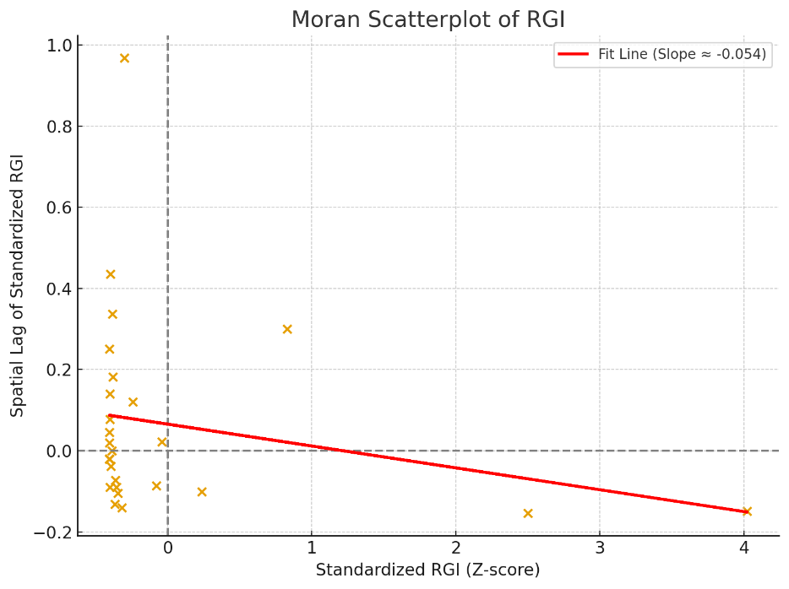
RESULTS (Spatial Clustering of Reparations Gap Index (RGI))
This indicates an overall absence of spatial dependence in the RGI across African countries. This absence may reflect the highly country-specific institutional and historical trajectories of land governance, underscoring the need for context-sensitive, nationally tailored reparatory frameworks rather than regionally harmonized strategies.

Slide 21
SYNTHESIS AND POLICY SENSITIVITY ANALYSIS
The spatial distribution of RGI scores across Africa demonstrates a fragmented and weakly clustered pattern, evidenced by a Moran’s I value of −0.054
The uneven spatial patterns indicate the limited effectiveness of voluntary international frameworks, notably the FAO’s Voluntary Guidelines on the Responsible Governance of Tenure (VGGT)
The case for country-specific reform becomes even more compelling when viewed through the lens of persistent legal pluralism and the marginalization of customary tenure systems
The simulation revealed that while an increase could reduce RGI scores by 20–30% in moderately affected countries, the impact is muted in structurally vulnerable states with high deal volumes and weak governance

Slide 22
POLICY RECOMMENDATIONS MOVING FORWARD
Regional institutions such as the African Union and UNECA must transition from soft law to binding regional compacts
National governments must recognize customary tenure as equal to statutory rights, especially in agrarian zones vulnerable to LSLAs
Civil society organizations must be empowered with legal tools, geospatial evidence, and capacity-building support to monitor land deals and challenge unlawful acquisitions
Investors must be subject to binding impact assessments and publicly disclosed risk evaluations tied to tenure conditions and displacement histories
Without structural realignment at these levels, the Reparations Gap will persist as both a spatial injustice and a policy failure

Slide 23
CONCLUSION
The spatial and econometric analyses presented in this study affirm that the Reparations Gap is less a regional phenomenon and more a structural failure of governance, law, and accountability
While improvements in tenure security offer a pathway toward justice, they cannot substitute for broader reforms in investor behaviour, contract governance, and regional enforcement
The cumulative evidence calls for a shift from fragmented, symbolic reforms to coordinated and binding frameworks that address land injustice as both a historical debt and a contemporary policy crisis

Slide 24
Thank you!
man.nanor@gmail.com

