Slide 1


From Dark to Light: Energy Poverty and International Migration An assessment of the impact of energy poverty on international migration flows from Sub-Saharan Africa (SSA). Séraphin Brice Bikoula Minkoe Fabrice Ewolo Bitoto Arnold Foko Kengne* University of Dschang, Cameroon CLPA, ddis Ababa, Ethiopia 10-14 November 2025

Slide 2
Plan
Introduction
Issues
Objectives
Methodological strategy
Results
Conclusion and Recommendations

Slide 3








Introduction
Global Migrants
African Origin
281 million international migrants in 2020, representing 3.6% of the global population.
Most African-born migrants live in Europe (11M), Asia (5M), and North America (3M).
Growing Trend
Top Destinations
The number of international migrants has more than tripled since 1970 (84M).
Europe (87M), Asia (86M), and North America (59M) are the primary destination regions.

Slide 4
Number of refugees per 100,000 population, by country of origin
Source: Authors, data from UN High Commissioner for Refugees

Slide 5
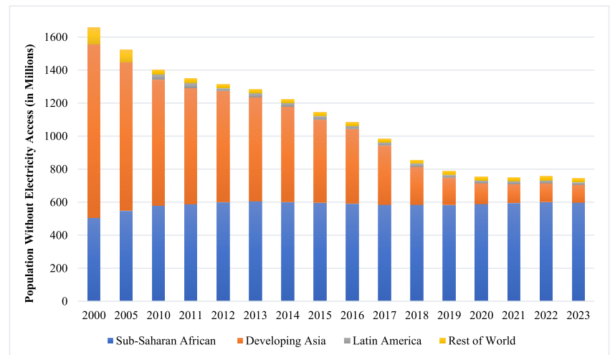
Global population without electricity access (2000 – 2023)
Source: International Energy Agency (IEA) https://www.iea.org/

Slide 6
Issues
Existing literature identifies several factors driving migration from Sub-Saharan Africa to developed countries. However, the role of energy poverty has been largely overlooked.
Economic Hardship
Poverty and limited opportunities for social and economic advancement. Huguet, (2003) Adams & Page (2005)
De Haan, A. (1999).
Instability
Political instability and conflict drive forced migration Naudé, W. (2009), Collinson, S. (2011)
Climate Issues
Climate-related environmental problems like drought and desertification Abel, et al.. (2019) Akindoyin, & Akuche, C. C. (2024)..
Lack of Services
Limited access to basic services such as healthcare and education Stiehm, W. L. (2000)..

Slide 7
Issues
Energy Poverty: The Missing Link
Access to modern energy is a luxury for millions, especially in SSA. Improving electricity access is a potential lever for retaining populations, as it improves key development indicators:
Economic growth and income generation Castro-Cárdenas & Ibarra-Yunez, (2023) : Raghutla, C., & Chittedi, K. R. (2022) .
Education and industrial results Apergis, Polemis, & Soursou (2022) ; Sule, I. K., Yusuf, A. M., & Salihu, M. K. (2022) .
Health and food security Jessel, S., Sawyer, S., & Hernández, D. (2019) : González-Eguino, M. (2015). ..
The lack of reliable electricity constitutes a "push factor," forcing people to seek better services elsewhere to meet economic, social, and health needs.

Slide 8

Objective
The SSA Energy Access Crisis
Despite global progress towards SDG7, SSA remains the most challenged region, with the number of people without electricity increasing between 2000 and 2019.
578M
32%
771M
Without Electricity
Rural Access
Global Total
Africans in SSA lacked electricity access in 2020 (49% of the total population).
Only 32% of the rural population has access, compared to 78% in urban areas.
People worldwide still had no access to electricity in 2019.
SSA is home to three-quarters of the world's population without access to electricity, highlighting the urgency of this issue.

Slide 9



Methodology
This paper assesses the impact of energy poverty on international migration in 47 SSA countries from 1998 to 2021.
Goal
Data
Techniques
Assess the impact of energy poverty on international migration flows.
Sample of 47 SSA countries over 1998–2021, using three indicators of energy poverty.
Fixed effects, IV-2SLS (Lewbel), and Two-stage instrumental-variables (2SIV) to address endogeneity.

Slide 10
Methodology
The main objective of this study is to analyze the effect of energy poverty on international migration in sub-Saharan Africa, using a direct effect analysis based on the model of equation (1), is described as follows:
In this study we use it as a robustness model. Equation (2) represents the model in its dynamic form:

Slide 11
Results
 | Dependent variable : International migrant stock
 | OLS-FE |  |  |  | Lewbel 2SLS
VARIABLES | (1) | (2) | (3) |  | (4) | (5) | (6)
EPOV1 | 0.009*** |  |  |  | 0.130***
 | (0.003) |  |  |  | (0.032)
EPOV2 |  | 0.007** |  |  |  | 0.029***
 |  | (0.004) |  |  |  | (0.006)
EPOV3 |  |  | 0.005** |  |  |  | 0.013**
 |  |  | (0.002) |  |  |  | (0.005)
LET | -0.024*** | -0.018* | -0.014 |  | -0.318*** | -0.058*** | -0.030**
 | (0.009) | (0.010) | (0.011) |  | (0.076) | (0.015) | (0.014)
Oil rents | 0.028** | 0.026** | 0.032** |  | -0.009 | 0.028*** | 0.035***
 | (0.013) | (0.012) | (0.013) |  | (0.014) | (0.005) | (0.006)
lnGDPpc | -0.128*** | -0.134*** | -0.119*** |  | -0.560*** | -0.255*** | -0.135***
 | (0.036) | (0.040) | (0.034) |  | (0.136) | (0.051) | (0.043)
Freedom of trade | 0.151** | 0.199*** | 0.229*** |  | 0.485*** | 0.258*** | 0.242***
 | (0.059) | (0.062) | (0.076) |  | (0.155) | (0.071) | (0.076)
Remittances | -0.016*** | -0.013*** | -0.018*** |  | -0.075*** | -0.019** | -0.018*
 | (0.005) | (0.005) | (0.007) |  | (0.021) | (0.009) | (0.011)
Constant | 5.105*** | 4.740*** | 4.545*** |  | 27.473*** | 8.340*** | 5.518***
 | (0.923) | (1.025) | (1.046) |  | (6.045) | (1.451) | (1.403)
Country Effect | Yes | Yes | Yes |  | Yes | Yes | Yes
Time Effect | Yes | Yes | Yes |  | Yes | Yes | Yes
Obs. | 972 | 974 | 849 |  | 944 | 972 | 849
Kleibergen-Paap rk (Wald F) |  |  |  |  | 29.100 | 198.672 | 45.577
Kleibergen-Paap rk LM (p-value) |  |  |  |  | 0.0001 | 0.0000 | 0.0000
Notes: EPOV1 : access to electricity (% total population), EPOV2 : access to electricity (% urban population) and EPOV3 : access to electricity (% rural population). Note: Robust standard errors are in parentheses. ***, **, *: represent the significance thresholds at 1%, 5% and 10% respectively. Hansen J Statistic: H0: over-identiﬁcation restrictions are valid. Endogeneity Test: H0: speciﬁed endogenous variables can be treated as exogenous. We reject the null of the Kleibergen-Paap rk Wald F test should be based on Stock and Yogo's critical values.

Slide 12
Results
Energy poverty significantly increases international migration in Sub-Saharan Africa
This result suggests that foreign countries are more likely to attract migrants from countries experiencing exacerbating energy poverty ;
Immigrants may be concerned about their reputation and social responsibility ;
technology and infrastructure externalities developed from realable electricity production ;
migratory flows are seen as a socio-economic lever, thanks to the rents they generate.
Notes:
although we use three different measures of energy poverty, it significantly increases international migration from Sub-Saharan Africa (columns 1-3).
immigrants may be concerned about their reputation and social responsibility, and may be more likely to settle in countries that take measures to protect social welfare and human existence
immigrants would benefit from the technology and infrastructure externalities that are developed, thanks to the energy wealth in countries with high electricity production.

Slide 13
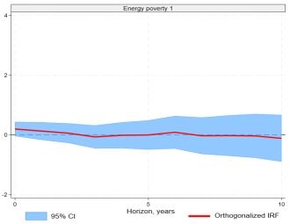
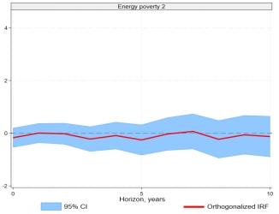
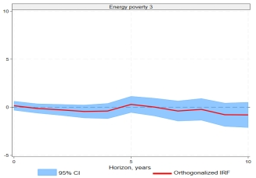
Sensitivity analysis
We estimate short and long dynamic relationships using the Local Projection (LP) method developed by Jorda (2005)
The result in Figure 4 argues that although energy poverty limits human development capacities (Sovacool, 2012), its impact on migration depends on intermediate factors, such as access to information, support networks, or the financial capacity to migrate. To further explore this result, we perform a mediation analysis in subsection (4.4)
Notes:
Notes : The red curve shows the response of the stock of international migrants to an exogenous energy poverty shock. Specifically, this curve shows the evolution of the shock over time. The horizontal axis represents the time (steps) after the initial shock, while the vertical axis shows the estimated effect of the shock on the flow of migrants. The shaded area indicates the 95% confidence interval around the impulse response.

Slide 14
Key Finding: Energy Poverty Increases Migration
The econometric analysis, robust across multiple methods (OLS-FE, Lewbel 2SLS, System-GMM), confirms a significant positive association.
Direct Link
Attraction Effect
Direct Policy Implication
Energy poverty significantly increases international migration flows from Sub-Saharan Africa.
Foreign countries with reliable electricity are more likely to attract migrants seeking better services and opportunities.
SSA countries must build infrastructure for electricity production and distribution to retain their populations.

Slide 15
Sensitivity by sub-region
The regional sensitivity analysis shows that the link between energy poverty and international migration can differs from on African sub-regions to another. Energy poverty has a positive and significant effect on migration in Central Africa (0.030*) and Austral Africa (0.004**), indicating that a lack of energy increases the pressure to leave these areas. In contrast, East Africa exhibits a markedly distinct trend, wherein energy poverty exerts a negative and significant influence (-0.012***) on migration. This may suggest a "poverty trap" mechanism.
 | Dep. var: International migrant stock
VARIABLES | (1) | (2) | (3) | (4)
 | Central_Africa | West_Africa | East_Africa | Austral_Africa
EPOV1 | 0.030* | 0.002 | -0.012*** | 0.004**
 | (0.016) | (0.003) | (0.004) | (0.002)
Inflation | 0.046** | -0.003 | 0.000 | -0.000**
 | (0.022) | (0.004) | (0.005) | (0.000)
Oil_rents | 0.008 | -0.012 | 0.038 | -0.012***
 | (0.019) | (0.012) | (0.058) | (0.004)
lnGDPpc | -0.455** | -0.143* | 0.049 | -0.007
 | (0.216) | (0.083) | (0.073) | (0.065)
lnFreedom_trade | 1.825** | -0.114 | -0.083 | -0.017
 | (0.800) | (0.163) | (0.187) | (0.060)
Remittances | -0.020 | -0.006 | 0.035 | -0.009**
 | (0.090) | (0.014) | (0.028) | (0.004)
Arable_land | -0.064 | 0.015* | 0.007 | -0.008*
 | (0.071) | (0.009) | (0.007) | (0.005)
Time FE | ✓ | ✓ | ✓ | ✓
Country FE | ✓ | ✓ | ✓ | ✓
Constant | 8.175** | 4.433** | 0.212 | 1.361
 | (3.447) | (1.795) | (1.572) | (1.467)
Observations | 160 | 307 | 143 | 264
R-squared | 0.171 | 0.059 | 0.105 | 0.49

Slide 16
Transmission channel analysis
 | (i) Mediator: Climate change |  |  |  | (ii) Mediator: Human capital |  |  | (iii) Mediator: ICT |  |  | (iv) Mediator: Labor Force P.
 | (1a) |  | (1b) |  | (2a) | (2b) |  | (3a) | (3b) |  | (4a) | (4b)
Dep. variables | Climate change |  | IMS |  | Human Capital | IMS |  | ICT (Mobile) | IMS |  | Labor Force P. | IMS
EPOV1 | 0.002*** |  | 0.015 |  | 0.002*** | 0.015 |  | 0.986*** | 0.005* |  | -0.224*** | 0.002
 | (0.000) |  | (0.010) |  | (0.000) | (0.009) |  | (0.044) | (0.003) |  | (0.010) | (0.002)
Mediator |  |  | 0.105* |  |  | -2.467 |  |  | 0.986*** |  |  | -0.008***
 |  |  | (0.089) |  |  | (3.375) |  |  | (0.044) |  |  | (0.003)
Controls | Yes |  | Yes |  | Yes | Yes |  | Yes | Yes |  | Yes | Yes
Bootstrap | 500 |  | 500 |  | 500 | 500 |  | 500 | 500 |  | 500 | 500
 |  | Composition of the effect
% of the total effect mediated | 25 % |  |  |  | 38 % |  |  | 21 % |  |  | 43 %
Note: ***, **, * indicate signiﬁcance at 1%, 5% and 10% level, respectively. Robust standard errors reported in parenthesis.

Slide 17

Mediation Analysis: Aggravating Factors
Energy poverty acts less as a direct trigger and more as an aggravating factor of structural immobility.
Its effect on migration is mediated by several factors at varying thresholds.
Labor Force
Participation — 43% mediation strength.
ICT Access
Connectivity — 38% mediation strength.
Climate Change
Environmental stress — 25% mediation strength.
Human Capital
Skills and education — 21% mediation strength.

Slide 18
Other Significant Determinants
Beyond energy poverty, other macroeconomic variables influence migration decisions in SSA.
GDP per Capita
Low GDPpc in the country of origin is a repulsion factor; high GDPpc in destination countries is an attraction factor.
Oil Rents
Positively associated with migration, confirming the "resource curse" hypothesis where growth gains are poorly distributed.
Trade Freedom
Lack of trade freedom in the home country encourages migration to places with better investment opportunities and governance.
Remittances
Negatively associated with migration, suggesting financial pressures or taxes on repatriated funds may demotivate potential migrants.

Slide 19



Conclusion and Policy Recommendations
Reducing energy poverty is a critical prerequisite for regulating the stock of international migrants from Sub-Saharan Africa.
Increase Energy Access
Extend power grids and prioritize renewable energy infrastructure, especially in rural areas.
Subsidize Private Sector
Offer tax exemptions and remove administrative bottlenecks for private sector installation of energy infrastructure.
Improve Governance
Address governance issues like corruption and lack of trade freedom to foster local economic development.

Slide 20
Thank you!
arnoldfoko14@gmail.com

