Slide 1


Climate Justice, Urbanisation, and Sustainable Land Use in Sub‑Saharan Africa Okunade, S.O., Assoua, J.E., Alimi, A.S., Bomdzele, E.J., AbdulKareem, H.K.K., Aquilas, N.A., Ode‑Omenka, L.C., Osabuohien, E. Chrisland University, Abeokuta, Nigeria
Notes:
Slide 1 - Introduction

Slide 2
Why this study matters
SSA is urbanising fastest globally amid climate vulnerability and land degradation.
The environmental consequences of unregulated urban expansion are severe.
Urban growth without justice risks sprawl, deforestation, and exclusion in various degrees.
Climate justice ensures equitable distribution of climate burdens and adaptation resources.
A need for empirical integration of climate justice within urbanisation–SLU models is rare.
Notes:
Point 1:
This nexus not only undermines environmental sustainability but also entrenches inequalities, underscoring that urban expansion cannot be understood solely as spatial transformation but must be viewed through the lens of climate justice.
Point 2:
For instance, floods in rapidly urbanising cities like Accra (Ghana) and Lagos (Nigeria) is a typical direct consequence of unregulated urban expansion.

Slide 3
WHAT WE DID!
We identified and addressed some of the most pressing challenges toward achieving Sustainable Development; SDG-15, -11 and -13 in SSA.
Operationalised climate justice and SLU using quantitative indicators by creating climate justice and SLU indices from several indicators within an empirical framework.
explained the patterns of urbanisation, climate justice, and SLU in SSA.
Climate change → urbanisation: quantify the impact of temperature/ precipitation and readiness effects..
Urbanisation → SLU: estimate direct impacts and controls.
Mediation: test interactions (Urbanisation × Climate Justice Index, CJI) on SLU.
State‑dependence: Panel quantile regression (τ = 0.25, 0.50, 0.75, 0.90)
Notes:
Point 1:
SDG) 15 – Life on Land - To protect, restore and promote sustainable use of terrestrial ecosystems, sustainably manage forests, combat desertification, and halt and reverse land degradation and halt biodiversity loss.
SDG 11 – Sustainable Cities and Communities (through sustainable urban land management)
SDG 13 – Climate Action (through land use planning that mitigates climate change impacts)

Slide 4
Conceptual framework: justice as a mediator
Urbanisation exerts pressure on land use and ecosystems, but institutions determine sprawl and manage densification.
Climate justice (rule of law, regulatory quality, press freedom, access to justice, climate readiness, etc.)
→ improves planning, accountability, and equitable access to adaptation.
Climate justice dimensions:
→ Distributive — fair allocation of adaptation/green space/tenure security.
→ Procedural — participation, transparency, press freedom, access to courts.
→ Restorative — remedies for dispossession/environmental harms.
Hypothesis: Justice capacity attenuates/reverses urbanisation’s penalty on SLU.
Notes:
Point 1:
Point 2:

Slide 5
Study Scope and Data
Coverage: 28 SSA countries; 2000–2023 (≥ 644 country‑years).
Outcomes: SLU (PCA of FOA, ARL, AGL, DFR, and NFD).
Key regressors:
Urbanisation: Urbanisation rate (% of total population), Urban concentration (UCR).
Climate justice (CJI) via PCA: REQ, ROL, VAC, PFI, JUS, GRS, VNR, and EXPR.
Controls: GDPpc, access to electricity, ecological footprint, temp, precipitation, population growth.
Sources: ND‑GAIN, WDI, WGI, RSF, SDR (2024).
Notes:
Point 2:
SLU via PCA (5-indicators): forest area, (adjusted) net forest depletion, arable/agricultural land, deforestation rate.
Point 4:
Climate justice (CJI) via PCA (8-indicators): Climate vulnerability, governance readiness, rule of law, regulatory quality, press freedom, access‑to‑justice, voice and accountability, and Expropriations (lawful/adequately compensated).

Slide 6
Econometric Strategy
Indices: PCA for CJI and SLU (z‑scored, direction‑consistent).
Estimators:
PCSE and FE‑DKSE — robust to cross‑sectional dependence, autocorrelation, heteroskedasticity.
Panel Quantile Regression — heterogeneity across SLU distribution (25th–90th) for state‑dependent effects.
KRLS (machine learning) — to capture non‑linearities without strong functional forms, and for interaction‑rich robustness.
Interactions: Urbanisation × Climate Justice to test moderation.
Notes:
Points
The combination of econometric techniques (parametric) with machine learning (nonparametric) is innovative for robust findings and consistent policies in SSA studies.

Slide 7
Why these Methods?
Data realities: SSA panels show strong CD, serial correlation, and non‑stationarity at levels.
Second‑gen panels (DKSE) give consistent SEs with spatial/temporal correlation.
PQR reveals who benefits/loses at different SLU levels (policy targeting).
KRLS reduces functional‑form risk; checks asymmetric pillar effects – Non-parametric test.
Notes:
Point 2:
Point 4:

Slide 8
Stylised Facts and Trend Analyses
Urbanisation rising rapidly; dense agglomerations with service gaps.
Widespread land degradation & deforestation, especially peri‑urban interfaces.
Governance readiness and press freedom vary widely across SSA; linked to adaptive capacity.
Notes:
Point 2:
Point 4:

Slide 9
Results and Findings
Finding 1
— Urbanisation ↓ SLU (Main Effects).
PCSE: UCR ≈ −1.32 to −1.58; LUR ≈ −2.30 to −2.88 (p<0.01).
DKSE: UCR negative and large (≈ −2.28 to −2.97, p<0.01); LUR ~ 0.
Interpretation: Where/how people concentrate matters more than urban share alone.
Controls: Ecological footprint (+), temperature/precipitation (+) linked to SLU dynamics.
Notes:
Point 2:
The findings explain that both PCSE and DKSE show negative coefficients for urbanisation, confirming that unregulated urban growth reduces sustainable land use. Highlight magnitude differences and robustness.
Point 4:
GDP per capita and electrification (ACE) are strongly positive - Economic scale & infrastructure dominate.
Climate exposure contributes: temperature/rainfall shift associates with urban migration.
Justice components are mixed: readiness & voice/accountability push urbanisation; while strong rule‑of‑law & regulatory quality temper chaotic expansion.
Policy Implication:
Urban growth is inevitable; it should be channeled with credible institutions and infrastructure.

Slide 10
Results and Findings (Cont.)
Finding 2
— Justice Mitigates the Penalty.
Interaction terms:
UCR × CJI ≈ +0.57 to +1.04 (DKSE/PCSE) — offsets urbanisation damage.
LUR × CJI ≈ +0.99 to +1.11 — can overturn penalty at higher quantiles.
Asymmetric pillars:
Positive: Regulatory Quality (REQ), Rule of Law (ROL), Press Freedom (PFI).
Mixed/short‑run frictions: Voice & Accountability (VAC), Access to Justice (JUS).
moderation: with justice capacity, urban growth can be redirected toward conservation/densification.
Institutions convert growth from sprawl to managed densification.
Notes:
Point 2:
Emphasise that climate justice moderates this negative effect. Discuss how interaction terms turn positive, implying institutional quality changes the direction of impact.
Point 4:
Policy Implication:

Slide 11
Results and Findings (Cont.)
Finding 3
— Climate, Income & Infrastructure → Urbanisation
PCSE/DKSE: GDPpc and electrification strongly raise UCR/LUR (β≈0.09–0.45, p<0.01).
Climate stressors: Temperature/precipitation generally increase urbanisation (migration channels).
KRLS (DV-urbanisation): CJI (+), GRS (+), VAC (+); REQ (−), ROL (−); PFI (−) in some specs.
Interpretation: Different justice pillars either attract concentration or discipline sprawl.
Notes:
Point 2:
Policy Implication:

Slide 12
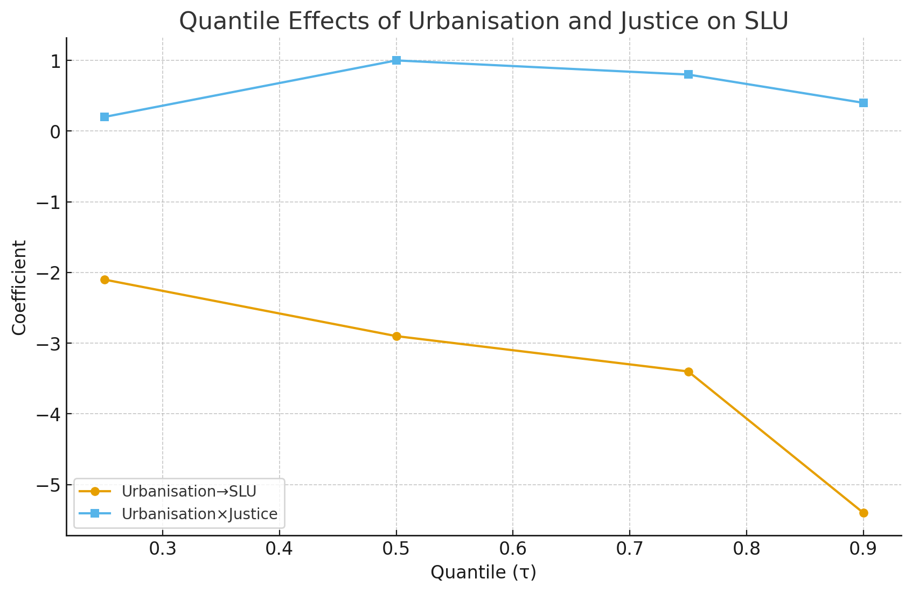
Results and Findings (Cont.)
Finding 4
— State‑Dependent (Quantile) Effects
PQR: Urbanisation harms SLU at all τ; magnitudes grow from τ=0.25 to τ=0.90.
Justice × Urbanisation positive/significant around median quantiles.
Targeting: Mid‑urbanising, mid‑SLU countries yield highest marginal benefit from reforms.
Notes:
Interpretation:
Use the line chart (Figure) to illustrate state-dependent effects- Describe quantile results): urbanisation consistently harms SLU across quantiles, but justice interactions improve outcomes at mid-quantiles.
Policy Implication:
Implication: Phase reforms early to avoid lock‑in of sprawl/deforestation.

Slide 13
Robustness & heterogeneity
DKSE confirms core findings; cointegration supports long‑run relationships.
Quantile results: effects hold across 25th–90th percentiles — state dependence matters.
KRLS validates non‑linear moderation and pillar‑specific channels.
Notes:
Implication:
These Underscore that findings are not estimator‑specific or artefacts of one model.

Slide 14
Policy implications
Embed justice metrics in urban planning (rule‑of‑law, regulatory quality, transparent expropriation).
Prioritise mid‑urbanising countries/cities for reforms to preempt sprawl.
Justice‑centred urban policy is pivotal: procedures/enforcement matter more than income.
“Grow‑first, fix‑later” contradicted: GDPpc often negatively affected SLU conditional on justice.
Press freedom + rule of law curb extractive land deals; regulatory quality enables compliance.
Short‑run VAC/JUS frictions reflect enforcement that temporarily slows measured gains.

Slide 15
Actionable Policy Recommendations
1) Planning & Metrics
Embed justice KPIs (ROL, REQ, PFI, VAC/JUS access) in plans and reforms; and publish open permit registries.
Digitise cadastre/tenure; interoperable land‑use and zoning GIS.
2) Institutional Upgrades
Professionalise municipal land governance; and strengthen land/administrative courts.
Ensure predictable, compensated expropriation for serviced‑land assembly and transit corridors.
Community legal aid & paralegal desks to operationalise access‑to‑justice.
3) Targeted Sequencing
Prioritise mid‑urbanising countries; and align donor finance with measurable governance benchmarks.
4) Infrastructure with Governance
Targeted electrification & transit investments in rural areas to steer compact and slow down urbanisation rate.
5) Data & Accountability
Geospatial monitoring of deforestation/urban fringe; protect whistleblowers and media.

Slide 16
Conclusion & call to action
Urbanisation is not destiny: justice determines whether growth harms or heals land systems.
Where justice capacity is credible, urban growth and SLU are complements, not competitors.
The most cost-effective route to land sustainability in SSA’s cities is therefore a justice-first agenda that hard-wires accountability into every stage of land assembly, conversion, and use.
Takeaway: Climate justice turns urban growth into resilience and sustainable land outcomes.
Notes:
Point 2:
Strengthening rule‑of‑law, regulatory quality, and transparent expropriation can flip the sign on SLU.
Invest in municipal capacity and civic oversight to deliver resilient, equitable cities

Slide 17
Thank you!
sokunade2@gmail.com
sokunade@chrislanduniversity.edu.ng

