Slide 1





Symbolic Sovereignty for Border Communities:
An African Customary Law Principle for Resolving South Sudan-Uganda Territorial Disputes
JOHN GERRY EMMANUEL Landlocked Policy Institute

Slide 2

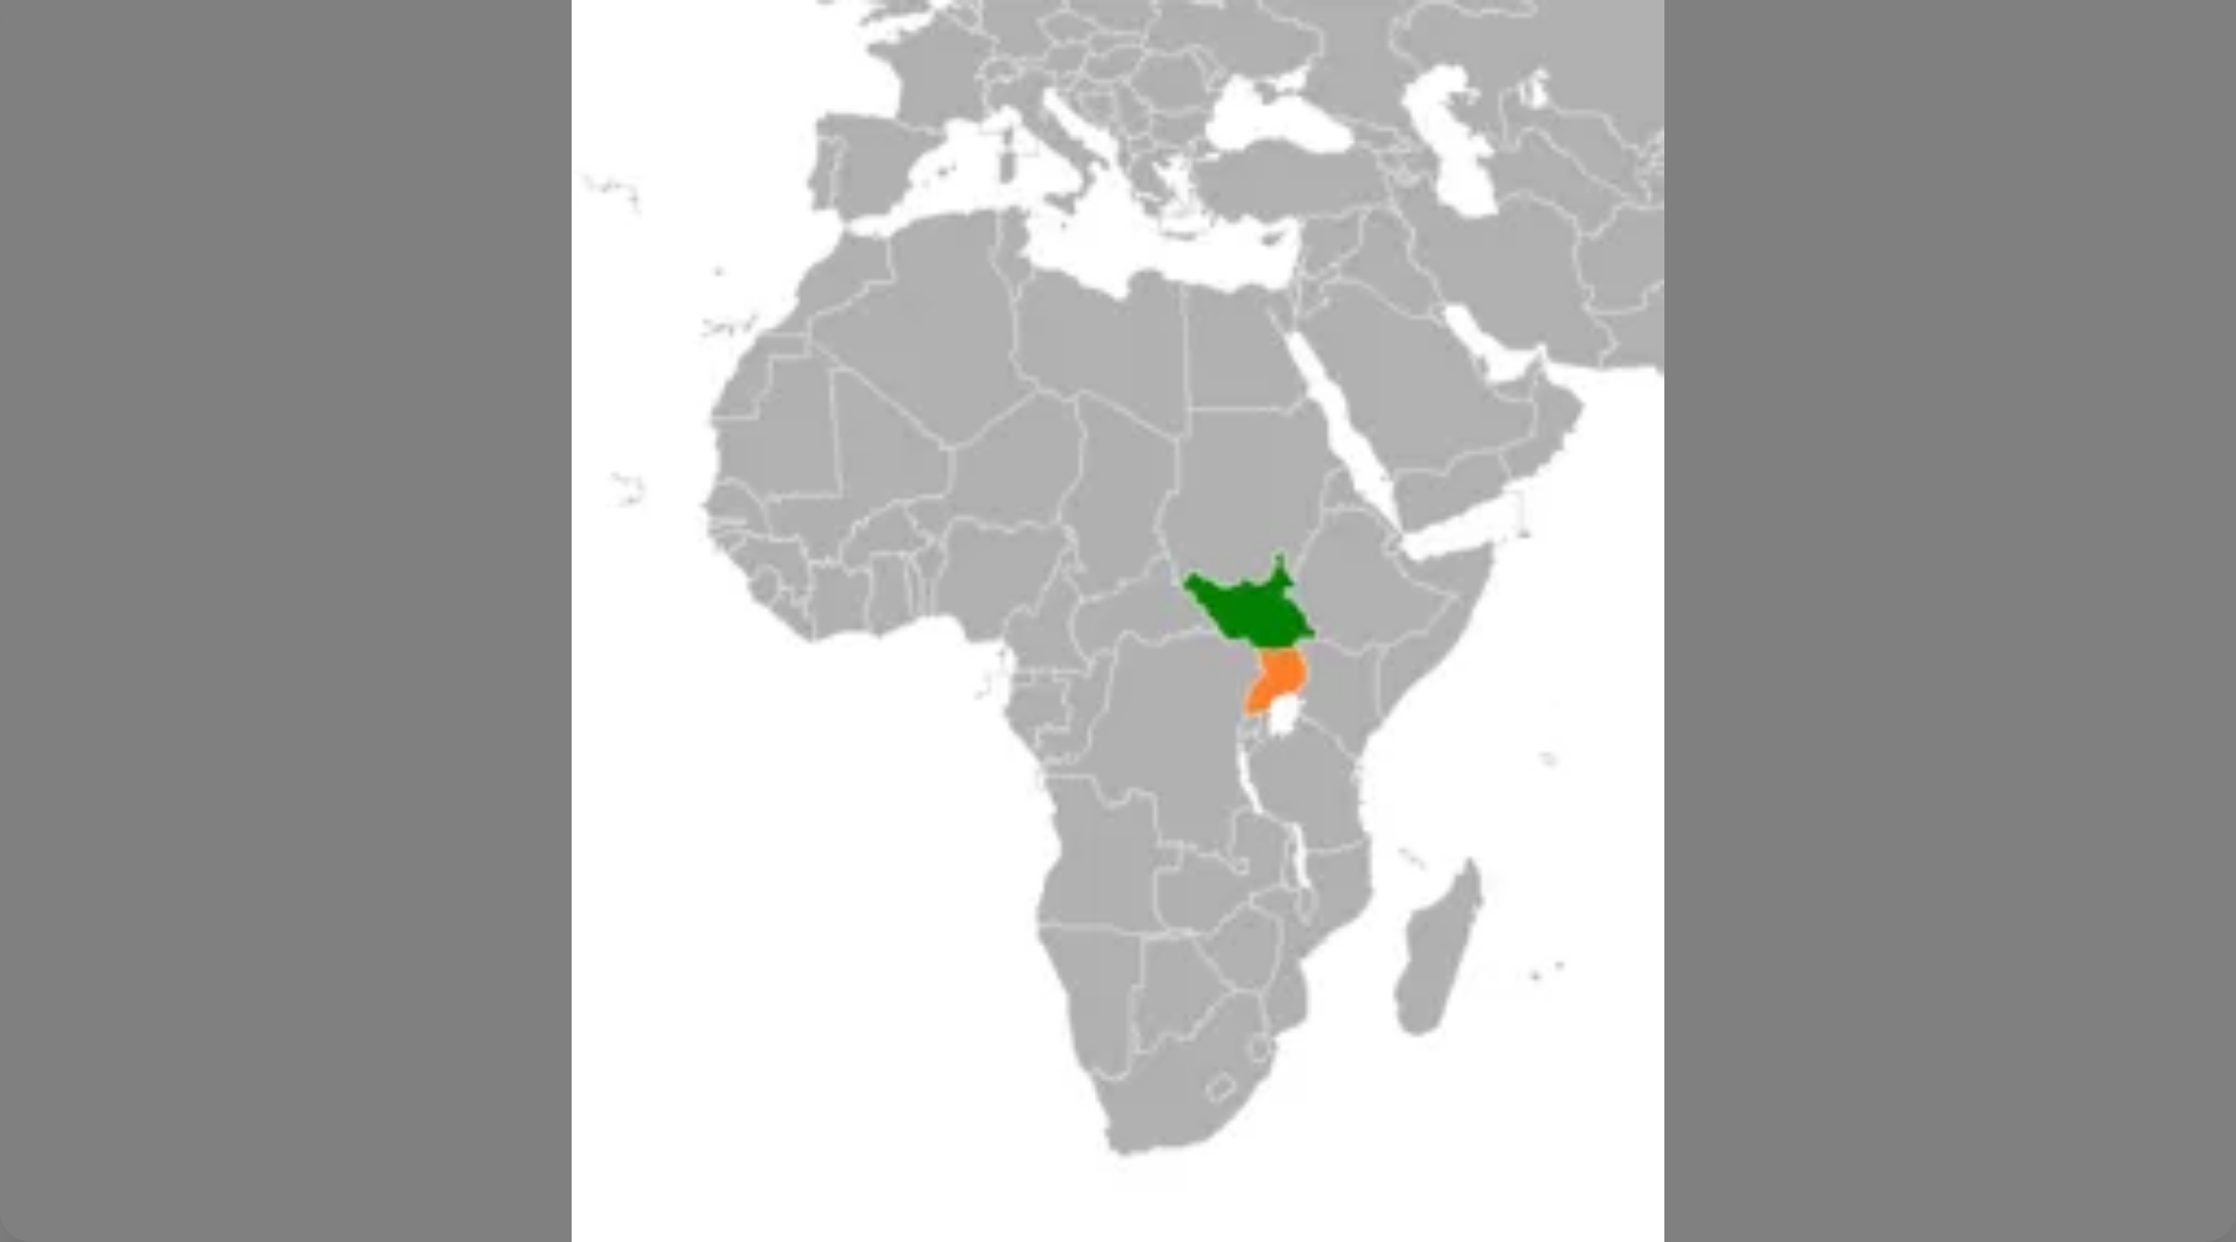

The Core Problem: A Legacy of Colonial Cartography
The South Sudan-Uganda border is a product of the 19th-
century
"scramble for Africa"
, specifically the
1894 Anglo-Congolese
Treaty
and the ambiguous
1914 British Order
.
The 1914 Order defined the border by
"the southern boundary of
the Kuku tribe"
, an ethnographic marker that was never properly
demarcated, creating lasting
confusion and conflict.
This has led to a
crisis of legitimacy
, pitting rigid state sovereignty
against the lived realities and customary rights of border communities
like the Kuku, Madi, Acholi, Lango, and Kakwa.
Recent Escalation: Violent clashes 2014-2025, including
lethal military engagement in July 2025, displaced over 15,000
people. Mineral discoveries have intensified tensions.

Slide 3


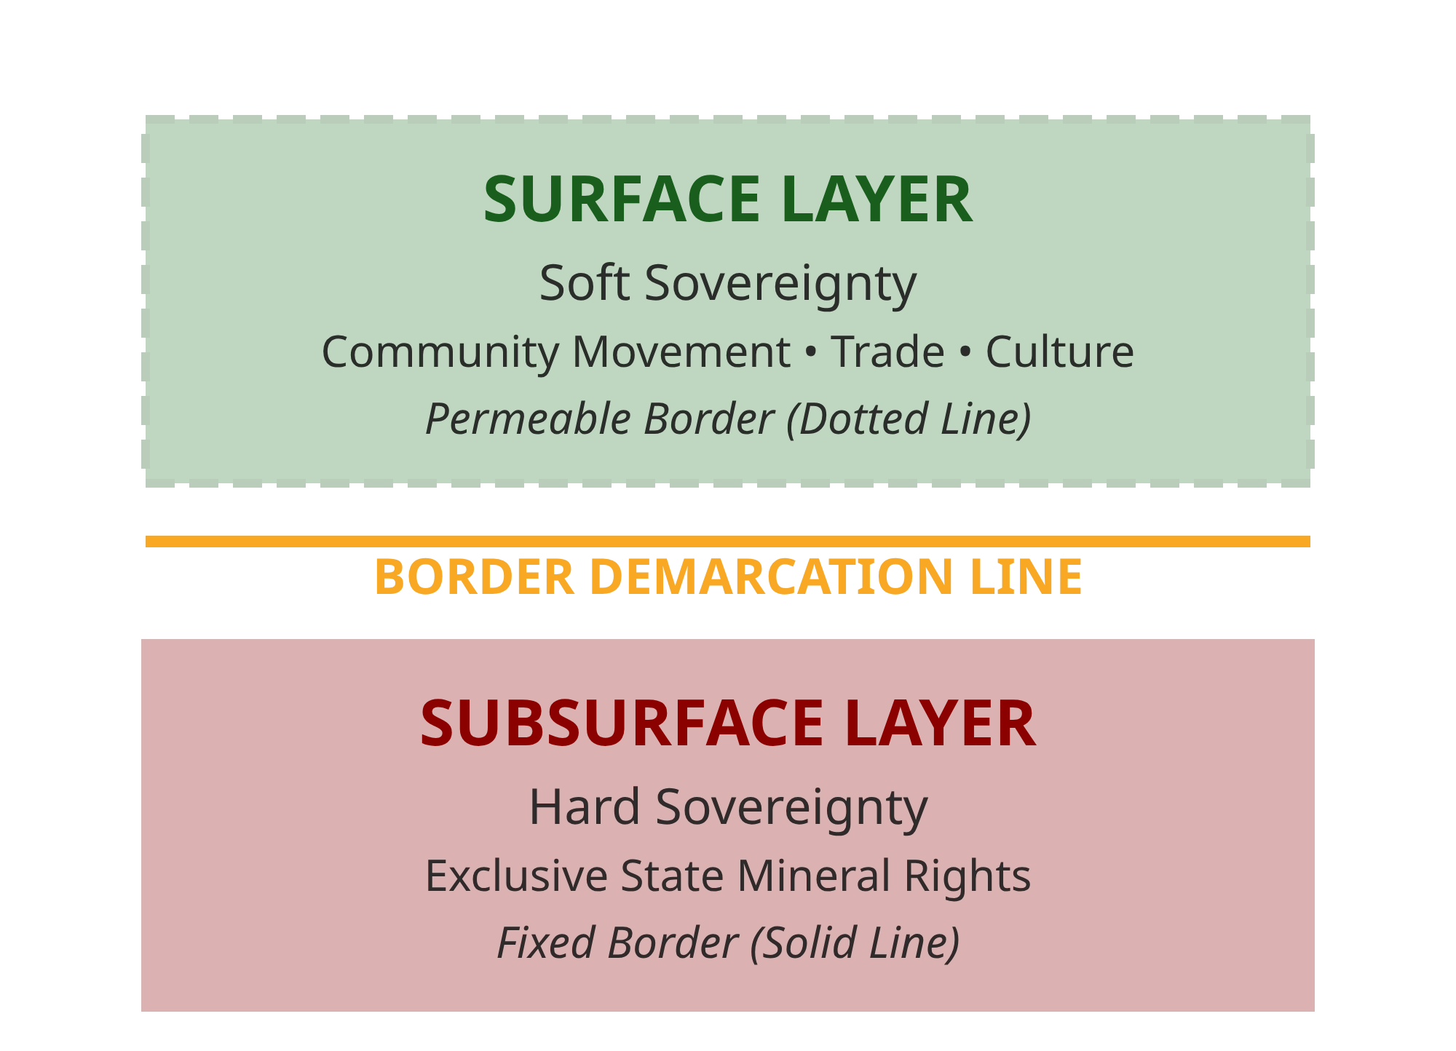




The Proposed Solution: Symbolic Sovereignty
Layer 1: Hard Sovereignty
(Subsurface)
Dual-Layer Framework
Definitive demarcated border with
exclusive state sovereignty over
all mineral and subsurface resources. States exercise absolute control
over strategic minerals like gold and green transition metals on their
side of the line.
Satisfies national security and economic interests
Layer 2: Soft Sovereignty (Surface)
The border becomes a "soft membrane” for people and communities.
Customary rights of border communities to movement, trade,
grazing, and cultural practice are legally recognized within designated
THE GRAND BARGAIN: States Get Resources,
Cross-Border Access Zones
Communities Get Mobility
Honors historical community rights and livelihoods.

Slide 4



Distinguishing Symbolic Sovereignty from Other Models
Joint Border Management
Technocratic coordination between states for security and customs.
State-centric
, focused on efficiency
and control. Does not address community rights or customary law.
Functional Sovereignty
Pragmatic sharing of specific sovereign functions (e.g., resource management). Still
state-driven, treats
communities as subjects rather than rights-holders with agency.
Symbolic
Community-centric, decolonial framework
that validates and institutionalizes customary laws and
social realities as the foundational governance layer for surface-level management.
Sovereignty
A
qualitative shift
in how sovereignty operates.
Symbolic Sovereignty uses state legal authority not to manage communities, but to validate their inherent
rights — transforming the border from a barrier into a bridge.

Slide 5

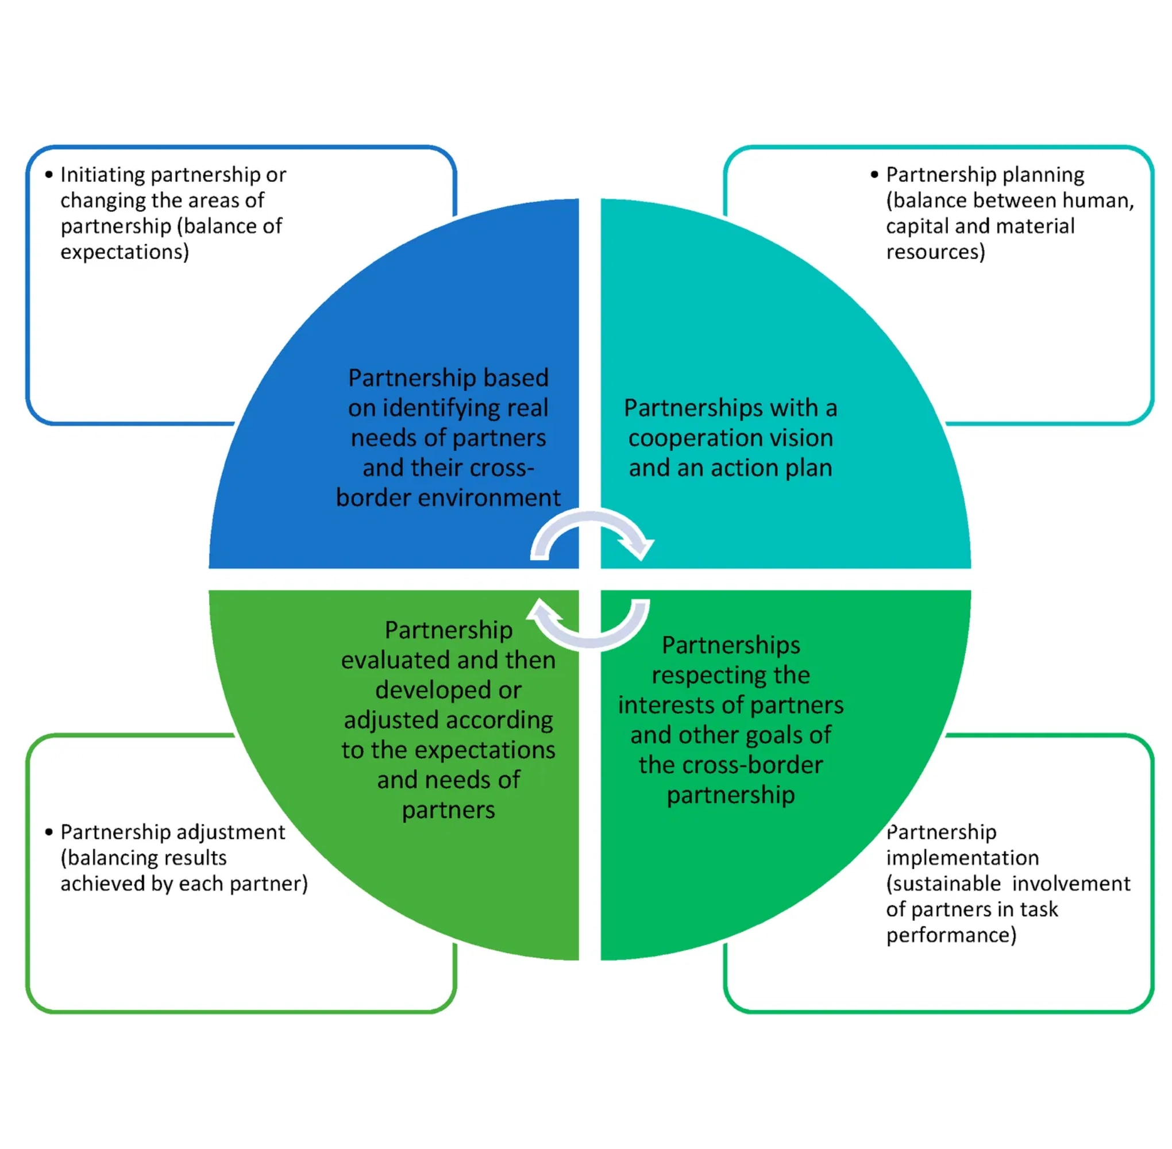
How Symbolic Sovereignty Works in Practice
Governance Framework
De Jure Demarcation
A
Joint Technical Commission
uses historical archives, oral
histories, and satellite imagery to formally demarcate the border
for resource ownership, settling the subsurface question
definitively.
Local Border Governance Councils
Composed of
traditional leaders, local officials, and community
representatives
(youth, women), these councils manage Cross-Border
Access Zones, resolve local disputes, and oversee shared resources
like water and pasture.
Soft-Border Security
Security is reframed: instead of policing people,
joint patrols focus on
high-value transnational crime
like mineral smuggling, thus securing
state economic interests while
enabling community mobility.

Slide 6







Grounded in Law and Pan-African Policy
Legal Precedent: ICJ Jurisprudence
Alignment with African Union Policy
The concept builds on the ICJ’s idea of
"symbolic sovereignty"
Africa Mining Vision (AMV) & Green Minerals Strategy:
in the
Botswana v. Namibia
case,
which argued that
de jure
Symbolic Sovereignty directly implements the AMV's call to
sovereignty can coexist with de facto rights
of access and use.
ensure mineral wealth benefits local communities, providing
The ICJ has shown flexibility, stating that
uti possidetis
should not
a model for responsible resource governance.
lead to
"inequitable or absurd"
outcomes, opening space for
AU Border Programme (AUBP):
.
innovative solutions.
Aligns with the AU's dual mandate to demarcate borders while
"The ICJ's jurisprudence on African border disputes reveals a pattern of pragmatism and a willingness to adapt to the specific circumstances of each dispute."
promoting cross- border cooperation and turning
"barriers into
bridges"
International Court of Justice
African Union
IGAD
EAC

Slide 7






A Pragmatic, Phased Implementation Roadmap
Confidence Building
PHASE 1
0-12 months
Immediate military de-escalation overseen by a neutral body (e.g., ICGLR-EJVM). Establish ceasefire
protocols and create political space for dialogue.
PHASE 2
Technical & Dialogic Foundations
12-36 months
Establish two parallel commissions: one for technical border demarcation (for resources) using
archives and satellite data, and one for mapping customary land use through community
consultation.
Pilot Project
PHASE 3
36-48 months
Launch a pilot "Cross-Border Access Zone" in a high-interaction area like the Kajo Keji-Moyo
corridor. Demonstrate tangible benefits: reduced conflict, increased trade, improved livelihoods.
Formal Treaty
PHASE 4
48+ months
Based on the pilot's success, negotiate and sign a formal bilateral treaty enshrining the principles
of Symbolic Sovereignty. Scale successful mechanisms across the entire border region.
Incremental adoption creates momentum: technical work runs parallel with community dialogue, and a
successful pilot makes the formal treaty politically attractive and achievable.

Slide 8
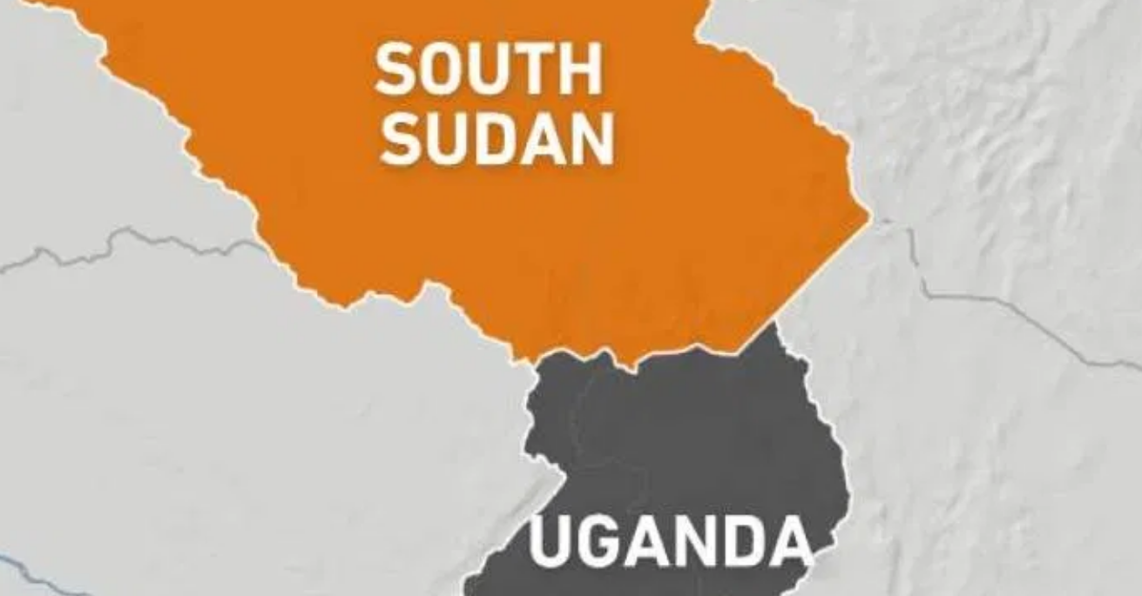





Benefits and Expected Outcomes
Conflict Reduction & Human Security
Transforms militarized tensions into cooperative frameworks, enhancing safety and security for border communities while respecting their historical rights and livelihoods.
Economic Integration & Trade Facilitation
Enables seamless cross-border trade and economic activity, aligning with EAC and IGAD integration goals while boosting local economies and regional prosperity.
Transparent Resource Governance
Ensures communities benefit from mineral wealth extraction through clear frameworks, implementing the Africa Mining Vision's commitment to local stakeholder participation.
Continental Model for Border Disputes
From Conflict to Cooperation: Building Shared
Establishes a replicable framework for resolving similar colonial-era border disputes across Africa, offering a decolonial alternative to rigid Westphalian approaches.
Prosperity Through Community-Centered Governance

Slide 9




Recommendations for Stakeholders
For South Sudan & Uganda
For International Community
●
Immediately de-escalate military presence and establish
●
Provide diplomatic backing and financial support for peaceful
ceasefire protocols with neutral oversight
resolution mechanisms
●
Establish Joint Technical Commission for border demarcation
●
Fund cross-border development projects that strengthen
and resource mapping
community ties and economic integration
●
Adopt the Symbolic Sovereignty framework through the phased
implementation roadmap
For AU / IGAD / EAC
●
Endorse Symbolic Sovereignty as a model for implementing
the Africa Mining Vision and AU Border Programme
●
Provide technical support for resource governance, demarcation,
and community consultation processes
●
Facilitate dialogue and mediation between the two nations
throughout implementation phases

Slide 10



Conclusion: A Path to Shared Prosperity
Transforming Colonial Legacies into Futures of Cooperation and Peace
FROM
TO
Hard Borders
Smart Borders
FROM
TO
Zones of Conflict
Zones of Cooperation
Symbolic Sovereignty: A Continental Model for Turning Painful Colonial Legacies into
Shared Prosperity and Lasting Peace

Slide 11
QUESTIONS & ANSWERS
Thank you!
jongeryema@gmail.com

