Slide 1


“Farmer-herder” conflicts in Nigeria: Identity politics, women's agency and pathways towards peaceful coexistence

Slide 2
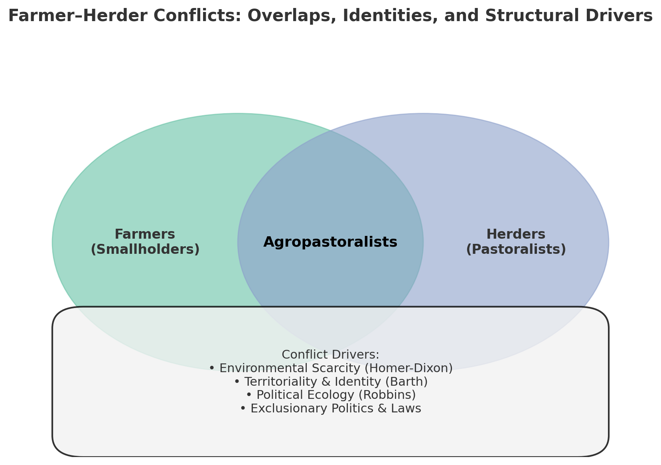
Farmer–Herder Conflicts? Rethinking Causes and Narratives
The conflicts generally termed as “farmer–herder conflicts” have received considerable attention in both academia and conflict resolution practice (Moritz, 2010; Tonah, 2004, 2010; 2012, 2020; 2024; Mainagwa, 2020; Benjaminsen, 20212)
Scholars theorise multiple, intersecting drivers: climate change, which alters rainfall patterns and prompts mobility (Walwa, 2019; Adams et al., 2019)
Environmental Scarcity – competition over land, water, and pastures (Feldt et al., 2020; Lenshie et al., 2020; Mamuda et al., 2018; Bukari et al., 2018; Homer-Dixon, 1999).
Political Ecology – links resource use, power relations, and marginalisation (Akov. 2017; Benjaminsen et al, 2009; Robbins, 2012).
Resource-based conflicts are not simply about scarcity of resources, climate change or resource distribution and access, but also about how identities and grievances are constructed, narrated, and exploited.

Slide 3
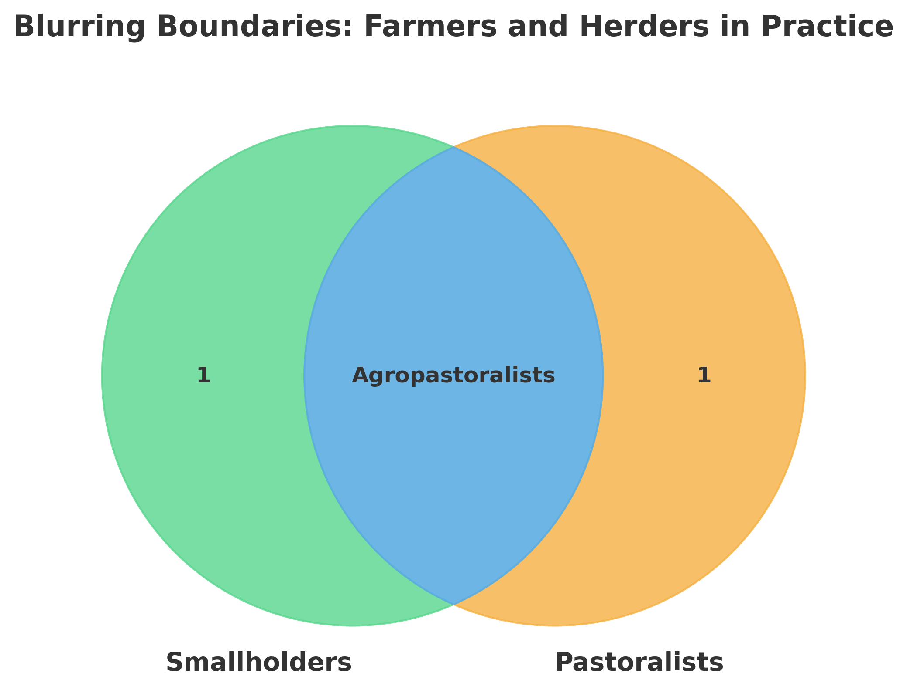
Why “farmer-herder” conflict?
The term 'farmer-herder conflict' is problematic and, at best, misleading.
Many farmers are also herders; likewise, many herders are also farmers.
This overlap raises the question: What exactly do we mean by farmer-herder conflict?
This narrow label risks oversimplifying the complex resource, livelihood, and identity struggles involved.
A more accurate framing should capture the multi-dimensional nature of land use, mobility, and livelihood intersections.

Slide 4
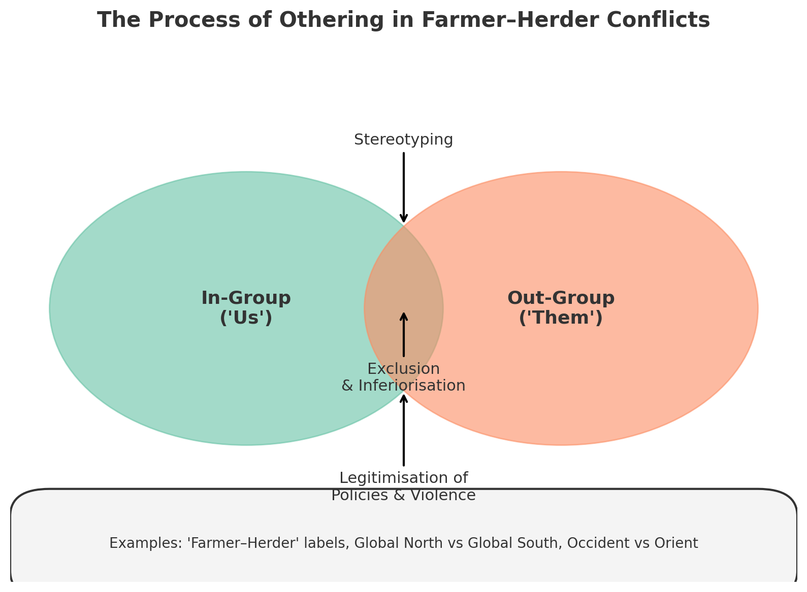
While not communicating much, this label serves as a handy tool for othering and justifying violations
Similar to the imperial logic: “White-Black”, “Occident-Orient,” and “Global North-Global South.”
Farmers and herders, rather than depicting distinct occupational groups, become constructed social identities associated with pre-conceived essences and telos
Laws and policies are then formulated to eliminate one group, which is now framed as an existential threat (Olaniyan et al., 2015; Lane, 2014; Blench, 2001 )
Other groups are appeased, romanticising and legitimising state power.
Resistance to exclusionary policies comes in several forms, including surprise attacks, displacement and occupation, crop destruction, arson, etc
Fulani herders are terrorists, rapists, inhumane and do not deserve to be called humans. They have chased people away and have now taken our lands, planting crops on one side while grazing on the other (Smallholder farmer, Ayilamo)

Slide 5
Political ecology of lawmaking: exclusion, identity politics, and the reproduction of power.
In 2017, the Benue State House of Assembly passed the Anti-Open Grazing Prohibition and Ranches Establishment Law
This, according to the state authorities, was aimed at preventing perennial conflicts between smallholder farmers and pastoralists who were largely of Fulani extraction.
It was largely exclusionary (economic, social, cultural and axiological violations)
Smallholder farmers were well pleased with the law, as Fulbe herders were indirectly expelled
Resistance came shortly after, and this changed the nature of the altercations between these groups
Was this the only solution to the conflicts?
The law empowered their youths to attack and kill our herds. I lost all my herds of over 500. When someone deliberately hurts you, it becomes difficult not to push back” (Fulani man in Keana on 25th August, 2025)
It was a political strategy. Ortoms' abysmal performance in his first term made it clear to him that he would never win the 2018 gubernatorial elections. He needed something to endear himself to the people. He pulled the ethnic shot, claiming attempts to Fulaniise Benue by the FG with a choreographed resolve to resist the Fulaniisation attempt. This resonated very well with the people. He won the 2018 elections based on the narratives of Fulanisation and the need to resist such attempts by the state. He decamped to the PDP after gaining popularity with the Fulani rhetoric” (Traditional leader in Anyiin on July 30th, 2025)

Slide 6
Actor mapping
Actor mapping is often concentrated on directly referenced, in this case, farmers and herders (Mehl, 2009)
This study found that non-referenced actors, such as women and politicians, play remote but significant roles in farmer-herder conflict escalations and de-escalations.
While politicians construct and manipulate social identities for votes, women mobilised funds for the purchase of ammunition, cooked, washed and treated wounded combatants, and some women mocked their husbands for abandoning their lands to Fulani herders.
“If we run along with our men and children, then what makes them men? Real men protect their ancestral lands with their last breath. They cannot face Fulani herders but are rather here lording over us” (Displaced woman farmer, Bassa)
“ I regret making huge contributions to the purchase of ammunition. In the end, Fulani herders have taken over our land, so what is the essence of those contributions in the first place?” (Displaced woman farmer, Ayilamo)

Slide 7
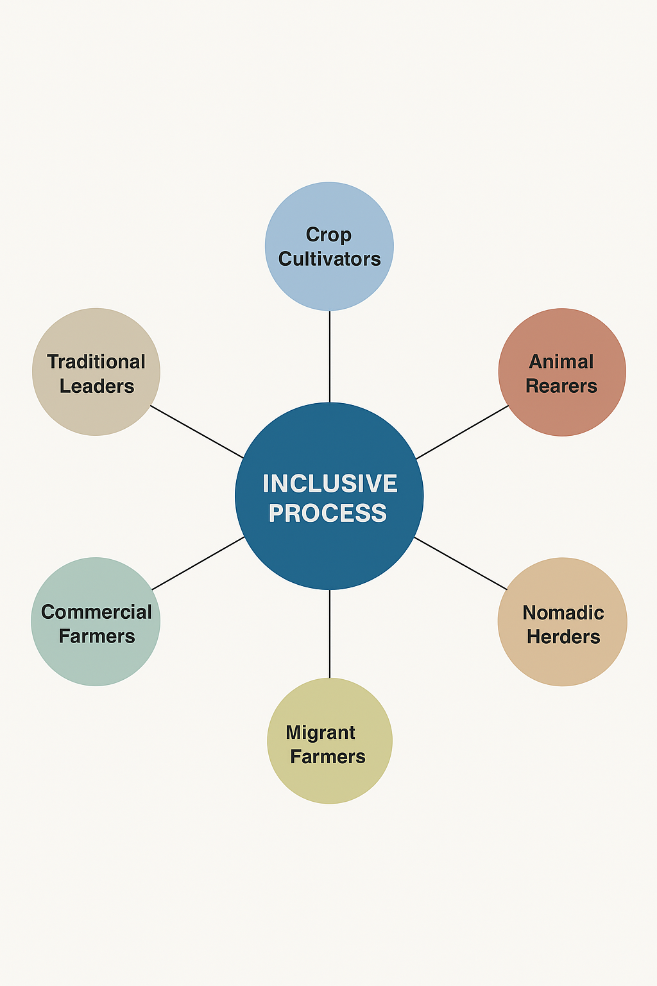
Pathways to peaceful coexistence
Pathways to peaceful coexistence
Exclusionary laws (e.g., anti-grazing bans) do not resolve conflicts; instead, they generate resistance, escalation, and more sophisticated forms of conflict.
Need to decolonise conflict resolution: move beyond imposed, top-down, and state-centric approaches.
Revisit traditional peace processes – draw from local practices but adapt them to be inclusive.
Ensure all groups (farmers, herders, women, youth, religious leaders, political actors) are represented in peace dialogues.
Promote co-created and co-managed mechanisms by all occupational groups to strengthen legitimacy and acceptance.

Slide 8
Conclusion
Farmer-herder conflicts label is misleading, but is maintained and widely used to sustain preconceived essences and telos, which are then appropriated to justify violations
In central Nigeria, discursive violence embedded in narratives of Fulanisation and jihadism serve to incite emotions and heighten resentment and expulsion desires where states then exploit these for political favours
The expulsion of labelled groups appears more as a political strategy than a conflict resolution effort
Non- referenced actors play significant roles in conflict escalation, and so conflict analysis should be widened to include them
The path to peace lies in inclusive governance of resources and shared ownership of solutions.

Slide 9
Thank you for your audience
I am ready for your corrections
ttseer@ubids.edu.gh

