Slide 1






Thomas Wiedenmann & Christian Mesmer Deutsche Gesellschaft für Internationale Zusammenarbeit (GIZ) GmbH
Reclaiming Communal Land Justice: The Land-Forest-Nexus Pilot in Ethiopia as a Model for Forest Landscape Restoration through Tenure Security

Slide 2
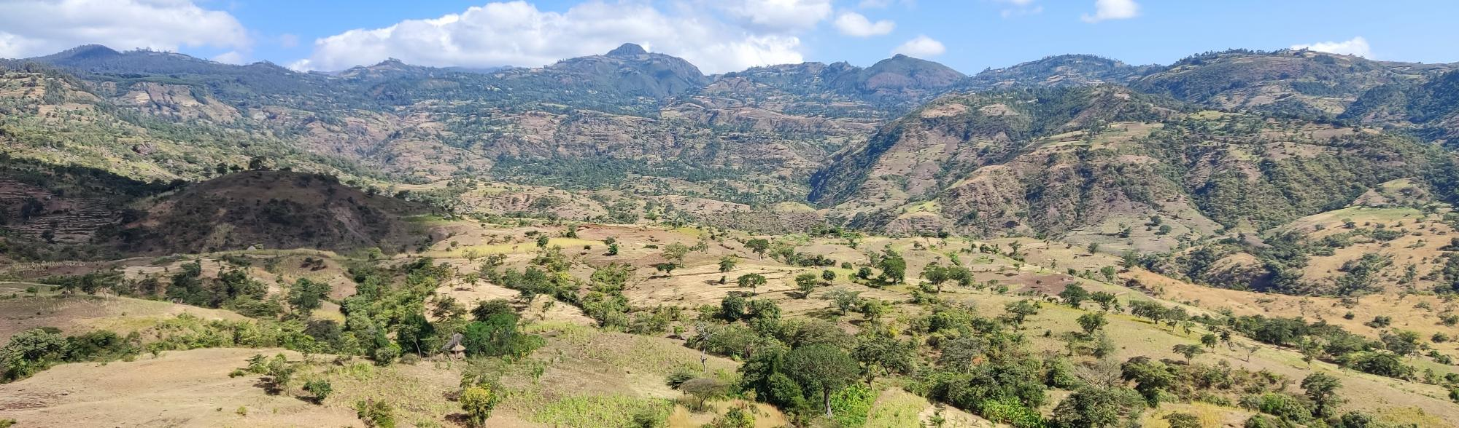
Background / Context
Communal lands in Ethiopia historically insecure → vulnerability to degradation and marginalization
Overlapping legal frameworks hinder recognition of community rights
Importance: Land governance affects both ecological and social outcomes

Slide 3
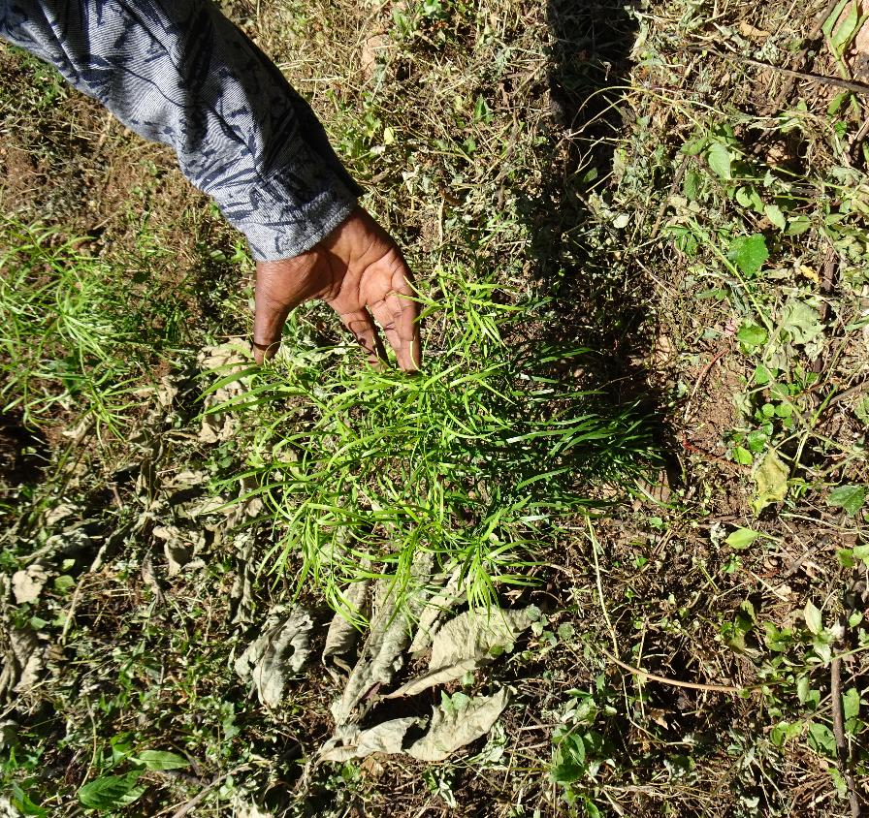
Research Gap & Objective
Gap: Limited empirical evidence on how communal land titling affects land use and ecological restoration in Sub-Saharan Africa
Objective: Assess how participatory communal land certification and cooperative governance influence tenure security, ecological outcomes, and policy alignment

Slide 4
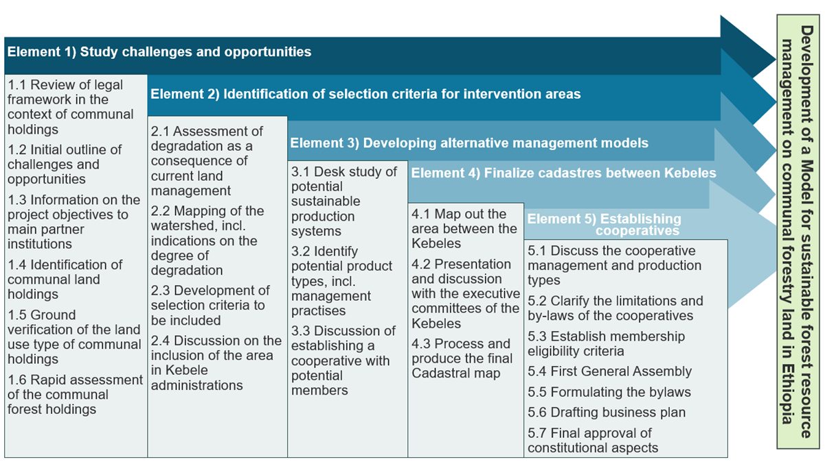
Methodology
Approach: Retrospective qualitative case study of the Lake Chamo pilot
Data Sources: Project reports, legal documents, field observations, participatory mapping, AI-assisted documentation
Phased Implementation: 5 phases from legal scoping to cooperative formation

Slide 5
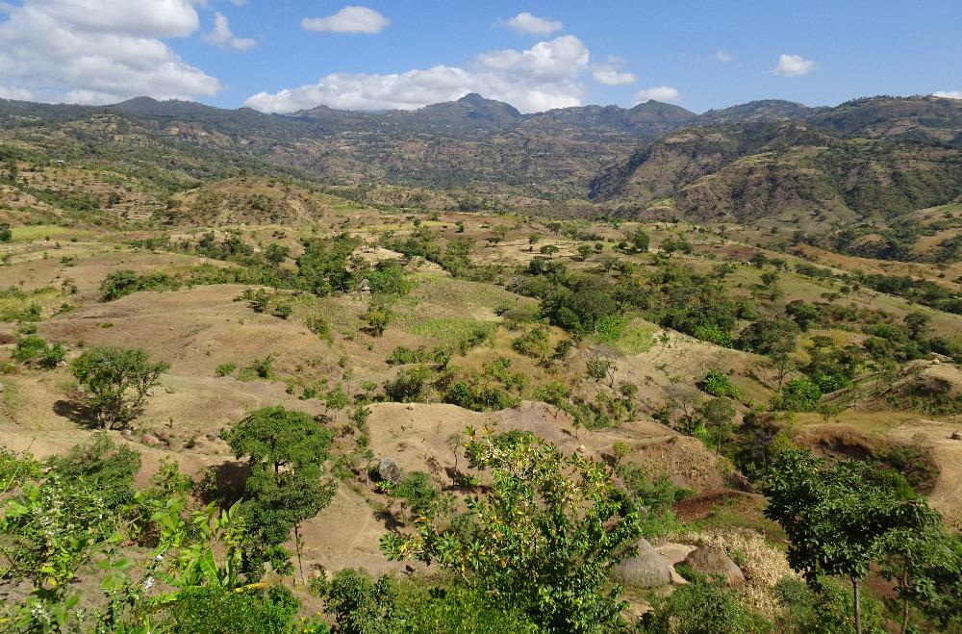
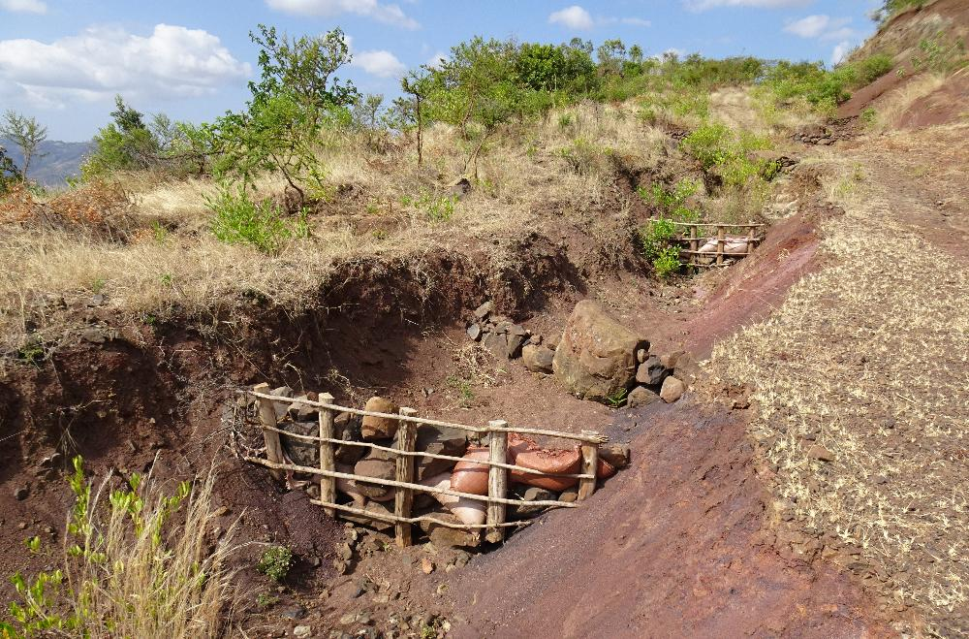
Study Site
Location: Lake Chamo watershed, Gamo Zone, Southern Ethiopia
Context: Ecologically sensitive area with forest degradation, customary land governance

Slide 6
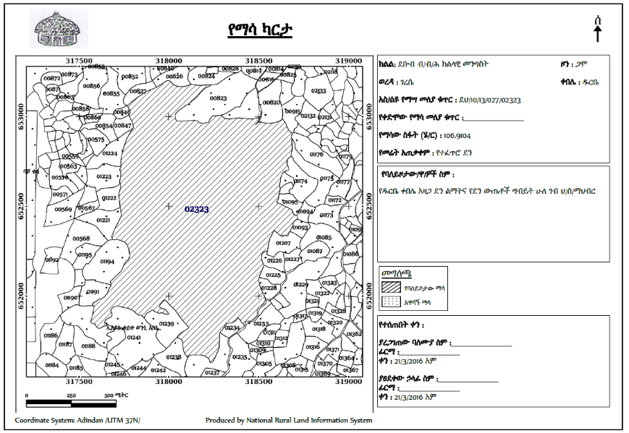
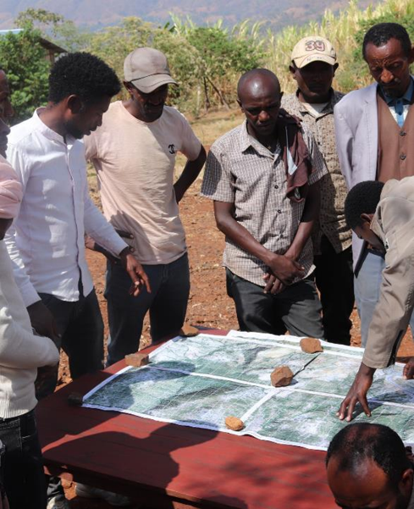
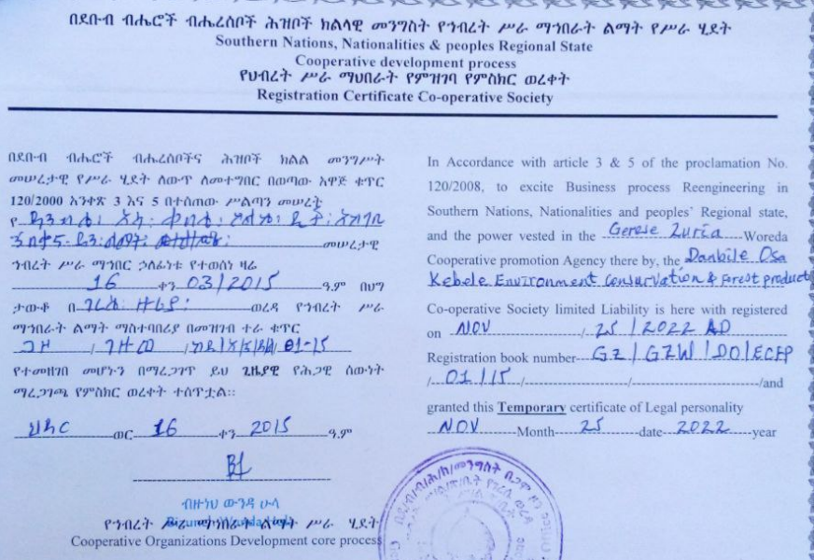
Key Results – Tenure & Governance
Legal Tenure: 1,500+ ha certified across 5 kebeles
Cooperatives: 5 legally registered forest user cooperatives formed
Community engagement: Participatory boundary demarcation, bylaws, elections, gender inclusion

Slide 7
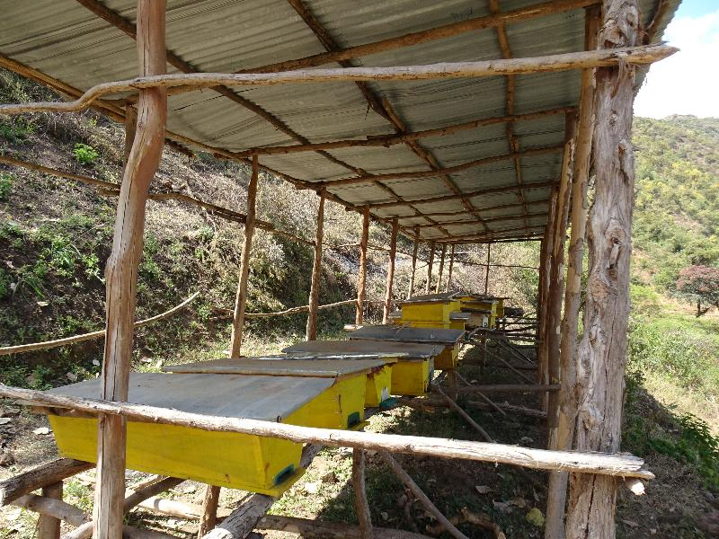
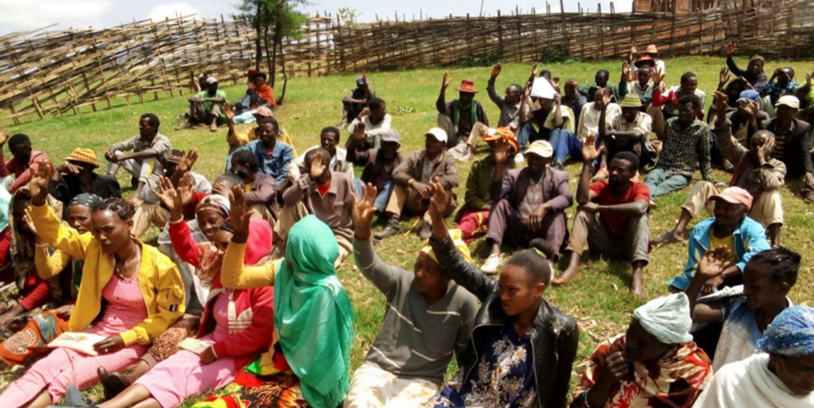
Key Results – Ecological & Social Outcomes
Ecological: Reduced encroachment, early forest regeneration, uptake of agroforestry
Social: Increased local ownership, cooperative governance, administrative participation

Slide 8
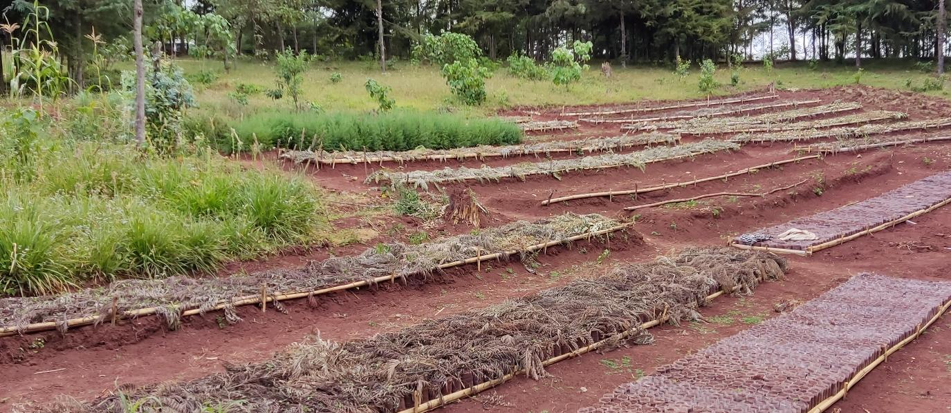
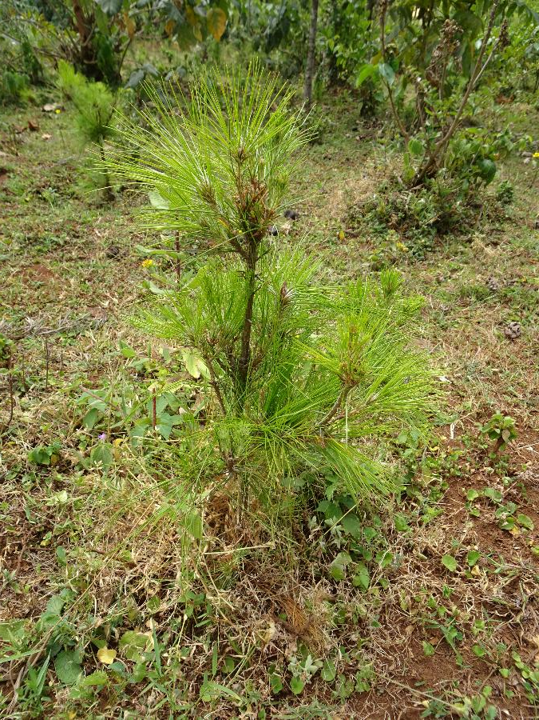
Discussion / Implications
Insights:
Tenure security → long-term stewardship
Participatory governance → justice, inclusion, empowerment
Integration of customary and statutory law → practical and scalable

Slide 9



Limitations & Future Research
Limitations:
No counterfactual or control group
Limited quantitative data (forest, biodiversity, income)
Context-specific findings
Future Directions:
Longitudinal studies, comparative analysis, policy evaluation on cooperative longevity

Slide 10




Conclusion & Significance
Key message:
Nexus Pilot demonstrates that legally recognized communal tenure can restore dignity, ecological integrity, and community agency
Offers a model for reparative land governance and sustainable landscape restoration in Ethiopia and beyond

Slide 11
Thank you!
Thomas.Wiedenmann@giz.de

