Slide 1
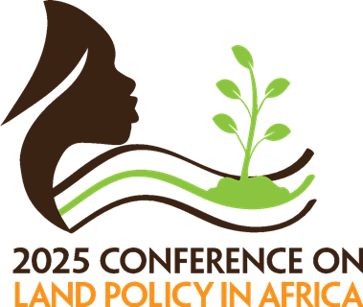

When Urban Land Cover Outpaces Population Growth: Rethinking Peri-Urban Land Governance in Southern Africa (2020-2050)
Tazviona Richman Gambe
Centre for Development Support, University of the Free State

Slide 2

Presentation Outline
Introduction
Objectives
Methods
Results
Concluding Remarks

Slide 3
Introduction: The Urbanisation Challenge
Africa’s urban population will double by 2050.
Southern Africa is urbanising rapidly but unevenly.
Urban sprawl dominates → inefficient land use, high infrastructure costs, ecosystem loss.
Need to shift towards compact, well-planned urban forms

Slide 4
Conceptual Framework
Guided by the Sustainable Urban Development (SUD) concept.
Planned-Unplanned Continuum → Compact vs Sprawling Human Settlements.
Anchored in the Compact City Model → efficient land use, mixed-use development, reduced travel demand.
Balances economic, environmental, and spatial dimensions.

Slide 5
Research Objectives
Examine
Examine urban population growth patterns in Southern Africa.
Analyse
Analyse relationships between population growth and land consumption.
Explore
Explore context-sensitive & sustainable land-use strategies that can be adopted to address challenges in the region.

Slide 6
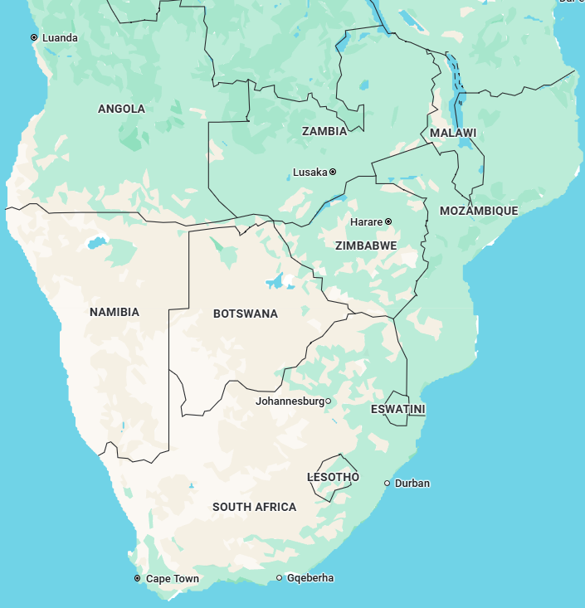
Study Area
Ten countries: Angola, Botswana, Lesotho, Malawi, Mozambique, Namibia, South Africa, Zambia, Zimbabwe, Eswatini.
Region shows varied urbanisation trajectories and governance capacities.
Contrasts between resource-driven growth and land-constrained contexts.
Source: Google Maps

Slide 7
Data and Methods
Main dataset: Africapolis 2024 (OECD/SWAC).
Definition: Built-up areas ≥ 10,000 people and ≤ 200 m building gaps.
Approach:
Descriptive & trend analysis of urban population and land cover.
Calculated CAGR and API to measure change rates.
Reviewed literature on peri-urban governance & policy.
Framework: Guided by SUD and compact-city lens.

Slide 8
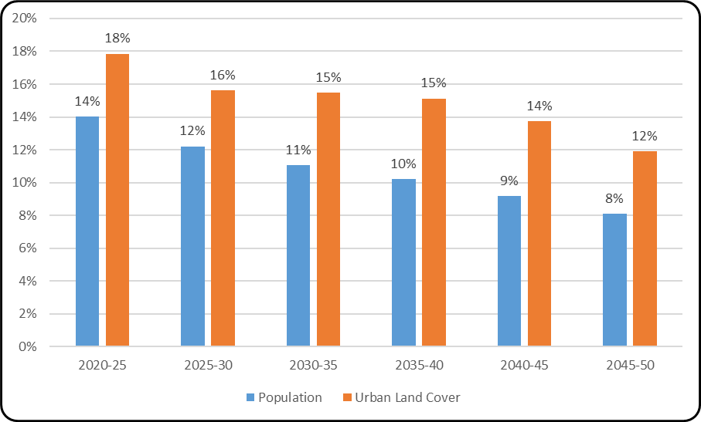
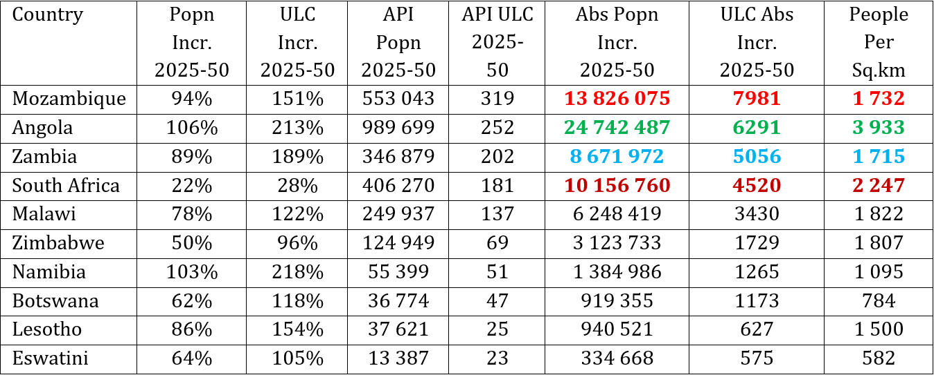
Urban Growth Trends (Regional Overview)
2020 → 2025:
  Urban land cover – 18% (CAGR 3.3%)
  Urban population – 14% (CAGR 2.7%)
2025 → 2050:
  Urban land cover – 96% (CAGR 2.7%)
  Urban population – 62% (CAGR 1.9%)
Land expansion > population growth in most countries → sprawl.
Weak peri-urban governance & fragmented institutions

Slide 9
Country Focus: Angola (Luanda)
Civil war → mass in-migration and returnees → population surge.
Musseques (peri-urban informal settlements) expanded rapidly.
High housing demand → unregulated land occupation.
Policy shift: integrate ecological & landscape-based planning in upgrading.

Slide 10
Country Focus: Zimbabwe
Spatial Development Plans (2023/24): mandatory for all municipalities.
Urban Stateland Management Policy (2025): clarifies land-allocation roles.
Promotes collaborative peri-urban management.
Integrates ecological & landscape-based planning for future resilience.

Slide 11
Policy Implications
No “one-size-fits-all” policy: must fit distinct drivers & contexts.
Strengthen spatial planning and enforce development controls.
Apply ecological and landscape-based design to guide urban expansion.
Leverage big data (Africapolis) for evidence-based decision-making.

Slide 12
Concluding Remarks
Southern Africa’s rapid urbanisation reshapes peri-urban landscapes.
01
Compact, data-driven, ecologically sensitive planning is vital.
02
Institutional capacity & governance reforms are key enablers.
03
Future directions: integrate spatial data analytics & local governance innovation.
04

Slide 13
Thank you!
trgambe@gmail.com

