Slide 1
The Global Digital Compact and Governance of AI

Slide 2
Summit of the Future

Slide 3
A comprehensive framework for the global governance of digital technology and AI
Member
States
Negotiated and agreed by 193 Member States and multistakeholder consultations
Aims to harness digital technology potential and close digital divides with concrete commitments & actions by Governments & stakeholders
Commits to upholding international law and human rights online
UN System
Private Sector
Civil Society
Tech Community
Academia
Regional &
International
Organizations

Slide 4
Global Digital Compact
Principles
1
Close digital divides
2
Expand inclusion digital economy
3
Foster safe digital space & human rights
4
Advance data governance
5
Enhance AI governance
Vision
Principles and objectives for strengthened digital cooperation.
Action
Concrete commitments & actions by Governments & stakeholders.
Follow up
Implementation actions and high-level review (2027).

Slide 5
Principles
Inclusive
Development-oriented
Human rights-based
Gender empowering
Sustainable
Equitable
Accessible
Interoperable
Responsible
Innovation-friendly
Multistakeholder
Implementation-directed
Future-oriented

Slide 6
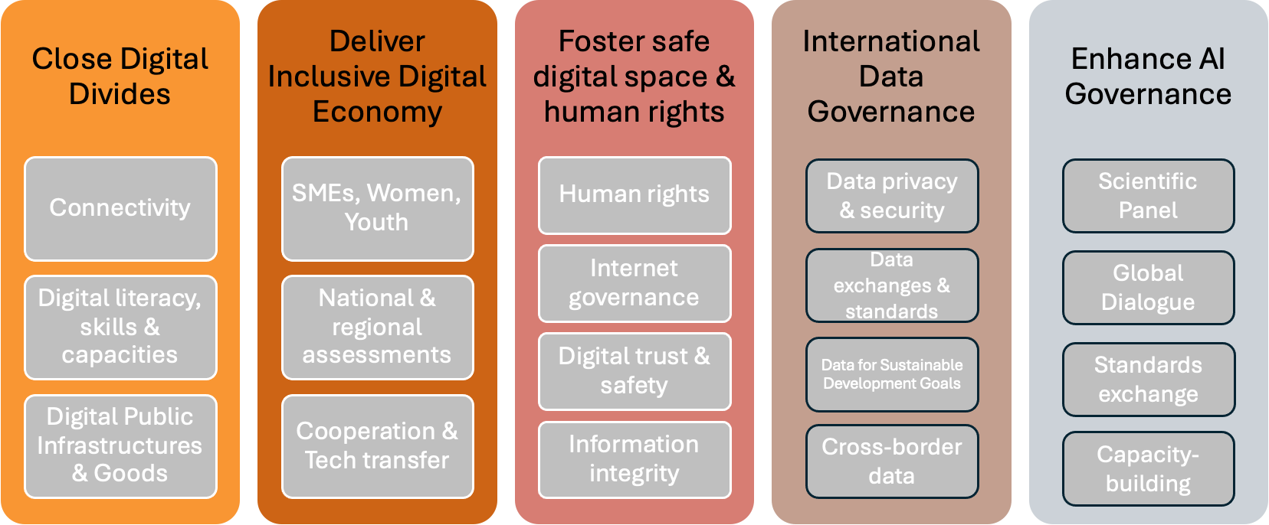
Commitments and Actions

Slide 7
Implementation Timeline
Compact implementation map & endorsements
Compact open for endorsement
AI modalities & WSIS+20 Review
High-Level Review
SEP
Q1
MID
Q3
2024
2025
2027
GDC Endorsement is on a rolling basis with regular updates of the contributors.
You can find more details at
https://www.un.org/global-digital-compact/en

Slide 8
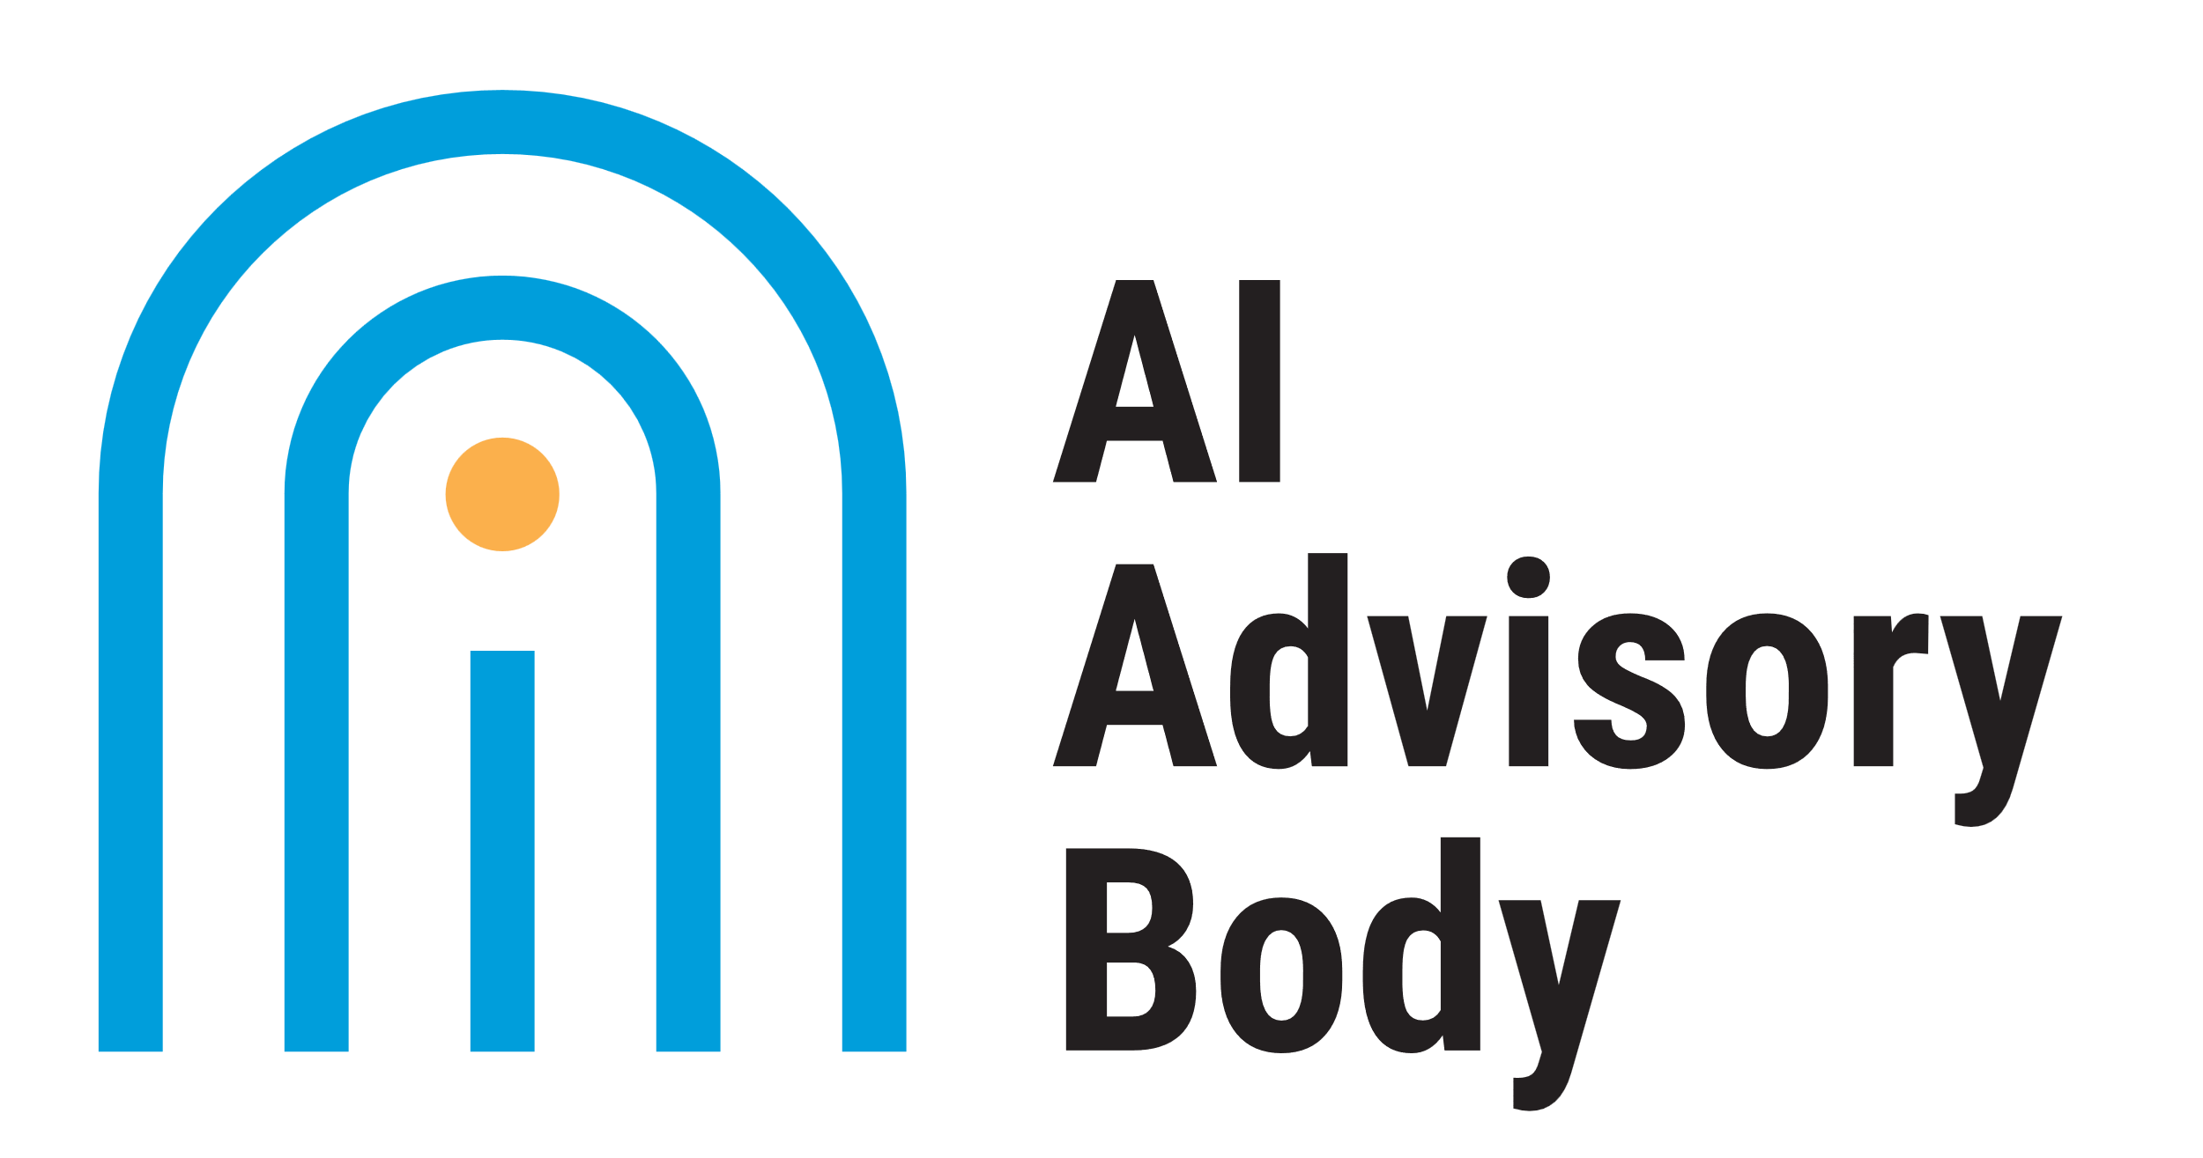
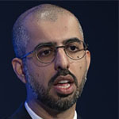
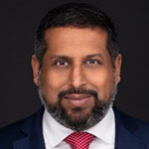
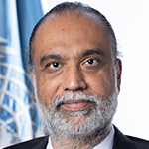
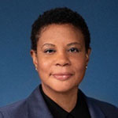
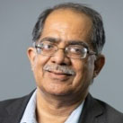
Members of the AI Advisory Body
39 Members, all experts in relevant domains
Across government, industry / private sector, academia, civil society
Representing diverse perspectives on how AI can be governed for the common good
33 nationalities represented
From all 5 UN regional groups
Gender-balanced
High-level Advisory Body on Artificial Intelligence

Slide 9
UNSG’s High-Level Advisory Body on Artificial Intelligence October 2023 – October 2024
The Global AI Imperative
Globally coordinated AI governance is the only way to harness AI for humanity
To address its risks and uncertainties as well as unlock its opportunities
Critical as AI becomes more widespread internationally
The UN’s Response
To foster a globally inclusive approach, the UN Secretary-General convened a multi-stakeholder High-level Advisory Body on AI to undertake analysis and advance recommendations for the international governance of AI
Link to Global Digital Compact process (September 2024)
A Multi-stakeholder, Networked Approach
The Body engaged and consulted widely with existing and emerging initiatives and international organizations
To bridge perspectives across stakeholder groups and networks
High-level Advisory Body on Artificial Intelligence

Slide 10
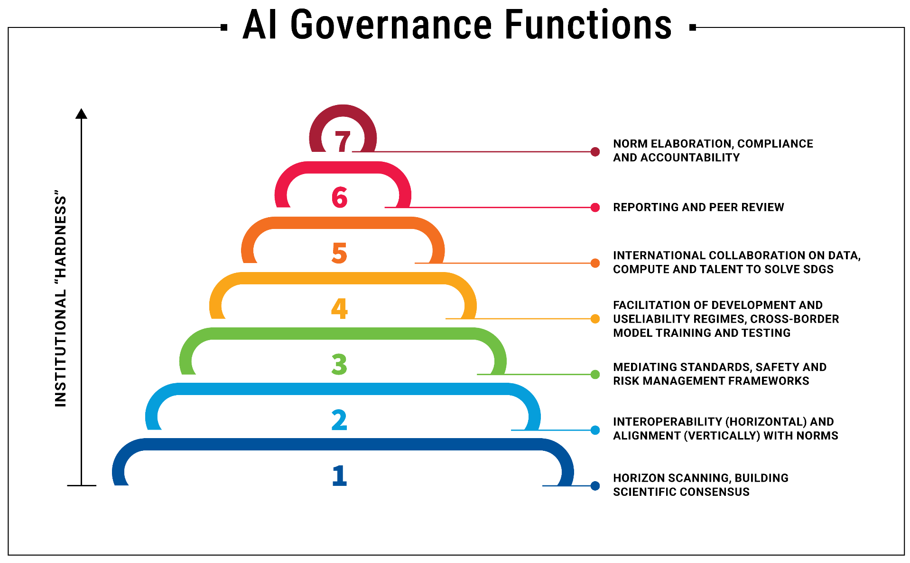
International AI Governance Functions
To properly govern AI for humanity, the Interim Report proposed that an international governance regime for AI should carry out at least these functions
Could be carried out by individual institution(s) or a network of institutions

Slide 11
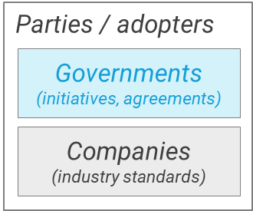
Sources of AI¹ governance initiatives
Not exhaustive
US-UK,
NZ-UK,
US-SGP,
US-EU…
QUAD…
AISs, CoE, G7, G20, GPAI, OECD…
UN
AISs, FMF, IEC, IEEE, ISO, ITU, WSC…
Inter-regional international between regions
ASEAN, AU, EU, OAS...
CEN-CENELEC, ETSI…
Regional
international within regions
Adoption
by companies
Adoption
by governments
AISIs, BSI, SAC, [ANSI, NIST]...170+ more
Domestic
Bilateral
Tri/quadri/ minilateral
Plurilateral
Universal
Large-n multilateral
Industry standards
& commitments
Inclusiveness
Existing laws and standards can also apply to AI applications within specific areas, with corresponding international specialized agencies e.g. in agriculture (FAO), health (WHO), education (UNESCO), intellectual property (WIPO), labour markets (ILO), meterology (WMO) etc

Slide 12
Most countries not in sample plurilateral efforts With clear regional imbalance – every WEOG / EEG country involved vs. very few elsewhere
Not exhaustive
Countries by how many of 7 sample international initiatives / instruments they are party to
(1) OECD AI Principles (2019), (2) G20 AI Principles (2019), (3) CoE drafting group (2022), (4) GPAI Ministerial Declaration (2022), (4) G7 Hiroshima Guiding Principles, (5) CoC, Comprehensive Policy Framework (2023), (6) Bletchley Declaration (2023), (7) Seoul Ministerial Statement (2024)
2
193 total
countries
Initiatives / instruments party to:
0 of 7
1
2
3
4
5
6
7 of 7
119 countries (62%) are party to none of the sample initiatives / instruments
AG
54
countries (Canada, France, Germany, Italy, Japan, UK, US) are party to all 7 sample plurilateral initiatives / instruments
APG
55
EEG
1
23
GRULAC
33
Countries not party to any
Countries party to at least one
WEOG
1. For this analysis, countries are not considered involved in a plurilateral initiative solely because of membership in the EU or AU.
12

Slide 13
HLAB-AI Proposals: Common Understanding
An International Scientific Panel on AI
Common understanding on AI needed at the global level, to…
Help member states develop a shared understanding of AI
Address information asymmetries between AI labs and the rest of the world
Suggested Deliverables
Annual reports surveying AI-related capabilities, opportunities, risks and uncertainties, Annual reports
Quarterly thematic research digests on areas in which AI could help to achieve the SDGs
Ad hoc reports on emerging AI risk
Notes:
Purpose - common understanding (guiding beacon, global voice)
-to inform: risk communication / signalling, boost public awareness
-to empower: evidence-based, impartial analysis to correct information asymmetries, level playing field for govts, enable proactive national strategies for harnessing opportunities
-to align: agree (minimal consensus) on shared risks (and uncertainties / known unknowns) amidst accelerating AI development at the frontier across range of applications, the when / priorities (early warning) and where (policy gaps) of intervening
Actions –
-develop risk assessment frameworks
-projections via multi-disciplinary working groups (per domain), continuous risk monitoring development / application via horizon scans (incident / vulnerability database, rigorous scientific evidence literature reviews, perceptions gauges, policies analysis) for continuously updated spectrum of AI risks
-continuous engagement, orchestration of academic networks
Equity – focus on opportunities / empowerment, nuances of socio-economic contexts (resonates with global diversity)
Effectiveness
-UN (authoritative, independent, no regulatory capture) as trusted location to create common knowledge, collating knowledge that is distributed across siloes in multiple countries / companies; work with ICRAI
-UN perspective – evaluating risks from a global perspective
Efficiency – work with OECD, GPAI, CoE, COMEST, UNESCO Policy Observatory, National initiatives, Network of Academic Partners. Global public good – pre-negotiated burden-sharing

Slide 14
HLAB-AI Proposals: Common Ground
2) Policy Dialogue on AI Governance
3) AI Standards Exchange
A new policy dialogue on AI governance at the UN to…
Foster common ground and regulatory interoperability rooted in human rights
Featuring intergovernmental and multi-stakeholder meetings
Suggested Deliverables
Share best practices on AI governance
Promote common understandings on the implementation of AI governance measures
Share voluntarily significant AI incidents that stretched or exceeded the capacity of State agencies to respond
Discuss International Scientific Panel on AI reports
Global cooperation on AI Standards Exchange to…
Ensure technical interoperability of AI systems across borders
Involving representatives from standards organizations, tech companies, and civil society
Suggested Deliverables
Developing and maintaining a register of definitions and applicable standards for measuring and evaluating AI systems
Debating and evaluating the standards and processes
Identifying gaps where new standards are needed
Notes:
Purpose - common understanding (guiding beacon, global voice)
-to inform: risk communication / signalling, boost public awareness
-to empower: evidence-based, impartial analysis to correct information asymmetries, level playing field for govts, enable proactive national strategies for harnessing opportunities
-to align: agree (minimal consensus) on shared risks (and uncertainties / known unknowns) amidst accelerating AI development at the frontier across range of applications, the when / priorities (early warning) and where (policy gaps) of intervening
Actions –
-develop risk assessment frameworks
-projections via multi-disciplinary working groups (per domain), continuous risk monitoring development / application via horizon scans (incident / vulnerability database, rigorous scientific evidence literature reviews, perceptions gauges, policies analysis) for continuously updated spectrum of AI risks
-continuous engagement, orchestration of academic networks
Equity – focus on opportunities / empowerment, nuances of socio-economic contexts (resonates with global diversity)
Effectiveness
-UN (authoritative, independent, no regulatory capture) as trusted location to create common knowledge, collating knowledge that is distributed across siloes in multiple countries / companies; work with ICRAI
-UN perspective – evaluating risks from a global perspective
Efficiency – work with OECD, GPAI, CoE, COMEST, UNESCO Policy Observatory, National initiatives, Network of Academic Partners. Global public good – pre-negotiated burden-sharing

Slide 15
HLAB-AI Proposals: Common Benefits
4) Capacity Development Network 5) Global Fund for AI 6) Global AI Data Framework
Global Capacity Development Network to…
Boost AI governance capacities, offering training, compute resources, and AI datasets to researchers and social entrepreneurs
Suggested Deliverables
Catalyse and align regional and global AI capacity efforts
Build AI governance capacity of public officials
Make available trainers, compute and AI training data across multiple centres to researchers and social entrepreneurs
Establishing Global AI Fund to…
Address gaps in capacity and collaboration
Empower local efforts to further the SDGs
Suggested Deliverables
Computing resources for model training and fine-tuning by AI developers
Sandboxes, benchmarking and testing tools to mainstream best practices
Governance, safety and interoperability solutions with global applicability
Research on how data and models could be combined for SDG-related projects
A repository of AI models and curated data sets for the SDG
Fostering Global AI Data Framework to…
Standardize data-related definitions, principles, and stewardship
Ensure transparency and accountability in AI systems
Suggested Deliverables
Outlining data-related definitions and principles for global governance of AI training data
Common standards around AI training data provenance
Market-shaping data stewardship and exchange mechanisms
Notes:
Purpose - common understanding (guiding beacon, global voice)
-to inform: risk communication / signalling, boost public awareness
-to empower: evidence-based, impartial analysis to correct information asymmetries, level playing field for govts, enable proactive national strategies for harnessing opportunities
-to align: agree (minimal consensus) on shared risks (and uncertainties / known unknowns) amidst accelerating AI development at the frontier across range of applications, the when / priorities (early warning) and where (policy gaps) of intervening
Actions –
-develop risk assessment frameworks
-projections via multi-disciplinary working groups (per domain), continuous risk monitoring development / application via horizon scans (incident / vulnerability database, rigorous scientific evidence literature reviews, perceptions gauges, policies analysis) for continuously updated spectrum of AI risks
-continuous engagement, orchestration of academic networks
Equity – focus on opportunities / empowerment, nuances of socio-economic contexts (resonates with global diversity)
Effectiveness
-UN (authoritative, independent, no regulatory capture) as trusted location to create common knowledge, collating knowledge that is distributed across siloes in multiple countries / companies; work with ICRAI
-UN perspective – evaluating risks from a global perspective
Efficiency – work with OECD, GPAI, CoE, COMEST, UNESCO Policy Observatory, National initiatives, Network of Academic Partners. Global public good – pre-negotiated burden-sharing

Slide 16
Questions

