Slide 1
World Summit on the Information Society in Africa (WSIS+20) 2025 Africa Regional Review, Cotonou, 14 -16 May, 2025
Mozambique presentation on the implementation of the WSIS : results, challenges and perspectives
Cotonou, May 14, 2025

Slide 2
Contents
Introduction;
Legal, Regulatory Framework and ICT Guiding Instruments in Mozambique;
Vision and Mission of the Information Society Policy and Strategy;
Development axes defined by the Information Society Policy and Strategy;
Implementers of the Information Society Policy and Strategy;
Complementary Instruments to the Electronic Transactions Law;
Electronic Governance Initiatives: Axis 5 of the Strategic Plan for the Information Society (2019-2028);
African Union Convention on Cyber Security and Data Protection;
Challenges;
Perspectives.

Slide 3
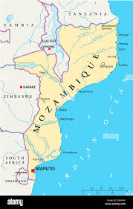
1. Introduction
Mozambique is a country located on the East coast of Africa:
Total area: 799 380 km2;
Capital: Maputo;
Official Language: Portuguese;
Population: 34 million;
Internet Users: 7.96 million;
Mobile Phones Users: 18.91 million.

Slide 4
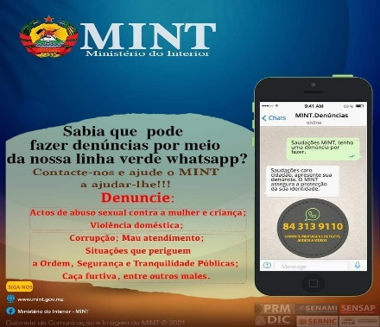
1. Introduction (cont.)
ICT offers a wide range of digital content and platforms that:
inform and entertain;
enable social relationships;
facilitate governance processes;
boost e-commerce;
Enable inclusion of the processes;
They facilitate entrepreneurship;
They make it easier to report abuse;
Speed up financial transactions; and
Promote the fight against corruption.
In cyberspace we find malicious content and crimes :
scam,
False information/news,
Drug trafficking,
Abuse of women and children.

Slide 5
2. Legal, Regulatory Framework and ICT Guiding Instruments in Mozambique
Approved legal, regulatory and guiding instruments
Law 3/2017 of January 9th – approve the Electronic Transaction Law
Resolution No. 59/ 2019 of October 16 - approves the Strategic Plan for the Information Society
Decree No. 67/2017, of December 1st - approves the e-Government Interoperability Framework;
Decree No. 82/2020, of September 10th- approves the Regulation on the Use of the Domain “.mz” Mozambique
Resolution No. 17/2018, of June 21 - approves the Information Society Policy
Resolution No. 69/2021, of December 31st - approves the National Cyber Security Policy and its Implementation Strategy
Resolution No. 5/ 2019 of June 20 - ratifies the African Union Convention on Cybersecurity and Personal Data Protection (Malabo Convention)
Decree No. 59/2023 of October 27 - approves the Regulation on the Registration and Licensing of Intermediary Providers of Electronic Services and Operators of Digital Platforms
Decree No. 59/2019 of July 3rd - approves the Regulation of the Digital Certification System of Mozambique.
Decreto N.º 42/2024, de 18 de Junho Aprova o Regulamento do Repositório Científico de Moçambique
Resolution no. 39/2024, of July 23rd - approve the National Policy and Strategy for Science, Technology and Innovation.

Slide 6
2. Legal, Regulatory Framework and ICT Guiding Instruments in Mozambique
1) Electronic Transactions Law (LTE) - Law 3/2017, of January 9 - establishes the principles, general rules and legal framework for electronic transactions in general, e-commerce and e-government in particular, with a view to ensuring protection in the use of Information and Communication Technologies..
2. Information Society Policy - Resolution no. 17/2018, of June 21 - establishes the guidelines for sustainable development, aiming to make Mozambique an inclusive and competitive society through the massification of Information and Communication Technologies (ICT).
3. Strategic Plan for the Information Society (2019-2028) and the respective Operational Plan - Resolution no. 52/2019, of October 16 - presents 120 initiatives to be developed, and these are described in the Operational Plan for the Information Society, which has a 5-year time horizon.

Slide 7
3. Vision and Mission of the Information Society Policy and Strategy
VISION
To make Mozambique a country in which everyone, without discrimination, has access to and makes use of Information and Communication Technologies for their own benefit and that of society in general.
MISSION
Promoting the development of the Information Society in a sustainable way, modernizing public administration, creating skills in citizens and stimulating productivity and socio-economic development.
Guiding Principles
Info-inclusion
2. Integration
3. Coordination
4. Sustainability
5. Good Governance
6. Information Security
Actors
Government
2. Private Sector
3. Academia
4. Civil Society Organizations
5. International Organizations
6. Media
7. Citizen

Slide 8
4. Development axes defined by the Information Society Policy and Strategy
Axis 1 – Education and Human Development
1.1. ICT in the Education System
1.2. Research and Development and Knowledge Sharing
1.3. Human Resources Development
Axis 6 – Acess and Conectivity
6.1. Integration into the Information Society
6.2 Communications Network
Axis 2 – Health
2.1. Preventive and Promotional Care
2.2. Curative Care
2.3. Health Logistics
Axis 3 – Agriculture, Environment and Rural Development
3.1. Agriculture
3.2 Sea, Fisheries and Aquaculture
3.3 Land, Environment and Rural Development
Axis 7 – Policies and Regulation
7.1 Adequate Legal Framework
Axis 5 - e-Governance
5.1. Modernizing Public Administration and Providing Services to Citizens
5.2 Judicial Sector
5.3 Security and Public Order
5.4 Infrastructure and Equipment
5.5 ICT Interoperability and Security

Slide 9
5. Implementers of the Information Society Policy and Strategy
Institutions Responsible for Implementing PESI Initiatives/Projects

Slide 10
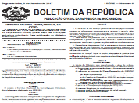
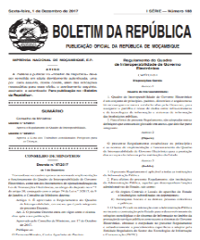
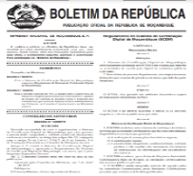
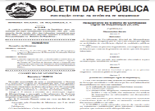
6. Complementary Instruments to the Electronic Transactions Law
Law no. 3/2017 of January 9th, Electronic Transactions Law - establishes the principles, general rules and legal framework for electronic transactions in general, e-commerce and e-government in particular, with the aim of guaranteeing protection in the use of Information and Communication Technologies.
Decree no. 67/2017, of December 1, establishing the principles and rules for the implementation and operation of the e-Government Interoperability Framework;
Decree no. 59/2019, of July 3, approving the Regulation of the Digital Certification System of Mozambique;
Decree no. 82/2020 of September 10, approving the Regulation on the Use of the Domain “.mz”
Decree no. 61/2017 of November 6, which creates the National Institute of Electronic Government (INAGE), the entity responsible for providing e-government services in the public administration
Decree No. 82/2020 of September 10, establishing INTIC as a Public ICT Regulatory Institute, coordinator of digital governance and Internet governance

Slide 11
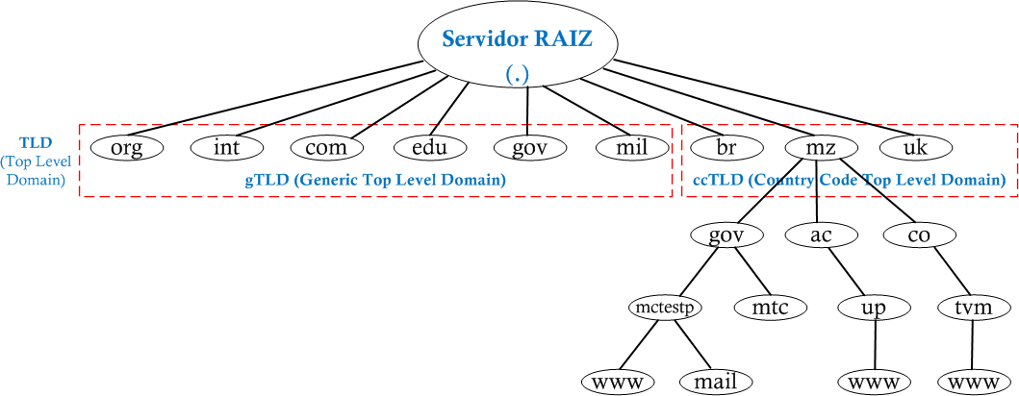
7. PESI Axis 5 initiatives
e-Governance: Internet Governance
Law no. 3/2017 of January 9th, Electronic Transactions Law
Decree no. 82/ 2020 of September 10, approving the Regulation on the Use of the Domain “.mz”
Hierarchical Structure of the Internet Domain Name System
Jurisdição Americana
Jurisdição Moçambicana
Aplicações e Serviços de Internet

Slide 12
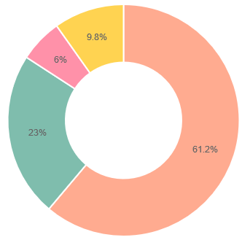
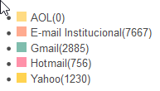
7. PESI Axis 5 initiatives
e-Governance: Internet Governance
40,904 USER ACCOUNTS OF THE OFFICIAL STATE MAIL created in the new correio.gov.mz system.

Slide 13
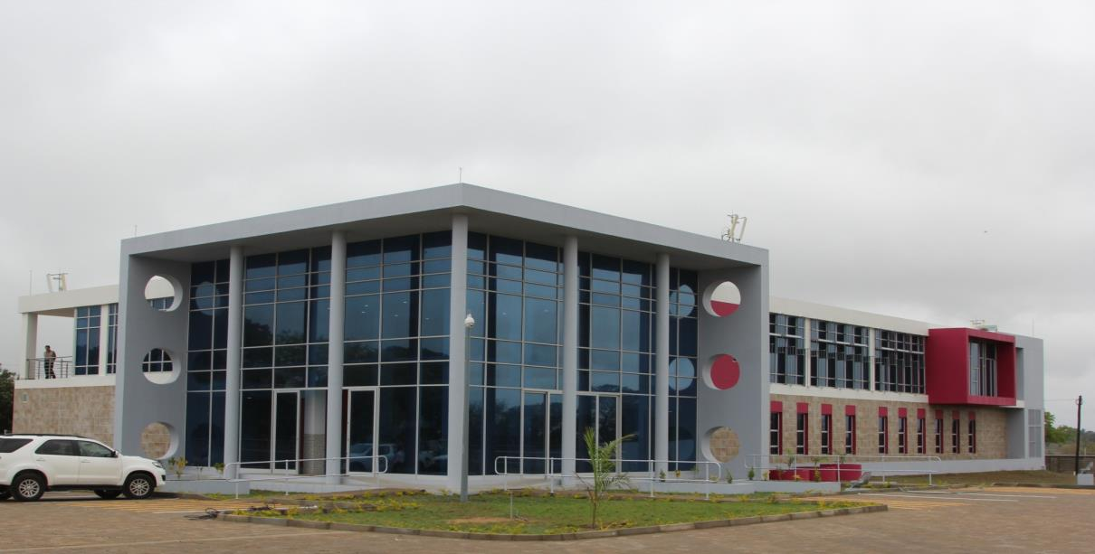
7. PESI Axis 5 initiatives
e-Governance: Infrastructure and Equipment
# |  | Servidores | Storage (TB)
1 | applications hosted on the servers | 49 | 336
2 | services and disaster recovery | 41 | 160
3 | Not used | 10 | 104
4 | Total | 100 | 600
National Data Center of the Government of Maluana

Slide 14
7. PESI Axis 5 initiatives
e-Governance: Electronic Government Network
Institutions connected to the e-government network
# | Instituições | Até 2019 | 2020 | 2021 | 2022 | 2023 | 2024 | 2020 a 2024 | TODOS
 | Ligadas |  |  |  |  |  |  |  | SITES
1 | GovNET | 846 | 32 | 38 | 16 | 16 | 4 | 106 | 952
2 | MoRENet | 163 | 7 | 14 | 7 | 5 | 2 | 35 | 198
# | Instituição | Provedor | Largura de banda | Estágio
1 | Hospital Geral José Macamo | Movitel | 100Mbps | Operacional
2 | Hospital Geral de Chamanculo | Movitel | 100Mbps | Operacional
3 | Hospital Geral de Mavalane | Movitel | 100Mbps | Operacional
4 | Instituto de Ciências de Saúde de Infulene | Movitel | 100Mbps | Operacional
5 | Hospital Geral de Polana Caniço | Movitel | 100Mbps | Operacional
6 | Hospital Psiquiátrico de Infulene | Movitel | 100Mbps | Operacional
7 | Central de Medicamentos e Artigos Médicos | TMCEL | 100Mbps | Operacional

Slide 15
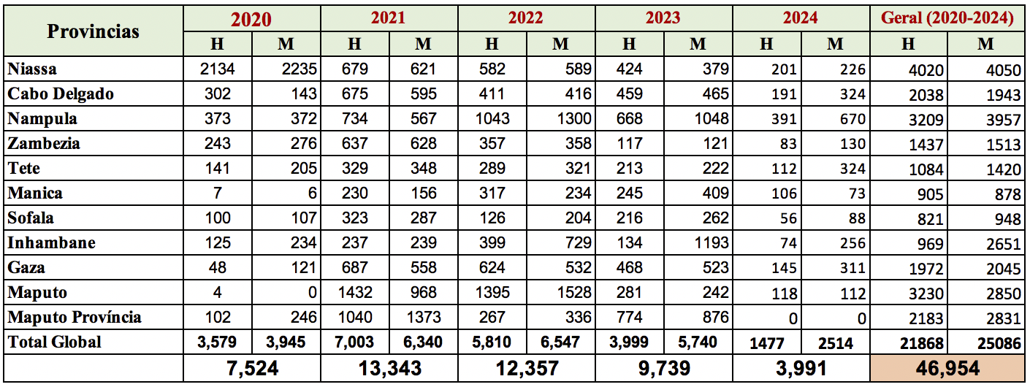
7. PESI Axis 5 initiatives
E-Governance: Electronic Government Network
46,954 civil servants and state agents trained in ICT subjects
Training for State Officials and Agents at the INAGE, IP Delegation in Cabo Delgado
Impact :
Improved institutional performance and responsiveness;
Increased efficiency in the services provided to citizens (reduction in service times);
Improved delivery of state e-services and will drive improvements in citizen service; and
Training and capacity-building actions tailored to the real needs of the sectors.

Slide 16
7. PESI Axis 5 initiatives
E-Governance: Electronic Government Network
Holding Internet Governance Forums
Activities carried out in the provinces of Maputo, Sofala and Cabo Delgado
The relevance of the Provincial Internet Governance Forums stems from the need for a mechanism that enables the processes of digitizing the economy and society at provincial level through:
Continuous alignment between developments at provincial level; and
good national and international practices.

Slide 17
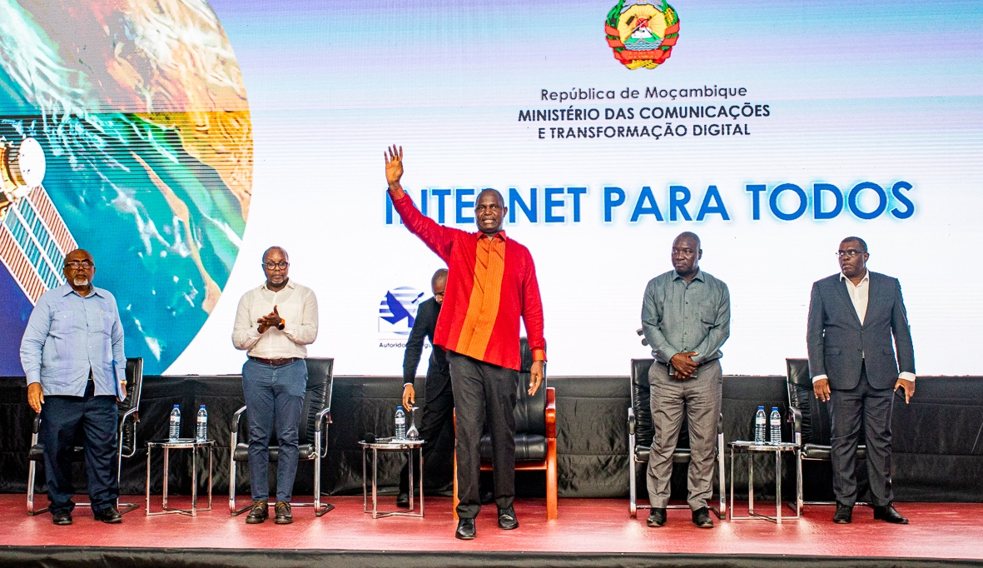
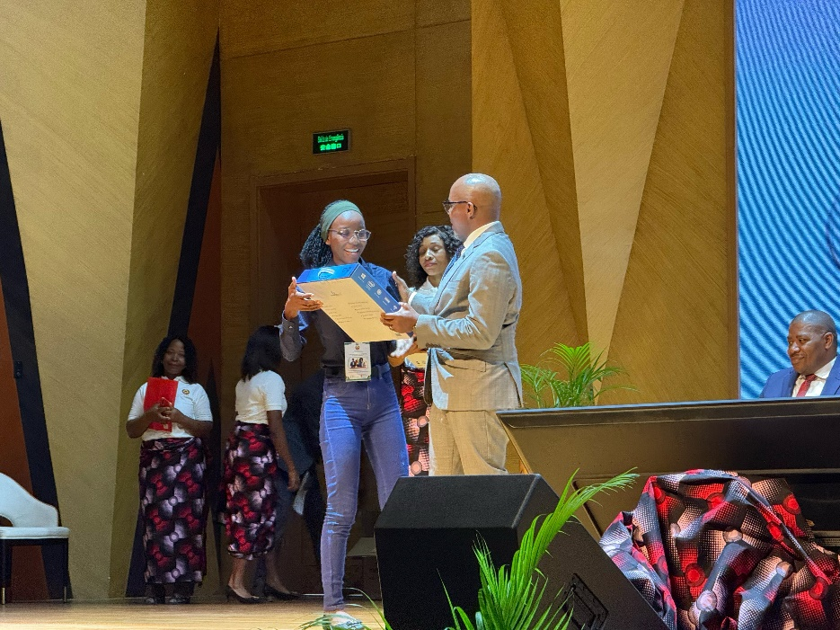
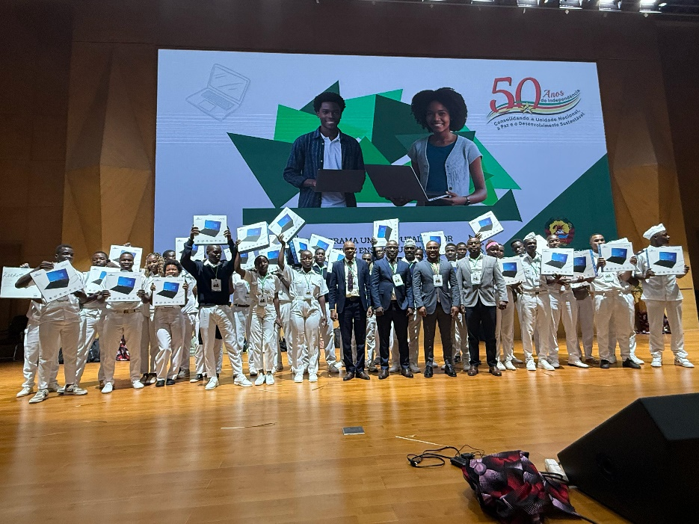
7. PESI Axis 5 initiatives
E-Governance: Other activities carried out
Internet for All Program - which aims to create digital plazas where the population can access the internet
1 computer per higher education student program - aims to provide digital devices to needy higher education students

Slide 18
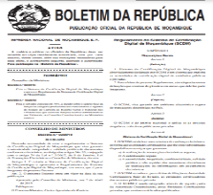
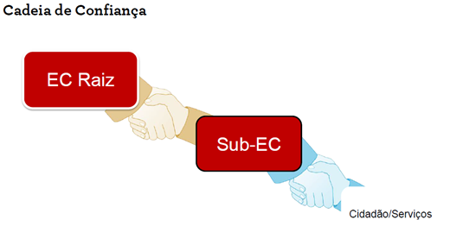
7. PESI Axis 5 initiatives
E-Governance: Cybersecurity
Law no. 3/2017 of January 9th, Electronic Transactions Law
Decree no. 59/2019, of July 3, approving the Regulation of the Digital Certification System of Mozambique;
Digital Certification System of Mozambique (SCDM)
It is based on the Public Key Infrastructure (ICP), which is established on the basis of a chain of TRUST, and guarantees secure electronic transactions through digital signatures on electronic information and documents, ensuring their authenticity, integrity, confidentiality and non-repudiation.

Slide 19
8. African Union Convention on Cybersecurity and Personal Data Protection
The African Union Convention on Cybersecurity and Personal Data Protection, was signed by the Government of Mozambique in 2014 and ratified by the Parliament of Mozambique in 2019.
This ratification was a sign of the commitment of Mozambique as a State, on this issue of Cybersecurity and Personal Data Protection.
The ratification of the Convention brings several advantages and development opportunities for Mozambique, especially considering the technological advances and demands for data security and privacy on the African continent and all over the world.

Slide 20
9. Challenges
Updating the National Cyber Security Policy and Strategy;
Approval of the Personal Electronic Data Protection Act;
Approval of the Cybercrime Law;
Ratification of the Budapest Convention;
Approval of the Electronic Commerce Regulation;
Approval of the Cybersecurity Regulation;
Drafting the Regulations for the Construction and Operation of Data Centers;
Draw up the Regulation on the Location of Critical Data in Mozambique's Area of Jurisdiction;
Draft the Open Data Regulation;
Draft the National Digital Transformation Strategy
Draft the Artificial Intelligence Strategy;
Draft the Digital Skills Development Plan; and
Operationalizing the Interoperability of Public Administration Electronic Systems.

Slide 21
10. Perspectives
Strengthen the ICT regulatory framework in Mozambique;
Strengthen cyber security and data protection;
Design the Digital Inclusion Strategy;
Draw up the National Digital Skills Plan;
Operationalize the digital certification system;
Continue to train human resources in ICT; e
Improve ICT infrastructure.

Slide 22
MUITO OBRIGADO!

