Slide 1

Bridging the Digital Divide through Academic Leadership
Prof. Charles O. Esimone
Vice-Chancellor (Emeritus), Nnamdi Azikiwe University
WSIS+20 Africa Regional Review Meeting
Cotonou, Benin | May 15, 2025

Slide 2
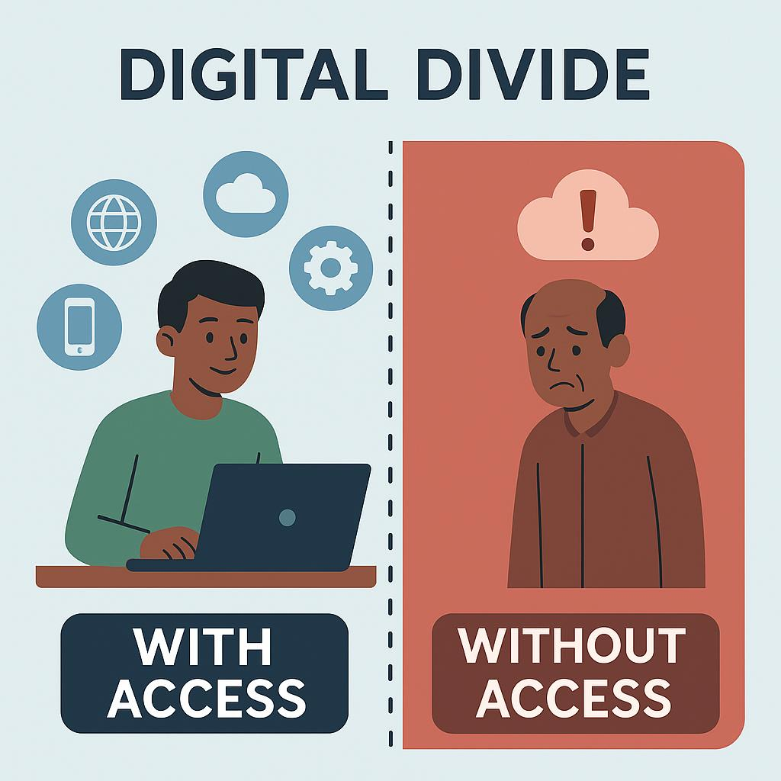
Introduction
The digital revolution offers unprecedented opportunities for inclusion and development.
    Yet, digital divides persist in Africa.
    Academia must lead in closing these gaps through education, innovation, and ethical digital transformation.

Slide 3
Academic Leadership: Closing the Digital Gap
Establish digital innovation hubs for local problem-solving
01
Integrate AI and digital skills into curricula
02
Promote inclusive ICT access for underserved groups
03
Train educators using AI competency frameworks
04

Slide 4
UNESCO AI Competency for Teachers
Raise awareness of AI among educators
Use AI tools to enhance pedagogy
Foster ethical thinking around classroom AI use

Slide 5
Ethical and Inclusive Digital Transformation
Follow UNESCO ethical AI guidelines
Ensure privacy, data governance, transparency
Address algorithmic bias in African contexts
Promote indigenous knowledge in digital content

Slide 6
Academic Input in Policy and Regional Frameworks
Engage academia in national digital policies
Align research with WSIS, AU 2063, and SDGs
Advocate for digital education in African strategies
Create academic consortia for digital policy input

Slide 7
Call to Action
Invest in academic-led ICT innovation
Partner across sectors for digital growth
Empower ethical digital citizens
Make universities leaders in digital transformation

Slide 8

Thank you

