Slide 1
UN GGIM Africa Workshop on geospatial value and integration - Geospatial e-learning webinar Sustainably financing IGIF-based SDIs Tuesday 15th August
“Business model options for sustainably financing IGIF Investment”
Looking at national geospatial information infrastructures Morocco
Mohamed Timoulali

Slide 2
Frameworks and Guidelines

Slide 3
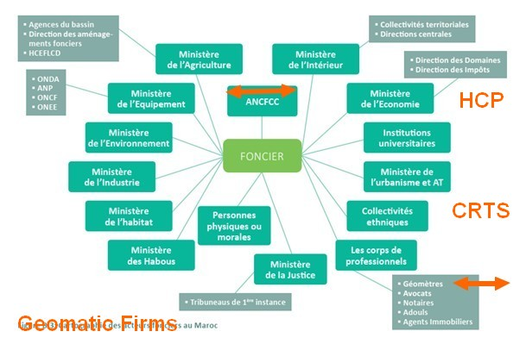
The National Geospatial Ecosystem

Slide 4
The Legal Framework
ANCFCC
Dahir n° 1-02-125 du 1er rabii Il 1423 (13 juin 2002)
portant promulgation de la loi n° 58-00 portant création de l’Agence nationale de la conservation foncière, du cadastre et de la cartographie (A.N.C.F.C.C)
ONIGT
Loi n° 30-93 relative à l'exercice de la profession d'ingénieur géomètre topographe et instituant l'Ordre national des ingénieurs géomètres topographes
promulguée par le Dahir n° 1-94-126 du 14 ramadan 1414 (25 Février 1994)

Slide 5
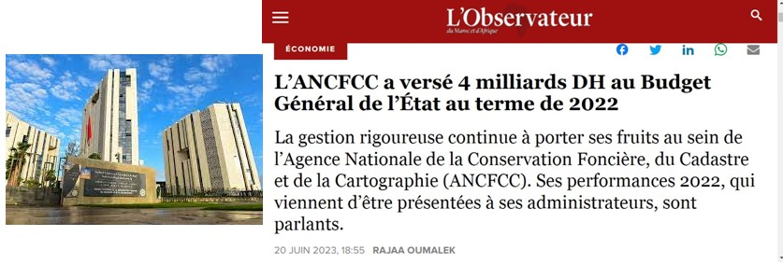
Land Registry, Cadastre, Mapping

Slide 6
Public Private Partnership
The main achievements of the 2022 financial year:
- The establishment of 438,258 Land Titles, including 188,664 from the ‘IFE’ in rural areas, an increase of 5% compared to 2021;
- Land registration of 667,084 hectares;
- A turnover of 8.03 billion DH;
- The payment of 4 billion DH to the General Budget of the State;
- A net accounting profit of 1107 Million DH.

Slide 7
The Land Survey Engineering Profession
LA PROFESSION EN CHIFFRES
CONSEILS RÉGIONAUX
PRIVÉ
Indépendant/Société
SALARIÉ Privé
PUBLIC
TOTAL
41%
57%
CASABLANCA-SETTAT | 185 | 3 | 108 | 296
FÈS-MEKNÈS | 143 | 3 | 110 | 256
RABAT-SALÉ-KÉNITRA | 266 | 28 | 239 | 533
MARRAKECH-SAFI | 135 | 5 | 86 | 226
 |  |  |  | 1311
2%
16 % de femmes (210)
1311 IGT dont 729 privés
+ 700 Entreprises
+15.000 emplois directs +30.000 emplois indirects
+15 salariés par Entreprise
+3 MMDHS C.A / an
+100 MDHS Investissement / an
ONIGT

Slide 8
Multiple PPP
ONIGT

Slide 9
International Cooperation
- SDI and EO
SEED4NA
- Land Governance
MCA-Morocco
NELGA-NA

Slide 10
Actual Business Models
Partnership and Consultations
Reached their limits due the Evolution of the Technology
Example
GNSS CORS networks
(Case in justice )

Slide 11
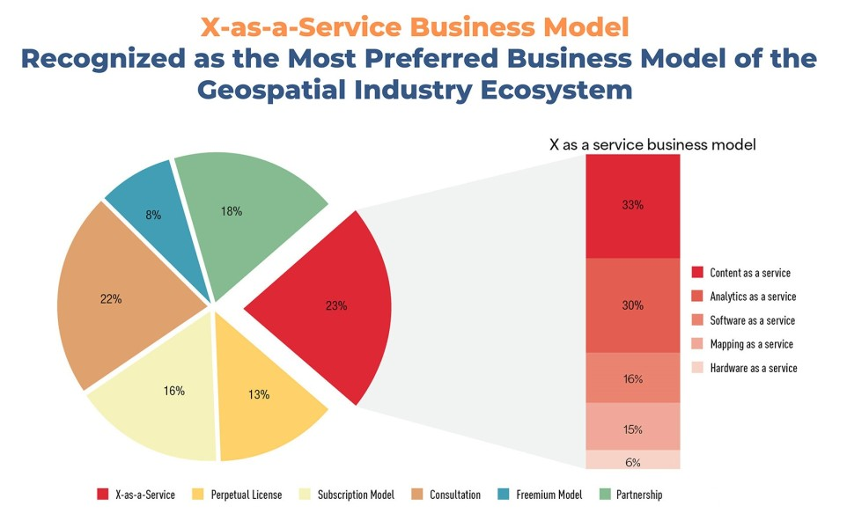
Urgent need for new Business Models
GW Consulting

Slide 12
The national context
New Development Model
Invesment charter
National Strategies:
Sustainable Development,
Digital Transformation,
Territory Development…

Slide 13
Improve Collaboaration within the Geospatial Ecosystyem
Develop IGIF Country Action Plan
Inclusion and participation of all Stakeholders
- Evaluate the actual PPP
- Identify new Business models
- Review the National Land Strategy
- Formulate a National Geospatial Strategy

Slide 14
Mohamed Timoulali
GTOPIC sarl
email: mtimoulali@gtopic.net
Tel: 212 537 264602 Fax: 212 537 264602
GSM: 0661165545
https://gtopic.net/blog/

