Slide 1

GEOSPATIAL
Public private partnerships africA
Readiness Index, Business Tools and
How-to-Guide for Developing a Successful Geospatial PPP
There are strong needs and compelling stories for the development
and support of geospatial infrastructure and Earth observation
sectors with PPPs in Africa

Slide 2
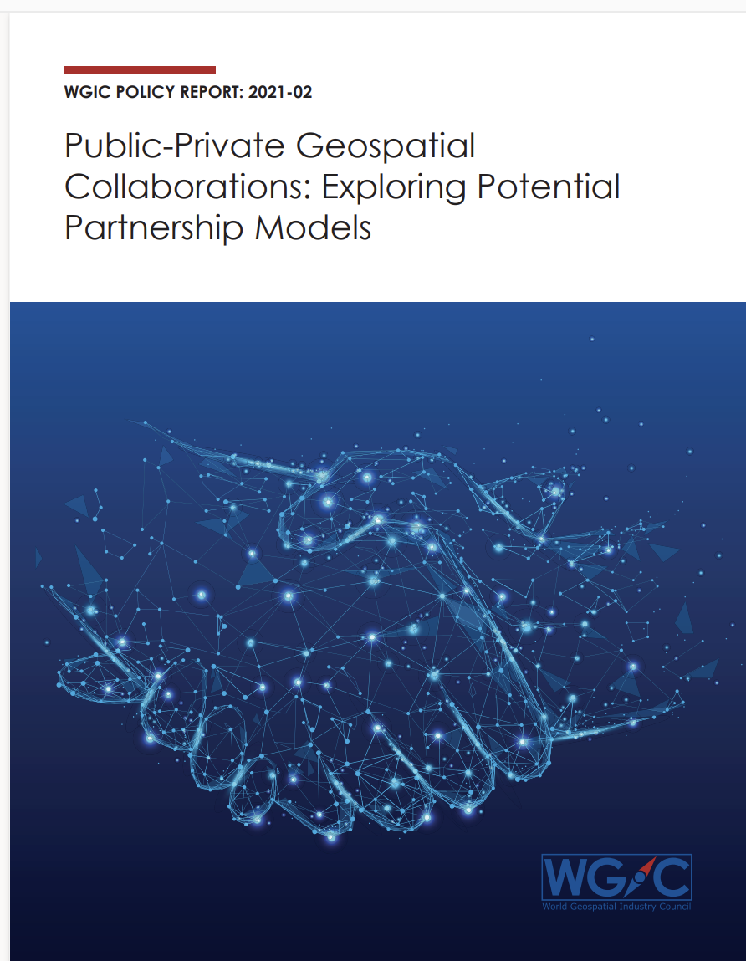
Context - WGIC PPP Committee
PPP Committee advocating the benefits of executing geospatial projects in PPP mode.
2021 - released report Public-Private Geospatial Collaborations: Exploring Potential partnerships Models - establishes the increased openness and adoption of PPPs.
2022 - Sharpened focus on developing countries - Africa, South-East Asia, South America and South Asia; Launched research for Africa Geospatial PPP Report
Objective - to develop a toolkit to enable stakeholders make informed decisions

Slide 3
Geospatial PPPs Africa -
Readiness

Slide 4
PPP Readiness - Africa
+490 PPPs in Africa since 1990; 44 countries have PPP Legal Frameworks; 26 with government PPP Units
PPPs are operational in countries regardless of government PPP units demonstrating interest and willingness to develop PPPs.
PPP Readiness Index – Africa
  A high level of interest towards PPPs in online quantitative survey (87 respondents) & qualitative interviews (60 respondents) representing 36 African countries.
  A-priori ranking of PPP readiness of African countries based on the existence of spatial data infrastructure, space agency presence, geospatial/EO infrastructure, business and legal environment, transparency, existence of PPP laws and framework, and PPP units
  24 countries in Developing Nation ranking - Favorable for geospatial PPP
  10 Countries in Emergent Nation ranking – Moderately favorable for geospatial PPP
  20 Countries in Nascent Nation ranking – Least favorable for geospatial PPP
Notes:
PPP Readiness: Developing Countries
Most of the Developing Countries had the presence of a spatial data infrastructure, evidence of geospatial infrastructure and Earth observation capabilities, and a space agency. They scored relatively higher in terms of their business and legal environments, evidenced by the presence of PPP laws and guidelines. Further, these countries registered higher on transparency in government functions. Overall, these countries indicate a higher readiness for geospatial PPPs. Countries evidencing these characteristics at a high level included Ghana, Rwanda, Namibia, and Tunisia.
PPP Readiness: Emergent Countries
Emergent Countries, although having some presence of a spatial data infrastructure had a much lower incidence of geospatial infrastructure and Earth observation capabilities, a space agency, and a less robust business and legal environment, as well as a significantly lower level of transparency in government functions, in general. Interestingly, all the countries listed as Emergent Nations have either PPP laws or policies, or both, making them high in readiness for engaging in PPPs. Examples of these include Angola, Madagascar, and Mauritius, all which have participated in PPPs in the past.
PPP Readiness: Nascent Countries
Nascent Countries are those that to date have had very little activity that is geospatial in nature, and only one has a spatial data infrastructure (Liberia), none have a geospatial infrastructure and Earth observation capabilities, only one has a space agency (Libya), and most have a very low score on business and legal environment as well as transparency in government functions. Despite these conditions, several have engaged in PPPs in the past, although only five nations have PPP laws in effect. These are Cabo Verde, Libya, Cameroon, Comoros, and Republic of the Congo. It is important to note that there were PPPs found in all three classification areas as noted in the Africa PPP Units and Frameworks.

Slide 5
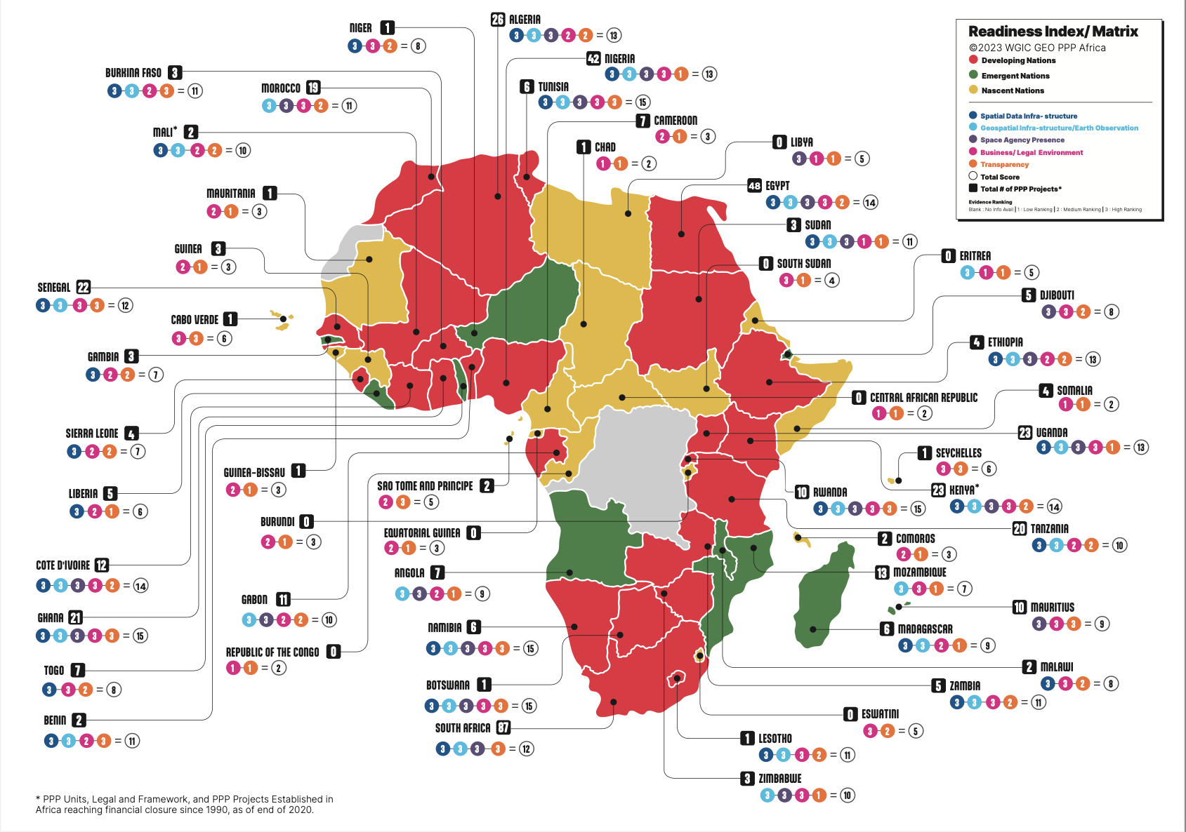
PPP Readiness Index - Africa
(draft graphic)

Slide 6
Towards A Mature Geospatial PPP – Business & Financial Considerations

Slide 7
Geospatial PPPs - Prevalent Business Models
PPP Business Models Africa ©2023 WGIC Geospatial PPPs Africa | Business Model Description | Business Model Utilized by Survey Respondents
Finance Only (FO) | A private entity, usually a financial services company, funds a project directly or uses various mechanisms such as a long-term lease or bond issue. | 41.5%
Build-Own-Operate (BOO) | The private sector finances, builds, owns and operates a facility or service in perpetuity. The public constraints are stated in the original agreement and through on-going regulatory authority. | 26.4%
Buy-Build-Operate (BBO) | Transfer of a public asset to a private or quasi-public entity usually under contract that the assets are to be upgraded and operated for a specified period of time. Public control is exercised through the contract at the time of transfer. | 20.7%
Build-Operate-Transfer (BOT) | The private sector designs, finances, and constructs a new facility under a long-term Concession contract and operates the facility during the term of the Concession after which ownership is transferred back to the public sector if not already transferred upon completion of the facility. | 9.4%
Design-Build-Finance-Operate (DBFO) | The private sector designs, finances and constructs a new facility under a long-term lease and operates the facility during the term of the lease. The private partner transfers the new facility to the public sector at the end of the lease term. | 1.8%
Build-Own-Operate-Transfer (BOOT) | A private entity receives a franchise to finance, design, build and operate a facility (and to charge user fees) for a specified period, after which ownership is transferred back to the public sector. | -
Build-Lease-Operate-Transfer (BLOT) | A private entity receives a franchise to finance, design, build and operate a leased facility (and to charge user fees) for the lease period against a payment of rent. | -

Slide 8
Business Model Revenue Share Options

Slide 9
Risks & Risk Allocation
S.No | Africa PPP Financing Risks ©2023 WGIC Geospatial PPPs Africa | Risk Factor Description | Risk Allocation: Sector Most Capable of Bearing Risk
1. | Technical risk | Arising from engineering and design failures | Private sector better able to anticipate Shared - both able to absorb
2. | Construction risk | Arising from faulty construction techniques, cost escalations, and delays in construction | Private sector better able to anticipate Shared - both best able to absorb
3. | Operating risk | Arising from higher than predicted operating and maintenance costs | Private sector better able to anticipate Shared - both best able to absorb
4. | Revenue risk | Arising from traffic/demand shortfall and failure to extract resources, the volatility of prices and demand for products and service sold, leading to revenue deficiency | Shared - both best able to anticipate and absorb
5. | Financial/fiscal risk | Arising from inadequate hedging of resource streams and financing costs | Shared, - both best able to anticipate and absorb
6. | Political force and regulatory risk | Arising from planning and legal changes or unsupportive and/or inconsistent government policies | Public sector best able to anticipate, mitigate, and absorb
7. | Natural force majeure risk | Arising from natural calamities such as floods and earthquakes | Neither best able to anticipate Shared- both best able to absorb
Risk varies by country and readiness index

Slide 10
Potential Funding Sources
POTENTIAL DEVELOPMENT & EXPORT FINANCE INSTITUTIONS TO FUND GEOSPATIAL PPPs ©2023 WGIC Geospatial PPPs Africa
Multilateral Agencies | Links
African Development Bank | https://www.afdb.org
Emerging Africa Infrastructure Fund (EAIF) | https://www.eaif.com
European Bank for Reconstruction and Development (ERDB) | https://www.ebrd.com
European Investment Bank (EIB) | https://www.eib.org
Green Climate Fund | https://www.greenclimate.fund
International Finance Corporation (IFC) | https://www.ifc.org
Multilateral Investment Guarantee Agency (MIGA) | https://www.miga.org
OPEC Fund for International Development (OFID) | https://opecfund.org
Private Infrastructure Development Group | https;//www.pidg.org
Sustainable Energy Fund for Africa | https://www.se4all-africa.org https://ndcpartnership.org https://www.icafrica.org
Bilateral Agencies
Development Bank of Southern Africa (DBSA) | https://www.dbsa.org
German Investment Corporation (DEG) | https://www.deginvest.de
FMO (the Dutch Development Bank) | https://www.fmo.nl
Japan International Cooperation Agency ( JICA) | https://www.jica.go.ja
Kreditanstalt fuer Wiederaufbau (KfW) | https://www.kfw.de
Oesterreichische Entwicklungsbank AG | https://www.oe-eb.at/en/
Overseas Private Investment Corporation (OPIC) | https://oig.usaid.gov/OPIC
U.S. International Development Finance Corporation | https://www.dfc.gov
Export Credit Agencies
Export-import Bank of China | http://english.eximbank.gov.cn
Export Development Canada | https://www.edc.ca
Export-Import Bank of Korea | http://www.koreaexim.go.kr

Slide 11
Good Governance Principles
Establish a clear, predictable, and legitimate institutional framework supported by competent and well-resourced authorities.
Ground the selection of Public Private Partnerships in Value for Money
Use the budgetary process transparently to minimize fiscal risks and ensure transparency in the procurement process.

Slide 12
WGIC Geospatial PPPs Africa
How-To-Guide

Slide 13
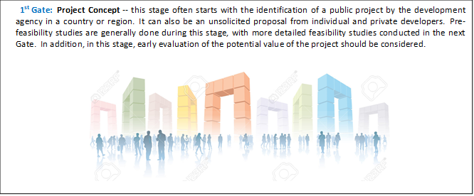
Geospatial PPP How-To-Guide: GATE 1

Slide 14
Geospatial PPP How-To-Guide: GATE 2

Slide 15
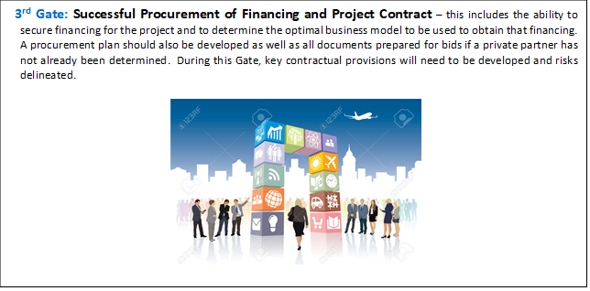
Geospatial PPP How-To-Guide: GATE 3

Slide 16
Geospatial PPP How-To-Guide: GATE 4

Slide 17
Geospatial PPP How-To-Guide: GATE 5
SUCCESS

Slide 18
Geospatial PPPs Africa
Successful Case Study

Slide 19
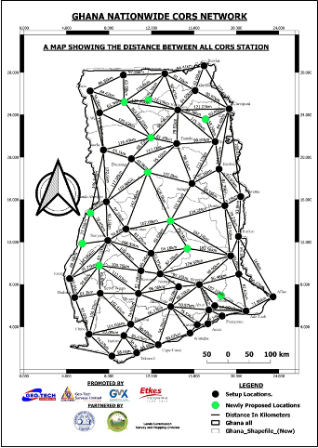
Nationwide CORS Network - Ghana
Project: Installation of first ever nationwide CORS network with 85 stations, the biggest network in West Africa
Partners: Geo-Tech Systems, Ghana and GMX Systems Israel entered into a PPP with Ghana Water Company Limited and Lands Commission’s Survey and Mapping Division
Project Duration: 20 years; Launch year: 2021
Business Model: Finance by GMX; Expertise & Human capital - Geo-Tech
Partnership Roles:
  GMX hosts the CORS network software on its virtual platform; GeoTech & GMX provide maintenance & technical support to run the CORS Network;
  Ghana Water Company (silent partner) site offices are home to most of the equipment setups;
  Lands Commission integrates the CORS receivers into the network, adopt the network, standardizes it for cadastral survey, hydrospatial survey, and other geospatial applications. Lands Commission solely responsible for quality control to ensure reliability, accuracy, and efficacy of the network.
Revenue Sharing: Discussions underway

Slide 20
THANK YOU

