Slide 1

MINISTRY OF LANDS -MALAWI
DEPARTMENT OF SURVEY
GEOCODING PHC DATA AND ITS IMPACT ON DECISION MAKING
National Addressing and Postcode Project;
Geocoding PHC
Julius Brian Chisi, SG, Malawi
chisibrian@gmail.com

Slide 2
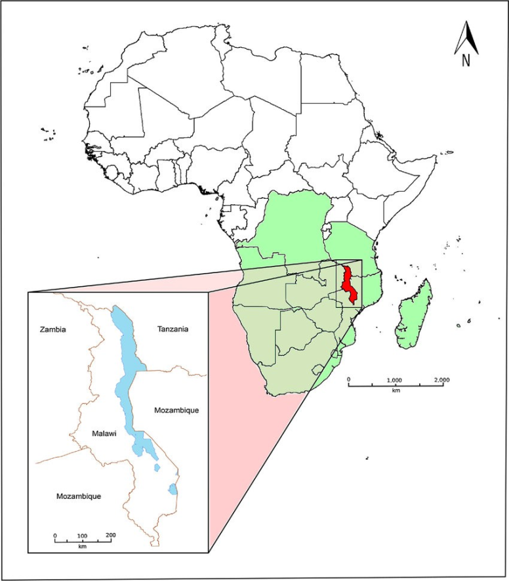
MALAWI
Malawi, a landlocked country in southeastern Africa;
Has total surface area of 118, 480 km²
The current population of Malawi is estimated to be 20,989,159 as of Wednesday, August 9, 2023
The country lies between latitudes 9° 45' and 17 °5' S and longitudes 30° to 36° E
Shares boundaries with Zambia, Mozambique and Tanzania

Slide 3
NATIONAL PHYSICAL ADRESSING SYSTEM
Malawi embarked on National Addressing and Postcode Project;
Aimed at developing and implementing a National Addressing and Postcode System (provide a physical address to every property in the country).
The project is implemented by DoS, NSO and Malawi Regulatory Authority (MACRA)
Involved property geocoding, numbering and mapping.

Slide 4
The Department of Surveys role is to provision of geospatial data (mapping and database creation);
National Statistic Office role is to collect statistical information based on geocodes and postcode data.
The project covers the following areas:
  A national postcode system,
  National Addressing Standards;
  Creation of Postcode Database; and
  Public Awareness & Sensitization.

Slide 5
Data Collection
Digitizing
From a Satellite Imagery where no cadastral survey was done;
Extracting coordinates from cadastral drawings
Field data collection using tablets with MSDC Software, HHGPS
Field Verification

Slide 6
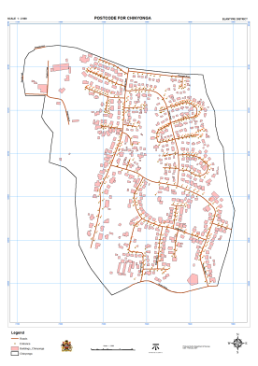
b) Mapping – Producing maps of project areas
Shows location map for physical addressing

Slide 7
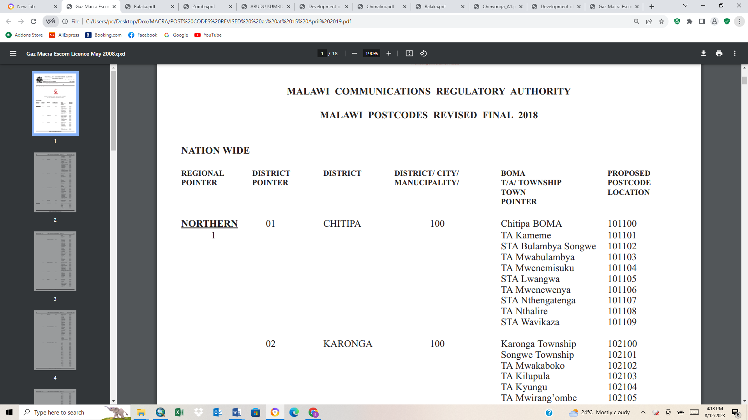
National Postcode
The postcodes are based on regional, district or township pointer.
E.g. Chitipa postcode is 101100, the first number (1) represents region, second (01) represents district pointer, next number 100 for District/City/municipality while the last 1 for Traditional Authority and add respective Geocodes:

Slide 8
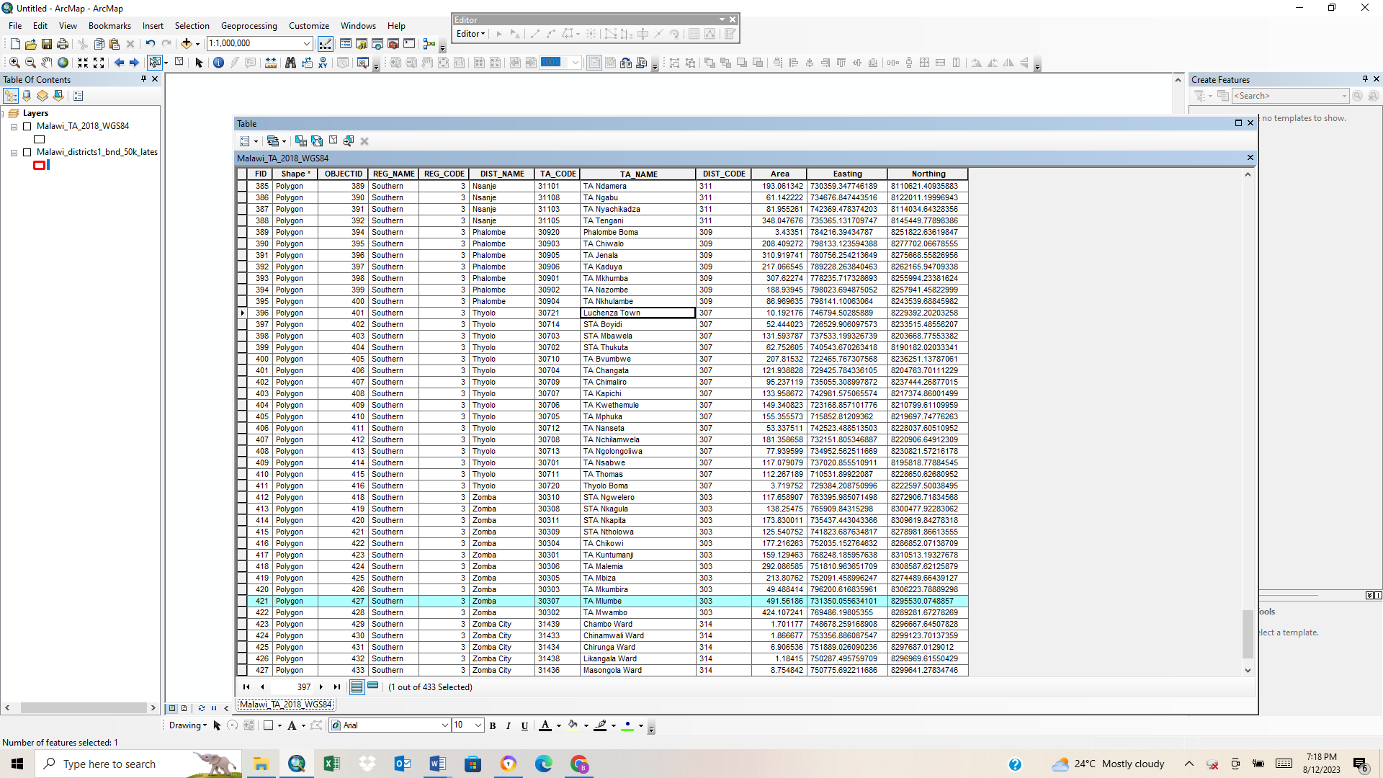
Database

Slide 9
District map showing administrative boundaries with postcodes

Slide 10
Geocoding and Postcode System -PHC
PHC carried - 2018
Activities
Topographic mapping for the whole country using a high resolution satellite imagery;
Feature extraction done using ESRI ArcGIS software
Create enumeration maps;
Field verification was done with support from traditional leaders;
Housing and Population statistics were then taken;
Postcodes and geocodes of centers were done for ease of attribute data capturing;

Slide 11
Each area was coded as follows region, district, TLMA, GCH and village name such as 101010, with geocodes with statistical information added.
REGION | REGION_CODE | DISTRICT | DISTRICT_CODE | TA_NAME | TA_CODE | GVH | VILLAGE_NAME
North | 1 | Chitipa | 101 | TA Mwabulambya | 10101 | Akim | Akim
North | 1 | Chitipa | 101 | TA Mwabulambya | 10101 | Akim | Jakapu
North | 1 | Chitipa | 101 | TA Mwabulambya | 10101 | Akim | Yamba Trading Centre
North | 1 | Chitipa | 101 | TA Mwabulambya | 10101 | Amosi | Amosi
North | 1 | Chitipa | 101 | TA Mwabulambya | 10101 | Amosi | Byname
North | 1 | Chitipa | 101 | TA Mwabulambya | 10101 | Amosi | Kayibale
North | 1 | Chitipa | 101 | TA Mwabulambya | 10101 | Amosi | Mtende
North | 1 | Chitipa | 101 | TA Mwabulambya | 10101 | Amosi | Vongonyo
North | 1 | Chitipa | 101 | TA Mwabulambya | 10101 | Asayire | Asayire
North | 1 | Chitipa | 101 | TA Mwabulambya | 10101 | Asayire | Glim
North | 1 | Chitipa | 101 | TA Mwabulambya | 10101 | Binon | Binon
North | 1 | Chitipa | 101 | TA Mwabulambya | 10101 | Binon | Chendo Trading Centre
North | 1 | Chitipa | 101 | TA Mwabulambya | 10101 | Binon | Kapelekezi
North | 1 | Chitipa | 101 | TA Mwabulambya | 10101 | Binon | Kapelekezi (Kondwani)
North | 1 | Chitipa | 101 | TA Mwabulambya | 10101 | Binon | Msenga
North | 1 | Chitipa | 101 | TA Mwabulambya | 10101 | Binon | Stuart
North | 1 | Chitipa | 101 | TA Mwabulambya | 10101 | Brair | Brair
North | 1 | Chitipa | 101 | TA Mwabulambya | 10101 | Brair | Sanya
North | 1 | Chitipa | 101 | TA Mwabulambya | 10101 | Chafwawaka | Chafwawaka

Slide 12
Challenges
Boundary maps produced by NSO different from those done by Department of Survey;
Inadequate trained human resource; and
Inadequate funding, process is slow.
Postcodes, geocodes, Integration of geospatial & Statistical Information
Easy to update, populate and generate reports
Enhance decision making;
Increased revenue through tax collection
Effective response to emergency situations – floods mitigation; Fire, Police and ambulance services
Effective identification and control of disease outbreaks
Need to promote collaboration between NMA and NSA through
Training of Staff
Strengthening legal framework;
Establishing a forum for agency collaboration - MAGIC; and
Implementation of National Spatial Data Infrastructure (NSDI)

Slide 13

THE END
THANK YOU FOR YOUR ATTENTION
NKOSI KAKHULU

