Slide 1






THE PARTNERS

Slide 2

The Problem
Despite significant advances in data collection and geospatial technology across the world, many developing countries still lack the resources, tools and technology to track progress toward the sustainable development goals (SDGs).
These gaps make it challenging for countries to achieve the SDGs and make informed development decisions that lead to better policies and investments. Many developing nations are at risk of being left out of the geospatial data revolution.
Notes:
Even though there have been advancements in geographic information systems (GIS) technology/software, these technologies are expensive and require significant knowledge, expertise, and training. Also, countries struggle with data sharing and access to track progress toward SDGs. Many developing nations are at risk of being left out of the geospatial data revolution.

Slide 3
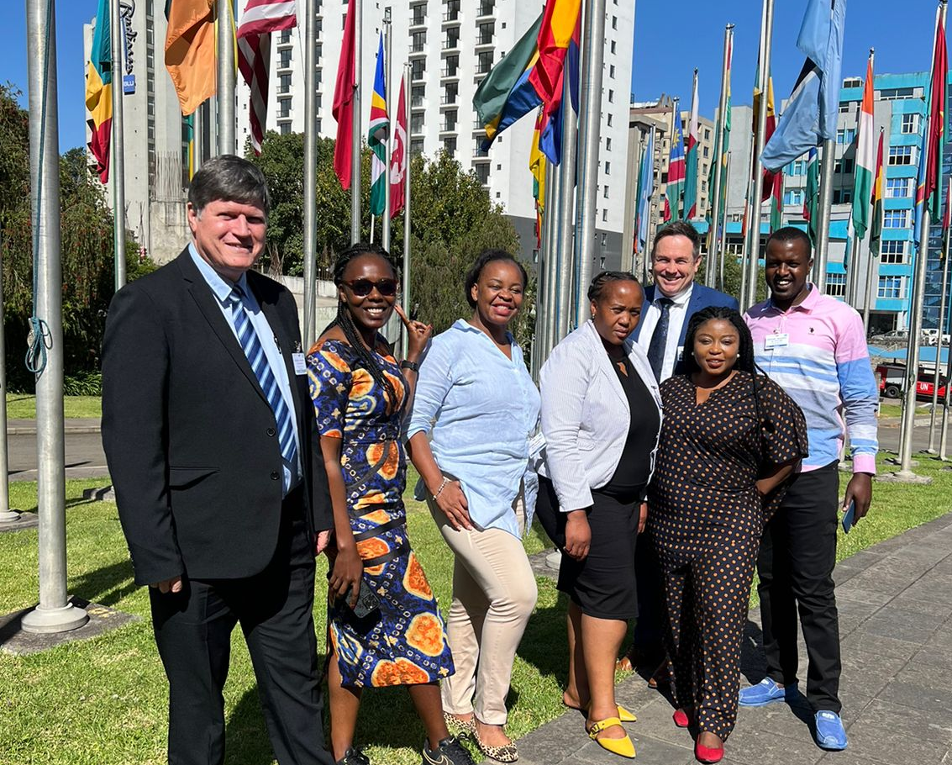
The SDG Data Alliance
The Solution
The SDG Data Alliance was formed to bring GIS technology capabilities, resources and training to developing countries (especially LDCs and SIDS) with the goal of accelerating the achievement of the SDGs.
The support of the Alliance will make it possible for developing countries to measure their progress toward SDGs and utilize geospatial data for decision-making purposes.

Slide 4

What is the SDG Data Alliance?
The SDG Data Alliance is an open, community-driven, multi-stakeholder partnership comprising of the private sector, foundations, UN organizations, and local and national governments.
The work is country-led. The SDG Data Alliance provides direct training and support to government teams that are creating geospatial Country-level Action Plans and SDG Data Hubs.
Notes:
The alliance started in 2021 and it focuses primarily on sustainable development goals and on reducing inequalities.
Using the power of purpose-driven collaboration and leading GIS technology, this influential group of partners will accelerate achievement of the SDGs by creating SDG Data Hubs across developing countries in Africa, Asia and the Pacific and Latin America and the Caribbean.
The sustainable goals are a collection of 17 interlinked global goals designed to be a "blueprint to achieve a better and more sustainable future for all". The SDGs were set up in 2015 by the United Nations General Assembly and are intended to be achieved by 2030.
The alliance helps developing countries in various ways, and two key aspects of the engagement is the creation of data hubs that allows countries to track sdg and frameworks + country level action plans.

Slide 5
2017
2018
2019
Federated Information System for the SDGs is created with a small number of countries.
Countries begin launching SDG data hubs.
United Nations Open SDG Data Hub launches to demonstrate the capabilities of a global dashboard on SDGs.
A Development Account Project to strengthen nationally integrated geospatial information management capacities is activated in six developing countries.
The Federated System for the SDGs was supported widely with a call to mobilize resources to support all countries wishing to join at the 2019 UN Statistical Commission.
Data Alliance History
2023
2022
2021
The Data Alliance evolves into a successful initiative with five collaborating partners, three implementing partners and 19 participating country governments.
The Data Alliance:
Builds first beta versions of country hubs and launches SDG.org
Hosts various workshops and convenings for countries.
PVBLIC Foundation, Esri, the United Nations Statistics Division (UNSD) and W.K. Kellogg Foundation joined forces to launch the Data Alliance.
Data Alliance engages 19 countries with the development of data hubs.

Slide 6





Founding Partners
Implementing Partners
A Multi-Stakeholder Partnership
Notes:
Here are the main partners involved with the alliance.
We have chia, kellog and esri and founders. Esri also provides training and licenses for developing countries.
PVBLIC – program management and funding
United Nations – IGIF frameworks/expertise

Slide 7

Data Alliance Key Activities
The Alliance works with countries to support the development of:
UN-IGIF Country-level action plans to improve national geospatial information management, an essential element of national digital infrastructures.
SDG Data Hubs for national governments to share data, monitor public investments, track SDGs and engage stakeholders. Data hubs allow countries to monitor progress toward SDGs by goal, target and indicator.

Slide 8





SDG Data Alliance Goals
Support developing countries with the creation of SDG Data Hubs and accelerate achievement of SDGs.
Implement the UN-IGIF Country-level Action Plans in beneficiary developing countries.
Strengthen geospatial skills and increase access to GIS technology.
Increase citizen engagement with the use of data, SDGs tracking and the SDG Data Alliance’s work.
Make SDG Data Alliance funding sustainable and increase funding sources.

Slide 9

Reducing inequality (SDG 10) is the most important step countries can take to improve standards of living
The SDG Data Alliance’s technology, expertise, and financial support enables countries to more precisely allocate resources to address all forms of inequity - reducing inequalities of all kinds.
Including
Equity for women, reducing hunger
Reducing poverty
Improving access to clean water
Taking action to reduce the impact of climate change
Notes:
Talking points in slide.

Slide 10
Paths to Engage with the Alliance
Traditional Path
Independent Path
Thought Leader Path
Countries recommended by founding partners to join.
Countries receive guidance and resources to complete a Country-level Action Plan and data hub.
Countries or organizations utilize the new ArcGIS SDG Solution to create a data hub using their own capabilities and resources.
Countries that have already developed an SDG Data Hub provide guidance to countries that are in the beginning stages of the process.

Slide 11
Candidate Countries
The SDG DATA ALLIANCE began country-level
engagement with an initial group of countries.
There are a total of 30 candidate countries, 15 of which are working on CAPs and SDG Data Hubs.
Africa | Asia and The Pacific | Latin America and The Caribbean
Burkina Faso* | Fiji* | Chile*
Cameroon* | Indonesia | Colombia
Comoros | Nepal | Dominican Republic
Congo DRC | Philippines | Ecuador
Eswatini* | Tonga* | El Salvador
Ethiopia* |  | Guatemala*
Kenya |  | Haiti
Madagascar |  | Honduras*
Morocco* |  | Panama*
Mozambique* |  | Saint Lucia
Nigeria
Rwanda*
Senegal*
South Africa*
Tunisia
*Currently working with Alliance
Notes:
For cohort 2 – Dominican Republic, Fiji, Guatemala, Honduras, Morocco, Panama and Saint Lucia

Slide 12
Benefits for Data Alliance Countries
1.
Countries can track SDGs through their hubs accelerating the achievement of these goals.
6.
Assessment of training needs and advice on capacity building as it relates to geospatial skills.
2.
Dedicated geospatial experts guiding countries step-by-step on the IGIF Country-level Action Plan – from early stages to completion.
7.
Free ArcGIS training to national governments
8.
Access to dozens of free training resources on SDG.org
3.
Analysis of data gaps, strengths and weaknesses of countries.
9.
Exposure to a network of geospatial experts and access to prestigious events hosted by United Nations, Esri and others.
4.
Dedicated technical team from Esri assists countries to build their SDG Data Hubs.
10.
SDG Data Hubs help countries make decisions and utilize data for investments.
5.
ArcGIS licenses provided up to 2030.
Notes:
United States Agency for International Development , USAID is a business-focused development agency focused on results.

Slide 13
SDG Data Hub Stages
Complete
Hub
Initial SDG Data Hub
SDG Data Hub Training
Data inventory and assessment
Notes:
United States Agency for International Development , USAID is a business-focused development agency focused on results.

Slide 14
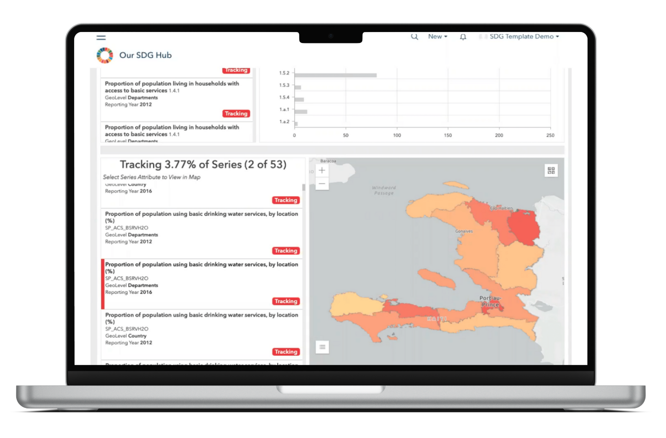
The Alliance has created a Geospatial Data Hub template in ArcGIS
Esri has created an SDG Data Hub solution using ArcGIS that is available to everyone at SDG.org
SDG.org features 9 active data hubs with 15 SDG Data Alliance country hubs in process
Notes:
United States Agency for International Development , USAID is a business-focused development agency focused on results.

Slide 15
What’s Next for the Alliance?
Continue making progress on IGIF Country-level Action Plans
*Aug 17-18, Cape Town
Data Alliance Workshop Series - Africa
Continue advancing SDG Data Hubs.
Obtain additional funding to continue advancing SDGs in developing countries
Engage with participating countries at relevant events to make progress and provide support
*Jan/Feb, Mexico
Data Alliance Workshop Series - LatAm

Slide 16

SDG Data Alliance Workshops, Aug 17-18
Cape Town, South Africa
The SDG Data Alliance is taking advantage of the convening of the Regional Committee on UN-GGIM for Africa and the 31st International Cartographic Conference (ICC 2023) to host two Workshops on 17 and 18 August 2023.
The workshops will be key capacity development and knowledge transfer elements of the UN-GGIM Africa and ICC meetings.
The Workshops will feature country experiences and be tailored towards enabling African Member States to accelerate the implementation of national UN-IGIF Country-level Action Plans and the deployment of SDG data hubs.

Slide 17


Thank
You

