Slide 1


WG2: Leveraging Technology in support of disaster-related statistics:
The science-policy interface
Pr. Sarra KASRI
SCIENCE AND TECHNOLOGY VERSUS SOCIO-TECHNOLOGY AND SENSOR-BASED CITIZEN

Slide 2
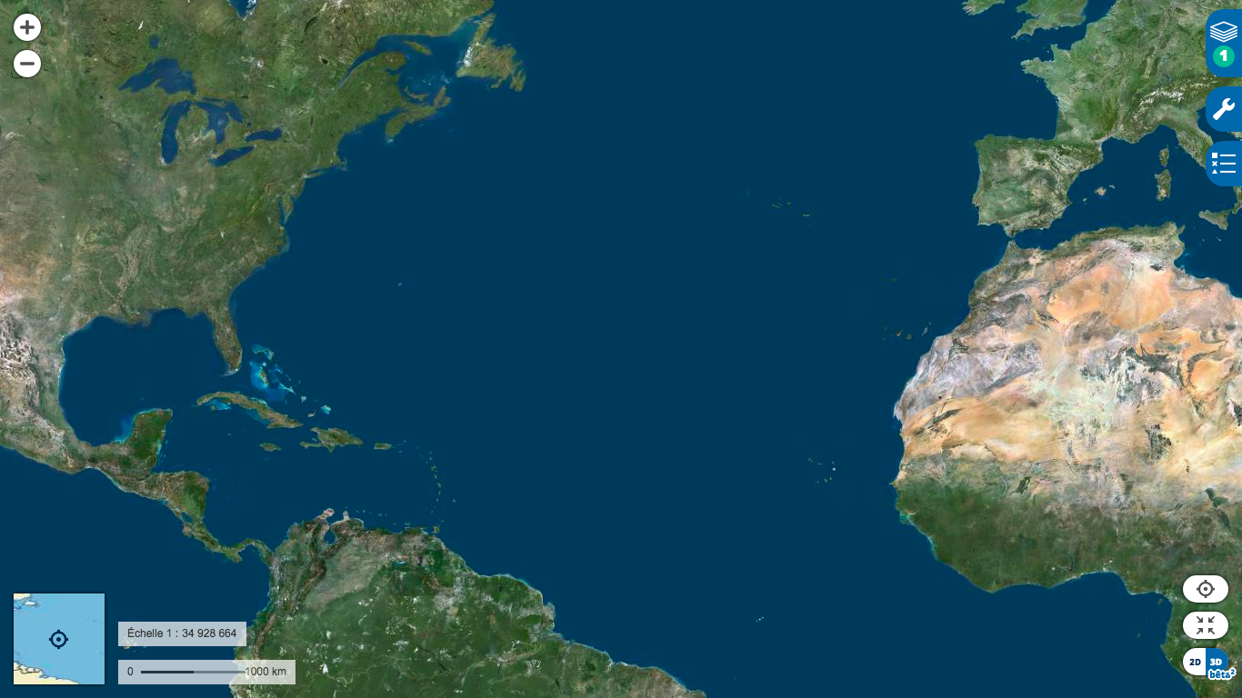
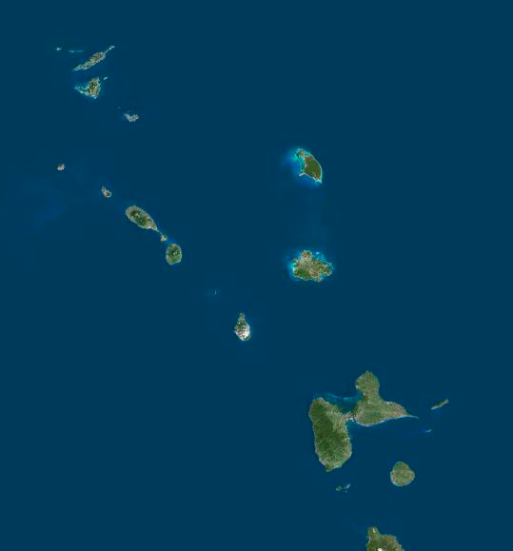
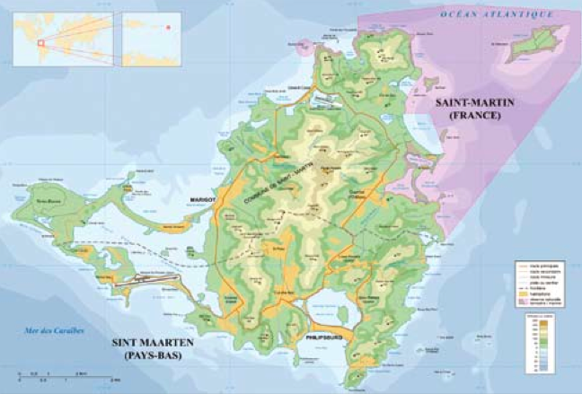
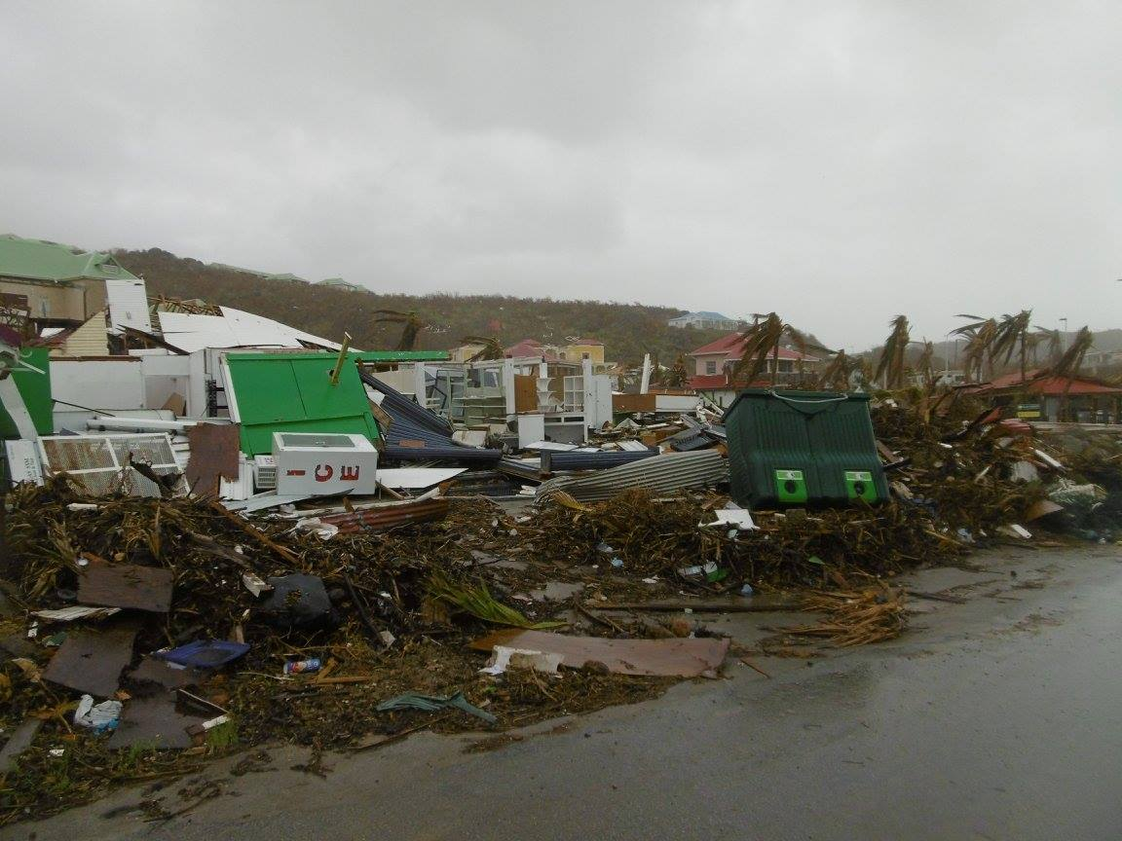
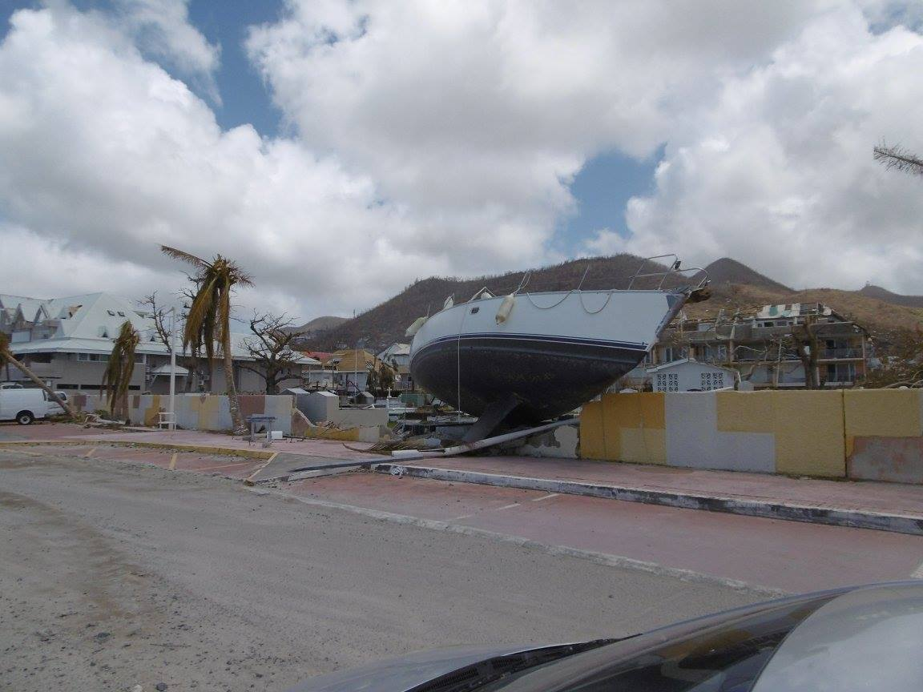
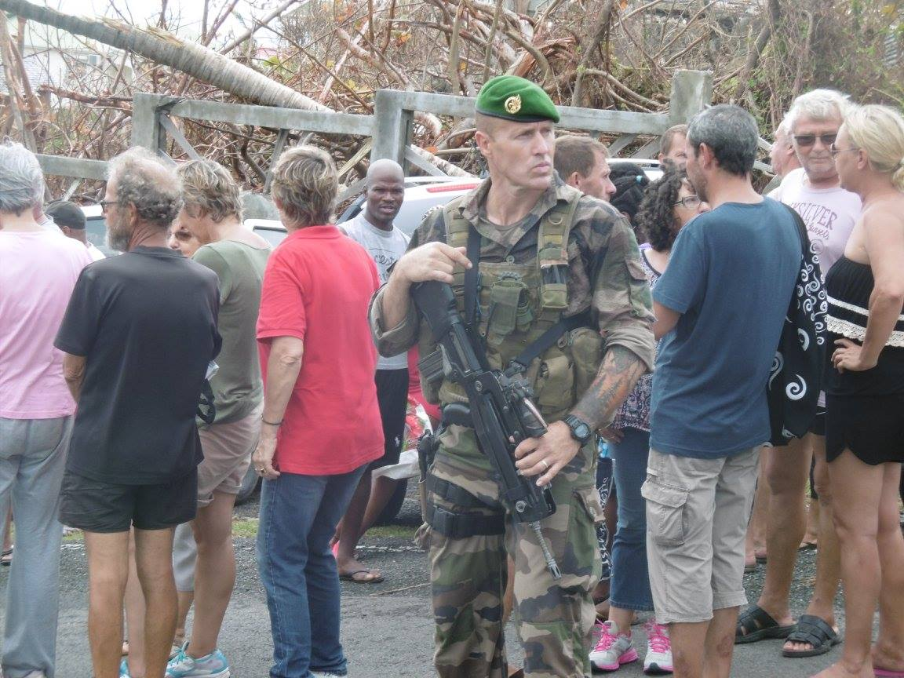
CASE STUDY: SAINT MARTIN ISLAND AFTER HURRICANE IRAM 2017
Photo J.Charville- mai 2017

Slide 3
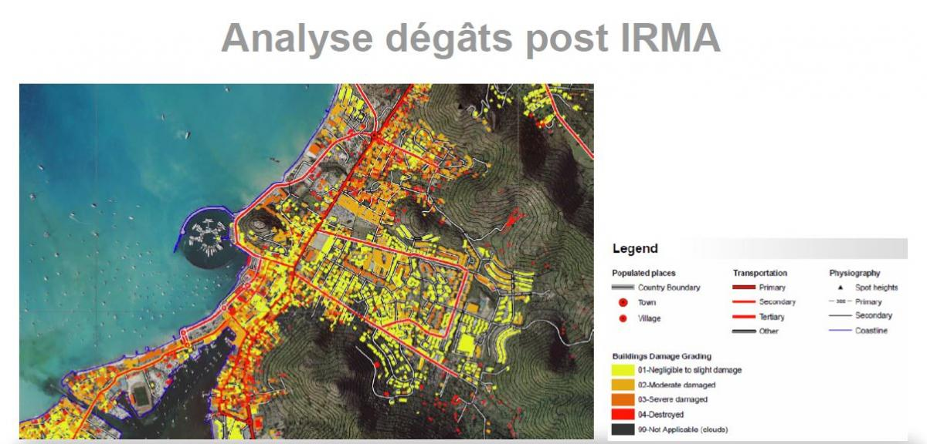
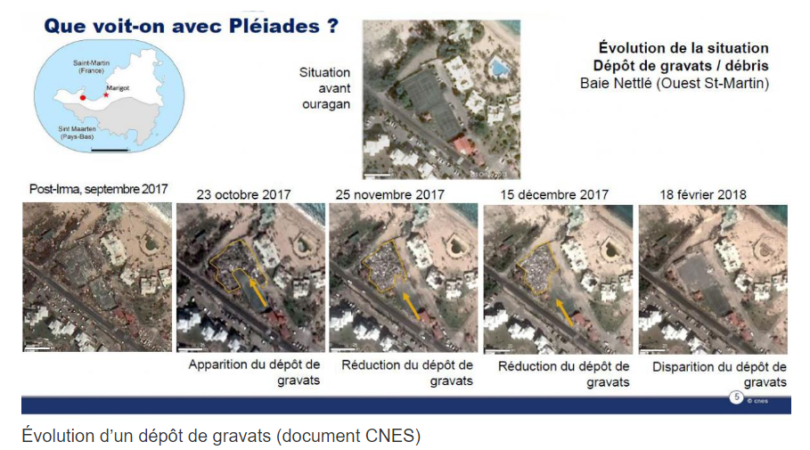
A TECHNO-CENTRIC APPROACH TO THE ASSESSMENT OF POST-HURRICANE IRMA DAMAGE
Copernicus Emergency Risk & Recovery

Slide 4
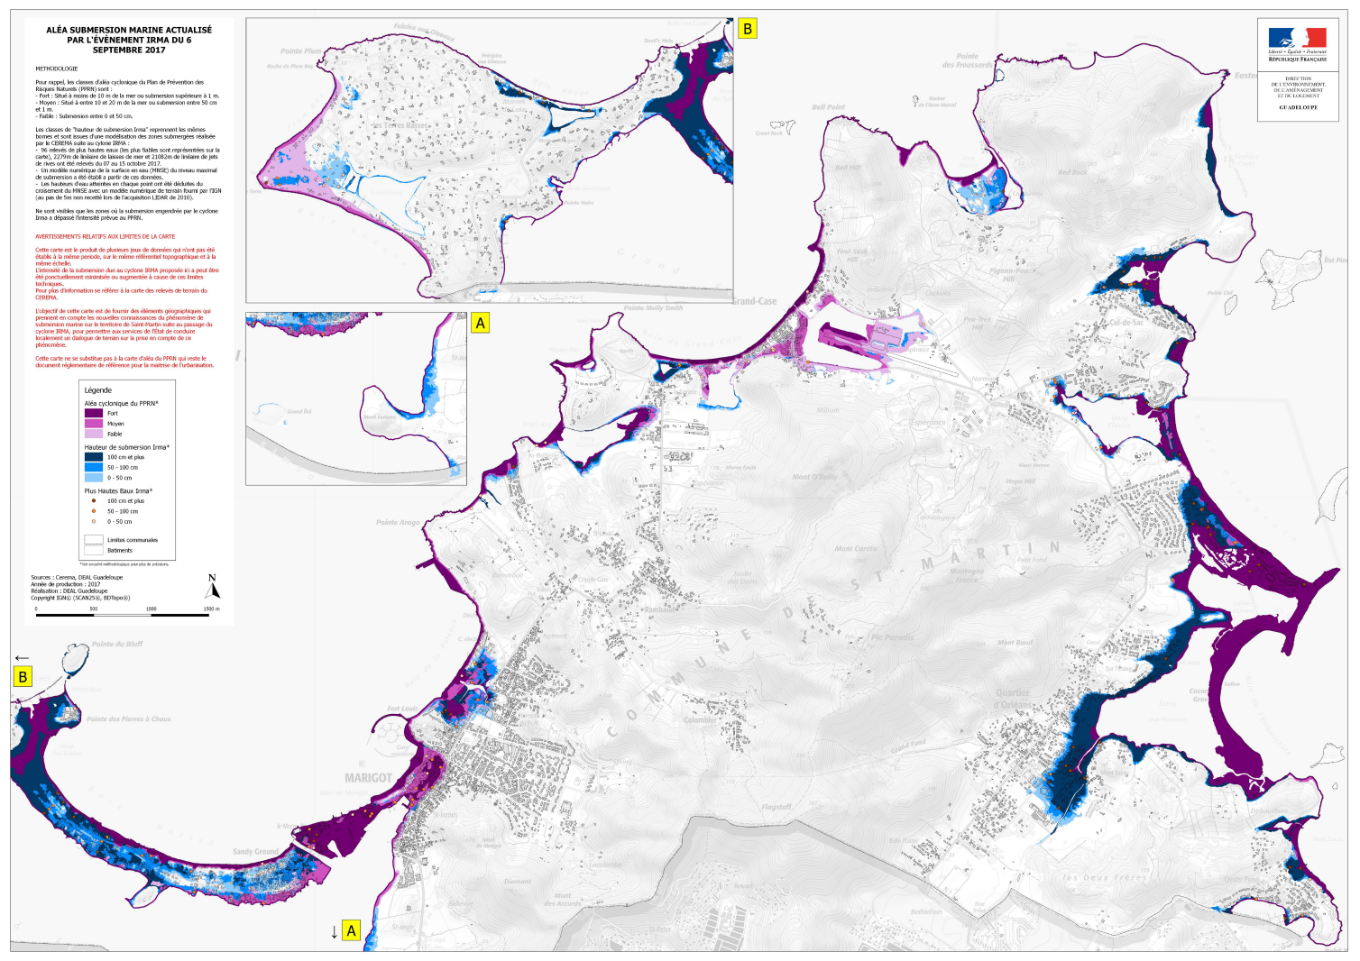
TECHNO-CENTRIC APPROACH TO THE PRODUCTION OF TECHNICAL AND URBAN DOCUMENTS FOR TERRITORIAL MANAGEMENT, CONSIDERING ISSUES, VULNERABILITIES AND RISKS : RISK PREVENTION PLAN

Slide 5

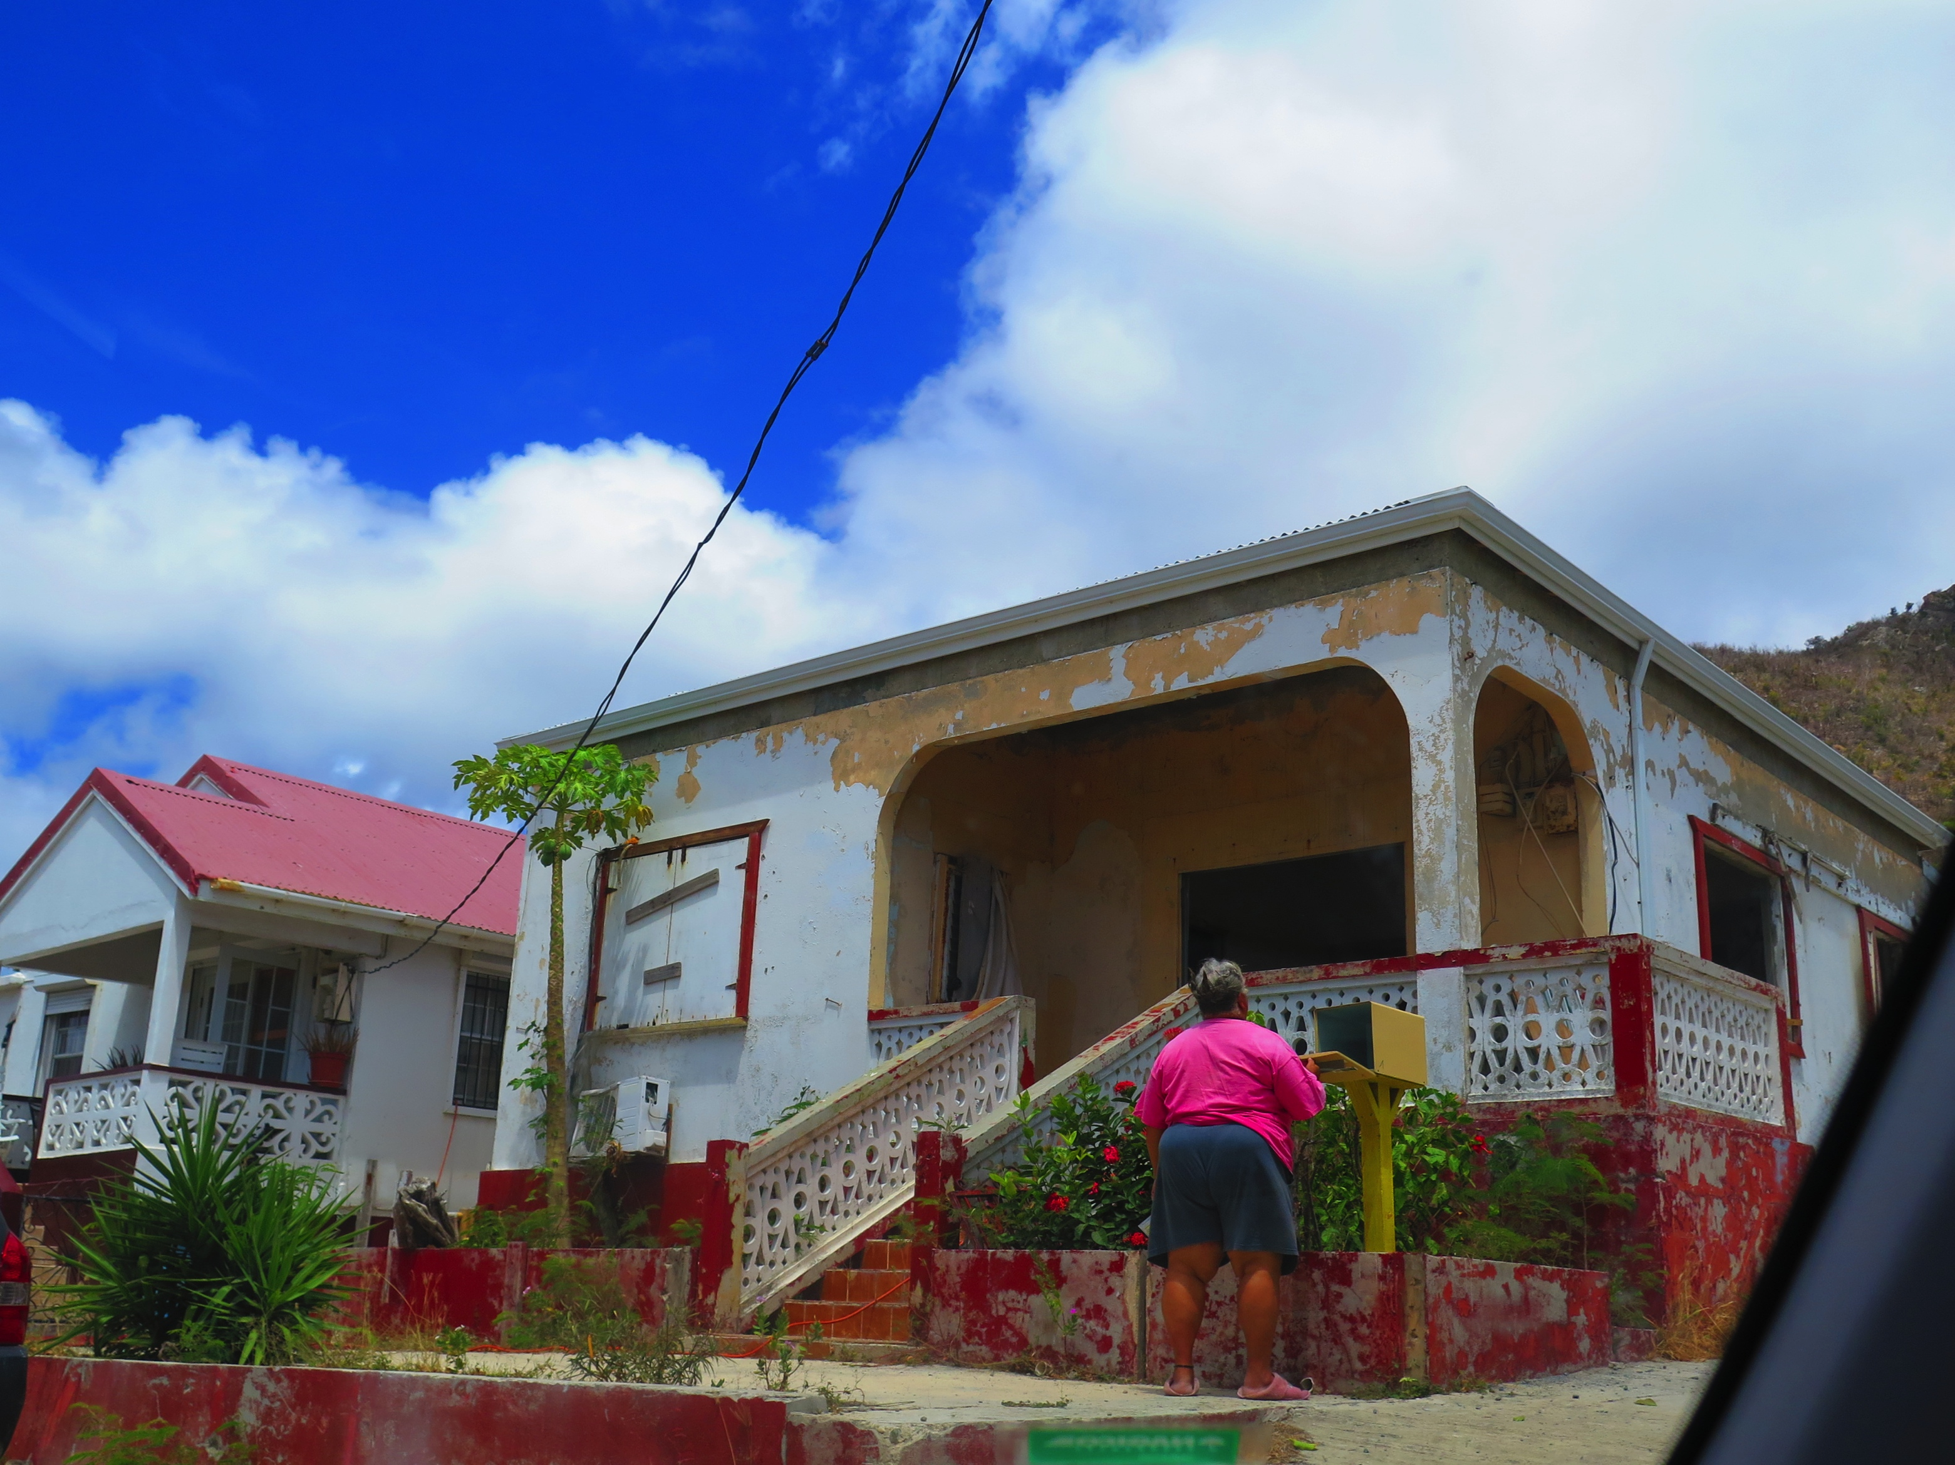
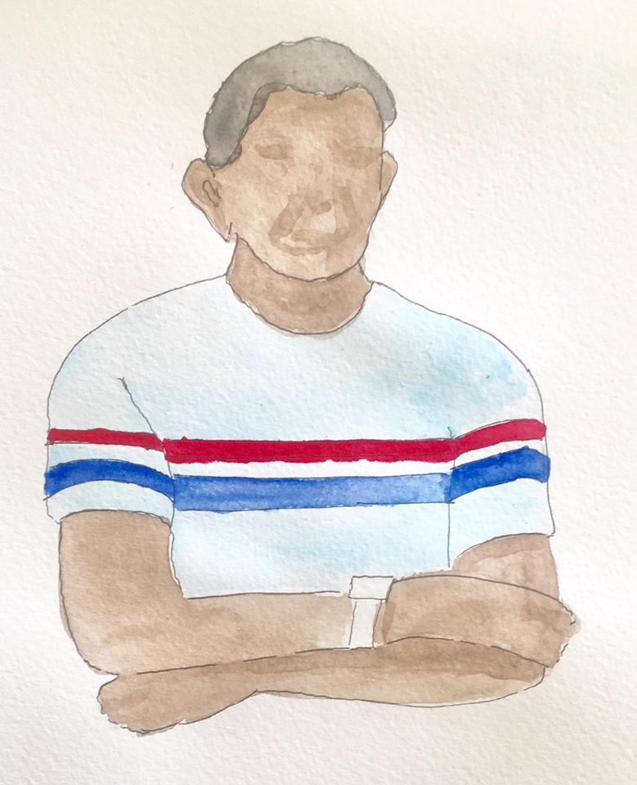

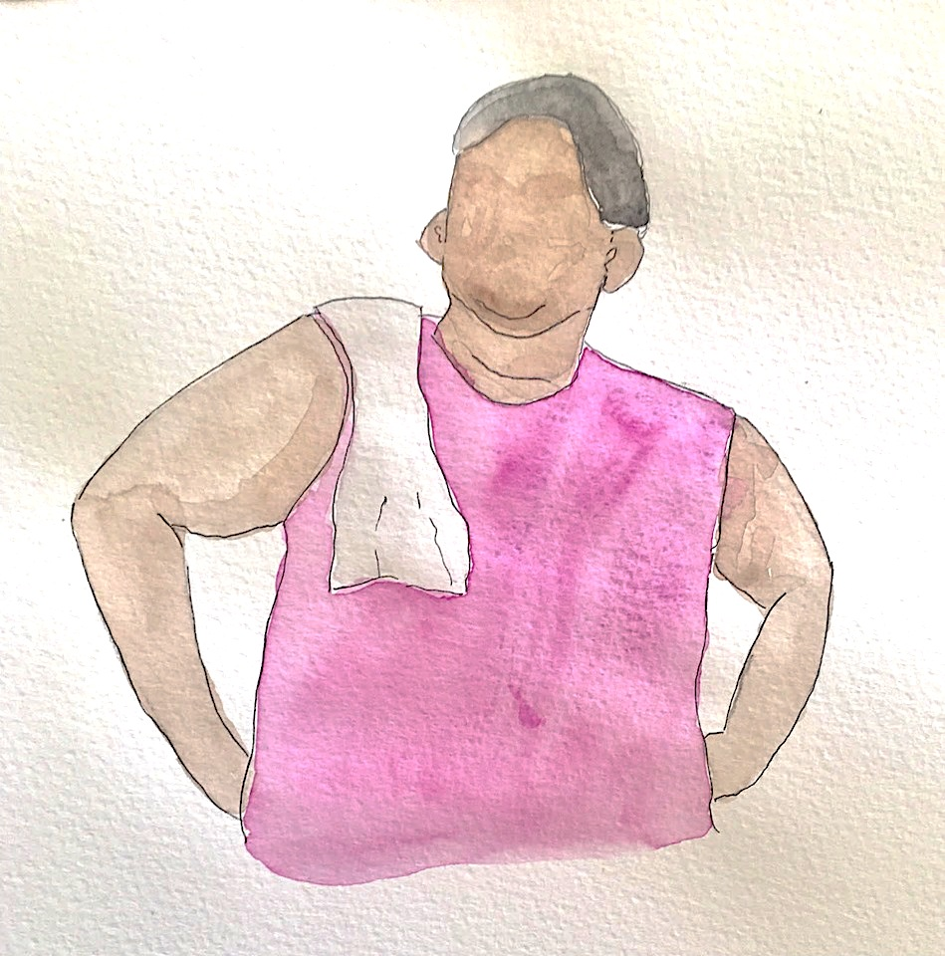
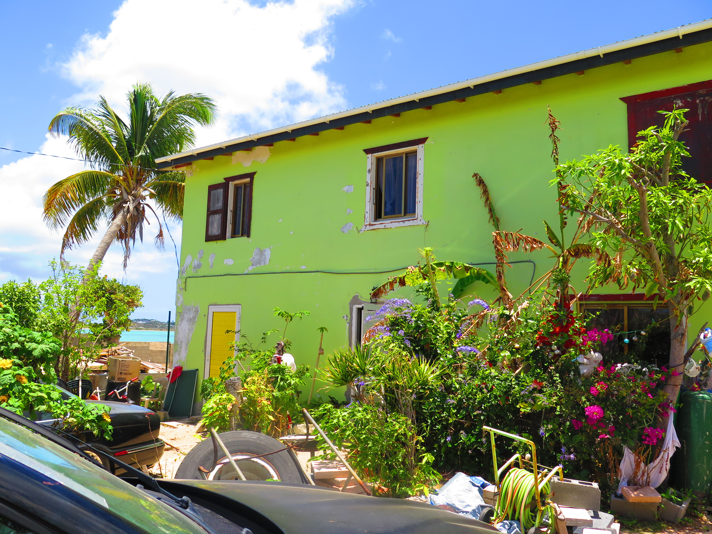
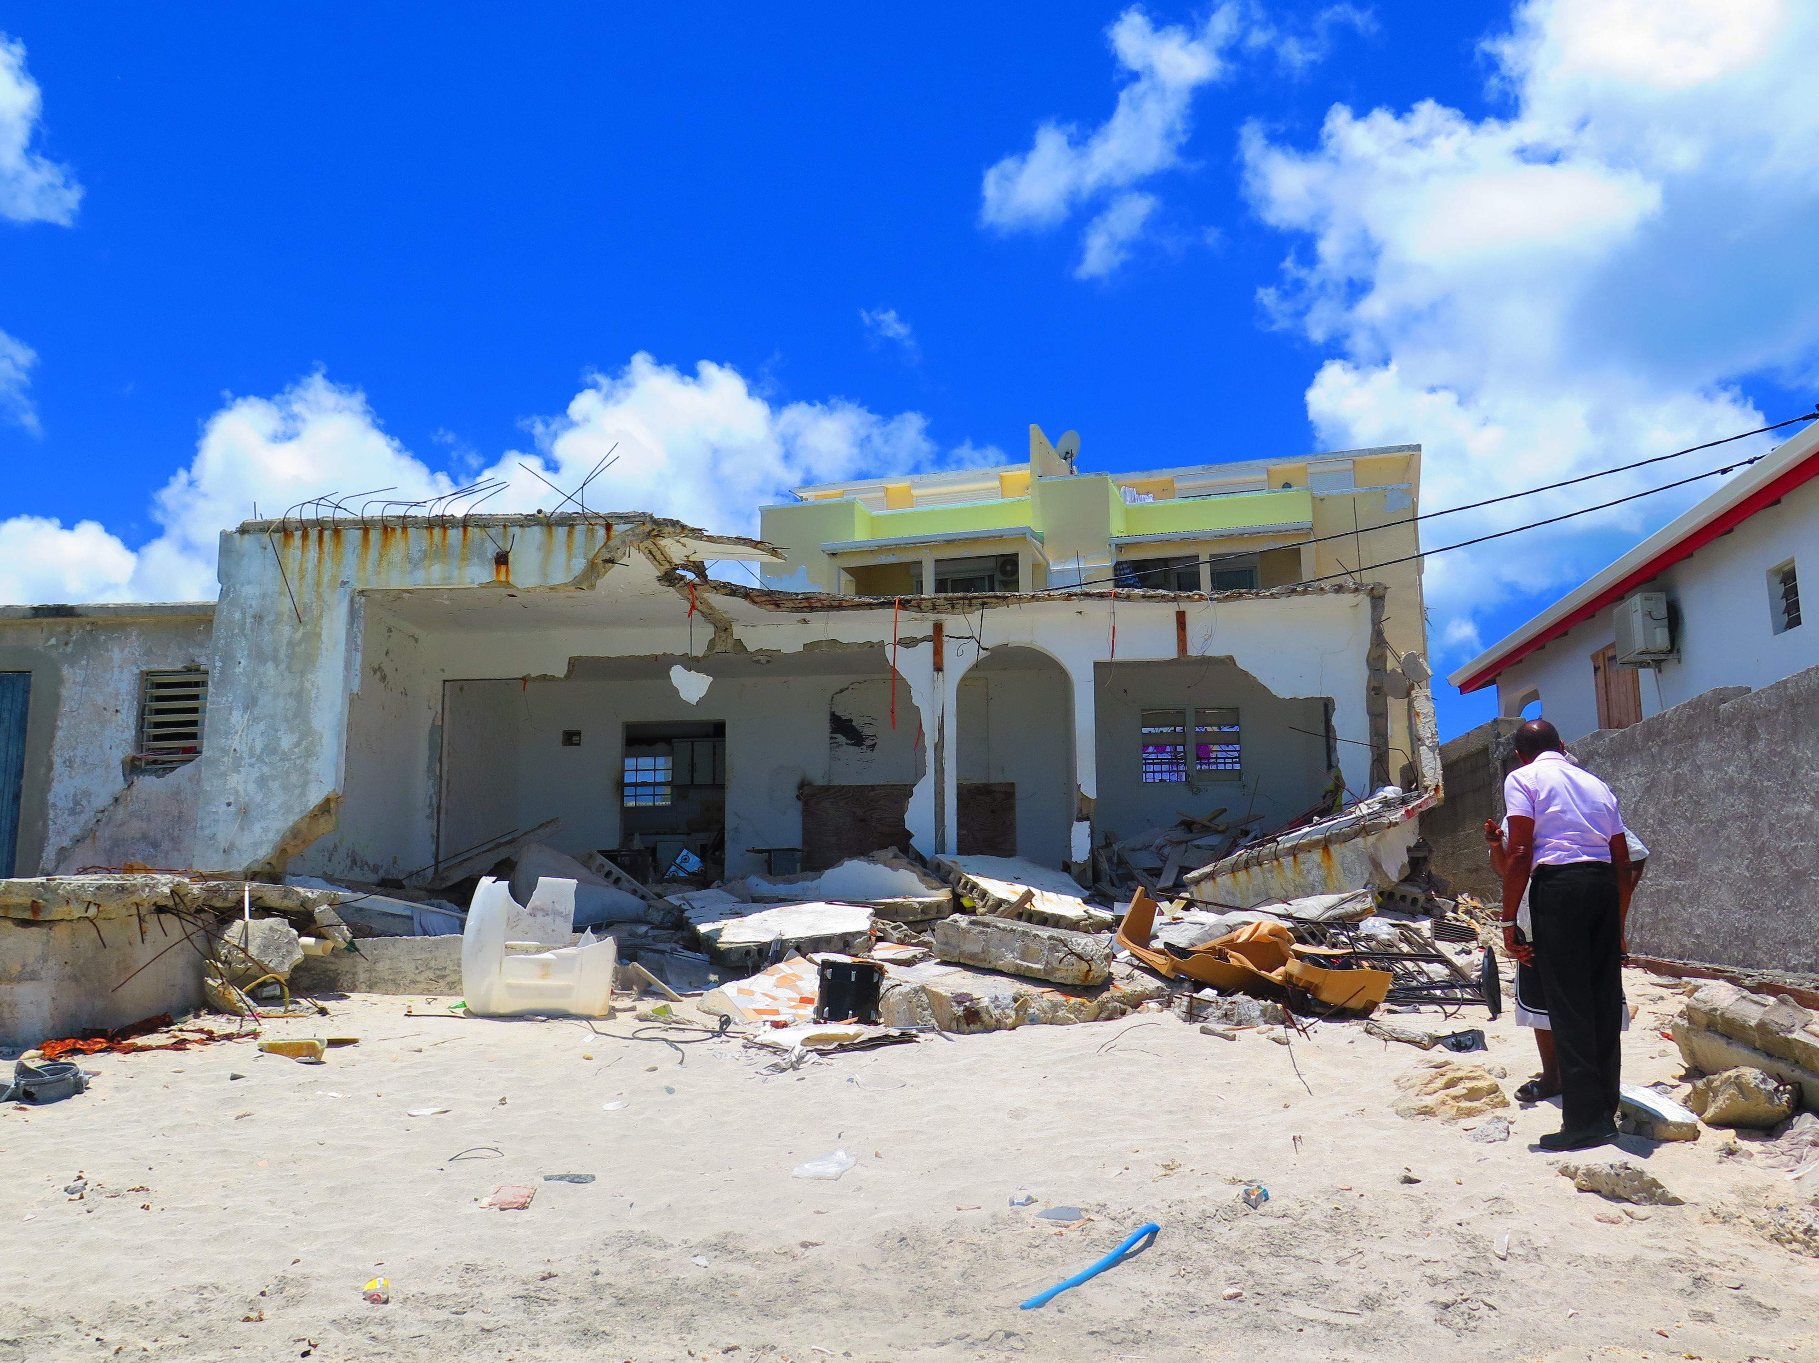
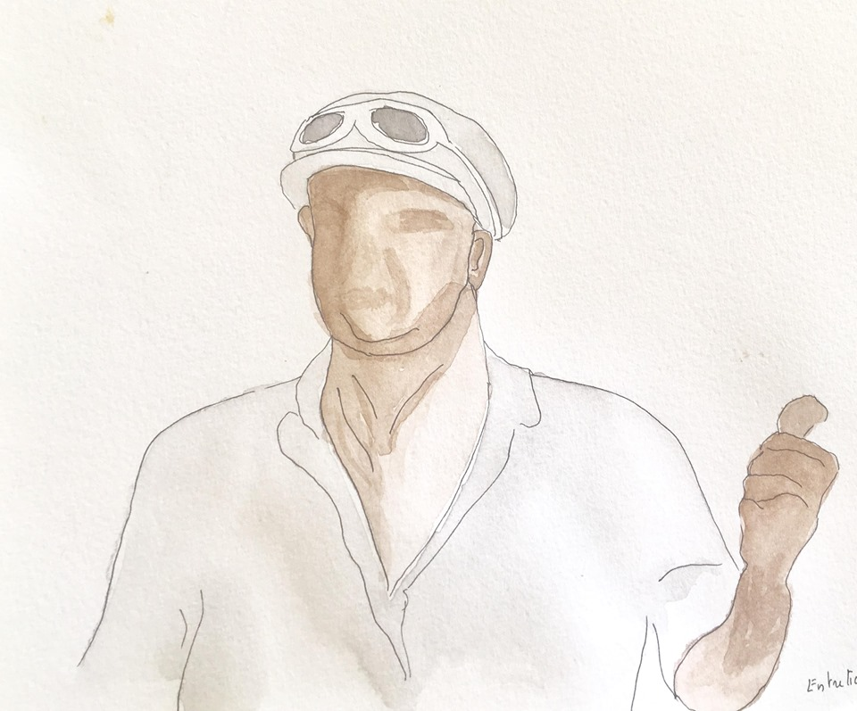
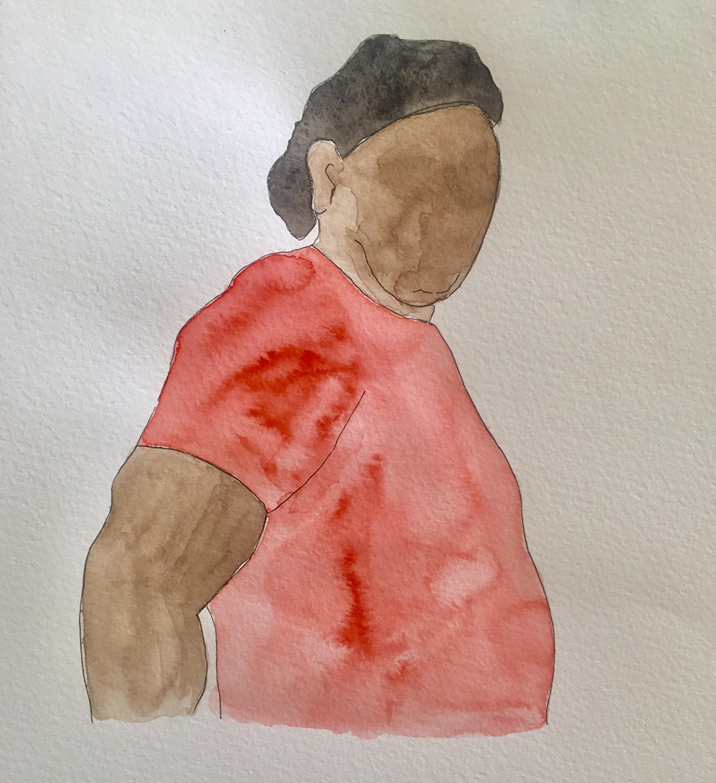
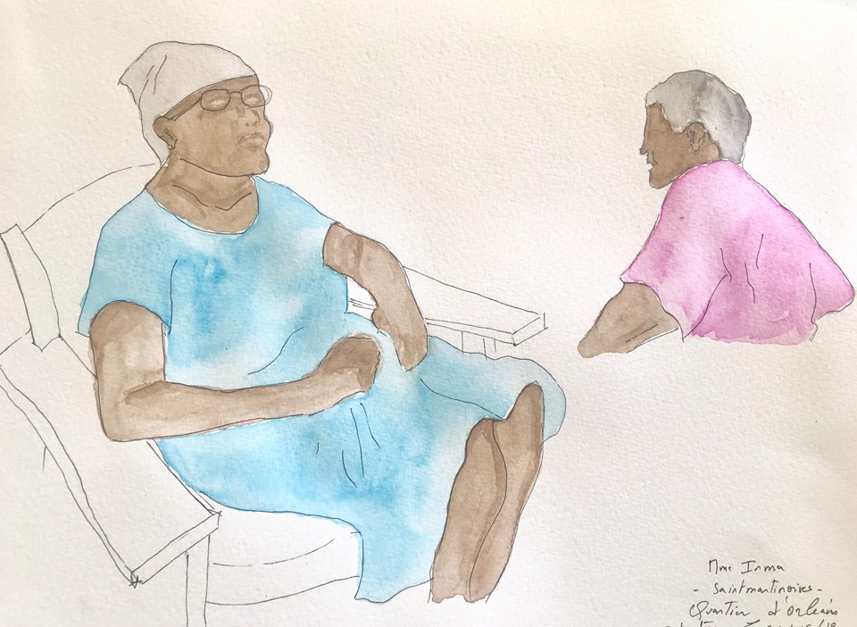
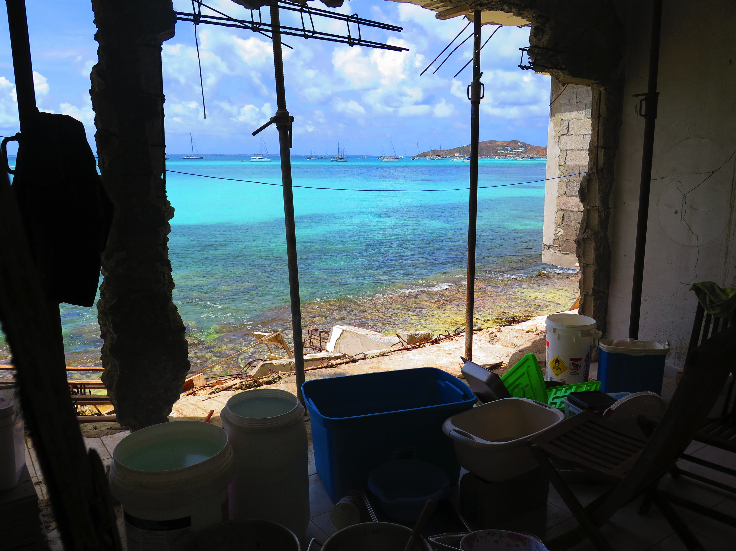
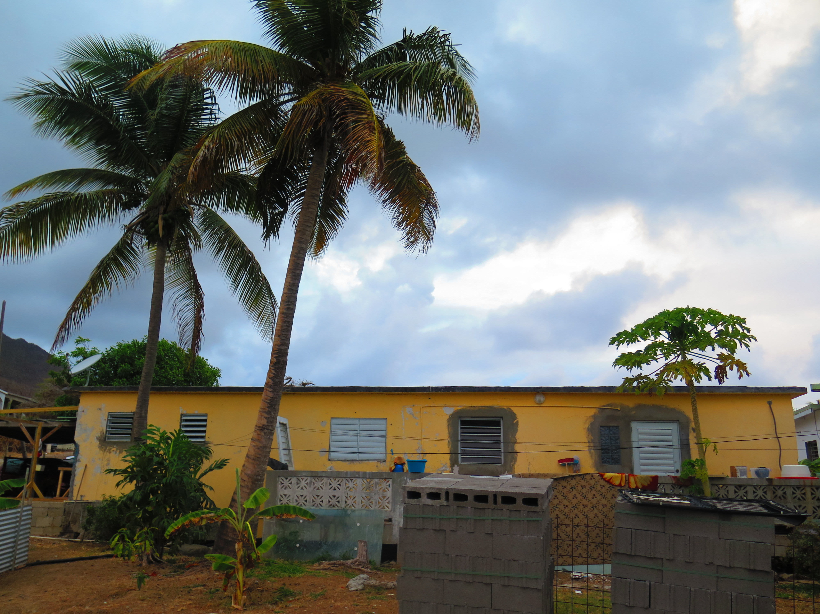
EMPIRICAL REALITY OF DISASTER EXPERIENCE FOR LOCAL RESIDENTS: INHABITING THE DISASTER

Slide 6
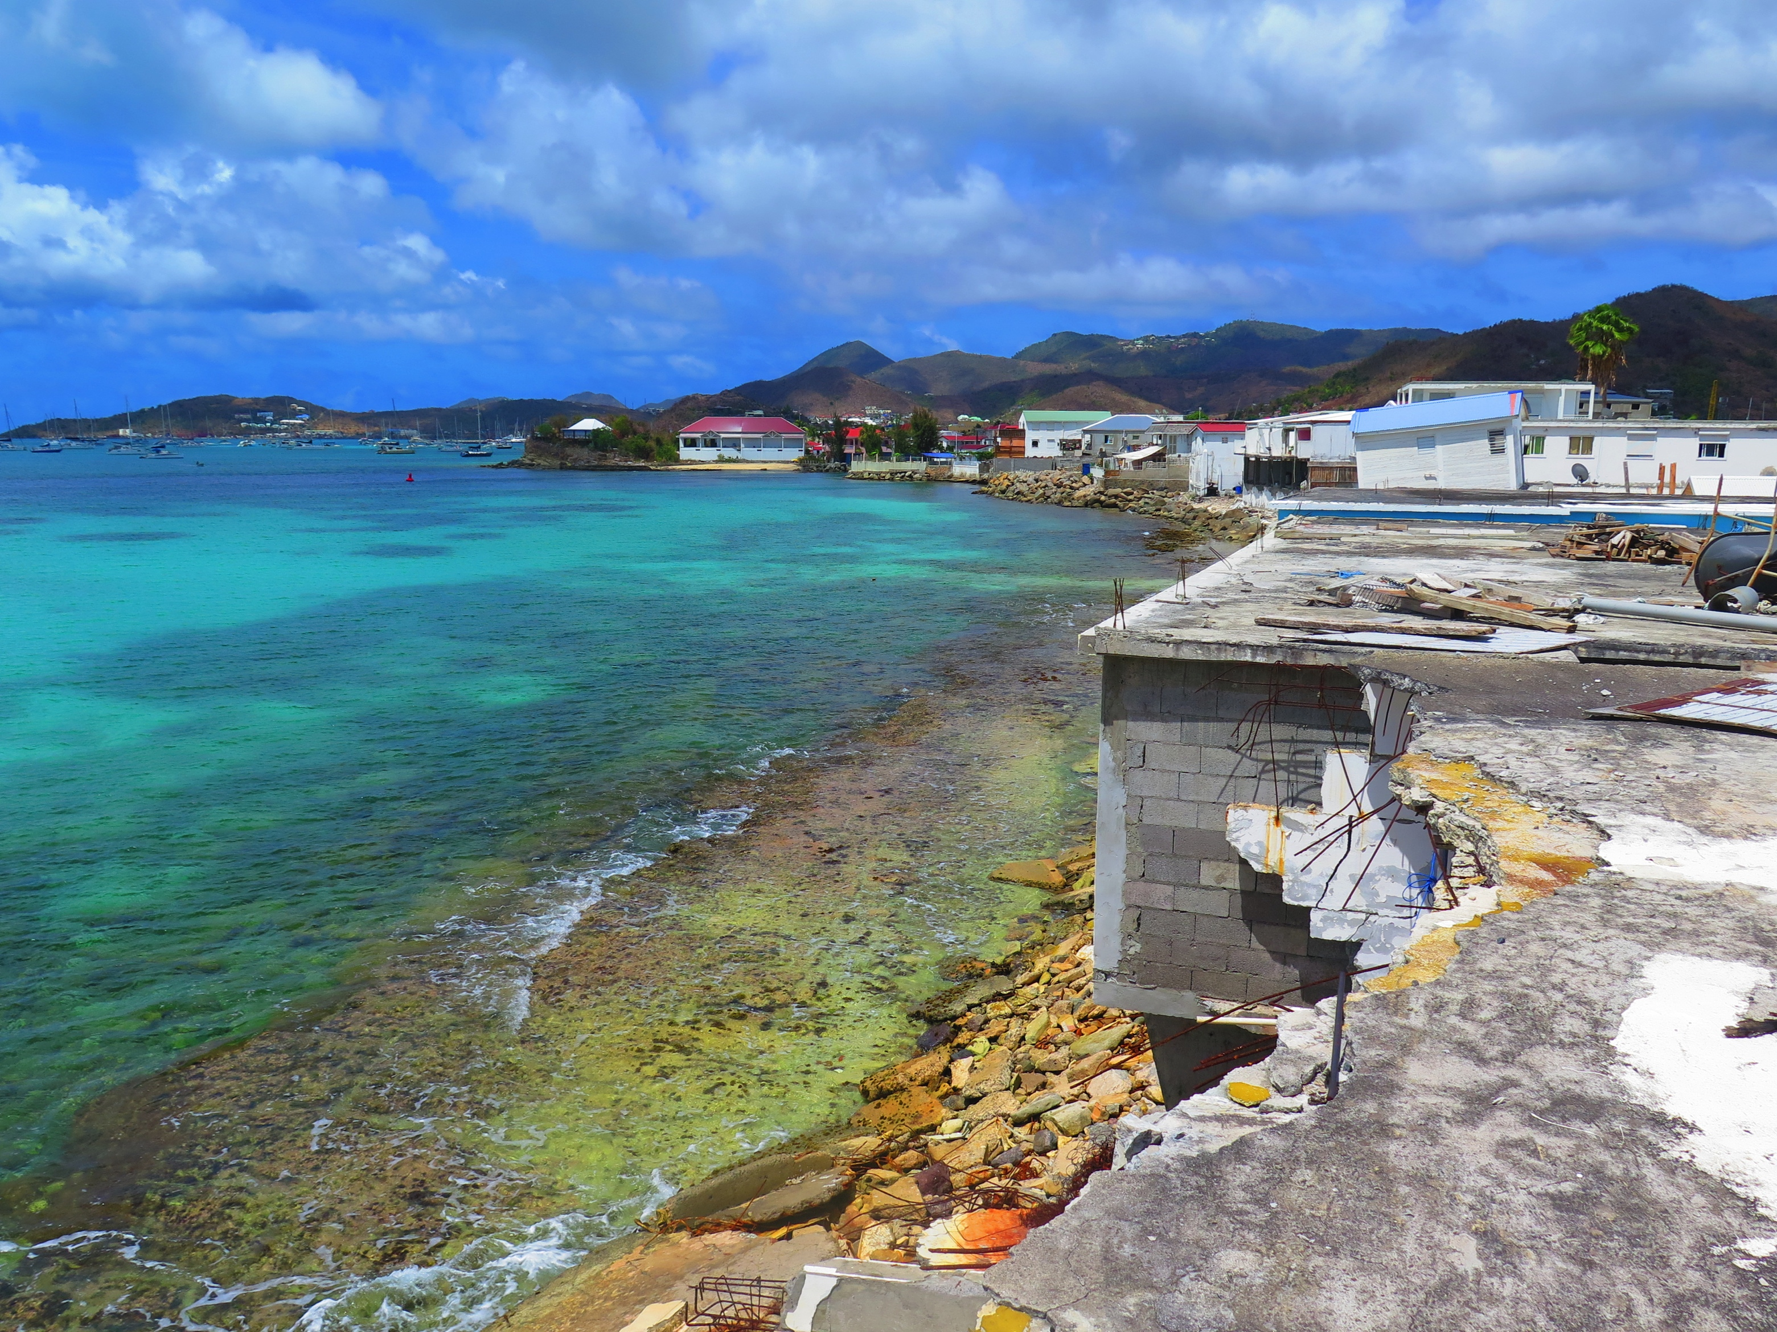
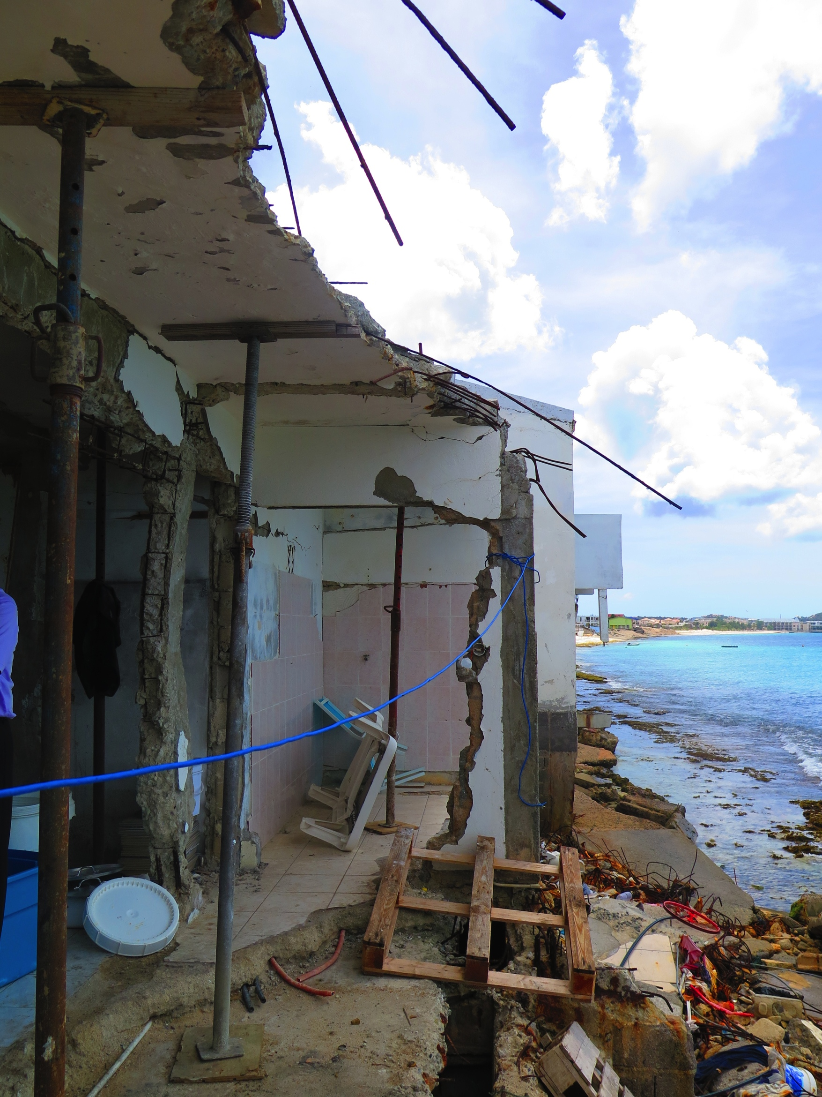
A HOME IS MORE THAN A PHYSICAL STRUCTURE

Slide 7
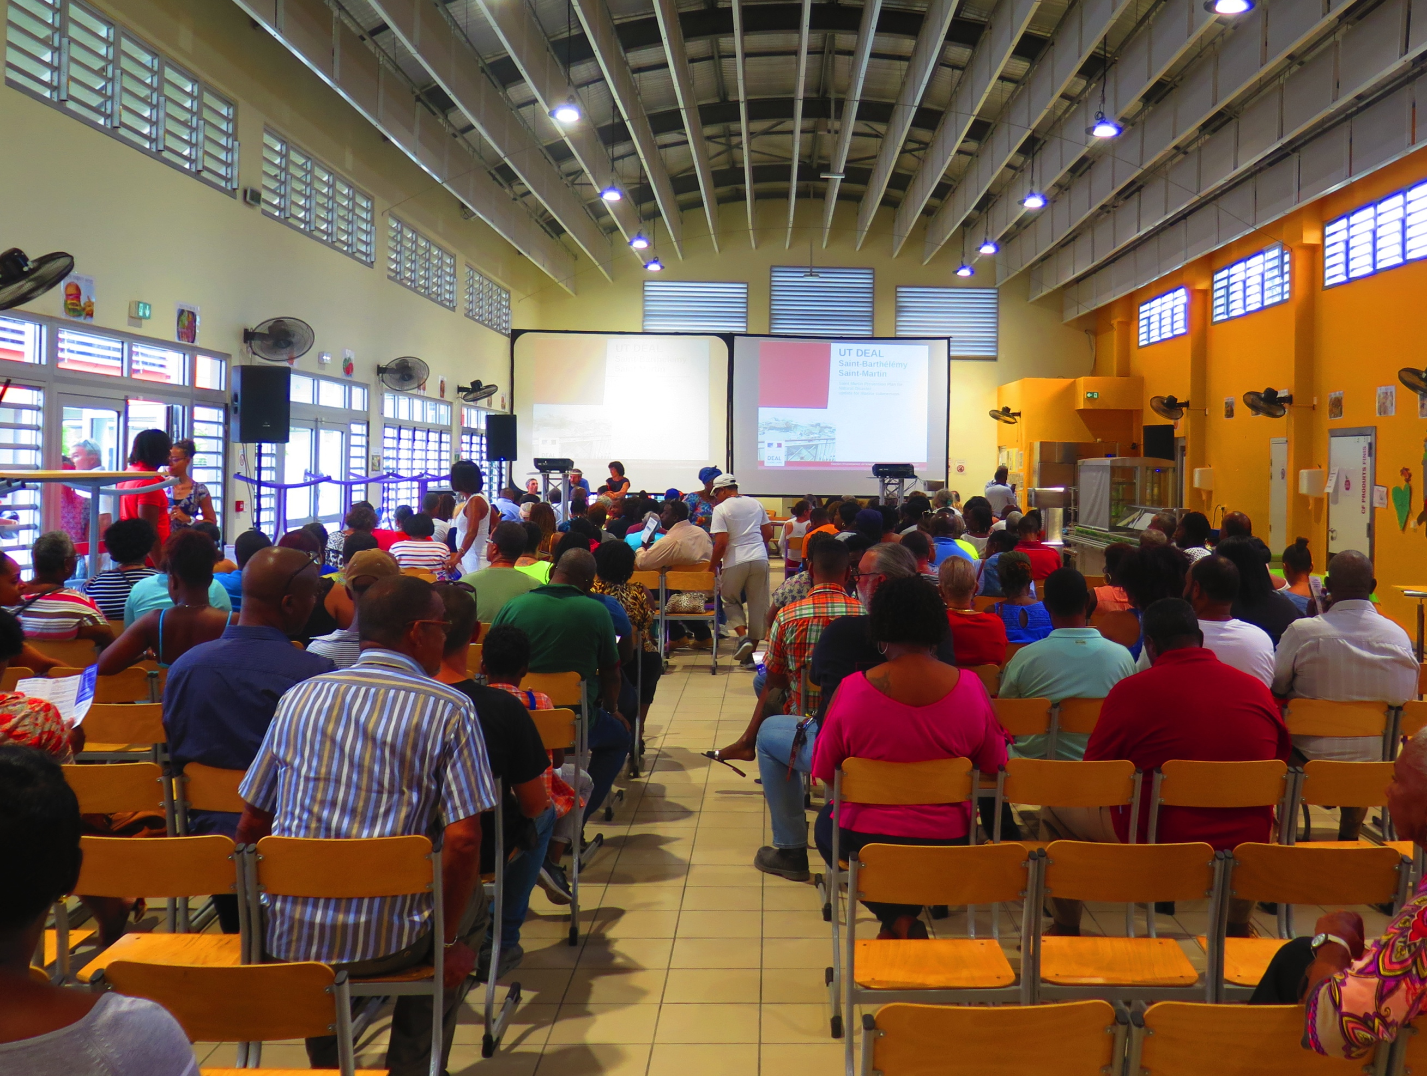
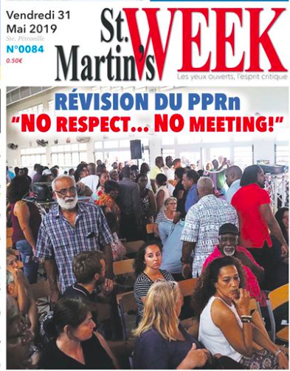
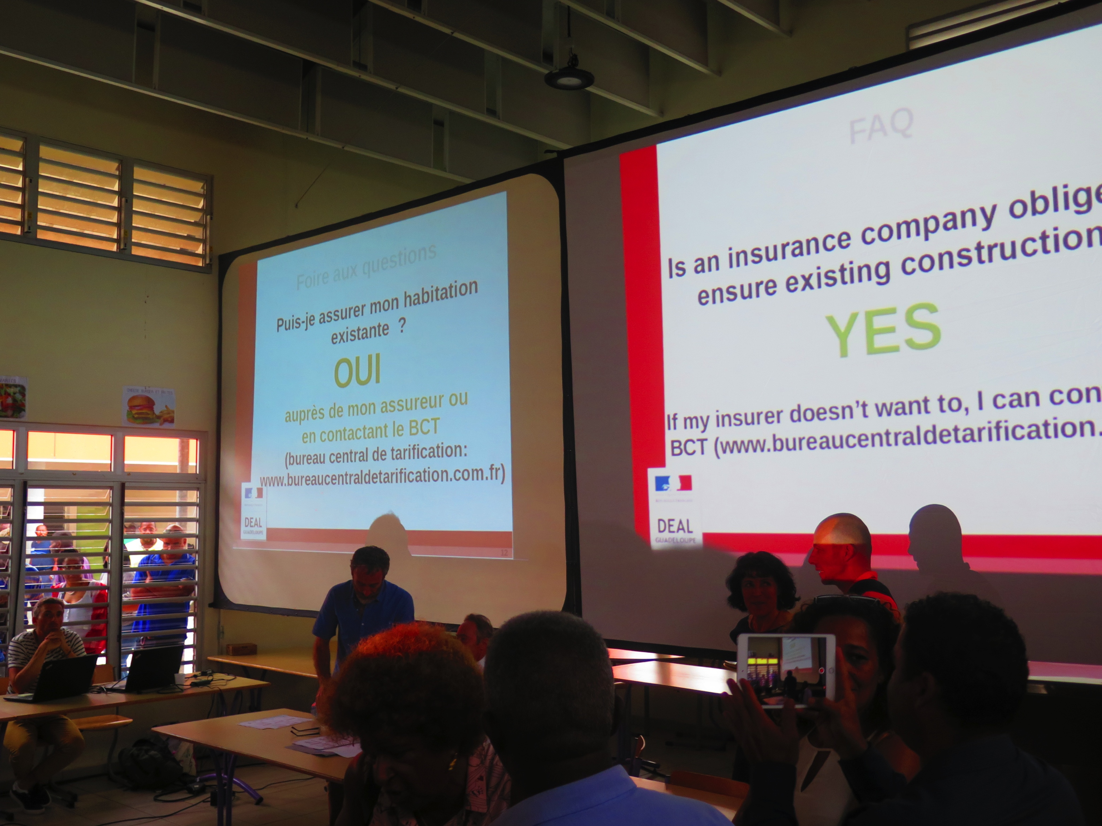
THE DIVERGENCE OF PERSPECTIVES BETWEEN THE EMPIRICAL REALITY OF HOW LOCAL PEOPLE EXPERIENCE DISASTERS AND A ‘METRIC’ APPROACH TO TERRITORIES IS CREATING ARENAS FOR NEGOTIATION AND CONTROVERSY ABOUT RISK MANAGEMENT

Slide 8
INTERNET AS THE DIGITAL NERVOUS SYSTEM OF OUR PLANET :Connected different communities
SMARTPHONE APPS AS RISK MITIGATION TOOLS
SENSOR-BASED CITIZEN: Tracking connected citizens (as sensors) enables us to understand their behaviour and survival strategies. A new integrative approach to social and technical issues will make territories more resilient.

Slide 9
Defining the issues and reconsidering policies
Questioning timeframes
Questioning technologies and their accessibility to society (practitioners and residents)
Defining responsibilities and empowering citizens

Slide 10
THANK YOU FOR YOUR ATTENTION

