Slide 1

Revamping UN-GGIM: Africa's Working Groups and Thematic Networks
OK
by Oumar H. Ka
Notes:
The United Nations Global Geospatial Information Management (UN-GGIM): Africa initiative aims to improve geospatial information management across the continent. This presentation outlines the process of revamping UN-GGIM: Africa's working groups and thematic networks to enhance their effectiveness and align them with current priorities. The review involved a comprehensive assessment of existing groups, stakeholder consultations, and the development of new terms of reference. The ultimate goal is to strengthen geospatial information management in Africa and support sustainable development efforts.

Slide 2
Background and Justification
1
Establishment of Working Groups
UN-GGIM: Africa established working groups and thematic networks to focus on specific aspects of geospatial development.
2
Need for Review
Most working groups struggled to fulfill their mandates, prompting a review of their effectiveness.
3
Revamping Process
A comprehensive review was initiated to revitalize the operations of these groups and align them with current priorities.

Slide 3




Methodology for Review
Documentary Review
Extensive review of best practices in geospatial working groups globally.
Stakeholder Assessment
Surveys and interviews with key stakeholders to gather perspectives and needs.
Analysis and Recommendations
Identification of strengths, weaknesses, opportunities, and threats, leading to recommendations for improvement.

Slide 4
Key Findings
Limited Group Performance
Secretariat Achievements
Working groups showed poor performance since their establishment.
UN-GGIM: Africa's achievements were primarily due to the Secretariat's efforts.
Resource Constraints
Communication Gaps
Insufficient financial, human, and technical resources hindered operations.
Ineffective coordination and communication with stakeholders impacted progress.

Slide 5
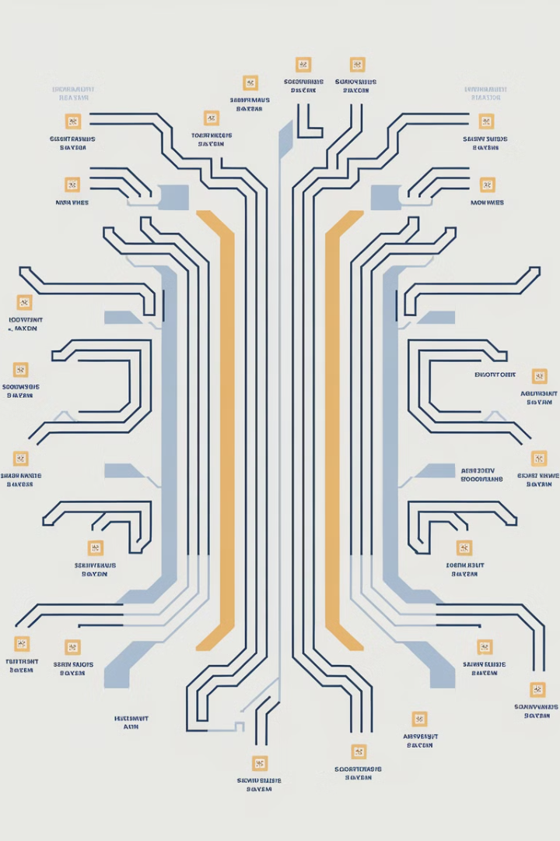
Proposed New Working Group Structure
Working Group
Focus Area
Geodesy
Subcommittee on Geodesy
Integration of Statistics & Geospatial
Data Integration
Integrated Geospatial Information Framework (IGIF)
IGIF Implementation
Land Administration and Management
Land Management

Slide 6
Recommendations for Improvement
1
Clear Objectives
2
Balanced Representation
Establish clear, specific, and measurable objectives for each working group that align with UN-GGIM: Africa's vision.
Ensure balanced geographic representation and expertise in group composition.
3
Resource Mobilization
4
Performance Monitoring
Develop financial appropriation mechanisms to secure necessary resources and funding.
Implement measurable performance indicators and periodic evaluations to assess progress and impact.

Slide 7
Role of Private Sector and Academic Networks
Private Sector Contributions
Academic Network Involvement
Collaboration Strategies
Technical expertise, training, innovation, and funding support.
Developing strategies for partnering with private sector and academic networks.
Degree courses, skills development programs, research support, and building expertise in geospatial science.

Slide 8




Way Forward
Implement Recommendations
Strengthen Partnerships
Monitor Progress
Align with SDGs
Regularly assess the impact and effectiveness of the new structure.
Ensure activities support sustainable development goals in Africa.
Put into action the proposed changes to revitalize working groups.
Foster collaborations with private sector and academic institutions.

