Slide 1
Medicines Regulatory Harmonization (AMRH) Initiative
Alex Juma Ismail

Slide 2
2005: AU Decision55 on Development of the Pharmaceutical Manufacturing Plan for Africa (PMPA) within the NEPAD Framework
Background
Creating an Enabling Regulatory Environment---AMRH
Pharmaceutical sector development (Optimizing the African Market for new medical products and technologies)
2005: AU Decision on development of PMPA within NEPAD
2007: AU Ministers Decision on PMPA
2012: PMPA Business Plan &
AU-Roadmap on Shared Responsibility & Global Solidarity for ATM response in Africa
2015: AU Executive Council Decision on AMRH as foundation for African Medicines Agency (AMA)
Increased access to medical products and technologies

Slide 3
> Sub-Saharan Africa covered with medicines registration harmonization (MRH) Projects
REC
Status
Comments
CEN-SAD/UMA/COMESA
EAC
CEMAC-OCEAC
WAHO/UEMOA
SADC
IGAD
Implementation
Implementation
Implementation
Implementation
Implementation
Launched March 2012
Launch Nov. 2016
Launched Feb 2015
Launched July 2015
Launched 2017
IGAD
WAHO/UEMOA
EAC
ECCAS/OCEAC
Completed or in-process RECs | Countries covered | Total members* | % pop covered
EAC & OCEAC EAC, OCEAC, ECOWAS EAC, OCEAC, ECOWAS, SADC | 12 (20%) 26 (46%) 41 (74%) | 11 26 41 | 17% 45% 72%
SADC
EAC Pharmacovigilance Project,
AVAREF alignment with AMRH on clinical trials ethics and regulatory oversight
3

Slide 4



MRH Programs benefits
.
Streamlined Regulatory Approach
One Submission ,
One Scientific Review &
One Recommendation applicable to all Partner States
Efficiency
Less Cost to Pharmaceutical Industry and Regulatory Authorities
Reduce Time and Duplication Efforts
High Level of Expertise and Competency of Assessors and Inspectors

Slide 5
Overall Achievements – RECs MRH to NRAs
Standards, guidelines and processes harmonized at the regional level
Countries within various RECs have domesticated and implemented harmonized guidelines
All the 5 implementing RECs initiated joint assessments and inspections leading to reduced timelines for approval of products
RECs supported countries within their regions to build capacity towards attaining higher levels of maturity
Advocacy through REC platforms for domestication of Model Law and ratification of the AMA Treaty

Slide 6
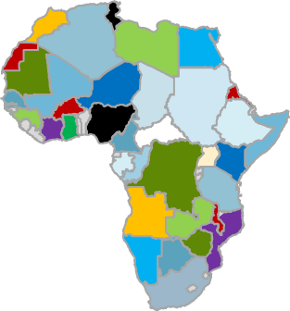

African Union Vision
IGAD / AMU
/ CEN-SAD
WAHO / UEMOA
West Africa Medicines Agency
African Medicines Agency
EAC
ECCAS/
OCEAC
East African Community Medicines and Food Safety Commission
SADC/
COMESA
54 countries
5regions
1 continent
Notes:
The African Medicines Regulatory Harmonization (AMRH) Programme provides a foundation for establishment of regional medicines agencies such as the East African Community Medicines and Food Safety Commission (as an offshoot of the MRH project) and in the long run the African Medicines Agency (AMA)

Slide 7
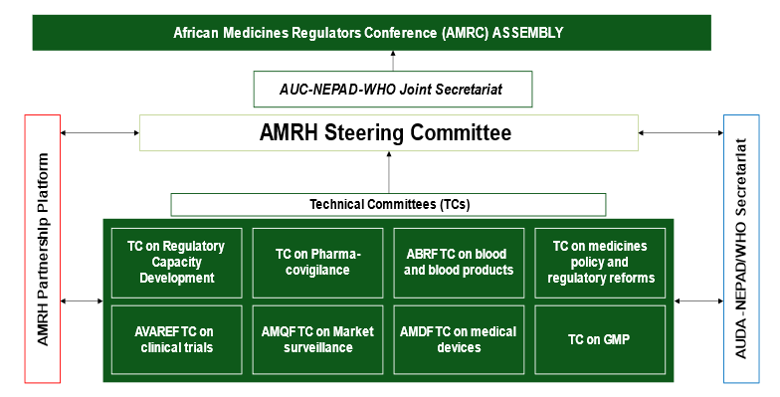
IMS TC
EMP TC
NRA Experts constituting continental TCs through regional MRH Platforms

Slide 8

Evaluation of Medicinal Products (EMP)
Medicines Policy and Regulatory Reforms (MPRR)
Support joint reviews and
marketing authorization
Policy and regulatory reforms
Inspection of manufacturing
sites
Good Manufacturing Practice (GMP)
Information Management Systems (IMS)
Support implementation of RIMS
Regulatory oversight on clinical
trials
African Vaccines Regulatory Forum (AVAREF)
African Medicines Quality Forum (AMQF)
Laboratory capacity strengthening
AMRH TECHNICAL COMMITTEES
Technical oversight on medical
devices
African Medical Devices Forum (AMDF)
African Blood Regulatory Reforms
Blood & blood products regulation
Coordination of regulatory
capacity strengthening efforts
Regulatory Capacity Development (RCD)
Pharmacovigilence / Safety Surveillance
Safety monitoring of medical
Products (yet to be established)

Slide 9
EMERGING AFRICA REGULATORY ECOSYSTEM: Key components
AUC
AMA
Continental procedures: Harmonised, Faster, Simpler, Stringent; Specified for limited products & procedures; NRAs to implement.
TCs to support continental, regional/national activities
Regional Procedures to support national activities, and coordinate regional inputs into AMA procedures
NRAs –majority of work & backbone of regulatory systems
AMRH
Partners
AUDA-NEPAD
&
WHO
Joint
AMRH Sec
AMRH TCs – Existing
Regional
MRH initiatives
(RECs)
National
[Enable NRAs reach ML3]
some

Slide 10
Prioritizing enablers for a successful AMA and the continental ecosystem
AMA to build on continental standards and processes that meet international standards and best practices
Strengthened NRAs with systems to enable reliance on AMA scientific recommendations and decisions
Strengthened networking and trust among the regulators
AMA to depend of experts from NRAs to undertake its scientific work – human capacity
RECs-MRH programmes anchors of AMA
Sustainable financing mechanisms

Slide 11
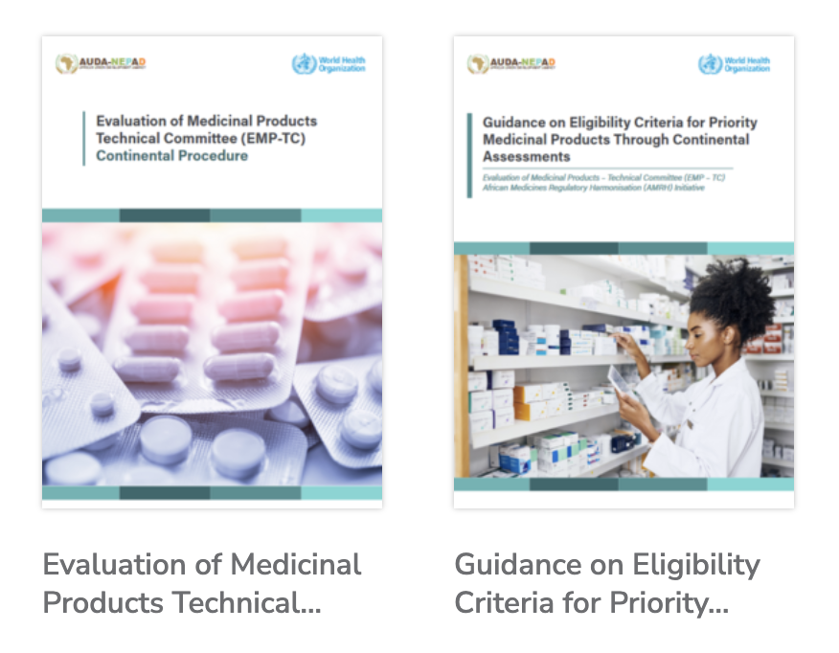
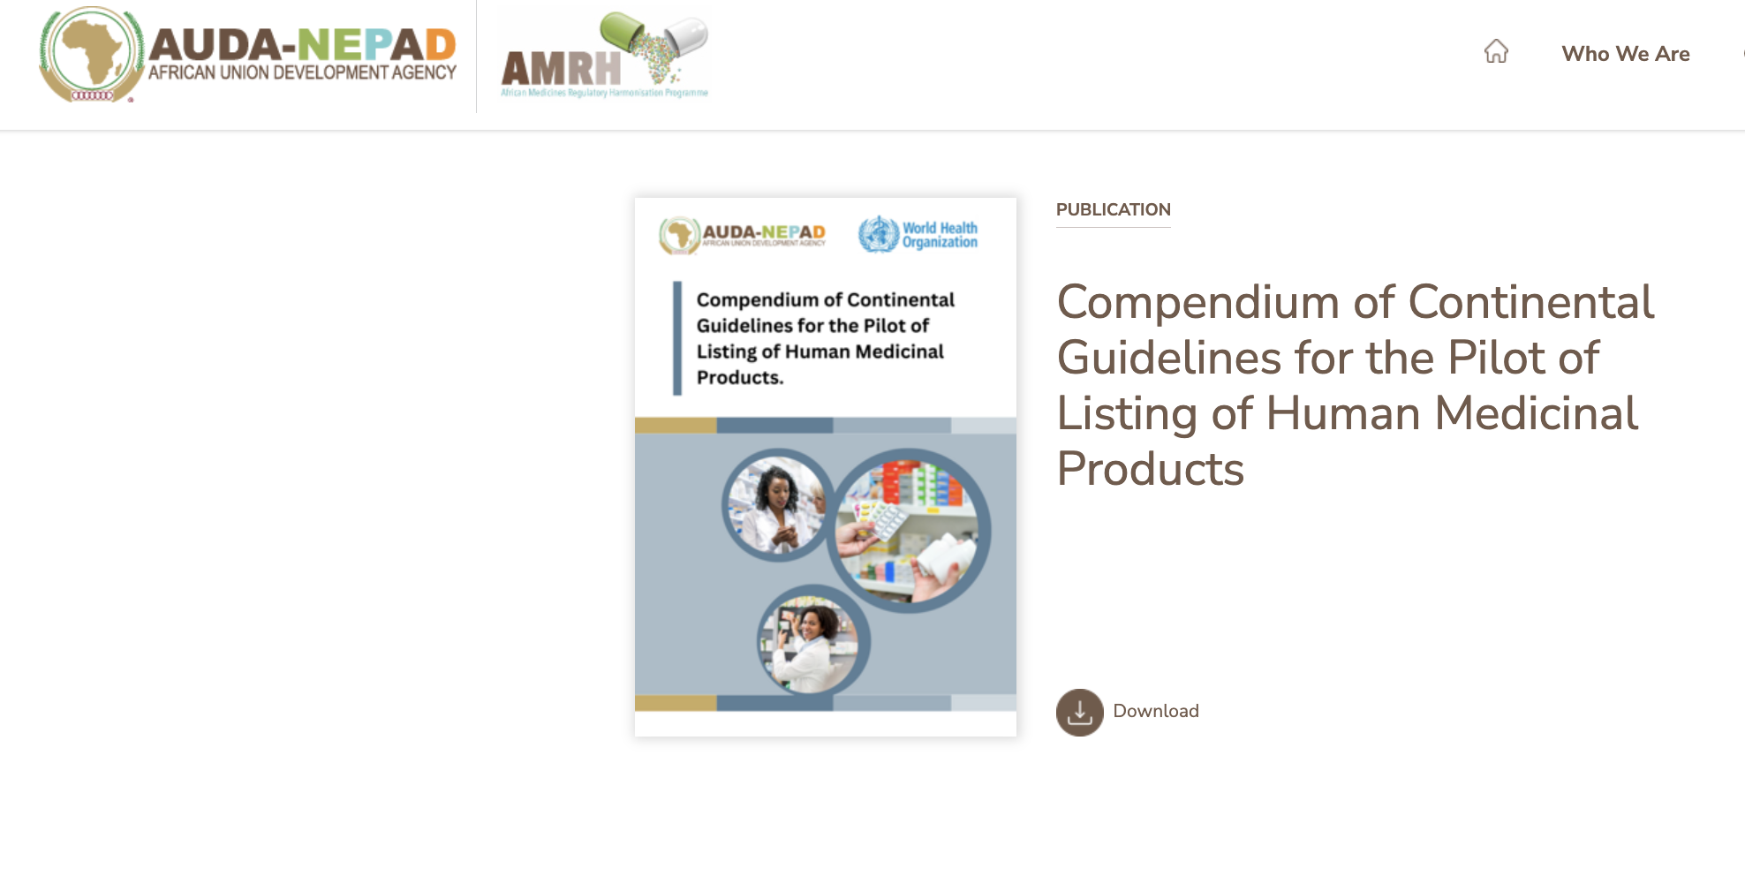
Continental standards and processes
AMRH TCs fundamental in development of continental standards, guidelines, SOPs and processes
AMRH SC & AMRC approve all guidance documents
Pilot to mainly focus on products that fall within the Eligibility Criteria Of Priority Products For Continental Assessment
Continental Evaluation Pilot launched in November 2023
46 EOIs received
SAHPRA processing Applications during Pilot
Stakholders Engagements – On going
Establishment of Pool of Assessors and inspectors - Competency Assessment
Technical partnerships –WHO, EMA, USFDA, BfArM, Swissmedic
https://amrh.nepad.org/amrh-resources

Slide 12


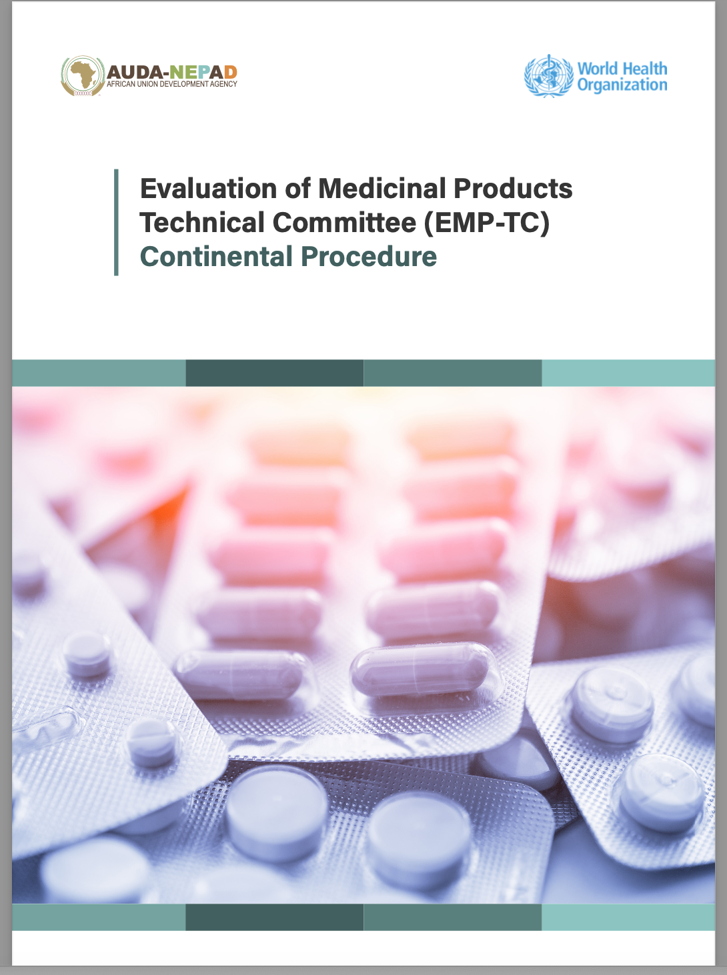

Continental Pilot on Listing of Human Medicinal Products
Support to CPPM

Slide 13
Continental Procedure
The EMP TC will undertake a comprehensive evaluation of the quality, safety, and efficacy of priority medicinal products, based on medicinal products dossiers submitted by the applicants and on an assessment of the GMP/GCP/GLP compliance through relevant continental technical committees under AMRH
If evaluation demonstrates that a product and its corresponding manufacturing and clinical site(s) meet the continental standards acceptable by the Technical Committees (i.e., internationally acceptable standards), the medicinal product will be issued with an INDEPENDENT SCIENTIFIC OPINION or RECOMMENDATION which will then allow the product to be included in the continental list (listing) of medicinal products recommended by the EMP-TC (if positive)
The assessment as well as inspection reports will be shared with concerned National Regulatory Agencies (NRAs) in Africa to support and facilitate registration and marketing authorization of Africa’s priority medicinal products.

Slide 14

Pilot Objectives
Pressure test and validate the proposed continental process and procedures by the EMP TC and the GMP TC including work-sharing and reliance models
1
Review and propose operational modalities for evaluation and approval of priority medicinal products through the AMA
2
Identify and propose best operational modalities of the continental GMP inspection activities
3
Review and propose best and practical working relationship between AMRH or AMA with the RECs and NRAs and other international organisations such as the WHO, EMA,PICS e.tc.
4
Identify and address gaps in the proposed continental procedures and pathways
5
Identify and propose any additional processes or procedures required as appropriate for the success of the continental pathways to strengthen the existing regulatory ecosystem on the continent.
6

Slide 15
Expected Output and Outcome of the Pilot
EMP TC and GMP TC continental processes validated
Best operational models at continental level for evaluation and inspections identified and adopted
Working relationship between AMRH/AMA, RECs and NRAs in collaboration with other international bodies identified and adopted
Gaps on proposed continental processes identified and means for addressing them identified
Additional documents (If any) to complement existing/identified developed or adopted as appropriate

Slide 16



UPDATES: Continental Pilot
Call for Industry Applications
Window opened 1st Nov 2023 and closed 29th Feb 2024
46 EOIs received from 11 Applicants (13 manufacturers)
Extension of call 8th April closed 10 May 2024
7 Applicants have expressed interest (Only few will be accepted for Phase 1)
Dossier receiving window – 1st April – 31st May 2024
Onboarding and walkthrough sessions on the eCTD platform on-goning successful applicants
Continental Reviews & Inspections – June/July 2024

Slide 17
Structurers Established to Support Continental Listing
African Medicines Regulators Conference (AMRC)
Adoption of requirements and Guidelines by EMP-TC and its substructures – 55 AU countries platform
Forum of the Heads of MA and Registration
For facilitating translation of continental scientific decisions and recommendations to national registration or MA – 55 countries

Slide 18
Updates on African Medicines Agency (AMA) Operationalization
AMA Treaty came into force on 5th November 2021
28 ratifications – Tanzania and Zambia recently deposited
Several meetings of the Conference of States Parties (CoSP) convened so far
CoSP adopted its Rules of Procedure.
Ghana elected as Chair of Bureau
Rwanda confirmed as the host country for the AMA and Agreement Signed
Nomination of AMA Board concluded 22nd April 2024
Benin Chair
Chad Vice Chair
Board to be responsible for the process of selecting DG
Terms of Reference of the DG approved – AUC will advertise in the coming weeks
AUC supports admin operationalization with technical support led by AUDA-NEPAD

Slide 19

The END
Any Questions???

