Slide 1
AfCFTA-anchored Pharmaceutical Initiative
Transformative Journey
Jane Karonga
Economic Affairs Officer

Slide 2
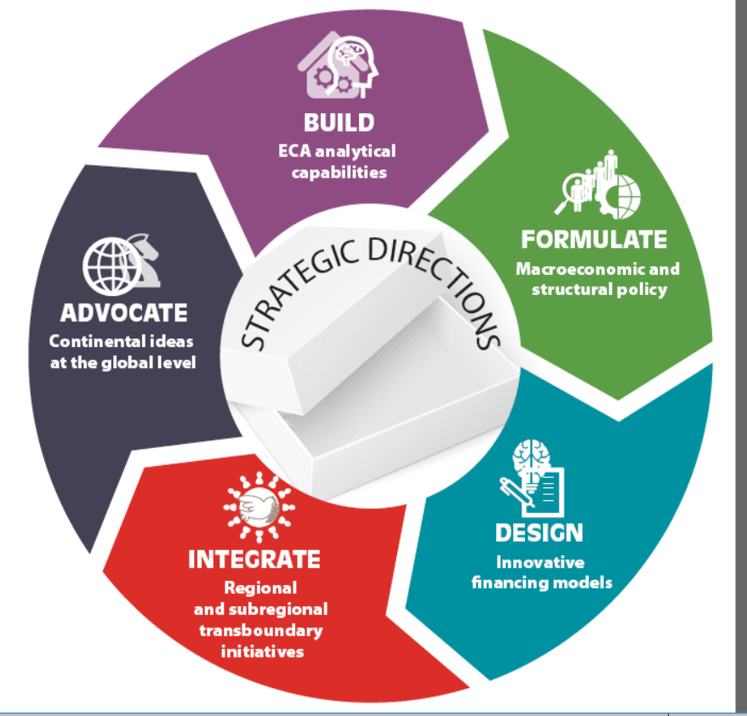
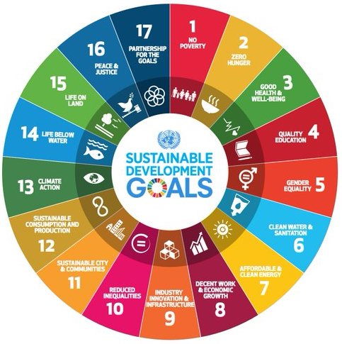


ECA Guiding Frameworks
| Sub-Title goes here
UNECA.ORG

Slide 3
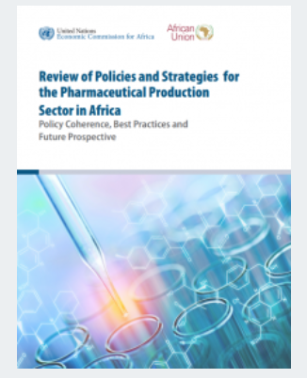
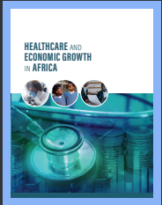
The Present Health Landscape from ECA Research
Health matters for Economic Growth: COVID-19 has exposed us further to this reality, there is a robust link between health outcomes and economic growth
According to WHO estimates, investing an additional average of US$21 to US$36 per capita per year over five years in Africa would save 3.1 million lives (of which 90% would be among mothers and children) & prevent between 3.8 million and 5.1 million children from stunting.
  Life expectancy at birth }
  Child mortality rate } → GDP per capita growth
  Maternal mortality rate }
Notes:
We are at a cross road with an increasing mismatch of demand and supply in our region.
Demand factors are not only the increasing demographic profile
A myriad of complex issues influence the current access challenges to safe, affordable medicines in the region
UHC remains a serious challenge due to myriad of complex issues
Medicines shortages also mean procurement happens at much higher price- to cover gap and eats away al already limited budgets
Study found 15/18 (83%) LMIC countries reviewed had 1+ RMNCH drug stock-out in past year, and 3 countries had 9+ RMNCH stock-outs. (Briggs 2018
2017 study found in one case, Ghana paid almost double for cholesterol drugs vs. UK, & 50x if adjusted for inflation (Chalkidou 2017; Lu 2019)
: Anti-TB drug quality failure rate of 43.5% for non-registered drugs in African cities (Bate 2013), & 44% of Africans have seen falsified drugs (FTF 2018)
: ~1.6M Africans died from malaria, TB, HIV in 2015; largely preventable/treatable w/ better access (Pheage)
ost productivity 49% of Africans went w/o medicine/medical care in past year (Afrobarometer)
Economically devastating out of pocket household
Medicine affordability study found lowest-paid gov. worker would pay 5+ days salary every month for the cheapest generic in 9 out of 10 African countries (Laing 2007: 21); Another study found that 18 out 32 essential medicines in Malawi were unaffordable (Khuluza 2019)
Sources:
Joanne Lu (July 8, 2019), “Drug price can take a surprising turn when a poor country gets richer,” NPR, https://www.npr.org/sections/goatsandsoda/2019/07/08/737786567/drug-prices-can-take-a-surprising-turn-when-a-poor-country-gets-richer
Felix Khuluza, Christine Haefele-Abah (February 12, 2019), "The availability, prices and affordability of essential medicines in Malawi: A cross-sectional study," https://doi.org/10.1371/journal.pone.0212125
Briggs, Jane, Martha Embrey, Blerta Maliqi, Lisa Hedman, and Jennifer Requejo (December 7, 2018), "How to assure access of essential RMNCH medicines by looking at policy and systems factors: an analysis of countdown to 2015 countries." BMC health services research 18(1): 952, https://www.ncbi.nlm.nih.gov/pmc/articles/PMC6286577/; file: 12913_2018_Article_3766.pdf
Fight The Fakes (July 25, 2018), "Study shows that African citizens consider themselves ill-informed about the dangers of falsified drugs," http://fightthefakes.org/resources/study-shows-that-african-citizens-consider-themselves-ill-informed-about-the-dangers-of-falsified-drugs/; file: Sanofi_Infographie_EN.pdf
Kalipso Chalkidou (November 21, 2017), “More Health for the Money through Better Purchasing Decisions: The Case of Ghana,” Center for Global Development, https://www.cgdev.org/blog/more-health-money-through-better-purchasing-decisions-case-ghana
Afrobarometer (March 20, 2017), "Highlights of Round 6 survey findings from 36 African countries," http://afrobarometer.org/sites/default/files/summary_results/ab_r6_afrobarometer_global_release_highlights8.pdf
TEFO PHEAGE (December 2016 - March 2017), "Dying from lack of medicines: Encouraging local production, right policies the way out," Africa Renewal, https://www.un.org/africarenewal/magazine/december-2016-march-2017/dying-lack-medicines
Bate et al. (March 2013) "Substandard and falsified anti-tuberculosis drugs: a preliminary field analysis," Int J Tuberc Lung Dis. 17(3), https://www.aei.org/wp-content/uploads/2013/02/-substandard-and-falsified-antituberculosis-drugs-a-preliminary-field-analysis_142125219328.pdf
Laing et al. (2007), Medicines prices: measurement and findings in countries, p. 20-21, http://slideplayer.com/slide/8431967/

Slide 4
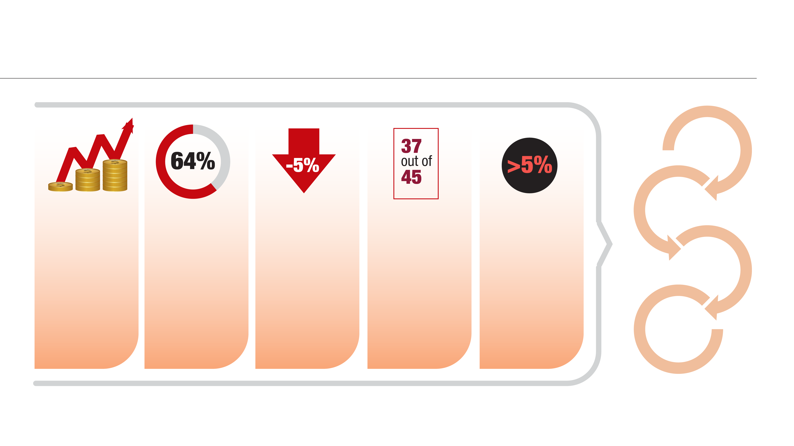
Limited fiscal space to finance health calls for private sector development in health sectors
Debt distress of African Economies
Interest payments absorb revenues
Africa’s debt vulnerability is high and exacerbated by exogenous shocks, inflation and rising interest rates.
In 2022 Africa’s debt-to-GDP ratio was 64%
Fiscal space
of African economies remain constrained,
in 2022 fiscal deficits reached -5%
African countries surpass the WHO recommended threshold of OOP health spending
Government expenditure on health in all but two countries is less than 5 per cent of GDP
High out-of-pocket expenditure
Limited fiscal space to finance public health

Slide 5
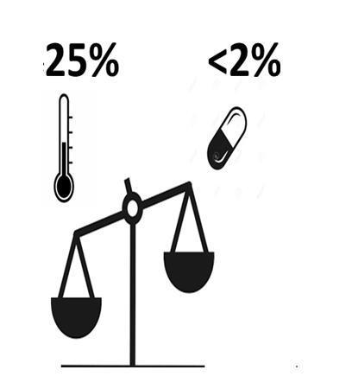
Rationale – Mismatch Demand to Supply
25% of global disease burden is in Africa while <2% of consumed medicines are manufactured on the continent….
~ 2 billion people, many who reside in low- or middle-income countries, still lack access to medicines that could prevent unnecessary illness and death
AFRICA IS AT A CROSS ROAD…..Unless we do something differently, the mismatch and gap will keep on growing….
The demand for essential medicines and others will continue to increase due to a myriad of factors such as demographic growth & epidemiologic transition on the demand side but also other supply side constraints that hinder a sustainable supply….
Notes:
We are at a crossroad with an increasing mismatch of demand and supply in our region.
Demand factors are not only the increasing but demographic profiles and epidemiological transition as well as myriad of other factors
UHC remains a serious challenge due to myriad of complex issues
Medicines shortages also mean procurement happens at much higher price- to cover gap and takes away already limited budgets
Study found 15/18 (83%) LMIC countries reviewed had 1+ RMNCH drug stock-out in past year, and 3 countries had 9+ RMNCH stock-outs. (Briggs 2018
2017 study found in one case, Ghana paid almost double for cholesterol drugs vs. UK, & 50x if adjusted for inflation (Chalkidou 2017; Lu 2019)
: Anti-TB drug quality failure rate of 43.5% for non-registered drugs in African cities (Bate 2013), & 44% of Africans have seen falsified drugs (FTF 2018)
: ~1.6M Africans died from malaria, TB, HIV in 2015; largely preventable/treatable w/ better access (Pheage)
cost productivity 49% of Africans went w/o medicine/medical care in past year (Afrobarometer)
Economically devastating out of pocket household
Medicine affordability study found lowest-paid gov. worker would pay 5+ days salary every month for the cheapest generic in 9 out of 10 African countries (Laing 2007: 21); Another study found that 18 out 32 essential medicines in Malawi were unaffordable (Khuluza 2019)
Sources:
Joanne Lu (July 8, 2019), “Drug price can take a surprising turn when a poor country gets richer,” NPR, https://www.npr.org/sections/goatsandsoda/2019/07/08/737786567/drug-prices-can-take-a-surprising-turn-when-a-poor-country-gets-richer
Felix Khuluza, Christine Haefele-Abah (February 12, 2019), "The availability, prices and affordability of essential medicines in Malawi: A cross-sectional study," https://doi.org/10.1371/journal.pone.0212125
Briggs, Jane, Martha Embrey, Blerta Maliqi, Lisa Hedman, and Jennifer Requejo (December 7, 2018), "How to assure access of essential RMNCH medicines by looking at policy and systems factors: an analysis of countdown to 2015 countries." BMC health services research 18(1): 952, https://www.ncbi.nlm.nih.gov/pmc/articles/PMC6286577/; file: 12913_2018_Article_3766.pdf
Fight The Fakes (July 25, 2018), "Study shows that African citizens consider themselves ill-informed about the dangers of falsified drugs," http://fightthefakes.org/resources/study-shows-that-african-citizens-consider-themselves-ill-informed-about-the-dangers-of-falsified-drugs/; file: Sanofi_Infographie_EN.pdf
Kalipso Chalkidou (November 21, 2017), “More Health for the Money through Better Purchasing Decisions: The Case of Ghana,” Center for Global Development, https://www.cgdev.org/blog/more-health-money-through-better-purchasing-decisions-case-ghana
Afrobarometer (March 20, 2017), "Highlights of Round 6 survey findings from 36 African countries," http://afrobarometer.org/sites/default/files/summary_results/ab_r6_afrobarometer_global_release_highlights8.pdf
TEFO PHEAGE (December 2016 - March 2017), "Dying from lack of medicines: Encouraging local production, right policies the way out," Africa Renewal, https://www.un.org/africarenewal/magazine/december-2016-march-2017/dying-lack-medicines
Bate et al. (March 2013) "Substandard and falsified anti-tuberculosis drugs: a preliminary field analysis," Int J Tuberc Lung Dis. 17(3), https://www.aei.org/wp-content/uploads/2013/02/-substandard-and-falsified-antituberculosis-drugs-a-preliminary-field-analysis_142125219328.pdf
Laing et al. (2007), Medicines prices: measurement and findings in countries, p. 20-21, http://slideplayer.com/slide/8431967/

Slide 6
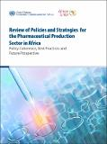


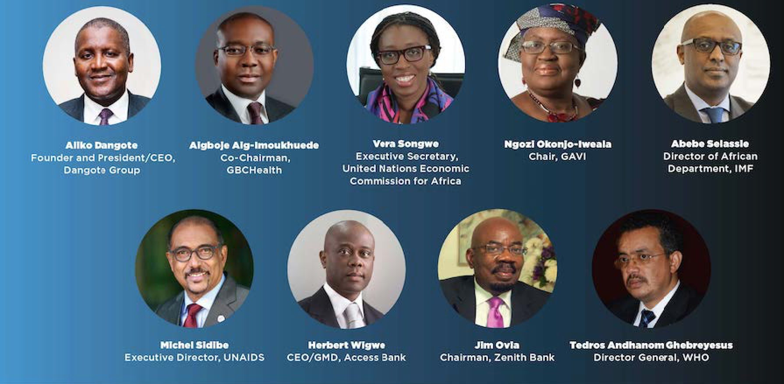
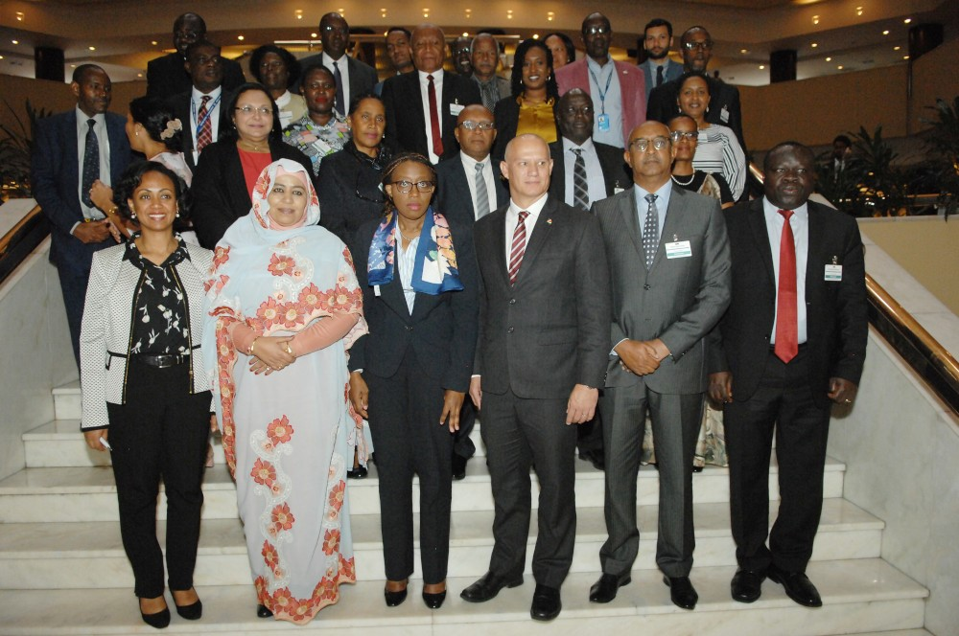



HOW IT ALL STARTED: AfCFTA-anchored Pharma Initiative Journey
INITIATIVE LAUNCH
21st November 2019
The AfCFTA-anchored Pharma Pilot Initiative was conceptualized by ECA and launched in 10 selected African Countries
AfCFTA Regional Forum for the Horn of African -Focus on pharma was the foundation for the conceptualization and commissioning of the AfCFTA- Pharma Initiative
27-28 June 2019
Africa’s Business Forum
(Margins AU Summit) linked Healthcare and Economic Growth in Africa Report
12 Feb 2019
UNECA’s Review Pharma Report was a catalyst
2018
ABC Health Launch: Private Sector Engagement in Health for Africa’s sustainability
12 Feb 2019

Slide 7
IDEAS to ACTION – “AfCFTA-anchored Pharma Initiative, the Game Changer”
Address Both Demand And Supply Side Constraints
Private Sector; Partnerships; Cross-Country Data and Information; Enabling Policies, etc.
MARKET SUPPLY Intervention
MARKET DEMAND
Intervention
AfCFTA
Economies of scale
PMPA & AMA
Pooled
market-
55 countries
1.4Bil. People
Combined GDP USD 3.4 Trillion
Localized Production
Harmonized policies
Quality
Regionalization
Sustainability
Fiscal Space
Notes:
Our proposed framework is a game changer and proposed a new approach – addressed both the demand and supply side constraints
But the challenge is not only the demand and making sure people have access to affordable medicines
But also ensure medicines markets are capable of responding to the needs and meeting evolving burden: AMR and NCD (real concerns)

Slide 8





















Key Regional Partnerships Across The Initiative 3 Pillars of Intervention
Focus on Sexual Reproductive, Maternal and Child Health Commodities
THREE PILLAR INTERVENTIONS
Partners
POOLED PROCUREMENT
LOCAL PRODUCTION
HARMONIZED REGULATORY AND QUALITY ASSURANCE
Seychelles
Kenya
Ethiopia
Djibouti
Madagascar
Rwanda
Comoros
Mauritius
Sudan
Eritrea

Slide 9
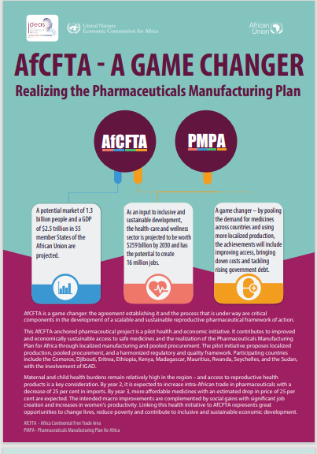
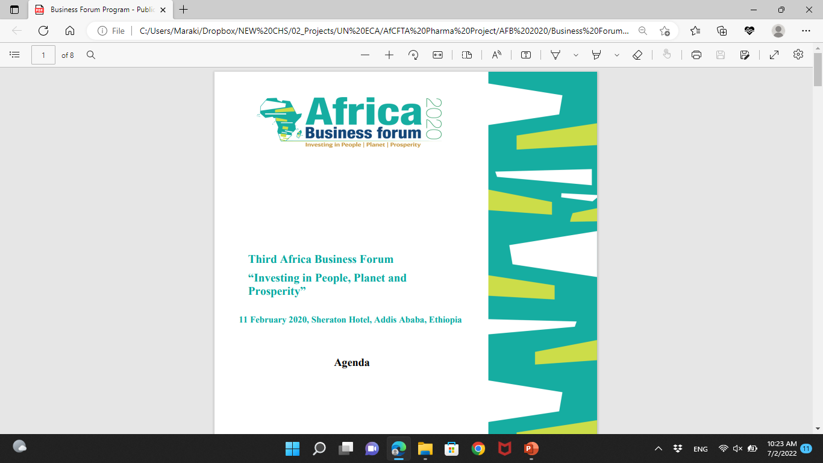
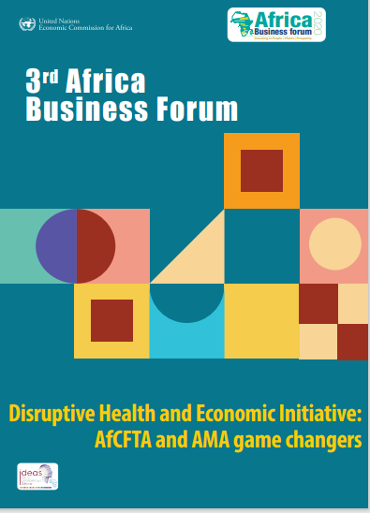
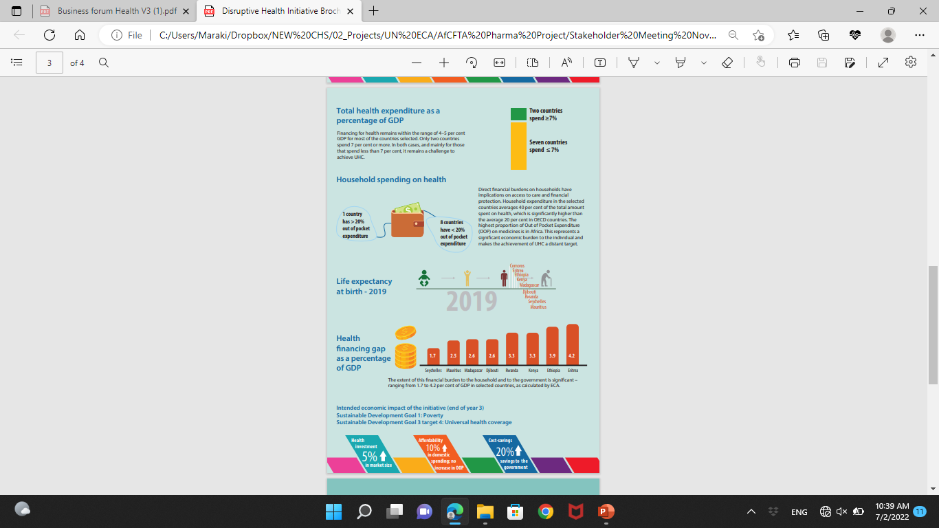
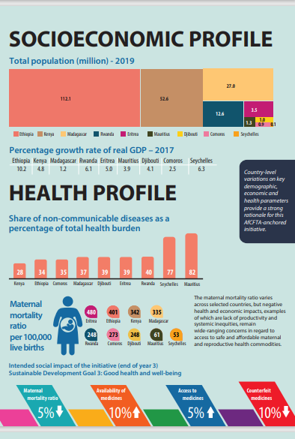
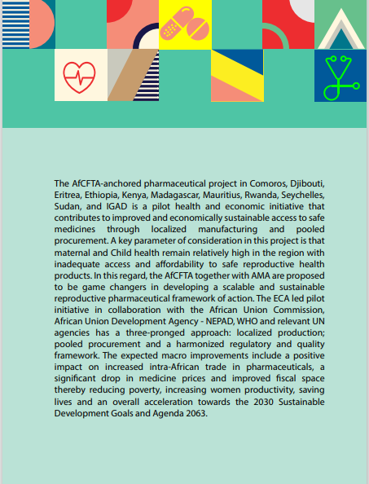
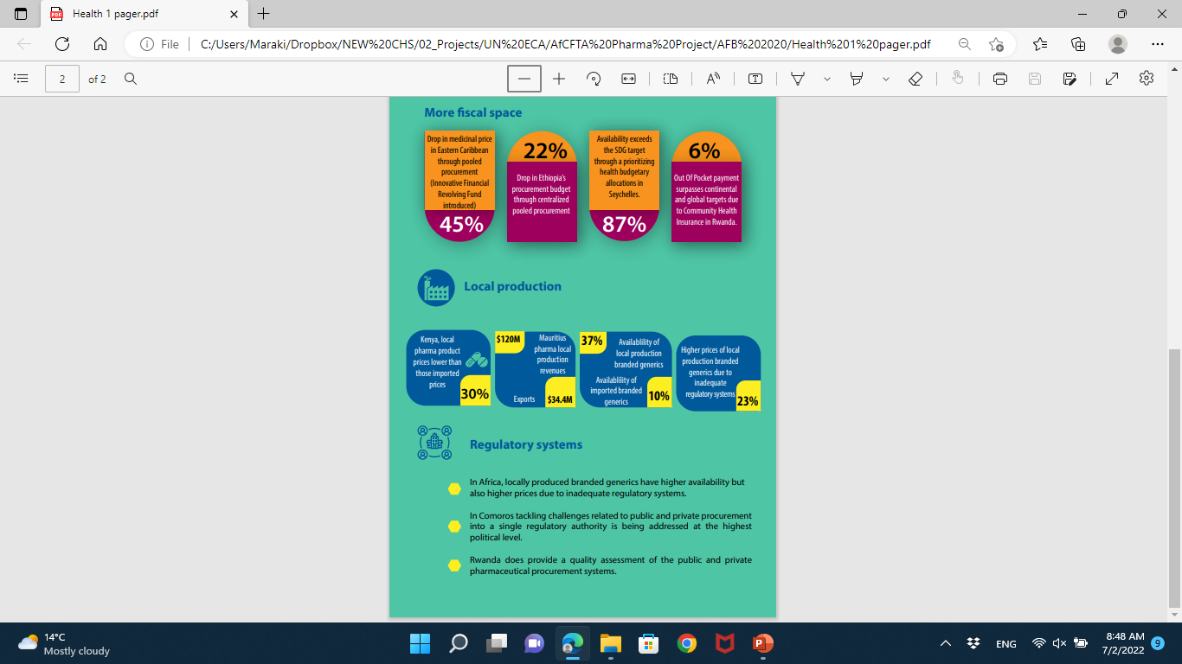
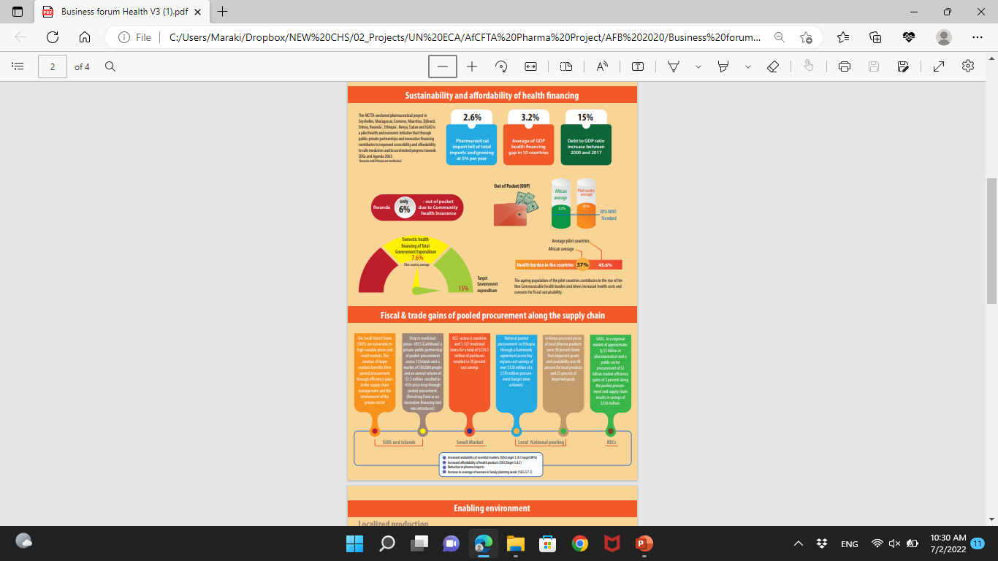
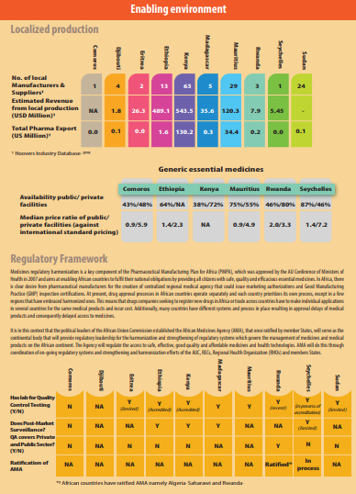
Phase 1 (2019-2021): Feasibility Study & PP Framework
Engagement, Convening, Data Outcomes
PHASE 1 OUTCOMES
INITIATIVE FEASIBILITY
PP FRAMEWORK
Africa Business Forum
Feb 2020
INITIATIVE COMMITENT SIGNING CEREMONY
Africa Business Forum
Feb 2021
INITIATIVE FEASIBILITY PILOT COUNTRY RESULT
Initiative Launch Event
Nov 2019
COUNTRY PROFILING/LANDSCAPING

Slide 10






Phase 2 – AfCFTA-anchored Pharma Collaborations
Phase 3 - Engagements, & Offshoots
The 3 strategic pillars of the Pharma Initiative (pooled procurement, facilitation of local production and harmonized regulatory standards and quality) are being leveraged upon on the ATEX Platform
Financial support from Afreximbank 2020 in
Capacitating local production
and pooled procurement
Dialogue/discussions on the WA AfCFTA-anchored Pharma Initiative
Several Policy Documents and Advocacy inc ABF

Slide 11
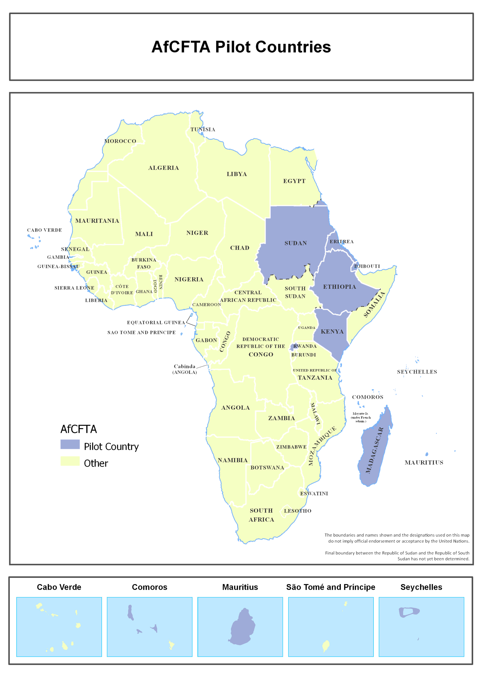
Phase II: AfCFTA-anchored Pharmaceutical Initiative: A business blueprint For Pvt Sector
The Pilot Initiative is the business blueprint that offers opportunities for emergence of value chains and industrialization in Health Sector
Results
Pooled
procurement
Localized
production
Harmonized regulatory standards and quality framework
Covid response Initiatives such as AMSP, AVAT, PAVM and ATEX
Information Sharing Medicines Database at the first step towards APPM
7 Manufacturers eligible for Technical support from ECA & Partners
Manufacturing Report
Contributed to the ratification of AMA
A Report on the Preparedness of 10 NMRA to Harmonize Medicine Regulation to Facilitate PP & LP
Notes:
The AfCFTA-anchored Pharma Initiative aims at increasing intra-Africa trade by supporting local production of pharmaceuticals. (Rwanda and Ethiopia)

Slide 12






Strategies for Shaping Local Production Markets-PP
Successful implementation of market shaping activities requires unified stakeholder efforts and commitments
Market shaping strategy for Africa, including a pilot pooled procurement mechanism provides financial and demand certainty for scaling local manufacturers, while giving member states access to medicines, vaccines and products to ensure health and sustainable markets and quality of life for our Africa populations
Benefits; access, prices, quality assurance, resilient markets, job creations
Political will and commitment from member states
Central pricing & framework. Central PO’s
Market shaping activities that enable a sustainable African vaccine market
Large product volume
Facilitate Local production
Collaboration and unified efforts from funders & partners
Secure payments
Volume depend on commitment
Co-operation and support from manufacturers
Predictable demand
and admin
Funding reserved Payment centralized
Notes:
The AfCFTA-anchored Pharma Initiative aims at increasing intra-Africa trade by supporting local production of pharmaceuticals. (Rwanda and Ethiopia)

Slide 13
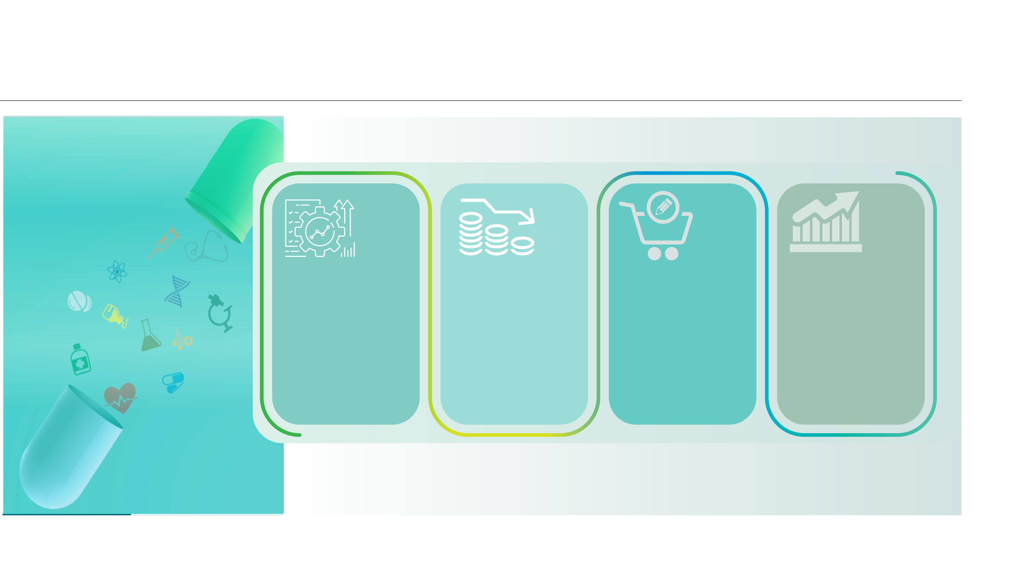
Establishing a pooled procurement mechanism can lead to:
Efficient procurement and management of medicine stocks
Reduction of unit, administrative and operational costs
Earmarking procurement of locally produced medicines
De-risk of investments and further attract investors to invest in upscaling capacity and access technology

Slide 14
Phase III: Pharma Initiative into Start- Up Phase of the APPM- the road ahead requires long-term leadership, commitment, partnerships and investment
Phase 1- Feasibility Study
&
PP Framework
Phase 2 –Reorientation of Pharma Initiative to mitigate COVID -19 Pandemic
Adoption and Implementation of CPPM with first stage of PP data collection in pilot countries ongoing
Continued prequalification process of manufactures via EOI (7 manufactures)
AfCFTA-Anchored Pharmaceutical Platform (AAPP) Developed
Technical support to manufactures with support from Afreximbank and other partners
Reports on state of regulatory affairs and pharmaceutical manufacturing in pilot countries
Phase 3 –Facilitate
the Transitioning of the Pharma Initiative into the Start-Up Phase of the APPM in Pilot countries
Where we are today

Slide 15
www.uneca.org

