Slide 1



THE POLITICAL ECONOMY OF LAND GOVERNANCE IN AFRICA
22 – 26 July 2024

Slide 2
Welcome to the NELGA 2024
Introduction Session
Welcome
Charity Rusere, PLAAS, UWC
Introduction to the course
Prof. Ruth Hall, PLAAS, UWC
Message from the African Land Policy Centre
Dr Medhat Elhelepi, ALPC, UNECA
Assessment and logistics of the course
Carla Henry, PLAAS, UWC
Introduction of Facilitators & Working Groups
Stha Yeni, Lead Facilitator, PLAAS, UWC
Introduction of participants by country
Facilitators
Breakout groups
Getting to know one another
Discussion of a key question

Slide 3
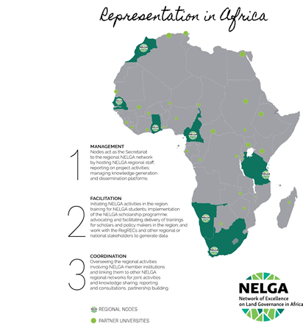
NELGA NODES

Slide 4
CURRICULUM DEVELOPMENT

Slide 5
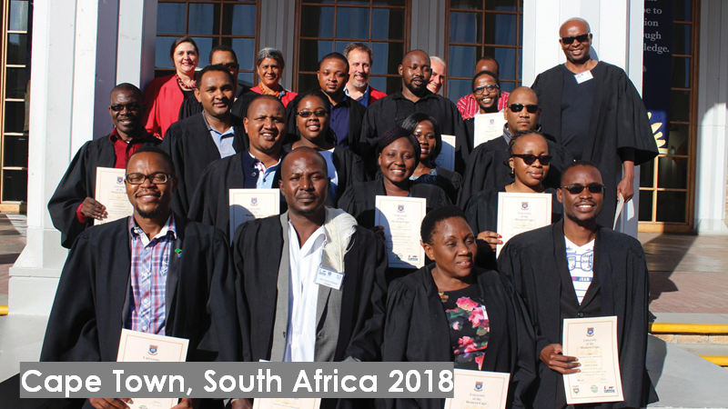
Southern Africa

Slide 6
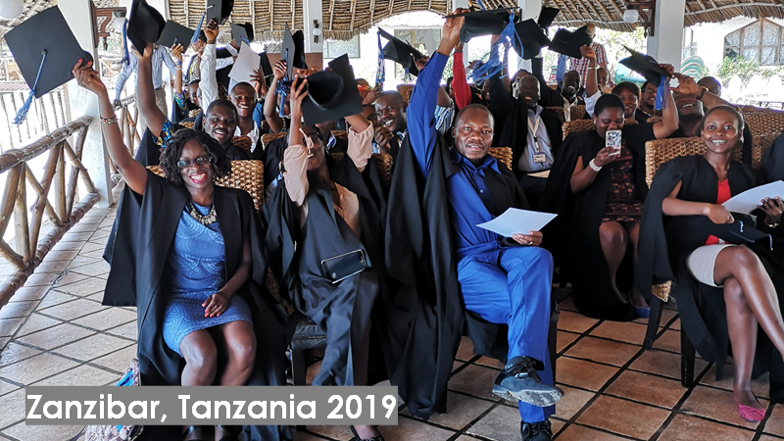
East Africa

Slide 7
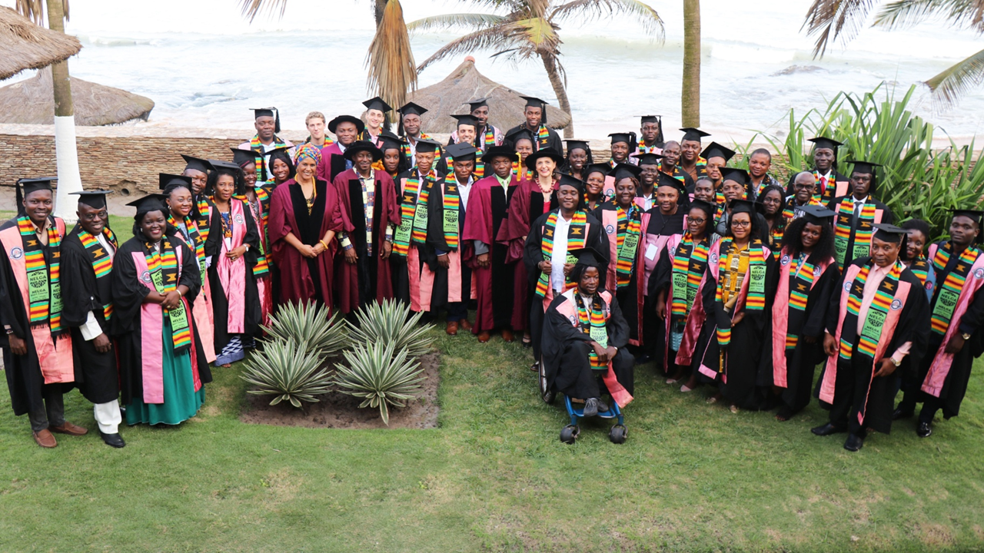
West Africa
Accra, Ghana 2019

Slide 8
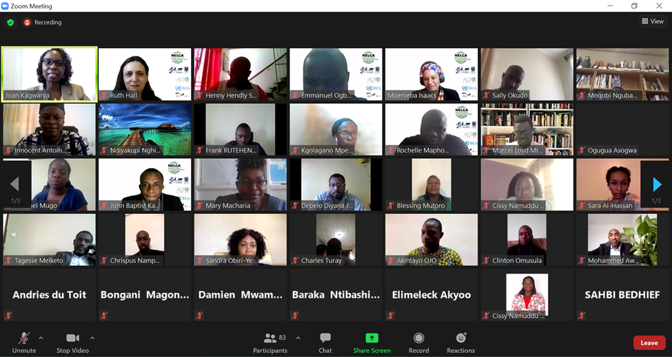
Online in 2021

Slide 9
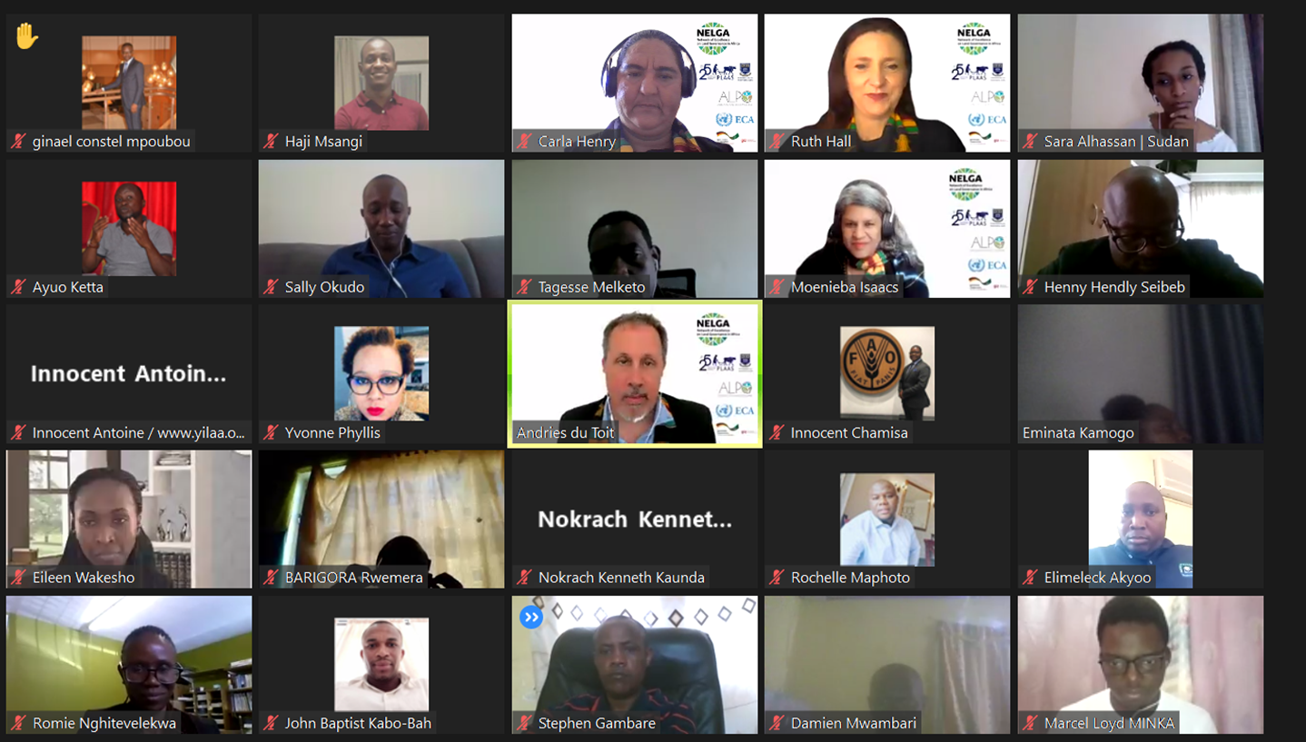
Online in 2021

Slide 10
Online in 2023

Slide 11
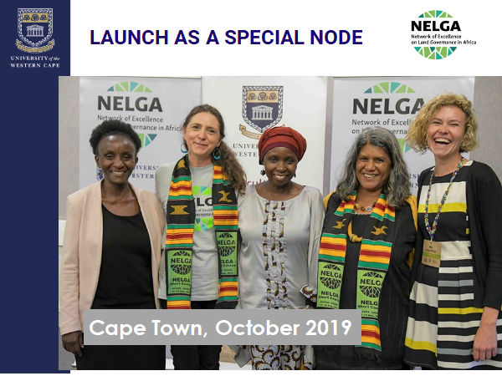

Slide 12
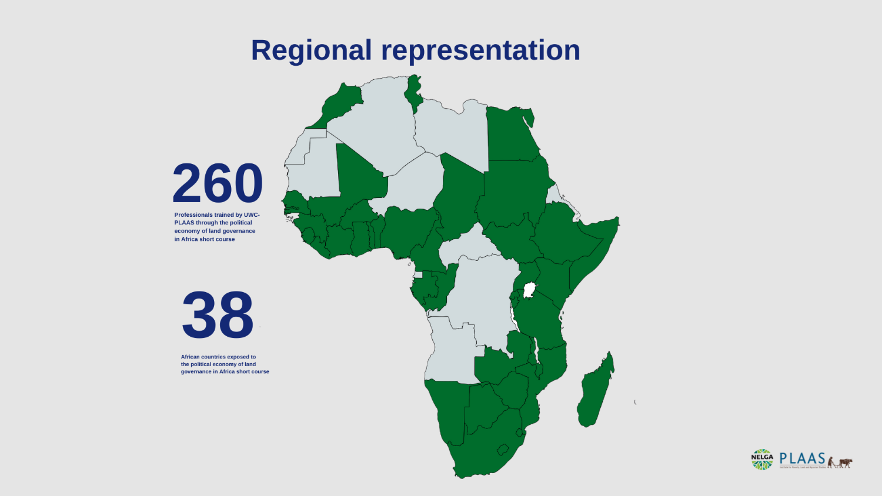
TRAINING STATISTICS

Slide 13
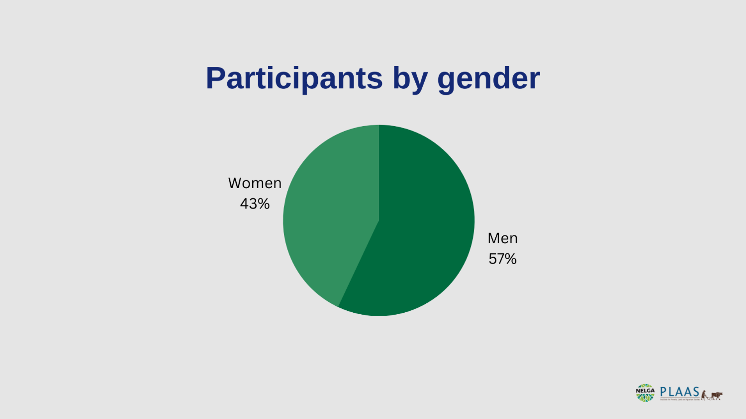
TRAINING STATISTICS

Slide 14
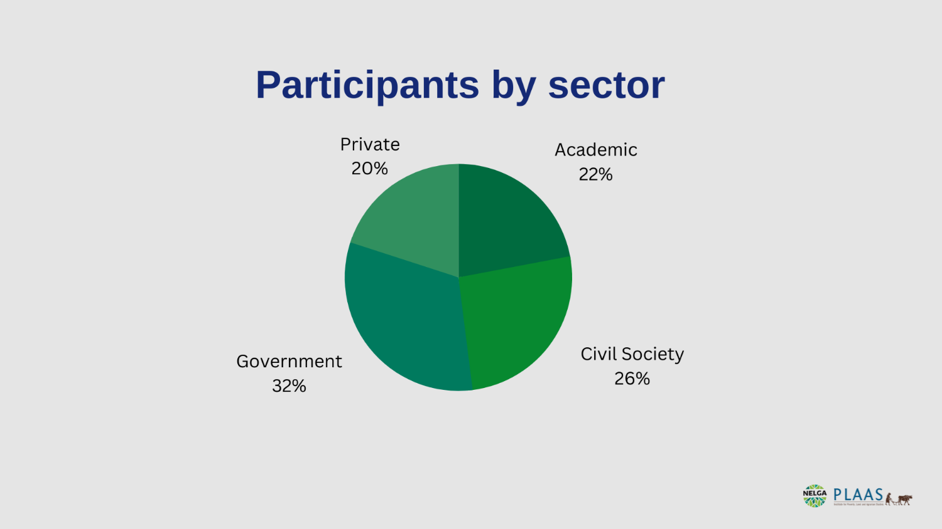
TRAINING STATISTICS

Slide 15
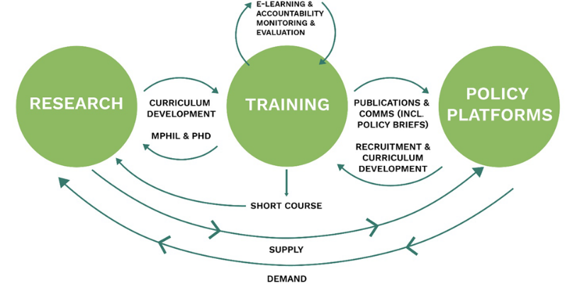
THEORY OF CHANGE

Slide 16
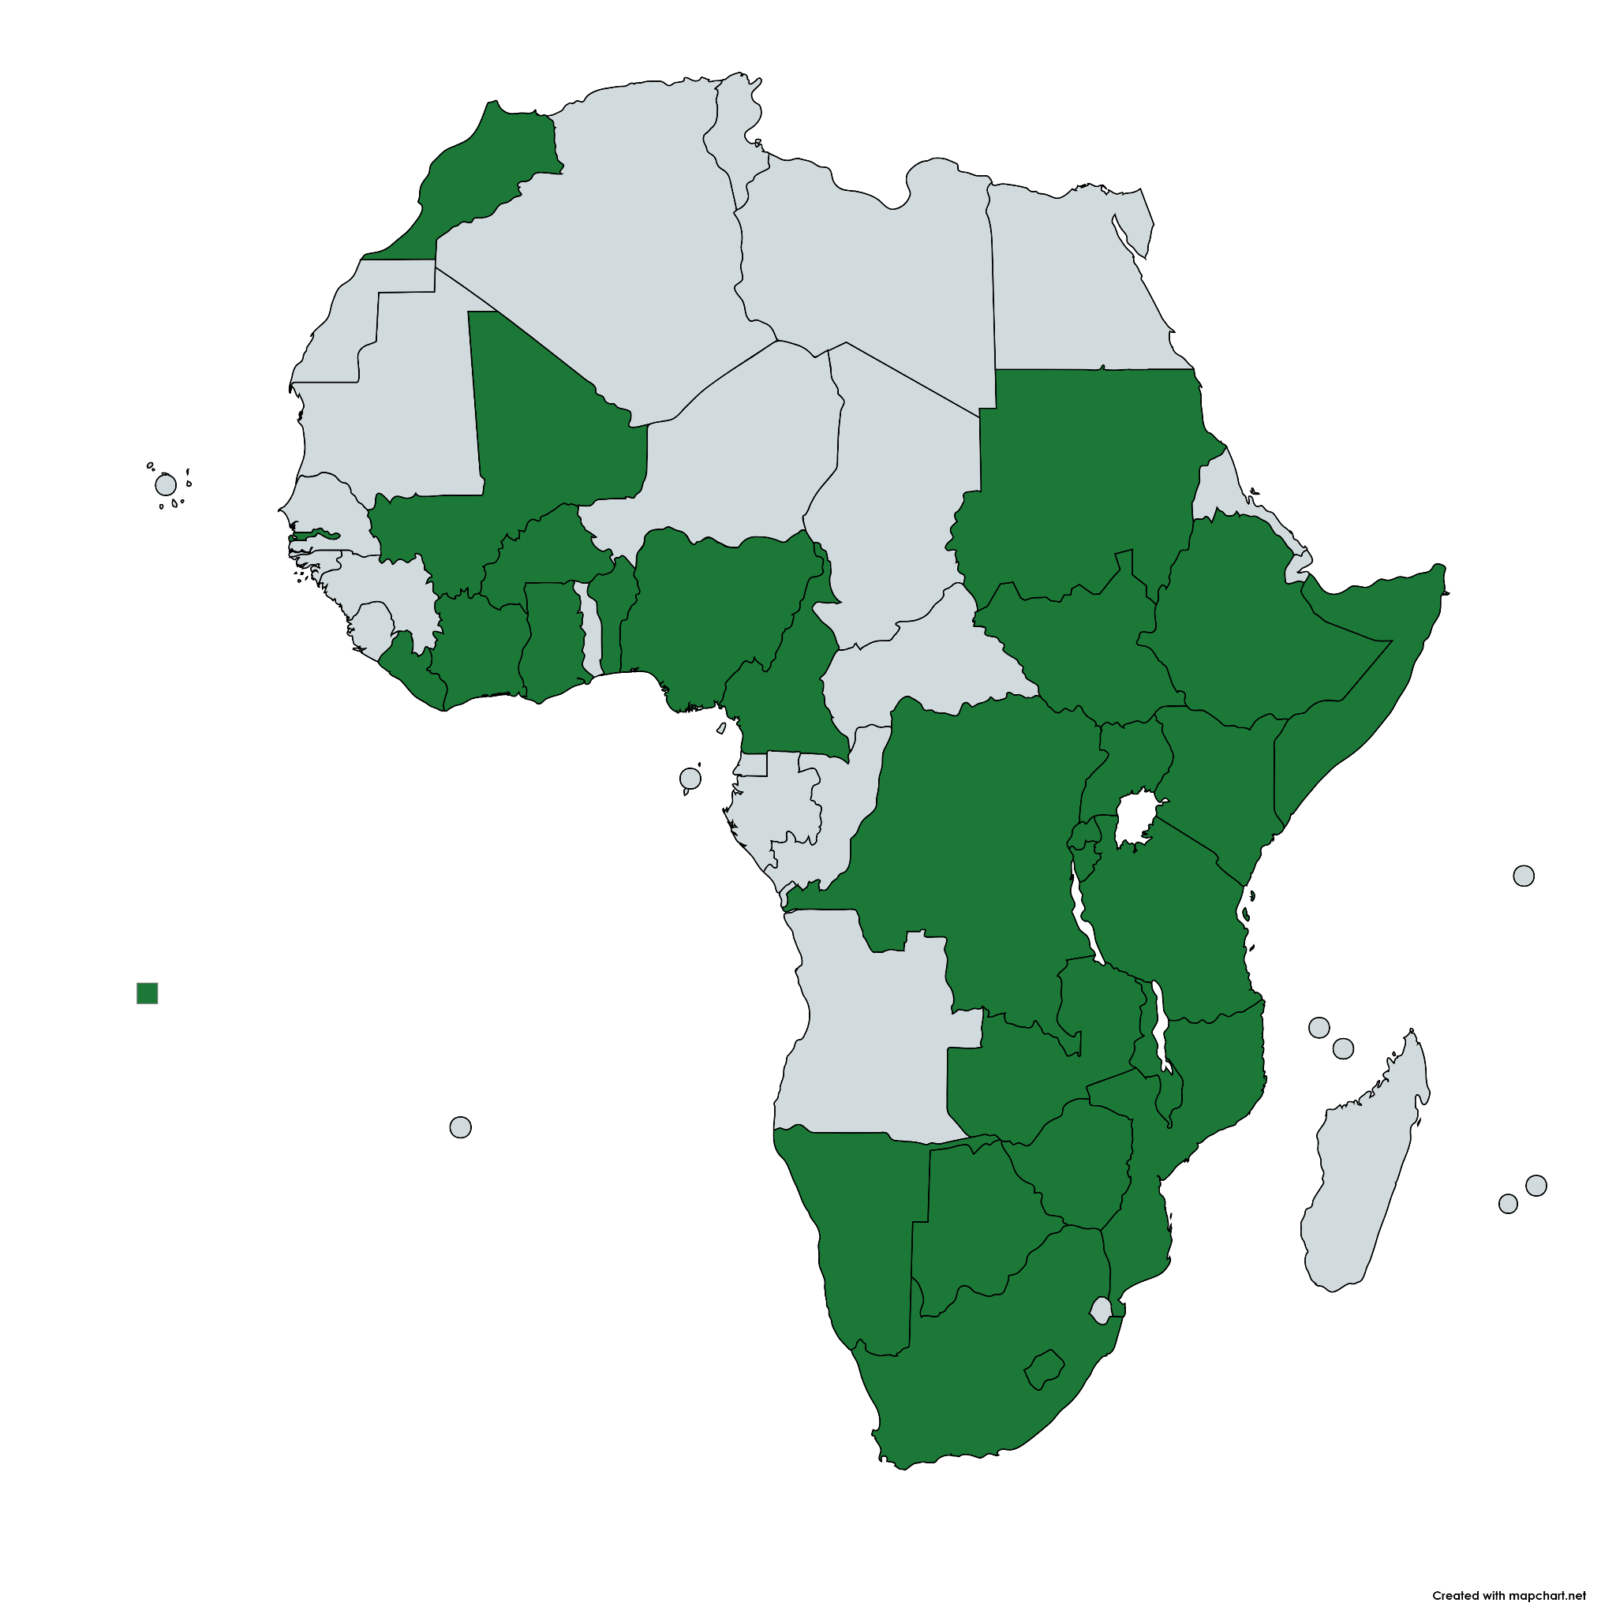
THIS YEAR’S COHORT
82 land professionals
across
28 African countries

Slide 17
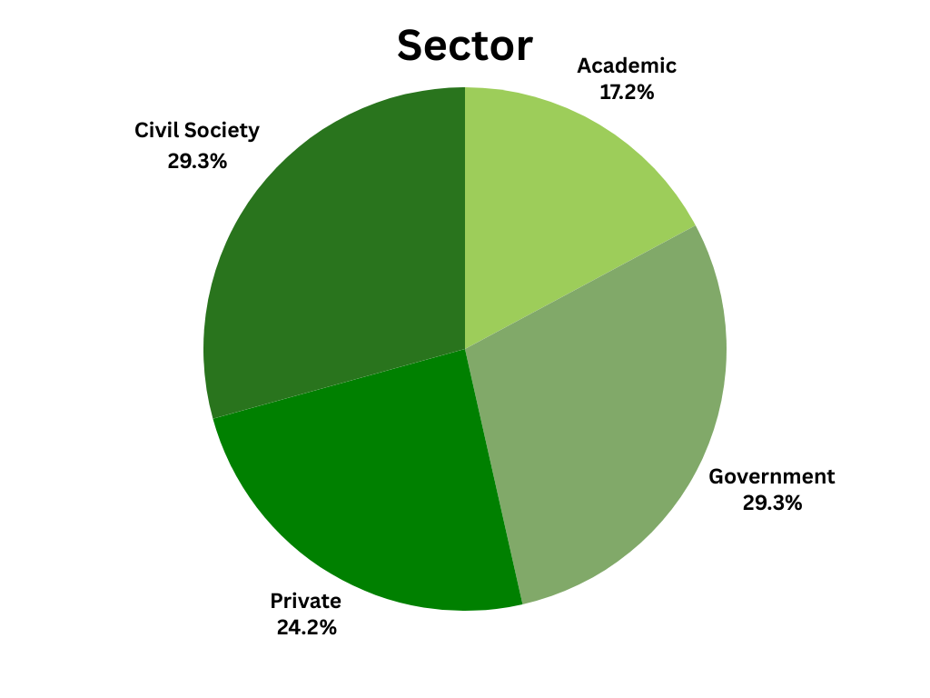
THIS YEAR’S SECTORAL PROFILE

Slide 18
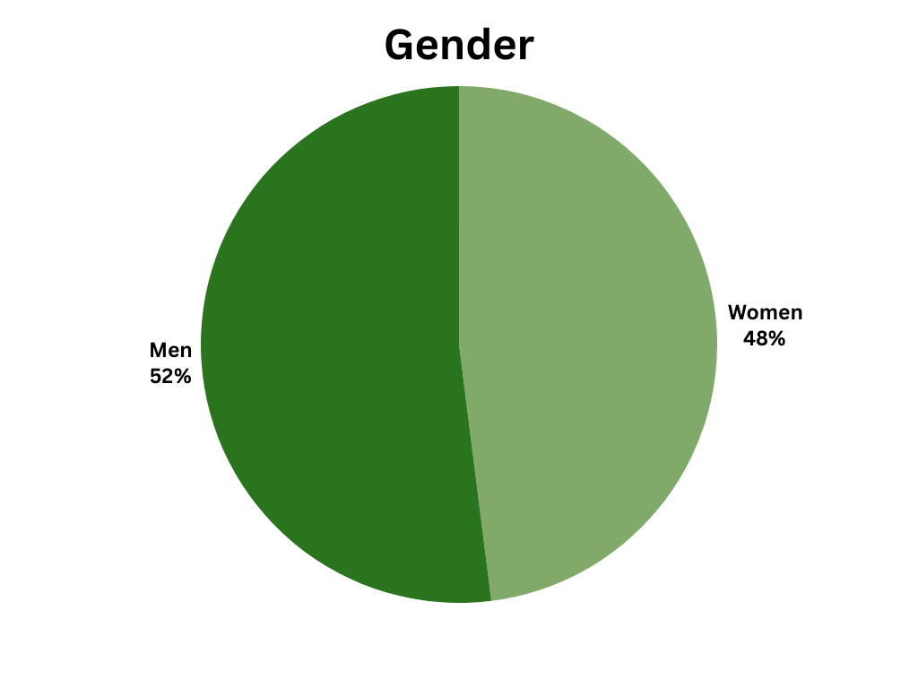
THIS YEAR’S GENDER PROFILE

Slide 19
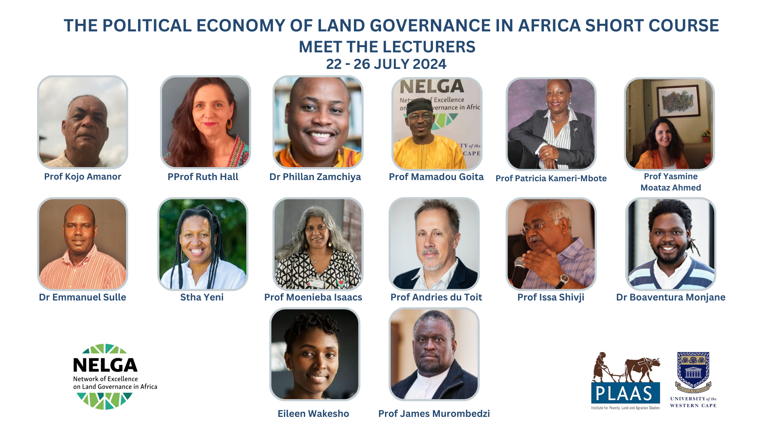
MEET THE LECTURERS

Slide 20
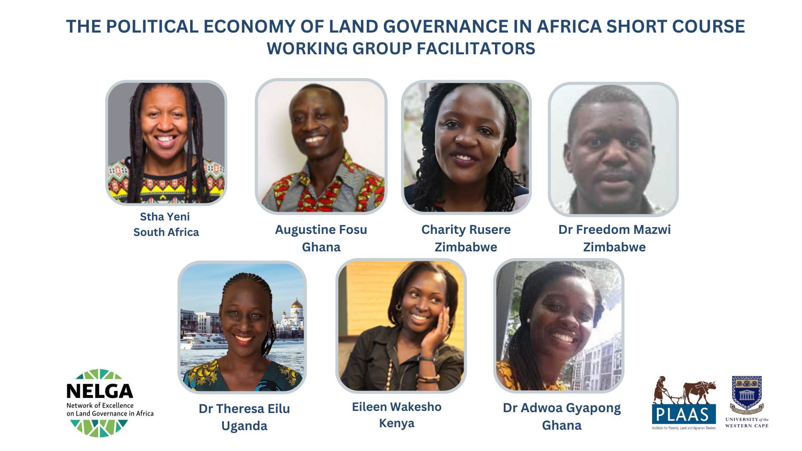
MEET THE FACILITATORS

Slide 21
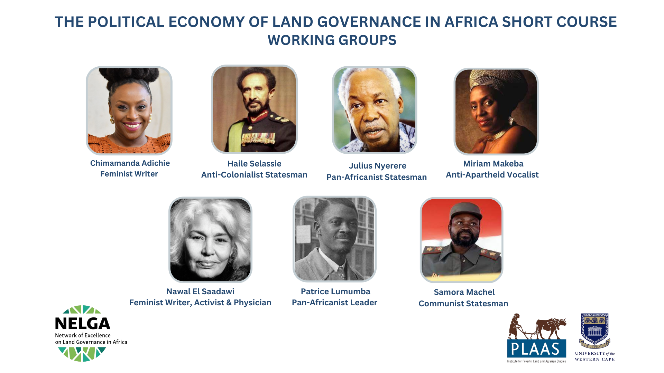
Working Groups

Slide 22
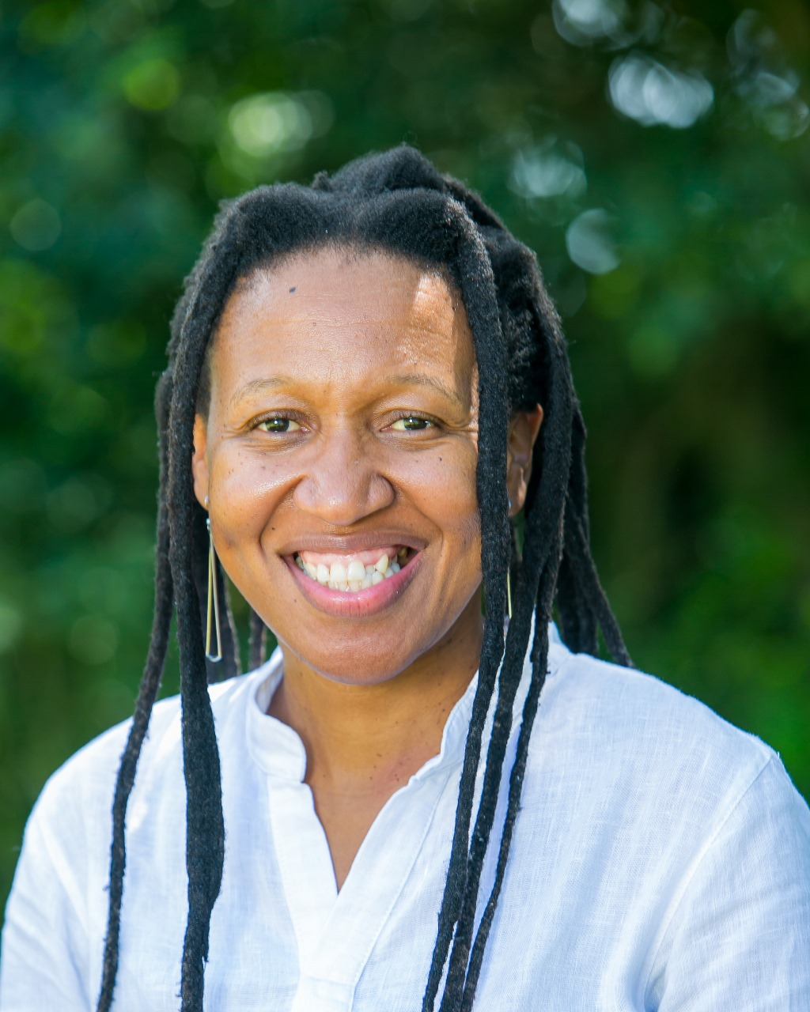
Group 1: Chimamanda Adichie
Alrich Adelin Mahoukpo (Benin)
Baboloki Semele (Botswana)
Zulfatu Umar Faruk (Nigeria)
Abraham Magsiah Adongo (Ghana)
Petit Patrick Ahishakiye (Burundi)
Ahmed Abdillahi Abdi (Somalia)
Lewis Mweu (Kenya)
Enos Denhere (Zimbabwe)
Samantha Chimombe (Zimbabwe)
Jessica Olouch (Kenya)
Genet Kelem (Ethiopia)
Florence Ofosu Aburam (Ghana)
Facilitator: Stha Yeni, South Africa

Slide 23
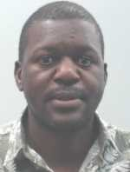
Group 2: Haile Selassie
Ikanyeng Gaodirelwe (Botswana)
Youssouf Mathias Ouattara (Burkina Faso)
Joseph Sarpong (Ghana)
Abel Sainda (Mozambique)
Linda Ruben (Namibia)
Owen Dhliwayo (Zimbabwe)
Godsway Agbeli (Ghana)
Demeke Sewnet Ayele (Ethiopia)
Sharon Nzuki (Kenya)
Susan Akello (Uganda)
Mariam Diakite (Mali)
Soini Nangula (Namibia)
Facilitator: Freedom Mazwi, Zimbabwe

Slide 24

Group 3: Julius Nyerere
James Kai Maker Duol (South Sudan)
Mark Boahndao (Liberia)
John Magombo (Malawi)
Ter Manyang Gatwech (Sudan)
Ronald Murungi (Uganda)
Godiramang Motlhagodi (Botswana)
Charles Kofi Menlah (Ghana)
Prisca Obomele Nsiah (Ghana)
Nnam Solange (Cameroon)
Pemphero Chinseu Banda (Malawi)
Samekelisiwe Nqayi (South Africa)
Facilitator: Eileen Wakesho, Kenya

Slide 25
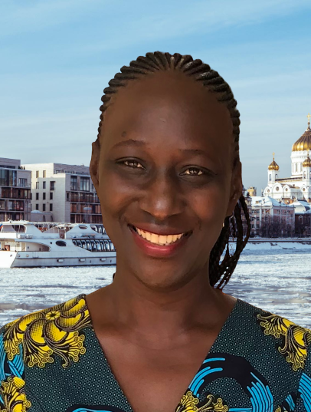
Group 4: Miriam Makeba
Workat Sebnie (Ethiopia)
Rexford Newton-Akpor (Ghana)
Ngadi Edjienguele Sylvie (Cameroon)
Esther Choima Ajah (Nigeria)
Tulipohamba Bevenalius Jason (Namibia)
Eunah Siapenga (Zambia)
Mastewal Yami Degefa (Ethiopia)
Agbor Tabe (Cameroon)
Hazel Tariro Chimbiro (Zimbabwe)
Alhagie Haruna Cham (Gambia)
Akibu Abdulai (Ghana)
Facilitator: Theresa Auma, Uganda

Slide 26
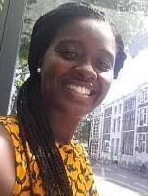
Group 5: Nawal El Saadawi
Ndumiso Camngca (South Africa)
Mercy Masanga (Tanzania)
Sandra Matendere (Zimbabwe)
Gashaw Goshem (Ethiopia)
Rebecca Chepkemboi (Kenya)
Bedu Mambo (Botswana)
Abdihakim Osman Ali (Somalia)
Alain Parfait Ngulungu (DRC)
Cathbert Tomitho (Tanzania)
Joseph Niyomukiza (Rwanda)
Comfort Naadu Nartey (Ghana)
Shastelle Philander (South Africa)
Facilitator: Adwoa Gyapong, Ghana

Slide 27
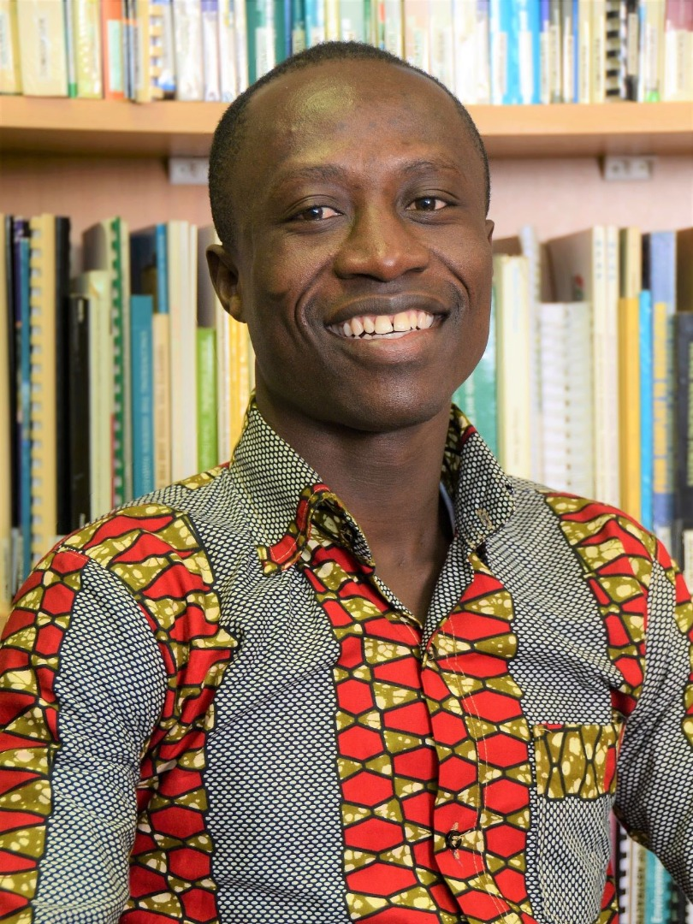
Group 6: Patrice Lumumba
Michael Mutale (Zambia)
Cecilia Owusu (Ghana)
Elvis Munetsi (Zimbabwe)
Adelaide Auma Ombudo (Kenya)
Bulus Sunday (Nigeria)
Bridget Masikati (Zimbabwe)
Mpho Lebelo (South Africa)
Isidro Macaringue (Mozambique)
Birtukan Fikadie Mesfin (Ethiopia)
Poloko Mokbocho (Lesotho)
S’phamandla Mchunu (South Africa)
Diom Jasper Yam (Cameroon)
Facilitator: Augustine Fosu, Ghana

Slide 28
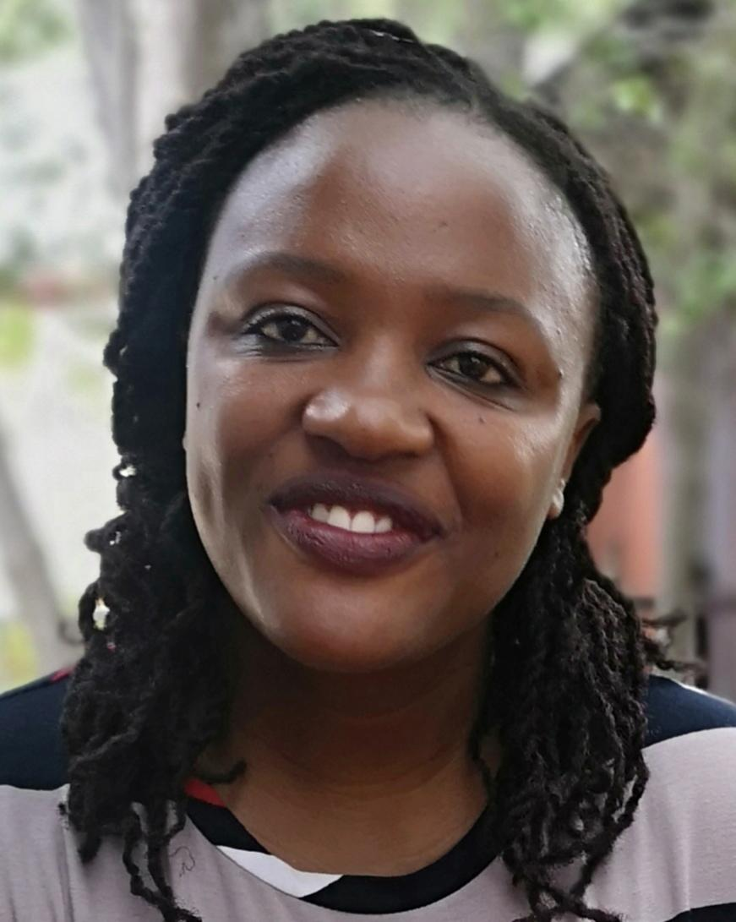
Group 7: Samora Machel
Eiltruder Makupa (Tanzania)
Delphine Ekpang (Nigeria)
Lassana Kone (Cote d’Ivoire)
Carolyne Tumuhimbise (Uganda)
Shumirai Guzha (Zimbabwe)
Vincent Moses (Malawi)
Chenayi Mnangagwa (Zimbabwe)
Mogae Makonyela (Botswana)
Mohamed El Mehdi LAAS (Morocco)
Abel Molla (Ethiopia)
Mannete Makhetla (Lesotho)
Godfrey Rammoi (South Africa)
Facilitator: Charity Rusere, Zimbabwe

Slide 29


WELCOME
AND ENJOY NELGA 2024
Hashtag: #landgovernance
Handles: @NELGA_AU | @PLAASuwc | @UWConline |
@ECA_OFFICIAL| @giz_gmbh

