Slide 1

2027 PROGRAMME PLAN
Reference No. XX
Said Adejumobi,
Director,
Strategic Planning, Oversight and Results Division (SPORD)
March 2026
2026

Slide 2









ADAPTING TO A FAST-EVOLVING AND CHALLENGING CONTEXT
GUIDING FRAMEWORKS
Global complexity and tightening resources call for greater agility, coherence, and responsiveness across the UN system (UN80).
Persistent fiscal constraints & tightening financing conditions
Climate vulnerabilities, food insecurity & energy transitions
Accelerating technological change and digital connectivity needs
Social pressures around jobs, demographics, youth & inclusion
Need for integrated regional responses to cross-border challenges
MANDATE
ECA’s primary mandate is to promote the economic and social development of its member states, foster intra-regional integration, and to promote international cooperation for Africa’s development. Derives from ECOSOC resolution 671 A (XXV)
ECA’S STRATEGIC FOCUS AREAS
Macroeconomic policies & development financing
Regional integration, economic diversification, and sustainable industrialization
Infrastructure development, including energy
Technology, innovation, & connectivity
Climate action and food security
Data & statistics (cross-cutting)
Social dimensions (cross-cutting)

Slide 3
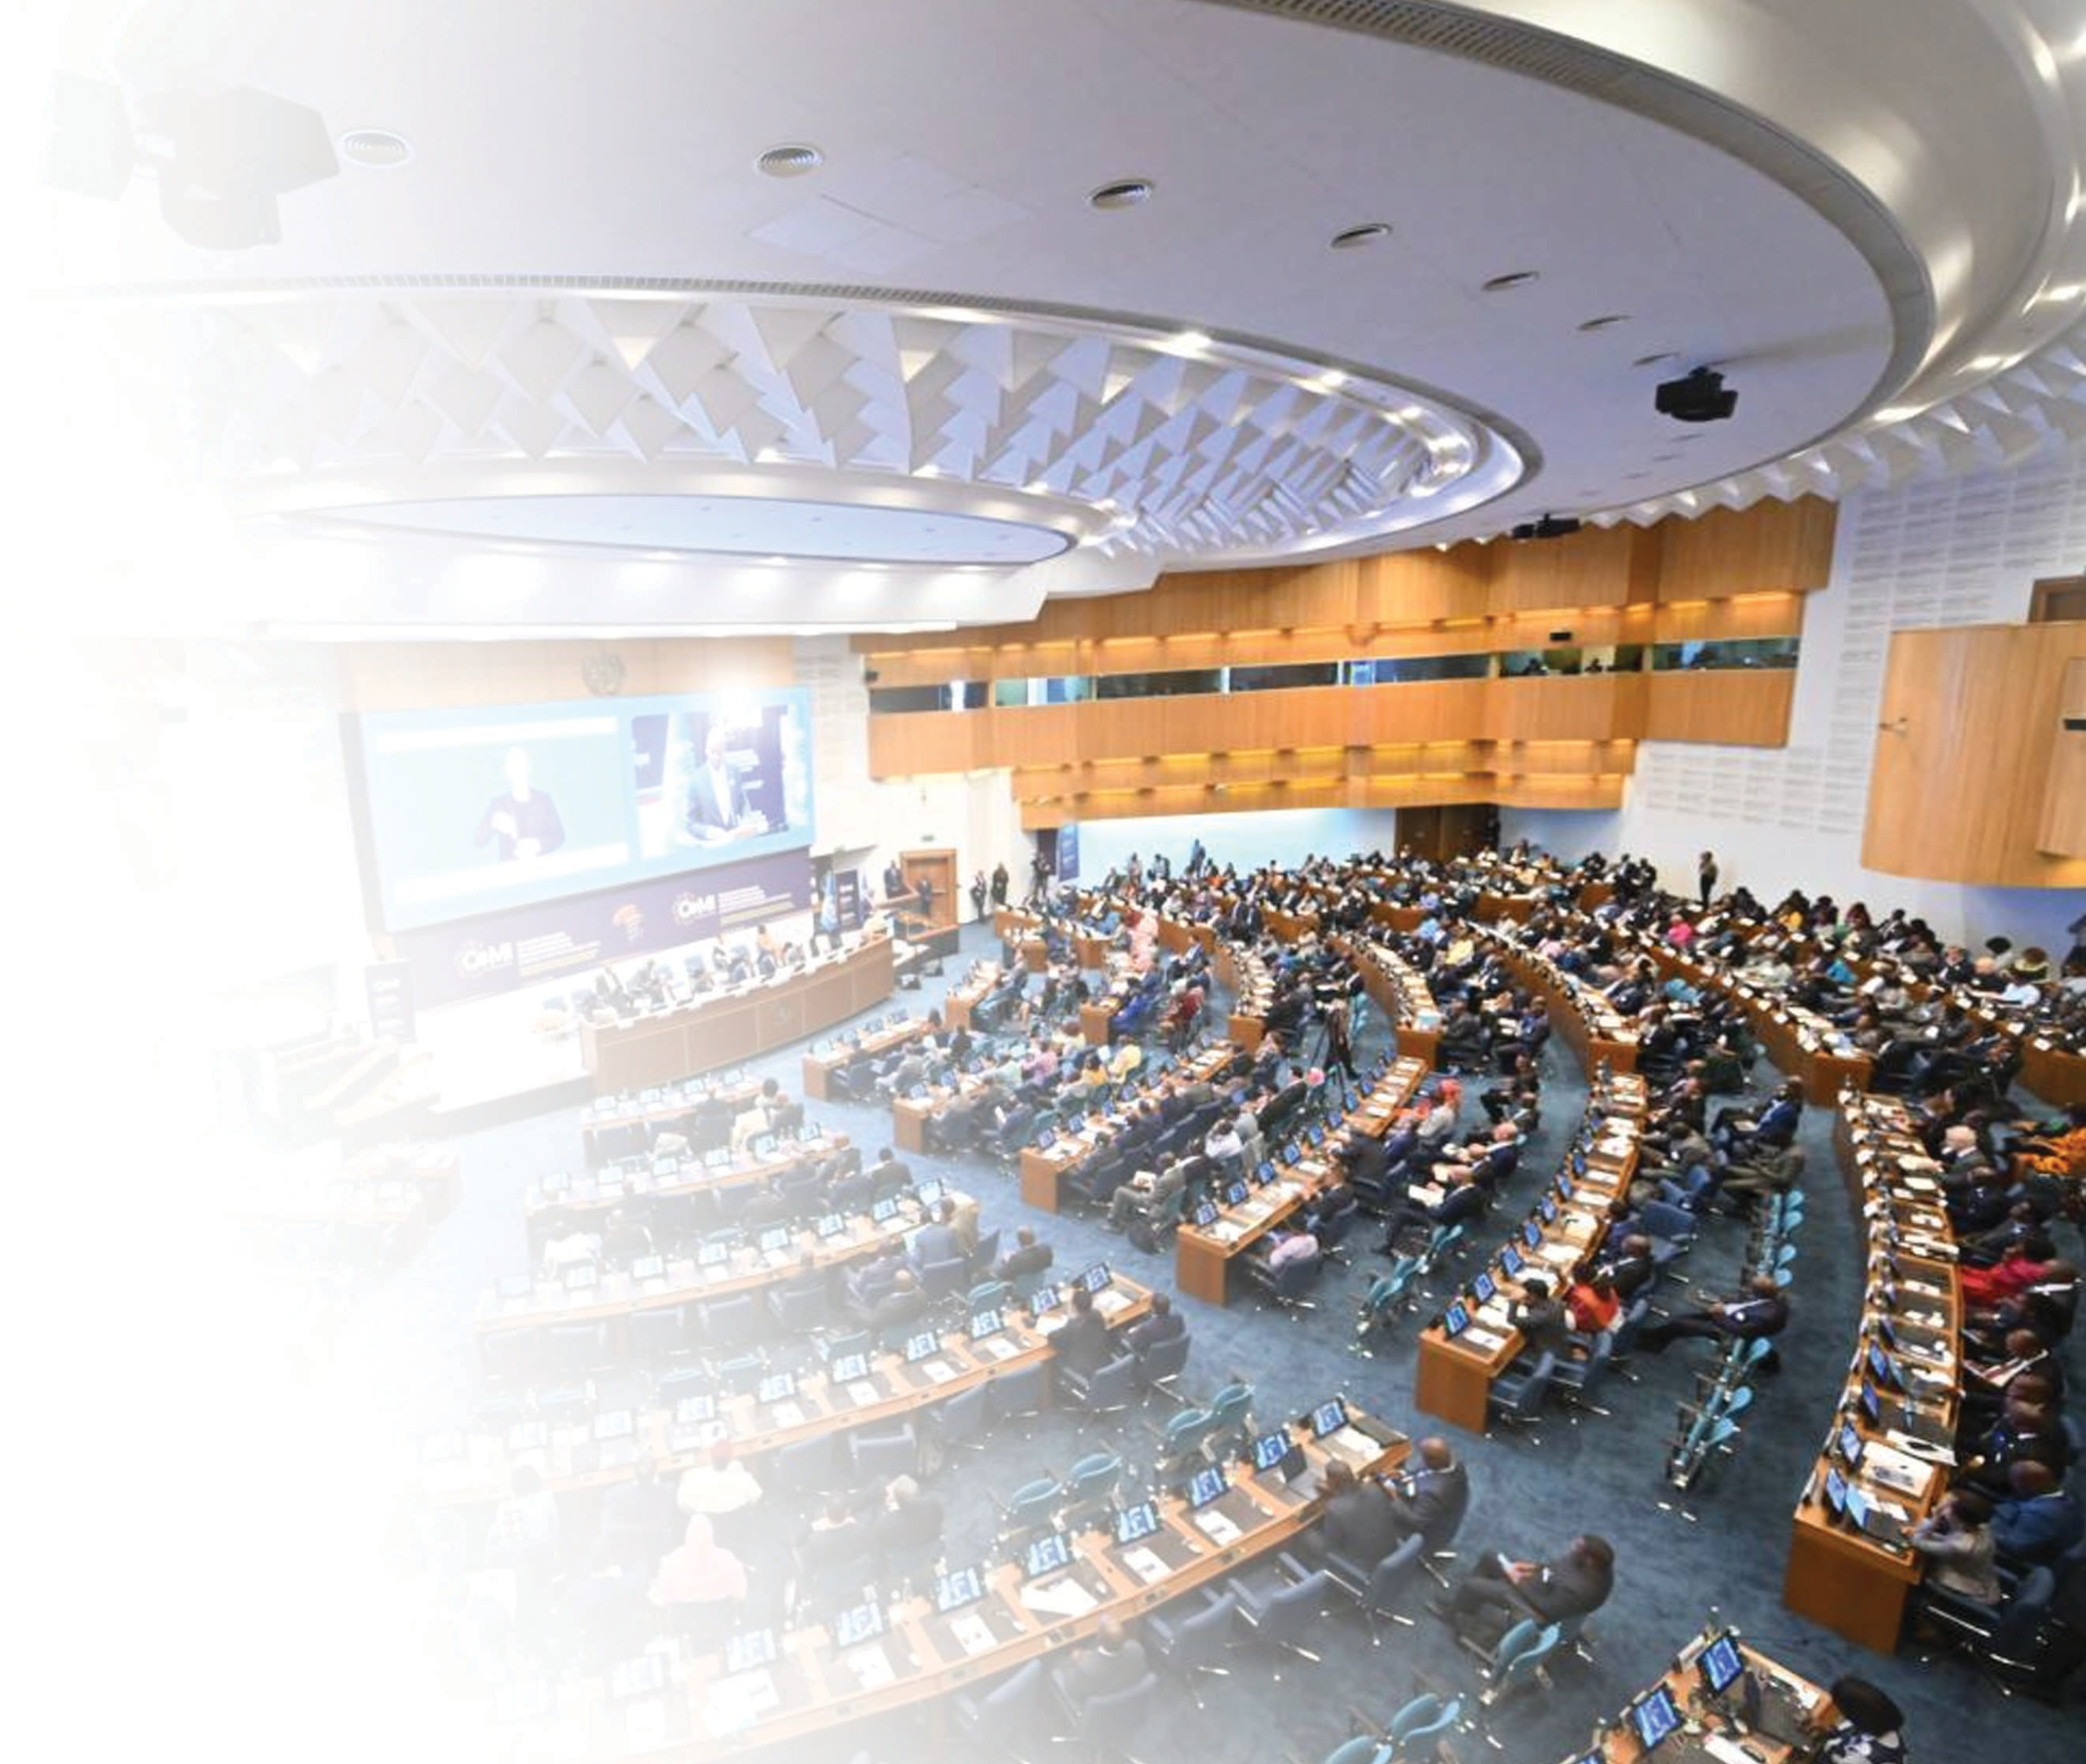







ECA’S RESPONSE TO THE EVOLVING ENVIRONMENT: PROGRAMME AND STRUCTURAL REALIGNMENTS
ECA introduced programme and structural realignments to be more agile, coherent, and responsive under UN80, as welcomed by the General Assembly.
The former Gender Equality and Women Empowerment of SP6 is renamed as Economic Empowerment of Women and Youth
The former Poverty and Socio-Economic Policy of SP9 is renamed as Poverty and Socio-Economic Policy
The urbanization workstream of subprogramme 9 is merged with the development planning workstream of subprogramme 1
The Division of Administration (DoA) and the Division of Publications, Conference and Knowledge Management (PCKMD) are consolidated to form a new Administration and Conference Management Division (ACMD)
The Knowledge Management Services Section (KMSS) of PCKMD has been moved to the Strategic, Planning, and Oversight Division
Sections within divisions and SROs are streamlined to improve coherence and reduce fragmentation

Slide 4

ECA’S RESPONSE TO THE EVOLVING ENVIRONMENT: INTERVENTIONS
In response to the fast-evolving and challenging context, ECA is delivering more agile, coherent, and impactful support to its member States by:
Promoting innovative financing (e.g. capital market development and climate financing) & stronger domestic resource mobilization
Tackling Debt, IFFs, and reforming the unjust and lopsided global financial architecture
Promoting regional value chains to accelerate growth, industrialization and transform African economies
Accelerating the implementation of the AfCFTA as driver of rapid economic development and regional integration in Africa
Delivering an integrated regional response to cross-border challenges
Driving digital transformation & infrastructure including energy & closing data gaps for decision-making
Advancing climate resilience & food security
Empowering women and youth and other marginalized groups and facilitating social inclusion
Stronger African voice and presence in the global arena and delivering tailored regional solutions & strengthening partnerships
Subregional & country focus + stronger UN and institutional coordination
01

Slide 5



























SNAPSHOT OF THE 2027 PROGRAMME PLAN
STRATEGIC ORIENTATIONS: Through collaborative efforts with Member States, development partners, and the UN, the 2027 Programme Plan aims to support the successful implementation of shared development goals with tangible impact at the regional, sub-regional, and country levels.
Macroeconomic Policy, Finance & Governance
Data & Statistics
Mobilize domestic/international, public/private resources by deepening domestic capital markets and deploying innovative, sustainable financing solutions.
Track progress in the implementation of the 2030
& 2063 Agendas, strengthen macroeconomic planning tools Improve tax systems & sovereign rating governance
Advance integrated statistical and geospatial frameworks Improve civil registration and vital statistics systems Expand harmonized, accessible data platforms
Climate Change, Food Security & Natural Resources
Regional Integration & Trade
Adopt sustainable trade strategies
De-risk investments in regional value chains & SEZs Improve the enabling environment for private sector participation in intra-African trade under the AfCFTA
Adopt frameworks for sustainable natural resources Advance resilient & inclusive agrifood systems Enhance climate ambition, investment & action
Technology, Innovation, Connectivity & Infrastructure
Women & Youth Empowerment
Digitalization & Digital Public Infrastructure Energy access & transition Transport/logistics modernization
Gender/youth mainstreaming in policies Improve financial inclusion of women Support for women- and youth led MSMEs

Slide 6


SUBREGIONAL ACTIVITIES (NORTH, WEST, CENTRAL, EAST, SOUTHERN AFRICA)
North Africa: Inclusive growth and sustainable development
West Africa: Demographic dynamics for development
Central Africa: Economic diversification policy and reforms
East Africa: Deepening regional integration – towards the implementation of AfCFTA
Southern Africa: Inclusive industrialization
Economic Development and Planning
Strengthen future-ready planning systems
Improve inclusive development policies, i.e., macroeconomic and social protection
Reskilling and upskilling public sector workforces
Poverty and Socioeconomic Policy
Support social protection systems
Advance inclusive social development policies
Support employment programme
Conclusion
The 2027 programme Plan reflects ECA’s realigned programme of work
Responds to Africa’s emerging macroeconomic and social issues, including on frontier technologies and climate
Reinforces internal and external institutional joint planning and implementation
Strengthen overall coherence between programme planning and budgeting, also through a Medium-Term Programme Plan and Resource Mobilization Framework (work in progress)

Slide 7
THANK YOU
06

