Slide 1

Outcome of the 6th Session of the Committee on Social Policy, Poverty and Gender (No. E/ECA/COE/44/14) Zuzana Schwidrowski Director, Socio-Economic Development Division [3/27/2026]

Slide 2
Outcome of the 6th Session of the Committee on Social Policy, Poverty & Gender
The 6th Session of the Committee on Social Policy, Poverty and Gender was held by the SEDD/ECA from Nov. 26–28, 2025, in Addis Ababa, Ethiopia.
Theme: From informal employment to sustainable livelihoods: emerging technologies as pathways for an equitable transition
Participation from 36 ECA member States with observers from AUC. Discussions focused on:
Employment, with focus on youth employment and sustainable urbanization
Poverty reduction, with focus on multidimensional poverty, and social protection
Gender equality and women’s economic empowerment
Recommendations adopted by the Committee are submitted to the Conference of African Ministers of Finance, Planning and Economic Development

Slide 3
WSSD2 (2025): Key Messages & Implications for Africa
Global Shift: From commitments to implementation; focus on equity, inclusion, and decent work, accountability, and financing for inclusive development
Core Priority Outcomes: Poverty reduction & social protection, decent work & jobs, human capital (health & education), social inclusion
Cross-cutting enablers: Gender equality, youth empowerment, digital inclusion, informal economy transitions
Emerging Narratives: Ageing as an innovation opportunity, alongside youth participation and agency and expanded digital inclusion.
Implications for Africa: Focus on youth boom, high & persistent informality, need for inclusive and climate-resilient economic transformation
Opportunities: Digital transformation, AfCFTA, remittances, stronger global voice
Bottom Line: Turn commitments into inclusive, youth-centered, job-rich, and resilient action

Slide 4
Africa’s Notable Socio-Economic Achievements
Policy Momentum: AUC 10-Year SSE Strategy + Africa Youth Strategy
Global Thought Leadership: South Africa’s G20 Presidency (2025) elevated equity, solidarity, and sustainability—embedding social and inclusive development in global economic policy
Global Practice Leadership: Africa emerging as leader in community-driven development models
Jobs & Inclusion: Social enterprises creating large-scale youth and women employment (e.g., Kenya, Nigeria, South Africa)
Innovation: Digital tools are transforming agriculture, markets, & strengthening resilience
Health Gains: Expanded access & improved outcomes via tech-enabled systems (e.g., HIV/TB care)
Education Progress: Increased access, digital learning, and youth skills development

Slide 5
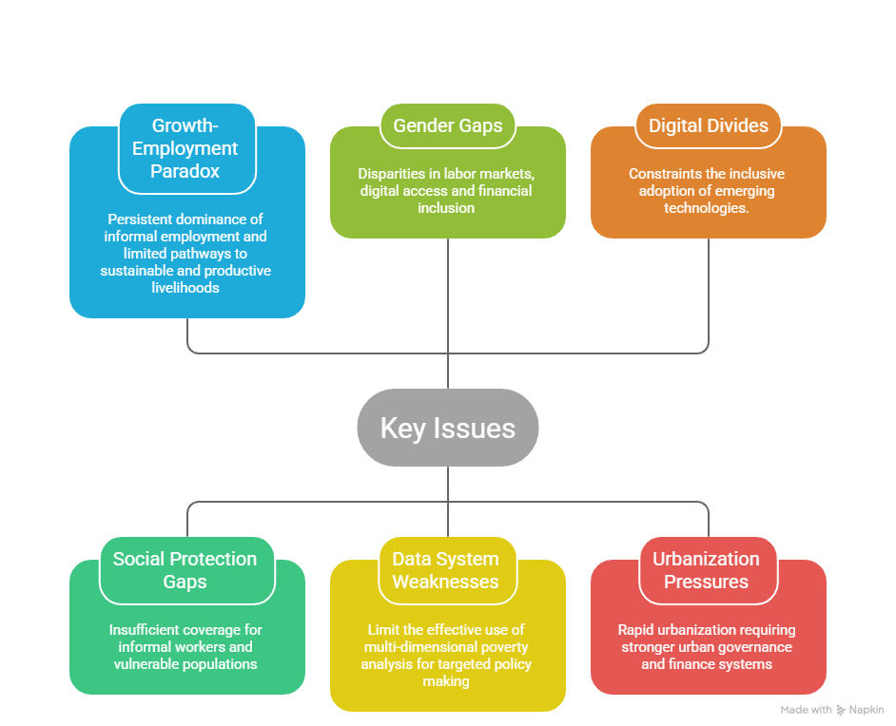
Key Policy Issues Emphasized in Committee Discussions (Visual)

Slide 6
Africa’s Youth Bulge – Labor Market Pressure & Opportunity
Youth Bulge
Africa’s population, by age (mln)
~60% of population under age 25
~32% aged 10–24 (~200+ million)
Median age ≈ 19 years
Youth population set to double by 2063
Each age cohort (15 – 35)includes tens of mlns
→ Massive & growing pressure on labor market

Slide 7
ECA conceptual framework for equitable transition pathways towards sustainable livelihoods
Informal Employment
Sustainable Livelihoods
Value-added sectors
Formalisation
Digital equity
Upskilling/reskilling
Standard of living
Representative institutions
Strong social contracts
Decent work and productive employment and enterprise
Low- (value, productivity, skills, wage)
Precarious livelihoods/ vulnerability to shocks
Working poor/time poverty
Fragmented labour markets
Inclusive/universal access to services and infrastructure
Capital assets (human, social, physical, natural, financial)
Resilience to shocks and stresses and coping capacity
Exclusion/exploitation/ discrimination
Emerging Technologies
Technology diffusion
Industrial leapfrogging
New jobs and markets
High social mobility
Low social mobility
Challenges to asset ownership

Slide 8
Toward Gender-Equal Labour Markets in Africa
👥
📉
🏪
Labour Force Participation
Unemployment
Informality
Women's access to employment
Joblessness and exclusion
Vulnerable work conditions
Headline Messages
⚠️
Women remain disadvantaged across all labour market dimensions
🌍
Regional disparities demand tailored interventions
🔄
Informality and unemployment exacerbate exclusion

Slide 9
Interconnected pathways to women's economic empowerment in Africa
Why These Three Pillars Matter
💼
💻
💰
Employment
Digital Inclusion
Financial Inclusion
89%
23%
48%
of African women remain in vulnerable informal jobs despite decent work providing income and economic independence
gender gap in internet usage excludes millions from digital economy opportunities in education, markets, and entrepreneurship
of African women have formal account access enabling savings, credit, and business growth

Slide 10
Key Recommendations to Member States
Mainstream multidimensional poverty indices into national planning and budgeting and link them with social protection databases and registries
Scale up digital social protection systems, including digital identification, harmonized social registries and mobile payment platforms
Invest in digital infrastructure, STEM education and technical and vocational training to better align skills with labour-market needs
Align youth employment and entrepreneurship strategies with continental frameworks, including Agenda 2063, the AfCFTA and the African Youth Charter
Strengthen women’s economic empowerment policies, including access to finance, digital connectivity and entrepreneurship support
Strengthen urban governance and municipal finance systems to support inclusive and sustainable urban development

Slide 11
Key Recommendations to ECA
Strengthen analytical work, policy advice and capacity-building to support MSs in poverty reduction, decent job creation, reducing inequality, strengthening social protection and urbanization
Provide technical assistance to improve national data systems, including multidimensional poverty measurement and subnational data collection
Support the development of interoperable digital systems for social protection, urban data platforms and evidence-based policymaking
Strengthen gender monitoring and reporting systems, including support for the institutionalization of the African Gender and Development Index
Facilitate peer learning and knowledge-sharing platforms on gender equality, urban governance, job creation and entrepreneurial development
Support MSs in implementing the Doha Political Declaration, including developing a common African position on social development and aligning national policies with global commitments

Slide 12
Next Steps
Advance the development of a common African position on socio-economic development, with the AUC and pan-African institutions
Support Member States in implementing the Doha Political Declaration, and reporting on progress to advance its commitments,
Strengthen collaboration between ECA, MSs & regional partners to support implementation of the Committee’s recommendations, including through
Strengthened analytical work and knowledge products on youth employment, poverty reduction, migration, urbanization and social protection
Scaled-up regional peer learning and policy dialogue platforms to share best practices across African countries

Slide 13


Slide 14
Context and Focus of the Session
Sixth session of the Committee on Social Policy, Poverty and Gender held in Addis Ababa, 26–28 November 2025
Theme: “From informal employment to sustainable livelihoods: emerging technologies as pathways for an equitable transition”
Participation of 36 ECA member States, with observers from the African Union Commission, the World Meteorological Organization and civil society
Agenda included expert group discussions on:
Subprogramme 6 – Gender equality and women’s empowerment
Subprogramme 9 – Poverty, inequality and social policy
The Committee received a briefing on the Second World Summit for Social Development (Doha, 4–6 November 2025)
Recommendations adopted by the Committee are submitted to the Conference of African Ministers of Finance, Planning and Economic Development

Slide 15
<< Add title here >>
25
20
15
10
5
0
Insert Pictures/Imagery
Title A
Title B
Title C

Slide 16
Key Socio-Economic Challenges Emphasized in Committee Discussions
Lack of Decent Employment Opportunities, especially for Youth: Economic growth is not translating into sufficient job creation, limiting the growth of sustainable and formal employment. Youth unemployment, working poverty and high NEET remain a key challenge
Insufficient coverage and integration of social protection systems, particularly for informal workers and vulnerable populations
Persistent gender gaps in labour markets, digital access and financial inclusion, compounded by the burden of unpaid care work (Graphs)
Digital divides in infrastructure, skills and connectivity, constraining the inclusive adoption of emerging technologies
Rapid urbanization and displacement pressures, requiring stronger urban governance, planning and municipal finance systems
Weak and fragmented data systems, limiting the effective use of multidimensional poverty analysis for policymaking and targeting

