Slide 1


AFRICAN INSTITUTE FOR ECONOMIC DEVELOPMENT AND PLANNING
(IDEP) 2025 Activity Report
(Document Reference No. E/ECA/COE/44/15)
Karima Bounemra Ben Soltane
IDEP Director

Slide 2
The context
Challenging circumstances worldwide
> Polycrisis
Africa’s united voice
> Regional integration
Locally-made solutions
> Reliance on domestic resources
> Call to reinforce African countries’ capacity
to plan, implement and assess
their development
Collegially
Individually
> Paradigm shift
Immediate solutions and actions
Long term perspective
Approach

Slide 3







IDEP's Strategic Repositioning from training center
2026-2030 to operational policy support instrument
2026–2030
African Institute for
Economic Development
And Planning
A structurally transformed and prosperous Africa driven by its own skilled people
STRATEGIC FRAMEWORK
2026 - 2030
For a
Structurally transformed and prosperous
Africa driven by its own skilled people
African Institute for
Economic Development
And Planning
STRATEGIC FRAMEWORK
2026 - 2030
For a
Structurally transformed and prosperous
Africa driven by its own skilled people
Strategic Framework
2026-2030
Theory
of Change
Co-creation
One ECA
Continental anchoring
Shift in model
Input from TAC
Adopted by IDEP
Governing Council
6 pillars:
development financing
regional integration
social inclusion
natural resources & climate
infrastructure, digital transformation
Fragmented training
Integrated capacity development approach
Applied research
Policy advisory
Training
technical frameworks
national validation
implementation
Hackathons
technical workshops
cross-sector policy dialogues
ECA training arm
Aligned with
Agenda 2063
SDGs
Pact for the Future

Slide 4
2025 Results: Key Figures
34
Training activities delivered
Delivery modalities: In-person, online, hybrid
>> more interactions, improved impact assessment
10 National policy frameworks supported (7 countries)
>> countries’ ownership, long lasting impact
5,325
Beneficiaries - 52 countries
1,327
Women beneficiaries- 25% of total
Demand is booming
2025 applications = 5 * 2020 applications
Increasing countries’ requests
Clear signs:
Relevance of IDEP’s offer is recognized
Quality of the knowledge material and the pedagogical approach is appreciated

Slide 5
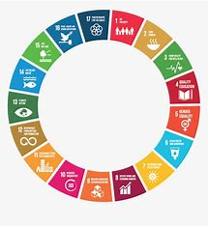
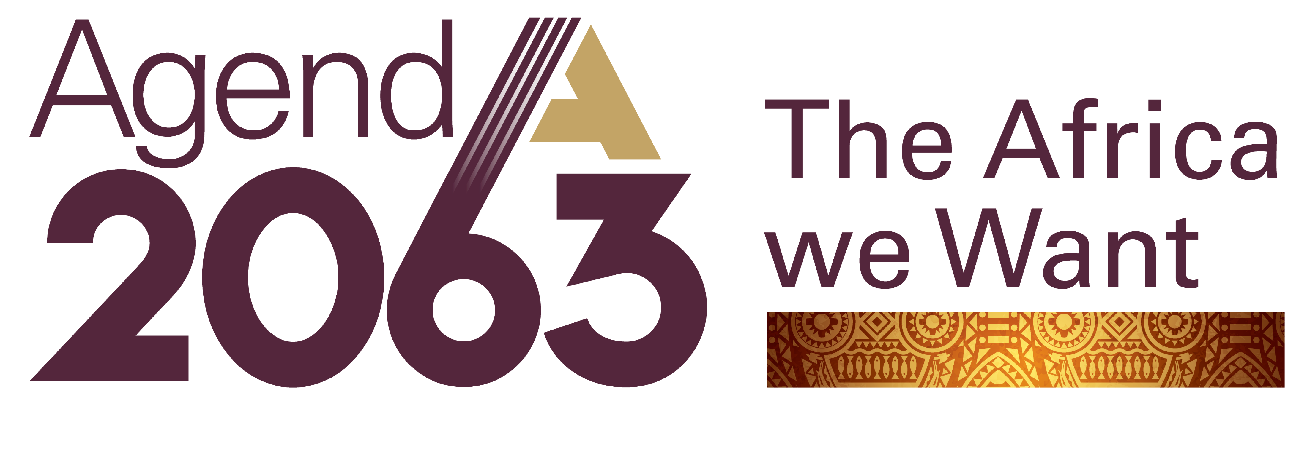



Thematic Impact: Three Main Areas of Intervention
Macro-Modeling for Sustainable Development Integrated Development Planning M&E, Accountability and Learning
Digital Technologies and Public Policies Youth Employability & Digital Economy for SMEs E-trade in the context of AfCFTA
Social Protection and the Care Economy Gender-sensitive economic policy management
Renewable energy & energy efficiency Climate change negotiations for young negotiators Structuring, Analysis and M&E of Mining Projects
Results feeding national and continental priorities
Risk Management
Social Protection & Care Economy
Future-Ready Workforce
Policy Mainstreaming of Migration Risk (Ghana)
4 national risk management strategies co-designed (Cameroon, Comoros, Malawi, Sierra Leone)
RBM, gender approach, inter-sectoral coordination integrated
1,138 decision-makers trained across 48 countries
3 national strategies co-designed (Cameroon, Senegal, Zimbabwe)
Post-training technical follow-up for budget & macro-fiscal coherence
Public administration management capacity building programme elaborated and validated by INAP Djibouti as a strategic document
Territorial planning curriculum: Senegal
Reform framework: Sierra Leone

Slide 6

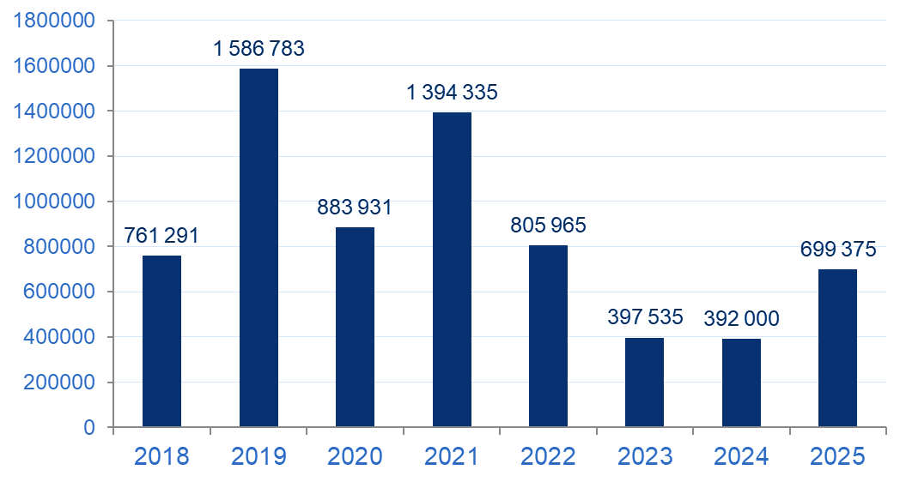

Member States support to implement IDEP SP 2026-2030
Strategic / Intellectual guidance Technical Advisory Committee
Governing Council
COM
+ regular needs assessments through surveys
Regular Financial support Member States annual assessed contributions
Member States Contributions (USD)
 | Country | Amount paid 2025
1 | Benin | 106 177
2 | Burkina Faso | 15 000
3 | Cameroon | 24 624
4 | Côte d'Ivoire | 177 378
5 | Equatorial Guinea | 10 000
6 | Namibia | 24 000
7 | South Africa | 80 000
8 | Tanzania | 142 196
9 | Zimbabwe | 120 000
TOTAL |  | 699 375
Uneven, unpredictable
22 M USD arrears
2025 Positive trend

Slide 7

IDEP new Business Model for financial sustainability
Preliminary recommendations
African Institute for
Economic Development
And Planning
IDEP Strategic Framework implementation calls for a new business model
STRATEGIC FRAMEWORK
2026 - 2030
For a
Structurally transformed and prosperous
Africa driven by its own skilled people
1
2
3
Collection of MS states annual contribution and recovery of arrears
+ collaboration within ECA for an integrated capacity development program
Hub for UN System
E.g. UN Habitat
4
5
6
Fees paying courses
Selected ones
Grants from partners
Focus on philanthropy institutions
Collaboration with MDBs
7
Endowment fund
Longer term

Slide 8



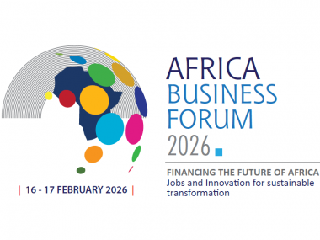
Way Forward
Opportunity to consolidate IDEP’s role as a regional capacity development hub and maximize the impact of its support to Africa’s member States
From Com to ADIF
> via ARFSD
> integrating AFB outcome

Slide 9


Thank You - Merci -

