Slide 1

Report on the ECA Subregional Offices
Intergovernmental Committees of Senior Officials and Experts (ICSOE)
(E/ECA/COE/44/16; E/ECA/COE/44/17; E/ECA/COE/44/18; and E/ECA/COE/44/19)
Eunice G. Kamwendo
Director, ECA Subregional Office for Southern Africa
Andrew Mold
Director ECA Subregional Office for Eastern Africa
March 2026

Slide 2

The Intergovernmental Committee of Senior Officials and Experts (ICSOE)
The ICSOE is statutory meeting:
Platform for strategic engagement among the member States on policy and programmatic issues of priority to each of the five subregions
Recommendations of each ICSOE are transmitted, for consideration, to the Conference of African Ministers of Finance, Planning and Economic Development
Constituted by the Commission Resolution 826 of 1977 and General Assembly Resolution 40/243

Slide 3
Dates and themes of the Sub Regional ICSOE sessions
4th Joint ICSOE for Central and Eastern Africa
31st ICSOE for Southern Africa
28th ICSOE for West Africa
40th ICSOE for North Africa
01
02
03
04
1 October 2025
30-31 October 2025
5-6 November 2025
11-13 November 2025
Held online (virtual)
Ezulwini, Eswatini (hybrid)
Niamey, Niger (Virtual)
Rabat, Morocco (hybrid)
“Investing in productive capacities and trade for a resilient future”
“Unlocking AfCFTA’s potential: building value chains and overcoming barriers to trade in Southern Africa”
“Leveraging digital technology to enhance domestic resource mobilization in West Africa”
“Enhancing domestic resource mobilization through innovation and technology in North Africa”
Attendance: 230
Attendance: 91
Attendance:
125
Attendance:
over 100

Slide 4
















Regional ICSOE Bureaus (2025-2026)
SRO-CA
SRO-EA
SRO-NA
SRO-SA
SRO-WA
CHAIR
Gabon
Uganda
Tunisia
Eswatini
Sierra Leone
VICE CHAIR
Chad
Burundi
Algeria
Malawi
Gambia
RAPPORTEUR
Sao Tomé et Principe
DRC
Egypt
Lesotho
Senegal

Slide 5



Statutory issues and selected study reports
Statutory issues
Recent Economic and Social Conditions
2025 SDG reports: Accelerating SDGs
Sub-regional Offices Activity Reports
Thematic Reports: AfCFTA implementation and economic diversification
Unlocking the potential of the AfCFTA - :building value chains and overcoming barriers to trade in Southern Africa
Advancing intraregional trade in Southern Africa through removal of tariff and non-tariff barriers
Investing in productive capacities to boost trade and enhance economic resilience in Central Africa
Thematic Reports: Macroeconomic stability and domestic resource mobilization
Leveraging digital technology to enhance domestic resource mobilization in West Africa
Implementation of sound monetary, fiscal and trade policies, control inflation in North Africa
Development of innovative and sustainable financing mechanisms and leveraging diasporas contribution by channeling remittances into long-term investments (North Africa)

Slide 6

Key development challenges
Macroeconomic Challenges
Infrastructure and energy deficits
Climate shocks, insecurity & Geopolitical tensions
GDP growth rate – robust but uneven across subregions (2024) with an improved outlook for 2025-2026.
High Debt Burdens: across all sub-regions impacting FDI, exchange rates and overall macroeconomic stability.
Persistent Inflationary pressures (West and Central Africa) with moderate inflation pressures (East and Southern Africa). Food and energy prices induced.
Global Trade Shocks: recent US trade tariff increases impacting economic prospects
Significant energy deficits - impacting industrialization, economic growth and human development.
Persistent supportive Infrastructure deficits (transportation, ICT etc) to support trade and regional integration.
Low Digitalization: constraining domestic resource mobilization and undermines public financial management.
Low economic diversification: undermining sustainable socioeconomic development.
Persistent security risks (e.g. in West Africa),
Persistent climate shocks (across all regions) and;
Persistent geopolitical tensions: undermining or reversing development gains. (across all regions).

Slide 7
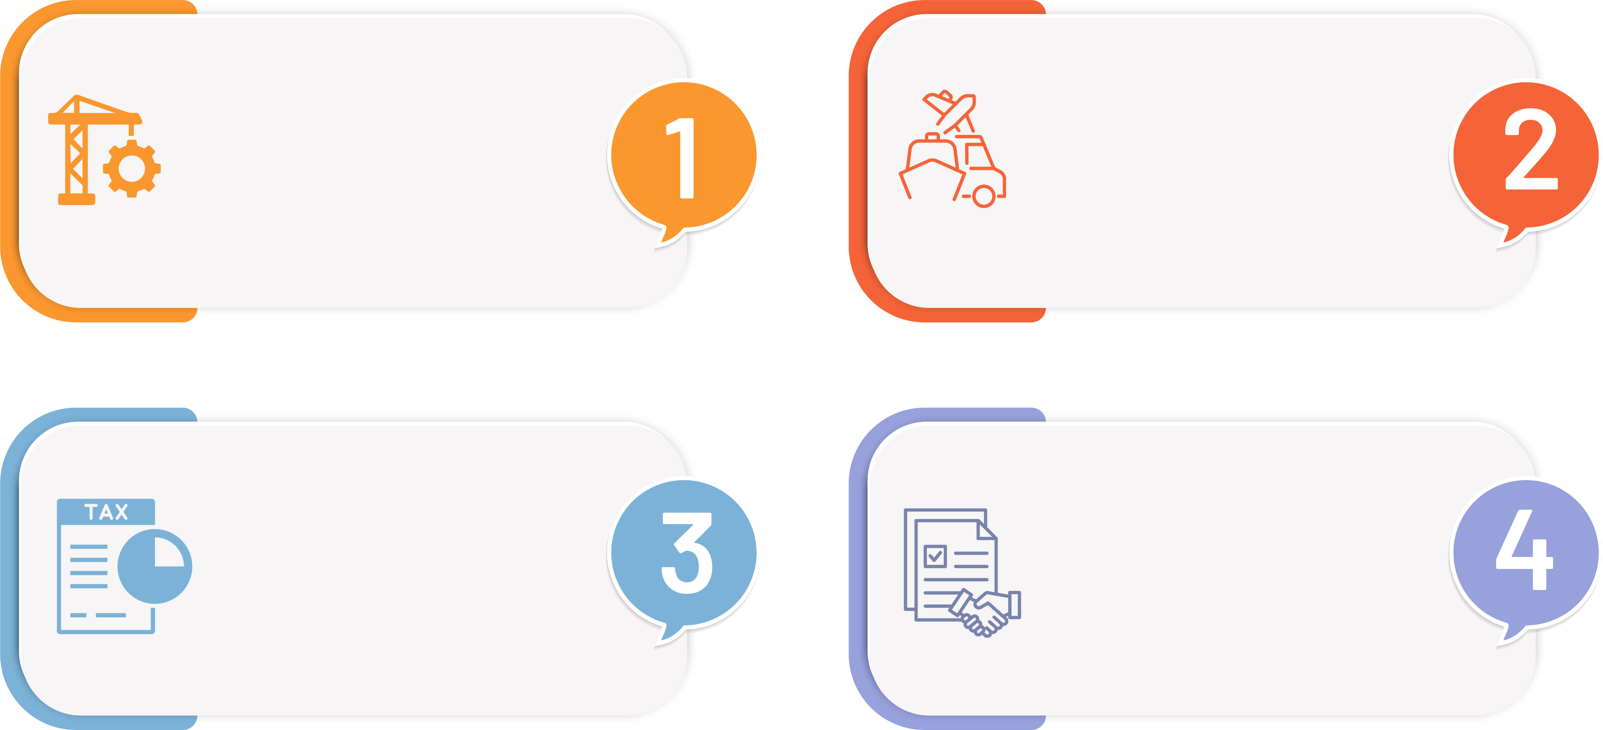
Key recommendations from All ICSOEs
ECA
MSs / RECs
MSs / RECs
Accelerate industrialization, value chain development, AfCFTA implementations for sustainable socioeconomic development.
Invest in critical economic infrastructure, transport networks and connectivity for trade competitiveness and regional integration.
Accelerate digital transformation for tax base expansion (crowding in the informal sector) foe enhanced domestic resource mobilization (DRM) and reduction of tax inequalities.
Enhance macroeconomic stability, debt and public finance management to support economic growth and investments.

Slide 8
PRE
DIALOGUES

Slide 9

Dates, Formats &Themes of SROs Pre-COM Consultations
Eastern Africa
Southern Africa
North Africa
Central Africa
Western Africa
Date & Location
Date & Location
Date & Location
Date & Location
Date & Location
1 - 3 October 2025 & 17 February 2026, Kigali, Virtual
31 October 2025, Eswatini
Hybrid
March 2026, Yaounde,
Virtual
12 March 2026 Niamey,
Virtual
11-13 November 2025
Themed Discussion
Themed Discussion
Themed Discussion
Themed Discussion
Themed Discussion
Growth through innovation: Harnessing data and frontier technologies for the economic transformation of Africa
Enhancing domestic resource mobilization through digital technologies in North Africa
Growth through innovation: Harnessing data and frontier technologies for the economic transformation of Africa
Growth through innovation: Harnessing data and frontier technologies for the economic transformation of Africa
Leveraging digital solutions for cross border trade

Slide 10
Major Challenges to Growth through Innovation?
Seychelles Cabinet endorsed the cruise tourism CBA report
officials:
Digital infrastructure deficit, limited internet penetration, high connectivity costs, and unreliable broadband networks
Low tax performance and fiscal capacity
High dependency on imports, especially food and essential commodities raising trade deficits & exposure to global price volatility
Slow uptake of the Pan-African Payment and Settlement System (PAPSS)
Shrinking external financing, including reductions in development assistance and concessional funding
Supply chain disruptions exacerbated by climate shocks, geopolitical tensions, and weakened regional infrastructure

Slide 11

Key policy responses…
Strengthen fiscal systems through the digitalization of tax administrations across MS to improve domestic resource mobilization
Build institutional and technical capacity of MS for frontier technologies and digital governance
Upgrade infrastructure and improve regional connectivity
Strengthen fiscal systems through the digitalization of tax administrations across MS to improve domestic resource mobilization
Upgrade infrastructure and improve regional connectivity
Build institutional and technical capacity of MS for frontier technologies and digital governance
Diversify revenue sources including environmental and digital taxes
Leverage digital tools to facilitate regional trade and buffer global shocks
Establish cross border data sharing agreements to enable regional digital markets under AfCFTA
Diversify revenue sources including environmental and digital taxes
Leverage digital tools to facilitate regional trade and buffer global shocks
Establish cross border data sharing agreements to enable regional digital markets under AfCFTA

Slide 12
Recommendations from all
Digital tax system acceleration
Integrate digital trust& governance
Building institutional capacities
Strengthen fiscal systems through the digitalization of tax administrations across MS to improve domestic resource mobilization
Build Institutional and Technical Capacity of MS for Frontier Technologies and Digital Governance
Upgrade Infrastructure and Improve Regional Connectivity
Digital transformation of tax administrations with automated customs systems to streamline revenue collection and facilitate trade
Formalize the informal sector to broaden the domestic tax base
Enhance efficiency, transparency, and compliance with integrated digital public financial management (PFM) system
Enhance integration between data protection and public financial governance
Prioritize the interoperability of digital systems for seamless cross-border data flows and digital trade
Create ethical data sharing frameworks
Build necessary digital and institutional capacities to enable unique context
Target R&D investment (aiming for 1% of GDP) with PPPs in priority areas
Foster homegrown innovation, human capital, and innovative skills development.
Diversify revenue sources including environmental and digital taxes
Leverage Digital Tools to Facilitate Regional Trade and Buffer Global Shocks
Establish cross border data sharing agreements to enable regional digital markets under AfCFTA

Slide 13
Recommendations from all Cont’d
Enhanced data security & inclusive economy
Regional digital integration
Adoption of data driven & frontier technologies
Strengthen fiscal systems through the digitalization of tax administrations across MS to improve domestic resource mobilization
Build Institutional and Technical Capacity of MS for Frontier Technologies and Digital Governance
Upgrade Infrastructure and Improve Regional Connectivity
Enhanced data security to build public trust
Mechanisms to prevent digital exclusion, protecting small-scale economic actors
Cyber cooperation and regional digital sovereignty with regulators and researchers.
Operationalize the AfCFTA digital trade protocol and cross-border trade framework.
Deploy automated customs, Single Window platforms, and cross-border data exchange
Strengthen regional non-traditional value chains (e.g.,, minerals, agri-tech)
Adopt AI, big data, blockchain, and internet of things solutions for economic resilience.
Create regional startup databases and incentives to nurture fintech.
Modernize services and revenue (environmental/digital taxes).
Diversify revenue sources including environmental and digital taxes
Leverage Digital Tools to Facilitate Regional Trade and Buffer Global Shocks
Establish cross border data sharing agreements to enable regional digital markets under AfCFTA

Slide 14
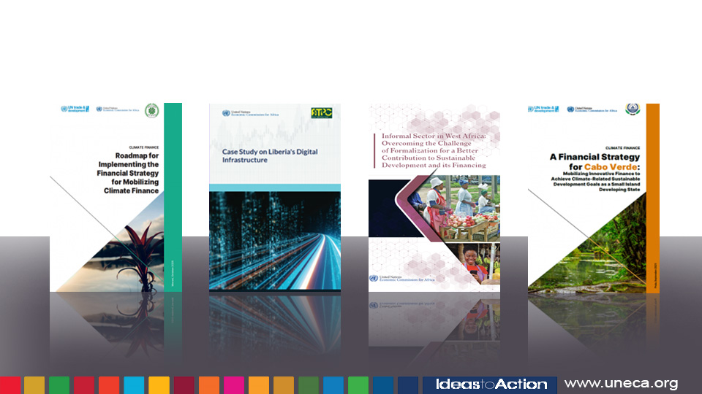
Recent publications by SROs

Slide 15
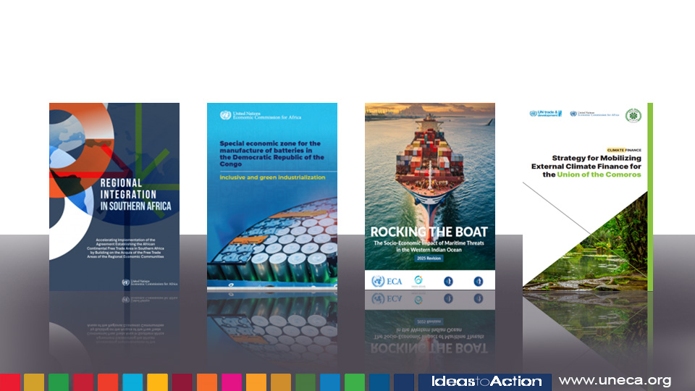
Recent publications by SROs cont’d

Slide 16
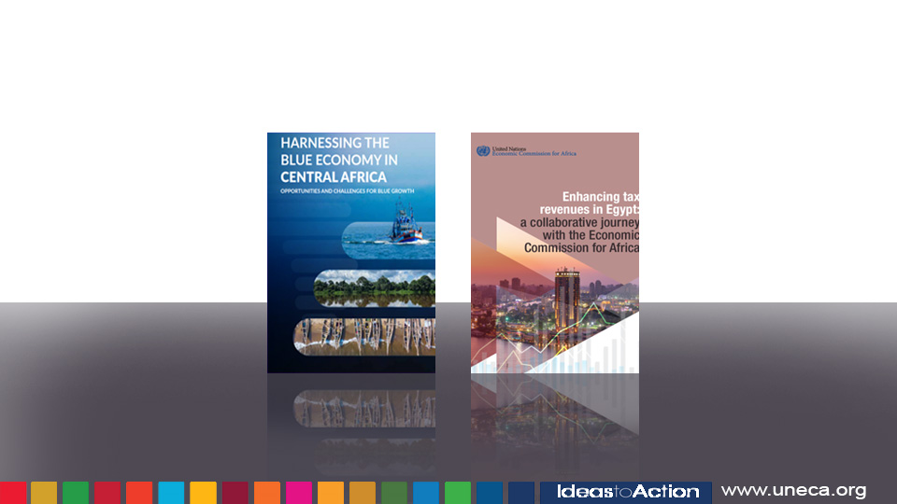
Recent publications by SROs cont’d

Slide 17

Merci
Jërëjëf
Shukran
Asante
Zikomo
Obrigado
Ameseginalehu
Gracias
Na gode
Mwebale
Murakoze

