Slide 1
State of Women’s Financial Inclusion & Entrepreneurship in Sierra Leone
Situation Analysis Findings · Logit & Fairlie Decomposition Evidence · August 2026
NewBrook Fields Hotel, Freetown, Sierra Leone

Slide 2
Outline
1
Context & the case for action
2
Status of financial inclusion
Demographics, informality, entrepreneurship
Accounts, savings, credit — national baselines
3
Gender gap evidence
4
What actually drives inclusion
Education, employment, phones, ID, accounts
Logit models & Fairlie decompositions
5
Entrepreneurship & policy landscape
6
Implications for technical guidelines
NSFI2, GEWE Act, ecosystem barriers
Priorities for workshop discussion

Slide 3
Why This Matters Now
Sierra Leone's youth-dominated, informal economy makes financial inclusion the critical enabler of entrepreneurship — and the evidence base for technical guidelines must reflect what actually drives access, not assumptions.
75%
92%
92%
2.1M
39%
Population under age 35
Employment that is informal
Women running micro-enterprises
Adults financially included
Women's inclusion is even lower at 36%, versus global and African averages of 76% and 48% for women respectively.

Slide 4
The Sierra Leone Paradox
Entrepreneurially active
Structurally excluded
MSMEs are ~80% of businesses continent-wide; women dominate petty trade, agro-processing and food services; youth cluster in transport, ICT and vending.
59.2% multidimensionally poor; over 90% self-employed or in family work; irregular, seasonal income with minimal collateral or documentation.
This is the core tension the technical guidelines must resolve: the population most active in enterprise is the population least served by formal finance.

Slide 5
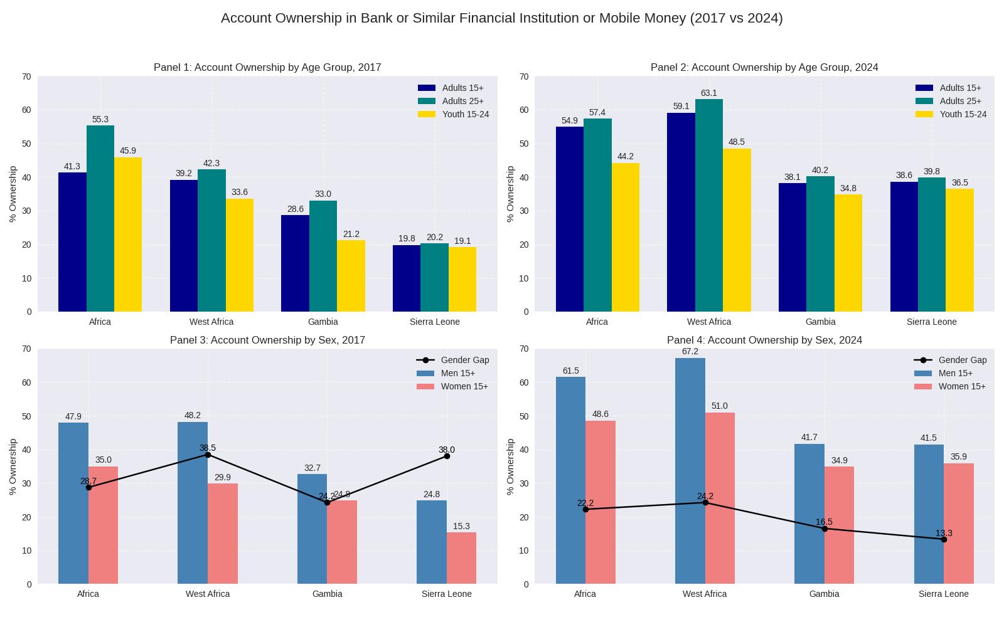
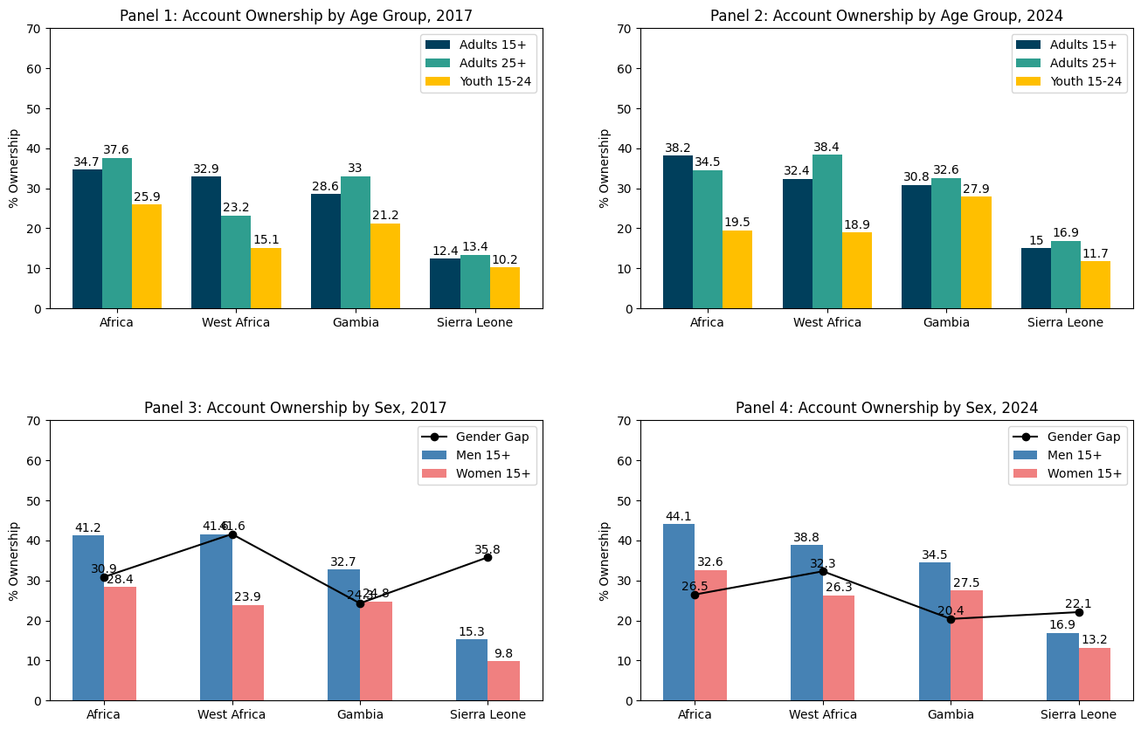
Account ownership
Digital finance is expanding in Sierra Leone, but women and young people risk being left behind, especially in mobile-money access and use.

Slide 6
Raw Gender Gaps in Account Ownership
Men have higher ownership across every channel — the question is why.
Any account — Men 41.5% / Women 35.9%
+5.54 pp
Financial-institution account — Men 16.9% / Women 13.2%
+3.74 pp
Mobile-money account — Men 33.6% / Women 30.9%
+2.68 pp

Slide 7
Central Finding
Once education, income, employment, phone and ID access are controlled for, gender is not statistically significant in accounts, savings, or borrowing.
Accounts: female AME −1.45pp to +1.10pp, all p>0.5
Savings: female AME −0.5pp to +2.8pp, all p>0.4
Borrowing: female AME −1.8pp to +1.9pp, all p>0.4

Slide 8
What Explains the Raw Gap? Fairlie Decomposition
Account ownership gap decomposed into observed characteristics vs. unexplained residual.
Financial-institution account
Mobile-money account
Any account
4.08pp
2.61pp
3.75pp
explained of 5.54pp gap (74%)
explained of 3.74pp gap (70%)
exceeds 2.68pp raw gap
Secondary education +2.32pp; top income +1.31pp; employment +0.97pp
Secondary +1.05pp; tertiary education +0.70pp
Education & employment predict a larger gap than observed
Interpretation: education, income and employment gaps — not gender itself — drive most of the observed male advantage in account ownership.

Slide 9
The Real Drivers of Account Ownership
Tertiary education
+32.5 pp
Phone ownership
+23.1 pp
Secondary education
+16.6 pp
Internet use
+12.2 pp
Employment
+9.5 pp
Rural residence
−6.3 pp
Average marginal effects, extended any-account model. ID ownership positive but borderline (+5.5pp, p=0.077).

Slide 10
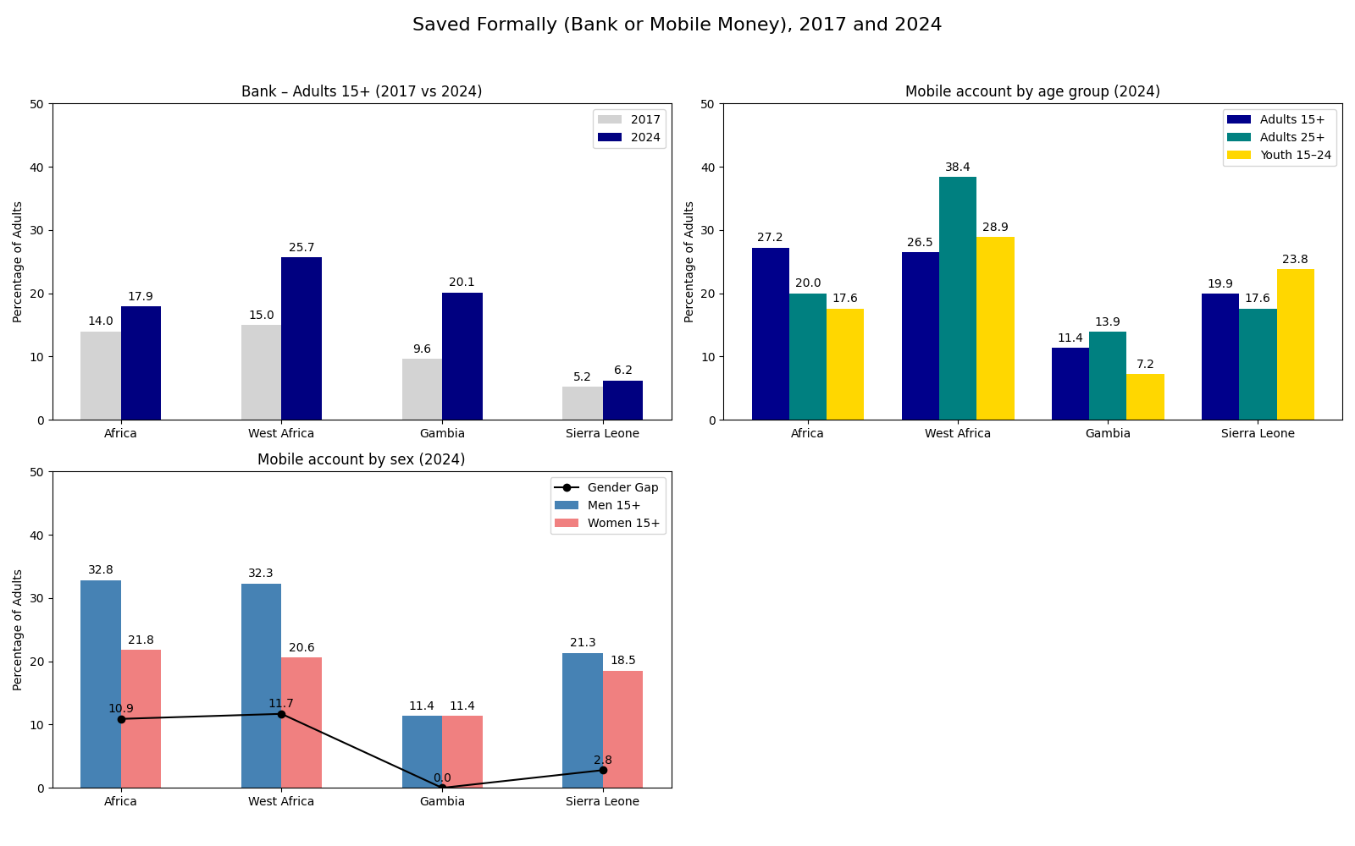
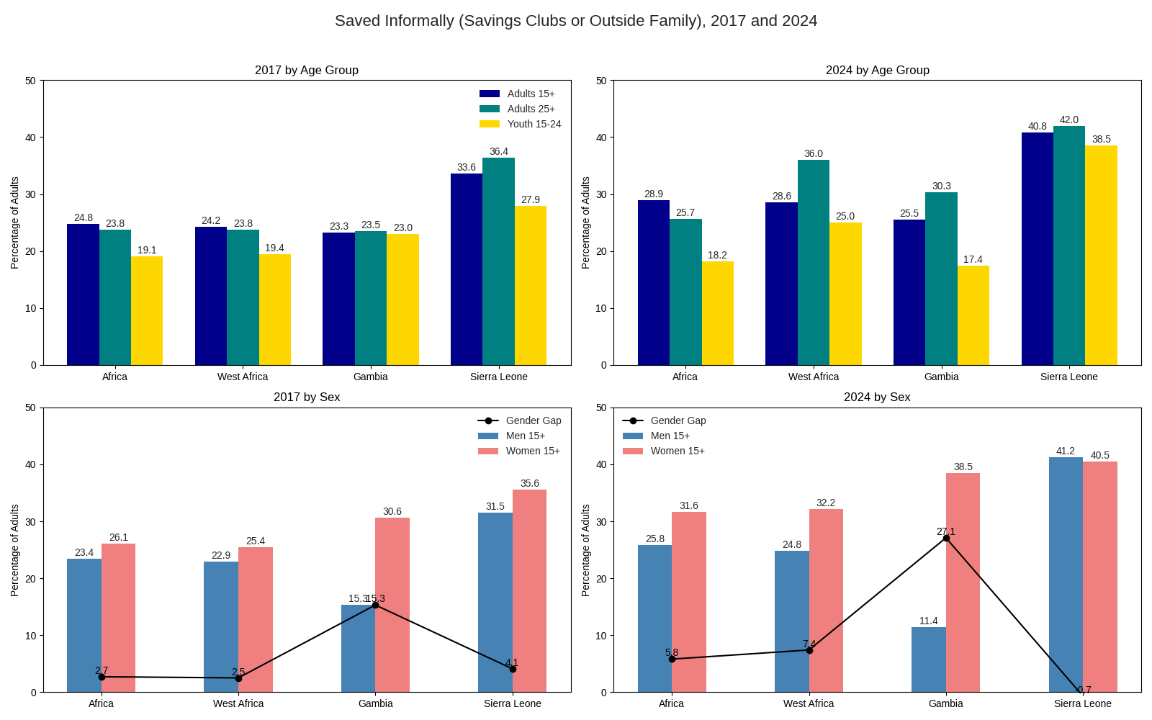
Gender and Age Gap in Savings

Slide 11
Savings behaviour: No gender gap, but account effect is huge
61.9% of men and 60.7% of women save from any source — a statistically insignificant 1.18pp difference.
24.0 pp
14.7 pp
11.6 pp
Formal-saving boost from account ownership
Boost from phone ownership
Boost from employment
Semi-formal/group saving (VSLAs, osusu) is widespread among both men and women (70–71%), with no significant covariate distinguishing users — it functions as broad-based community finance, not a women-specific channel.

Slide 12
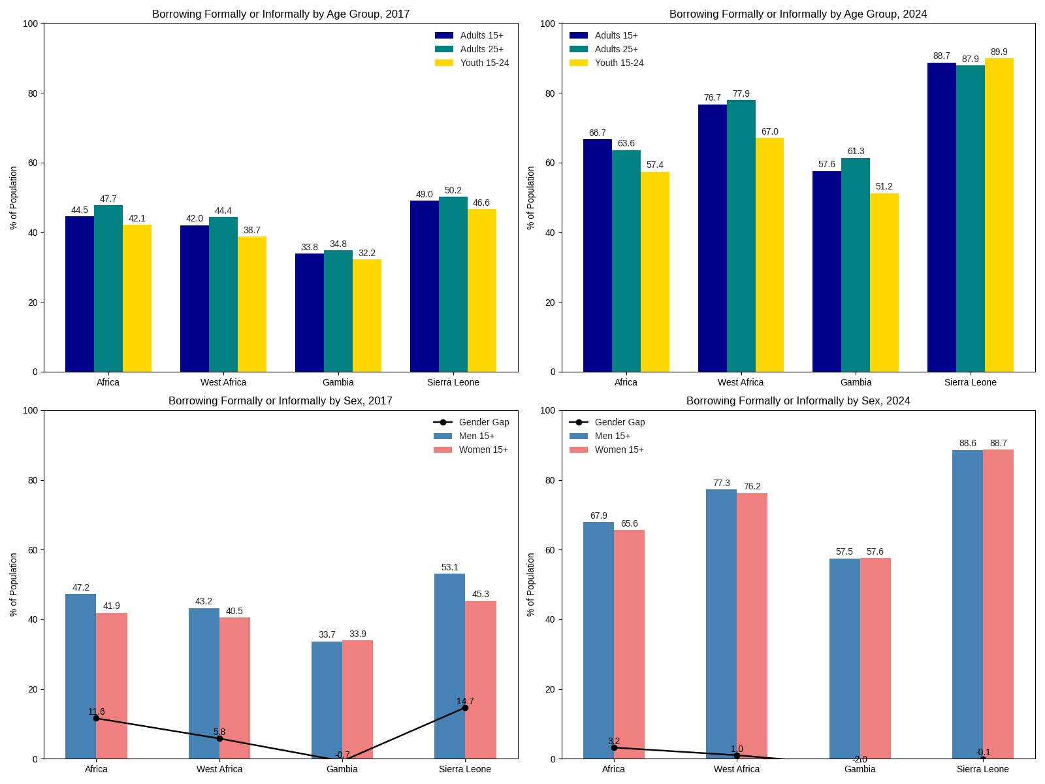
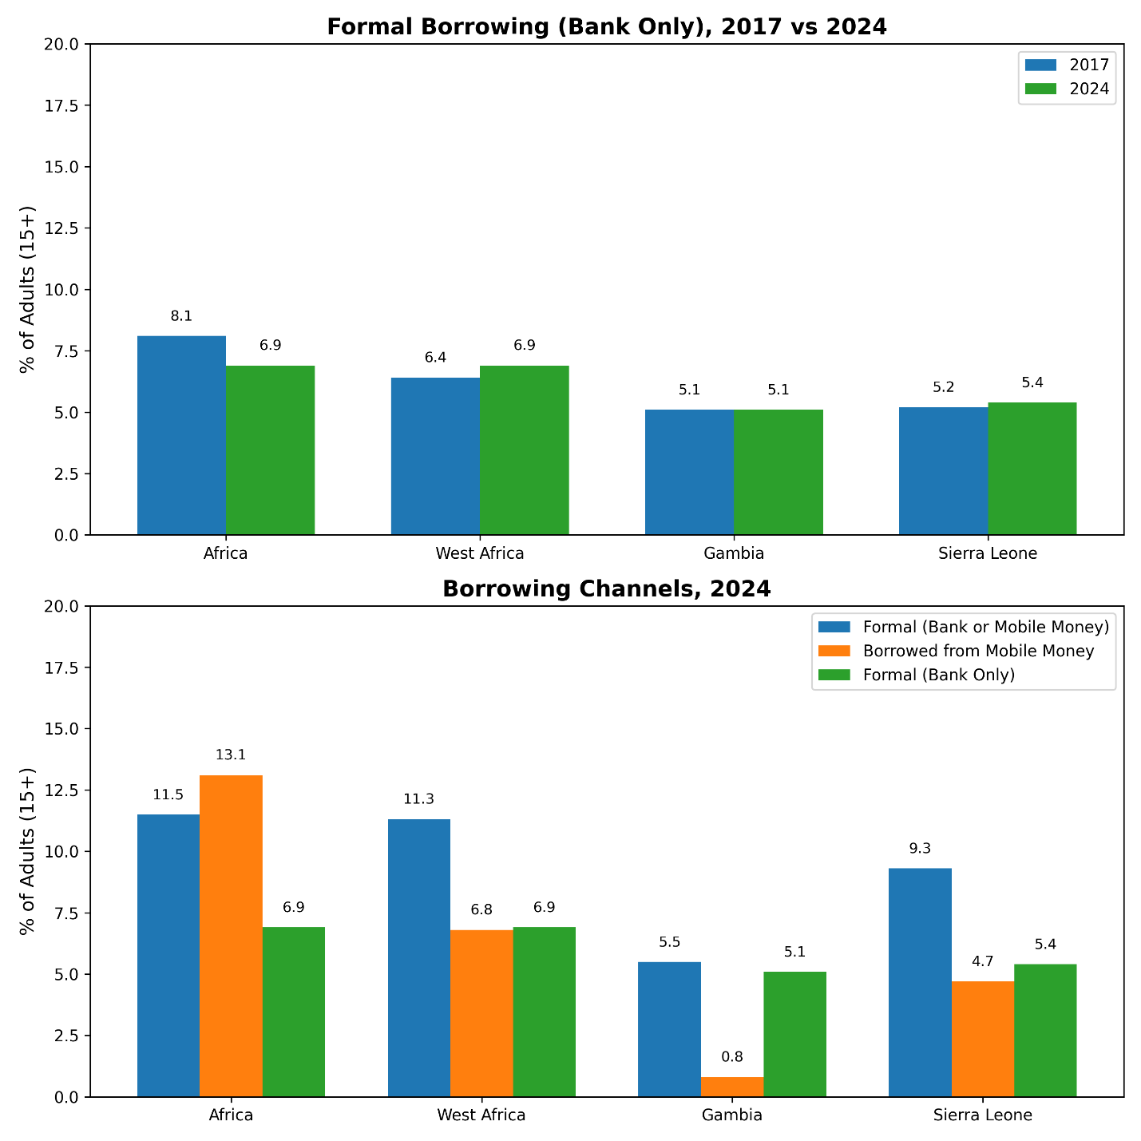
Borrowing Channels

Slide 13
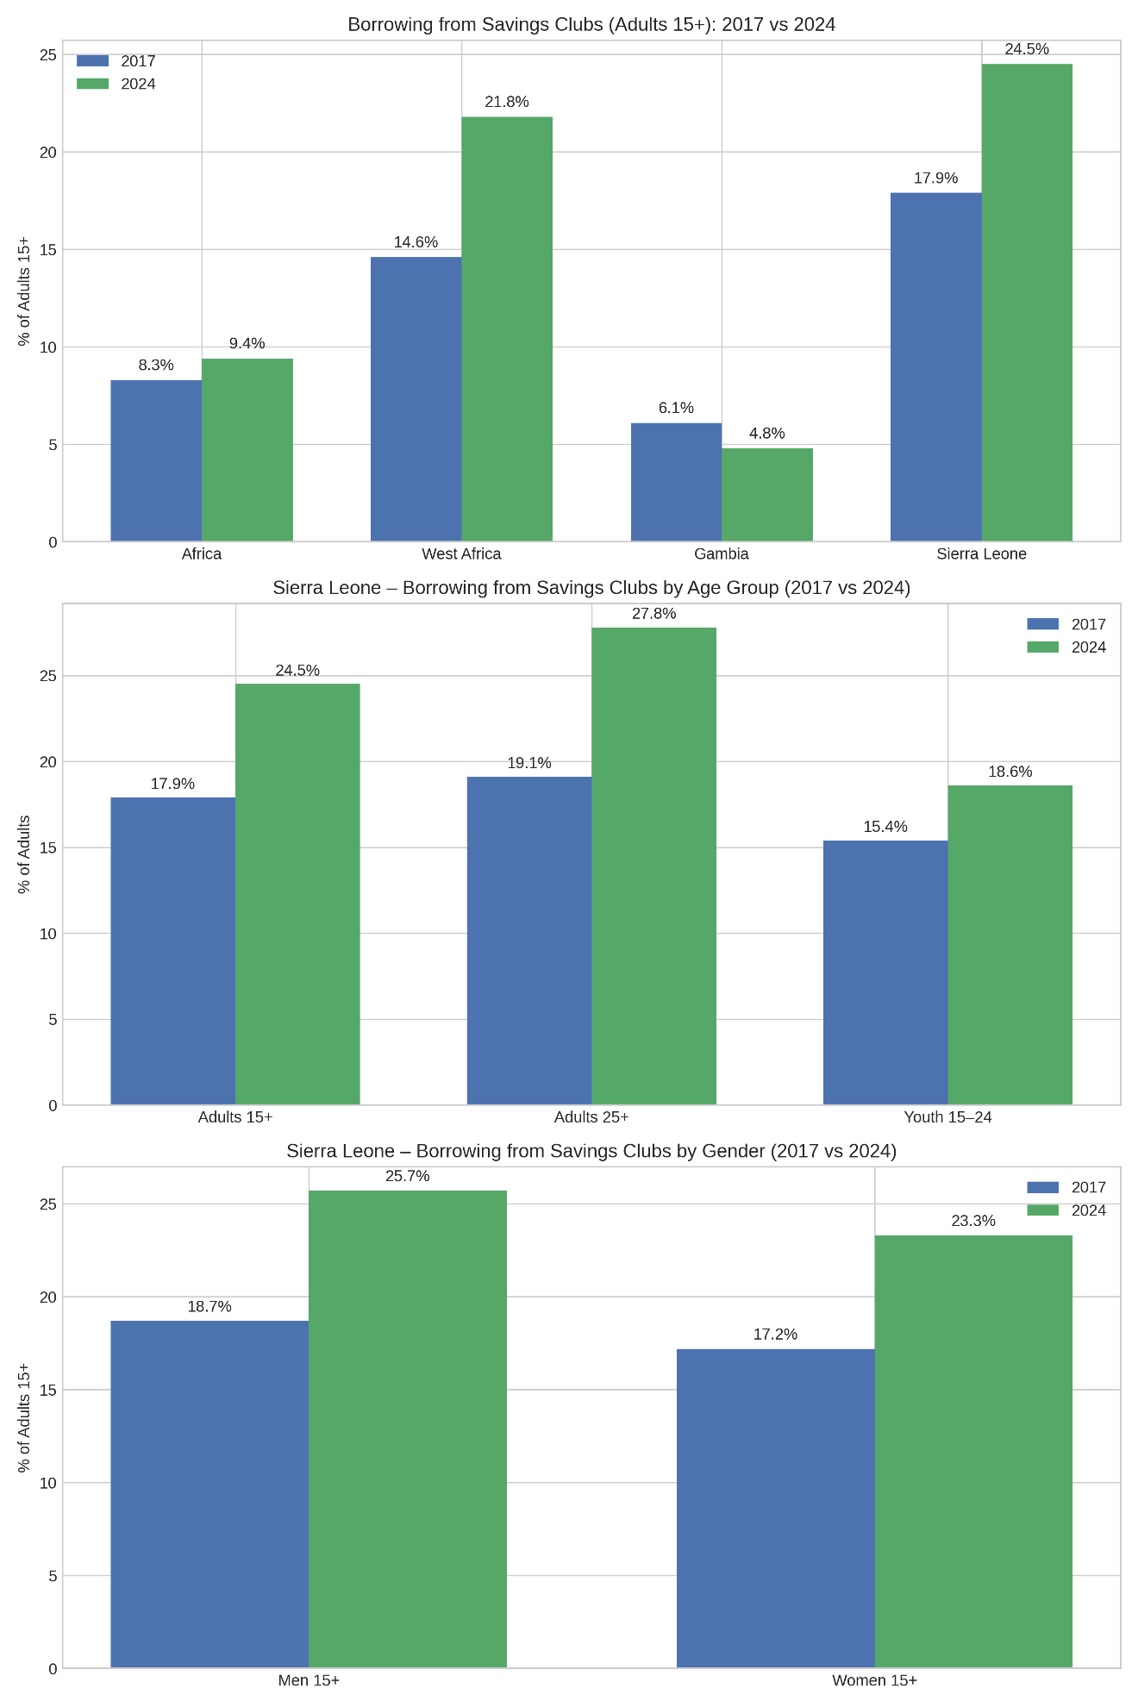
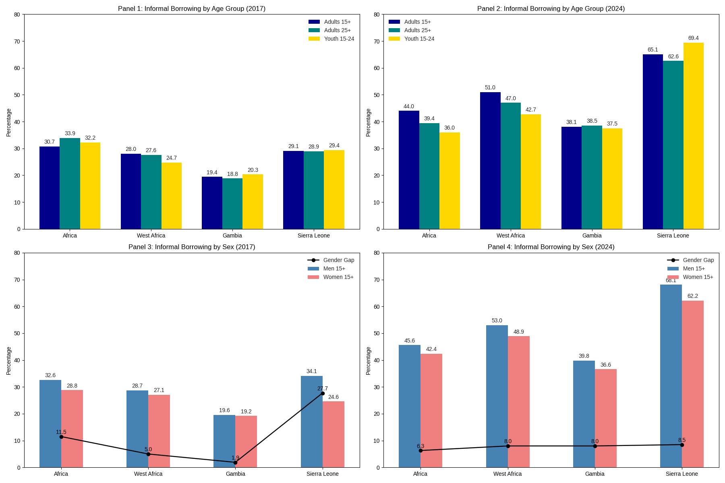
Borrowing channels

Slide 14
Borrowing: Access Infrastructure Matters More Than Gender
No significant adjusted gender gap in borrowing from any source (724 to 1,001 sample), formal borrowing, or group borrowing.
Formal borrowing correlates
Group borrowing (non-formal)
Employment: +15.9 pp
Account ownership: +7.9 pp
Phone ownership: +7.4 pp
ID ownership: +7.0 pp
Rural residence: +14.1 pp
Employment: +14.6 pp
ID ownership: −16.8 pp (substitutes for formal access)
Fairlie: men's formal-borrowing rate (14.9%) exceeds women's (11.5%); observed endowments explain ~88% of this 3.39pp gap.

Slide 15
Cross-Cutting Synthesis
Not a gender-coefficient problem
Across accounts, savings and borrowing, adjusted female effects are consistently small and statistically insignificant.
It is a capability-and-access problem
Education, employment, phone ownership, internet use and ID ownership are the consistent, significant correlates across every outcome — and these are themselves gendered.
Community finance is gender-neutral infrastructure
VSLAs and osusu groups serve men and women alike; the priority is voluntary linkage to formal services, not women-only targeting.
Absence of a coefficient ≠ absence of a barrier
Models cannot observe control over phones/money, safety, social norms, provider bias or product quality — qualitative work must fill this gap.

Slide 16
Sierra Leone's Policy Foundation
NSFI2 (2022–2026)
GEWE Act (2022)
Non-Discrimination Directives (2021)
Prioritises women, youth, rural populations and MSMEs; client-centred products, DFS, literacy, consumer protection.
Mandates equal access to financial services and economic opportunities for women.
Prohibit gender-based discrimination in access to financial products across regulated institutions.
Sierra Leone holds a Women, Business and the Law Entrepreneurship Score of 75% (2024) — a regional leader on paper. The binding constraint now is operationalisation, not legislation.

Slide 17
Governance and regulatory framework for financial inclusion in Sierra Leone
Note: The framework places the Bank of Sierra Leone at the centre of strategy coordination, regulation and supervision, linking line ministries, financial service providers and development partners within the implementation architecture of the National Financial Inclusion 2022-2026

Slide 18
Where Implementation Falls Short
📊
Weak sex- and age-disaggregated data
🏦
Provider capacity & incentives
Providers inconsistently collect/report SADD; central bank systems still maturing.
Business models skew to urban, higher-income clients; limited incentive for tailored products.
🔌
Digital & infrastructure bottlenecks
⚖️
Uneven enforcement
Rural network gaps, power interruptions limit agent/DFS rollout at scale.
Non-discrimination directives exist, but supervisory follow-up and redress systems are still evolving.
🧩
Pilot-heavy delivery
🔗
Weak policy coherence
Many innovations remain donor-funded pilots, not embedded in national systems.
NSFI2, GEWE Act, MSME and youth-employment instruments not yet fully linked.

Slide 19
Guidelines Priority 1
Turn account access into Active, Usable Finance
→Pair onboarding with low-cost products, simplified KYC, reliable agent cash-in/cash-out, and transparent fees.
→Design small-ticket, flexible-repayment credit and savings products matched to irregular, seasonal micro-enterprise cash flows.
→Embed financial-capability content in real use cases: payments, market trading, farming, school fees, group funds.

Slide 20
Guidelines Priority 2
Link Community Finance to Formal Providers — Voluntarily
→Treat VSLAs and osusu-type groups as local financial infrastructure serving both women and men.
→Offer optional group accounts, digital ledgers, agent-assisted deposits and graduated credit — without imposing fees or documentation that exclude the poorest members.
→Preserve group autonomy, trust and privacy; formalisation must be a choice, not a mandate.

Slide 21
Guidelines Priority 3
Close the Capability Gap, Not Just the Access Gap
→Invest in secondary/tertiary education access and financial literacy — the strongest, most consistent correlate across every model.
→Expand affordable phone/connectivity access and simplified ID enrolment, since both raise account, savings and credit probability by 7–23pp.
→Bundle finance with business development services, mentoring and market linkages — not credit alone.

Slide 22
Guidelines Priority 4
Build gender-sensitive monitoring — even when headline gaps are not significant
→Track account activation, deposit frequency, balances, dormancy, complaints and uptake by sex, rurality, education and enterprise type.
→Launch regular, nationally representative MSME/informal-sector surveys with sex- and age-disaggregated variables, at least every three years.
→Commission qualitative research on control over phones/money, safety, documentation barriers and trust — factors the quantitative models cannot see.

Slide 23


