Slide 1
Macroeconomic Outlook of Africa, Challenges and Opportunities for Domestic Resource Mobilization, Action Areas, and Main Expected Outcomes from the Fourth International Conference on Financing for Development
Second Session of the Committee on Economic Governance
Priorities for Africa towards the Fourth Financing for Development Conference in 2025
Nadia S. Ouedraogo, PhD
Macroeconomic, Finance and Governance Division (MFGD)
Saturday 16 November 2024
Notes:
1

Slide 2

OUTLINE
Macroeconomic Outlook of Africa
Challenges for Domestic Resource Mobilization (DRM)
Opportunities for increasing DRM
Expected Outcomes from the Fourth International Conference on Financing for Development (FfD4)
Conclusion
Notes:
2

Slide 3
Macroeconomic Outlook of Africa
Economic Growth Trends, Key growth sectors and regional disparities
Figure 1: GDP growth in global regions, 2022-2024 Figure 2: Structural contribution on growth
Source: UNDESA 2024. Source: ECA calculations based on data from EIU (2024)
and UNDESA (2024)
Notes: e= estimates and f = forecasts
3
Notes:
3

Slide 4
Macroeconomic Outlook of Africa cont’d
2. Current account balance performances and inflation trends
Figure 3: Current account balance Africa & other economies, 2020-2026
Figure 4: Consumer Price Inflation, 2020-2025
Source: ECA calculations based on IMF, 2024.
Notes: e= estimates and f = forecasts
Source: UNDESA, 2024
Notes:
4

Slide 5
Macroeconomic Outlook of Africa cont’d
2. Fiscal balance performances
Figure 3: Fiscal balance IMFs in Africa by subregion, 2020–2026
Source: ECA calculations based on IMF, 2024.
Notes: e= estimates and f = forecasts
Notes:
5

Slide 6
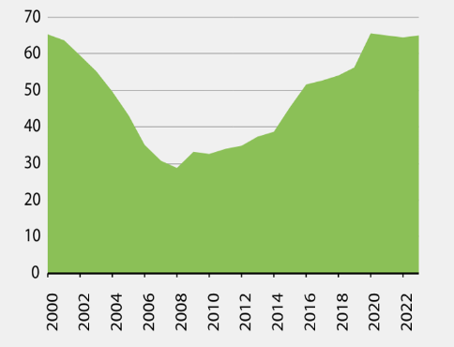
Macroeconomic Outlook of Africa cont’d
3. African Debt Trends
Figure 5: General Government Debt as a share of GDP (%)
Figure 6: Gross Government Debt in Africa by subregion, 2020–2026
Source: ECA calculations based on IMF data, 2024
Source: ECA calculations based on IMF, 2024
Notes: e= estimates and f = forecasts
Notes:
6

Slide 7
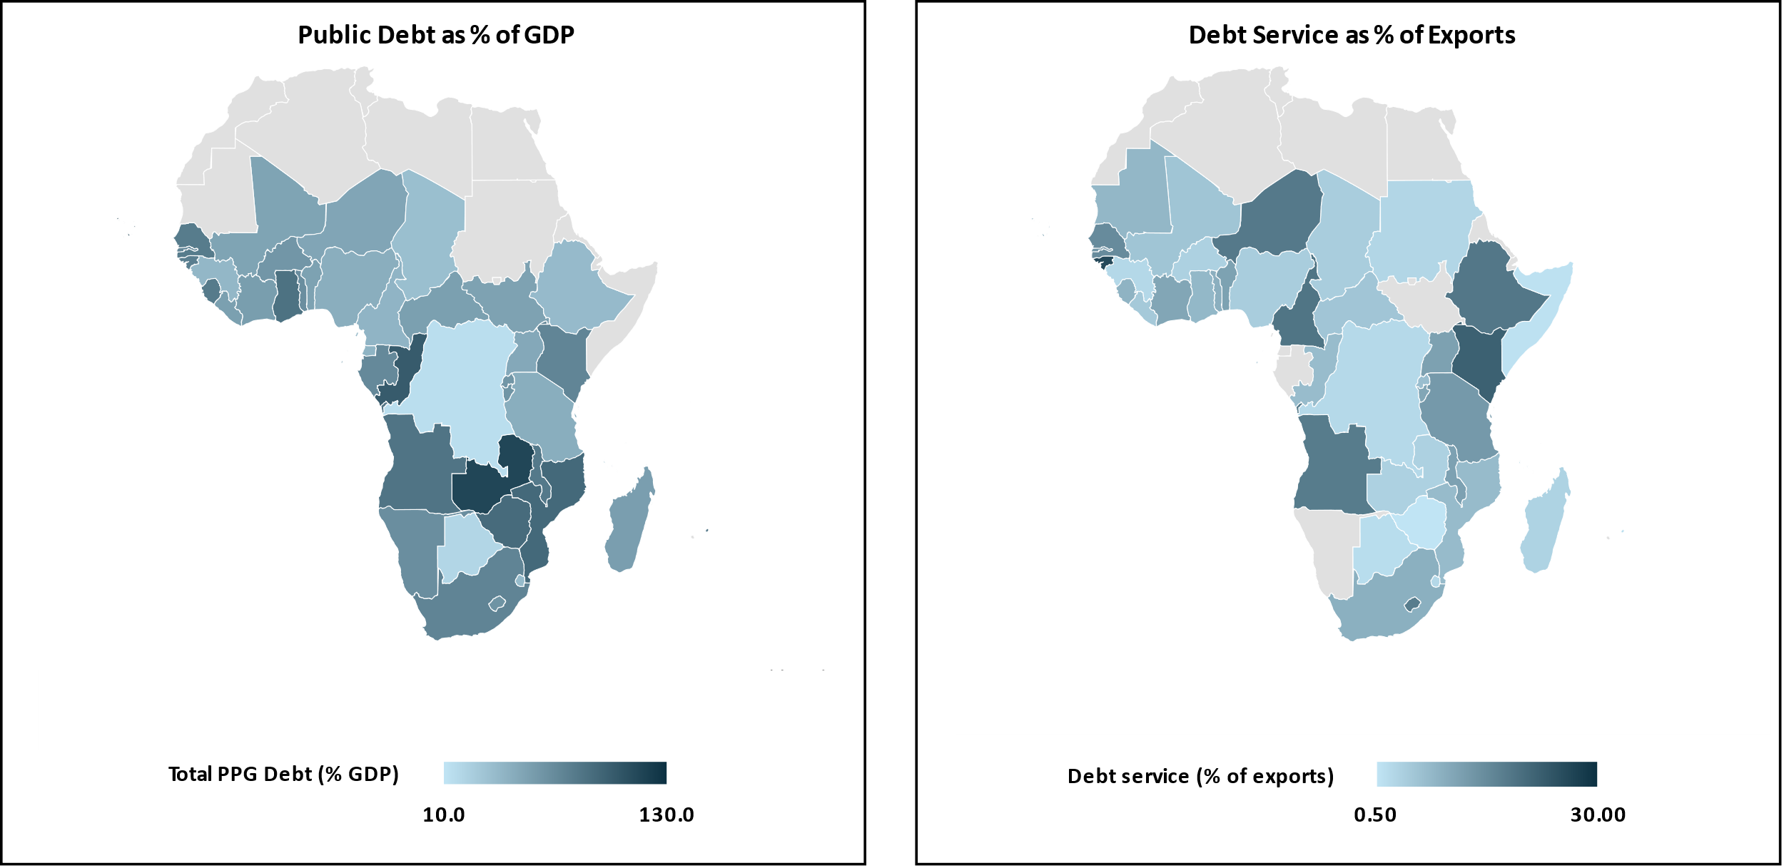
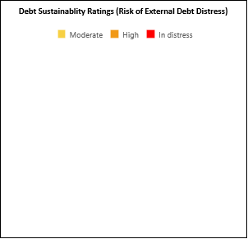

Macroeconomic Outlook of Africa cont’d
3. African Debt Trends cont’d
Figure 7: Africa Public and Publicly Guaranteed Debt Levels
Figure 8: Africa Debt Sustainability Ratings
Source: IMF (2024)
Source: World Bank (2024)
Notes:
7

Slide 8
II. Challenges for Domestic Resource Mobilization (DRM)
Limited Tax Bases
Weak tax administration systems
Excessive tax exemptions
Substantial illicit financial outflows
Shallow domestic capital markets, large informal sectors
Tax avoidance and evasion, and narrow tax bases
Shallow domestic capital markets which result into Africa’s overreliance on global financial markets.
Weak debt management and monitoring of its use
8
Notes:
Challenges for Domestic Resource Mobilization (DRM)
2.1 Limited Tax Bases
Compared to other regions, the average tax-to-GDP ratio remains relatively low. The average tax-to-GDP ratio of reporting African countries in 2020 was 16.0%, below the averages of countries in Asia and the Pacific (19.1%), Latin America and the Caribbean (21.9%) and the OECD (33.5%).
A significant challenge for DRM is the narrow tax base, exacerbated by the informal nature of many African economies. Large informal sectors mean that many businesses and individuals are not taxed, limiting government revenue collection.
Systemic constraints to domestic resource mobilization include weak tax administration systems, excessive tax exemptions, substantial illicit financial outflows, shallow domestic capital markets, large informal sectors, tax avoidance and evasion, and narrow tax bases. More recently, external shocks, such as the COVID-19 pandemic and the war in Ukraine, have further eroded taxation revenue in African countries through subdued growth. Lower domestic resources coupled with the increased financing needs for countering socio-economic impacts of global crises, supporting economic recovery, and accelerating the implementation of the SDGs result into wider fiscal deficits, hence greater debt financing requirements.
Shallow domestic capital markets which result into Africa’s overreliance on global financial markets.
Undeveloped and undiversified capital markets limit the extent to which African countries can mobilize domestic resources through attraction of domestic and international capital. On the supply side, high cost and onerous regulatory requirements stop many institutions to raise capital through capital markets. On the demand side, the narrow investor base, many local banks and lack of capacity of domestic institutional investors to dealing in fixed income instruments is an issue.
Weak debt management and monitoring of its use
• Capacity Deficits: Technical and institutional weaknesses.
• Accountability Gaps: Transparency and oversight issues.
• Strategic Missteps: Poor alignment with development and fiscal policies.
• Debt Vulnerability: Susceptibility to external shocks and economic downturns.
8

Slide 9
II. Challenges for DRM cont’d
Declining Official Development Assistance
Inadequate and high cost of global finance
Ineffective international financing architecture
9
Notes:
9

Slide 10
II. Challenges for DRM cont’d
Inefficiency and Corruption
Political Instability and Conflict
External shocks
External shocks, such as the COVID-19 pandemic and the war in Ukraine, have further eroded taxation revenue in African countries through subdued growth.
10
Notes:
10

Slide 11
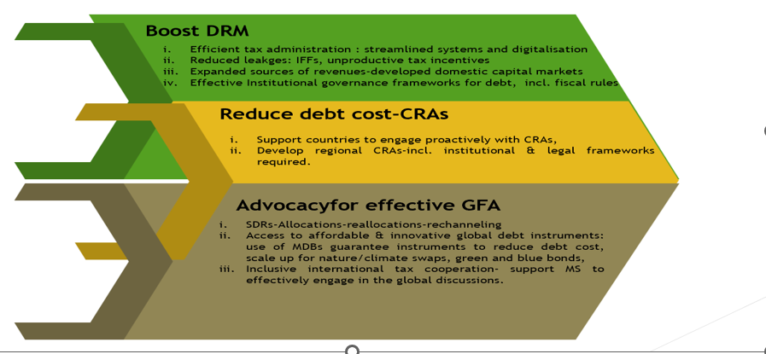
III. Opportunities for increasing DRM
11
Notes:
11

Slide 12

IV. Expected Outcomes from the Fourth International Conference on Financing for Development (FfD4)
Re-thinking Methodologies for Allocating Funding
  International Level Actions:
    Effective ODA Contribution: Reflection on best strategies, including technical assistance and financing for capacity building, to strengthen national resource collection.
    Tax Cooperation: Progress needed on tax cooperation and addressing tax evasion/illicit financial flows.
      Potential solutions: Establishing an inclusive global body under the UN
  National Level Actions
    Best Practices for Revenue Collection: Focus on transparency, combating corruption, and improving tax administration/policies.
    Formalization of the Informal Sector: Strategies for formalizing informal sectors and leveraging technological advancements.
    Balance of Power: Reassessing the power dynamics between domestic governments and multinational companies in developing economies.
12
Notes:
FfD4 contributes to the emergence of concrete advances on subjects that had already been little or poorly addressed at FfD3, such as the issue of taxation. The changes and new challenges facing countries mean that we need to rethink the methodologies for allocating funding, such as aid allocation, sovereign risk analysis, debt accountability and taxation.
At international level, in-depth reflection is needed on the best strategies (including technical assistance and financing for capacity building) to ensure that ODA makes an effective contribution to strengthening the collection of national resources. Tax cooperation also needs to progress, as does the fight against tax evasion and illicit financial flows. This raises the question of the most appropriate institutional form to combine effectiveness and inclusiveness in the definition of tax rules, for example through the establishment of an inclusive global body for the definition of tax rules under the auspices of the UN. At national level, the issues to be raised include best practice in transparency in the collection of tax and non-tax revenues, the fight against corruption, improvements in tax administration and policies, the formalization of the informal sector, and the role of technological change. Thought will also need to be given to changing the balance of power between domestic governments and multinational companies operating in developing economies.
12

Slide 13
CONCLUSION
Developing economies must increase their capacity to mobilize domestic resources which, in addition to their role in financing development, can strengthen the ownership of public policies and help reduce dependence on external aid and improve a country's solvency.
The impact of FfD4 will depend essentially on the responsibility and ability of stakeholders to overcome divisions and postures. Frank and constructive discussions will need to be held on the need to rethink international solidarity, ODA, synergies and leverage effects on domestic resources, and the mobilization of the private sector in development financing strategies.
FfD4 is an opportunity for the United Nations to send a strong message about the usefulness and relevance of international cooperation in achieving the SDGs. It is not just a question of declarations, but of highlighting concrete examples of bilateral and multilateral cooperation, free from the logic of competition.
FfD4 must focus on concrete actions to address taxation, debt, and DRM, strengthen global partnerships, and ensure more efficient use of financial resources to achieve the SDGs.
Promoting the INFF and enhancing capacity building for resource mobilization are essential for better alignment with national priorities and achieving sustainable development.
Notes:
13

Slide 14


