Slide 1
Domestic and international public finance to enhance resource mobilization Regional Consultation for the Fourth International Conference on Financing for Development in Africa by Gamal Ibrahim Chief Economic Governance and Public Finance Section Macroeconomics and Governance Division UNECA
Addis Ababa, Ethiopia 18 November 2024

Slide 2
A glimpse into the prevailing macroeconomic status
Recent global shocks including the Covid-19 pandemic, the Russia-Ukraine war and climate threats have worsened the already constrained and fragile Africa’s financing landscape;
Progress gap between the current status and the target of Agenda 2030 is huge;
Real GDP growth in Africa declined to 2.8% in 2023 but is projected to rise to 3.5% in 2024 and reach 4.1% in 2025;
Average public debt relative to GDP in Africa exceeds 60 per cent of GDP;
Africa’s debt has increased by 183% since 2010, a rate roughly four times higher than its growth rate of GDP in dollar terms;
The annual financing gap for SDGs in Africa ranges from USD200 billion to USD 1.3 trillion per year. The upper limit is more realistic, as the financing gap for all developing countries was estimated by UNCTAD to be USD 4 trillion;
Continued multifaceted global crisis along with population growth implies growing financing needs for various support measures.

Slide 3
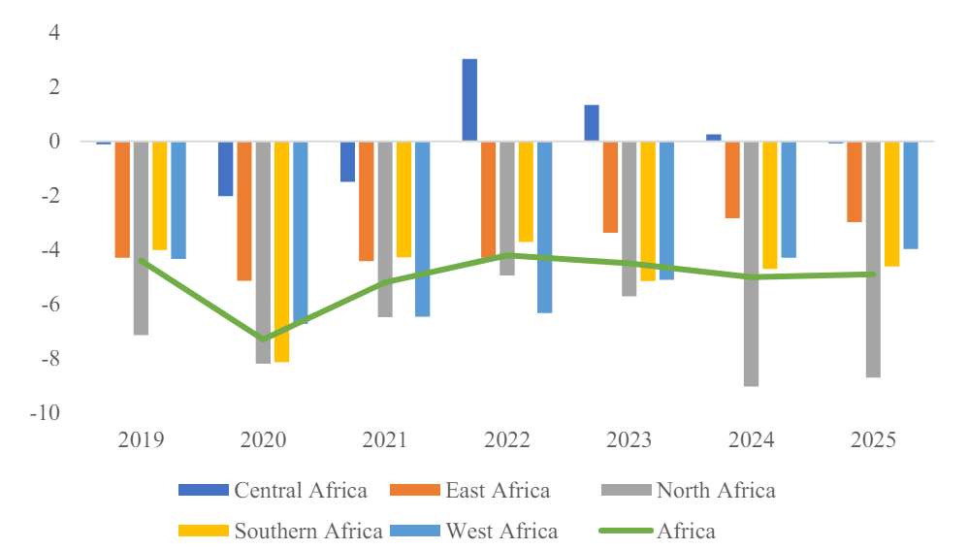
In 2023, the African fiscal deficit surpassed its 2019 level of 4.4 per cent of gross domestic product (GDP), reaching 4.5 per cent, and is projected to rise to 5.0 per cent in 2024.
Average tax-to GDP ratio remaining below its 2019 level of 15.8 per cent.
Fiscal balances in Africa by subregion, 2020–2025 (% of GDP)
Source: UNECA, 2024
Source: IMF, World Economic Outlook, 2023
Source: ECA calculations based on International Monetary Fund (IMF)
Notes:
Over half of African countries on the continent are either in debt distress or high risk of debt distress
In Africa, 25 countries spent more on interest payments than on health during 2019 – 2021. This means that progress towards Agenda 2063 and the SDGs will undoubtedly be hampered particularly on the outcomes of education, food, health, and water.
UNCTAD, “A world of debt. A growing burden to global prosperity”, 2023. Available at: https://unctad.org/publication/world-of-debt

Slide 4
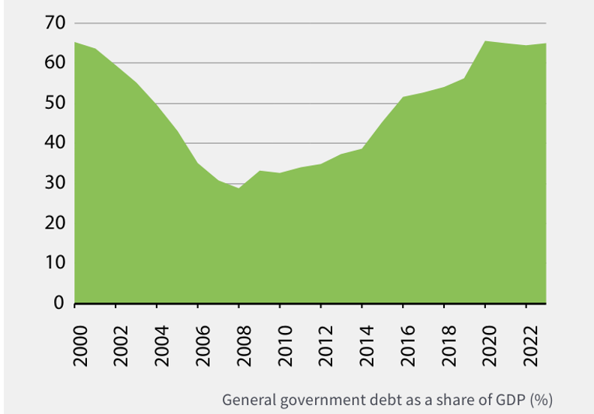
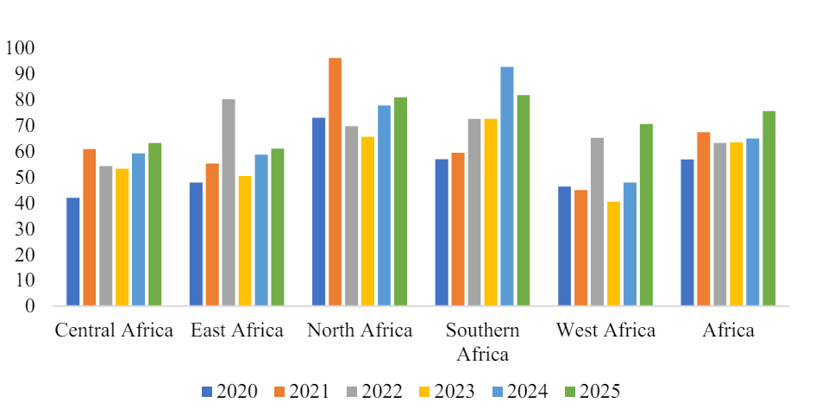
General government debt as a share of GDP exhibited a sharp rise between 2000-2023 with some regional variations among various subregions from 2020 to 2025
Source: UNECA, 2024
Source: IMF, World Economic Outlook, 2023
Notes:
Over half of African countries on the continent are either in debt distress or high risk of debt distress
In Africa, 25 countries spent more on interest payments than on health during 2019 – 2021. This means that progress towards Agenda 2063 and the SDGs will undoubtedly be hampered particularly on the outcomes of education, food, health, and water.
UNCTAD, “A world of debt. A growing burden to global prosperity”, 2023. Available at: https://unctad.org/publication/world-of-debt

Slide 5
Lack of efficiency in public expenditure remains a big issue
More than 44 African countries have undertaken reforms to improve public financial management systems
Nevertheless, weak institutional capacities, limited technical expertise, corruption and the need for greater transparency and accountability frameworks in public planning and expenditure monitoring remain.
Fragmented budgeting processes which exclude tax expenditures granted for various reasons and weak links between planning and budgeting further hinder the effective allocation and use of public resources.
Strengthening anti-corruption measures and promoting good governance remain essential to ensuring that public funds are used effectively and contribute to sustainable development.
Governance is also critical in reducing resource leakages from IFFs. ECA’s estimate shows that Africa lost over US$439 billion in 2019 in IFFs;
Notes:
More than 44 African countries have undertaken reforms to improve public financial management systems, including the adoption of medium-term expenditure frameworks, performance-based budgeting, and integrated financial management information systems. These reforms were aimed at contributing to better planning, execution, and monitoring of public expenditures. Nevertheless, several challenges continue to inhibit public financial management efficiency mostly arising from weak institutional capacities, limited technical expertise, corruption and the need for greater transparency and accountability frameworks in public planning and expenditure monitoring. Moreover, fragmented budgeting processes which exclude tax expenditures granted for various reasons and weak links between planning and budgeting further hinder the effective allocation and use of public resources. Strengthening anti-corruption measures and promoting good governance remain essential to ensuring that public funds are used effectively and contribute to sustainable development.
https://papers.ssrn.com/sol3/papers.cfm?abstract_id=3043168
https://www.uneca.org/economic-governance-report-ii-%28egr-ii%29
https://hdl.handle.net/10855/46555

Slide 6
A complex landscape of different stakeholders of IFFs
Source: ECA 2020

Slide 7
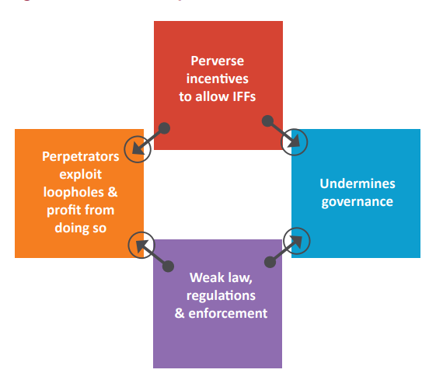
The vicious cycle of illicit financial flows and weak institutions
Source: ECA 2020

Slide 8
Illicit financial flow–induced tax losses as a percentage of total tax exhibits substantial loss
Source: ECA 2020

Slide 9
Substantial tax expenditure while the continent faces a narrowing fiscal space
Only TEs under CIT and VAT were identified in ten countries. Also, only a small portion of TEs were costed due to data constraints.
The estimated TEs ranges 4 to 76% of total revenue for CIT and VAT. Therefore, the real total cost of TEs is larger than what is reported under EGRII.
TEs are provided under arbitrary and discretionary practices outside the country’s tax laws and central administration system. As such, it is susceptible to corruption.
Lack of centralization in the governance of TEs results in ineffective analyses, reporting, oversight and scrutiny of total TEs.
TEs are not subjected to the same budgetary control procedures as direct budgetary spending.
Data availability and institutional capacity need significant improvements.

Slide 10
African countries are providing huge tax incentives depleting the fiscal space further
 | Education expenditures | Total imports bill | Total Interest payments | Total Govt cash payments
Benin | Almost 1/2 | 5% | Not available | Not available
Burkina Faso | Almost 1/4 | 2% | Almost 50% | 4%
Ghana | 1/5 | 4% | 12% | 4%
Kenya | Almost 3/4 | Almost 1/5 | Almost 90% | Almost 1/4
Mauritius | Almost double the education expenditures | 18% | More than 3 times of total interest payments | More than 1/4
Morocco | 1/3rd | 4% | More than 60% | 6%
South Africa | 1/4 | 6% | 1/3 | Almost 50%
Tanzania | Almost 1/4 | 6% | Not available | Not available
Uganda | 40% | 3% | 1/3 | 5%
Zambia | More than 4 times | Almost 50% | Almost double | Almost 60%
Notes:
Education expenditure refers to the current operating expenditures in education, including wages and salaries and excluding capital investments in buildings and equipment.
Imports of goods and services represent the value of all goods and other market services received from the rest of the world. They include the value of merchandise, freight, insurance, transport, travel, royalties, license fees, and other services, such as communication, construction, financial, information, business, personal, and government services. They exclude compensation of employees and investment income (formerly called factor services) and transfer payments. Data are in current local currency.
Interest payments include interest payments on government debt--including long-term bonds, long-term loans, and other debt instruments--to domestic and foreign residents.
Goods and services include all government payments in exchange for goods and services used for the production of market and nonmarket goods and services. Own-account capital formation is excluded.
Clearly, despite the fact that only some tax expenditures were estimated due to data availability, tax expenditures do cost governments significant money in comparison with other direct government spending.

Slide 11
While absolute ODA volumes have increased, Africa's share in total ODA has remained stagnant at around 35.3% since 2000
Source: Data source: OECD, DAC2A: Aid (ODA) disbursements to countries and regions, Access date: October 14, 2024
Notes:
This stagnation suggests that donor countries have diversified their recipient base regardless of development needs, potentially undermining the AAAA's emphasis on targeting assistance to the most vulnerable nations.

Slide 12
Inadequate and low-quality ODA for Africa
Huge gap between committed and disbursed amounts of ODA for Africa-15% of the promised amount.
Increasing expenditure on humanitarian aid, which may be reducing support for long-term investments and other development priorities in more crisis-prone countries.
On MDB lending, annual disbursements have shown significant growth. However, this headline figure obscures a concerning trend in concessional financing, which went from 35% of total MDB lending in 2004 to a mere 13% in 2022.
The dominance of loan instruments (56%) over grants (30%) in climate finance raises concerns about debt sustainability
The evolution of South-South cooperation since 2015 represents huge opportunities but lack of standardised measurement frameworks makes it challenging to quantify the precise impact of these initiatives
The current emphasis on the quantity of ODA, rather than its quality, has created a damaging dynamics.
Notes:
The inclusion of in-donor refugee costs, debt relief, and vaccine donations inflated ODA figures by USD 30.9 billion (15 percent), masking the true allocation toward long-term development priorities )
The evolution of South-South cooperation since 2015 represents huge opprtunities but lack of standardised measurement frameworks makes it challenging to quantify the precise impact of these initiatives. The emergence of platforms such as the BRICS (Brazil, Russia, India, China, and South Africa) and IBSA Forum has created new channels for resource mobilisation and knowledge exchange.
The current emphasis on the quantity of ODA, rather than its quality, has created a damaging dynamics. Donor countries often justify their failure to meet quantitative targets by focusing on highly visible but short-term initiatives, mainly in the humanitarian and social services sectors.
While these actions address some immediate issues, they do little to establish the policy frameworks and institutions necessary for sustainable development.

Slide 13
Closing Africa’s financing gap could require trillions annually-Potential sources of financing for the SDGs
Source: UNECA, 2024

Slide 14
African Leadership to the UN Framework Convention on International Tax Cooperation Development
The 77th UN GA's Second Committee adopted resolution 77/244, introduced by a group of African nations.
The UN Secretary-General report was released, outlining three potential paths to create a more inclusive tax framework
The UN GA adopted Resolution 78/230 to establish an Ad Hoc Committee to formulate the approach for a Framework Convention.
On 7 June 2024, the Ad Hoc Committee's Bureau released and requested stakeholder feedback on a “Zero Draft” for the ToR
A revised ToR was released in mid-July and was the basis for discussions at the Second Session of the Ad Hoc Committee from 29 July to 16 August 2024
On 16 August, the Intergovernmental Committee on International Tax Cooperation adopted the Draft ToR for a UN Framework Convention on International Tax Cooperation.
Notes:
Mobilization and effective use of domestic resources is central to financing sustainable development.
The 77th UN General Assembly's Second Committee adopted resolution 77/244, introduced by a group of African nations, recognizing the need for a universally inclusive international tax framework.
The resolution 77/244 paved the way for a fully inclusive and more effective international tax cooperation.
Secretary-General report titled "Promotion of Inclusive and Effective International Tax Cooperation" was released, outlining three potential paths to create a more inclusive tax framework: (1) a multilateral convention on tax, (2) a framework convention on international tax cooperation, and (3) a framework for international tax cooperation.
The UN General Assembly's Second Committee approved a resolution on 22 November 2023 to support inclusive international tax cooperation through establishment of an Ad Hoc Committee to formulate the approach for a Framework Convention. Resolution 78/230 was adopted on 22 December 2023 by the UN General Assembly, with 111 jurisdictions in favor, 46 against and 10 abstentions. The resolution called for finalization of the deliverables by August 2024 for submission to the 79th session of the General Assembly.
On 7 June 2024, the Ad Hoc Committee's Bureau released and requested stakeholder feedback on a "zero draft" for the ToR; more than 100 submissions resulted. A revised ToR was released in mid-July and was the basis for discussions at the Second Session of the Ad Hoc Committee from 29 July to 16 August 2024.
The UNSG report lays out three options for how Member States can make international tax cooperation fully inclusive and more effective.
ECA report provides recommendations on the substance of the UN framework convention on international tax cooperation and outlines a proposed structure of the global tax body that should be created
The ECA report takes a pragmatic and results-oriented approach, proposing an accelerated timeline for action

Slide 15
How Can the Proposed UN Framework Convention Ensure Equitable Representation for the Global South?
Support member states to pursue better alternatives than the OECD’s two pillar proposal
Continue to call for international tax cooperation that is fully inclusive and gives every nation an equal say in decision-making on international tax matters
Facilitate partnerships or collaboration at regional level with specialised bodies/institutions that can provide technical assistance to help build robust tax systems and policies
Use the intergovernmental tax body as a platform for dialogue and cooperation to foster an environment of transparency, ensuring fair tax competition and reducing IFFs

Slide 16
Strengthening DRM as a reliable financing sources through reducing IFFs and improving international tax cooperation
The 2024 African Ministers of Finance asked the ECA and AU to support member States to enhance DRM through more efficient tax policy and tax administration and by contribute to closing leakages;
To enhance DRM, national and international efforts for:
Improving governance and policy to curb IFFs and reduce unproductive tax incentives;
Implementing new technology and digitalization be leveraged to improve tax administration and compliance
Promoting a more inclusive international tax cooperation, through partnerships with other regions and countries as well as relevant stakeholders with similar goals and concerns;
Increasing the efficiency of public expenditure and public financial management systems
Leveraging a concerted approach for the FfD4 discussion.

Slide 17
Thank You

