Slide 1


Integrated National Financing Frameworks: integrated approaches to financing Sustainable Development
Presented by
Farzana Sharmin
Economic Affairs Officer
Macroeconomics, Finance and Governance Division, ECA
Ana-Maria Beldiga
SDG Finance Analyst
UNDP Africa Sustainable Finance Hub
Resina Katafono,
Inter-Regional Adviser,
Financing for Sustainable Development Office, DESA
18 November 2024

Slide 2
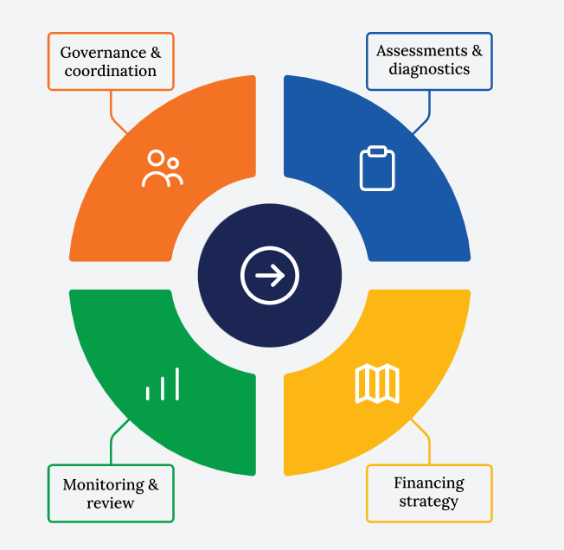
Four Building blocks of INFFs
Cohesive nationally owned sustainable development strategies, supported by integrated national financing frameworks, will be at the heart of our efforts”.
– Addis Ababa Action Agenda, 2015

Slide 3
Why should countries adopt an INFF?
To better manage an increasingly complex financing landscape.
To enhance coherence of different financing policies.
To mobilise additional financing to support sustainable development.
To strengthen the voice of developing countries in global policy processes.
To support long-term investment and strengthen medium- and long-term planning.
To match different types of financing to their most appropriate use.
To align development cooperation with country priorities and enhance the transparency of financing flows.

Slide 4
INFFs as a means of implementation for financing for development
ECA approach to INFF
Country support at Burkina Faso and Zambia
Regional support by knowledge sharing
INFFs as a tool for financing for development

Slide 5
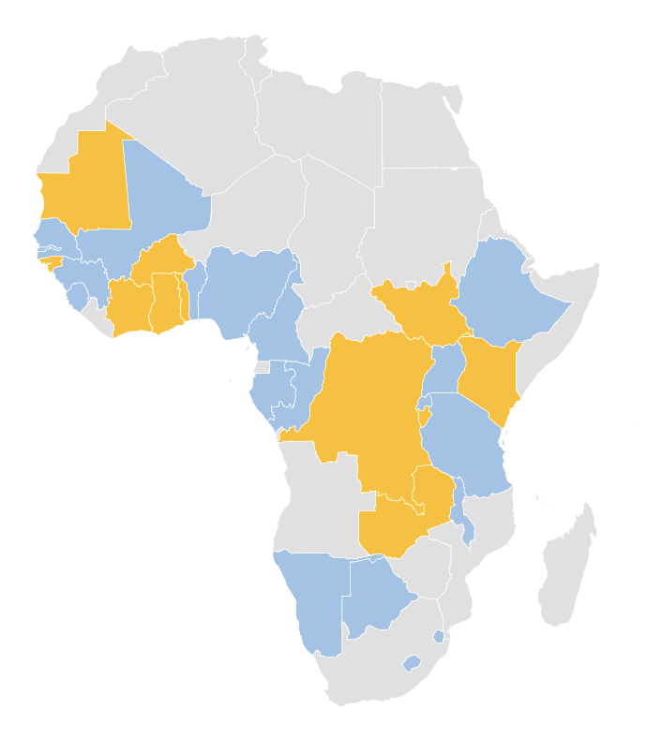

Integrated financing strategies across Sub-Saharan Africa in 2024
20
13 DFA
20 DFA & Financing strategies
Benin
Botswana
Cameroon
Comoros
Eswatini
Ethiopia
Gabon
Gambia
Guinea
Lesotho
Malawi
Mali
Namibia
Nigeria
Rwanda
R. Congo
Senegal
Sierra Leone
Tanzania
Uganda
Notes:
INFFs have rapidly advanced in Africa since 2019. In the past four years, UNDP has assisted over 30 countries in Sub-Saharan Africa with INFF development. About 20 have finalized their financing strategies, and some are now in implementation.
These strategies align with National Development Plans and provide an integrated framework for public and private finance reforms, including SDG-aligned taxation, budgeting, thematic debt instruments, public-private partnerships, diaspora finance, Islamic finance, and robust monitoring systems.

Slide 6
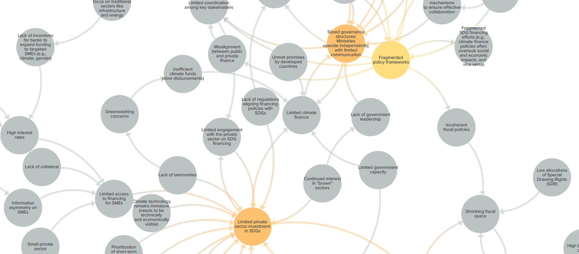
What is undermining INFF implementation?
Fragmented approaches and role of leadership: Are tax, expenditure, and debt policies coordinated and advancing SDGs? Are ministries competing for resources rather than collaborating? Who drives government integration efforts?
Trust and private sector misalignment: Is corruption and lack of transparency driving businesses in the informal? What incentives can align private sector ambitions with national priorities?
Knowledge, capacity and advocacy: Is there sufficient data, evidence, and opportunities for learning? Are country exchanges used enough to foster Africa-made solutions? Is Africa generating the knowledge needed to effectively advocate for its position within the global financing system?
Foster collaborative ecosystems that align priorities across stakeholders:
1. Within government (digital tools and integrated systems, shared targets, integrator role of leading ministries)
2. Private sector & civil society (incentives like blended finance and green funds, SDG Investor Map, e-government systems, open budgets)
3. Across regional and international partners (use INFFs to harmonise efforts among IFIs, bilateral donors; build civil society capacity to advocate for Africa’s voice in global forums, etc. )
Notes:
As countries progress in the INFF implementation, this forum is an opportunity to reflect:
What’s working and what isn’t?
Are ministries incentivized to collaborate, or is it business as usual?
Will private investments materialize without addressing governance challenges and developing SDG-aligned instruments?
How can regional and global partners better collaborate to build capacity, foster exchanges, amplify Africa’s voice, and resource INFF implementation?
Country experiences suggest that collaborative ecosystems are essential to success.
Incentivize inter-ministerial collaboration.
Enable civil society to strengthen governance and Africa's voice in global forums.
Engage the private sector to design SDG-aligned instruments.
Align regional and international partners' efforts within a jointly owned strategy.

Slide 7
Emerging outcomes
Use INFFs to harmonise efforts among partners
Aligning private sector incentives with SDGs
Integrated systems within the government
NIGERIA
TANZANIA
BENIN
$8m blended finance pilot
Sustainable financing securities framework (to attract $ 40m in 2024)
Sukuk framework for Zanzibar;
SDG investor maps
€500m SDG Eurobond to finance social and environmental projects.
Built on the previous SDG costing and aligned with pillars of 2018–2025 NDP.
Transparent impact reporting on 12 pre-defined expenditure categories
$100m INFF Fund (2024, 10yr, govt, DP, others)
$30m additional revenue collection via tax auditing capacity improv. (TIWB)
UGANDA
SENEGAL
$13m Climate finance facility
GHANA
€400m Partial credit guarantee from AfDB for the ESG bonds framework.
Civil Society participation in the INFF and global forums
5 assemblies adopted INFFs
To diversify local revenue streams, incl. own-sourced revenues, central government transfer, development partners and others.
84 local authorities trained on local revenue mobilization.
CABO VERDE
>$30m sustainable bonds issued on its sustainable financing platform (Blu-X)
For blue infrastructure, SMEs, social investment
Development of blue taxonomy
Notes:
For example, countries have:
Used INFFs to harmonise efforts among partners:
-Nigeria: Leveraged TIWB to raise $30M in additional revenues and is developing an INFF Fund to align partner efforts.
-Senegal: Developed an ESG bonds framework within INFF leading to a $400M AfDB partial guarantee.
Aligned private sector instruments with SDGs:
-Cabo Verde: Launched the BluX platform in partnership with the CB Stock Exchange, issuing $30M in sustainable bonds for blue infrastructure, SMEs, and social investments.
-Tanzania: Collaborated with UNDP and Tanzania Agricultural Development Bank to unlock $8M for agriculture through grants, loans, and equity.
Developed integrated systems:
-Ghana & Benin: Progress in integrated budgeting and financing across national and local levels, though breaking silos remains a challenge.

Slide 8
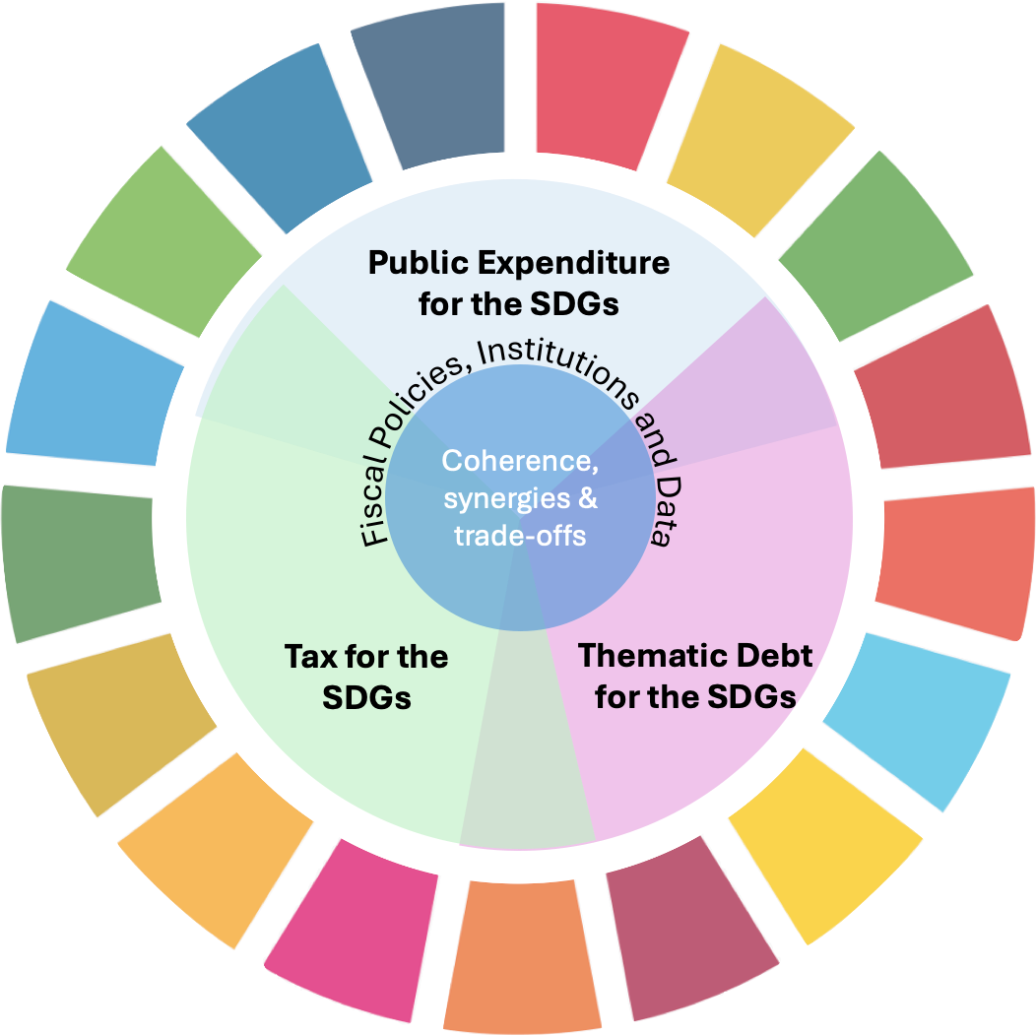
UNDP’s Integrated Public Finance for the SDGs
Key elements:
Fiscal policy decisions - tax, public expenditure & thematic debt undertaken coherently
SDGs lens in fiscal policy decisions
Strengthened governance and data
Coherent and synergetic decisions, balancing trade-offs, for impact:
Fiscal policy for poverty reduction
Fiscal policy for equality/inclusiveness
Fiscal policy for nature & climate
Notes:
Further efforts are needed. UNDP is supporting countries to reinforce the integration of tax, debt, and expenditure with SDGs in a more coherent and systematic way. In Gambia, for example, Public Expenditure Reviews have been institutionalized and are conducted quarterly. The next step could be to adapt these reviews to assess not only their efficiency but also the coherence of debt, expenditure, and tax policies in advancing priority SDGs.
Bottom Line:
Adopting integrated approaches is a journey. While challenges vary in each country, a key lesson from Africa is clear:
Fostering collaborative ecosystems that align stakeholder priorities is critical for INFF success.

Slide 9
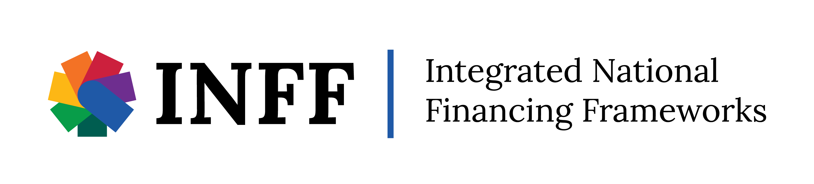
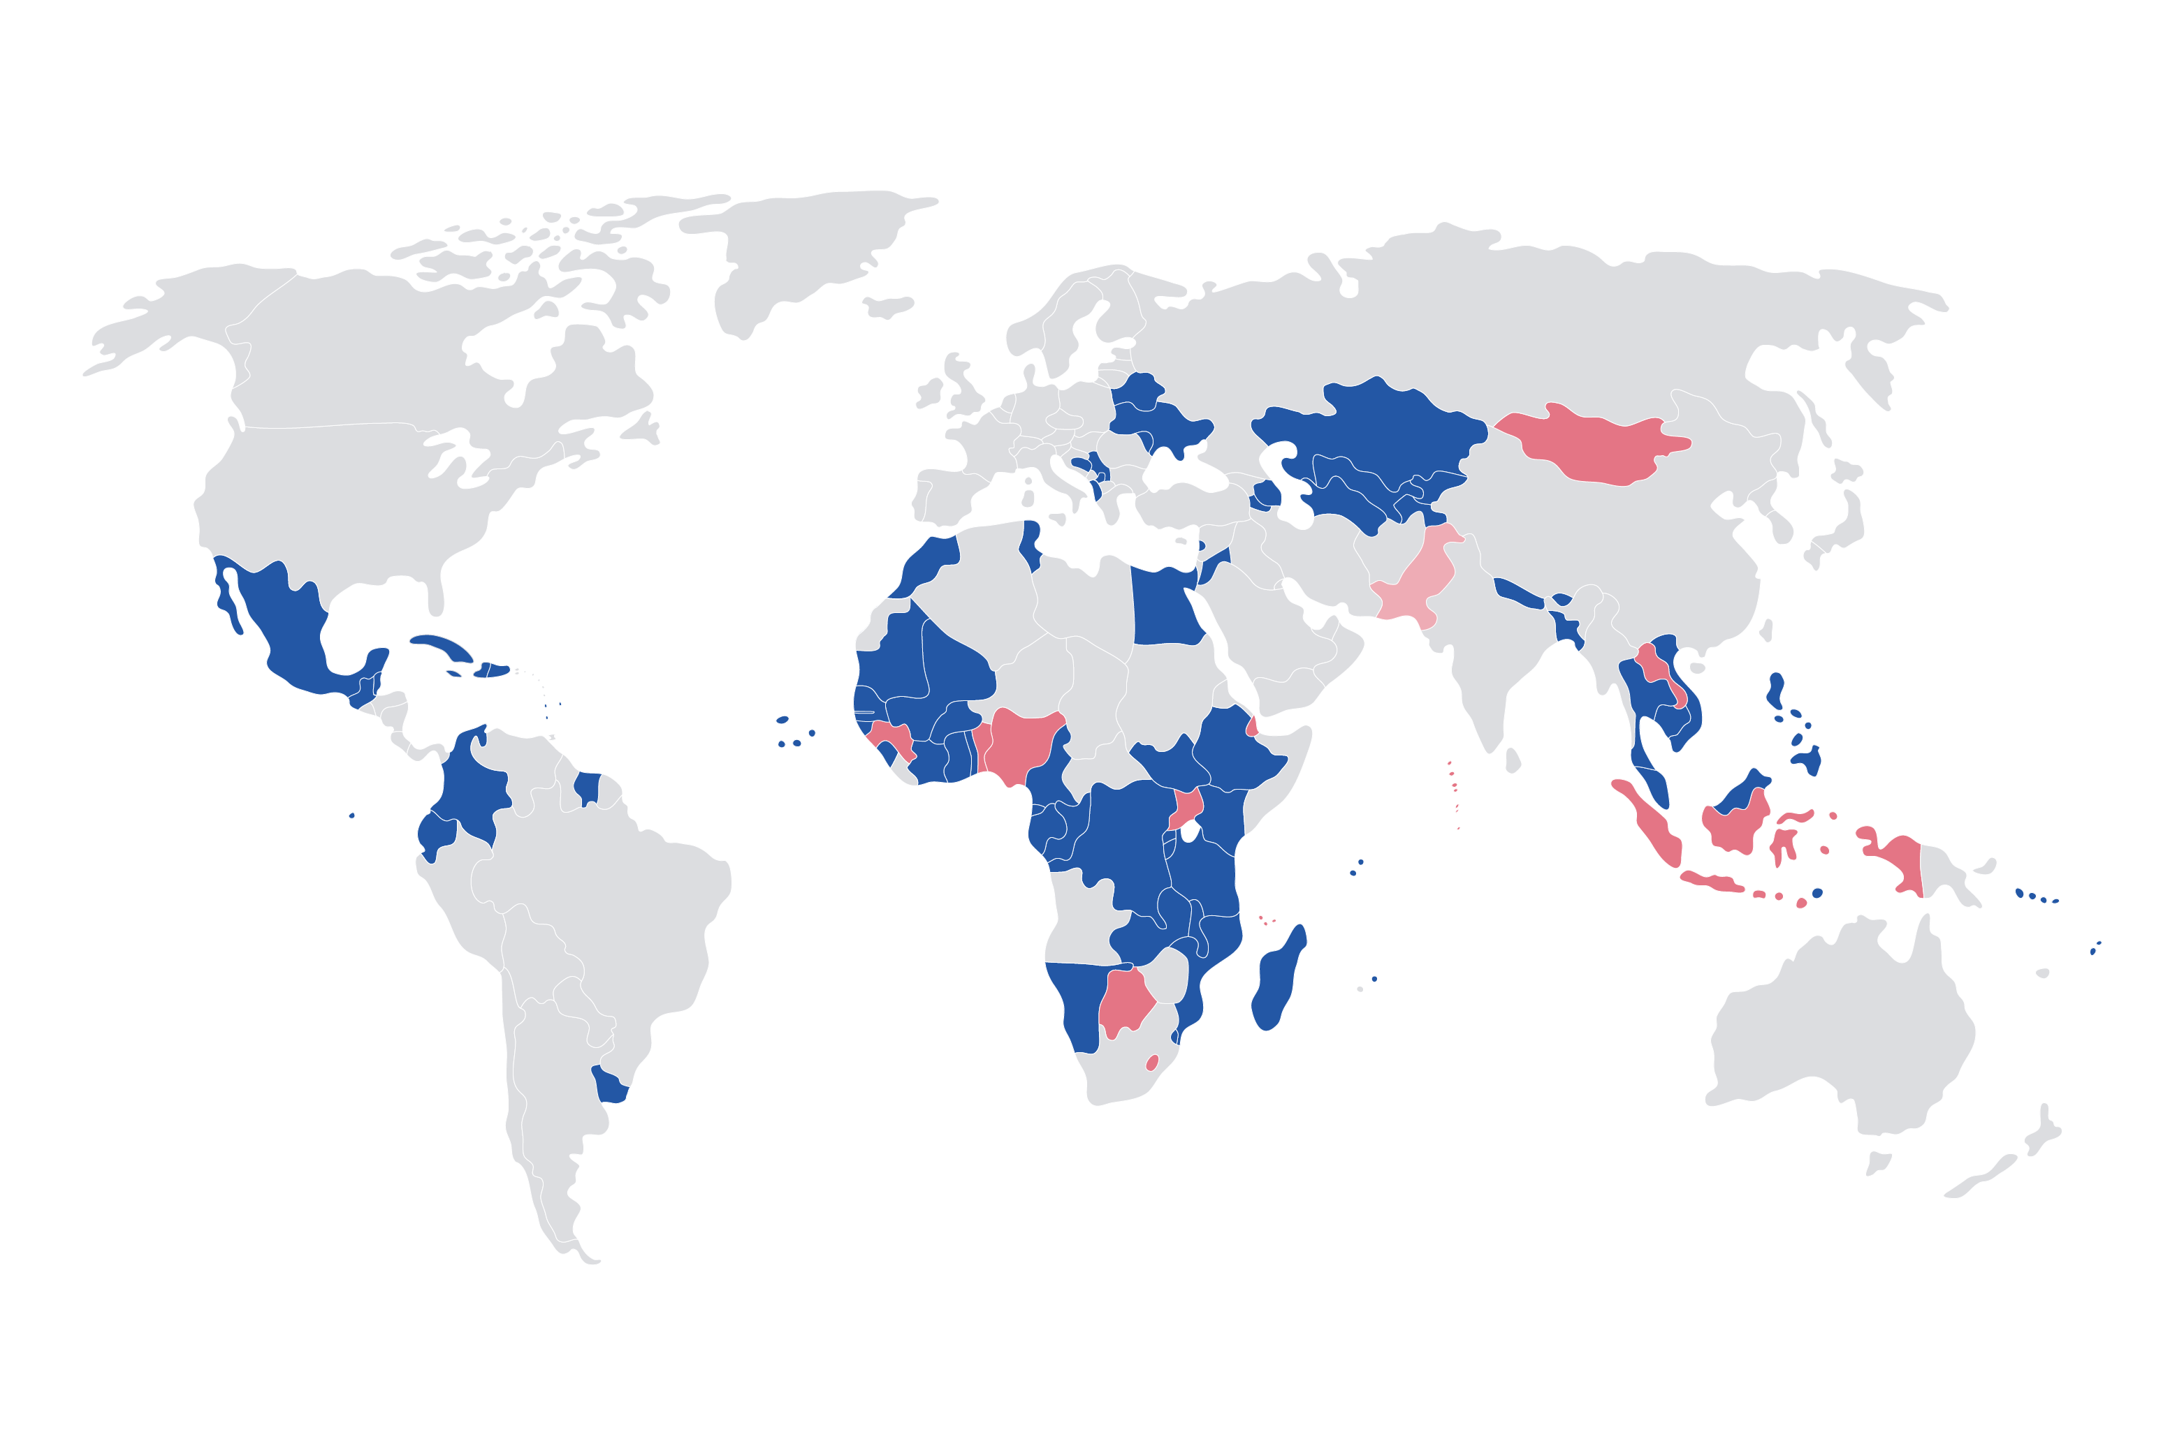
86
countries in different stages of INFF process

Slide 10
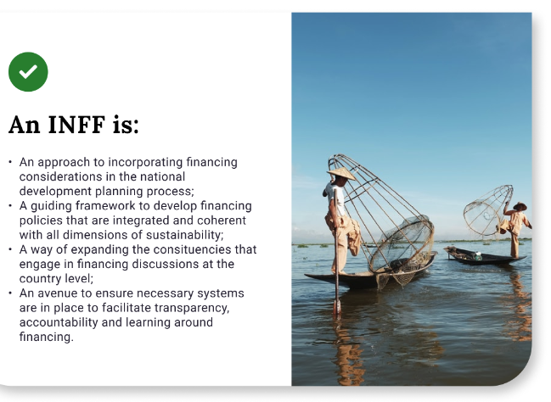
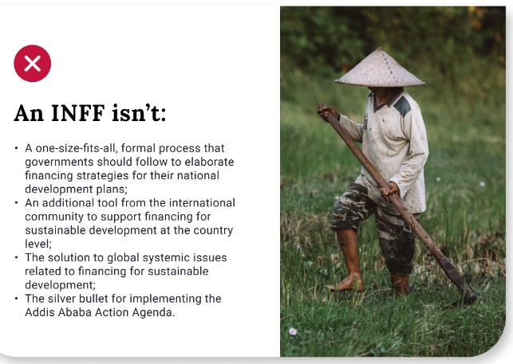
INFF Guidance
INFF Technical Guidance
Overview
INFF E-learning Courses
INFFs: An Introduction
INFF Technical Deep Dives
SIDS, Climate, DRR, LNOB, Development cooperation, Education, Health, Agriculture, DRR, Budget Credibility, LDCs
INFFs: From Theory to Practice
INFFs: Climate Finance
BB 1: Assessment & Diagnostics
BB 2: Financing Strategy
BB 3: Monitoring & Review
BB 4: Governance & Coordination

Slide 11

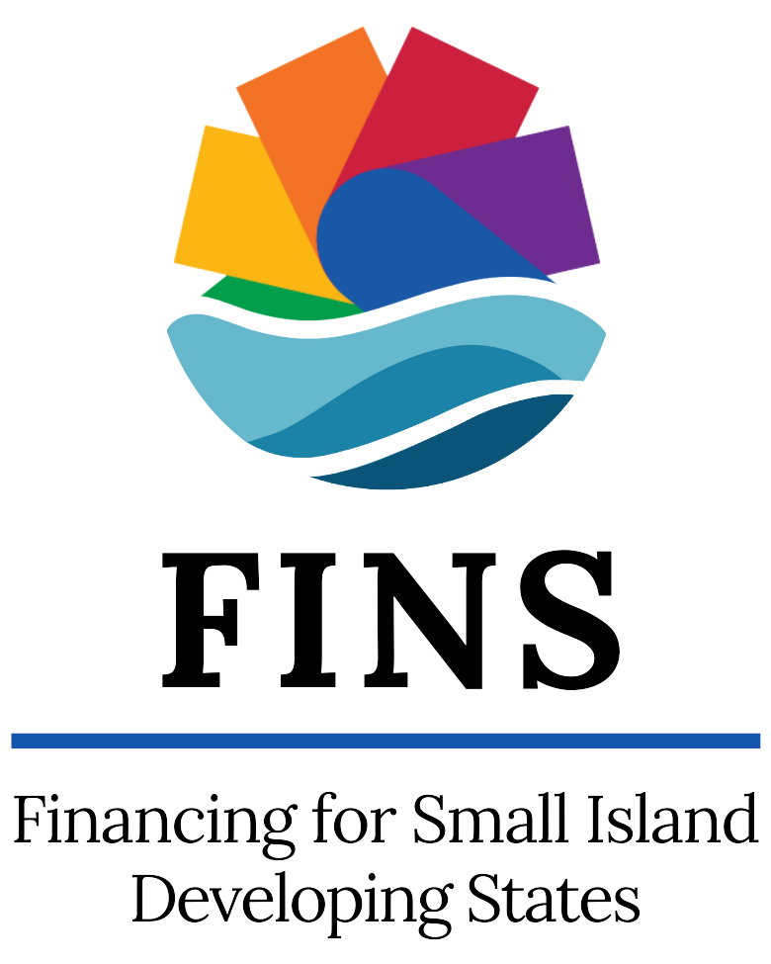










CORE PARTNERS
SUPPORTING PARTNERS
SUPPORTING PARTNERS
United Nations Regular Programme of Technical Cooperation

Slide 12
THANK YOU!

